Slide 1
Saturday 25/11/10 & Night
12:24 Dump fill #1523 after more than 8 hours in physics
It takes some time to get back:
Parallel sequences:
Fewer clicks to turn around, always in the same order
Ready for injection 50 minutes after dump
14:20 During injection: TI8 magnet problem – EPC piquet
Wait for ATLAS SOLENOID to ramp up – on slow ramp rate…
Trip of power converter RCBCV7.L2B2. ‘Only’ a corrector, but needed….. (see later)
Short access PM25, power converter rapidly changed
20:20 Problem on the door of power converter in TI2 RQID_20700
EPC piquet for TI2 ... unfortunately the CERN car that he has been issued with only summer tires on ....
21:30 Injecting for fill #1525
Pauses during filling because of PS cavity trips
23:56 Stable beams !
This time it took 11h32 min to get back in physics again
7:50 Ion source problem – wait with refilling

Slide 2
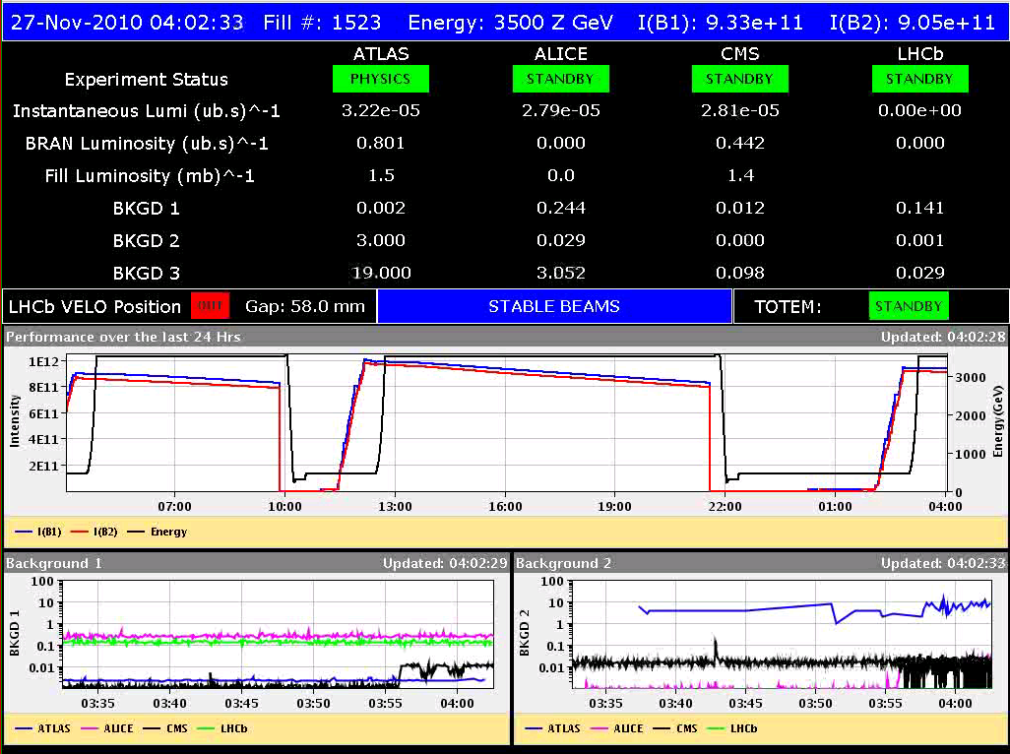
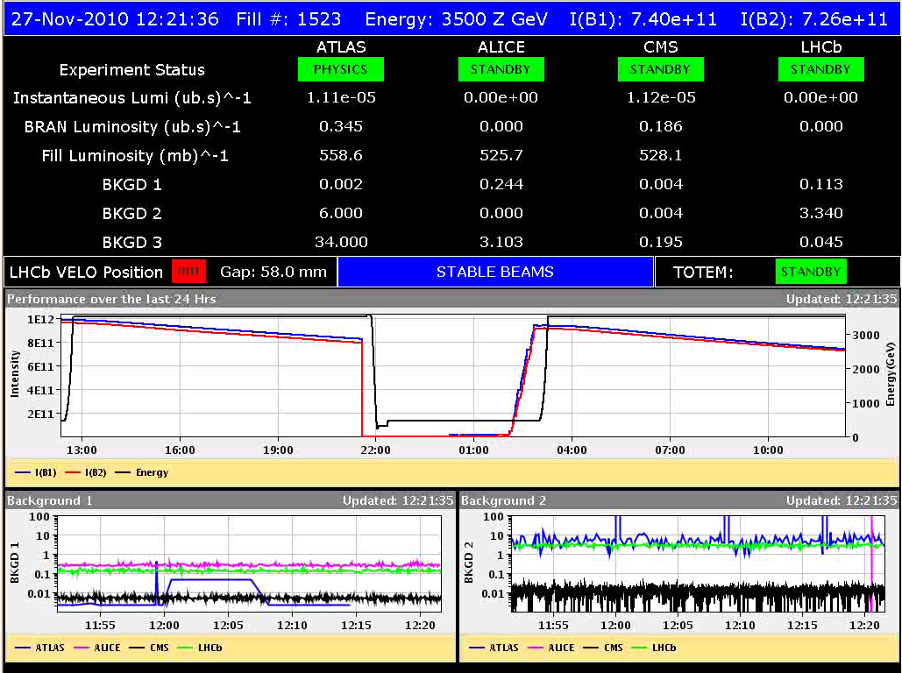
Fill #1523
Small emittances after filling at injection
B1H/V: 3/2.5, B2H/V: 3.3/3.6
Good start lumi’s, although no record beam intensities
04:00 Stable Beams
12:20 Dump

Slide 3
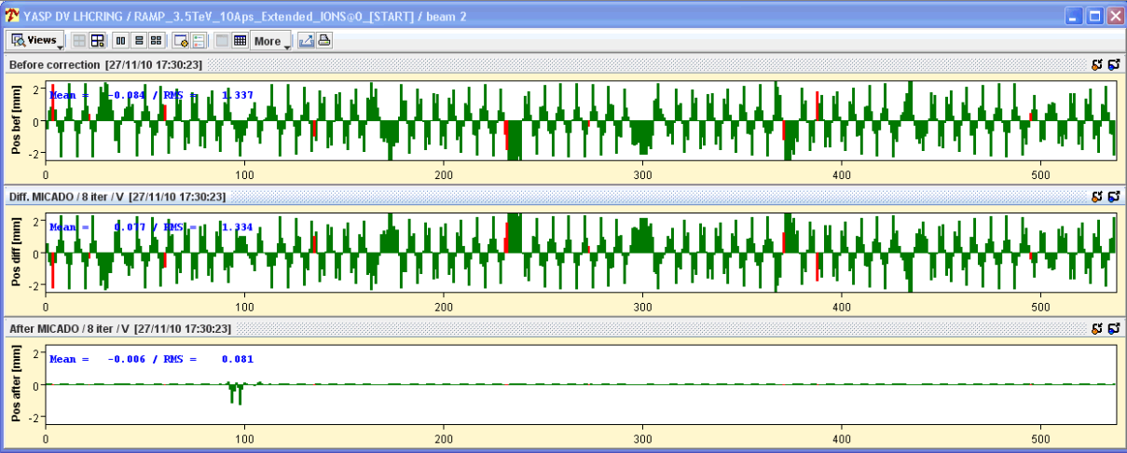
Power converter RCBCV7.L2B2
Trip of power converter RCBCV7.L2B2. ‘Only’ a corrector, but needed…..this is close to the IP
Jorg: There would be two 1 mm bumps after correction and one of these is at the Q5. With such bumps the correction may be difficult and also could have an influence on the crossing angle
Decision to do the access and fix the problem rather than creating new ones
EPC access is needed to fix it. Due to the snow the earliest that the piquet can get here is ~5:45, so the access starts at about 18:30
MAD guardian got lost (in the snow) – another 30 min delay
Power converter RPLB.UJ23.RCBCV7.L2B2 has been changed. Auxiliary power converter fault
Error not corrected out

Slide 4
Midnight: Stable beams fill #1525

Slide 5
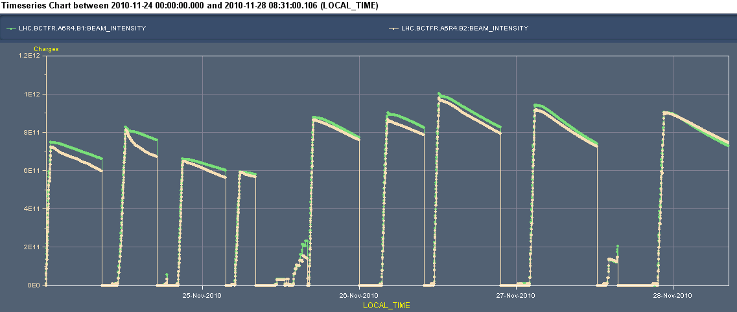
Beam currents and lumi’s since Wednesday
Can spend your time analysing the lumi’s...

Slide 6
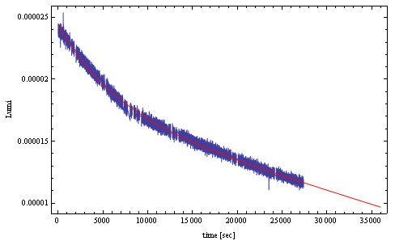
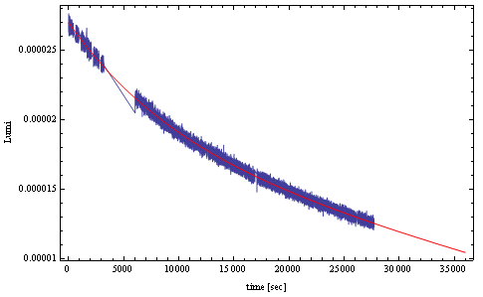
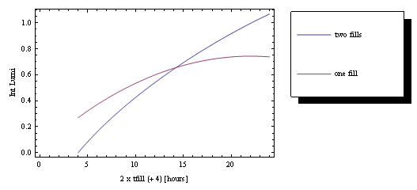
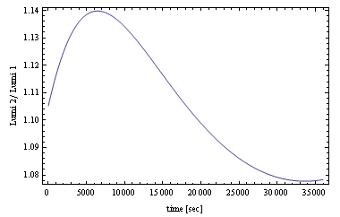
(ALICE) Lumi vs. time
Friday: Fill # 1522
Saturday: Fill # 1523
‘Elbow’
Fill # 1523 / Fill # 1522
For both fills optimum time to keep it in would be about 5 hours, for 4 hours refill….
Keep it for 6 hours, for an 8 hours refill.....
We tend to keep it longer: you know what you have Confirmed by yesterday’s experience

Slide 7
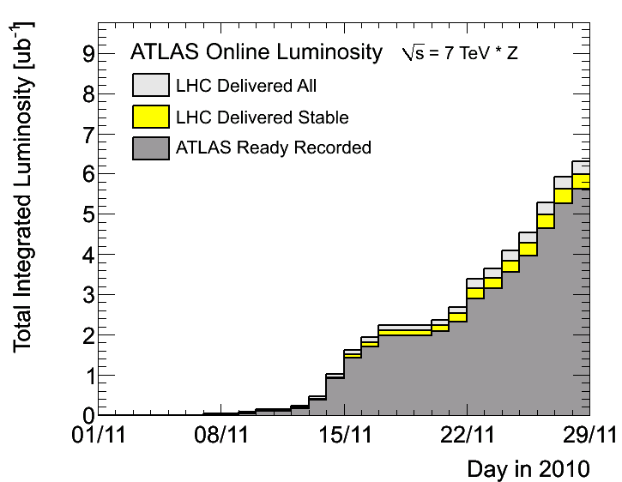
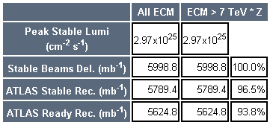
Total delivered lumi, this morning
Very close to the target for this week of 6 (µb)-1

Slide 8
Plan
Get beam back again from Linac - refill
More physics 121 x 121
Next Week:
Tuesday: Van der Meer Scans
Injection tests with 8 bunches
Discussing a few MD-style studies (IR aperture, …)

