Slide 1
Friday 26.11.
05h44: Stable beams #1521. 121b x 121b. Length: 4h10.
09h54: Beam dump.
Instability on electrical network (RD.LR1 tripped).
ATLAS solenoid ramp down.
Look at Q9.R2 trip from Thursday…

Slide 2
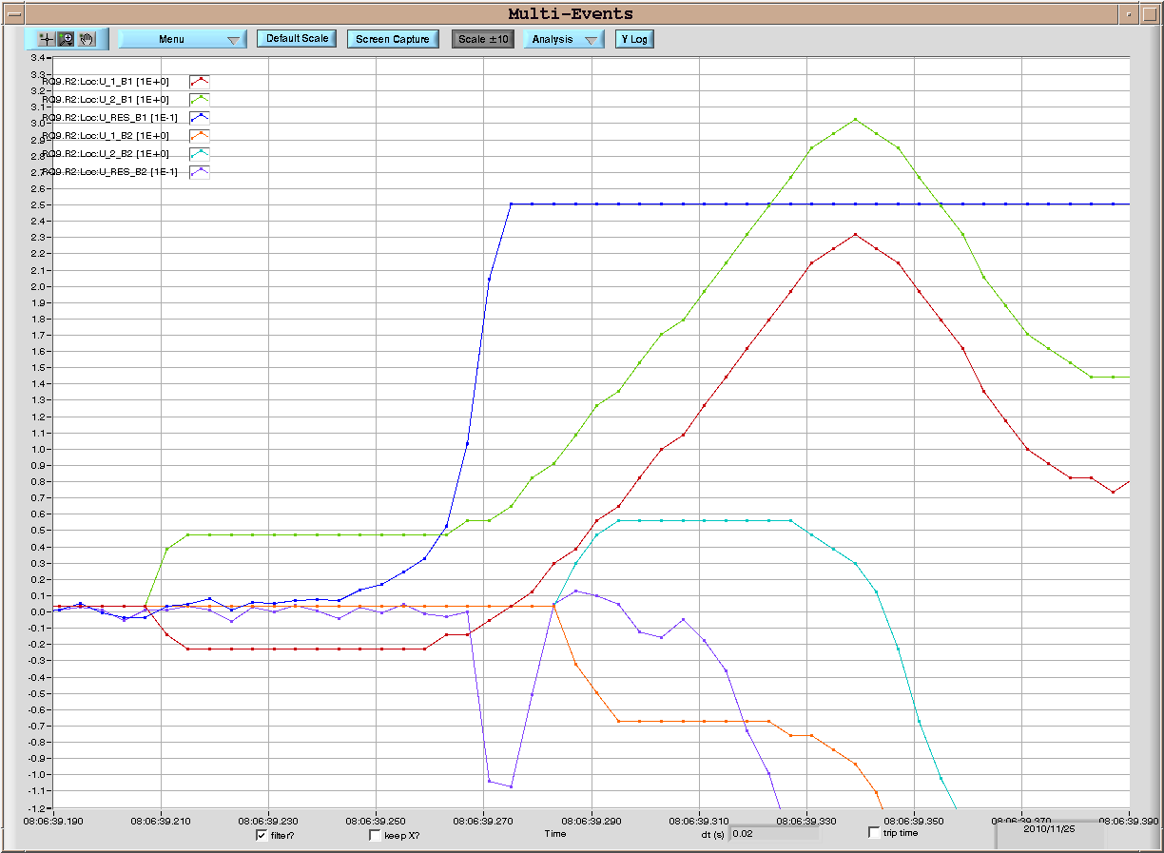
Trip of RQ9.R2 on November 25, 08:06:39
As already noticed by A. Verweij, there is a symmetric development of a voltage signal in the two halves of RQ9.B1; the two voltage loops go from the current leads up to the magnet mid point
U_Res_B1
U_2_B1
M. Pojer
U_1_B1

Slide 3
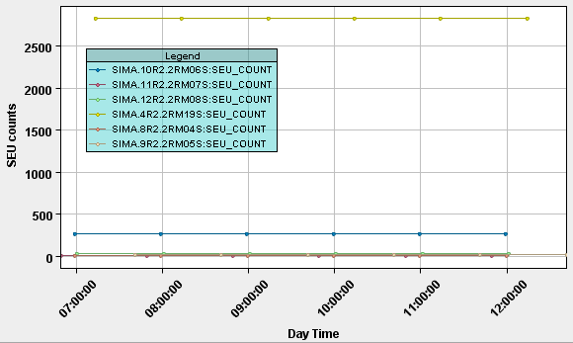
Trip of RQ9.R2 on November 25, 08:06:39
1- Similar signals were observed during the symmetric quenches on the dipoles
2- An EM disturbance would have produced a much noisier signal
Could radiations be at the origin?
No counts were recorded on the RADMONs from 4.R2 up to 12.R2 in the
time frame from 6h30 e 12h00
M. Pojer
Courtesy of M. Calviani

Slide 4
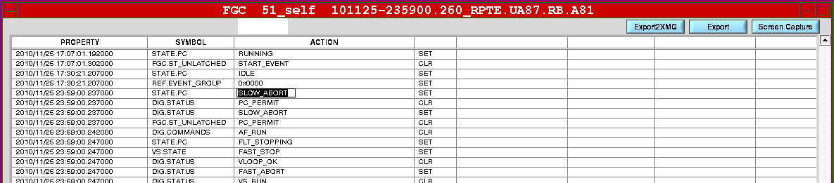
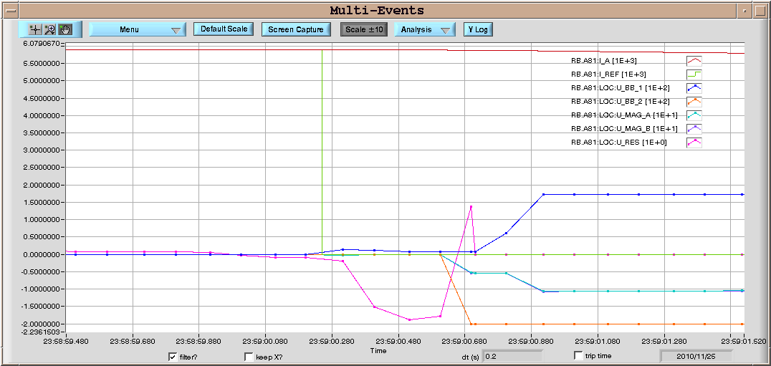
Trip of RB.A81 on November 25, 23:59:00
M. Pojer
The PC in SPA → I_ref goes to 0 and current goes down → U_Res rises and generates a FPA
I_ref
I_meas
U_Res

Slide 5
Friday 26.11.
11h01: Injection. Second oven (ion source) is on.
12h28: Start ramp.
13h32: Stable beams #1522. 121b x 121b.
Turnaround: 3h38.
Luminosity: 2.8e25 cm-2 s-1.
Length: 8h09.
21h41: Beams dumped on request.
BPM calibration needed to correct temperature drift on the electronics in SR7.
CV piquet has installed temperature monitoring at the crates concerned and will monitor the temperature over the weekend. At the moment the temperature is 22 degrees.
22h18: ALICE access required to fix trigger problem on half of their muon chambers.

Slide 6
SR7 Temperature – BPM Calibration

Slide 7
Improving the turn around in LHC
Two new sequences have been created:
PREPARE LHC FOR INJECTION (ALL BUT PCS)
INJECTION PROBE BEAM
To improve the turn around in LHC.
Reyes Alemany
RAMP DOWN – PRECYCLE COMBO V01
PREPARE LHC FOR INJECTION (ALL BUT PCS)
1. RUN IN PARALLEL
INJECTION PROBE BEAM
2. RUN:
LHC equipment ready for injection in a bit less than 1 hour
Turn around of today’s morning shift with this new sequences and a smooth injection from injectors: 3.5 hours (new record)

Slide 8
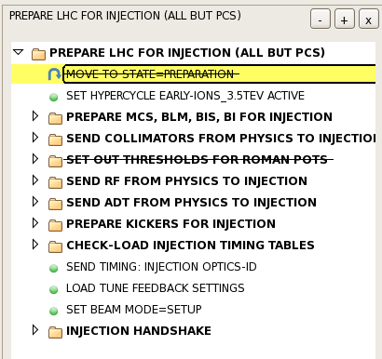
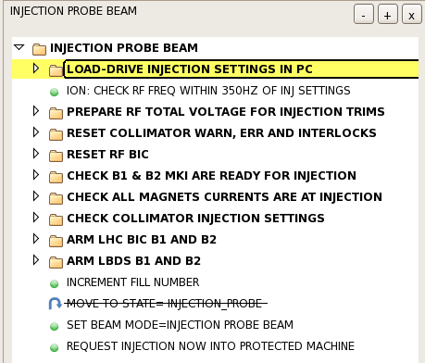
Tested today for the first time. Once well tested it will be included in the LHC Nominal Sequence
Reyes Alemany

Slide 9
Fill 1522
Emittances start injection:
B1-H: 2.5 B1-V: 2.3 B2-H: 2.6 B2-V: 3.2
Emittances end injection:
B1-H: 3.3 B1-V: 2.5 B2-H: 3.8 B2-V: 3.9
OK

Slide 10
Transverse Damper: Well Damped
Wolfgang Hoefle checked.
Already maximum gain at injection.
Nothing to gain more…
However, during 450 GeV at injection (Friday morning): interesting perturbation on beam 2 vertical

Slide 11
Damper Pickup B2
The “hump”?
1000 turns
89 ms

Slide 12
Damper Pickup B1

Slide 13
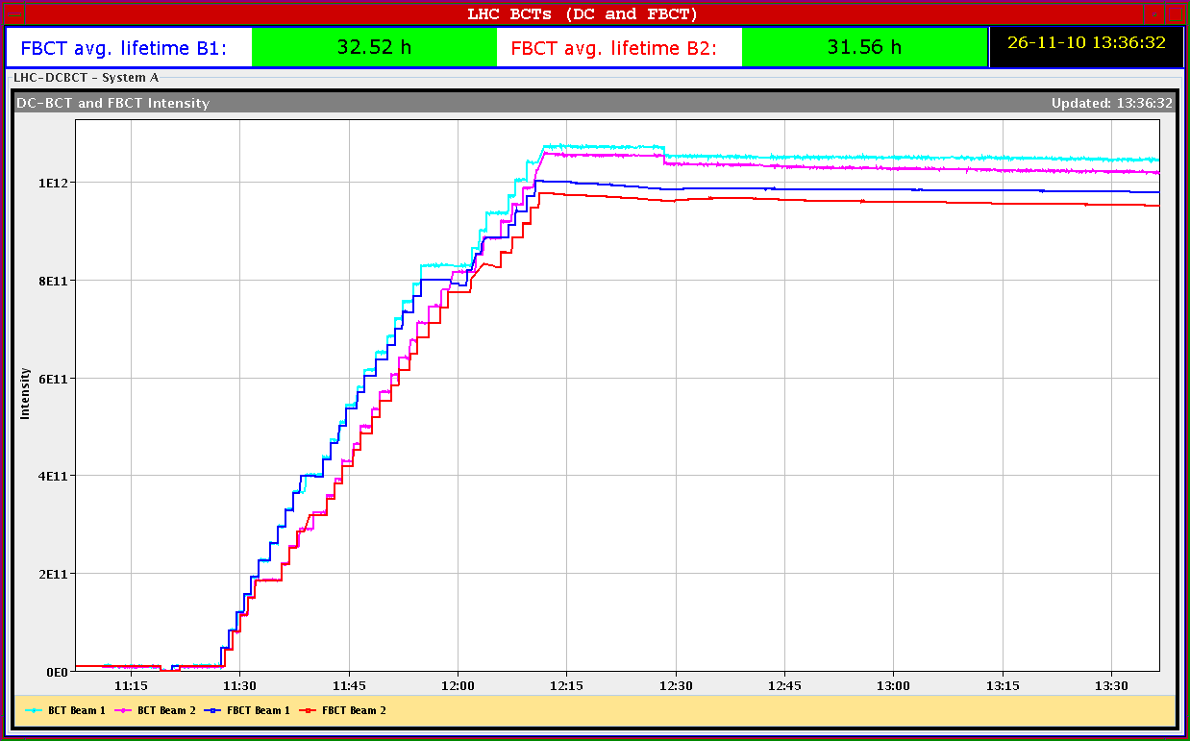
Fill 1522

Slide 14
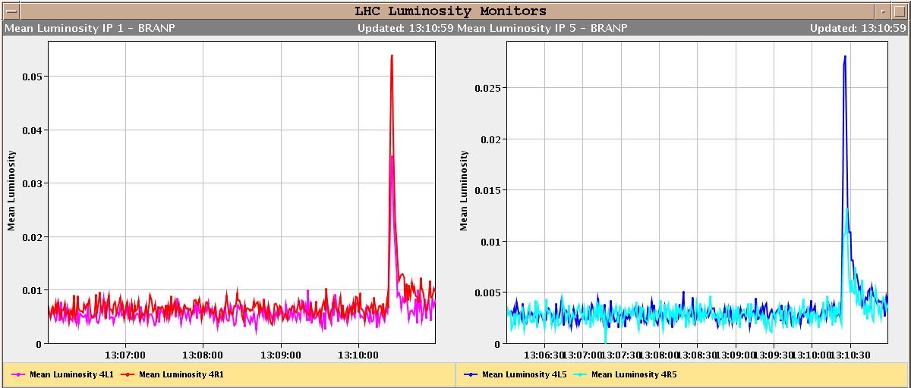
Lumi Spike During TCT Movement

Slide 15
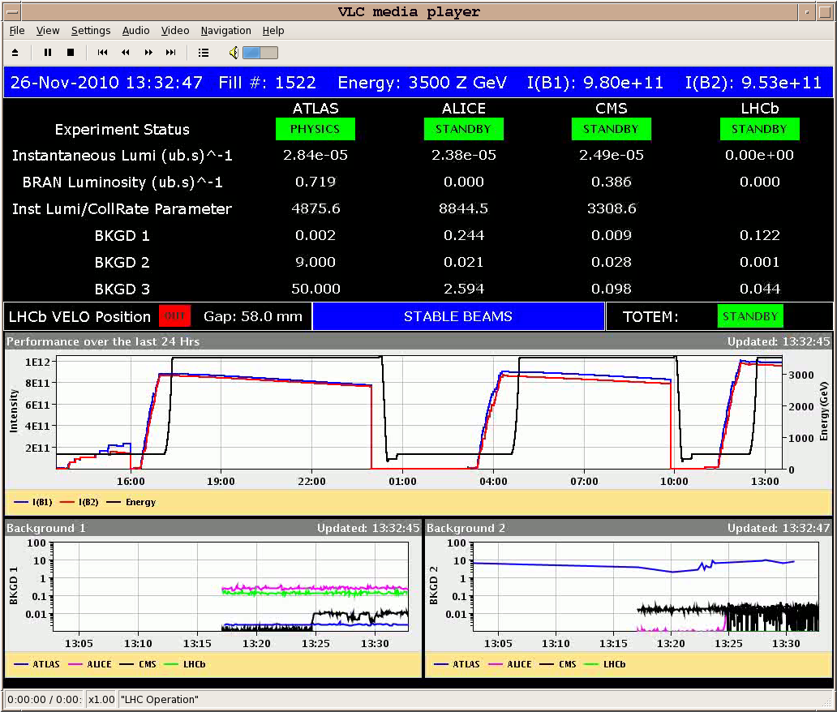
Fill 1522

Slide 16
Status Ghost Bunches (JJ Gras)
Just before ramp: ~8% difference between DC and fast BCT on both beams.
Loss of real debunched beam during the start of the ramp.
Remaining difference close to 6.5% per beam.
Lost ~1.5% of debunched beam during the ramp: roughly the same amount than with the previous RF injection schema.

Slide 17
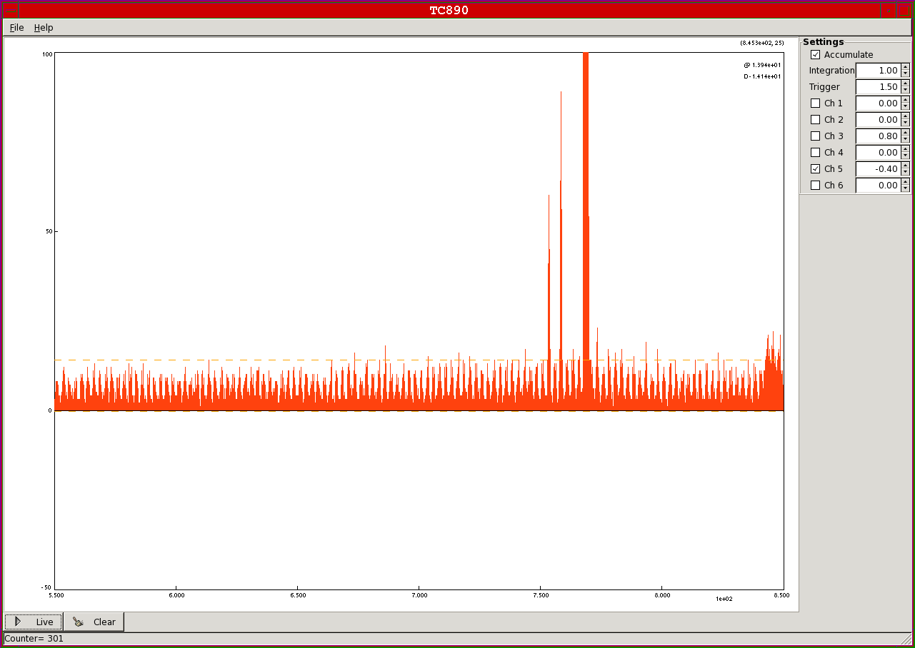
Ghost Bunches

Slide 18
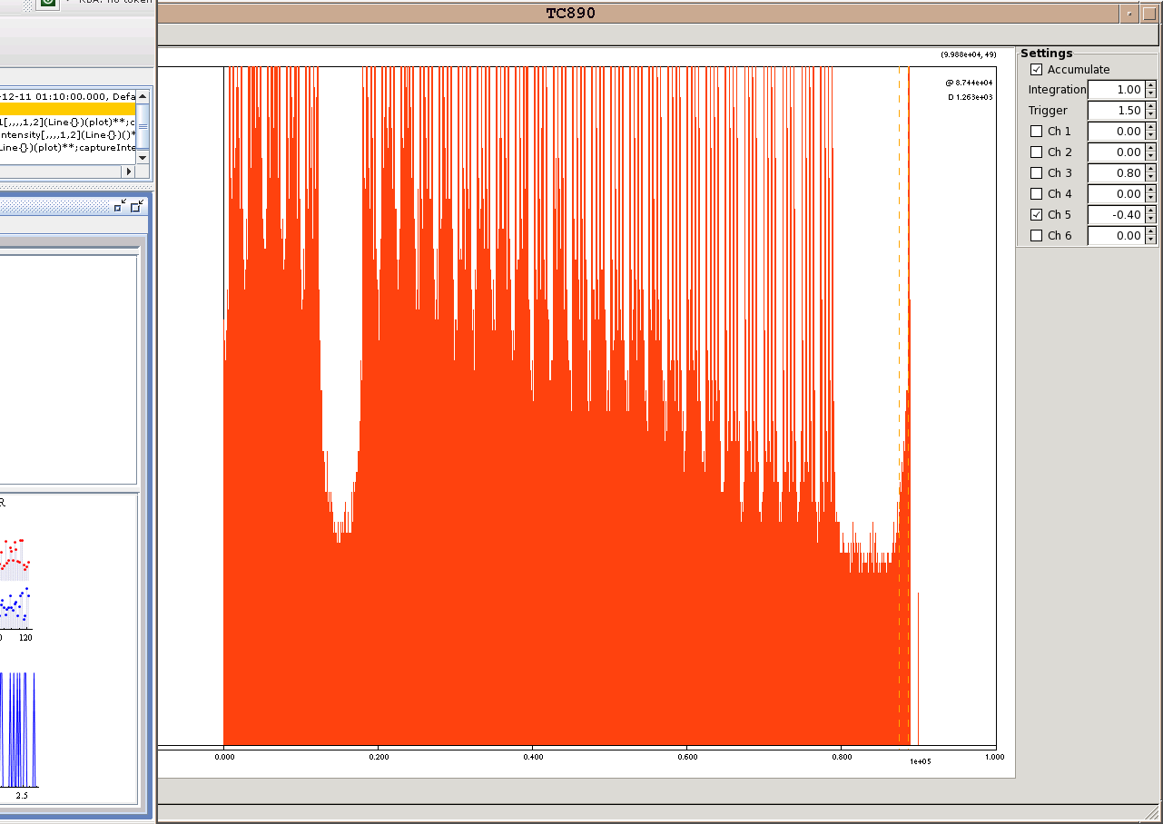
Ghost Bunches Full Turn

Slide 19
BSRT on Empty Slots

Slide 20
Friday/Saturday 26/27.11.
22h18: ALICE access required to fix trigger problem on half of their muon chambers.
During Friday total: ~0.7 μb⁻¹ delivered in stable beams.
00h10: Injection.
Some time spent to sort out chromaticity.
03h00: Start ramp.
04h01: Stable beams #1523. 121b x 121b.
Peak lumi: 2.8e25 - 3.2e25 cm-2 s-1
Still going…

Slide 21
New Record Lumi
Un Grand Merci to the injectors.

Slide 22
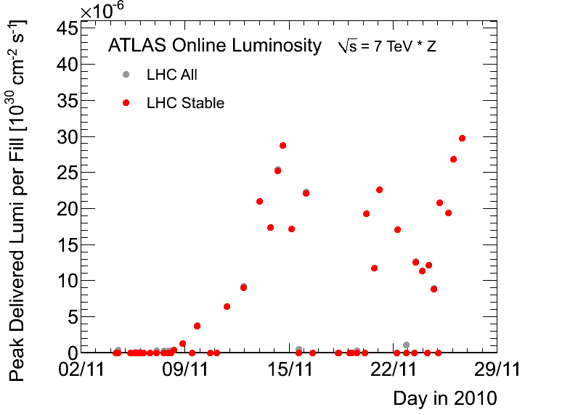
Peak Luminosity

Slide 23
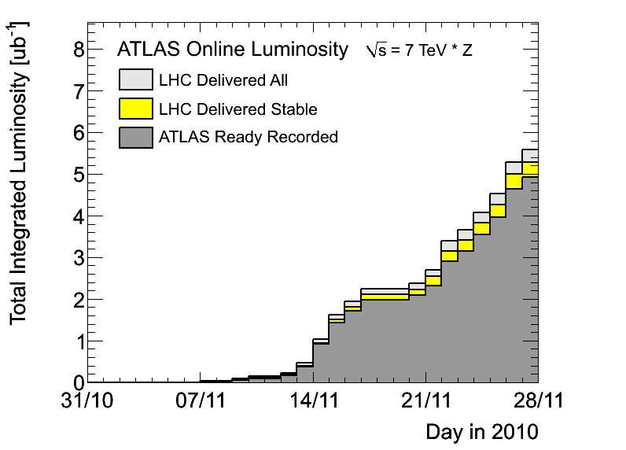
Integrated Lumi: > 5.3 μb⁻¹

Slide 24
Ahead
More stable beams… Well on track towards the week goal.
Next Tuesday: vdM scans.
Next week:
Check 8 bunch injection
Discuss a few MD-style studies (IR aperture, …)

