Slide 1
Monday 22.11.
01h30: Stable beams #1506.
08h29: Adjust mode. Transverse dampers to physics setting.
Neither negative nor positive effect seen.
09h55: Beams dumped on request. Ramp down and pre-cycle.
Other issues followed up:
G. Papotti: Fixed pattern file for BQMSPS, pattern check re-enabled on LHCION2 cycle at the SPS. Satellite thresholds from 20% to 3% again.
L. Jensen: Issues observed this weekend related to the wrong handling of RBAC token for the BCT proxy on cs-ccr-cmw4 have been understood by the CMW team. They have now restarted the proxy and the BCT sequencer task should no-longer fail. In parallel a separation of load between DC and Fast BCTs is being looked into.
11h14: RU.L4 tripped. Reset and restart it as instructed by piquet.
12h38: RU.L4 at 400 A.
13h02: Ramp started. 121b x 121b.

Slide 2
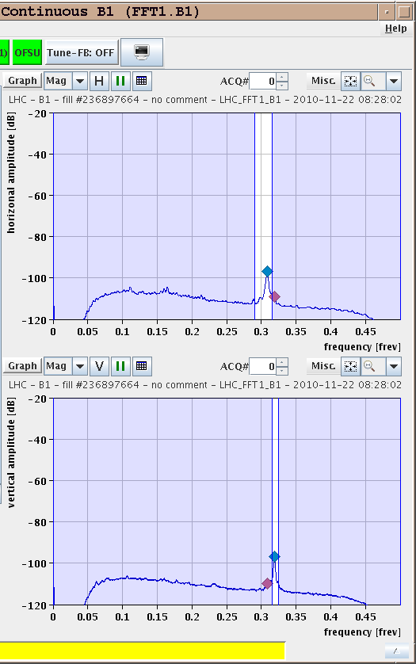
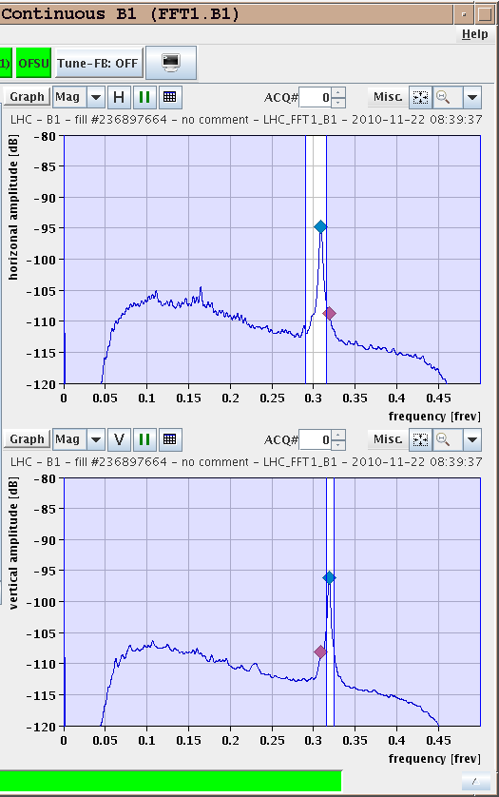
Damper Off (Left) / On (Right)

Slide 3
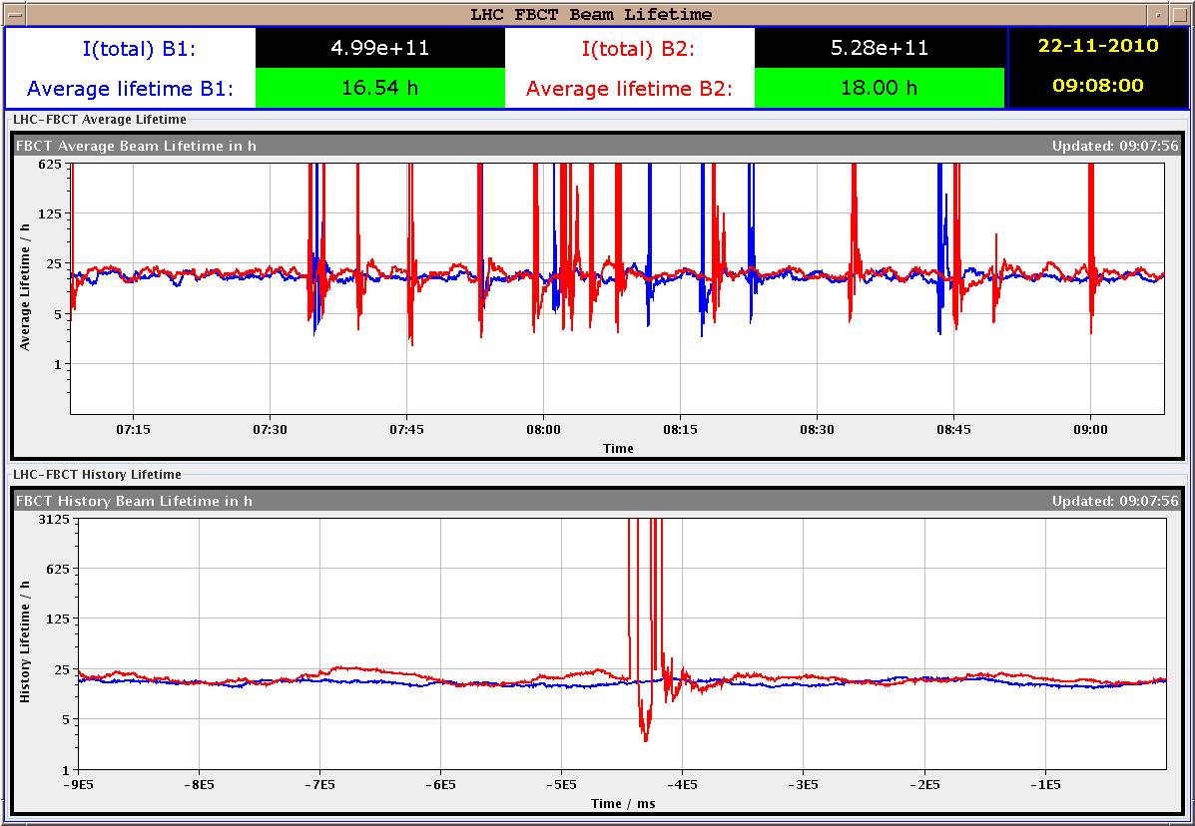
No Change of Lifetime

Slide 4
Monday 22.11.
14h07: Stable beams. Fill #1506.
15h17: Trip Q9.R2. Beam dump. Sector 23 tripped.
PIC event chain: quench loop of RQ9.R2 was opened → global protection mechanism → …
15h42: Ramp down. Pre-cycle 23 individually.
18h20: Injection. Various problems”
IQC does not get MKI data. Restart of 2 IQC processes.
Circulating bunch configuration is not updated in the BQM GUI and in the injection sequencer.
Publications from DB is not working properly.
PS cavity problem.
20h57: Ramp started. 121b x 121b.
22h00: Stable beams. Fill #1511.

Slide 5
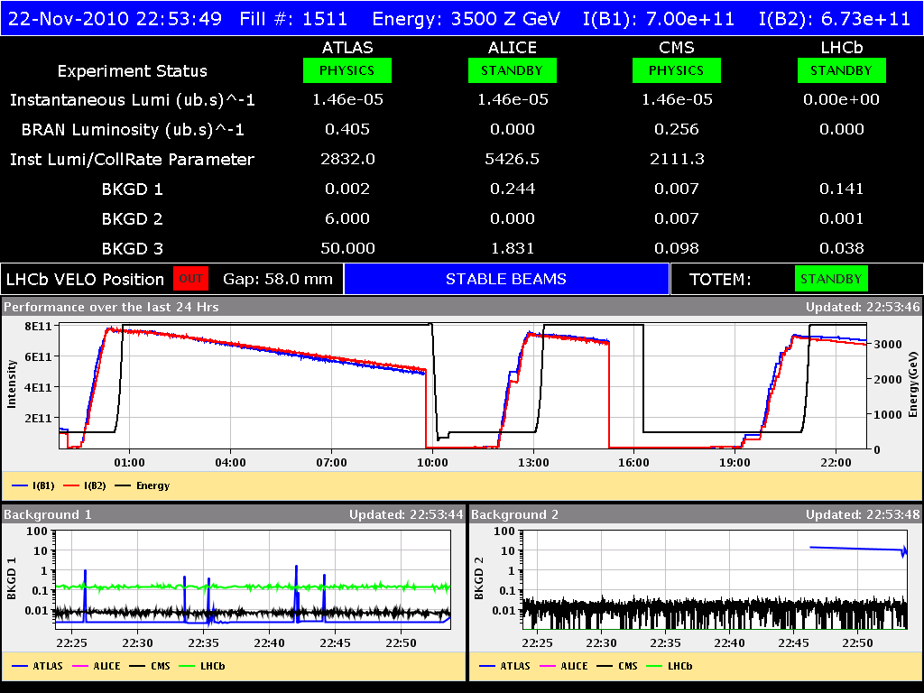
Ion Stable Beams

Slide 6
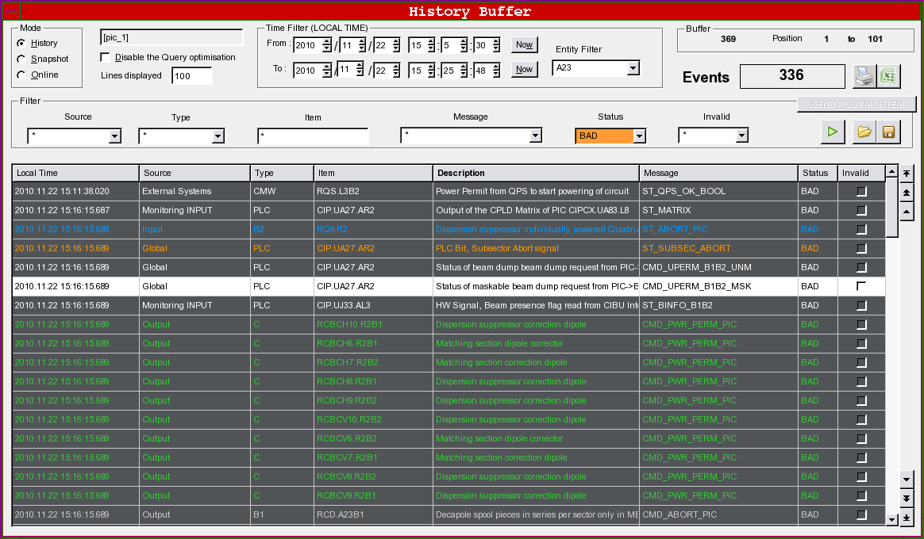
PIC Event Chain

Slide 7
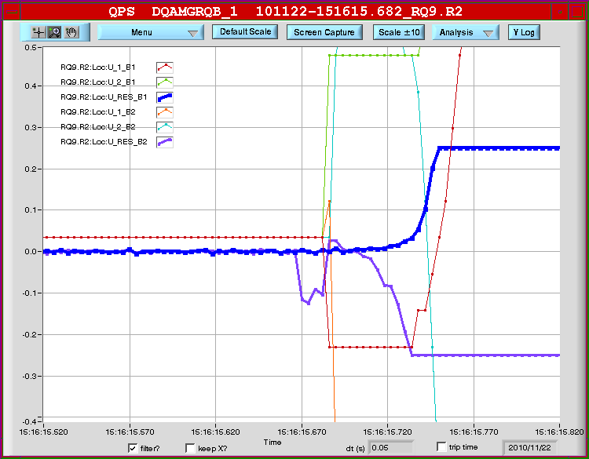
What Affected Q9.R2? Noise?

Slide 8
Ahead

