Slide 1
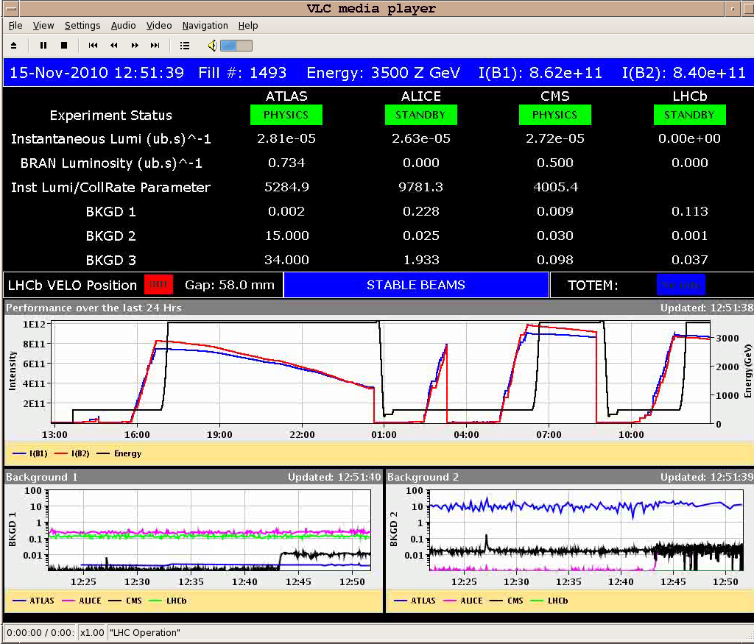
Tuesday Nov 16th
Fill 1492 into physics around 07.30
500ns_121b_113_114_0_4bpi31inj_IONS
Initial luminosity 2.5 10²⁵ cm⁻² s⁻¹
Lost at 08.45 - network instability triggered the FMCM for the D1 in P5
Refill for physics
Same configuration
Fill 1493
450 Z GeV emittances B1-H: 2.6 B1-V: 2.1 B2-H: 3.5 B2-V: 3.3
Beam intensities ~ equal
Stable beams from 12.50

Slide 2
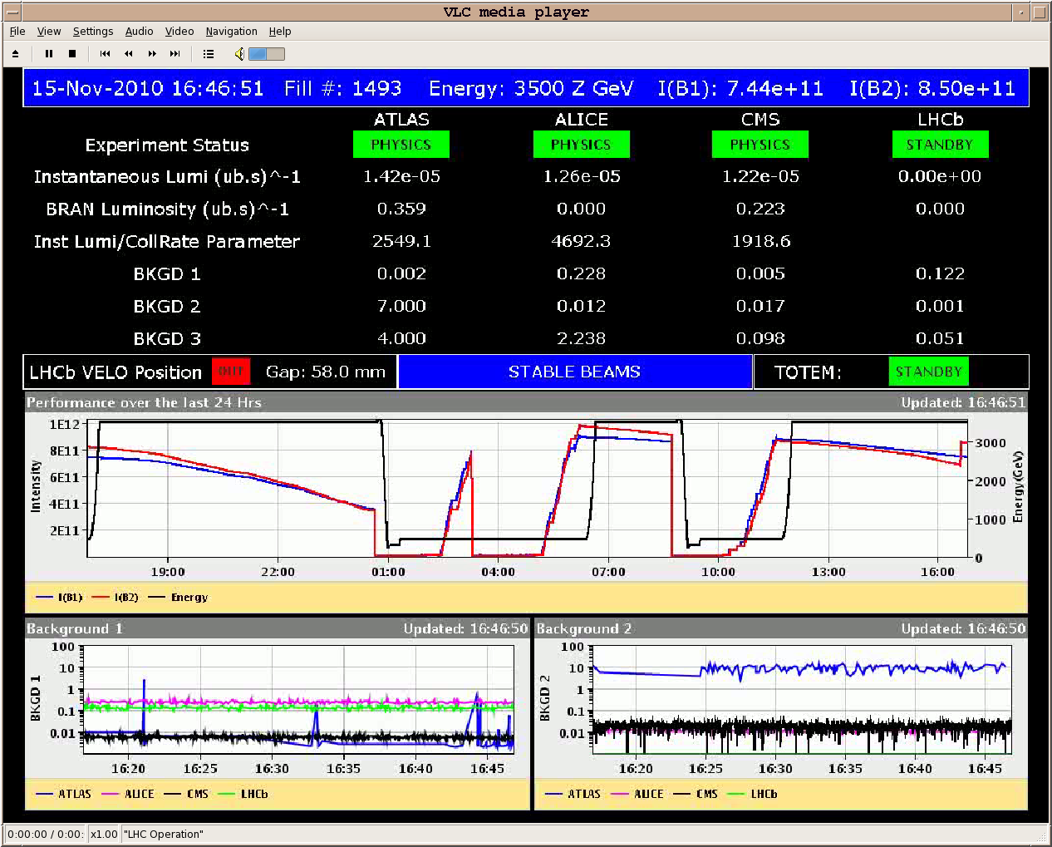
The step up in BCT IS NOT REAL
This is the result of an automatic switch of the BCT. The switching threshold to low gain channel for low BW BCT has now been set to 1.5e10 charges (instead of previous 1.2e10). This problem should not appear again.

Slide 3
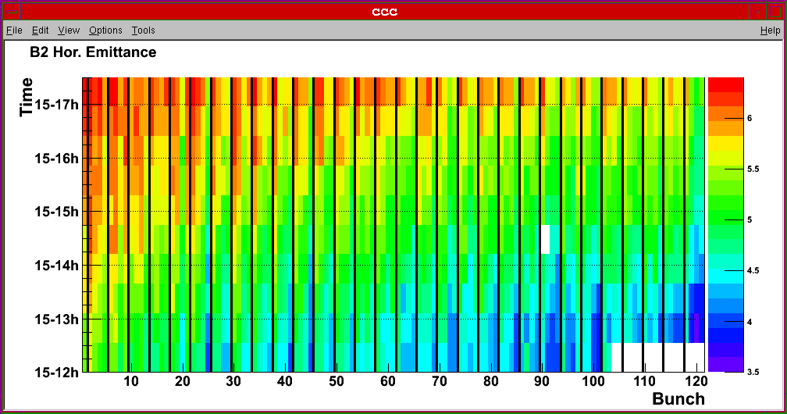
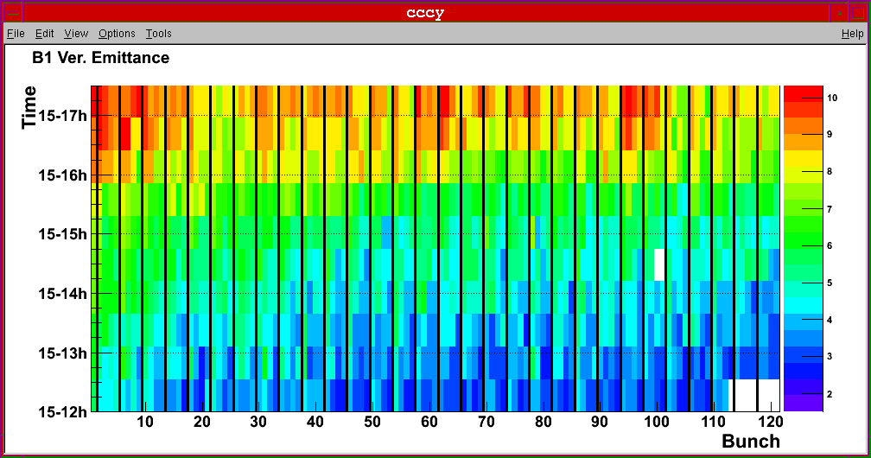
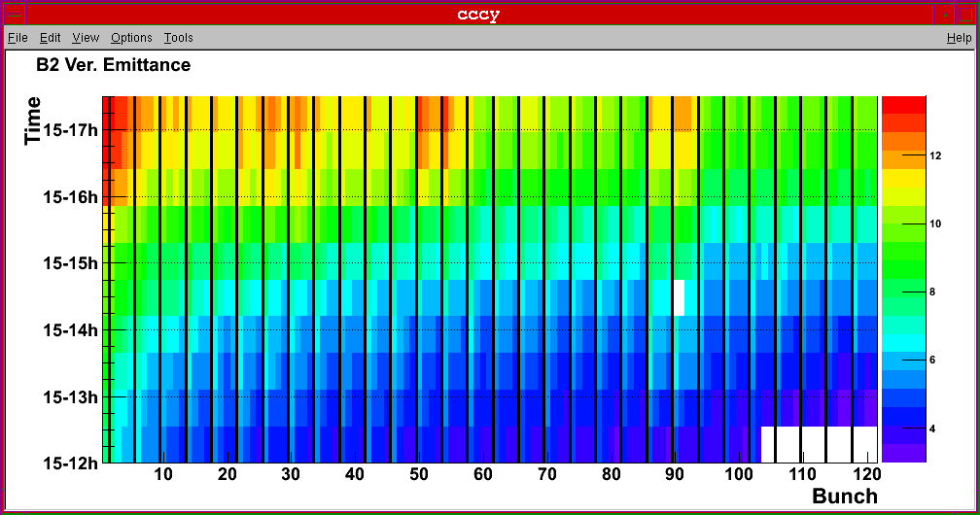
Emittances as seen by BSRT

Slide 4
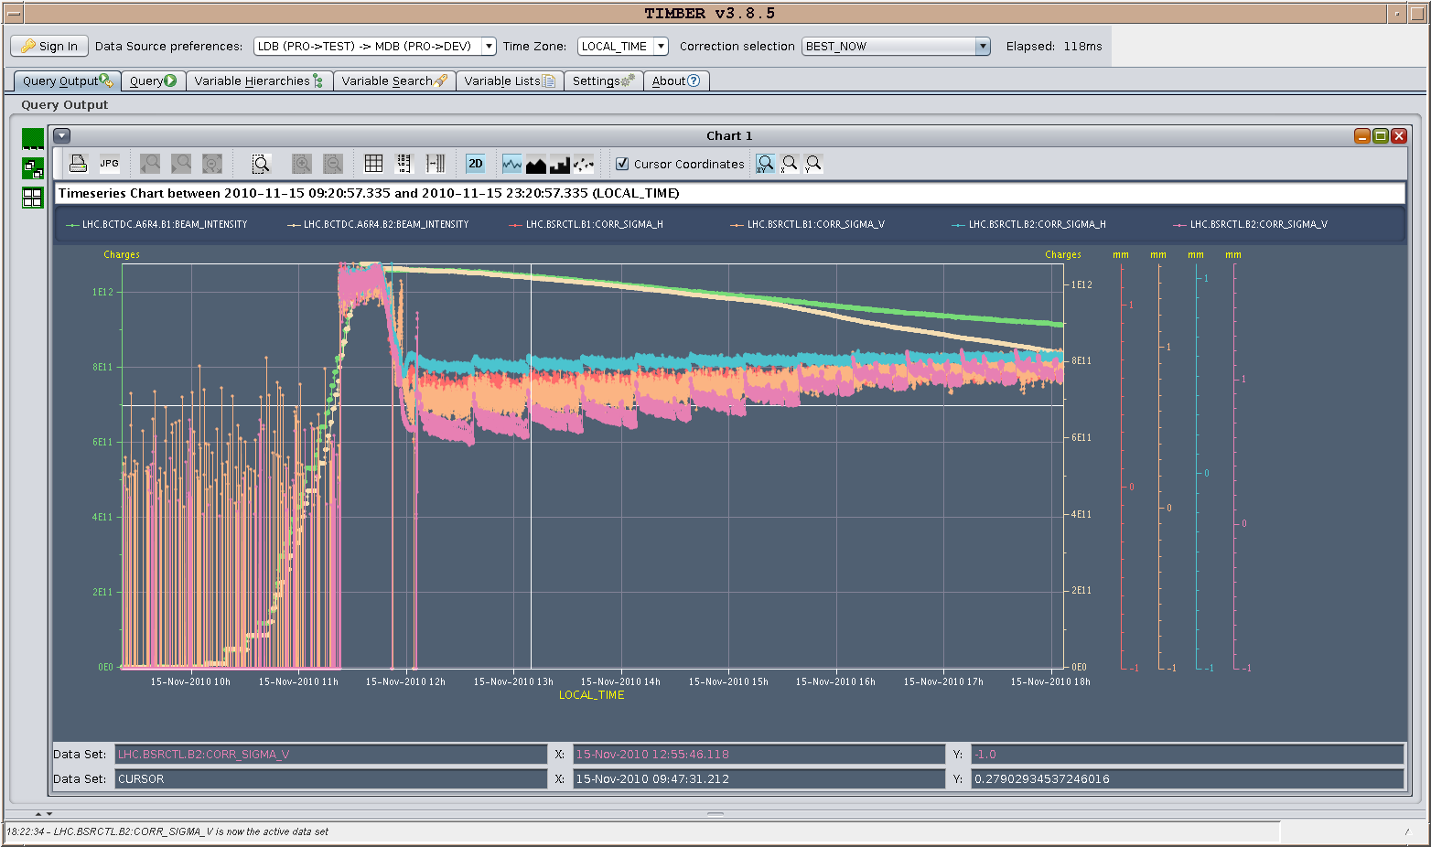
Intensity and beam size evolution

Slide 5
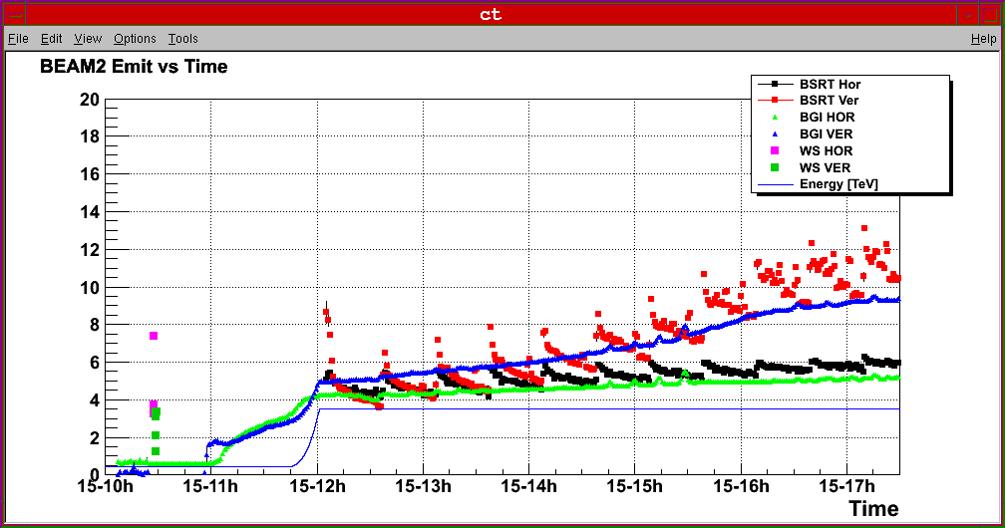
Comparison attempt BGI, BSRT, WS
WS only at inj (quite a large spread in the meas emittance)
BSRt only at 3.5 TeV, Saw-tooth because scanning on different bunches
BGI logged values multiplied by 2

Slide 6
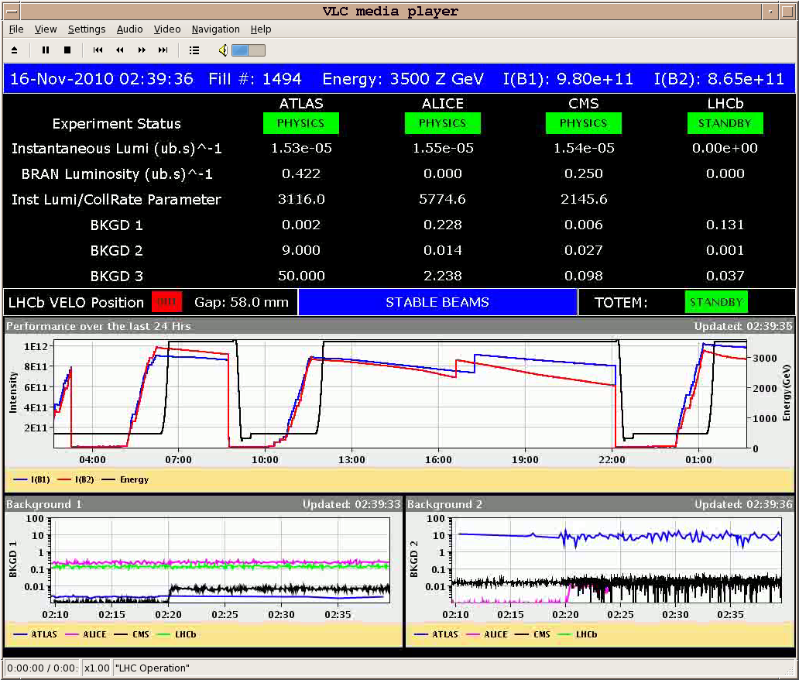
Tuesday Nov 16th
Fill 1493 dumped just after 22.00
Refill for physics
Same configuration
Fill 1494
450GeV emittances B1H 3.7 B1V 5.3 B2H 4.1 B2V 9.3
Decided to ramp anyway
Stable beams from 02.30
MKI problem IR2

Slide 7
Proton MD program
Wednesday 17 | 05 | 01 | Dump and recover
 | 06 | 03 | Access
 | 09 | 04 | Interlock checks
 | 13 | 07 | Injection and damper checks for 75ns
 | 20 | 10 | Injection of trains of 24 or 48 bunches
Thursday 18 | 06 | 12 | Qualification of e-cloud build up with 75ns
 | 18 | 4 | Switch to 50ns, injection and damper checks
 | 22 | 05 | Stability measurements, 50ns and 75ns beams
Friday 19 | 03 | 06 | Test ramp with pilots
 | 09 | 08 | Ramp 9x12 50ns bunches
 | 17 | 04 | Interlock checks
 | 21 |  | Back to ion physics
Total MD time |  | 64

