Slide 1
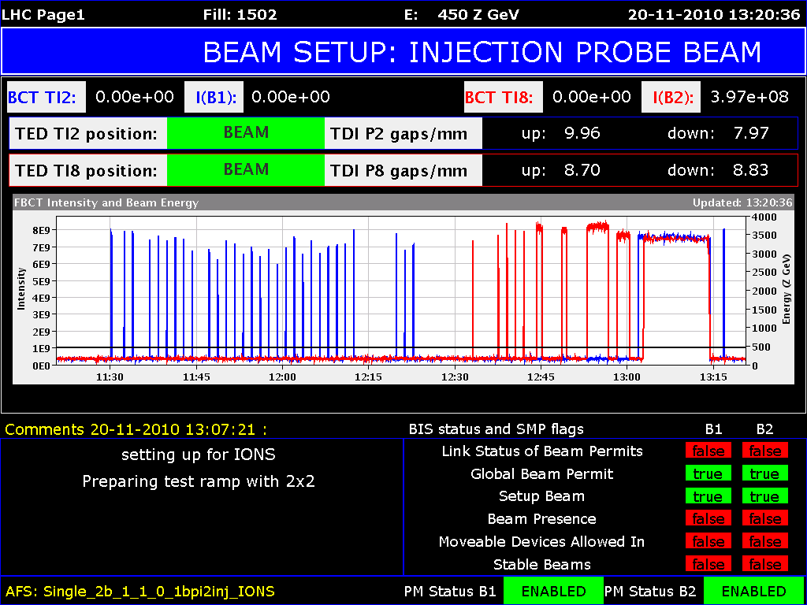
Saturday Nov 20
08.00 Stop proton operation. Switch back to ions
Interlocks, thresholds, synchronisation etc
10.00 Both beams circulating
10.30 PS RF problem (80 MHz cavity. No beam for 1 hour)
11.30 – 13.00 RF capture optimisation

Slide 2
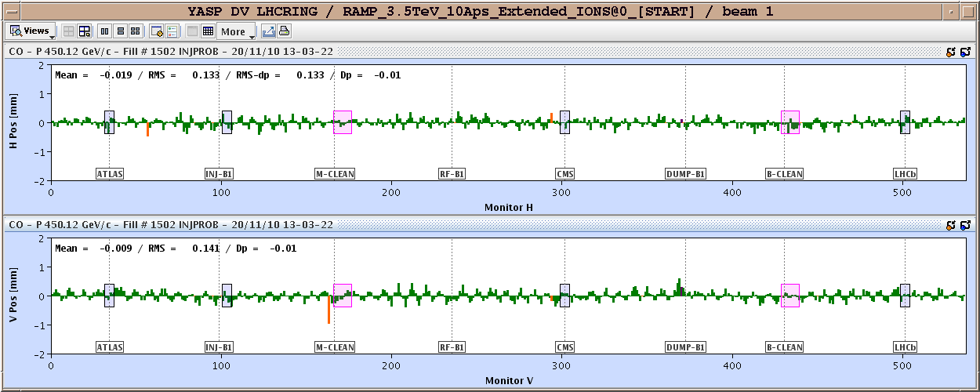
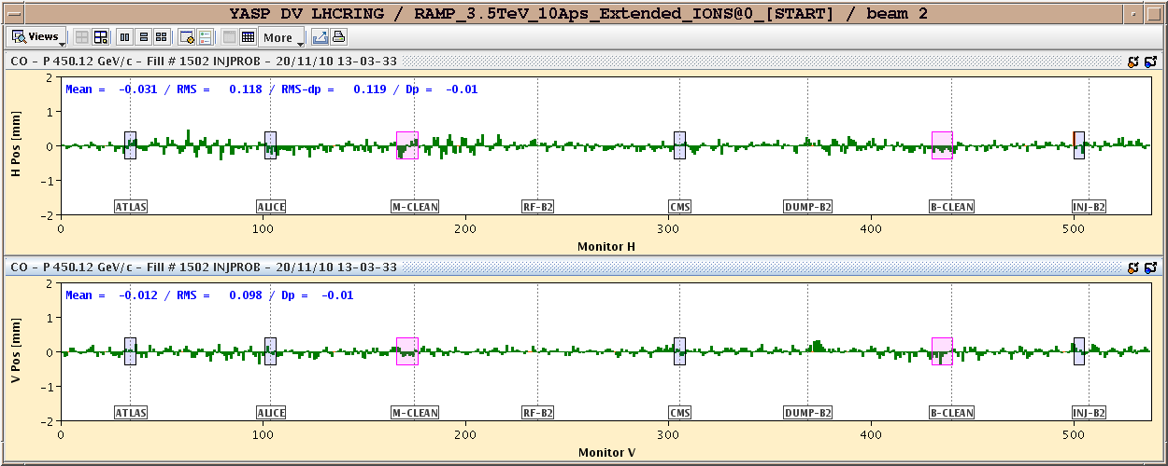
Orbits before any correction

Slide 3
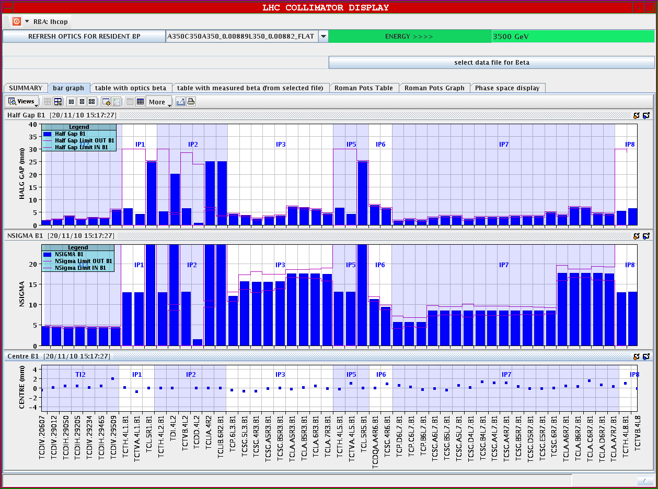
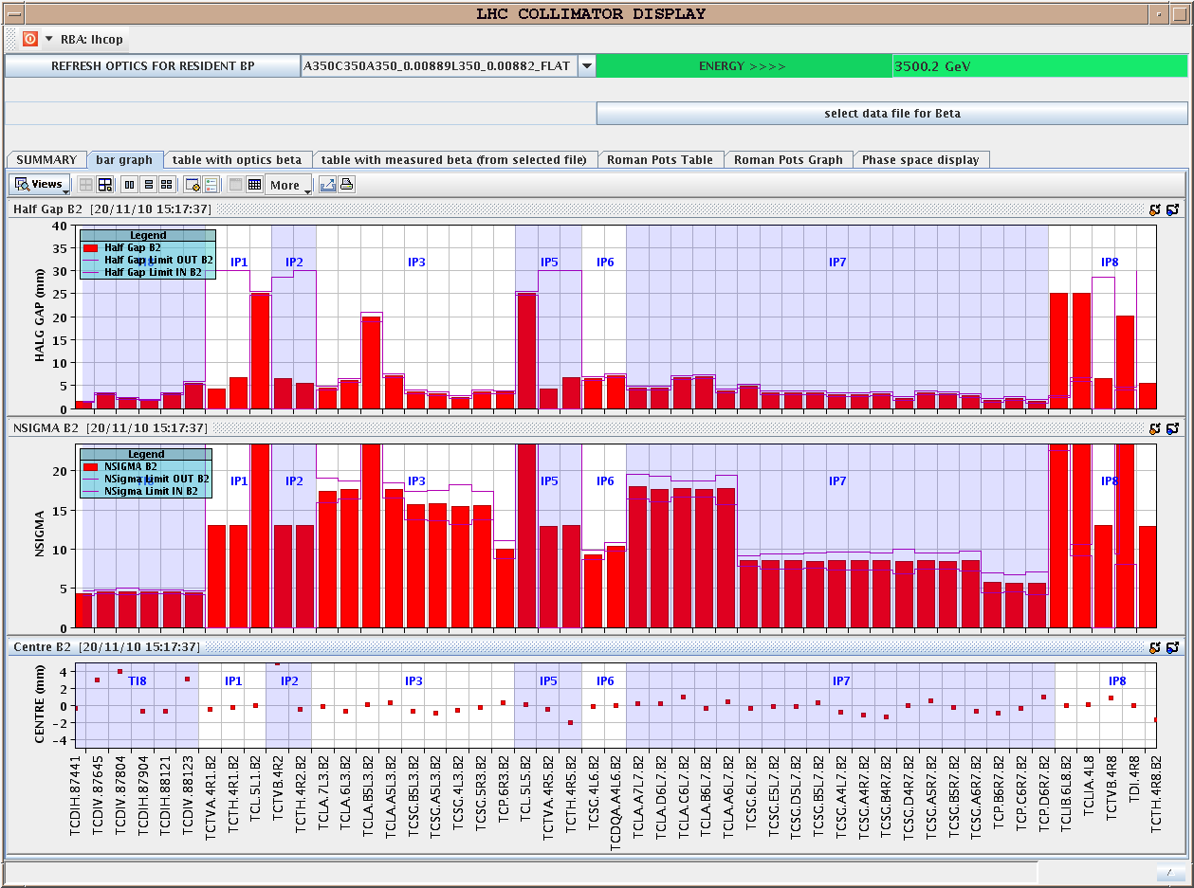
Saturday Nov 20
13.30 Test ramp, 2 bunches per beam
Ramp, squeeze, collide
Also used for qualification of luminosity scan range
TCTs in all IPs closed to 13 sigma

Slide 4
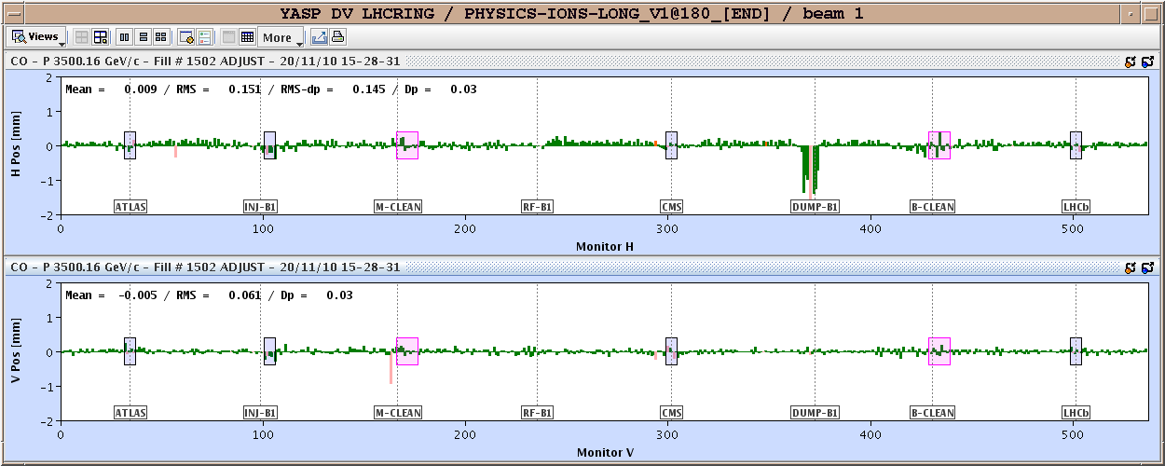
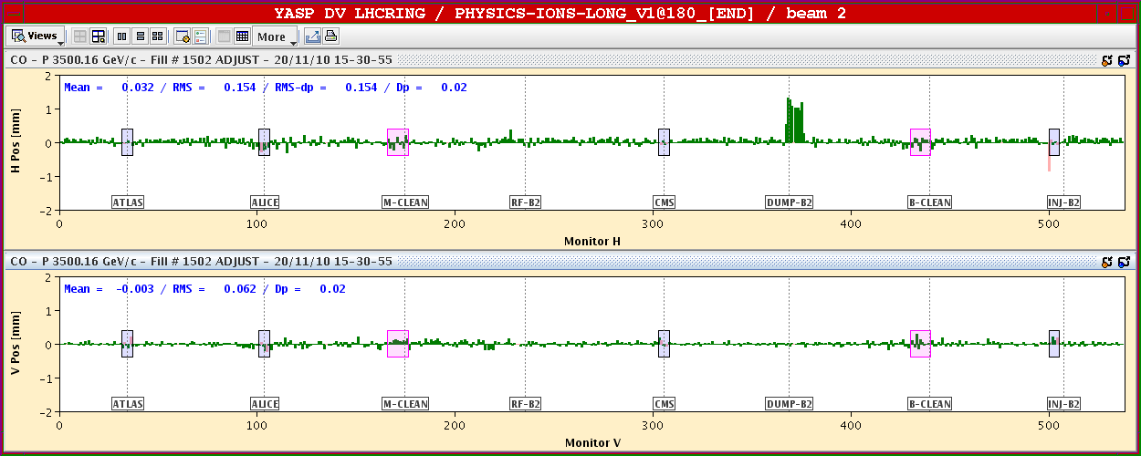
Bump at TCDQ
Bump -1.2 mm TCDQ, beam 1
Bump +1.2 mm TCDQ, beam 2

Slide 5
Saturday Nov 20
Asynch dump test
Filled the abort gap
Were triggered by the SIS orbit for TOTEM (should be masked automatically with setup beam flag?)
The abort gap was well filled by then however
Fill for physics from 17.00
Bunch intensities some 30% down on those before the stop
Emittances at 17.45 B1H 2.6 B1V 1.9 B2H 2.8 B2V 2.3
18.00 SPS RF problem (49 and 41 bunches in the machine)
Measure emittance from time to time
Emittances at 18.40 B1H 3.6 B1V 2.7 B2H 4.1 B2V 4.8
18.40 SPS RF OK, refill
19.30 PS RF problem (80 MHz cavity. No beam for 1 hour)

Slide 6
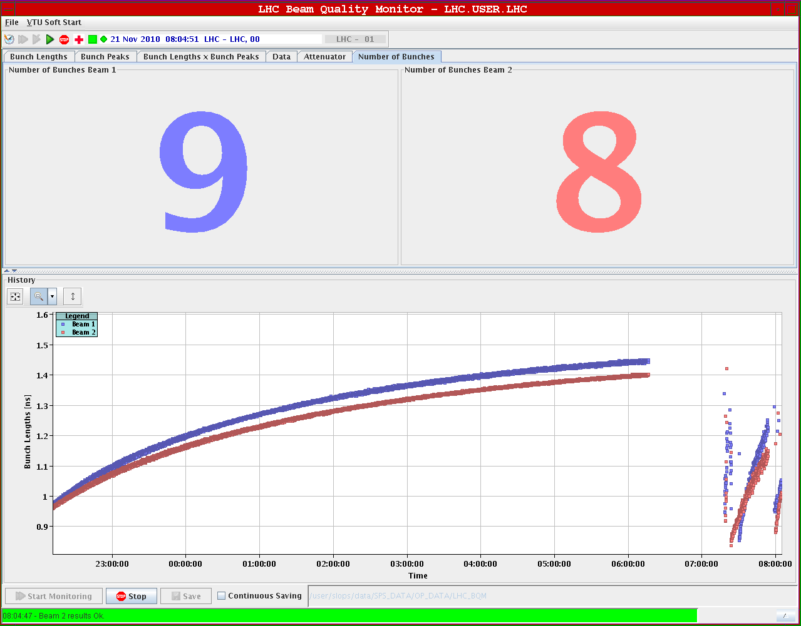
Physics
Filling for physics from 20.30
1 bunch missing for beam 2 (13461) in the last injected batch.
We carry on now.
Informed the experiments. It is OK for them.
21.50 Ramp 121 and 120 bunches
23.00 Stable beams. Initial lumis around 2 10²⁵
Beams dumped by Op after ~ 7 hours
Refill for physics
Again 1 bunch missing/not seen
Investigating …

Slide 7
Fill 1504

Slide 8
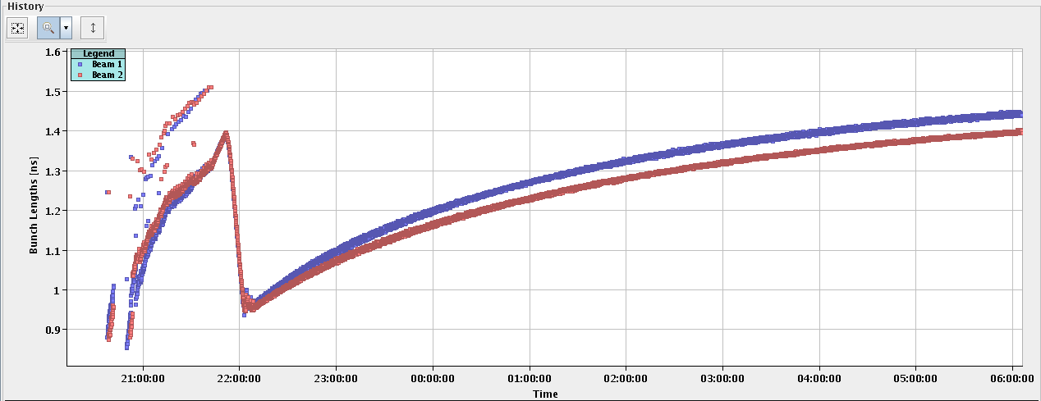
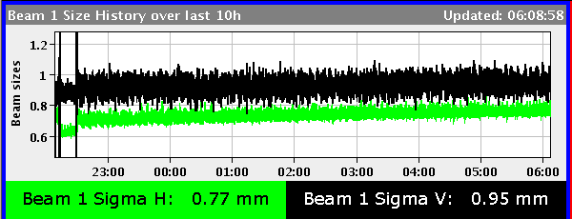
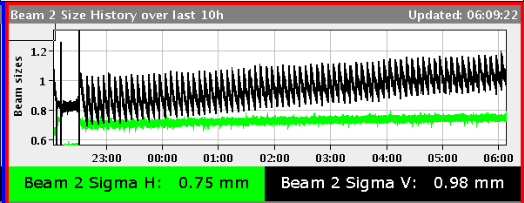
Beam size evolution through the fill

