Slide 1
Friday
08:30 – 10:00 Switch to protons 50 ns spacing
10:00 – 14:00 Setting up of 12, 24 and 24+24 bunch injection IP6 BPM test OK with 108 bunches
14:00 – 16:30 Test ramp with single nominal bunches. Full set of loss maps done. OK for ramp with 50 ns beam.
16:30 – 20:00 Set up for 'repeat' of fill 1459, night of Oct 30/31, 1+12*9 bunches of 1.1e11. Lost at 3.5 TeV because of trip of power converter (RQTD.A12B1) – related to tune feedback?
21:30 Self trigger of Beam dump: access necessary (one trigger unit for MKD generator C and D broken) ==> go with ramp with beam 2 only
23:45 Finally at 3.5 TeV with 1+12*9 bunches of 1.1e11 (Beam 2 only) for cryo and vacuum measurements.
01:30 End of measurements at 3.5 TeV (cryogenics, vacuum and beam stability) ➔ Beam dumped
Access for repair of the MKD trigger unit
05:00 Recover and go to injection of 50 ns beam (trains of 24+24 bunches)

Slide 2
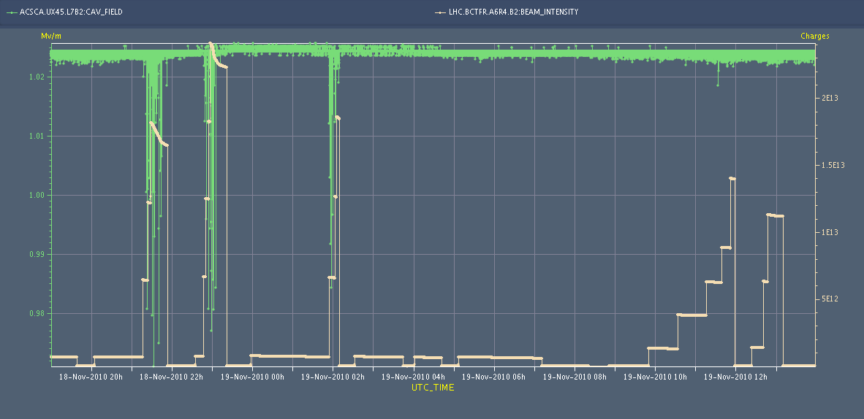
High intensity effects
Capture losses observed on beam 2 during last night are understood ➔ Cavity 7B2 is showing some noise on the accelerating voltage. It seems to be correlated with high beam intensity ➔ solution ➔ conditioning if running at higher intensity
A. Butterworth

Slide 3
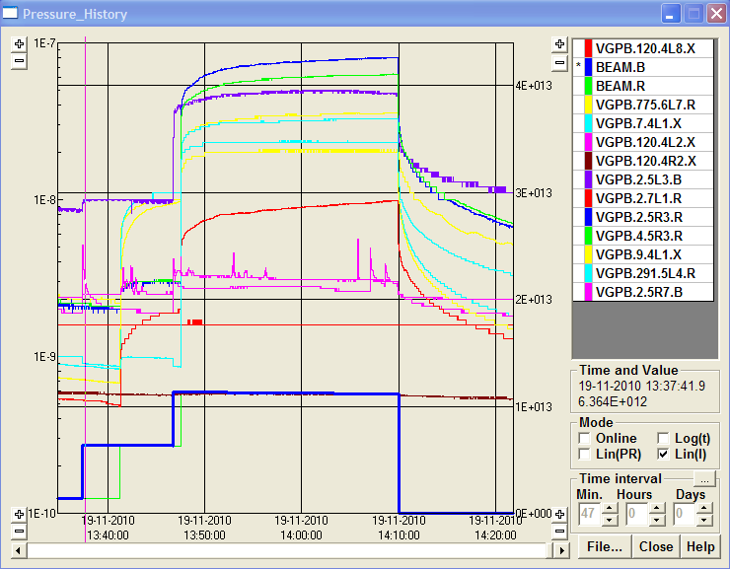
50 ns
Two trains of 24+24 bunches injected. Visible effect on vacuum ➔ there was no visible effect for two trains of 24+24 bunches for 75 ns spacing

Slide 4
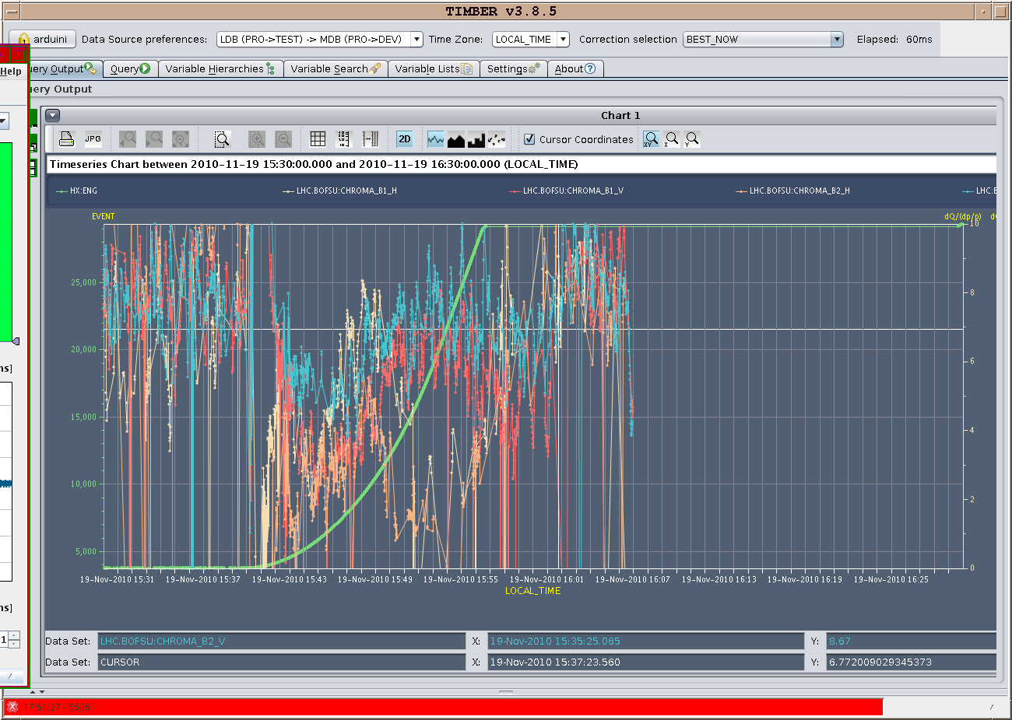
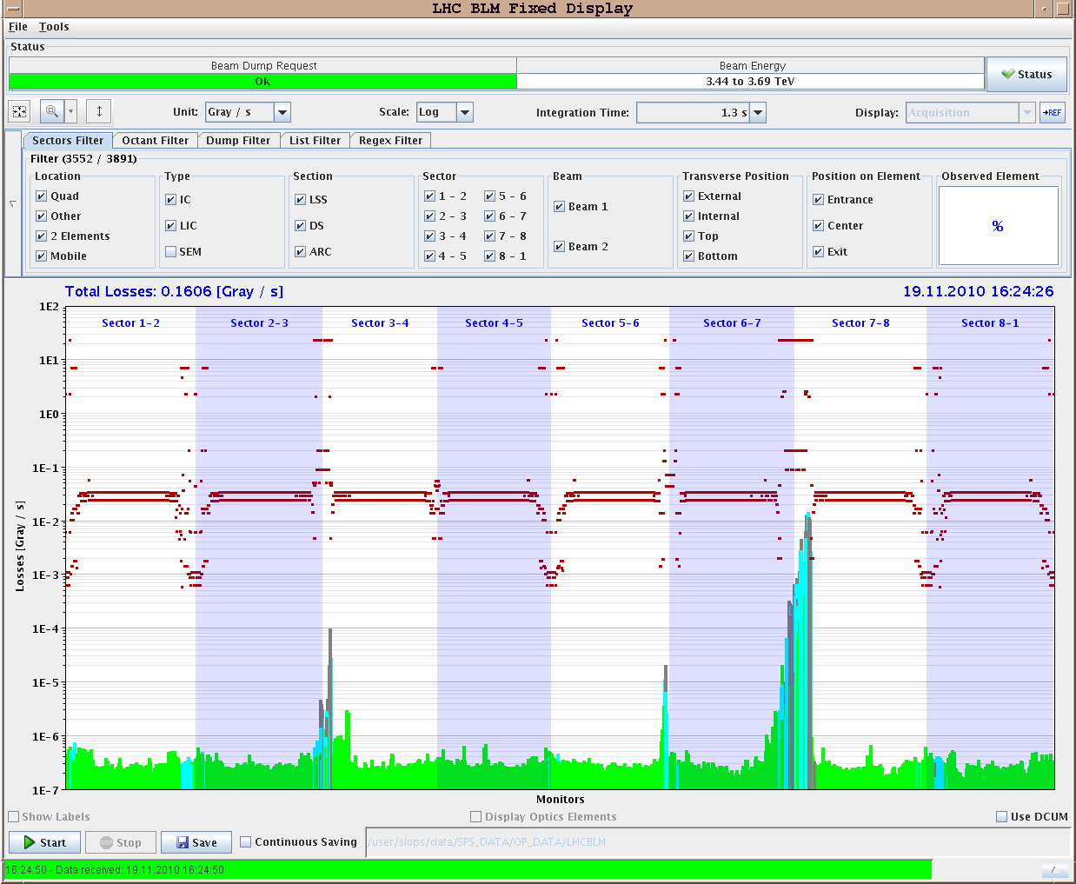
Test ramp
....in preparation of 50 ns ramp. Chromaticity measurement and loss maps.

Slide 5
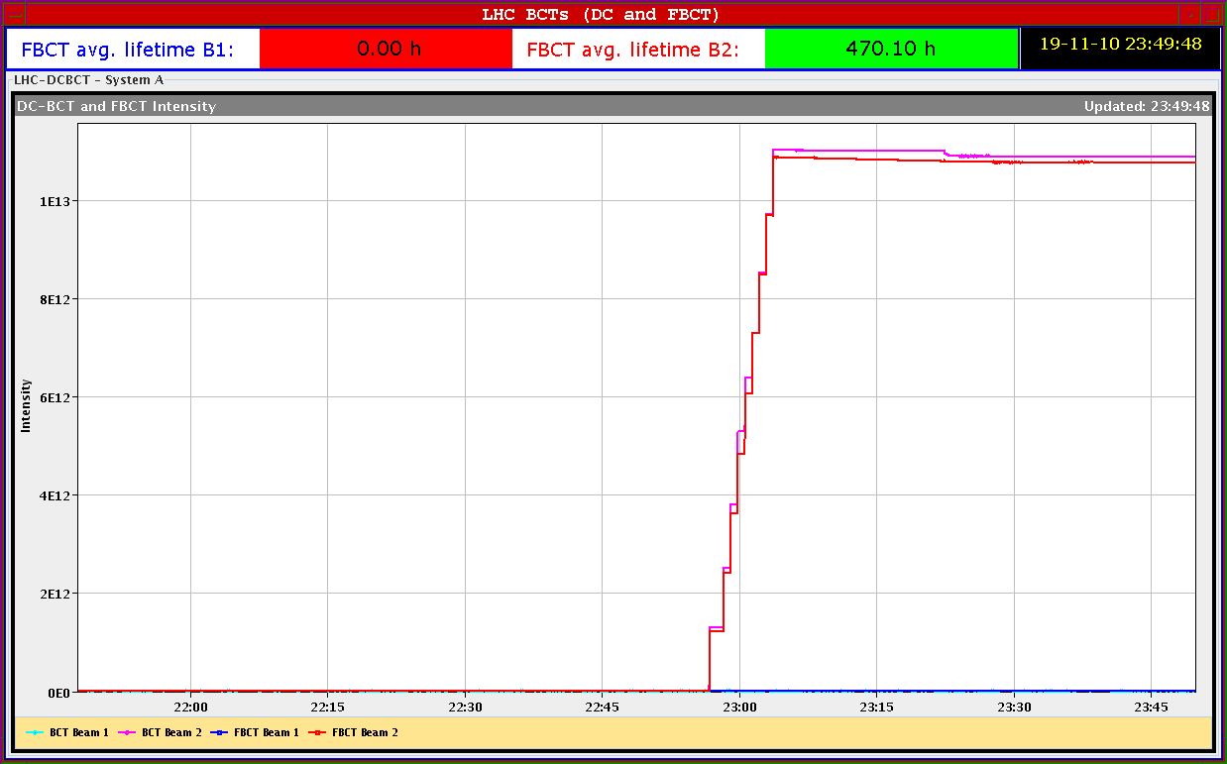
50 ns ramp (9x12 bunches)
Waiting for 1 hour at flat top for vacuum and cryogenic measurements. No sign of additional heat load on top of that due to image currents. Limited vacuum activity ➔ scrubbing at 450 GeV seems to be effective also in the arcs and at 3.5 TeV. Currents very similar to those of 30/10.

Slide 6
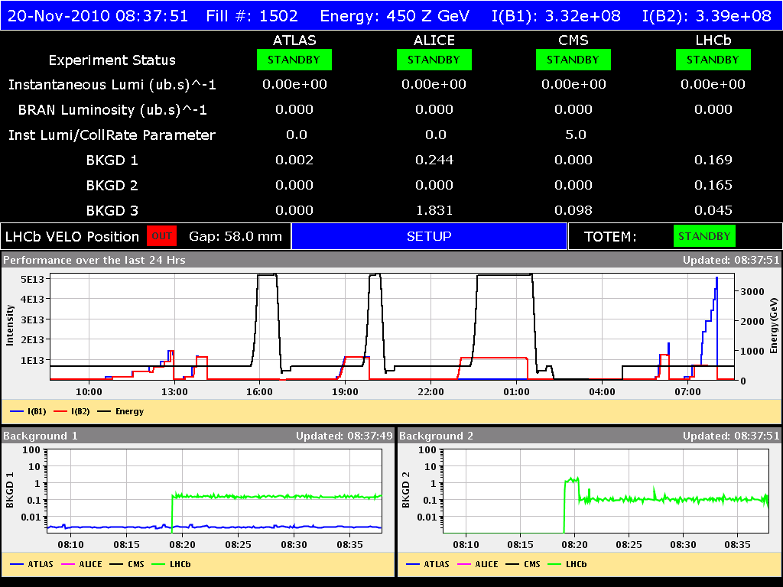
50 ns
After the access: Injection of trains of 48 bunches spaced by 1.85 microseconds (similar to what was done with 75 ns) for comparison purposes.
Go with beam 1 to speed up. Managed to inject 444 bunches with ~1.2x10¹¹ p/bunch. Clear sign of heat load on the cryogenics. Not visible with 75 ns spacing.

Slide 7
Plan
Switch to ions (source intensity dropped since the start – expert working. Improving and now at ~70% of value before the stop)
Verification of interlocks and test ramp
Stable beams 121 on 121

