Slide 1
Tuesday/Wednesday 9/10.11.
22h50: Stable beams with 17 bunches, 16 colliding pairs fill# 1485 - initial lumi 3.5e24 cm-2s-1.
12h30: Adjust mode for end-of-fill study.
13h21: Rampdown and precycle.
14h13: Problem with timing card in RF front end at SPS.
14h39: PS RF cavity down now.
15h10: Injection.
15h45: Tested dynamic change of reference for the Tune-FB and fitter window.
16h19: PS RF problem.
17h26: Injection.
18h28: Start ramp. 69 bunches.
18h41: RCBXH1.R2 tripped, beam dump.

Slide 2
Fill 1485
Much larger intensity losses for beam 2 than for beam 1.

Slide 3
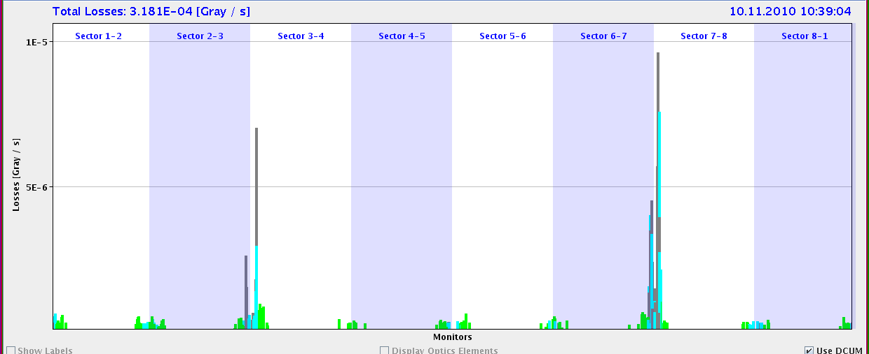
Losses (Linear Scale)
betatron
Off-momentum
b2
b2
b1
b1
Also see higher beam 2 losses at collimators.
Mainly seem to be betatron losses. Transverse emittance blowup pushes ions onto collimators.

Slide 4
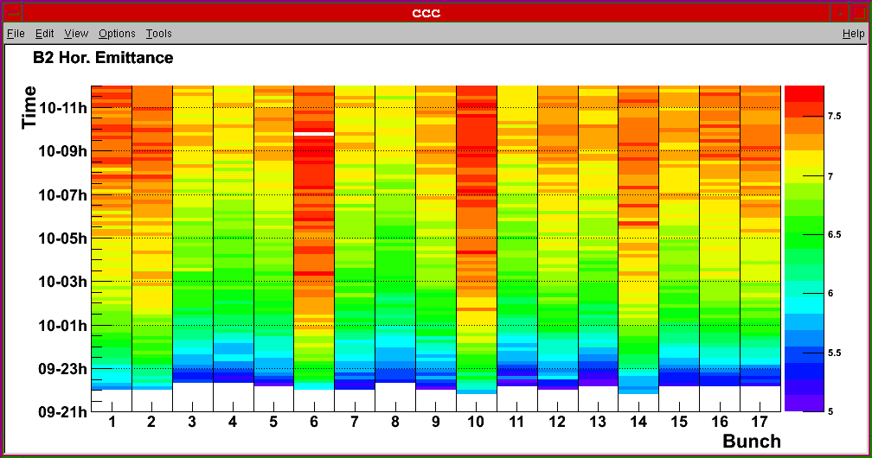
Blowup of Various Bunches
In horizontal emittance: blowup mainly in first bunch of a batch. This is also the most intense bunch.

Slide 5
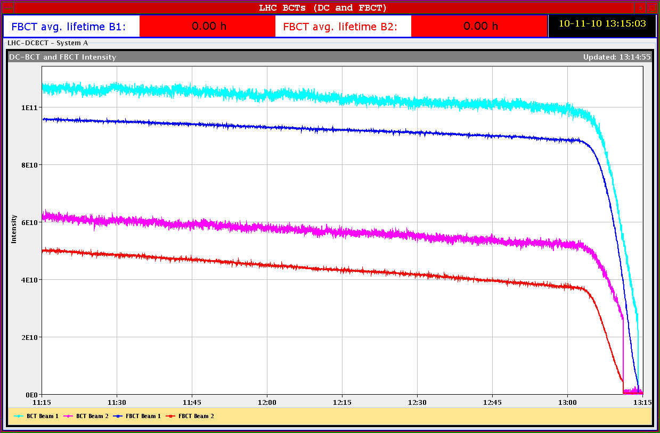
End-of-fill scraping

Slide 6
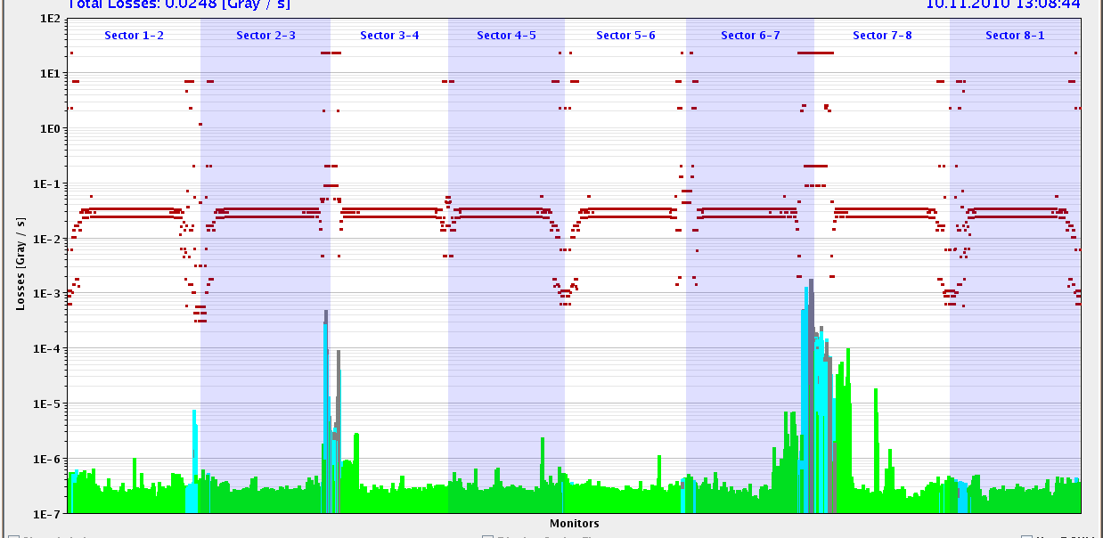
Losses While Scraping with TCPV B1

Slide 7
Fill with 69 Bunches

Slide 8
Reproducibility of Loss Locations
Compare data taken on Sunday and Monday.
Identical conditions: collimators at physics settings.
Compare vertical losses where we have best signal to noise for both data sets.
See very good reproducibility → loss peaks in locations far away from collimators are real (e.g. middle of arc losses).

Slide 9
Loss Maps: Physics Conditions B1 V

Slide 10
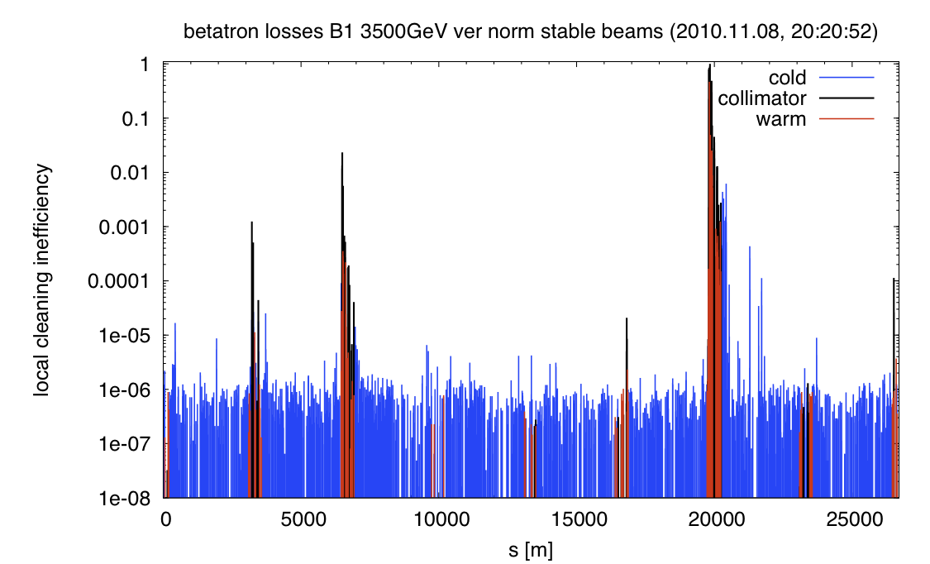
Loss Maps: Physics Conditions B1 V

Slide 11
Loss Maps: Physics Conditions B2 V

Slide 12
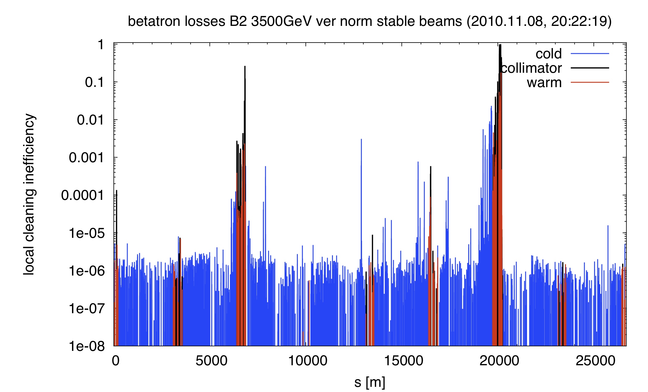
Loss Maps: Physics Conditions B2 V

Slide 13
Wednesday/Thursday 10/11.11.
18h41: RCBXH1.R2 tripped, dump. Access: board A high U_RES?
21h31: Recover and precycle.
21h48: RCBXH1.R2 tripped again. Access. Connector? Old card.
00h03: Recover and precycle.
00h56: Trip RQT13.L2B2. Piquet. Precycle.
03h14: Injection. Missing frequently injection because of wrong bucket. During the injection for physics, we got one train shifted by one RF bucket not intercepted by the SPS BQM. So we dumped and refill.
05h24: Start ramp. BCT logging stopped working. 69b. Low intensity.
05h32: Beam dump. RB_ENERGY_CHECK SIS interlock. Same event as in the morning of the 27th of October. XPOC failed also because the energy reading is -1 GeV.

Slide 14
Wednesday/Thursday 10/11.11.
05h56: Trip again RCBXH1.R2. Access.
07h08: RCBXH1.R2 fixed. Board bypassed.

Slide 15
Ahead
Until 11h00: working through several accesses on list:
DFBAN P7 exchange of card (2h)
CMS (2h)
ATLAS probably
Vacuum 3-4 communication
UPS cryo SM18
…
11h00: recover
12h00: Fill for physics (69 bunches).
Delayed: RF test at injection (increase of voltage after injection pulse 3.5 MV → 7 MV when not injecting)

