Slide 1
Monday 8.11.
8h43: Injection.
Prel. conclusion for collimation with ion beams (collisions):
V betatron losses OK for beam1, indication of wrong primary losses for beam 2.
H betatron losses not normal: 1% leakage into arc for beam 1, wrong primary losses for beam 2, 50% leakage from IR7 to IR3 for beam 1. Only acceptable due to 1 stage cleaning nature of ion collimation.
Off momentum loss: OK for negative delta p. Not normal for positive delta p: 10-20% leakage from IR3 to IR1.
OK for stable beams. Additional leakage into cold magnets and sensitive equipment is higher than expected, but still in the shadow of the observed high leakage into the DS (expected DS losses).
Requires detailed follow-up, understanding (what ion species are escaping?) and monitoring.
9h52: Start ramp. 2b of 1e10 per beam.

Slide 2
Loss Maps: Physics Conditions

Slide 3
Loss Maps: Physics Conditions

Slide 4
Loss Maps: Physics Conditions
ATLAS
CMS

Slide 5
Monday/Tuesday 8/9.11.
11h20: Stable beams. First for ions. Fill #1482.
12h57: Retracted TCTVB’s in IR2 to +- 23 mm (manually). Avoids shadowing problem for ZDC.
14h19: Some orbit optimization: explains collimation issues observed?
19h31: Adjust handshake starting. 20h00 in adjust.
End of fill loss map for reproducibility check.
Loss map with TCTVB’s in IR2 back in.
20h30: Rampdown and precycle. RF adjustments.
22h20: Injection.
Trip of RF module 1B1.
23h47: Start ramp. 5 bunches of 1e10 per beam.
01h01: Stable beams. Fill #1483.

Slide 6
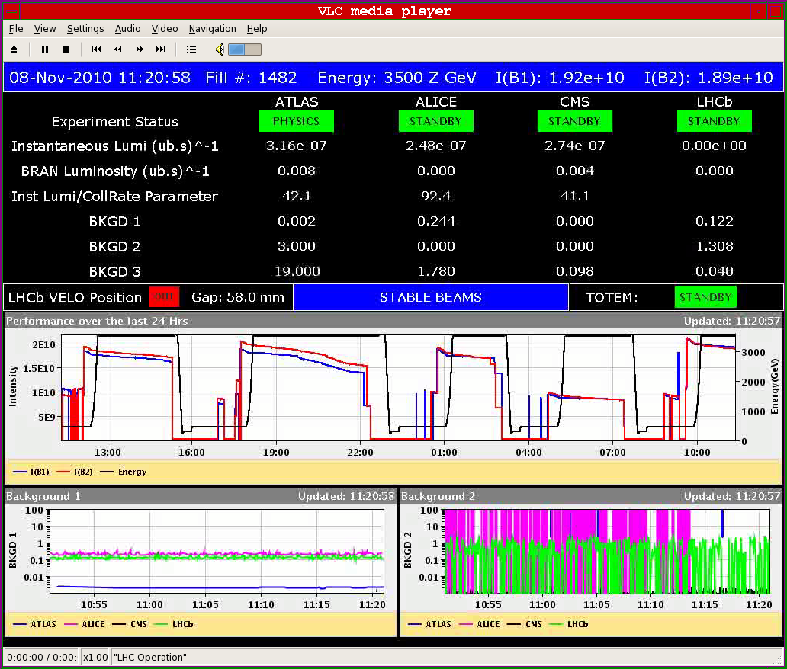
First Stable Beams Ions

Slide 7
First ALICE Heavy Ion Events…
… thanks for the drink…

Slide 8
RF Adjustments I
Re-adjust coupler position and voltage partition to work with 12 MV/beam at 3.5 Z TeV.
Voltage rised linearly from 4 MV on flat top to 12 MV during ramp (used to be 8 MV).
12 MV per beam:
Beam 1: Voltage partition 1,1,1,0,1,1,1,1 (Cav4B1 OFF) Cav Q P(kW) V(MV) 1 60k 118 1.71 2 60k 135 1.71 3 60k 144 1.71 4 15k OFF 5 77k 147 1.71 6 68k 147 1.71 7 65k 143 1.71 8 60k 137 1.71
Beam 2: Voltage partition 0.15,0,0.11,0.15,0.15,0.15,0.15,0.15 (Cav2B2
Philippe

Slide 9
RF Adjustments II
trip of RF module 1B1
Problem with klystron 2B1....
Switch it OFF -> leave POWER on READY
Adjust fcts: Voltage Phase: zero on flat bottom and at start ramp NOTE: did not chnage voltage partition to avoid saturating the other klystron on flat top.
4 MV at inj 10.3 MV at 3.5 TeV
Philippe

Slide 10
Procedure for Ion Stable Beams
TCTVB operation now in sequence task: no need for manual adjustments in expert tools (S. Redaelli).
Procedure to declare STABLE BEAM:
run collisions BP
finish trim of the IP2 crossing angle
mini-scan optimization all Ips
move out TCTV collimators in IP2 with the sequence ION PHYSICS: OPEN VERT TERTIARY COLLIMATORS IN IP2
declare STABLE BEAM : no more scan in IP2 with TCTV opened.
Worked well for second fill…

Slide 11
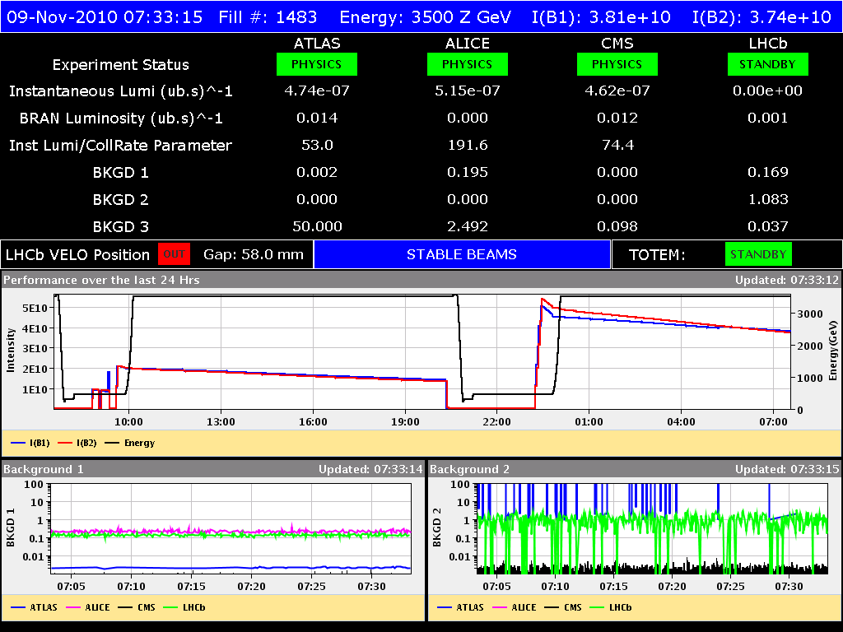
Second Ion Fill with Stable Beams

Slide 12
Ahead
Dump fill during morning.
Inject 4b from SPS.
Set up for 17x17b. Stable beams.
Push up intensity over the week.

