Slide 1
Summary first Scrubbing test 31/10/2010
G. Bregliozzi, G. Lanza, V. Baglin, P. Chiggiato

Slide 2
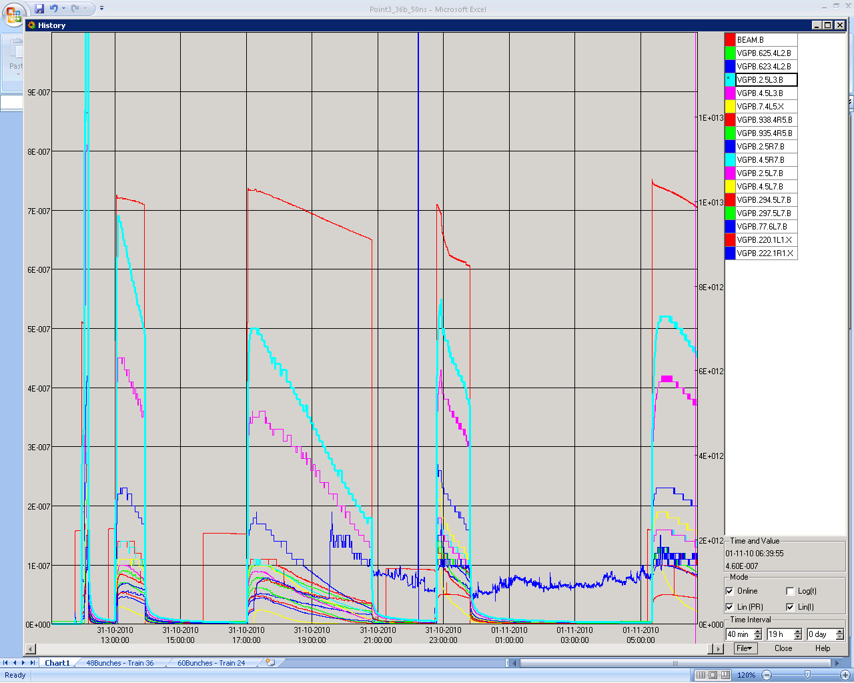
Beam 1 – Pressure Evolution
48b
60b
60b
48b
108b
12+24+24
12+36

Slide 3
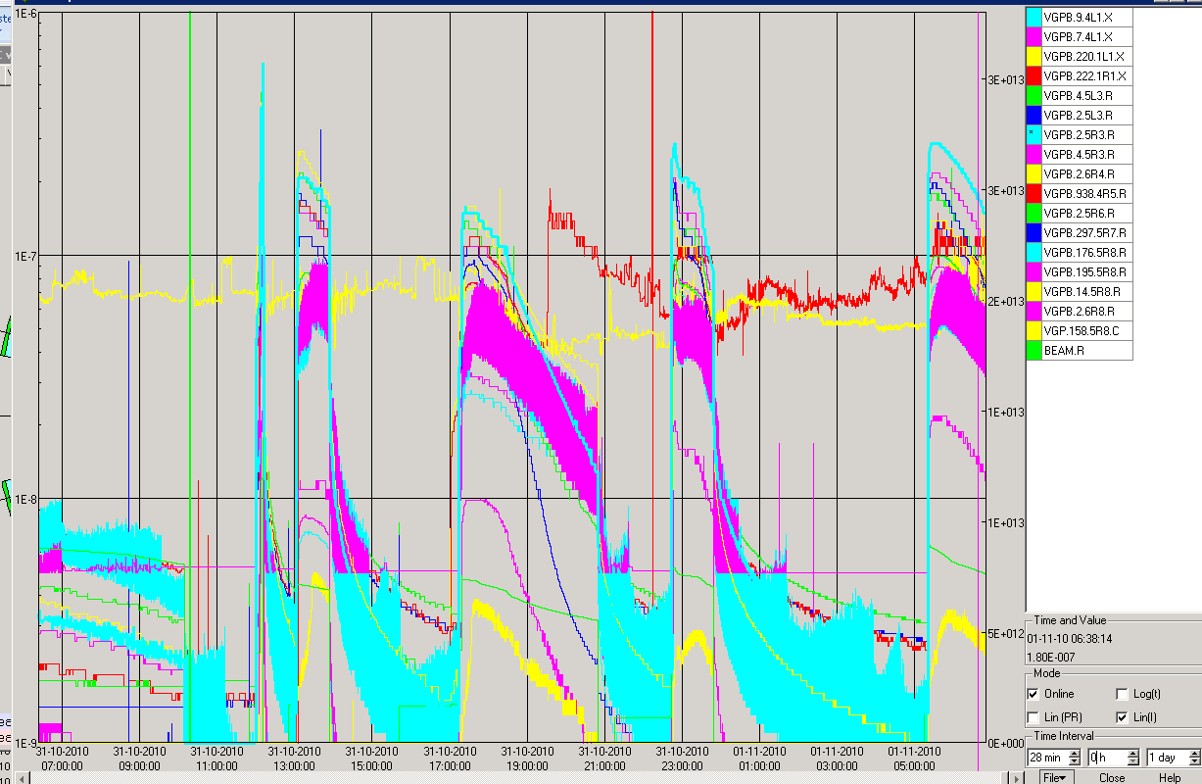
Beam 2 – Pressure Evolution
60b
48b
48b
60b
108b
12+24+24
12+36

Slide 4
Cleaning: Linear Scale

Slide 5
Pressure Variation on ITL8
Two Beams Circulating

Slide 6
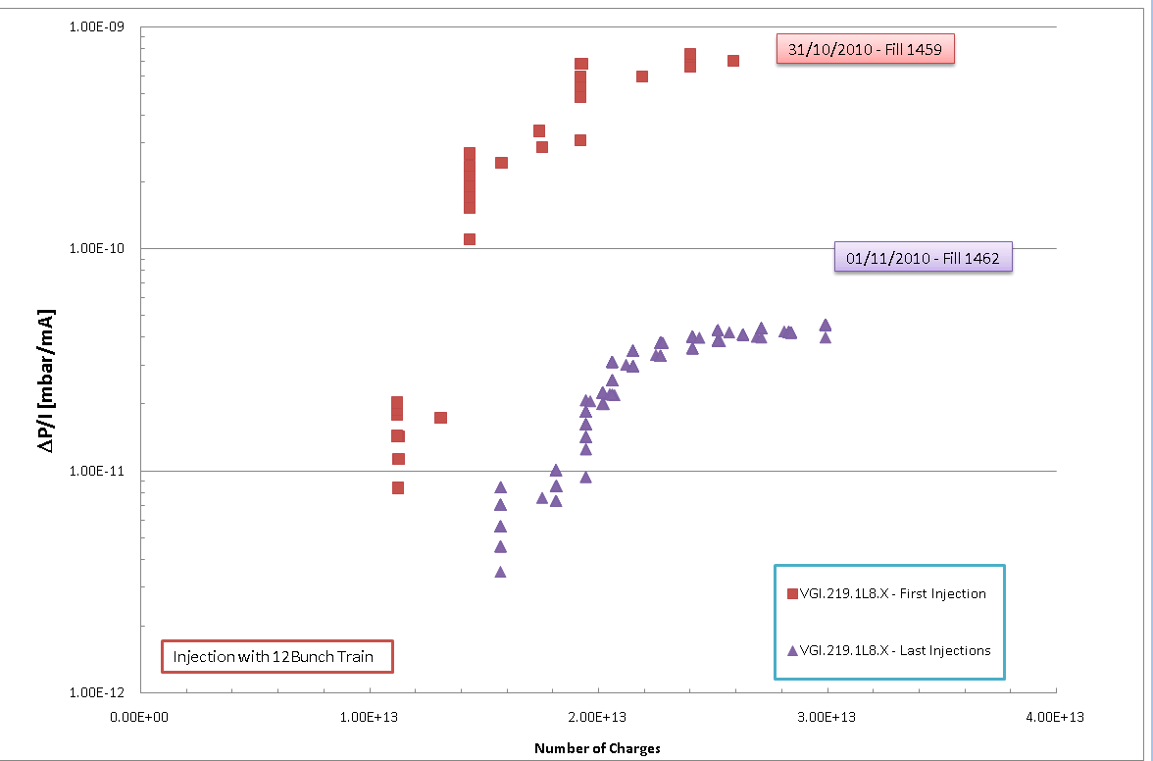
Pressure Variation on ITL8
109 Bunches
12inj

Slide 7
Maximum Pressure on A5L3.B During Fill
One Beam Circulating

Slide 8
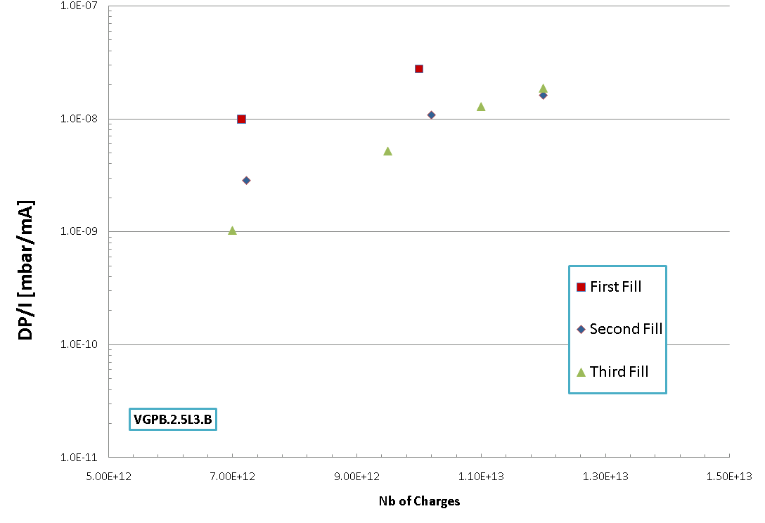
Maximum Pressure on Vacuum Sector A5L3.B During Fill
1450
1460
1461
24inj

Slide 9
Temperature Variation on ARC 5-6
LSS5
LSS6

Slide 10
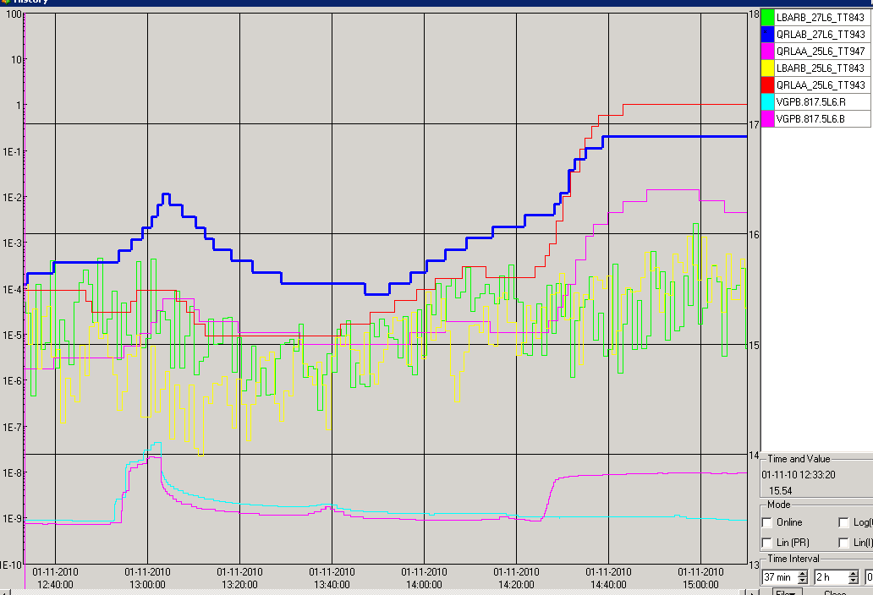
Temperature Variation on ARC 5-6
Exit BS
Entrance BS
450GeV
Pressure
3.7TeV

Slide 11
Summary of Injection with bunch Spacing 50 bns
12Injection:
144 bunches with well separated trains of 12x50ns – no problem also at 3.5TeV
Pressure increase on the crossing points decreased of factor 8
24 and 36 Injection:
Big rises in pressure when moving to 24x50ns and 36x50ns considerable worse
Cleaning seen for 12-24-24 and persistent after refilling
Cleaning with 36 less evident

Slide 12
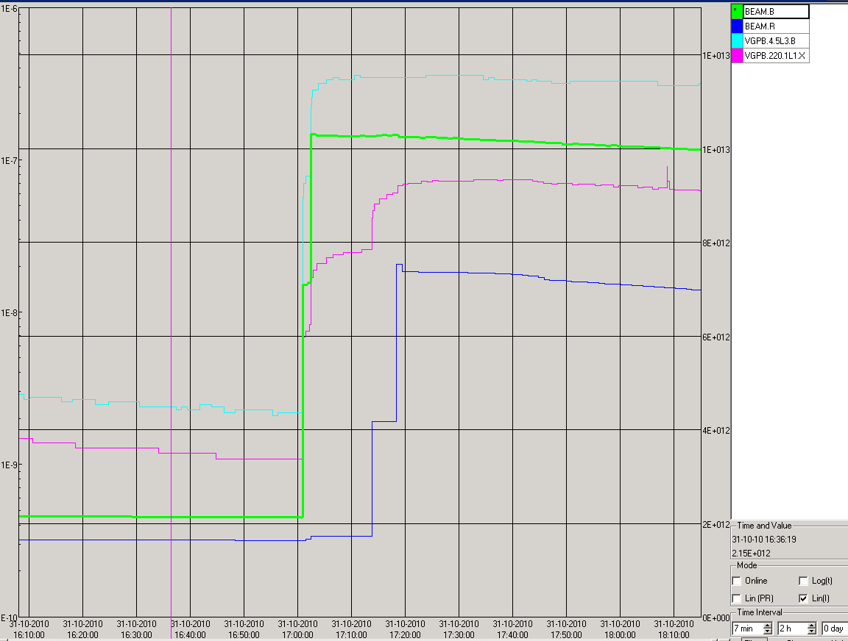
Effects of just one or two beam
Just one beam
Beam 1
60b
Two beams
36b
60b
Beam 2
36b
12b
12b

Slide 13
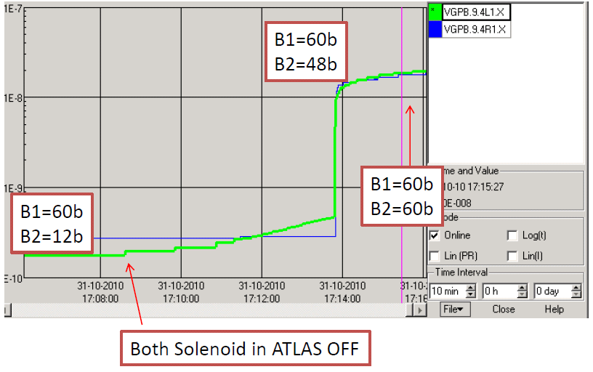
Solenoid in LSS1

Slide 14
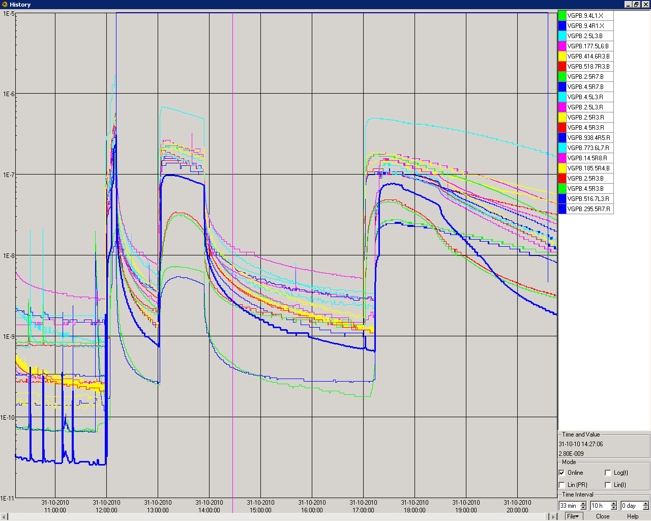
Vacuum Scrubbing
Injection of Bunch train of 24 with Bunch Spacing of 50ns
108b
1E-6
60b
60b
Scrubbing
Power Converter Problem
Vacuum Interlock
On cold-warm transition of Q6L7.R

