Slide 1
Summary of week 44
Aims of week 44
Scrubbing with 50 ns
Ion beam commissioning
J. Wenninger & J. Uythoven
for the operation and commissioning teams

Slide 2
E-cloud and beam scrubbing
End of week 43:
Strong vacuum and e-cloud activity with 50 ns beams for trains of 24 and 36 bunches.
Trains of 24/36 bunches with 50 ns could not be ramped.
Clear need to understand the e-cloud effects and associated vacuum pressure increases.
Attempt to scrub (‘clean’) the vacuum chamber with beam.

Slide 3
E-cloud studies
E-cloud studies and scrubbing plan
Effect of varying the bunch population for batches of 36 bunches (4E10 to 11E10).
Comparison of effect of batches of 12, 24 and 36 bunches.
Effect of 2 batches of 24 bunches as a function of the batch separation (from 20 μsec to minimum of 225 ns).
Vacuum chamber scrubbing with beam of increasing number of batches of 24 bunches.
Keep pressures high by adding more beam as conditions improve.
Attempt to bring ~100 bunches with batches of 24 bunches to stable beams.

Slide 4
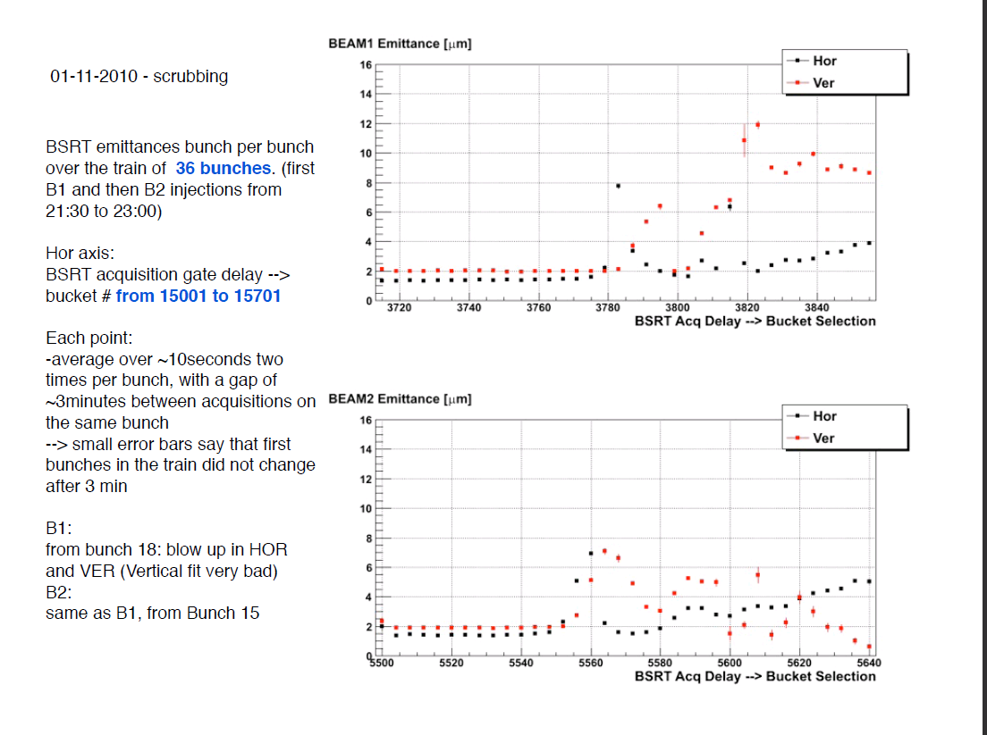
36 bunch trains
Onset of e-cloud/vacuum effects at 6E10 p/bunch.
Strong emittance increase along the train.
F. Roncarolo

Slide 5
Vacuum pressure as function of 24 b train spacing

Slide 6
Emittances for the different bunches (24 b trains)
Train 3
Train 4
Train 1
Train 2
F. Roncarolo

Slide 7
Vacuum for trains of 24 bunches
Cold to warm transition: worst case
2e-6
Sunday: Valves in
Tuesday evening with 228 bunches
Scrubbing 60 bunches
5e-7

Slide 8
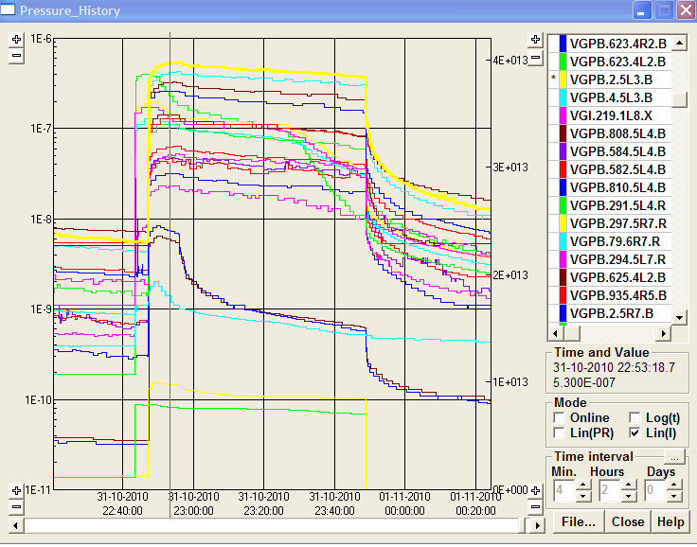
Comparison 12 + 36 bunches
31 October: max p @ LSS3 VGPB.5L3.B = 5.5E-7 mbar
Gained factor 10
with ~6 hours of scrubbing
03 November: max p @ LSS3 VGPB.2.5L3.B=6E-8 mbar

Slide 9
Collisions with 24 b per train (50 ns)
Last physics fill with 1 + 12 + 4 * 24 = 109 bunches in the night of Wednesday to Thursday.
Request by Alice to operate with spectrometer and solenoid off.
Strong effect on vacuum in IR2 with magnets off, leading to vacuum interlock when injecting 108b for B1.
Field of the solenoid is suppressing e-cloud effects !!
Solenoid and spectrometer had to ramped up again to be able to fill (and then ramp).
Towards physics
Beam lost on 3.5 TeV flat top when switching off transverse damper – beam is highly unstable !!
No collisions could be provided – lack of time.

Slide 10
IR2 pressure variation during injection
ALICE
ramping up
ALICE OFF

Slide 11
E-cloud studies
Dependence of e-cloud/vacuum pressure on number of bunches, bunch intensity and batch separation was measured.
Food for models.
Improvement of ~ 10 in pressure after around 6 hours of effective beam scrubbing.
Input for evaluating length of cleaning periods in 2011…
Beams are very unstable, collisions could not be established with 24b trains due to lack of time.

Slide 12
Quench test - Monday 1.11
Quench test at 3.5 TeV with wire-scanner
Beam of 12x12 =144 bunches with 50 ns spacing.
Local / critical BLM thresholds increased.
The wire was scanned on B2, slowing down the speed at each scan:
1 ms/s
0.75 m/s
0.5 m/s
0.37 ms/
0.3 m/s
0.2 m/s
0.15 m/s
0.05 m/s ….. finally quenched D4 ! Loss duration ~ 40 ms.
Data analysis ongoing…
Expected to quench here

Slide 13
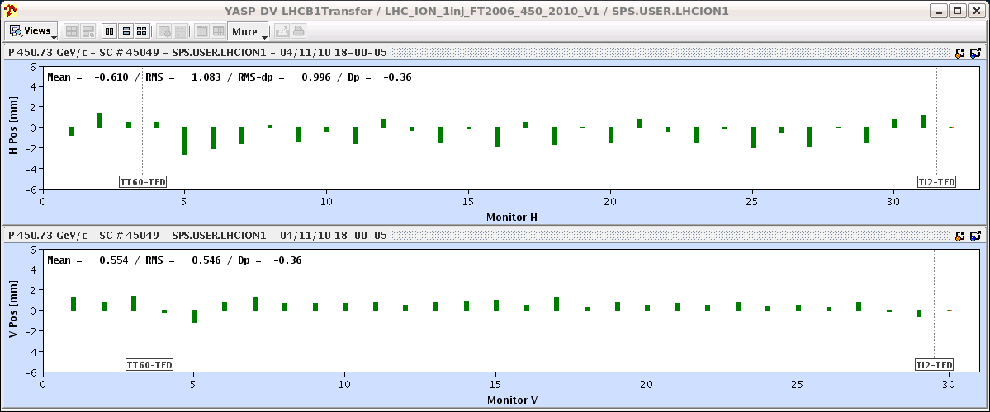
Thursday 4.11 – switching to ions
Morning and afternoon: access and preparation.
18:00 : Ions extracted to TI2/8 downstream TEDs.
A bit of steering of the trajectories. No problems.
B1 in TI2 before correction (wrt proton reference)

Slide 14
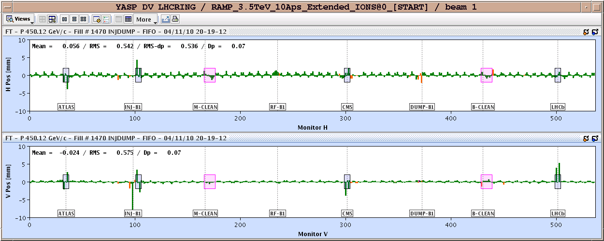
Thursday PM – ions to the LHC
Adjustment of the offsets LHC-SPS to place ions bunch on the MKI of B1.
20:20 First 75+ trajectories in the LHC.
B1 turn 1 compared to proton closed orbit – not bad !!

Slide 15
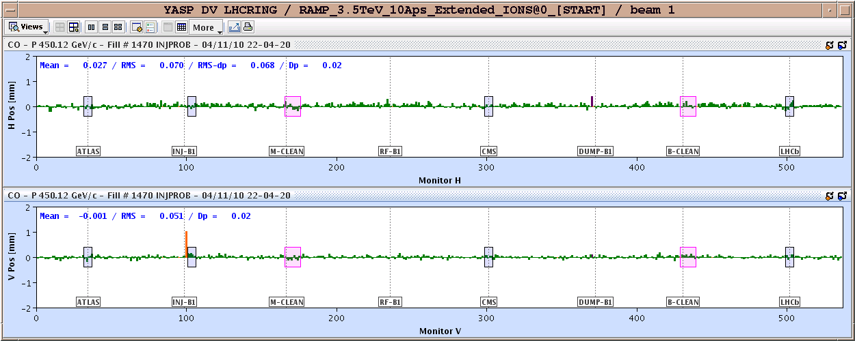
Circulating B1
20:30-22:00 RF : placing bunch into correct bucket.
22:00 :B1 captured and circulating for many seconds.
01:50 : both beams circulating.
B1 ion orbit compared to proton orbit – no steering !

Slide 16
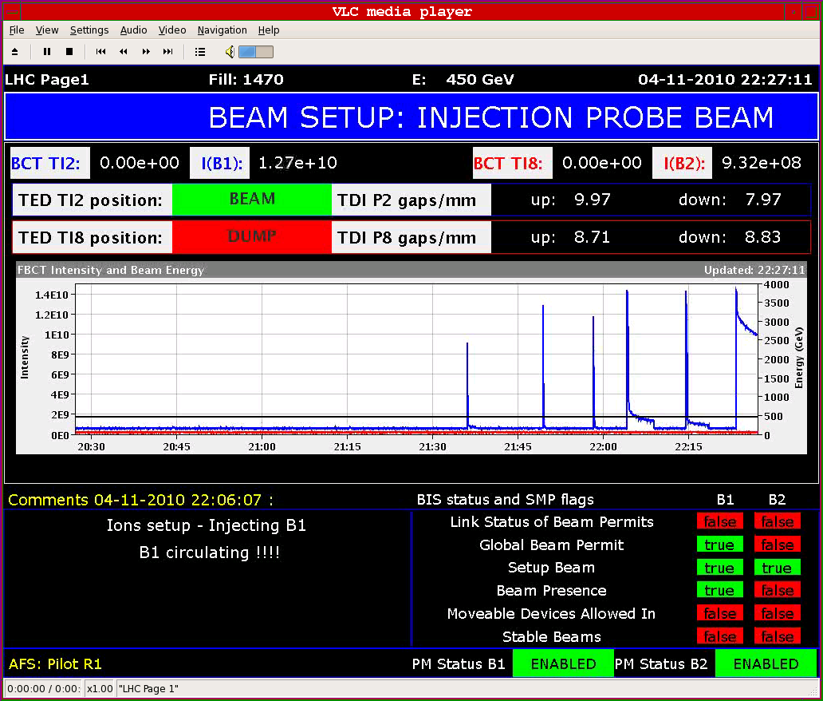
B1 (and RF) progress

Slide 17
Ion Commissioning: Thursday & Friday
Optics Checks BI Checks Collimation Checks
First Ramp Collimation Checks Squeeze
B1 Inj., Circ. & Capture
B2 Inj., Circ. & Capture

Slide 18
Beam instrumentation
No problems (at least for this stage !)
BPMs, WS, BRST, BCTs, BGI, Shottky, BRANs, FBs etc all working to full satisfaction at this stage of the ion commissioning.

Slide 19
Friday PM: first ramp – no losses
There is light a bit above 0.5 Z TeV
Bunch length increasing at injection (IBS), down during the ramp, increasing again at 3.5 TeV (IBS)

Slide 20
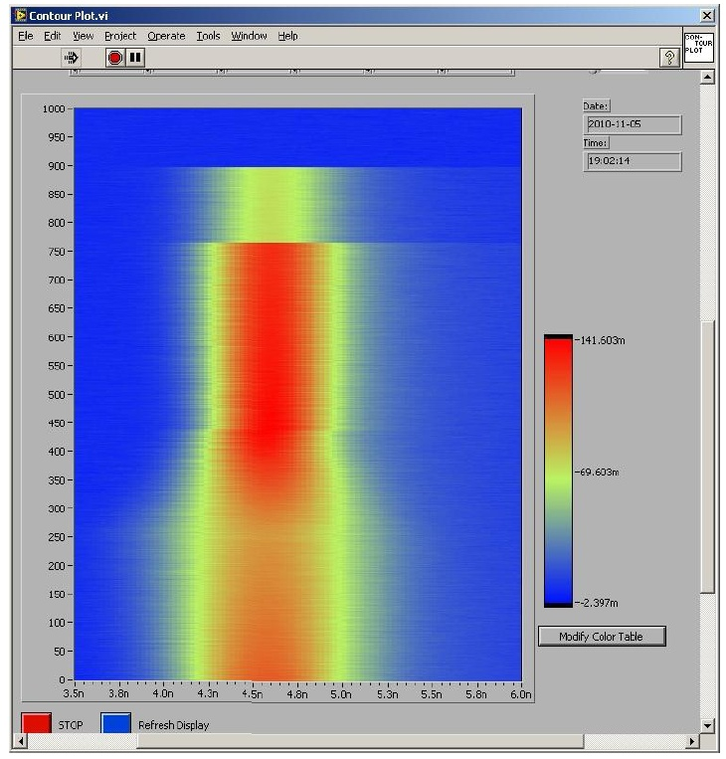
Bunch length – injection ramp
P. Baudrenghien et al.
Flat top
Ramp
Injection

Slide 21
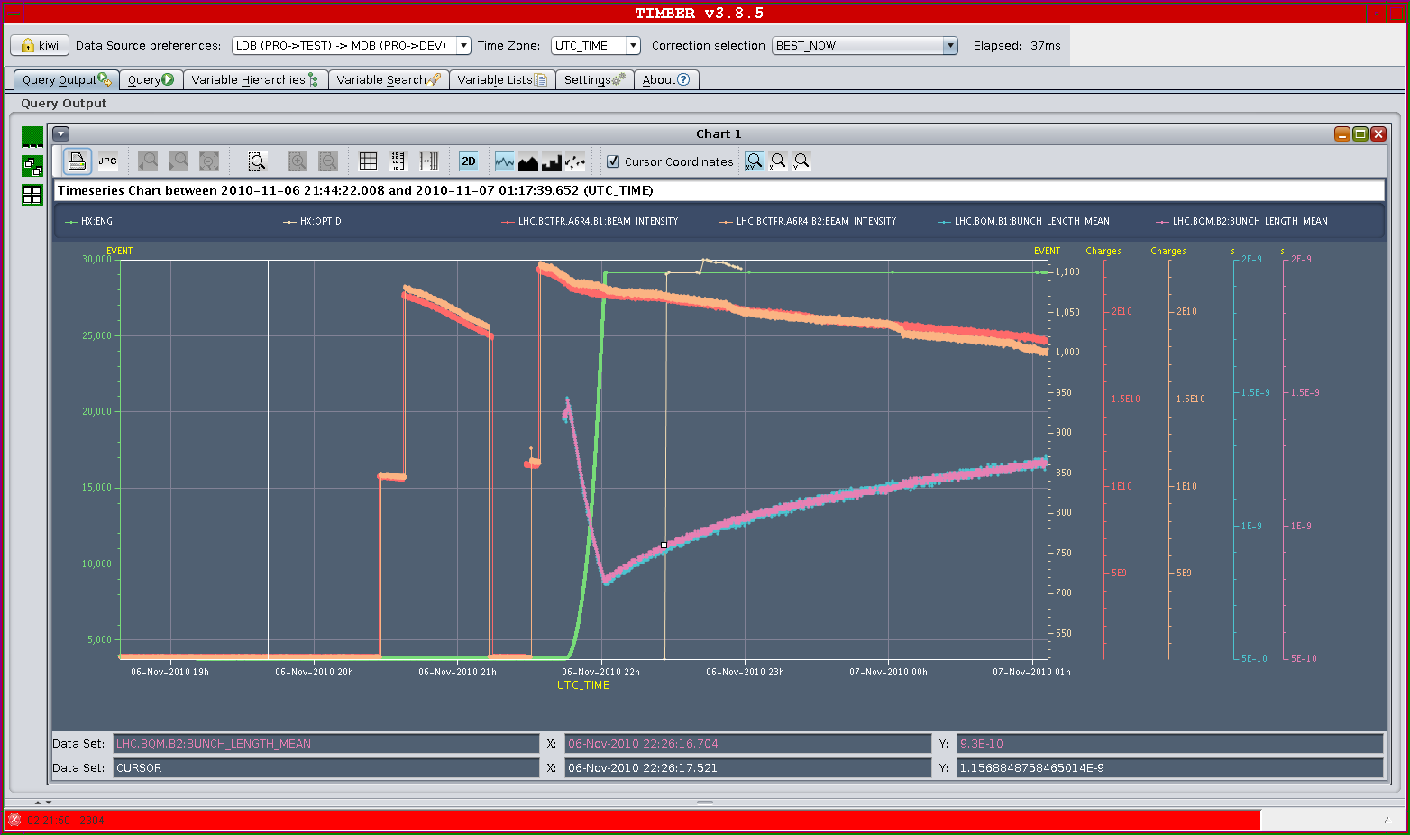
Bunch lengthening at 3.5 TeV

Slide 22
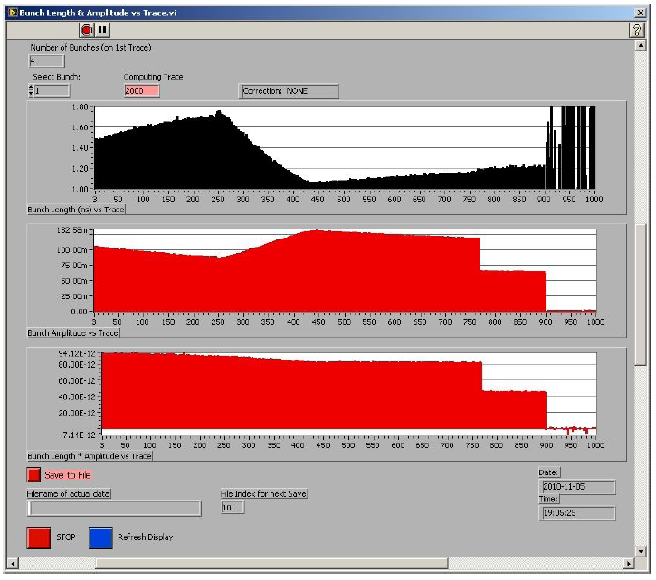
Loosing from the bucket
No losses from the bucket in the first few hours at 3.5 TeV
Bunch length
Amplitude
Length*amplitude
Losses
No losses
P. Baudrenghien et al.

Slide 23
Injection
Injection oscillation corrected on Sunday.
Injected ion energy matched to ring using horizontal correctors (Sunday) to improve capture and phase loop transients:
+0.25 permill B1
+0.2 permill B2
To be refined if required…

Slide 24
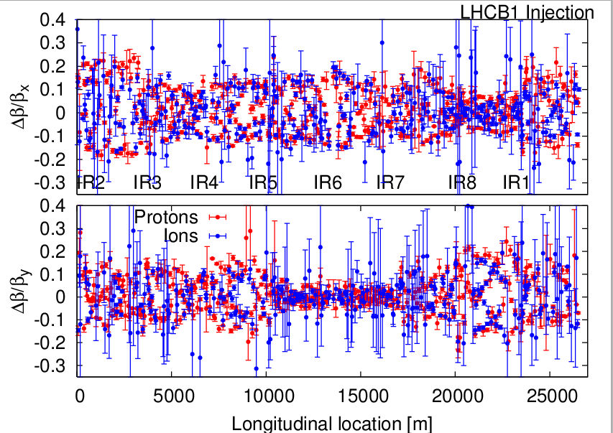
Optics measurements 450 GeV
Optics in good agreement with protons.

Slide 25
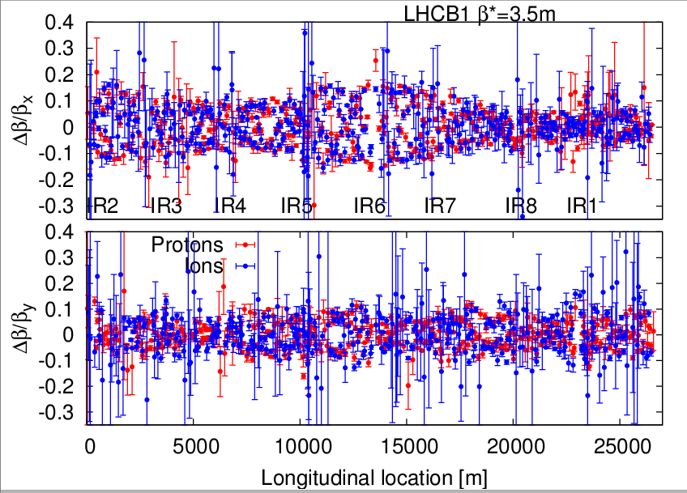
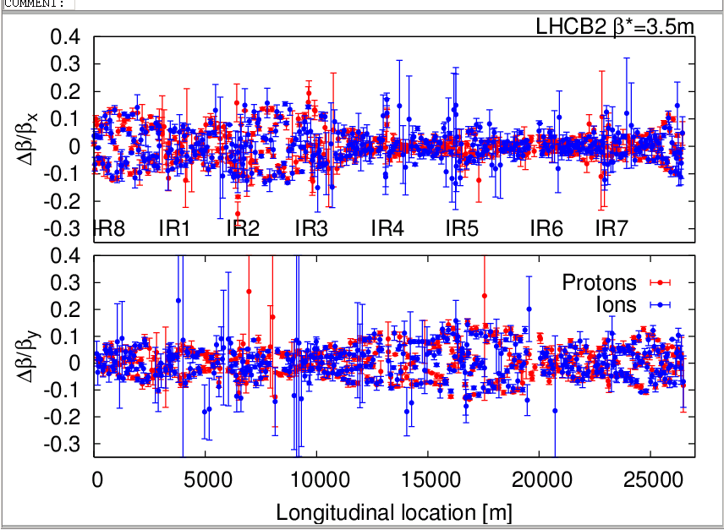
Optics measurements at 3.5 Z TeV, squeezed
Again very similar to protons
R. Tomas et al.

Slide 26
Emittances
Emittances at injection around 1-2 um (with Pb gamma!).
! Normalized emittances quoted in eLog and WS plots are ~2.5 x larger as they are based on proton gamma !
Emittances on flat top 1.5-3 um
Need more experience and stable conditions (collisions) to evaluate blow up.

Slide 27
Collimation checks at 450 GeV
Check collimator alignment at 450 GeV
Gap centers checked for 11 collimators per beam.
Reproducibility from proton to ion at 0.4 mm level (last alignmnet in May !).
Loss maps - betatron cleaning inefficiency:
Leakage to dispersion suppressor: 0.5% - 2%
Experimental IR's: clean
Arcs: 0.1%
RF: clean
Loss maps - momentum cleaning inefficiency:
Leakage to dispersion suppressor: 0.5% - 4%
Experimental IR's: 10% (TCTH in IR1, b2), 1% (TCTH in IR5, b1)
Arcs: 0.3%
RF insertion: 0.5%

Slide 28
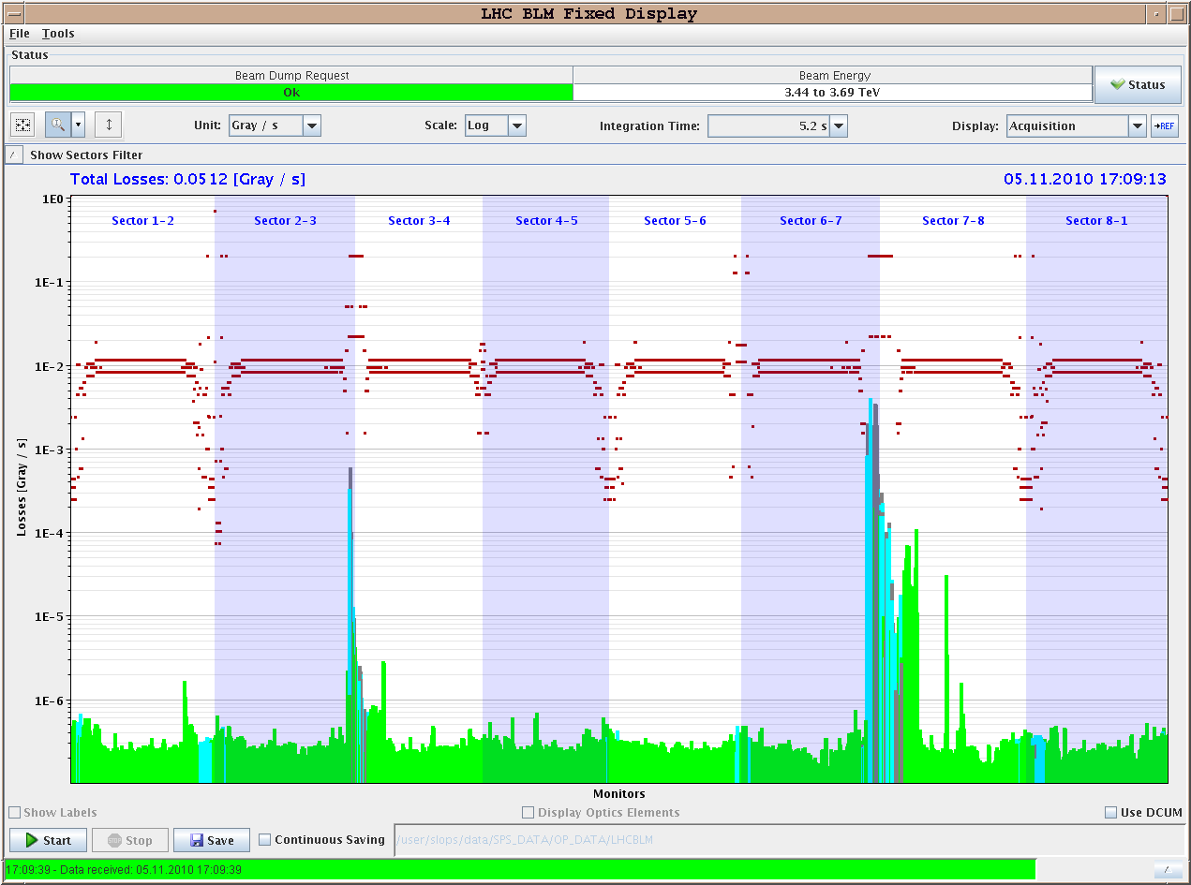
Betatron loss maps – 450 GeV
Leakage to DS

Slide 29
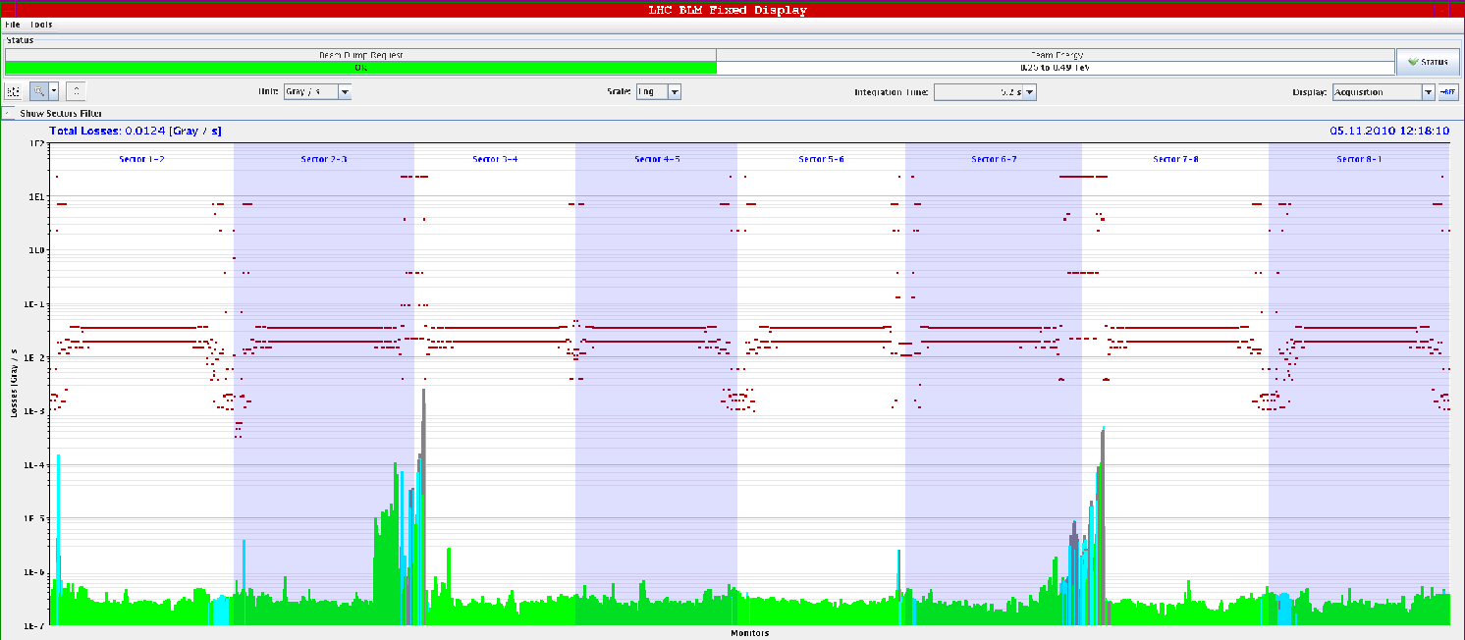
Off-momentum loss maps – 450 GeV
Momentum losses B1 -1000Hz (‘covered’ by RF freq interlock)
Momentum losses B2 -1000Hz (‘covered’ by RF freq interlock)

Slide 30
Conclusions from collimation team
We loose about a factor 50-100 in cleaning efficiency for ions compared to protons.
Expected (ion fragmentation and dissociation)
Main losses in predicted locations, namely the dispersion suppressor magnets.
At injection a large 10% leakage into IR1 from IR3 losses for beam 2 has been observed for positive momentum errors. It is not clear what ion species escapes IR3 and travels to IR1. To be analyzed in detail.

Slide 31
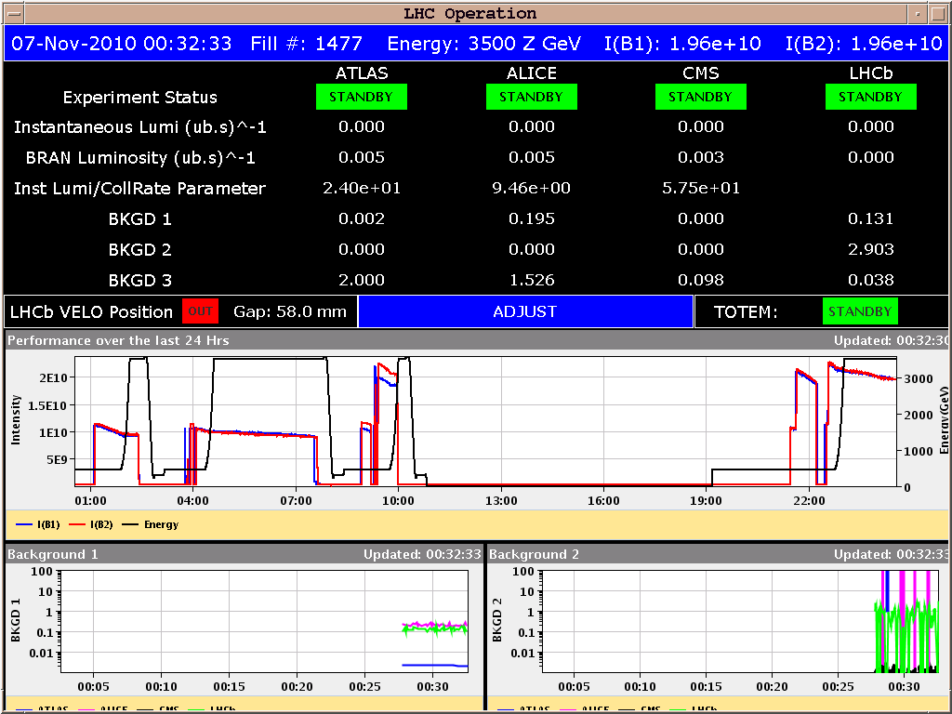
Saturday late evening – collisions !
00:30: Colliding in all IPs with TCTs at 25 sigma.
With proton settings for Xing and lumi scan knobs (ALICE separation to 0).
2 bunches / beam.

Slide 32
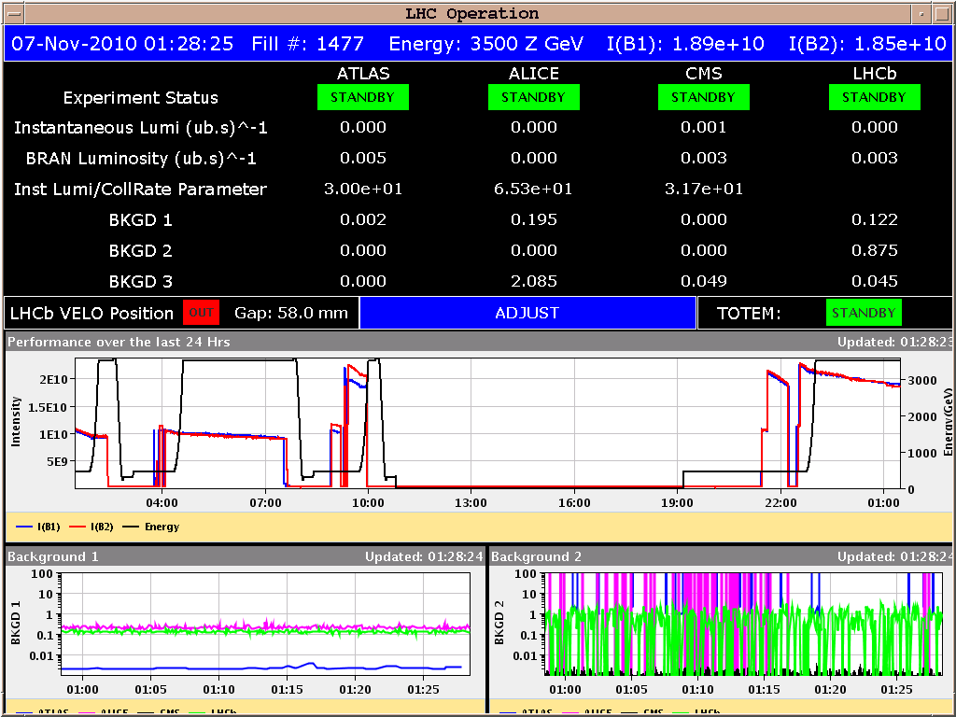
Saturday PM – collision setup
Xing in ATLAS and CMS to 0. Xing in ALICE to 0 effective Xing angle.
External angle -140 urad.
Optimized orbit and beam overlap.
Luminosity ~ 2 x 10²³ cm⁻²s⁻¹ (1 colliding pair / IP)

Slide 33
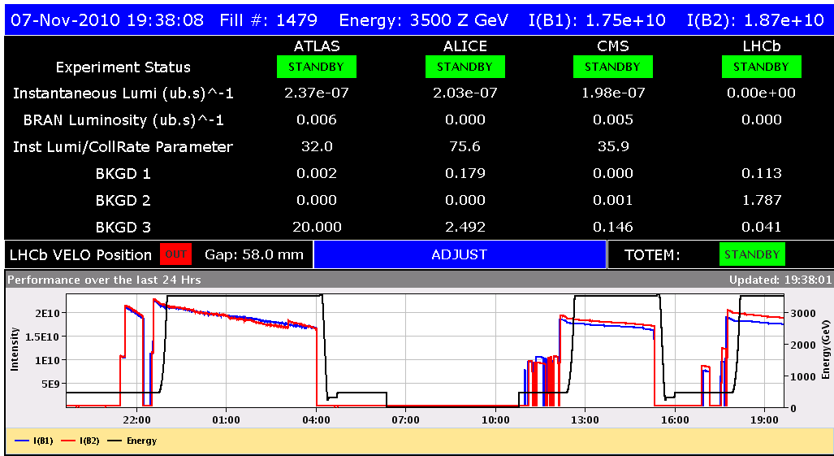
Collimator setup for collisions
Round 1 : beam dumped during TCT movement in Pt2.
5 TCTs setup in B1, 3 TCTs set up in B2
Round 2 : all TCTs aligned Sunday 21:00.
Round 1
Round 2

Slide 34
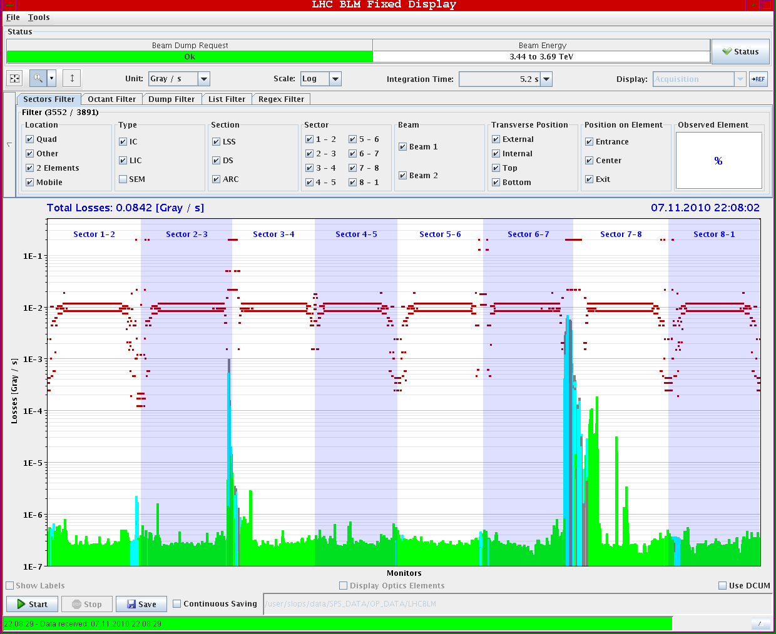
Loss maps in collisions – B1 V

Slide 35
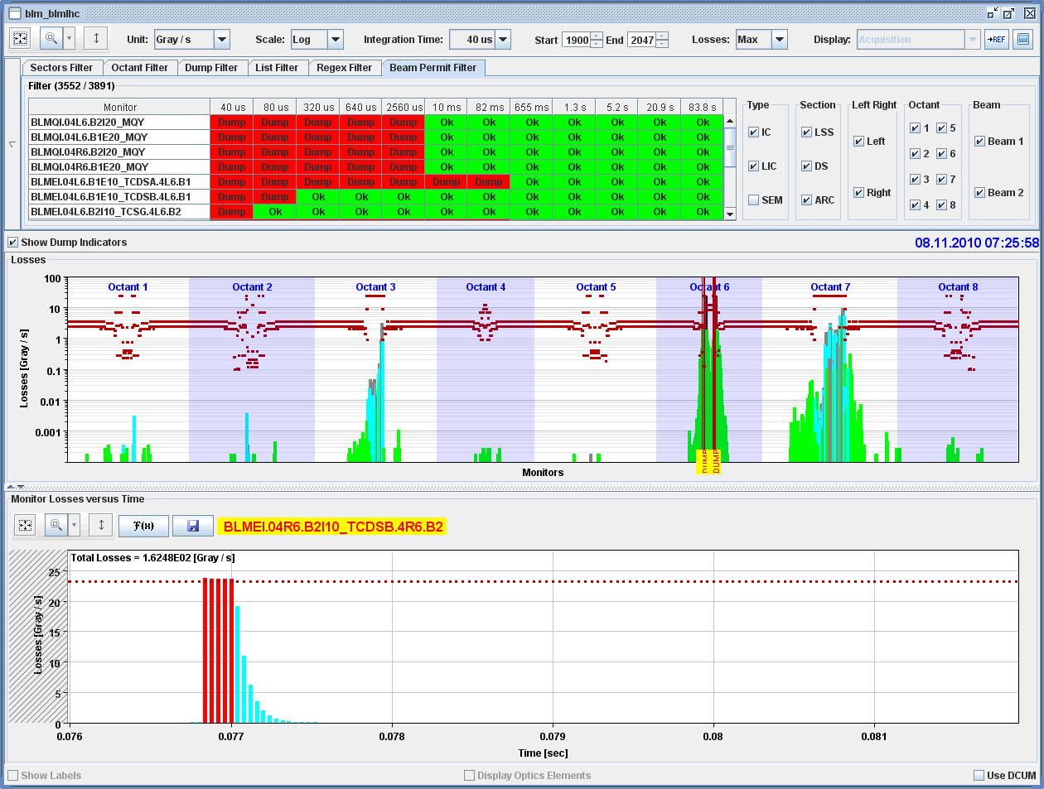
Asynchronous dump test
Looking good

Slide 36
Stable beams preparation status
Collimator loss maps done.
Conclusions similar to other maps. Leakage to exp. IRs small.
½ of them still required analysis.
Asynch. dump test done.
Analysis to be finished.
Collimator functions ready.
ALICE TCTV setting to be changed to OPEN.
IR2 triplet BLM thresholds reduced factor 2 wrt protons. Limited by noise spikes.
To be done
Length of beam process to go into collisions must be increased. The present length provides only time to switch ALICE from +110 urad to -40 urad. Last -100 urad must be trimmed by hand…

Slide 37
Coming next
Stable beams 2x2
Injection of 4 bunches
Stable beams with 17x17
Stable beams with 128x128

