Slide 1
Monday 1.11
Quench test 3.5 TeV with wire-scanner
Injected 12x12 =144 bunches with 50 ns spacing and ramped to 3.5 TeV.
Local / critical BLM thresholds increased.
The wire was then scanned on B2, slowing down the speed at each scan:
1 ms/s
0.75 m/s
0.5 m/s
0.37 ms/
0.3 m/s
0.2 m/s
0.15 m/s
0.05 m/s ….. finally quenched D4

Slide 2
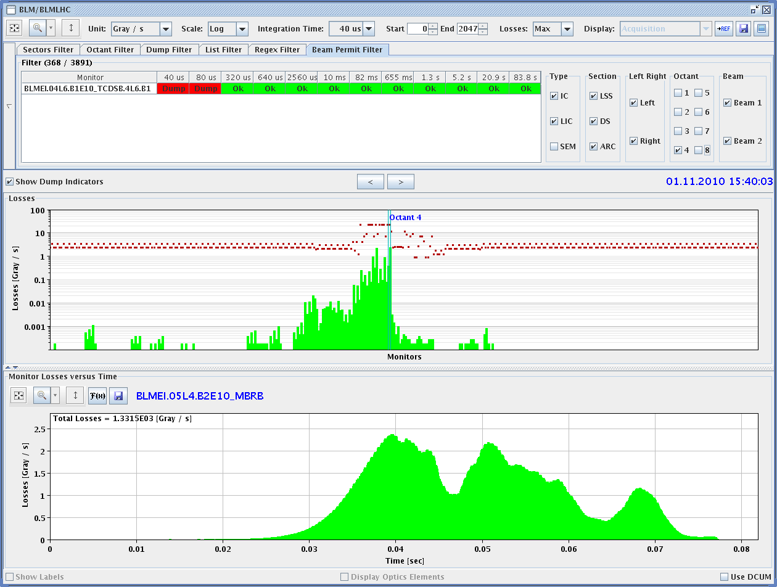
Weird loss evolution… duration around 45 ms. No longer UFO scale..

Slide 3
Monday 1.11
Evening: e-cloud studies and scrubbing.
Effect of varying the bunch population for batch of 36 bunches (4E10 to 11E10). Done.
Comparison of effect of batches of 12, 24 and 36 bunches. Done.
Effect of 2 batches of 24 bunches as a function of the batch separation (from 20 usec to minimum of 225 ns). Ongoing.

Slide 4
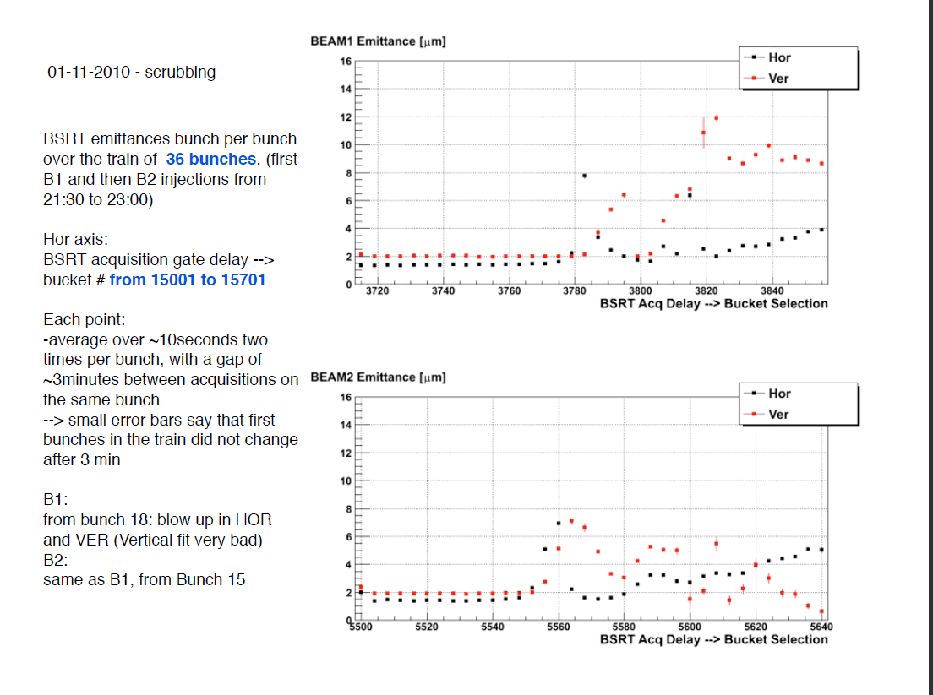
Emittance along 36b train

Slide 5
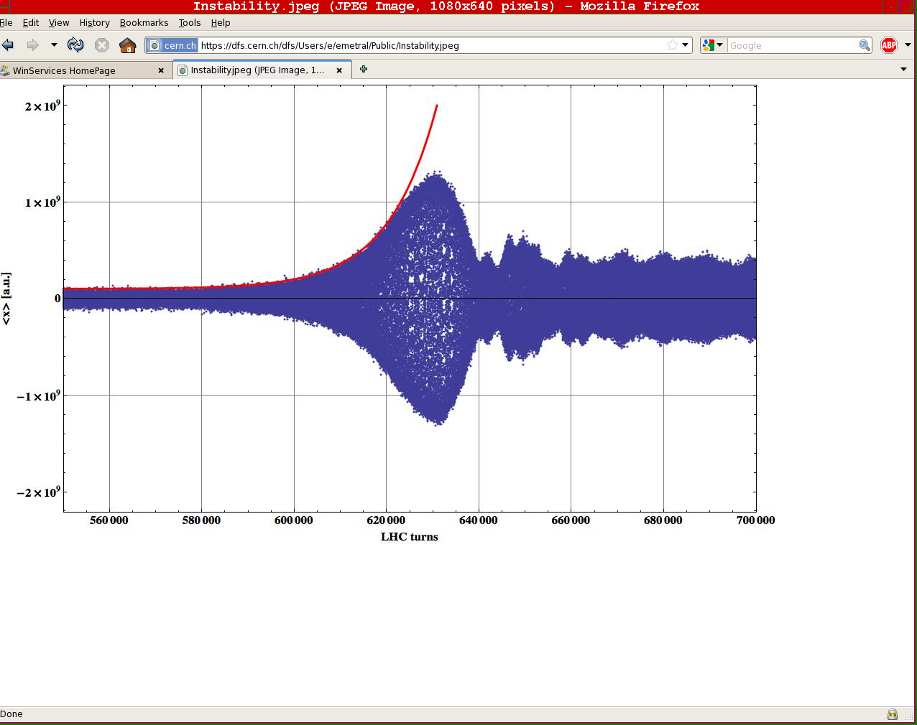
Instability leading to dump

Slide 6
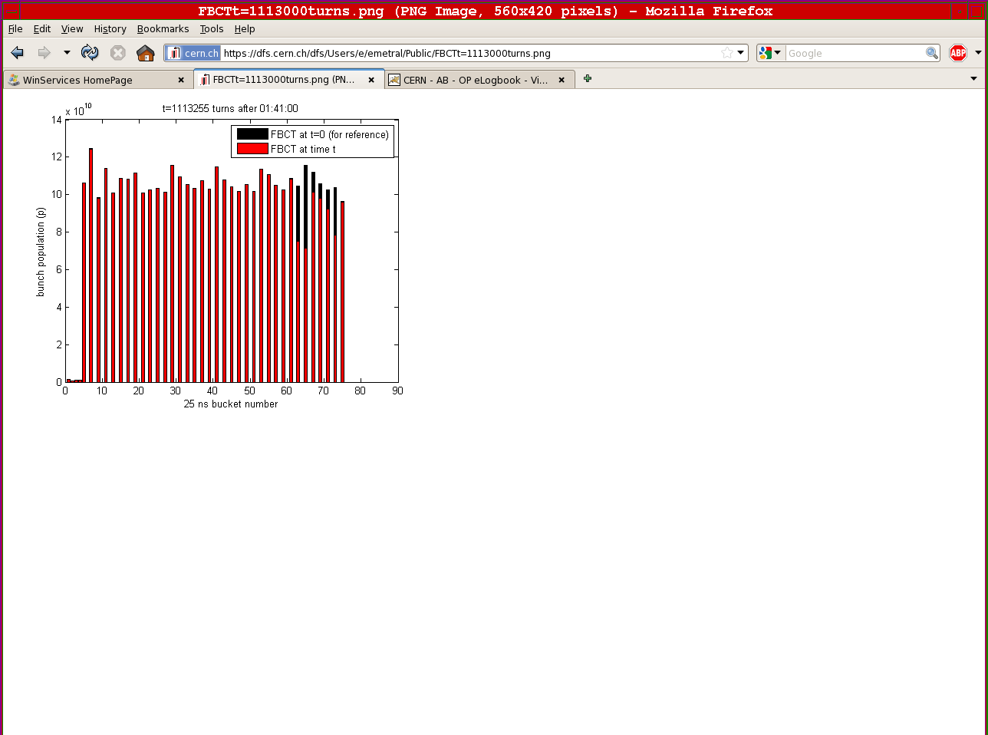
Losses affect bunches at the end of the train

Slide 7
Today 2.11
Finishing the batch separation studies.
Scrubbing with increasing number of batches.
Monday 1/11 – 20:00 | Measurements for the characterization of the e-cloud build-up | 12 hours
Tuesday 2/11 – 08:00 | Scrubbing run | 36 hours
Wednesday 3/11 – 20:00 | Physics fill with 109 bunches (1x12+4x24 bunches) | 8 hours
Thursday 4/11 – 04:00 | End of fill beam-beam studies | 4 hours
Thursday 4/11 – 08:00 | End of proton run – Start of lead ion beam commissioning

