Slide 1
Scrubbing / e-cloud studies with 50 ns
Start Monday 1/11evening:
Effect of varying the bunch population for batch of 36 bunches (4E10 to 11E10). Done: onset at 6 – 8 e10 p+
Comparison of effect of batches of 12, 24 and 36 bunches. Done – food for theories
Effect of 2 batches of 24 bunches as a function of the batch separation (from 20 µsec to minimum of 225 ns) Finished Tuesday 2/11 Cross – talk between trains of 24 bunches start between 5 and 7.5 µs spacing
Beam Scrubbing while adding 24 bunches
G.Arduini, V.Baglin, G.Bregliozzi, G.Lanza, P.Chiggiato, G.Rumolo,

Slide 2
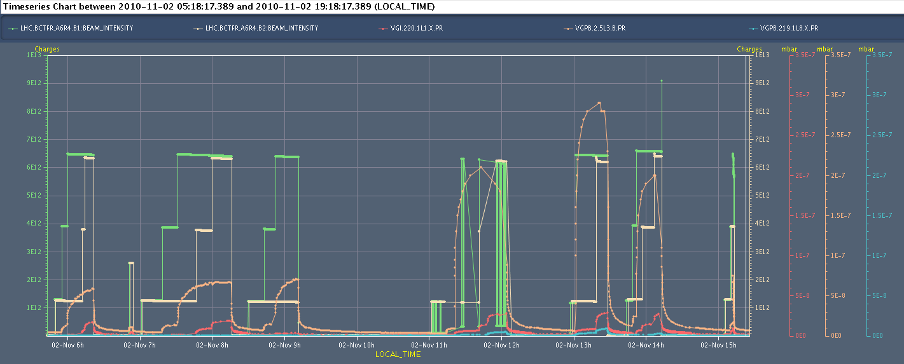
Tuesday 02/11
Checking e-cloud vac. vs. train spacing
CMS solenoid ramped down to 2T and up again
Verification/fine-adjustment of the ADT one-turn delay
Some vacuum interlocks increased from 4e-7 to 1e-6 mbar
Loss of 35 servers because of fuse blown in CCR: 1h15 min recovery

Slide 3
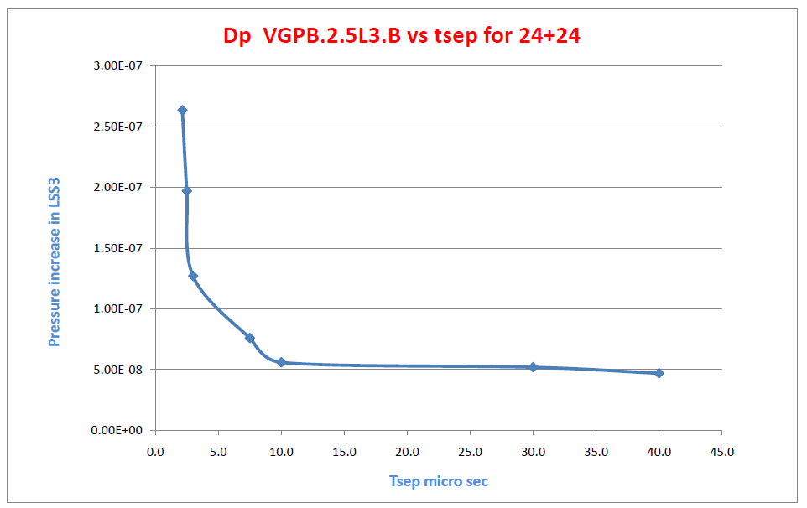
Vacuum as function of train spacing

Slide 4
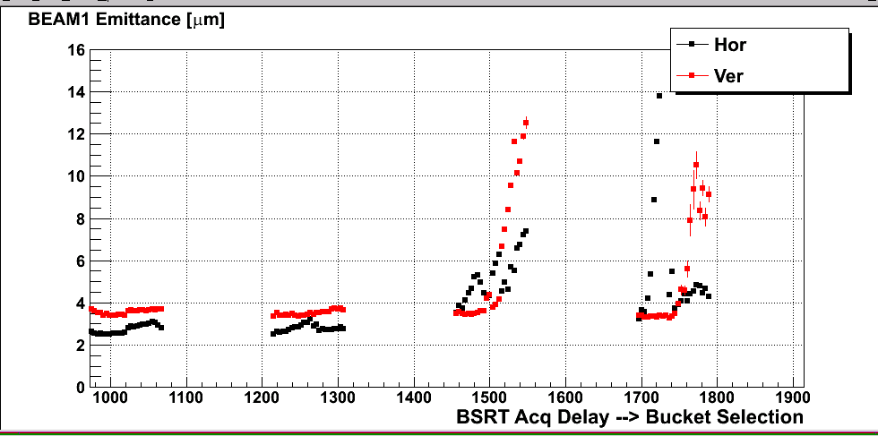
Beam Stabilities
Debunching while sitting at injection: abort gap cleaning really helps and allows to re-inject (but check the settings)
Injection is better with scraping in the SPS on
Losses on later trains are worse towards the end of the train. Trailing bunches are larger – unstable beams: increasing chroma’s up to 14
F.Roncarolo

Slide 5
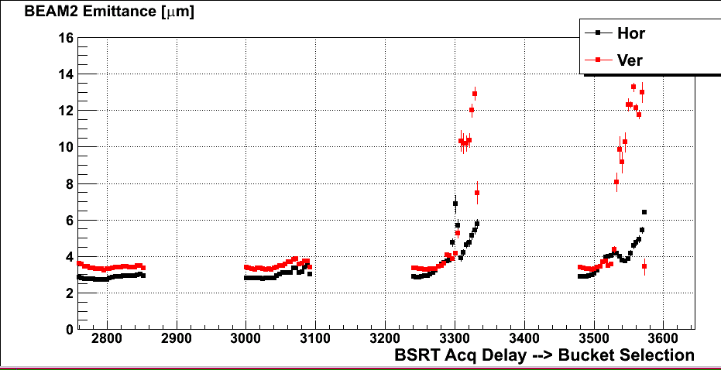
Emittances for the different bunches
F.Roncarolo

Slide 6
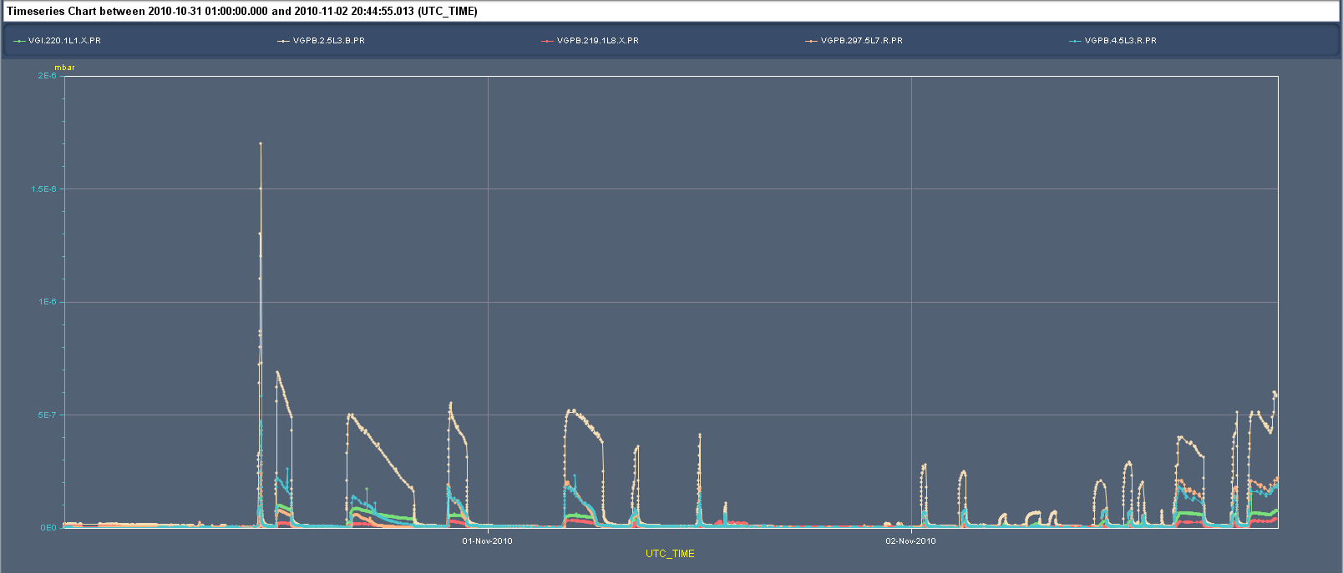
Vacuum for trains of 24 bunches
Cold to warm transition: worst case
2e-6
Sunday: Valves in
Tuesday evening with 228 bunches
Scrubbing 60 bunches
5e-7

Slide 7
O-night
Sector 81 was lost right due to an electrical problem.
Lost the power permit of all sectors due to the perturbation of the morning on the TIM/DIP, which left latched signals on the access interlock
Once precycled and corrected both probes, dump after injecting 228 bunches, due to instabilities with slow losses at point 8. Checked the chroma and brought it back to 14/14.
Get back to the same as late evening – but beam unstable
224 bunches

Slide 8
Plans
Wednesday 3/11 AM | Scrubbing 24 bunches – 160 +, stability
Wednesday 3/11 PM | Scrubbing check 12 +36 bunches
Wednesday 3/11 PM | Physics fill with 109 bunches 50 ns (1x12+4x24 bunches) | 8 hours
Thursday 4/11 – 04:00 | End of fill beam-beam studies | 4 hours
Thursday 4/11 – 08:00 | Access | 2 hours
Thursday 4/11 – 10:00 | Check machine after access with protons
Thursday 4/11 – 12:00 | Start of lead ion beam commissioning

