Slide 1
Production running
 |  |  | pb-1 |  | Lost to
Mon 25 | 1440 | 11h20 | 6 | 2e32 | EOF studies
Tue 26 | 1443 | 2h17 | .15 | 2e32 | UFO Q8.L5
Tue 26 | 1444 | 7h12 | 4.0 | 1.9e32 | OP request
Thu 28 | 1450 | 14h32 | 6.3 | 1.8e32 | OP request
Fri 29 | 1453 | 6h20 | 2.6 | 1.6e32 | OP request
Sun 31 | 1459 | 6h01 | 0.45 | 2.6e31 | OP request
Total |  |  | 19.5
11:00 Friday 29th October – end proton production running for 2010
Not so bad (considering what else was tried…)

Slide 2
UFOs
1442 | 17L4 B2 | after 5 minutes at flat top
1443 | 8L5 | stable beams after 2+ hours
1451 | Alice BCM “Ufino” | Beam dump just at flat top.
1452 | Q4.L2 | top of ramp

Slide 3
14:50 UFO – dust scan
single bunch intensity (average) was ~1.3e11
vacuum in MKI from beam related effects was higher than previously, but stable
no sign of a vacuum spike in any of the B1 MKI at the moment of the beam loss; we are very sensitive to vacuum changes and did not see anything.
beam losses started in MKI - factor 100 smaller signal in upstream Q5, which is probably cross-talk to BLMs
loss evolution as function of turn number in MKI (and TCTH downstream which catches a lot of the scattered beam) is perfect Gaussian which would have peaked after about 13-14 turns at 2.6 Gy/s (or 14 Gy/s on the TCTH).
sigma of loss profile is about 3.4 turns, and beam size at MKI.D is 0.14 mm vertically, 0.33 mm horizontally (assuming 2.5 um in both planes).
velocity of alleged UFO would therefore be between 0.15e-3/(3.4*89e-6) m/s and 0.33e-3/(3.4*89e-6) m/s, i.e. 0.46-1.08 m/s.
Brennan Goddard

Slide 4
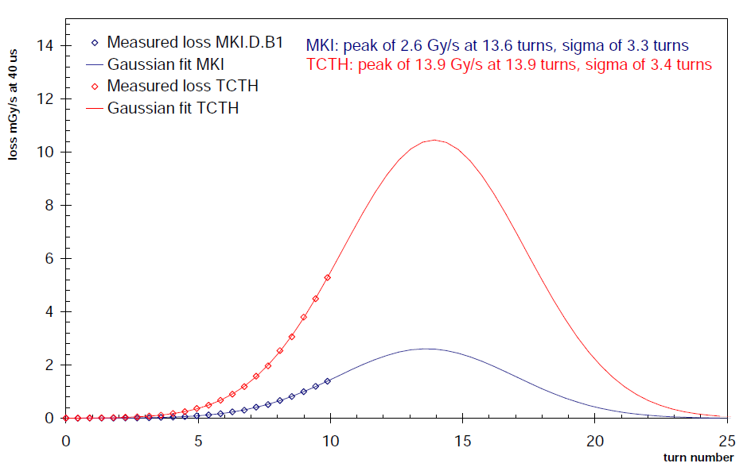
Brennan Goddard

Slide 5
424 bunch attempt
04h23: Beam dump just after arriving to 3.5 TeV. TCTH.4R8.B2 BLM in IR8 triggered on 0.6s running sum.
A few 10’s seconds before saw strange loss patterns
Big vacuum spike in injection kickers
Not fully understood

Slide 6
Friday - switch to 50 ns. etc.
Afternoon
Injection studies
Transverse damper
21:00 Start TOTEM special run (4 + 1 b)
00:04 Vertical primary to 4.5 sigma
01:15 after some discussion…
Final settings in unit sigma for the vertical pots: XRPV.A6R5.B1 7.66 XRPV.B6R5.B1 6.53 XRPV.B6L5.B2 6.46 XRPV.A6L5.B2 6.50
followed by
Alice length scale calibration;
Longitudinal scan;
Abort gap filling and cleaning studies at 3.5 TeV.

Slide 7
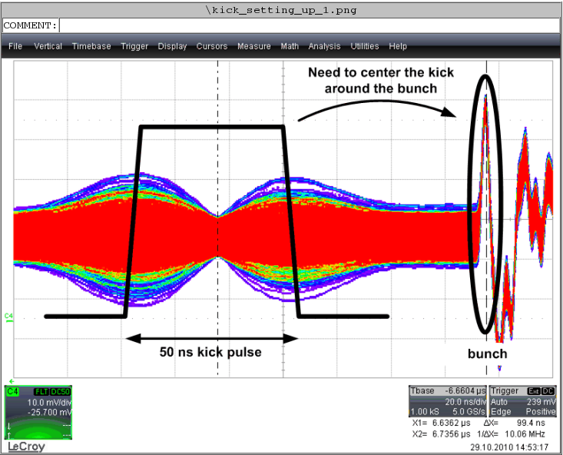
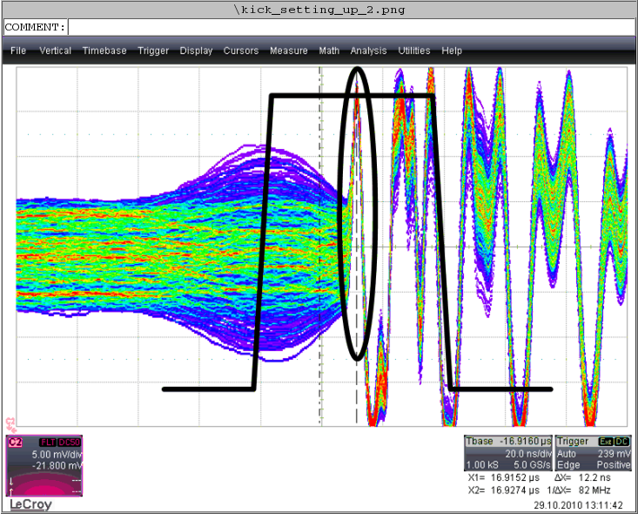
Transverse dampers
All 8 units for both planes and both beams were set-up and tested with single, nominal bunch. The performance still needs to be checked with a full 50ns train.

Slide 8
Saturday – Sunday morning
SPS/injection studies continued
Qualify 109 bunch@50 ns
3 access for Atlas
00h47: Start ramp. 109b. 50ns. ~1.1e11 p / bunch.
02h24: Stable beams. Fill 1459.
First collisions with 50ns bunch spacing.
A little rocky but nothing pathological
Injection c/o Chiara

Slide 9
Sunday
EOF studies
12h12:
lost beams, vacuum interlock point 7. 108 bunches were circulating.
(1 batch 12b + 4 batches 24b, 50ns)
eek!!!
Scrubbing
13:00 60 bunches circulating per ring).
vacuum pressures already at 2e-7.
Cleaning slowly
13:55 Beams dumped. Lost RSF2.A67B2.

Slide 10
Sunday
Investigations
Atlas solenoid on/off;
slight bunch length increase via RF voltage
Clean with 60b (12 + 2*24)
The memory of the previous conditioning appears not to be lost at this stage The reason for the different speed in cleaning for the first and second fill (slower on the second fill) is not clear.
22:45 inject 12 + 36 after a struggle
vacuum back up to original level

Slide 11
Overnight Sunday - Monday
23:55 Tried to inject B2 but no beam was extracted from SPS and the kickers kicked the uncaptured beam giving a BLM dump in IP8.
Lost sector 78 – 60 A power permit
Plus communication problem on nQPS in sector 67
Markus called for trip of S78, communication lost with old QPS crate MB.B10L8, looks like a loss of power in the crate. Decided to come to CCC to also fix issue with nQPS crate A67.B28R6 and RCO.A56B2.
Kevin will go to UA83 for the A78 story, I will start the power-cycle on nQPS crate in sector 67 (will switch OFF all circuits first).
01:00 Access 02:20 Access over Precycle

Slide 12
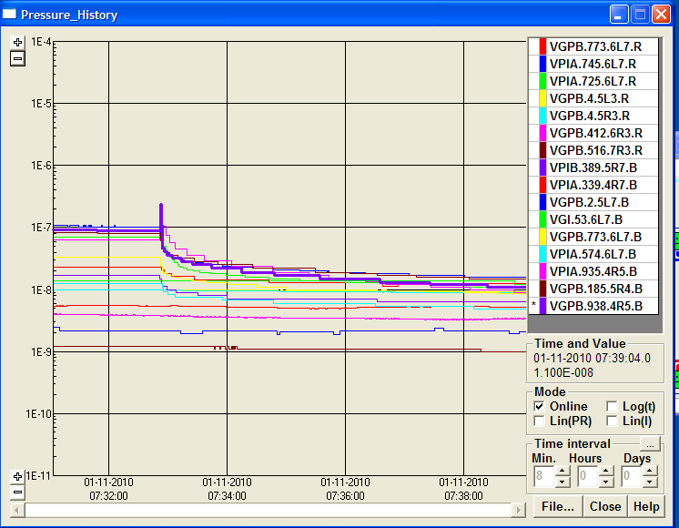
This morning
05:30
Restored the beam 1+12+36 bunch for each beam.
07:33
B1 dumped due to vac valve interlock at P5

Slide 13
Vacuum
150ns – seen similar, lower effects – solenoids – electron cloud
108 bunches with well separated trains of 12x50ns – no problem
Big rises in pressure when moving to 24x50ns
Pressure goes with number of batches injected
36x150ns considerable worse
Cleaning seen for 12-24-24 (factor 2 in four hours)
persistent after refilling
Cleaning with 36 less evident
in progress
Paolo Chiggiato, Giuseppe Bregliozzi, Giulia Lanza

Slide 14
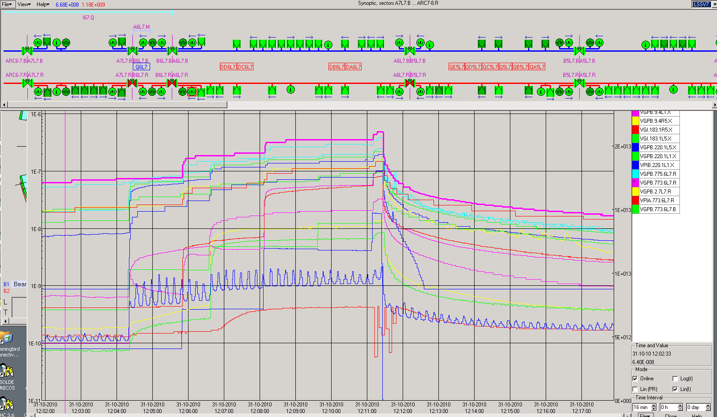
Vacuum Interlock on VVGSH.774.6L7.R due to pressure increase on the penning gauges VGPB.773.6L7.R on the cold-warm transition of the Q6L7.R. No crossing beam on the location.
108 Bunches on the machine – Train of 24b.

Slide 15
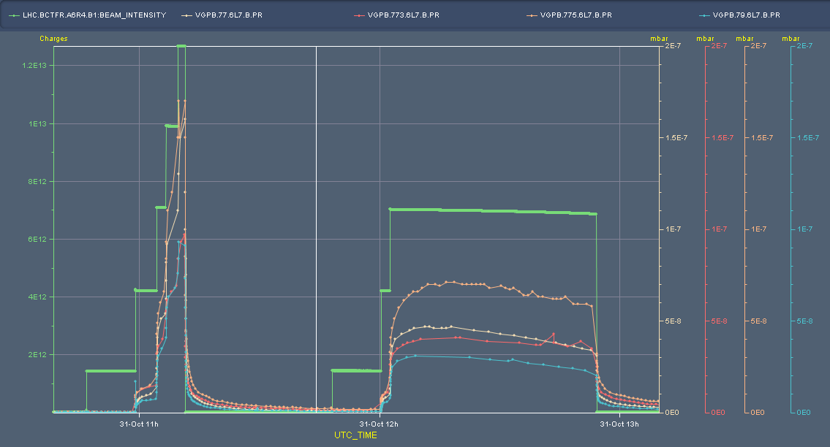
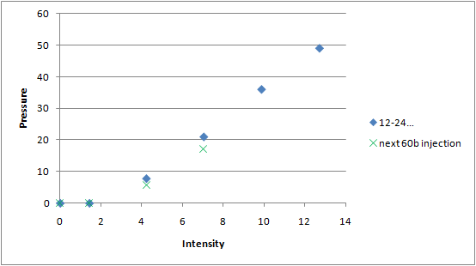
6L7 – beam 1

Slide 16
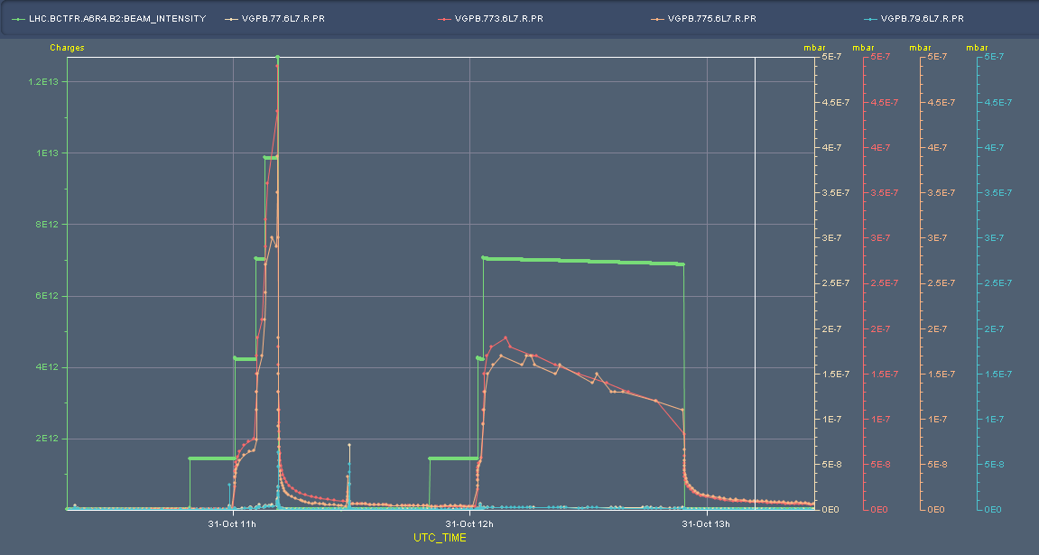
6L7 – beam 2

Slide 17
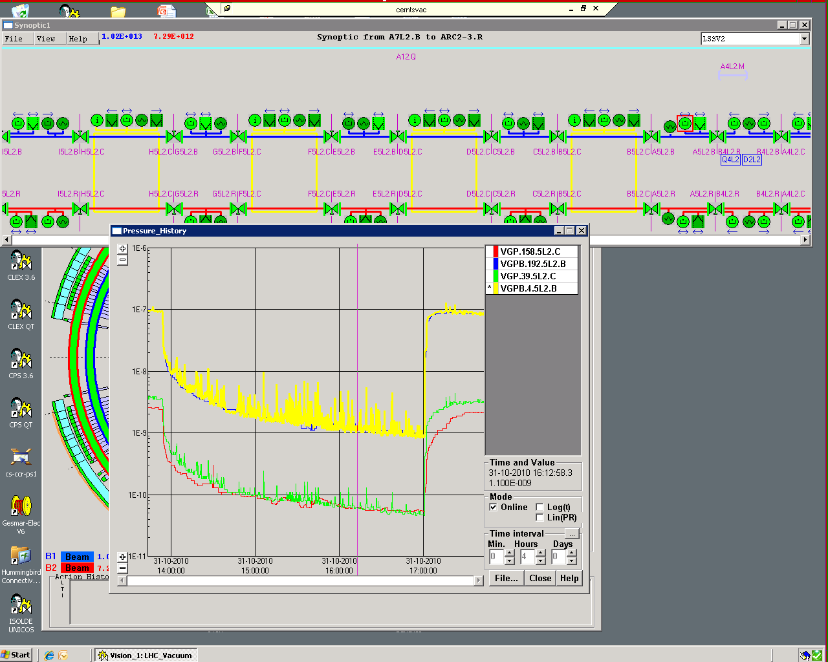
Kickers
Kickers clear activity coming from adjacent warm bits

Slide 18
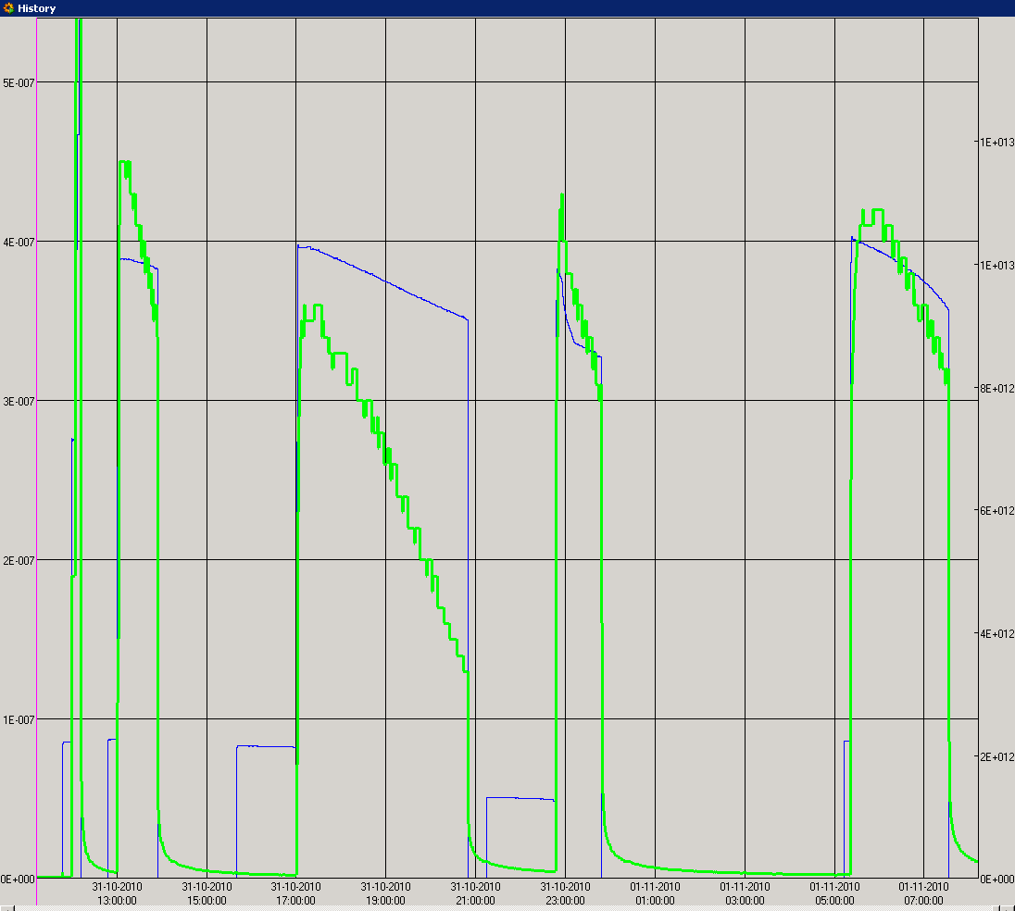
36
36
24
24

Slide 19
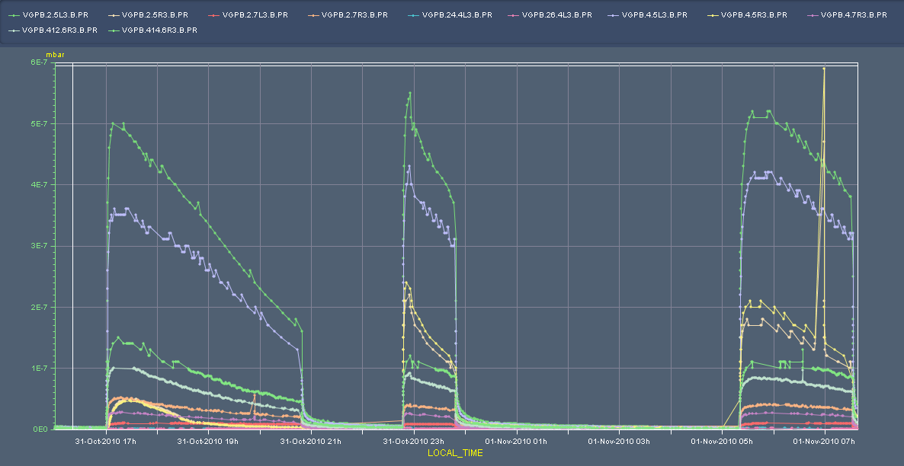
Cleaning

Slide 20
PLANNING

Slide 21
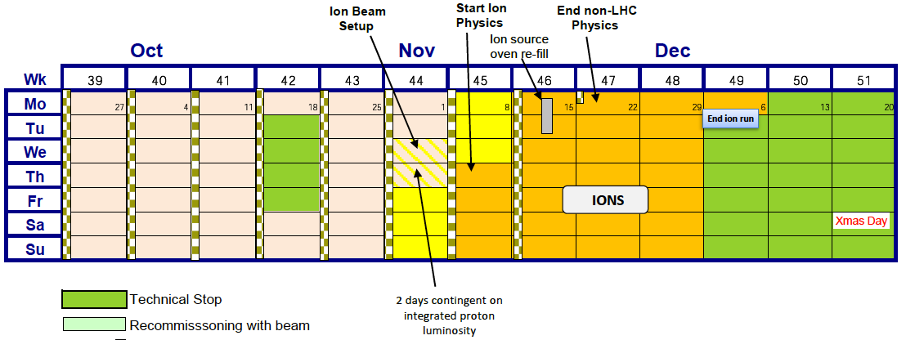
Next few days

Slide 22
Incoming
Continued scrubbing studies
75 ns; different batch configurations…
 | Time
Quench test 3.5 TeV with WS | 8 hours
Quench test 450 GeV – injected beam | 4 hours
Aperture in IRs at 450 GeV | 1 shift
BI studies | 1 shift
RF noise induced beam diffusion with pilot beam | 4 hours
Beam-beam with full complement of parasitic encounters | 8 hours
Injection of higher intensities | 8 hours
Alice – fill without solenoid & dipole | 1 fill
Planning to be established!

