Slide 1
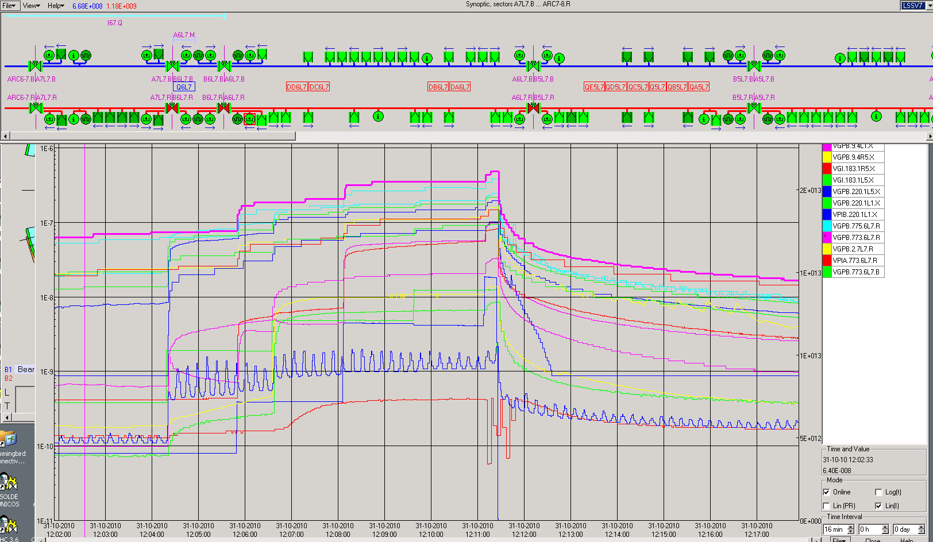
Vacuum Interlock on VVGSH.774.6L7.R due to pressure increase on the penning gauges VGPB.773.6L7.R on the cold-warm transition of the Q6L7.R. No crossing beam on the location.
108 Bunches on the machine – Train of 24b.

