Slide 1
Wednesday 27-10-2010
07:27 Beams dumped in ramp
Energy error… SIS
The telegram information on the energy was missing for a few seconds, effectively freezing the energy value of SIS. The energy values reconstructed from the 8 RBs continued to increase until the tolerance of 1% eas exceeded and the dump was triggered.
[JapcExecutor-thread-16] ERROR JapcDispatcherImpl => Exception occured for parameter id [tgmTelegram] name [LHC.TGM/FULL-TELEGRAM.ACQR]TGM timeout for machine: LHC
7:40 CMS start ramp-down of solenoid

Slide 2
Wednesday morning
09:32 Asked SPS for LHC3... but their mains tripped instead.
Cavity 4B1 back on
in case of de-bunching call Philippe (see later…)
MD in shadow of CMS filter cleaning

Slide 3
Injection cleaning
The cleaning kicker will start always 100 ns (kicker rise time) before the first bucket to be injected.
The injection cleaning (only) will be switched off shortly before each transfer and thus switched on right after.
Summary:
AG cleaning with v-dampers kept on along all the experiment.
Injection cleaning with h-dampers used to clean the region to be filled and switched off at each transfer.
Two physics fills (B1) with and w/o injection cleaning proved that the injection cleaning is feasible and efficient.

Slide 4
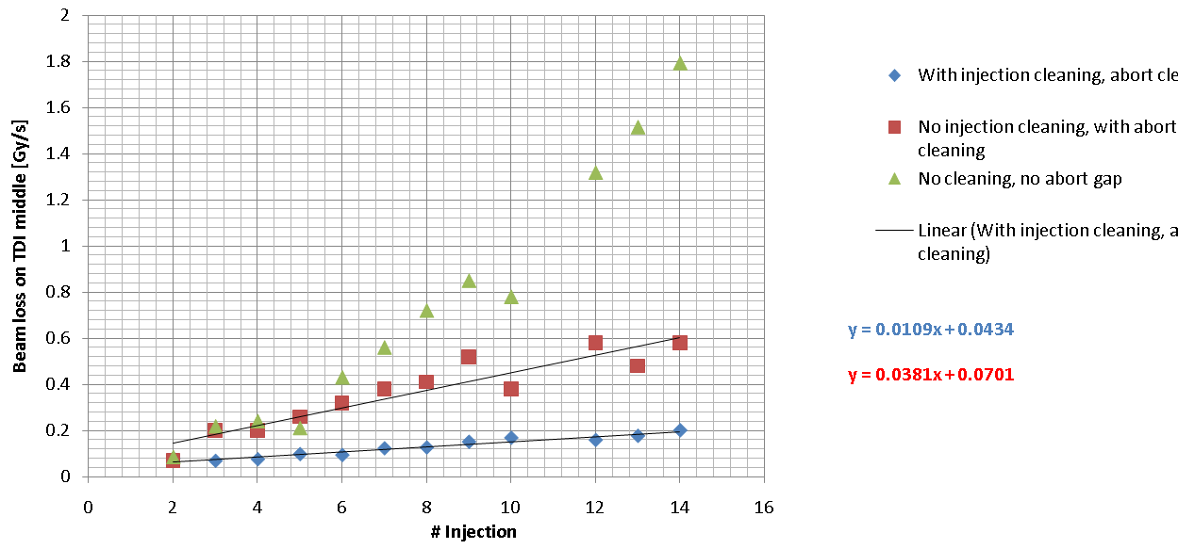
Injection cleaning

Slide 5
Two issues
** Should check the TDI setting and collimation heirarchy for B1 at 450 GeV, as this is the second case where we see losses here which are higher than expected wrt IR7. Only a factor of 5 lower losses on the TDI **
13:32 It turned out that the AG cleaning window was not correctly set – understood – low level bucket numbers wrong

Slide 6
RF MD
Changing klystron High Voltage with circulating beam at 450 GeV
RF MD:Use B2 only. Ask for "reasonnable beam" (128 nominal). Change HV on module 2 B2 (Cav5-8B2)
Played with HV from 50 kV up to 58 kV then down to 42 kV. Let cathode current adjust naturally (no change to Mandoline pos).
All loops remain stable and compensated for the change of klystron phase-shift with HV.
Two observations on beam:
14:55 Decrease of Bunch Length Min. Probably start scraping marginal bunch. Loss observed by EIC and orbit trimmed at 14:56. We go back to nominal HV (50 kV) but that does not cure the problem, and at…
15:07 Loss in DC BCT, Fast BCT and Bunch length decrease. Transverse?
15:19 with 46 kV, klystron 6B2 saturates. Further decrease in HV to 42 kV make ALL klystron saturate and effect on bunch length. Reversible when returning to nominal 50 kV.
CONCLUSION: Convincing, except for the not-understood loss around 15:00. Suggest the OP crew to refill quick....

Slide 7
Late Wednesday – refill for physics
18:03 Injection kicker – point 2 – flash over
18:10 Water leak CMS – emergency access
19:35 CMS out
22:40 RF glitch – rapid de-bunching
22:46 Start ramp
Big unbunched losses in IR3 at start – squeaked through
If we consider the intensity lost from the fast BCT, we had lost out of the buckets about ~1.6e12p (B1 only). They were then lost within the first ~25 s of the ramp. No BLM losses were seen when the particles left the buckets.
The peak loss rate at the TCP in IP3 was ~ 1 Gy/s and we had losses in all the sectors. See attached the loss map and the zoom in IP3. The hierarchy was respected.

Slide 8
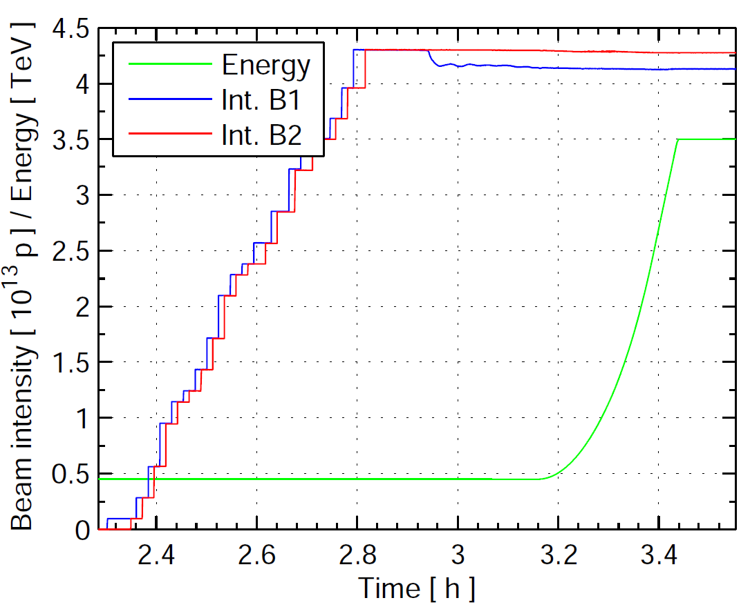

Slide 9
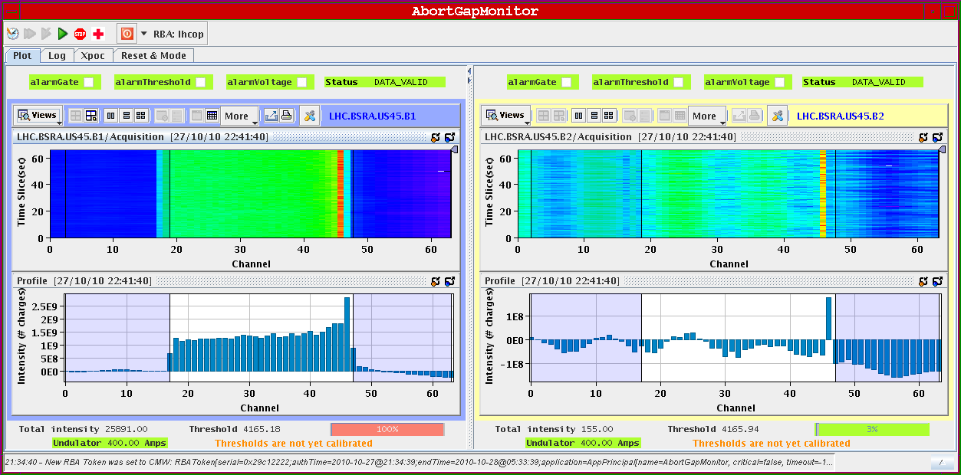
Unbunched beam…

Slide 10
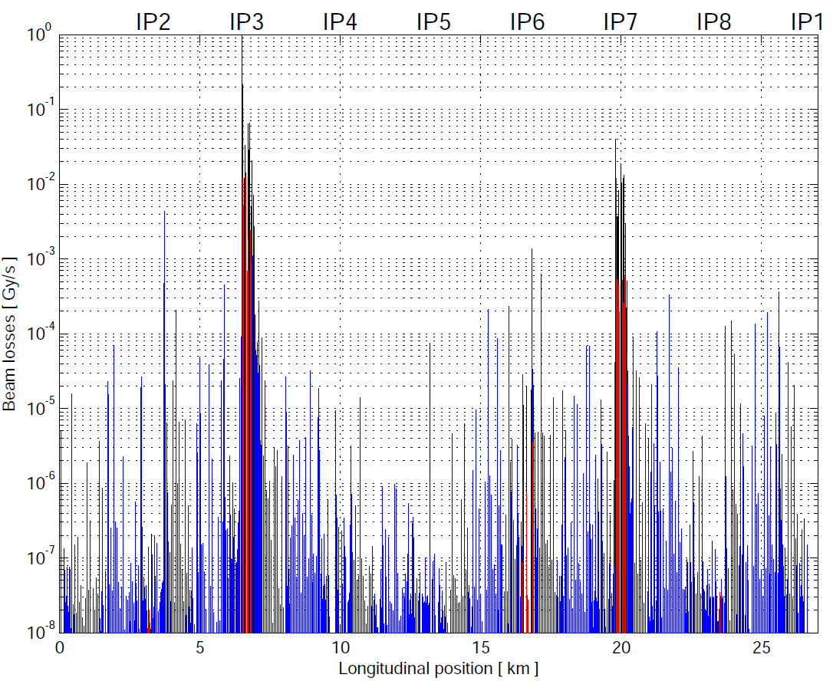
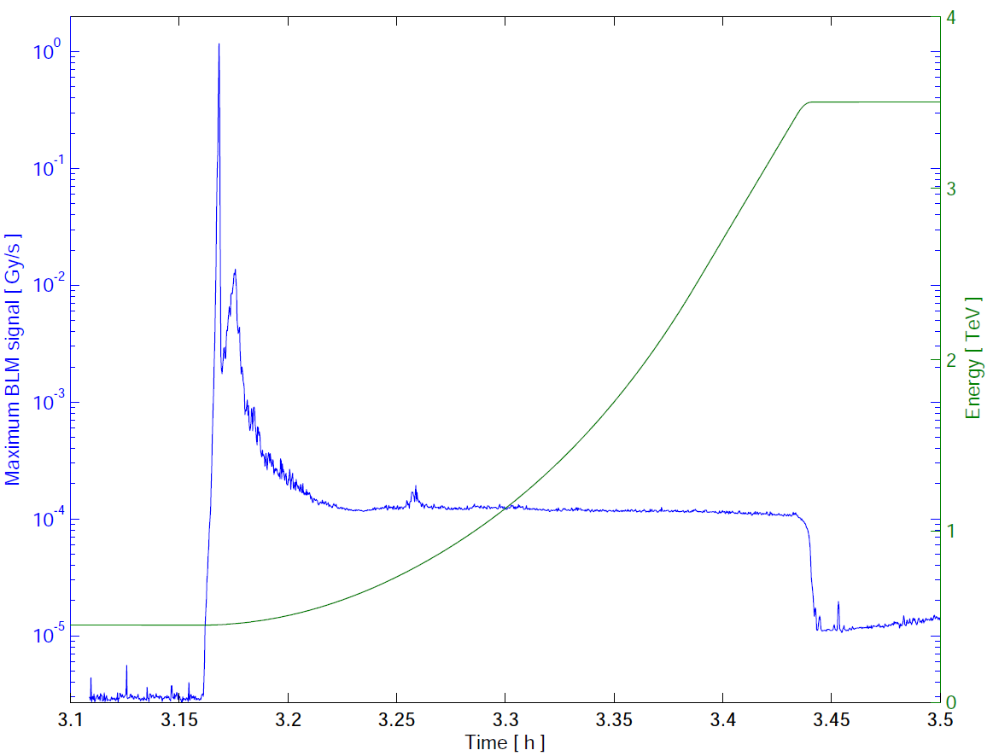
Start ramp
Stefano Redaelli

Slide 11
Thursday morning
00:37 Thursday STABLE BEAMS 1.8e32
Lost M1 B1 twice
beam in abort gap
cleaning in IR3
Vacuum looks reasonable

Slide 12
4B1
Noise Cav4B1 suspected ...again....
Loss around 22:33
Small spike in Cav4B1 field (actually shortly after loss starts).
Transient on BLM at the same time... also drop in DC BCT.
Fast BCT then oscillating with a period correlated to the tuner position (He pression ripple with period ~ 2 min, same in 3B1 and 4B1)
Philippe Baudrenghien

Slide 13
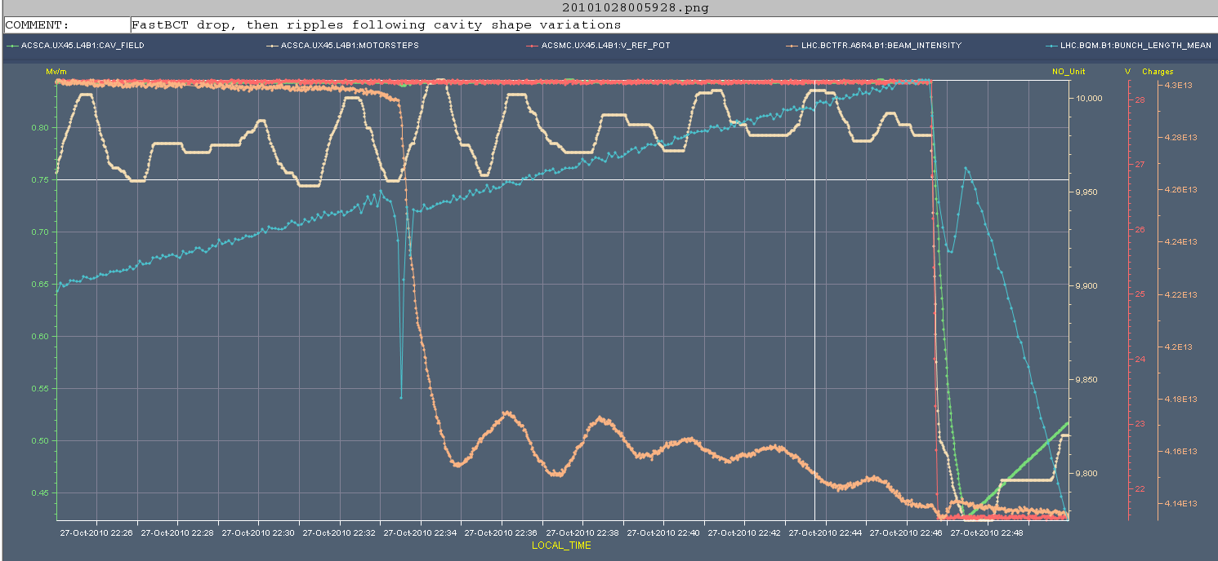
4B1
shows drop in FastBCT, with reduction of mean bunch length at the same time.
Then FastBCT oscillates (how can that be?) with a period of ~ 2 min that correlates with the fluctuations of the He pressure in the module (tuner motor steps trying to compensate for the change of cavity volume).
The relaxation takes ~ 10 min and is stopped by the start of ramp (change in voltage and displacement of main coupler). This pressure fluctuations are normal.
But how can FastBCT measurement oscillate while bunch length mean does not change (at least not with same period), and with a period apparently correlated with change of cavity shape (talk with BI)?

Slide 14
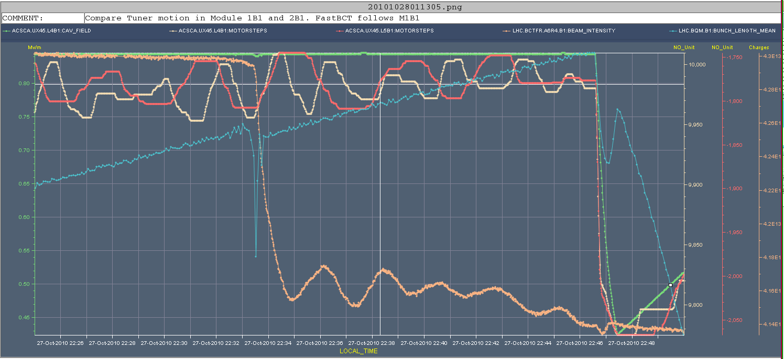
5B1
He pressure in Module2B1 also (Cav5B1). The shape variation are slower (~ 4 min period). Clearly the oscillations in FastBCT are correlated with the fluctuations in Module1B1 and not correlated with M2B1. Multipactoring? Consistent with the intermittent character of the problem.

Slide 15
Conclusions
Test to be done: Try to reproduce situation by changing Cavity field. Maybe multipactoring in the antenna?
At 3.5 TeV, all seems OK now (see attached): phase noise in 4B1 just like 3B1. Bunch lengthening B1 identical to B2. There does not seem to be a problem anymore.
Not sure that 4B1 was the cause of the problem. But to be conservative it is removed at 23:51 :
RESTORE conditions loaded on Sept 26th to work WITHOUT 4B1:
RFVOLTAGE_PARTITIONS, RFVOLTAGE_PHASE.3B1 (counterphased with 4B1), CAVITY_Q.4B1
in both RAMP_3.5TeV_10Aps_Extended and RAMP_3.5TeV_10Aps_V1@0[START]
Will put it back on tomorrow...

Slide 16
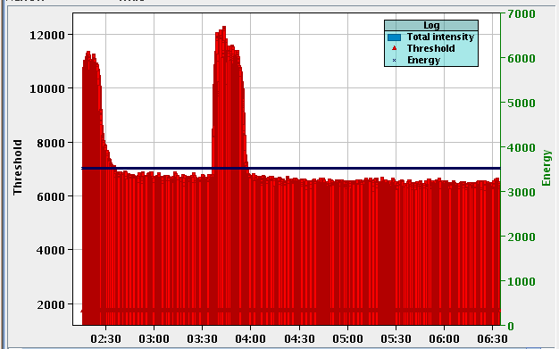
Abort gap population in stable beams

Slide 17
Today…
Hold this to around midday
RF intervention in PS until 13:00
368
420
Switch to 50 ns tomorrow morning

Slide 19
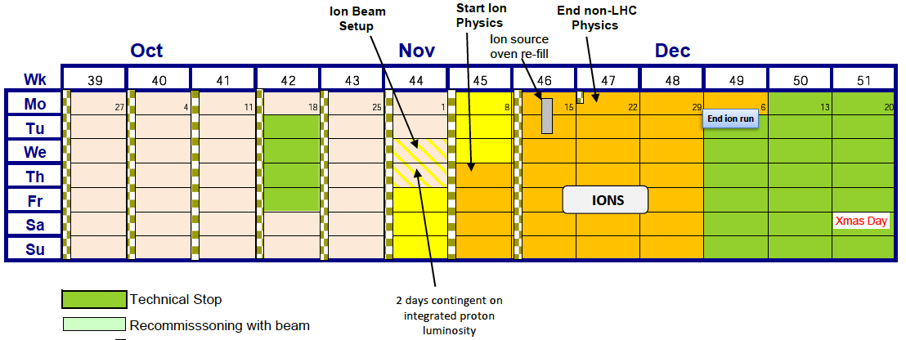
Next few days

Slide 20
Next few days
Run for physics until Friday am
368 bunches…
Try 400+ again
Friday
Switch to 50 ns.
Test ramp BI/TOTEM
Monday/Tuesday next week
Provisionally machine development
Wednesday – switch to ions
Contingent on delivery of integrated luminosity target

Slide 21
Provisional planning
Until Friday 08:00 | Physics 150 ns
Friday 08:00 | Switch to 50 ns
Friday evening | Test ramp 4+1 BI-TOTEM-AGC | 8 hours
Overnight Friday | MD – IR aperture (if time) | 8 hours
Sat – Mon a.m. | 50 ns – into stable beams and push including 1 fill with Alice dipole/sol off
Mon – Wednesday | High intensity at 450 GeV Quench test(s) RF MD 1 & 2 Longitudinal scan

Slide 22
50 ns
Start injection with 12 bunches (all fills will have the first injection with 12 bunches).
The first physics fill will be done with 1⋅12 bunches and 4⋅24 bunches (from 2 PH injections), in total 108 bunches.
This gives not yet the full beam-beam effect.
Further fills will be done with 200 bunches, 300 bunches and 400 bunches if there is sufficient time.
To be re-discussed if priority should be given to MD studies.
The fill with 200 bunches will be done with batches of 24 bunches, from 2 booster rings.

Slide 23
ABT
✓
test of injection gap cleaning - 4h at 450 GeV, high priority (potential limit for 2011 operation). This we are ready to do 'any day, any time' at relatively short notice.
abort gap cleaning at 3.5 TeV - 1 ramp with low intensity beam, high priority - we assume this can be fitted into the final MD period.

Slide 24
RF
1. RF noise induced beam diffusion with nominal LHC beam:
Beam conditions: End of fill study.
Method: We reduce phase noise gain and let "natural" noise blow-up the bunches. We measure lengthening and noise PSD.
Time needed: 1-2 hours at end of a physics fill. Preferably wk 43
2. RF noise induced beam diffusion with pilot LHC beam:
continuation of measurements done last week (see below)
Beam conditions: 4 bunches fat pilots ramped to 3.5 TeV (no blow-up, no squeeze)
Time needed:a 4 hours block
Preferably during wk 44
3. Ramping the klystron High Voltage on flat bottom, with beam:
Beam conditions: ~100 bunches nominal at 450 GeV
Goal: vary the HV with circulating beam and confirm no effect on beam.
Motivation: Prepare for High Intensity 2011 operation
Time needed: 1-2 hours, preferably second half wk 43
✓
Philippe Baudrenghien

Slide 25
OP etc.
Orbit shift versus TCT check:
collide 1 bunch and check the TCT center change as compared to predicted orbit change.
Quench tests
450 GeV with injected beam
3.5 TeV with wire scanners
Aperture in IRs at 450 GeV

Slide 26
BI studies – list to be updated
Check the linearity of the fast BCT’s in the new configuration for nominal bunches
Tune the High BW/Low Gain fast BCT calibration for the coming ion run
Measure the High BW/Low Gain fast BCT sensitivity limit and linearity for low intensity bunches (ion run)
Re-check BPM sensitivity limit
Calibrate the abort gap over the whole ramp
Check the abort gap acquisition gate timing resolution and stability
Commission BGI in preparation to ions
Check BSRT/BGI/BWS cross-calibration including corresponding emittance logging
Test and compare bunch/bunch profile measurement via BWS and/or BSRT
PLL studies during ramp continued
For all this, we would need the 2 rings for a few hours at 450 GeV then a ramp and again a few hours at 3.5 TeV. This would be really difficult to fit in a 4 hour slot. 8 would be perfect but we could try with 6.

Slide 27
TFB
1) multi-bunch acquisition of the damper pick-ups signals, update: Verena released her software, but some changes need to be still done for the drivers and the fesa class, see schedule below. We would like a slot on Wednesday (at the earliest) to reboot crates
2) gain in ramp: I have discussed with Delphine the specs to be seen if after she has implemented and tested the new scheme an LSA release should be done
3) abort gap cleaning @450 GeV: should be used from re-start onwards. Needs to be disabled for clean tune measurement. A beam based measurement is probably the best approach to identifying why we pollute the tune measurement; we have some ideas, could be done during the weekend during some of the test ramps.
4) injection cleaning: we suggest a manual test first, after that, implementation in sequencer
Wolfgang Hofle

Slide 28
TFB
5) abort gap cleaning in ramp: following discussion with Elena, convinced we would NOT need this; time scales can be found in Elena's papers (EPAC 2004 for example), start of ramp: beam lost after ~ 20 s, at full ramp rate used now lost after < 2 s; for more accurate numbers one would need to take into account the actual voltage, ramp rates, start-of ramp function and function for the momentum collimation.
6) abort gap cleaning at 3.5 TeV, probably advised for higher intensity as there is little energy loss at 3.5 TeV (7 TeV -> synch. radiation !), in particular during a long fill we may accumulate beam in abort gap. We should allocate some time to study this and make the cleaning operational at 3.5 TeV.
7) some time needed for the 50 ns set-up (2x4 hours)
Wolfgang Hofle

Slide 29
Experiments
40 - 50 pb⁻¹
Alice – fill without dipole
Totem – dedicated fill
Totem – 90m
Longitudinal scan

