Slide 1
Saturday 30.10.
08h07: Abort gap filling study.
09h48: Beam dump.
LHC: ramp down and recycle.
SPS working on setting up the 50 ns beam, longitudinal blow up.
LHC: In parallel tests with 12b 50ns injection.
13h45: SPS results (T. Bohl)
satellites at most .5 per mille observed;
+-18% intenisty varition (from bunch length x peak) at flat top; (we have from 0.8e10 to 1.1e11 ppb from our fbct)
bunch lengths: - at SPS inj: 3.1 to 3.6 ns; - at end of f.bottom: 2.3 to 2.8 ns; - at start flat top: 1.4 to 1.8 ns; - at end flat top: 1.2 to 1.7 ns.

Slide 2
Saturday/Sunday 30/31.10.
13h52: QPS A12 communication problem
14h08: QPS OK.
14h24: ATLAS access.
16h20: Injection pilots.
16h45: Injection setup 50ns. IP6 interlock test. RF setup 50ns.
21h26: ATLAS access.
22h44: ATLAS access.
23h49: Injection.

Slide 3
Injection Summary I
observed relatively high losses on TCDIs
steering of both TLs - no significant change in losses. Injection oscillations below +/-0.5 mm for both beams/planes
new golden trajectory for TI2
108b scheme filled with 12b injections - interlock BPM tests OK
capture losses and uncaptured beam from SPS seem good - some higher losses at end of filling sequence. LHCb confirmed much cleaner than yesterday re losses on kicker rising/falling edge.
centering scans of 3 TCDIs in TI2. Found new centre for 1 collimator TCDIH.29205
trimmed in new centre and thresholds to beam process
B. Goddard et al

Slide 4
Injection Summary
opening collimators to +/-5 sig: gain factor ~2 per collimator (for the 2 most critical). Left all TCDIs at +/-4.5 sigma for now
Injected a few batches of 24b at 50ns for both beams. See some vacuum activity for B2 on the MKI (increased to 7e-9, from 4e-11), and quite low beam lifetimes - vacuum elsewhere around the ring to check.
for injection losses we should be OK for filling with 24b per injection, i.e. 200b scheme - however needs experts to survey vacuum when trying this, and also capture losses may be an issue
might need to deploy abort gap cleaning.
B. Goddard et al

Slide 5
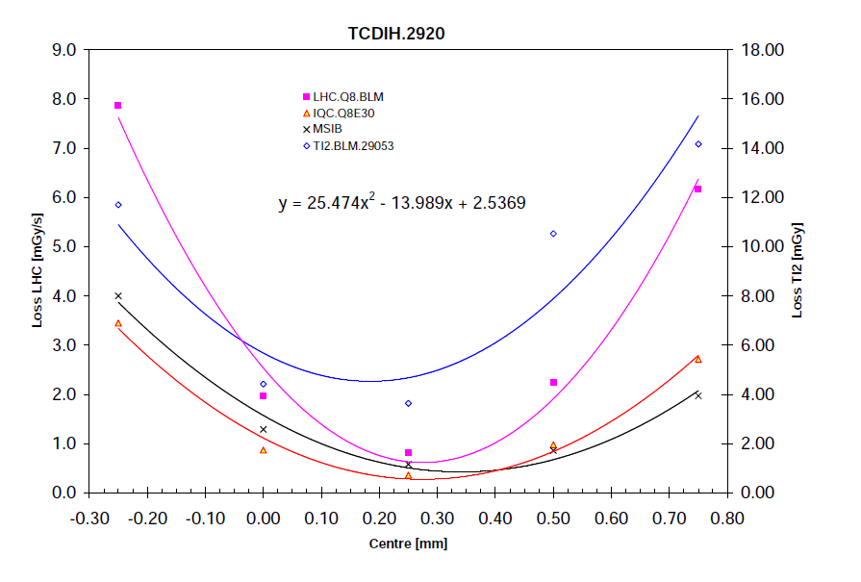
TCDI Centering Minimizing BLM
B. Goddard et al

Slide 6
Intensity History Since Yesterday
12b
12b injection
109b
Stable beams
24b

Slide 7
MKI2 Vacuum
B. Goddard et al

Slide 8
RF Setup 50ns
Look at 12b batch, 50ns in the LHC.
SPS well adjusted.
Comparing b1 and b11 of batch 4, ring 1 on first turn.
40 GSamples per s.
Conclusion:
We observe some dispersion in the profiles of the SPS bunches along the batch.
Probably some deterministic part due to the Transient Beam Loading in the SPS cavities plus a random part due to the imperfection of the longitudinal blow-up. In the above case the last two bunches were most affected.
We observe dipole oscillations but very small amplitude (200 ps pkpk max)
We observe quadrupole oscillation again of very small amplitude (200 ps pk-pk max) caused by the voltage mismatch (4 MV instead of matched ~ 2.5 MV)
P. Baudrenghien, T. Bohl et al

Slide 9
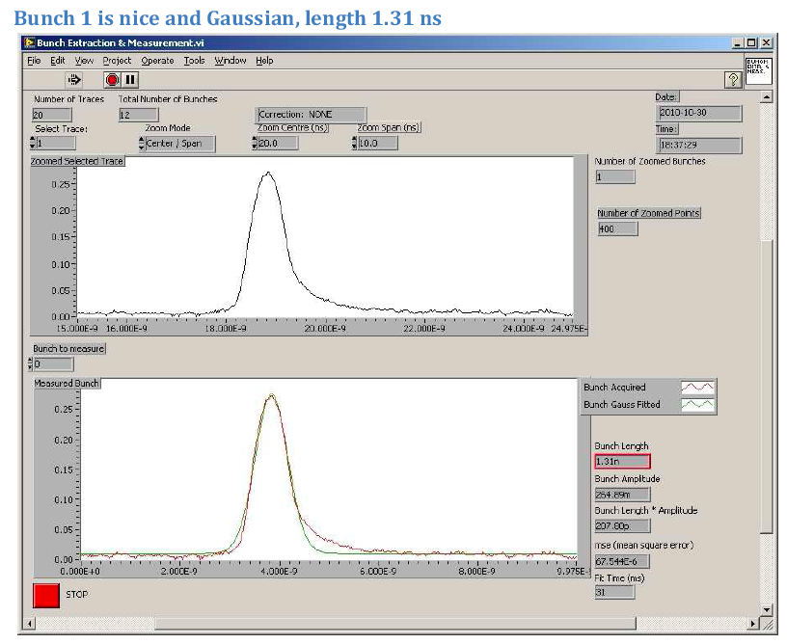
RF Setup 50ns
P. Baudrenghien, T. Bohl et al

Slide 10
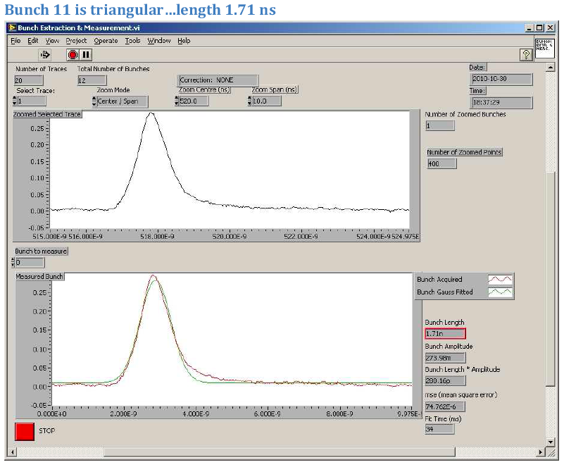
RF Setup 50ns
P. Baudrenghien, T. Bohl et al

Slide 11
Saturday/Sunday 30/31.10.
00h47: Start ramp. 109b. 50ns. ~1.1e11 p / bunch.
02h24: Stable beams. Fill 1459.
Lumi ~2e31.
Emittance ~3 um (from lumi).
Negative chromaticity at end of squeeze: Losses at warning level of BLM’s.
30-40% bunch to bunch intensity spread.
07h30: Adjust. End-of-fill studies.

Slide 12
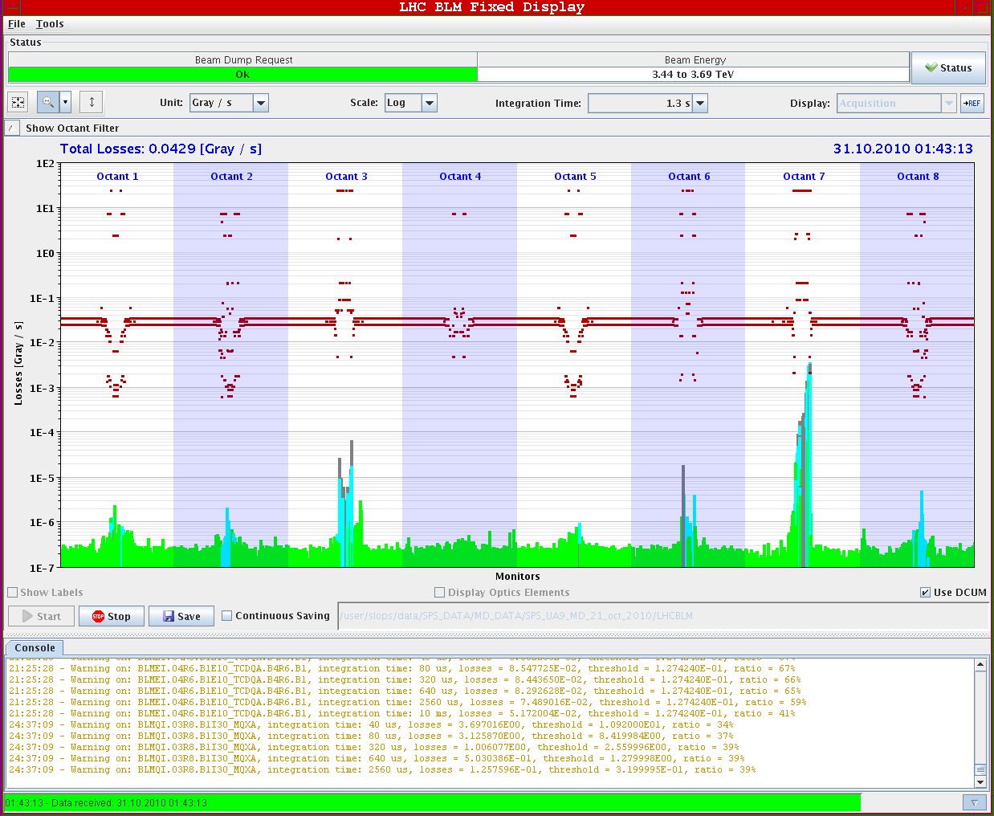
Losses at beta* = 6.5m (IP1/5)
… got better when we switched on transv. damper…

Slide 13
Vacuum IR2
R. Alemany

Slide 14
Vacuum IR1
R. Alemany

Slide 15
Vacuum IR5
R. Alemany

Slide 16
Vacuum IR8
R. Alemany

Slide 17
Ahead
ATLAS status?
09h00: Dump after end-of-fill study
10h00: Injection of 200b with 24b batches, 50ns. Experts required for MKI pressure rise.
12h00: Ramp 200b to 3.5 TeV or continue injection setup…
Push 50ns intensity at 450 GeV and 3.5 TeV.

