Slide 1
Tuesday 26.10.
08h42: Injection.
SPS transmitter problem (9h39-10h08).
Beams with 3.8e13 p dumped from slow losses at injection.
12h26: Start ramp, 368b.
13h35: Stable beams. Fill #1444.
16h56: Vacuum solenoid off/on.
20h48: Beams dumped by EIC.

Slide 2
Dump 3.8e13p with Slow Losses
450 GeV
83.8 s loss dump
Low tunes
Neg. vert. chroma
TCTVB.4L2

Slide 3
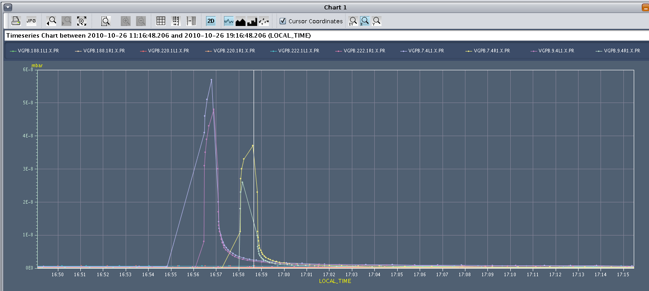
Solenoids off/on
ATLAS vacuum

Slide 4
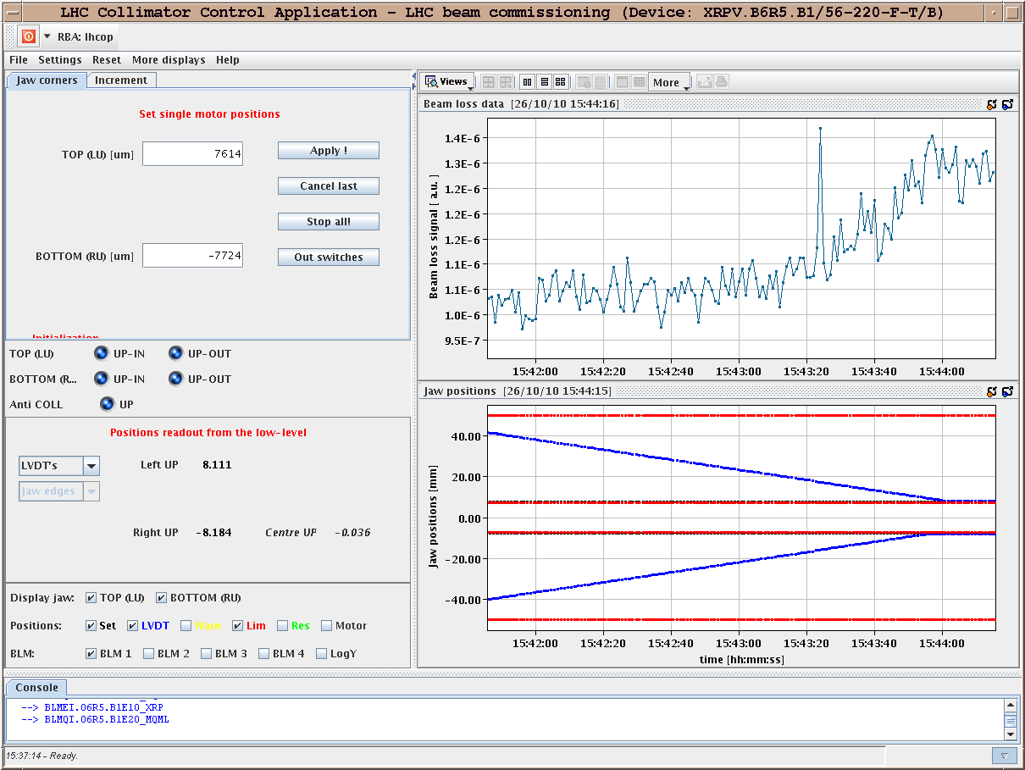
Losses when Moving RP
Nothing worrisome: tertiary halo…

Slide 5
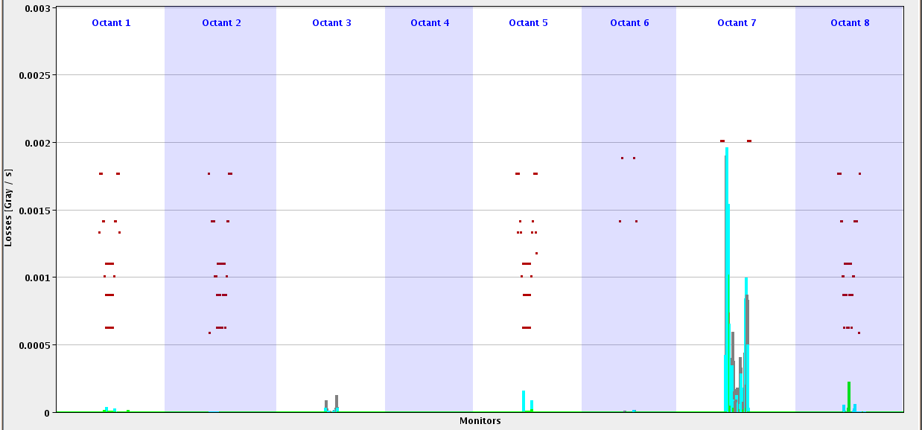
Losses in Stable Beams (Linear Scale)
… all normal

Slide 6
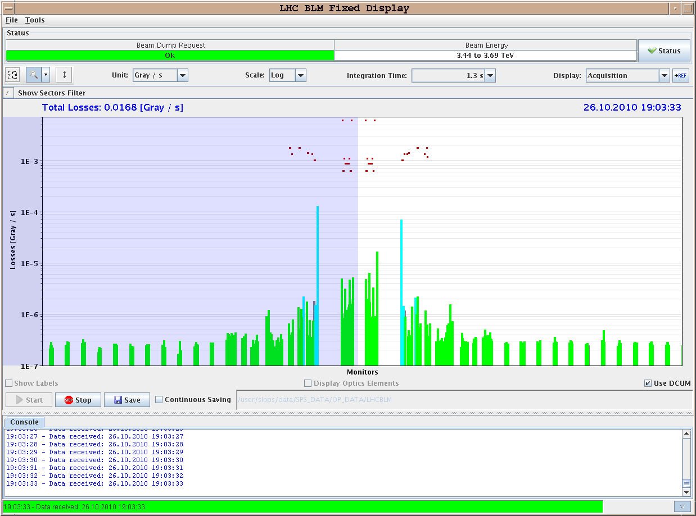
CMS Losses from Lumi

Slide 7
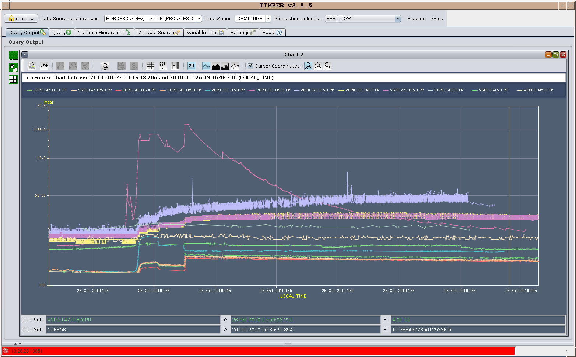
Vacuum

Slide 8
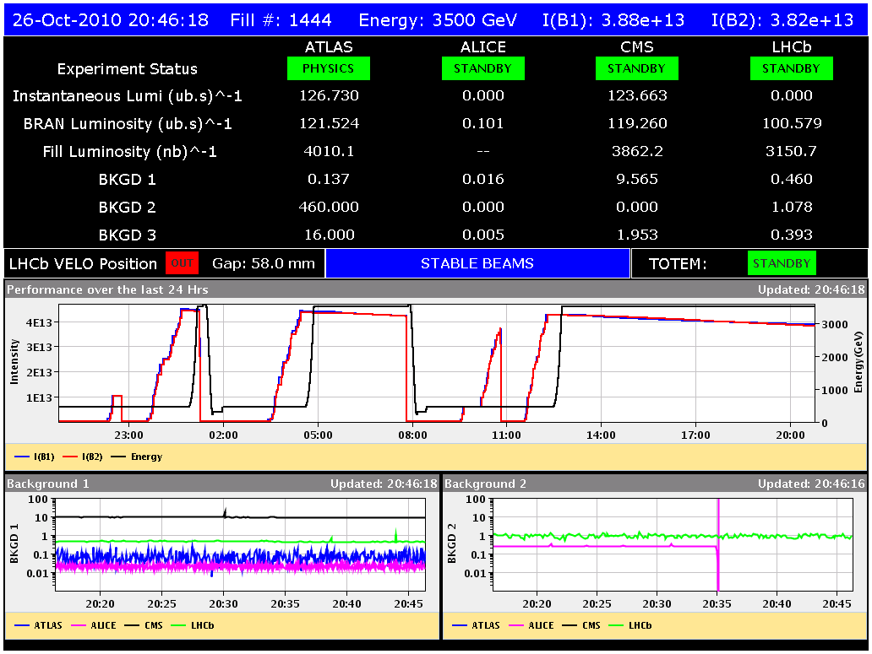
Fill Reached ~4 pb⁻¹

Slide 9
Tuesday 26.10.
21h14: Increase of various BLM thresholds through monitor factor.
ARC : All monitor factors pushed from 0.3 to 0.5
Dispersion Supressor. All monitors pushed from 0.3 to 0.5 except:
Empty cryostat monitors (belonging to family THRI_LEIR).
Monitor BLMQI.08L2.B1E20_MQML (belonging to THRI.DS.B1.2_MQM_RC) and BLMQI.08R8.B2E20_MQML (belonging to family THRI.DS.B2.2_MQM_RC) where monitor factor was left to 0.6.
Monitors BLM2I.10L3.B2E30_MQ_MQ, BLMEI.09L3.B2E30_MQ_MQ, BLM2I.09R3.B1I30_MQ_MQ and BLM2I.10R3.B1I30_MQ_MQ where left at 0.3.
This will be changed tomorrow.
23h18: Interlock beam dump test with 324b. OK.
Night: Laurette filled 1216b per beam (in several fills!)

Slide 10
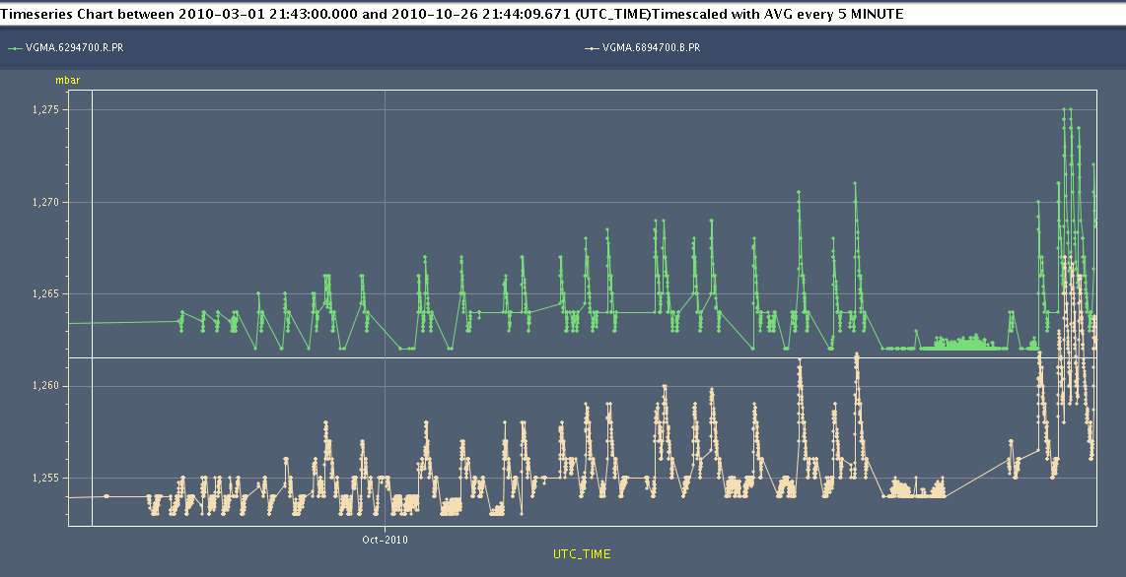
Pressure History Beam Dump

Slide 11
Wednesday 27.10.
01h04: Both beams filled with 424b. Had to dump at 450 GeV to reset QPS_OK on RB_A23/RQF/RQD_A23. Ramp down and pre-cycle.
02h46: Injection.
04h06: Start ramp. 424b.
04h23: Beam dump just after arriving to 3.5 TeV. TCTH.4R8.B2 BLM in IR8 triggered on 0.6s running sum. A few 10’s seconds before saw strange loss patterns. Beam-gas scattering?
05h26: Injection.
07h21: Start ramp. 364b.
07h27: Beam dump due to SIS error on beam energy (timing telegram or something else?). Beam dump fine.

Slide 12
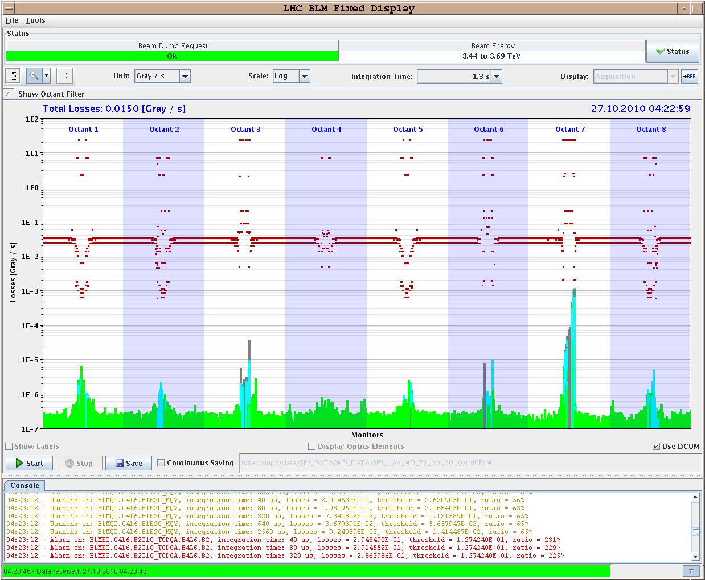
424b Losses 3.5 TeV

Slide 13
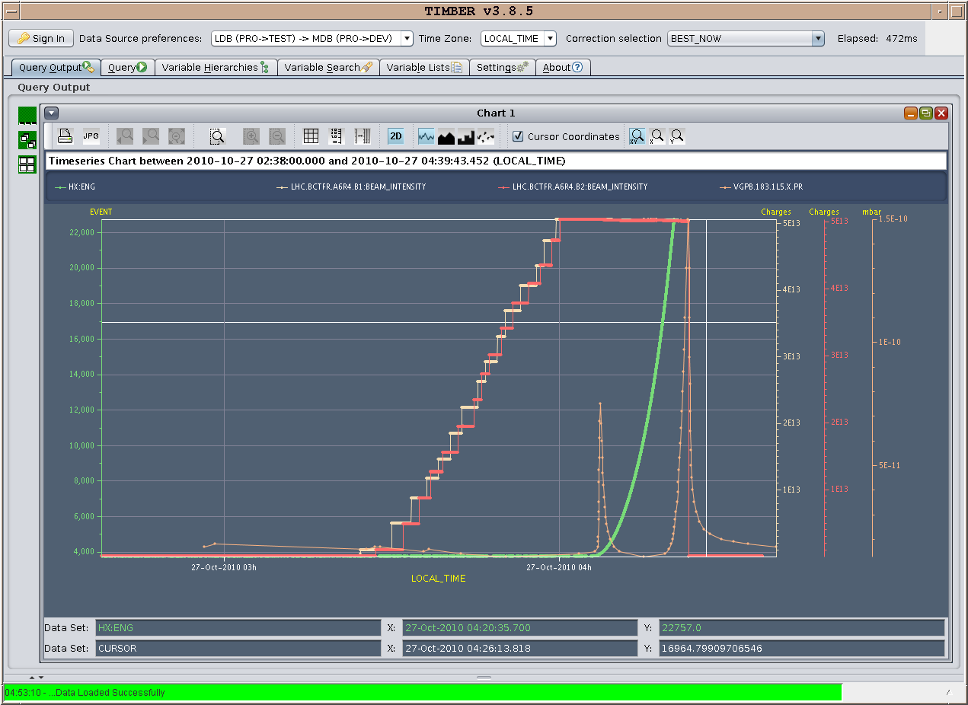
Vacuum CMS

Slide 14
Vacuum ALICE

Slide 15
Ahead
ATLAS has now 39.37 pb⁻¹. Last week: 15.7 pb⁻¹.
Now: CMS deicing. Injector RF intervention cancelled.
Until 14h00: LHC machine development at 450 GeV.
14h00: Recover for physics. Set up for stable beams with 424b.
around 16h30: Stable beams. Then physics until Thursday afternoon.
Afterwards 50ns commissioning.

