Slide 1
Status with LHC Beam
Coordination: Mike Lamont, Ralph Assmann
Last week coordination: Malika Meddahi, Joerg Wenninger
Thanks to operations, equipment groups and experiments

Slide 2
Last Two Weeks
Last week: Technical stop, advanced to fix finger problem in IR2 injection region.
Friday/Saturday: Recovery. LHCb spectrometer recovery. Test ramps with 1b x 1b and 2b x 2b. End of fill: Off-momentum loss map.
Stable beams since then:
Stable beams, fill 1439, 312b, peak lumi 1.5e32, 10h42, OP ended
Stable beams, fill 1440, 368b, peak lumi 2.1e32, 11h20, OP ended
Stable beams, fill 1443, 368b, peak lumi 2.1e32, 2h16, UFO
Stable beams, fill 1444, 368b, peak lumi 2.0e32, 7h13, OP ended
Then step up to 424b, but no stable beams yet…
ATLAS has now 39.37 pb⁻¹. Last week: 15.7 pb⁻¹.

Slide 3
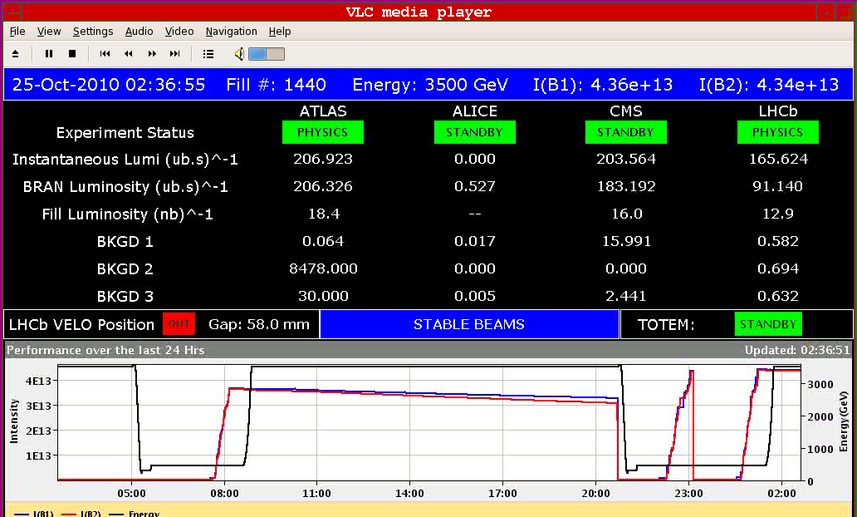
Fill 1440

Slide 4
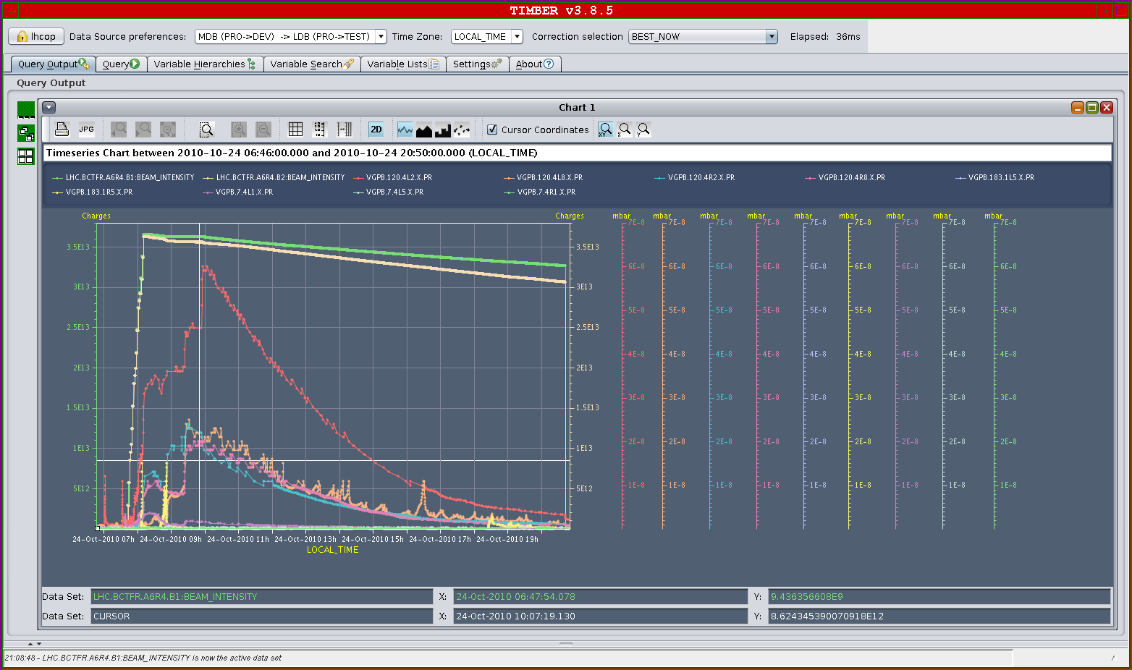
Vacuum fill 1439
7E-8

Slide 5
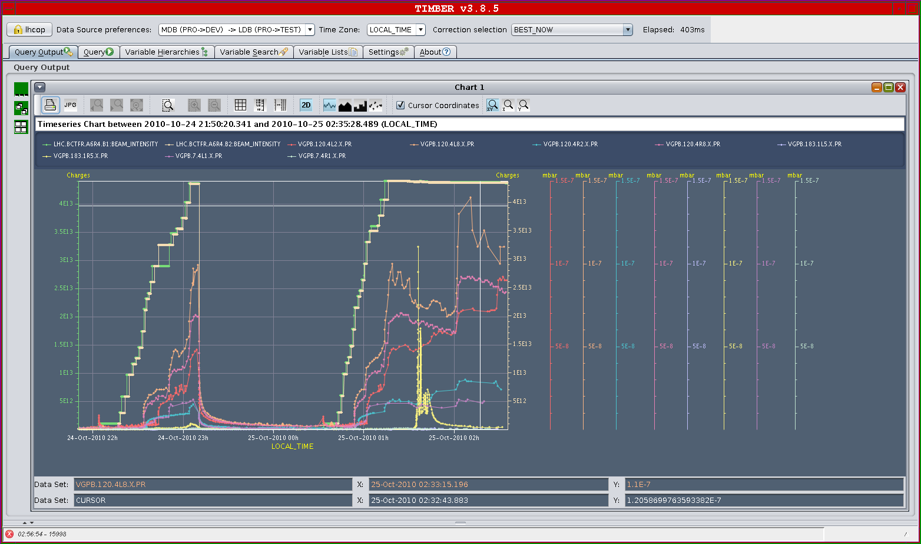
Vacuum 368b
1.5E-7

Slide 6
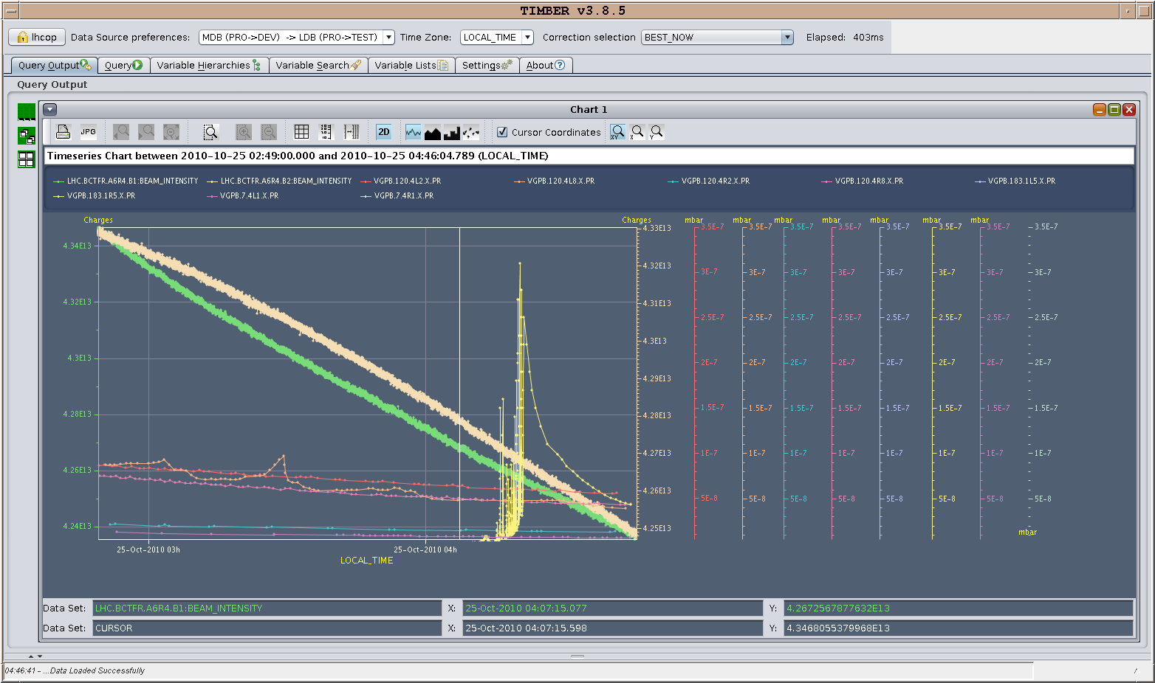
Vacuum spike F1440 – Pt5
3.5E-7

Slide 7
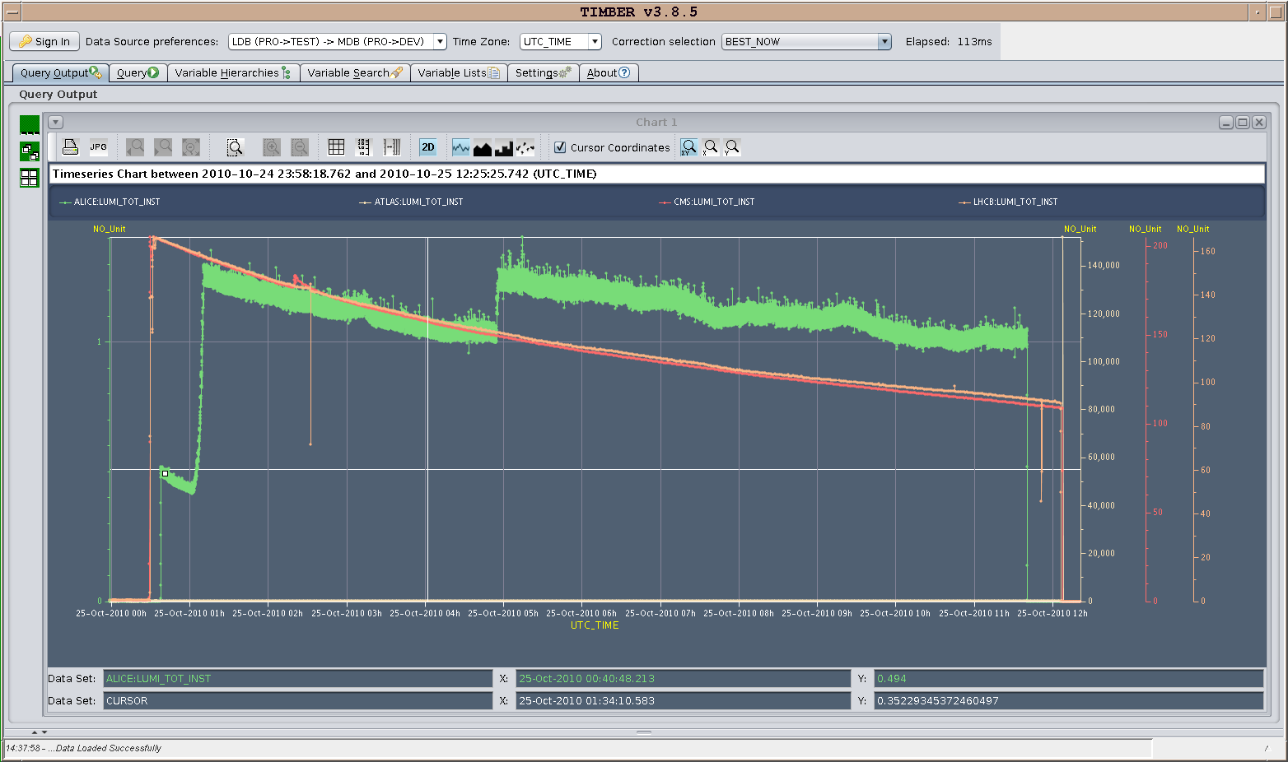
1440
Around 6 pb-1 in Atlas & CMS

Slide 8
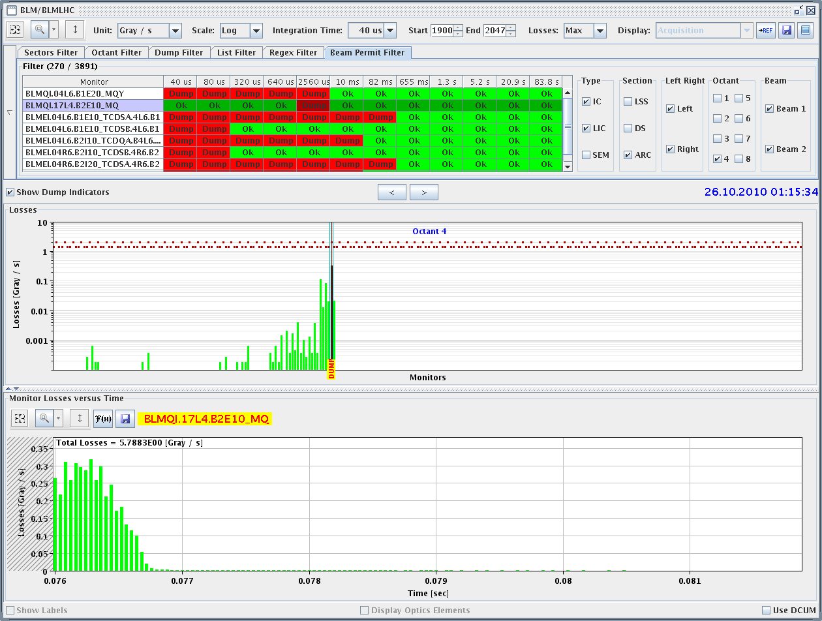
1442 - UFO

Slide 9
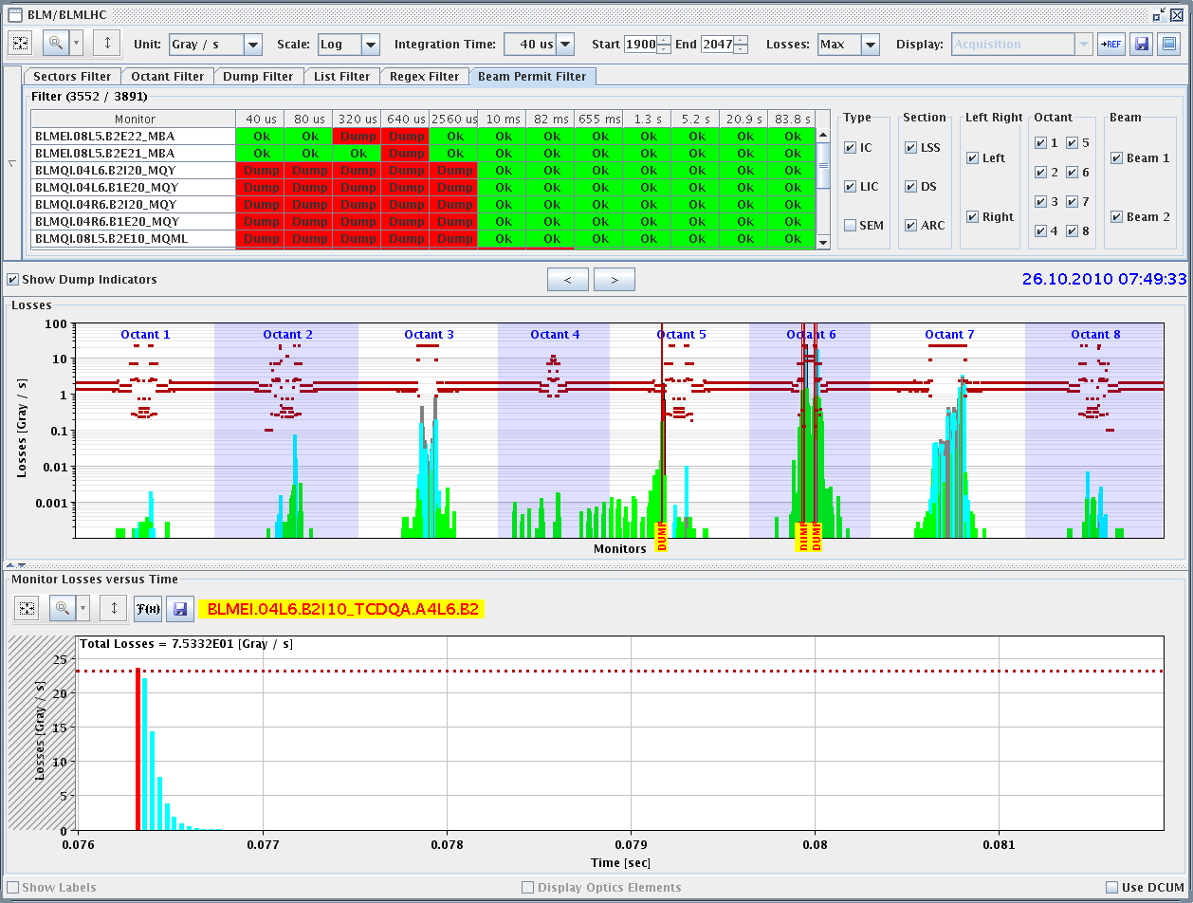
End 1443 – 07:50 - UFO

Slide 10
Dump 3.8e13p with Slow Losses
450 GeV
83.8 s loss dump
Low tunes
Neg. vert. chroma
TCTVB.4L2

Slide 11
Was the TDI…
➔

Slide 12
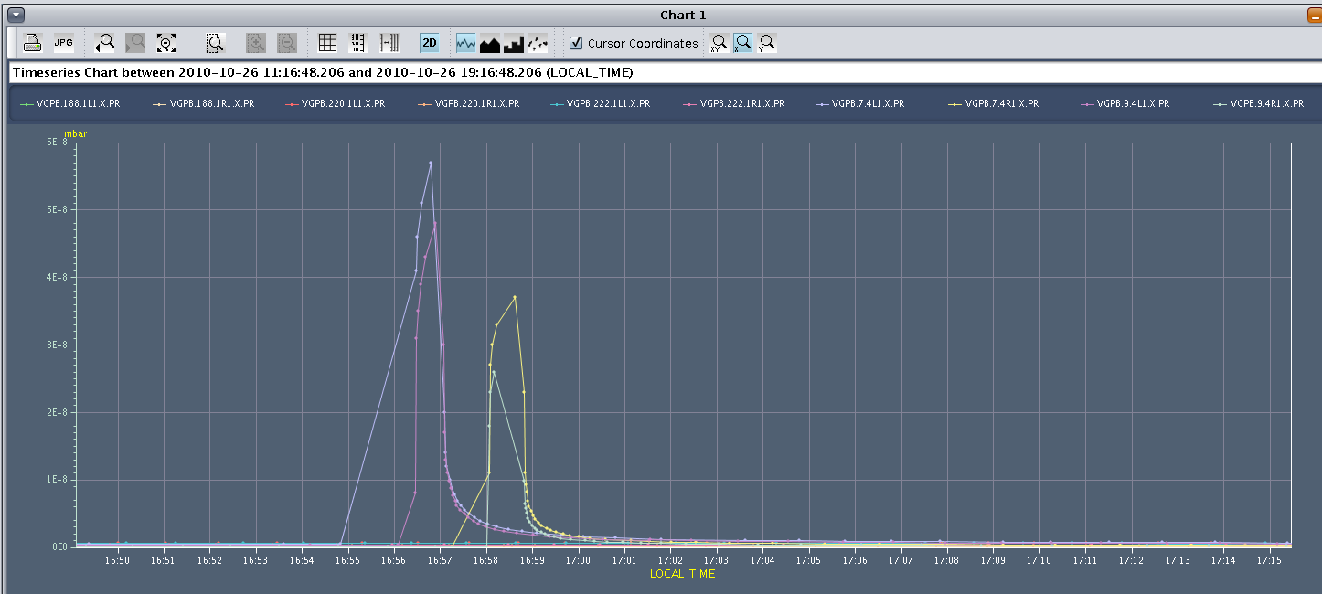
Solenoids off/on
ATLAS vacuum
…see vacuum talk…

Slide 13
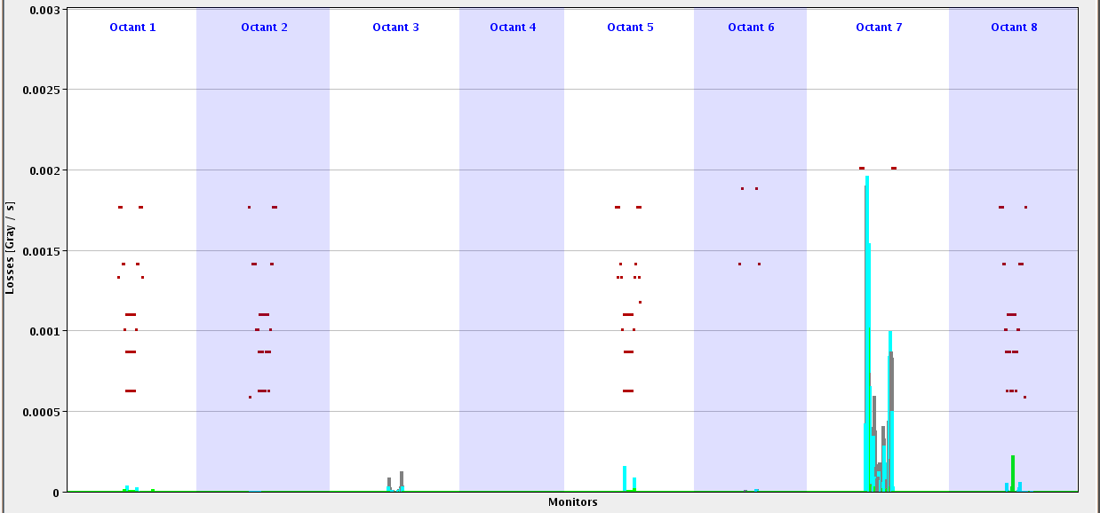
Losses in Stable Beams (Linear Scale)
Start of stable beams…
Betatron Cleaning
… all normal

Slide 14
Vacuum

Slide 15
Pressure History Beam Dump

Slide 16
Wednesday 27.10.
01h04: Both beams filled with 424b. Had to dump at 450 GeV to reset QPS_OK on RB_A23/RQF/RQD_A23. Ramp down and pre-cycle.
02h46: Injection.
04h06: Start ramp. 424b.
04h23: Beam dump just after arriving to 3.5 TeV. TCTH.4R8.B2 BLM in IR8 triggered on 0.6s running sum. A few 10’s seconds before saw strange loss patterns. Beam-gas scattering?
05h26: Injection.
07h21: Start ramp. 364b.
07h27: Beam dump due to SIS error on beam energy (timing telegram or something else?). Beam dump fine.

Slide 17
424b Losses 3.5 TeV

Slide 18
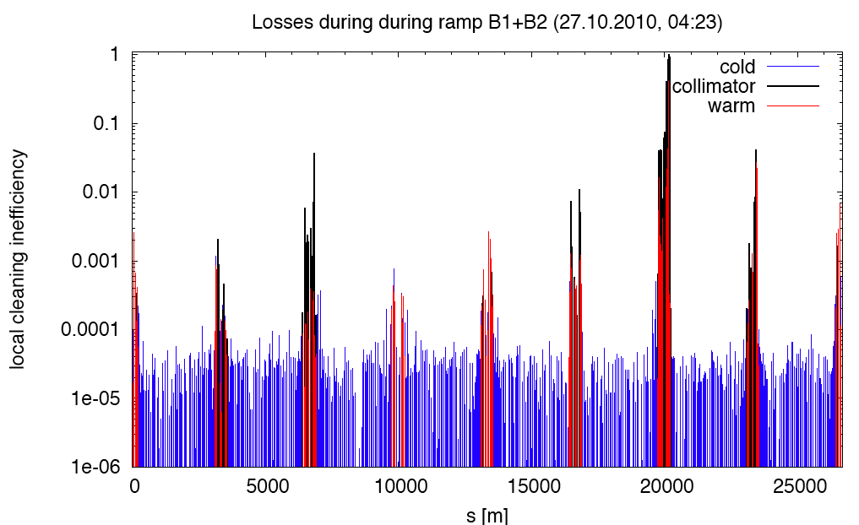
Losses Last Second Before Dump

Slide 19
Beam Dump 424b at 3.5 TeV
40 μs
… at 40 μs integration time for BLM’s

Slide 20
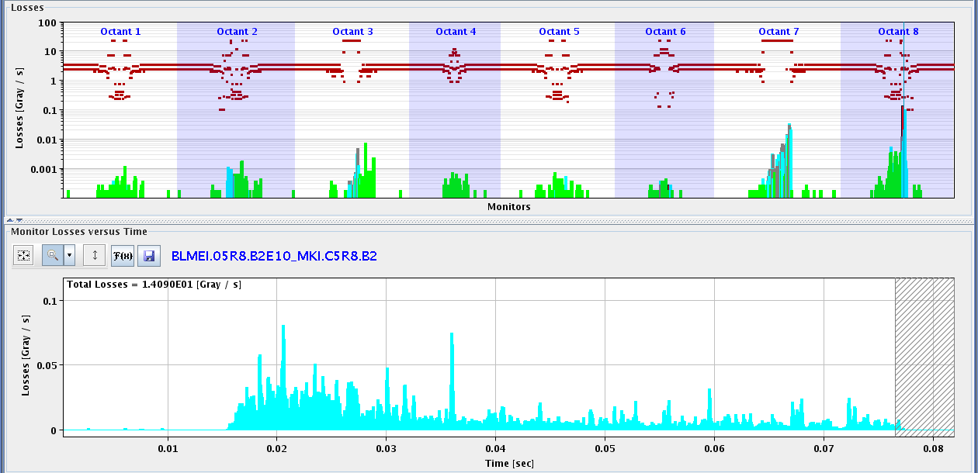
Loss at MKI Over 60 ms
40 μs

Slide 21
Vacuum CMS

Slide 22
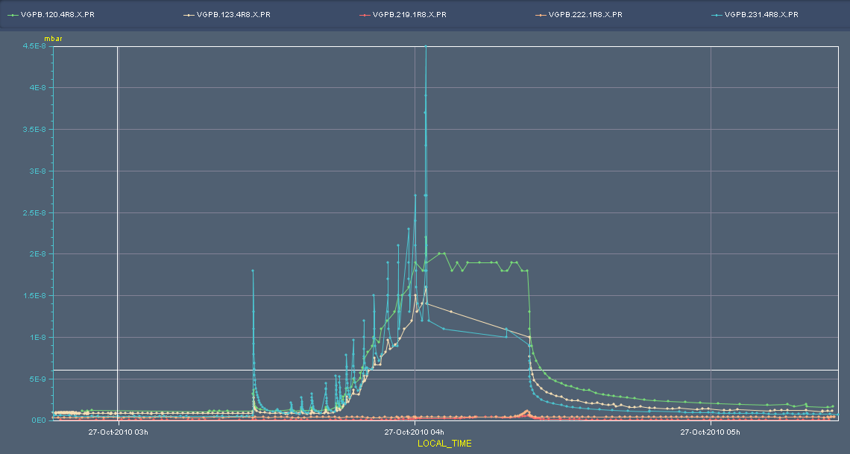
Last night – R8
Injection
Beam dump

Slide 23
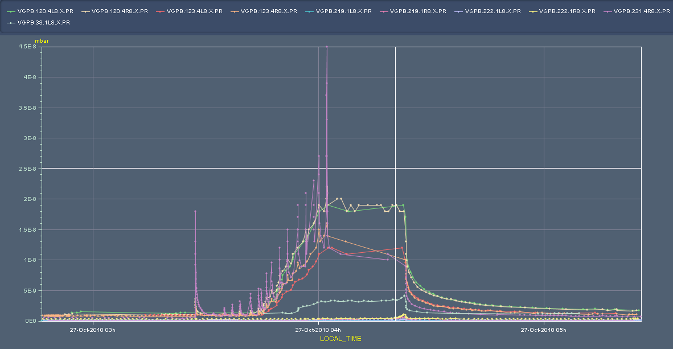
L8 & R8

Slide 24
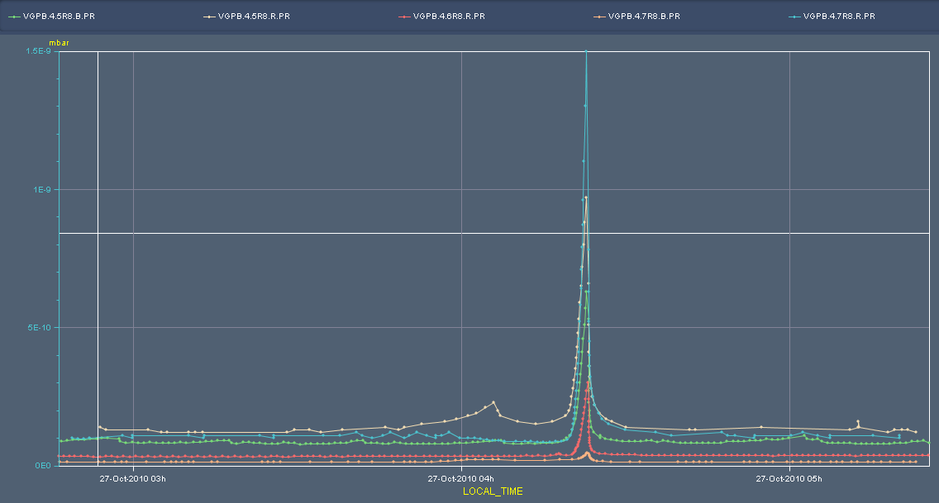
R8 – Q5 - 6 - 7

Slide 25
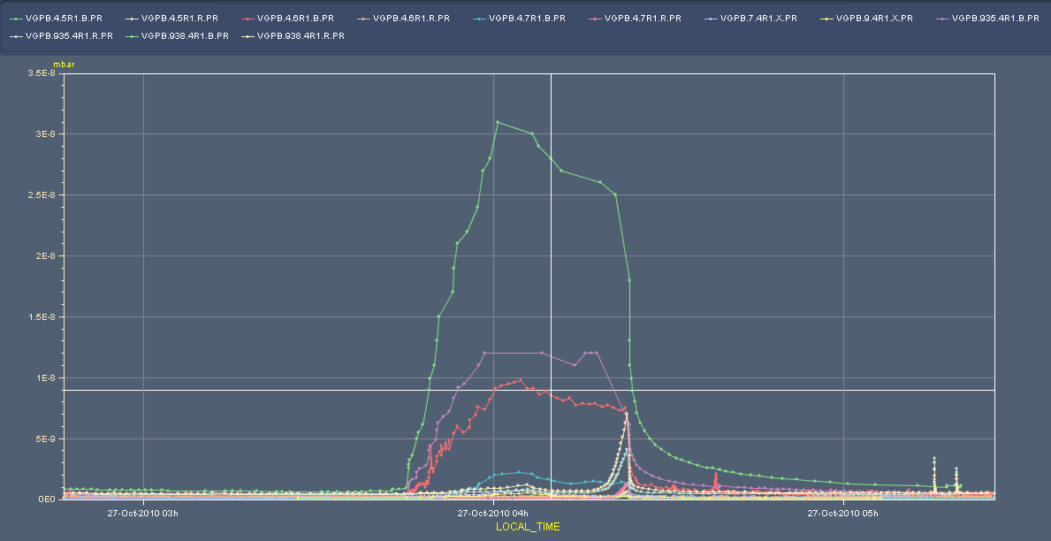
R1
6R1
5R1
7R1
2e-8
5e-9

Slide 26
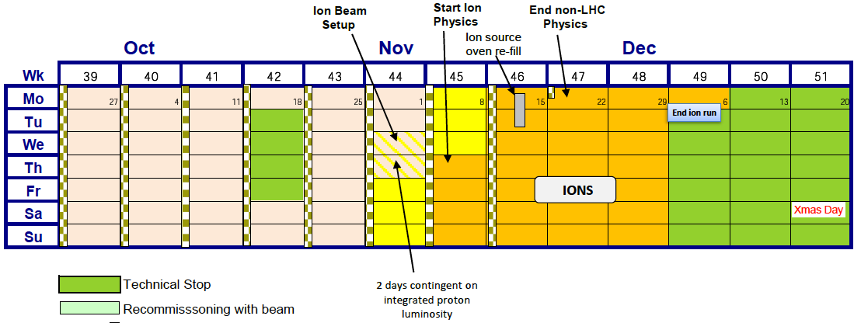
Next few days

Slide 27
Next few days
Run for physics until Thursday pm
368 bunches…
400+
Deliver 40+ pb-1
Friday
Test ramp BI/TOTEM
Switch to 50 ns.
Monday/Tuesday next week
Provisionally machine development
Wednesday – switch to ions
Contingent on delivery of integrated luminosity target

Slide 28
50 ns
Start injection with 12 bunches (all fills will have the first injection with 12 bunches).
The first physics fill will be done with 1⋅12 bunches and 4⋅(12+12)bunches (from 2 PH injections), in total 108 bunches.
This gives not yet the full beam-beam effect.
Further fills will be done with 200 bunches, 300 bunches and 400 bunches if there is sufficient time.
To be re-discussed if priority should be given to MD studies.
The fill with 200 bunches will be done with batches of 24 bunches, from 2 booster rings.

Slide 29
Experiments
40 - 50 pb⁻¹
Alice – fill without dipole
Totem – dedicated fill
Totem – 90m
Longitudinal scan

Slide 30
Provisional planning
Until Friday 08:00 | Physics 150 ns 400+
Friday 08:00 | Switch to 50 ns
Friday 17:00 | Test ramp 4+1 BI-TOTEM-AGC | 8 hours
Overnight Friday | MD – IR aperture | 8 hours
Sat – Mon a.m. | 50 ns – into stable beams and push including 1 fill with Alice dipole/sol off
Mon – Wednesday | Quench test(s) RF MD 1 & 2 Longitudinal scan

