Slide 1
LHC operation in week 42
Coordination:, Malika Meddahi, Joerg Wenninger
Thanks to OP crews, HW and SW teams + experiments
Aims for the week
Cure aperture restriction in TI 2 MSI (TS week 42)
Complete 312b stable beam period
Complete tests for 32b injection
368bx368b stable beams

Slide 2
Week 42 in short
Monday 18th October | Loss maps Abort Gap cleaning at 450 GeV RF studies PLL commissioning
Tuesday 19th 06:00 am to Friday 22nd October 17:30 | Technical Stop – Coordination by Katy Foraz All work done and complete on schedule
Friday 22nd October | Night : recovering from TS
Saturday 23rd October | Until 16:00: stopped by various hardware problems (pre-pulse distribution crate, re-phasing, cryo losses) . Injection studies: B1 and B2 both ready for 32b injection Overnight: LHCb spectrometer polarity switched to positive. Test ramps with 1bx1b (dump validation) and 2bx2b (loss map on momentum)
Sunday 24th October | Stable beams, fill 1439, 312b, peak lumi 1.51e32 Stable beams, fill 1440, 368b, peak lumi 2.05e32

Slide 3
Week 42: Stable beams
Date | Fill # | b # | Inj. | Fill dur. | Peak L cm-2 s-1 | Fill L nb-1 | Dump
24 Oct. | 1439 | 312 | 8b 16b 24b | 10.5h | 1.51e32 | 4200 | Programmed dump TOTEM RPs in CMS length scale cal.
25 Oct | 1440 | 368 | 8b 16b 24b 32b | 6+ | 2.05e32 | 3200+ | Emittance approx 2.3 um

Slide 4
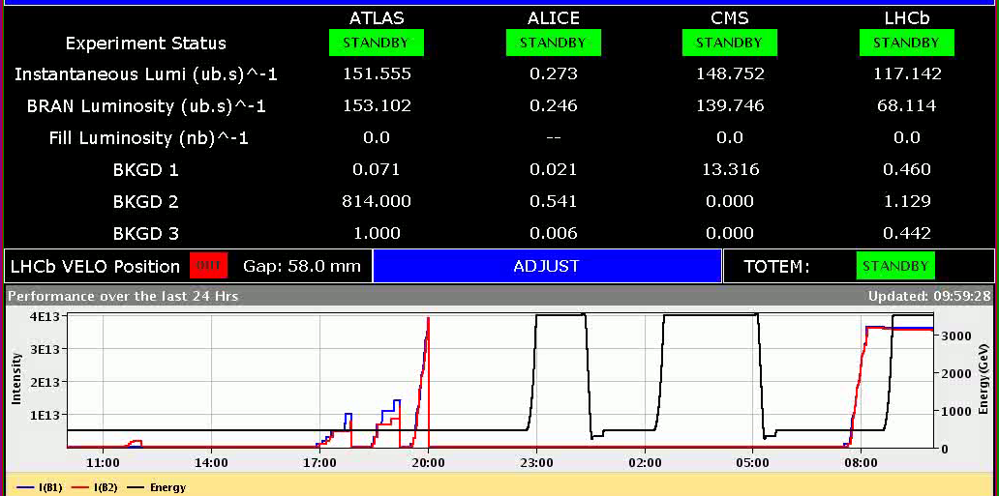
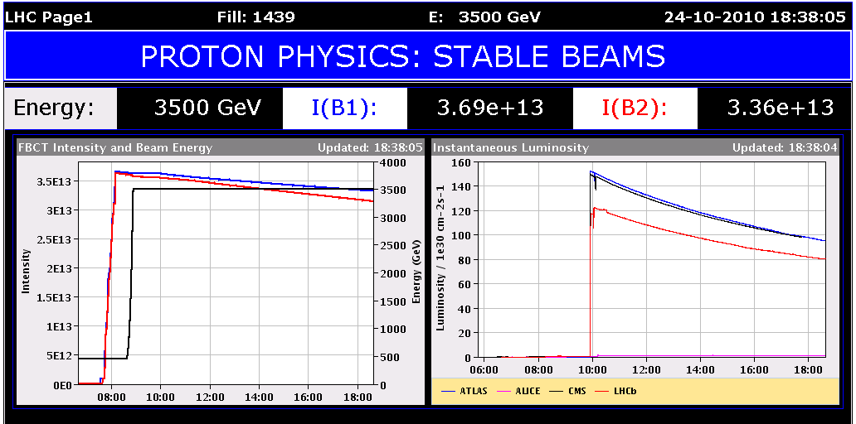
Week 42: fill 1439

Slide 5
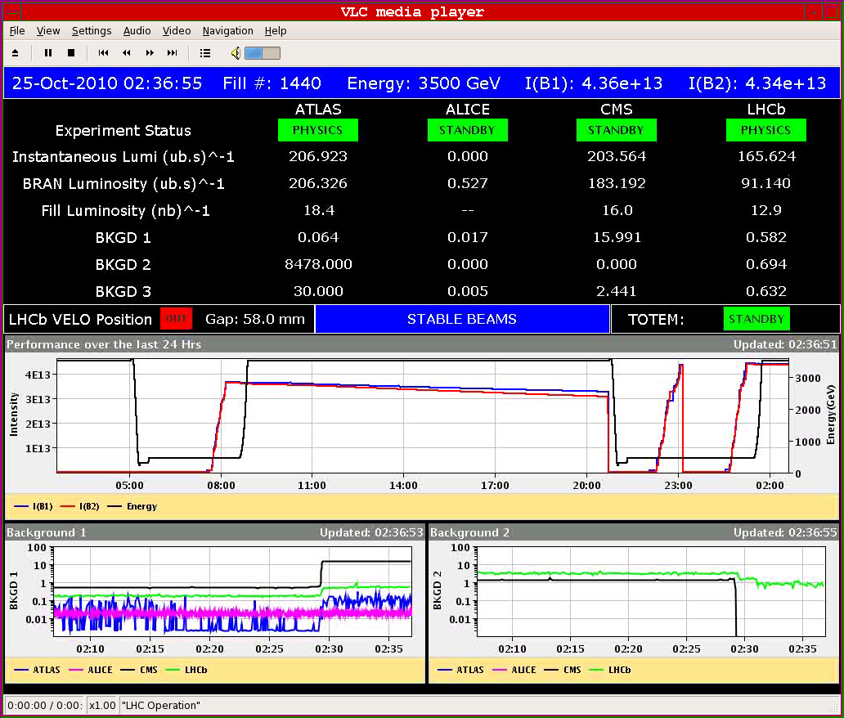
Fill 1440

Slide 6
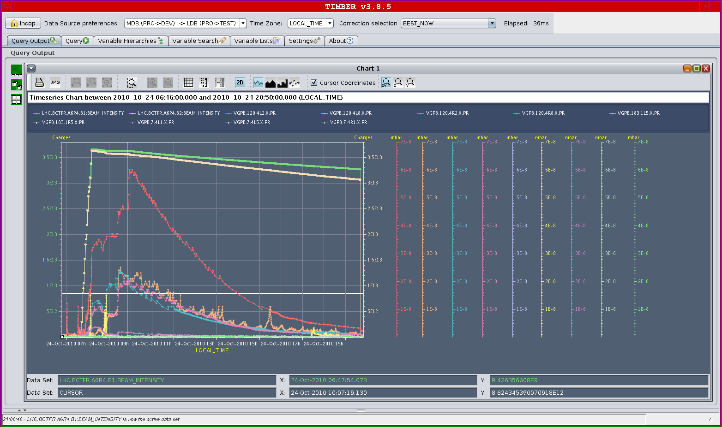
Vacuum fill 1439
7E-8

Slide 7
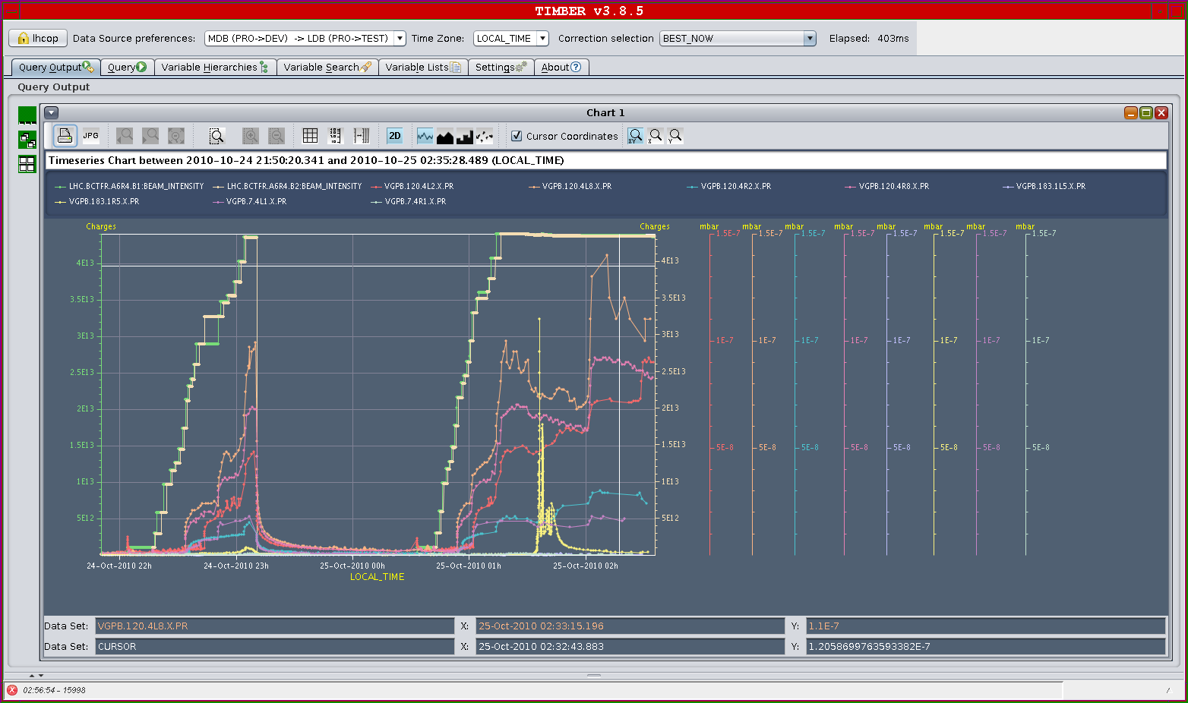
Vacuum 368b
1.5E-7

Slide 8
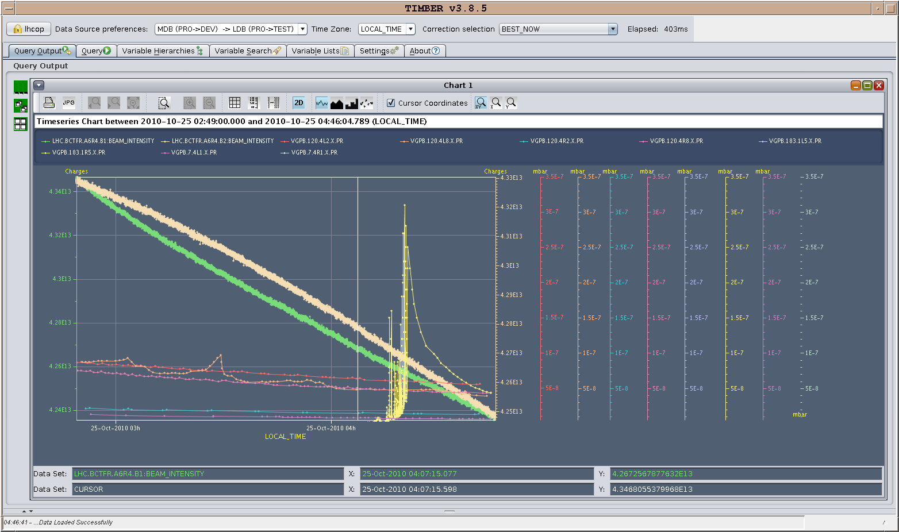
Vacuum spike F1440 – Pt5
3.5E-7

Slide 9
Week 42 in numbers
4 days of TS
Machine closed Friday at 18h30 - beam injected Sat. 04h30.
Statistics over 3 days of beam operations:
System faults : 10h → 15%
Stable beams : 16h → 23%
Setting-up without beam 17h → 25%
Setting up with beams : 25h → 37%
Week 42 peak luminosity: 2.05e32 cm⁻²s⁻¹
Week 42 delivered luminosity: 7.5+ pb⁻¹
LHC total integrated luminosity ~31 pb⁻¹

Slide 10
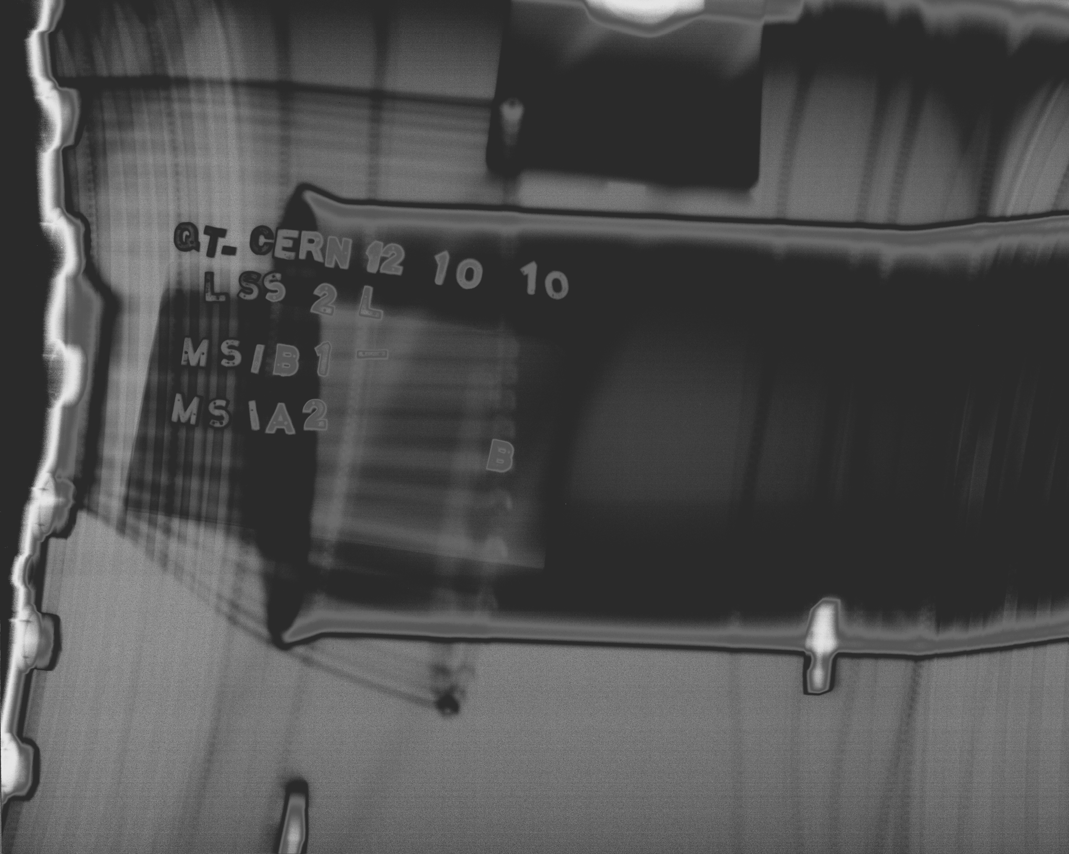
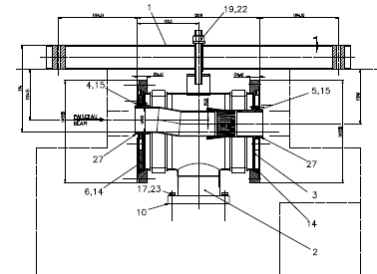
From last week: Injection losses B1
Radiation survey and X-ray (Tue 12/10) have evidenced a clear aperture restriction at the transition between the injection septa MSIB/MSIA due to a non-conformity in the mounting of the interconnection
Circulating beam
Injected beam
J-M. Dalin
Conditions for injection degraded too much → decision to anticipate the week 44 TS to week 42.

Slide 11
Injection after TS - Brennan Goddard and team
Injection of up to 32b checked for both beam.
Trajectories and losses small again.
Injection of 32b with batch spacing of 225 ns.
→ MSI aperture restriction fixed. No more problems– Acknowledgments to TE/VSC
Tuning of IQC settings after the PFN changes. Finer tuning after collection some statistics.
→ Injection ready for 32b / 368b filling

Slide 12
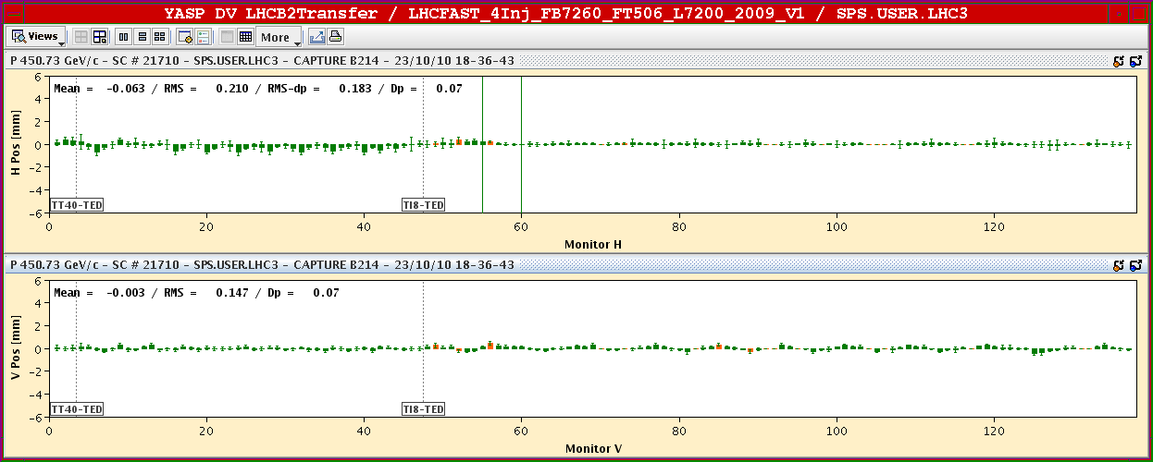
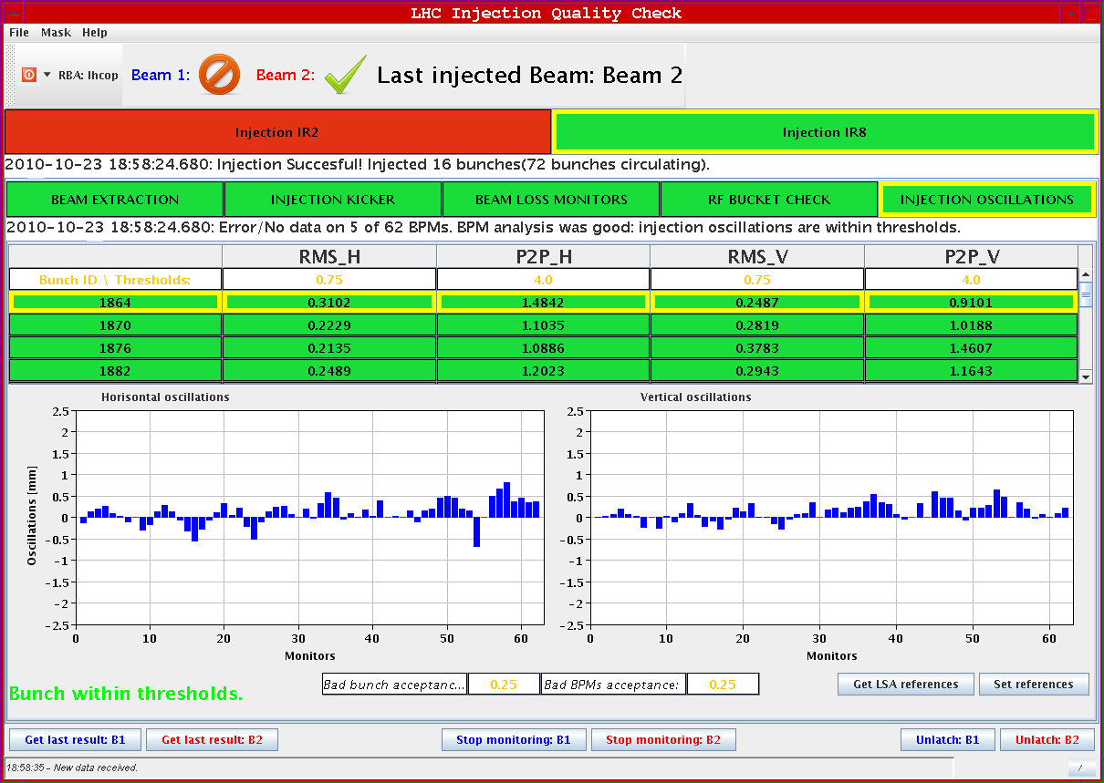
Saturday 23 October

Slide 13
Loss maps – OP - Ralph Assmann - Daniel Wollmann
Betatron loss maps 3.5 TeV with colliding beams (1x1)
Both beams and both planes (one at a time).
Leakage to IRs at the 0.1% level.
No unexpected losses.
Cleaning inefficiency: 2.2e-4 to 3.5e-4
Off-momentum loss map 3.5 TeV with colliding beams (2x2)
Negative momentum offset (RF freq. +800 Hz).
Leakage to IRs at the level of 1%.
No unexpected losses.
Final analysis to be done.

Slide 14
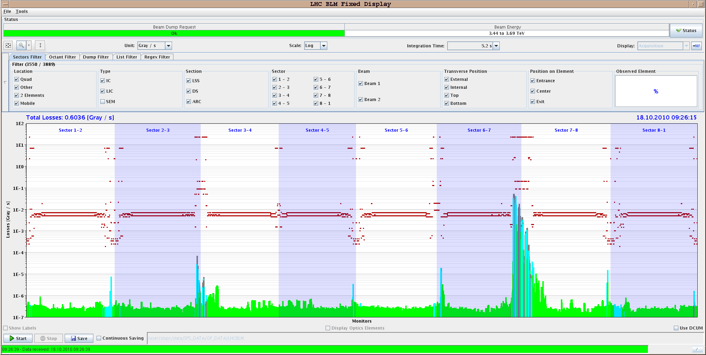
Betatron losses, B1 vertical
Daniel Wollmann

Slide 15
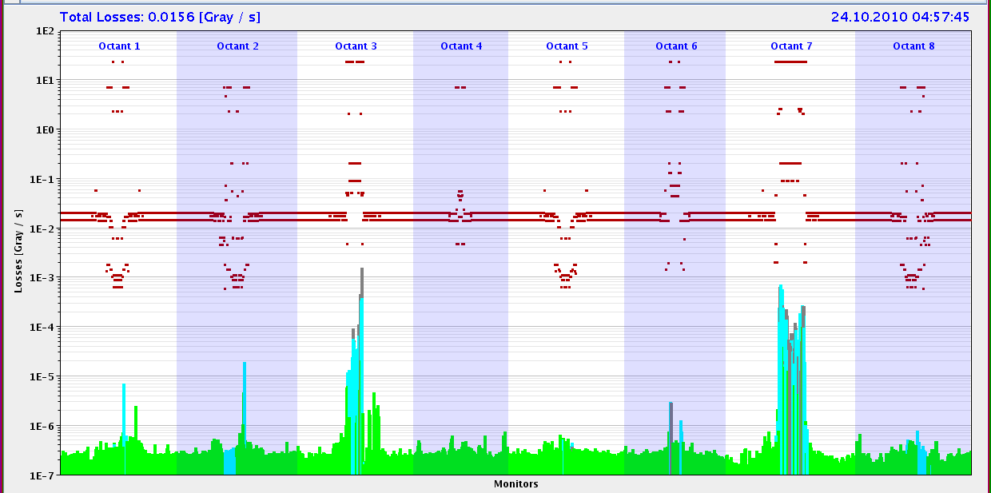
Momentum losses (+800 Hz)

Slide 16
Abort Gap Cleaning
Andrea Boccardi, Adam Jeff, Federico Roncarolo, Enrico Bravin, Wolfgang Hofle, Daniel Valuch, Verena Kain, Eliana Gianfelice, Malika Meddahi
AG cleaning tested using the vertical damper for beam1 and beam 2. With the voltage and frequency that were used, no emittance growth was observed, no lifetime problems.
450 GeV, 1e11/ bunch.
B1: buckets 1 and 31130, B2: buckets 1 and 31140.
RF voltage was decreased in steps and cleaning of the beam leaking into the AG was observed.
Experiment repeated with both beams in the machine. The beams were injected while the cleaning systems were on.
No anomalous observation made → ready to be switched on during regular operation

Slide 17
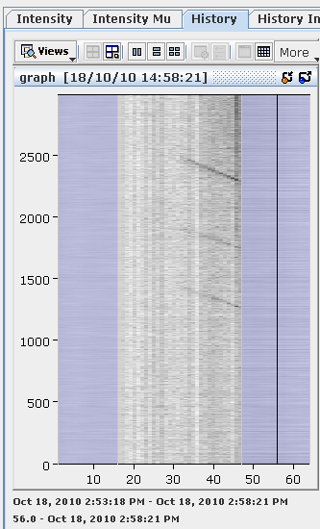
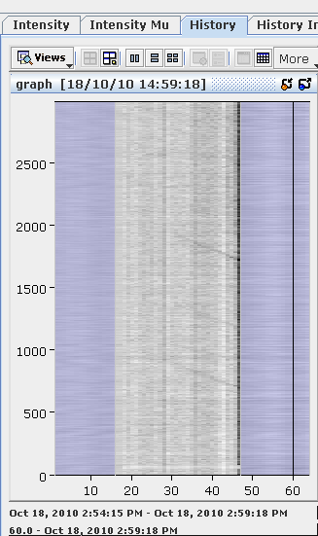
Abort Gap monitor
Adam Jeff – Andrea Boccardi
Beam 1
Beam 2

Slide 18
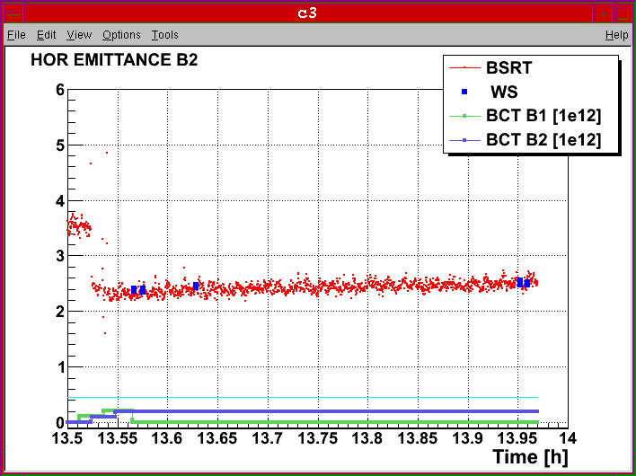
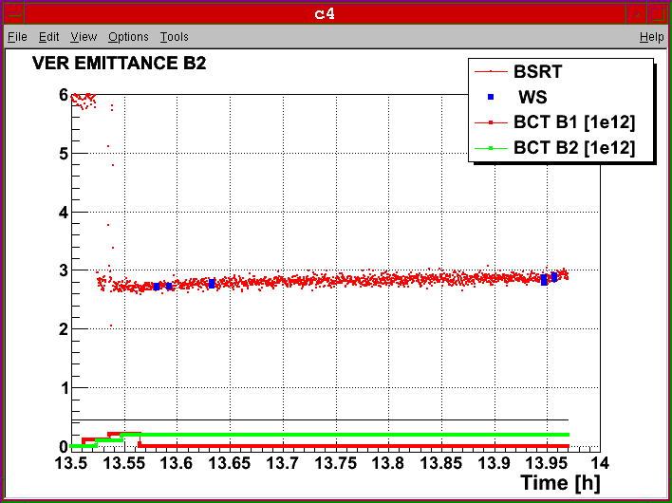
Emittance measurements during AGC tests
Federico Roncarolo

Slide 19
RF noise induced beam diffusion
Philippe Baudrenghien and team
Beam conditions: 4 x 4 b (1E10/bunch) both beams ramped to 3.5 TeV, no blow-up. Very short (400 ps long) bunches
Motivation: Prepare for higher intensity next year when 2 new systems will be introduced: longitudinal damper (active only at inj.) and 1-Turn feedback (active all the time). These will add RF noise. Need to assess the margin.
Data must be analyzed – no conclusions could be drawn online.

Slide 20
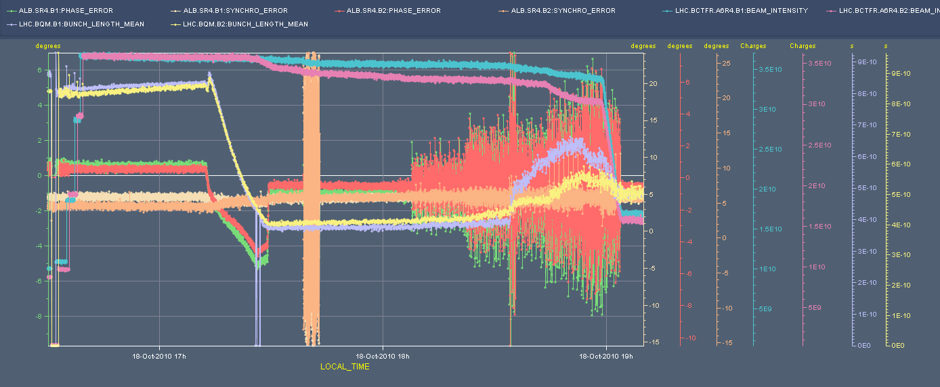
Preliminary results: from observation of BQM only, the bunch profiles suggest modification of bunch shape that goes from parabolic to triangular with the excitation.
It was realized that the method for introducing the excitation in the cavity was not ideal.
_{phase} _{error}
_{BFCT}
_{synchro error}
σ_{l}

Slide 21
PLL commissioning - Marek Gasior–Ralph Steinhagen
PLL kept lock during ramp- used as primary input to the Tune-FB
Achieved 99% transmission for both beams
PLL operation visible on life-time but always above 25 h
Stable PLL gains depend on the ADT settings and varied by more than a factor hundred between ADT 'off' and 'on‘.
Tune resolution acceptable and in agreement with FFT estimate.
Emittances:
Before ramp : B1-H = 1.8, B1-V = 1.6, B2-H = 2.6, B2-V = 2.9
3.5 TeV : B1-H = 3.3, B1-V = 2.7, B2-H = 3.6, B2-V = 3.2
>> suggests very strong emittance blowup !
Very encouraging results. Effect on emittance to be confirmed (or improved…).

Slide 22
What’s next?
- 368b operation to continue for stable beams
- 400+b operation stable beams
- Switch to 50ns bunch spacing –
to note: LHCb spectrometer polarity O.K.
- Long list of “to-be-done” before the end of the p operation…
Week 43 coordinators: Mike Lamont and Ralph Assmann

Slide 23
On the list of TBD before the end of p run
Orbit shift vs TCT check – Joerg Wenninger + Ralph Assmann
Push b-b tune shift with 150 ns – one test already performed with #1410 – Werner Herr
Beta* measurement in IP8 – Rogelio Tomas
IP aperture at 450 GeV (not 3.5 TeV) – Massimo Giovannozzi
RF noise induced beam diffusion – P. Baudrenghien

Slide 24
On the list – Wolfgang Hofle
Multi-bunch acquisition of the damper pick-ups signals, update - slot on Wednesday to reboot crates
Gain in ramp
50 ns set-up (2x4 hours)
Abort gap cleaning 450 GeV and 3.5 TeV and cleaning of injection slot (see ABT)

Slide 25
On the list from ABT/BTP – Brennan Goddard
Abort gap cleaning tests B1/B2 at 450 GeV and 3.5 TeV [2 shifts] + Calibrate the abort gap over the whole ramp (BI)
Injection gap cleaning deployment tests, 450 GeV, B1/B2 [1 shift]
MKI8.B2 fine timing adjustment (1st bunch in train always gets too large a kick) and also synchronisation checks [2 h]
50 ns bunch train injection for B2 [1 shift?]
Studies SPS-LHC emittance preservation at injection, and growth on flat bottom [1 shift]
Asynch dump tests 3.5 TeV for B1/B2, to check stability [1 ramp]

Slide 26
On the list from BI – J.J. Gras
Check the linearity of the fast BCT’s in the new configuration for nominal bunches
Tune the High BW/Low Gain fast BCT calibration for the coming ion run
Measure the High BW/Low Gain fast BCT sensitivity limit and linearity for low intensity bunches (ion run) + Re-check BPM sensitivity limit
Commission BGI in preparation to ions – started…
Check BSRT/BGI/BWS cross-calibration including corresponding emittance logging – Test and compare bunch/bunch profile measurement via BWS and/or BSRT - to be continued – 4h with a ramp
PLL studies during ramp continued

