Slide 1
Tuesday
08:30 – 14:30 Accesses
14:30 – 16:30 Pre-cycle and wait for the SPS still verifying the beam to be delivered
16:30 – 21:30 Difficulties at injection with Beam 1 in spite of the small emittance ➔ go to filling scheme with max. 16 bunches/injection. As a set-up of the injection is required.
22:40 Collisions but for a short time ➔ dump due to BLM in LSS7
Not possible to inject with intermediate emittances (~1.8-2 um) ➔ Reduced intensity and go back to small emittance. In spite of that and of steering not possible to inject 16 bunches ➔ Start preparing VdM scan.

Slide 2
Access
Access:
Injection area investigations (radiation survey, alignment, X-ray)
Installation of a magnetic probe L3
Cryogenics in PM85
UPS in UX45 ➔ One battery will need to be changed during the technical stop
Current lead for RCBXH3.R1: leaky cryo-valve, temporary fix. Final solution during tech. Stop
RCBH15.L6B1 power converter replacement
Intervention on energy extraction switch for RB.A81: found bad connection on a micro-switch but not clear whether this is the source of the trips observed (probably not)
RadMon installation close to the controls of the solenoid
In parallel: change of GPS repeater

Slide 3
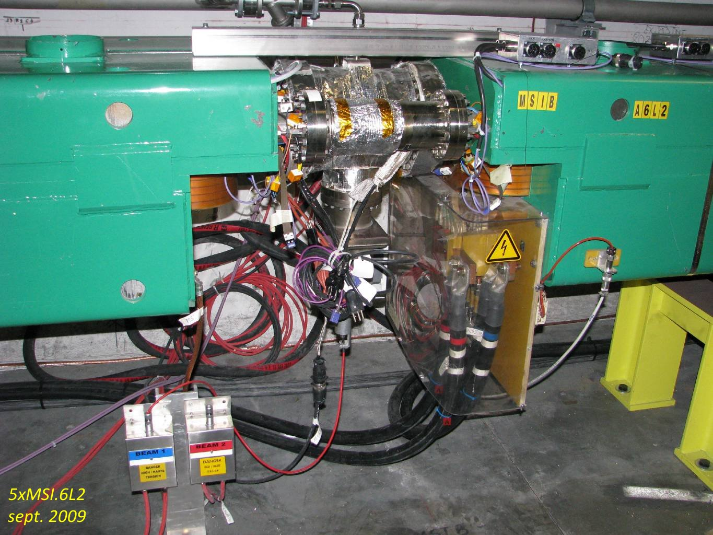
Injection area investigations at the MSI
Suspected aperture restriction at the transition MSIB-MSIA
Confirmed by radiation survey showing a maximum (although small: ~4 uSv/h) at the suspected transition

Slide 4
Injection area investigations at the MSI
Alignment survey did not show any important misalignment at the MSI, only some important tilt observed at the BTVSS
D. Missiaen

Slide 5
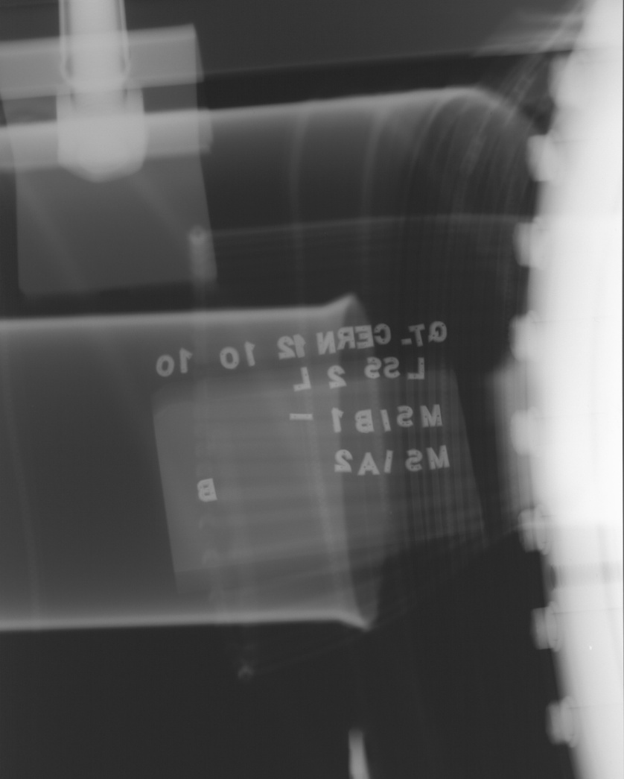
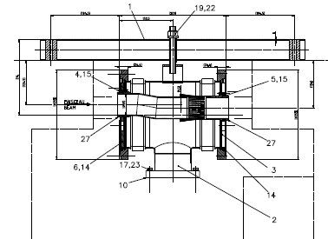
Injection area investigations at the MSI
There is a clear problem with the RF fingers at the transition. Not clear how did it get worse suddenly. Need to find a different injection trajectory, for the time being while preparing an intervention for the technical stop or the Christmas stop
New setting-up to be done this afternoon after the VdM scan
JM. Dalin

Slide 6
Injection
Difficulties to inject trains of 24 bunches in spite of the small emittances at injection (~1.3-1.6 μm)
Increased vertical bump of the injected beam at the MSI area
Change of the filling scheme to 256_240_8_224_8 with 17 injections and bunch trains with a maximum of 16 bunches
Finally got 256 on 256

Slide 7
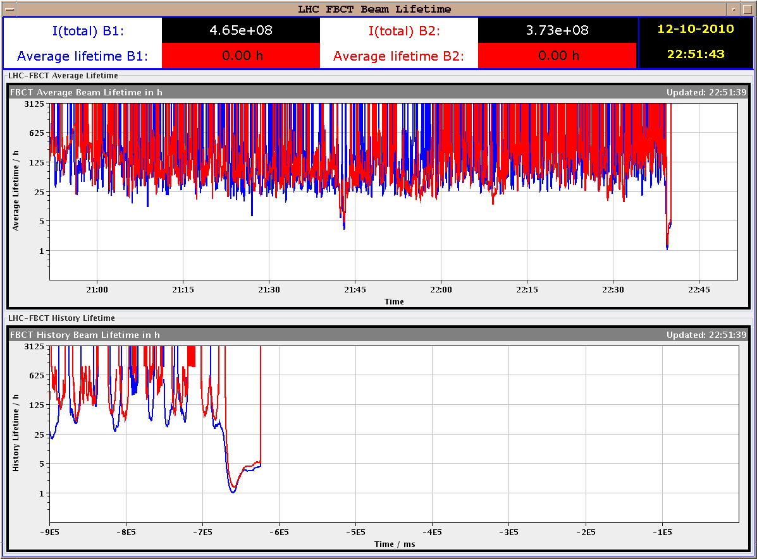
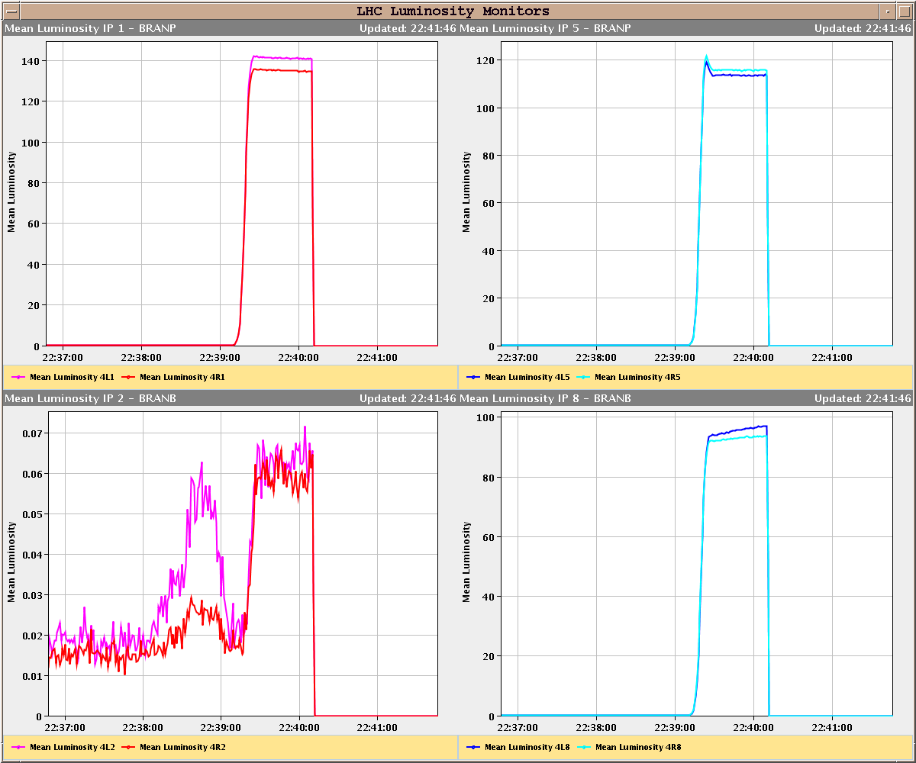
Collisions
Lifetime dip to ~1 hour recovering to 5 hours
BLM 83 s running sum triggered the beam dump
Luminosities compatible with emittances of ~2 μm for a beam-beam tune shift of approximately >0.02 (for bunches seeing 3 collisions)

Slide 8
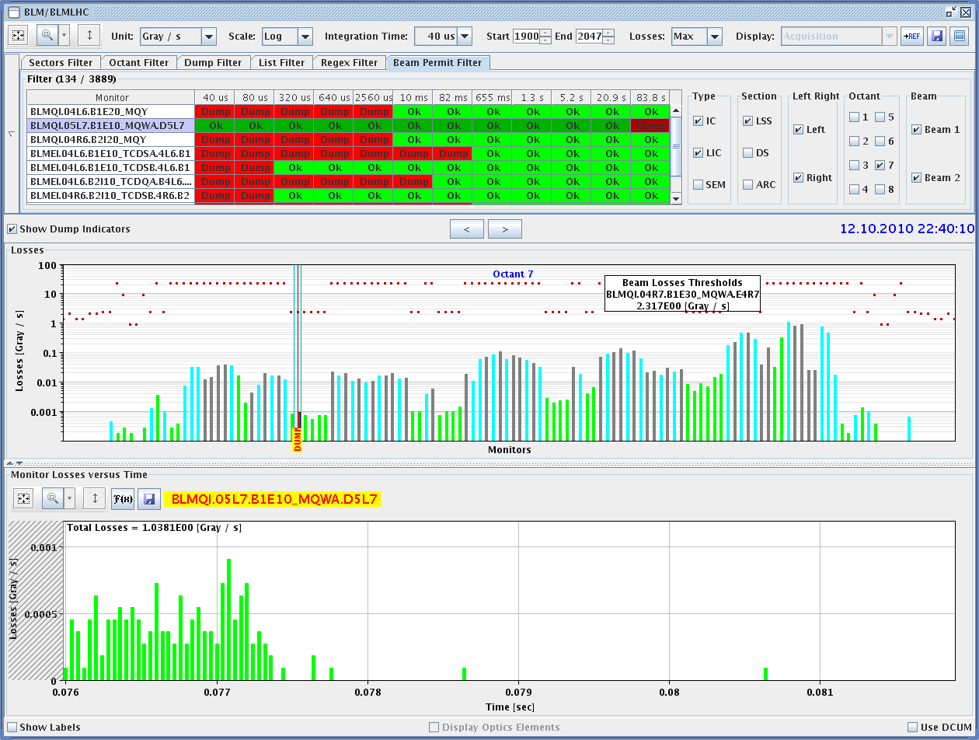
Collisions

Slide 9
Today
AM: Van der Meer scan. Should be kept to the minimum necessary
PM: Injection setting-up with up to 24 bunches for B1.
Night: Physics

Slide 10
Outstanding requests for studies
Periodic loss maps (not really MD)
Betatron loss map done week 40.
Orbit shift versus TCT check: collide 1 bunch and check the TCT center change as compared to predicted orbit change.
BI
PLL studies during ramp
Commission BGI in preparation to ions – switch on at injection
Other BI studies – list to be updated
Test of 'dynamic' references for the OFB (varying Xing.separation bump): injection, then test of ramp + first part of squeeze.
BT
Abort Gap Cleaning – on at injection for physics
Injection Studies 32 Bunches when required (344 bunches)
Setting-up of the SPS with tighter batch spacing (225 ns) - ongoing

Slide 11
Access Requests
Verification of the flange alignment between MSIB and MSIA
IR1 solenloid (for e-cloud suppression) controls

Slide 12
Scheduled lift maintenance
Some preventive maintenance has been requested on the LHC lifts, and agreed according to the following planning:
Wednesday 13 October: PZ65 from 8h to 12h00; PM76 from 13h30 to 17h30
Thursday 14 October: PM45 from 8h to 12h00; PZ45 from 13h30 to 17h30

