Slide 1
Fill 1418
Peak luminosity | ~1.03e32
Beam current | 2.62/2.61 e13
Average initial bunch current | 1.04e11
Initial emittance (reconstructed from lumi) | 2.4 micron
Integrated luminosity | > 2 pb⁻¹
Approx beam-beam tune shift at start | 0.016
Initial stored beam energy | 14.9 MJ
Pots in at 8:45
Lost at 12:05 to power converter (RTQX2.R1) problem

Slide 2
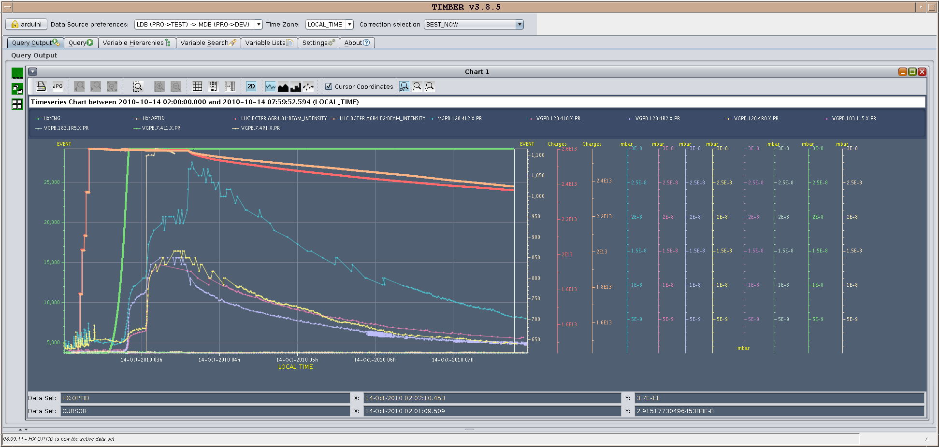

Slide 3
Yesterday afternoon
Philippe B. has trimmed the injection values of the cavities Q and adjusted the first point of the ramp accordingly for some lines.
Q5 aperture measurement
Aim: check aperture at MQY5 for injected beam after implementation of bump for losses at MSIA
Measured emittance in SPS: emittance varied from one shot to the other by 0.5um (1.7-2.2) and big tails were observed
Scan with vertical trajectory oscillations (60 and 180 degree phase advance (candidate for maximum amplitude at Q5)) up to -8.5 sigma--> no losses at MQY (bottleneck observed at the upstream MSI)
A full scan for all the different phases is needed for a better understanding
BGI commissioining
17:52 dumped B2 – valves in

Slide 4
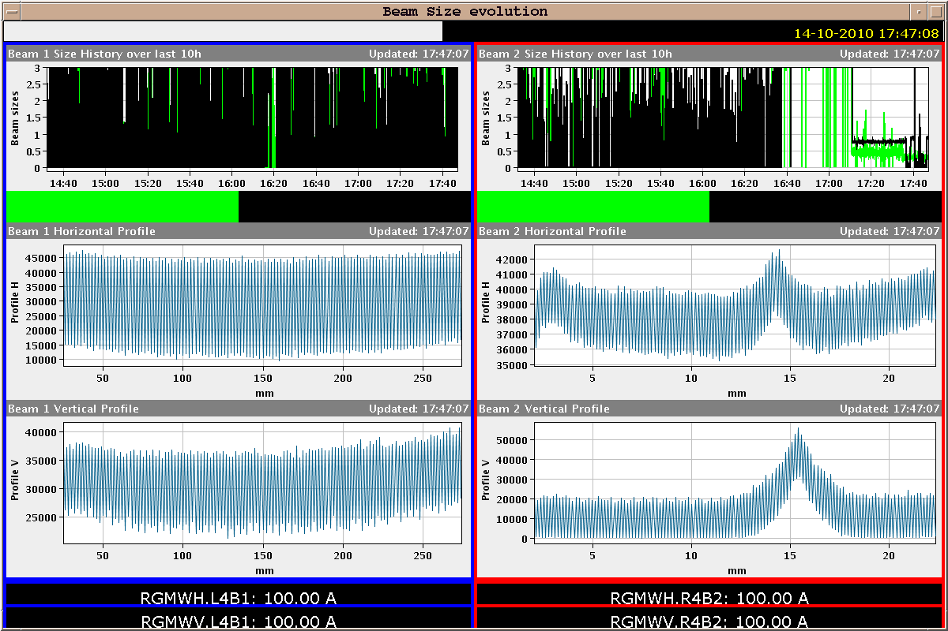
BGI

Slide 5
Evening/Overnight
Aim of evening: qualify 312 b and go for physics
From 21:00 Problems with injection – beam 2 – LHCb triggering
Unfortunately, every trial fill was dumped by LHCb BCM.
optimizing the orbit, disregarding RF injection errors;
optimizing RF inj errors (phase~=0, synchro~=10 pkpk), accepting the orbit to be off center;
tried injecting a previous pattern (248b);
tried removing the cavity Q trims done in the morning (they should be put back before the 312b fill!);
tried leaving 8+8 bunches in to observe de-bunching, nothing special seen;
tried kicking with MKI while SPS MKE disabled;
removed transverse and longitudinal blow up at the injectors;
corrected chromaticity at the SPS by 0.2 in H and 0.1 in V;

Slide 6
Continued…
tried injecting both rings, or b2 only;
reduced the intensity by 10% (to 0.95e11 ppb) and tried to improve the PS splitting;
tried logging all possible parameters per shot (inj oscillation, ring BLMs, IQC data, MKI, SPS V wires, SPS BCT, SPS FBCT, SPS inj oscillations)
Losses on the TCTVB.4R8 were often present, LHCb dumped when we got to 60/70% of ring BLM dump thresholds. Note that similar losses on TCTVB.4L2 were present.
LHCb's feedback: for the shots that dumped, the signal on the BCM is 3/4 times higher than previous shots (often signal from 8-b injection worse than i.e. for 24). This seems to indicate a variation shot to shot from the injectors, which we could not track though.
The signal on LHCb's BLS is not connected to our interlocks, but they saw a particular signature in all cases of dump: a much stronger signal on the C-side (inside of the ring) than on the A-side.
This same signature was seen also when our kickers kicked, but no beam was extracted from the SPS.

Slide 8
Morning shift this morning
07:00:12 Wide spread electrical glitch
S81 down
Pre-cycling at the moment
UPS to PIC – redundancy missing, OK to run but can’t re-start – masked in PIC at the moment

Slide 9
Weekend
Friday 07:00 – 19:00 | vdM
Friday evening | Check injection
Friday overnight | Physics 312b | 12 hour fill
Saturday
Saturday overnight | Physics 312b | 12 hour fill
Sunday | TL BL calibration | 3-4 hours
Sunday | Quench test? | 8 hours
Sunday overnight | Physics 312b | 12 hour fill

Slide 10
To-do list

Slide 11
OP
Periodic loss maps
Betatron loss map done week 40.
Orbit shift versus TCT check:
collide 1 bunch and check the TCT center change as compared to predicted orbit change.
All in one ramp, squeeze, collide - 1 shift
Plus test of 'dynamic' references for the OFB (varying Xing.separation bump): injection, then test of ramp + first part of squeeze
IR aperture at 3.5 TeV
50 ns – pilot runs
After 3-4 fills with ~400 bunches
Push beam-beam tune shift with 150 ns
one test already performed with #1410

Slide 12
BI studies – list to be updated
Check the linearity of the fast BCT’s in the new configuration for nominal bunches
Tune the High BW/Low Gain fast BCT calibration for the coming ion run
Measure the High BW/Low Gain fast BCT sensitivity limit and linearity for low intensity bunches (ion run)
Re-check BPM sensitivity limit
Calibrate the abort gap over the whole ramp
Check the abort gap acquisition gate timing resolution and stability
Commission BGI in preparation to ions – started!
Check BSRT/BGI/BWS cross-calibration including corresponding emittance logging
Test and compare bunch/bunch profile measurement via BWS and/or BSRT
PLL studies during ramp continued
JJG: for all this, we would need the 2 rings for a few hours at 450 GeV then a ramp and again a few hours at 3.5 TeV. This would be really difficult to fit in a 4 hour slot. 8 would be perfect but we could try with 6.

Slide 13
Other
Abort Gap Cleaning – on at injection for physics
continue testing
Injection studies 32 Bunches when required (344 bunches)
Injection studies with 50 ns
Setting-up of the SPS with tighter batch spacing (225 ns)
to be checked
Transfer line collimator cross-talk calibration
Quench test at 3.5 TeV – pilot beam
Bernd & co

Slide 14
Experiments
50 pb⁻¹ total (20 delivered so far)
10 fills@3 pb-1 ~ 10 good days
Alice – fill without dipole
Totem – dedicated fill
Totem – 90 m optics
LHCb – switch polarity – plus test ramp (combine with BI plus map)
vdM continued – count 1 – 2 shifts

