Slide 1
Tuesday
End of fill 1393
Movement of suspicious Roman pots OK
Luminosity scan OK
emittance estimates from lumi scans: h: 3.2 um v: 3.6 um
No wire scan due to intensity interlock (1.5 10¹³ per beam)
Beams dumped 09.45
Access through the end of the morning and all afternoon
Scheduled for CMS and ALICE
QPS S34, MB.B9R3 needed soon after
Revealed water leak. Took from 11.15 to 18.45
Seems like the evacuation hose was blocked up. More news about this tomorrow....
ATLAS
QPS in PM25 (delayed due to lift maintenance)
TCTs L1
CMS

Slide 2
Tuesday
BI systems studies postponed
Beam from 20.00
Some problems in the PB/PSB
Physics fill 1394 from 22.00
< N > 1.1 10¹¹
No emittance measurement before ramp (intensity)
Tune measurements lost during ramp
Stable beams from 24.00
Initial luminosities around 0.67 10³²
Beams lost at 01.45
because of a "BLM_energy_check" interlock.
BLM in L7 were lost
BLM data missing sector 6-7 - cfv-sr7-blml.. Reboot

Slide 3
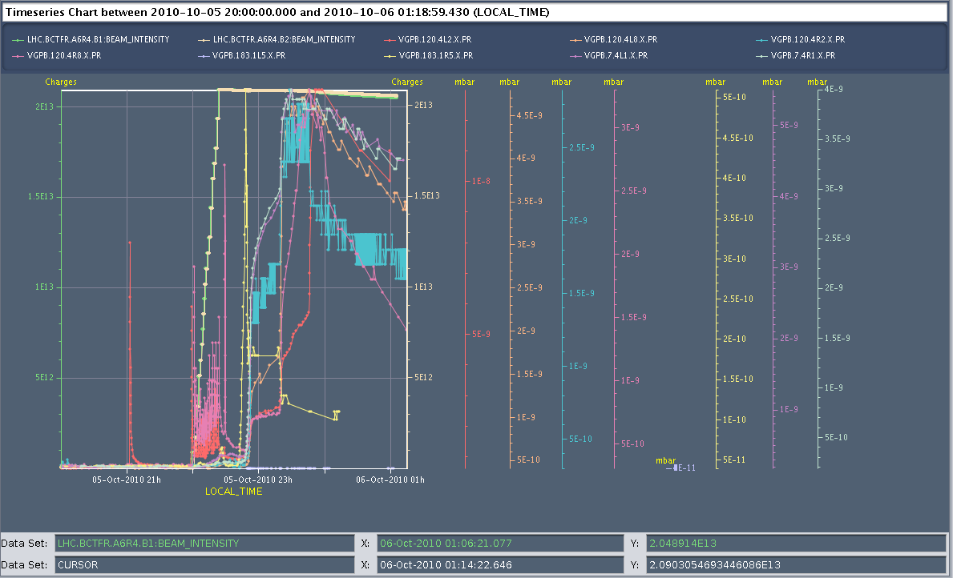
Fill 1394 - vacuum

Slide 4
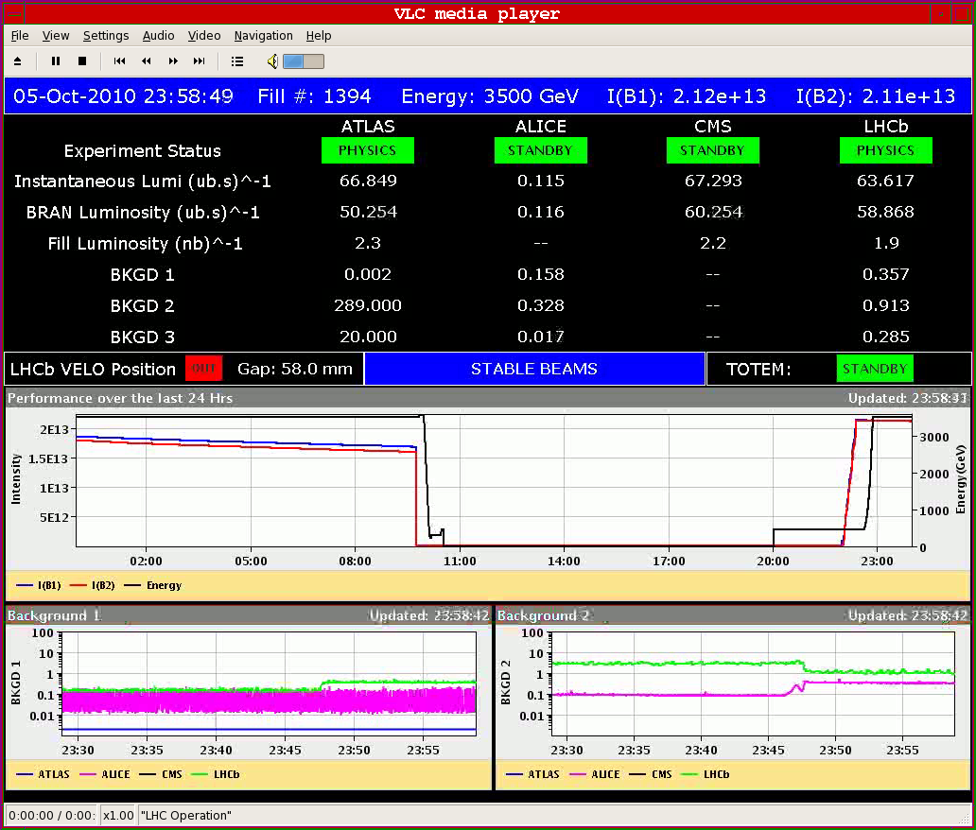
Fill 1394 – Stable beams

Slide 5
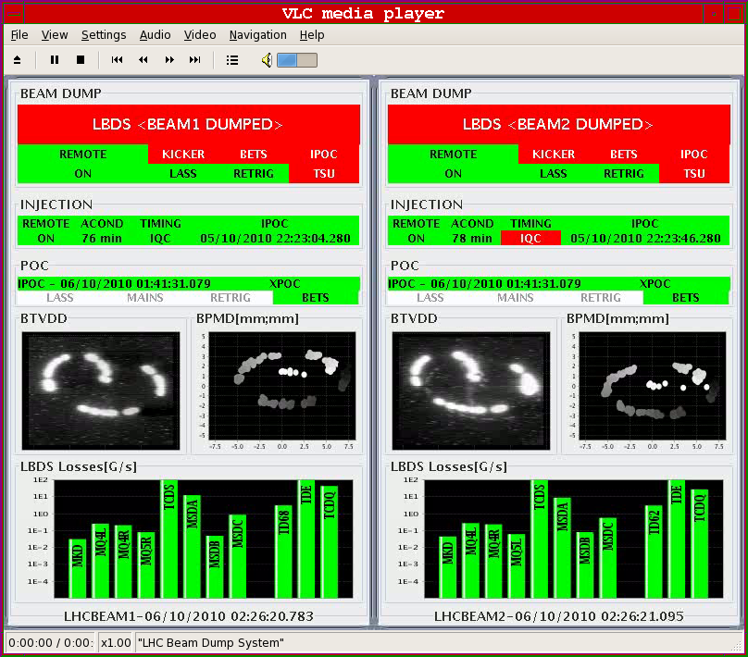
Fill 1394 – clean dump

Slide 6
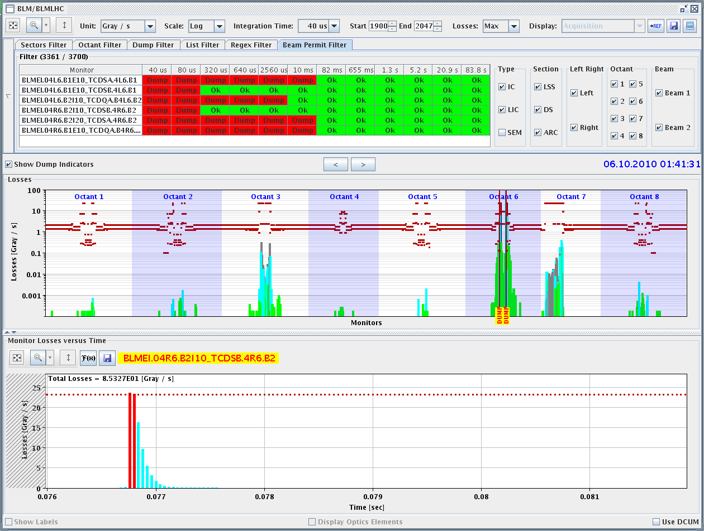
Fill 1394 - PM

Slide 7
Wednesday
Early hours
Booster problem (low level RF)
LHCb VELO interlock
Next
Quench test
Injection setting up for next step (includes 24 bunch injection)
PLL ramp ?
Physics with 200 bunches

Slide 8
Outstanding requests
Dedicated fill to complete VdM scans
Around 1 shift needed
Quench test (Wedn. – TBC) – Coord.: Joerg Wenninger
Transverse damper – 2 h without beam – no access W. Hofle
MKQA & AC-dipole – will need another access – E. Carlier
Voltage rampdown@injection
Test of new beam presence flag system – M. Gasior
CO security intervention to be scheduled - A.Bland
RCBH15.L6B1 to be exchanged
Mods to Q meter electronics (RS et al, from Thursday)
BCT access (JJG)
BI – Coord. J. J. Gras (see next)
Pumping station point 2 (30 mins access)

Slide 9
BI MD - c/o JJG – One Shift
PLL studies
Measure the sensitivity of Marek’s new beam presence detection system
Check the linearity of the fast BCT’s in the new configuration for nominal bunches
Tune the High BW/Low Gain fast BCT calibration for the coming ion run
Measure the High BW/Low Gain fast BCT sensitivity limit and linearity for low intensity bunches (ion run)
Re-check BPM sensitivity limit
Calibrate the abort gap over the whole ramp
Check the abort gap acquisition gate timing resolution and stability
Commission BGI in preparation to ions
Check BSRT/BGI/BWS cross-calibration including corresponding emittance logging
Test and compare bunch/bunch profile measurement via BWS and/or BSRT
For all this, we would need the 2 rings for a few hours at 450 GeV then a ramp and again a few hours at 3.5 TeV.
This would be really difficult to fit in a 4 hour slot. 8 would be perfect but we could try with 6.

Slide 10
Scheduled lift maintenance
Some preventive maintenance has been requested on the LHC lifts, and agreed according to the following planning:
Tuesday 5 October: PM15 from 8h to 12h00; PM25 from 13h30 to 17h30
Wednesday 6 October: PX24 from 8h to 12h00; PZ33 from 13h30 to 17h30
Thursday 7 October: PM85 from 8h to 12h00; PZ85 from 13h30 to 17h30
Tuesday 12 October : PM56 from 8h to 12h00; PM65 from 13h30 to 17h30
Wednesday 13 October: PZ65 from 8h to 12h00; PM76 from 13h30 to 17h30
Thursday 14 October: PM45 from 8h to 12h00; PZ45 from 13h30 to 17h30

