Slide 1
Saturday
09:40 Stable beams #1369 (56 bunch scheme)
11:06 Another fast loss when moving the Roman Pots although they were still out ➔ Movement of the Roman Pots only towards the end of a fill in the future.
from Alice, they're not fully finished with the checks... but they seem to be fine! No more parasitic collisions!

Slide 2
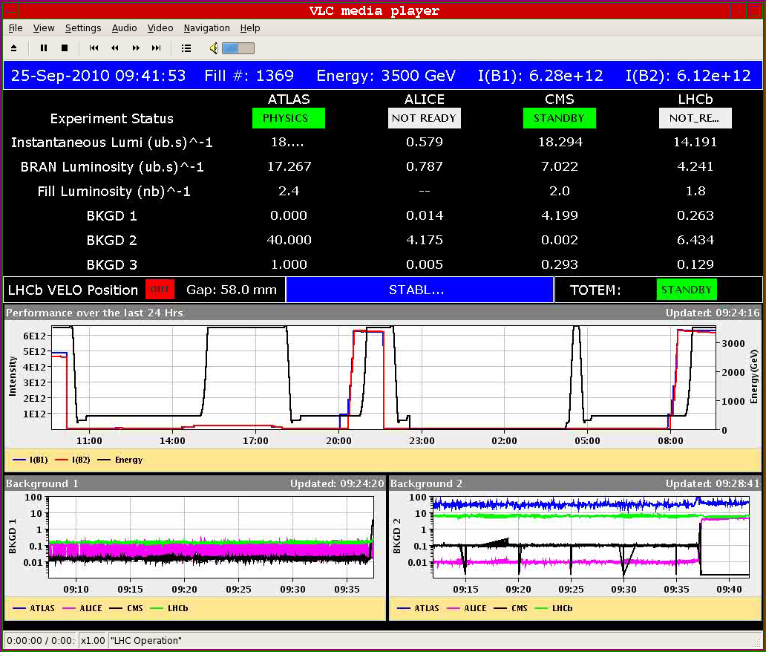
Stable beams #1369
Injection still not very clean
Initial luminosity compatible with emittance of ~2.9 μm
Emittances at the beginning of the ramp
B1H/V: 2.2/2.1
B2H/V: 2.6/2.9

Slide 3
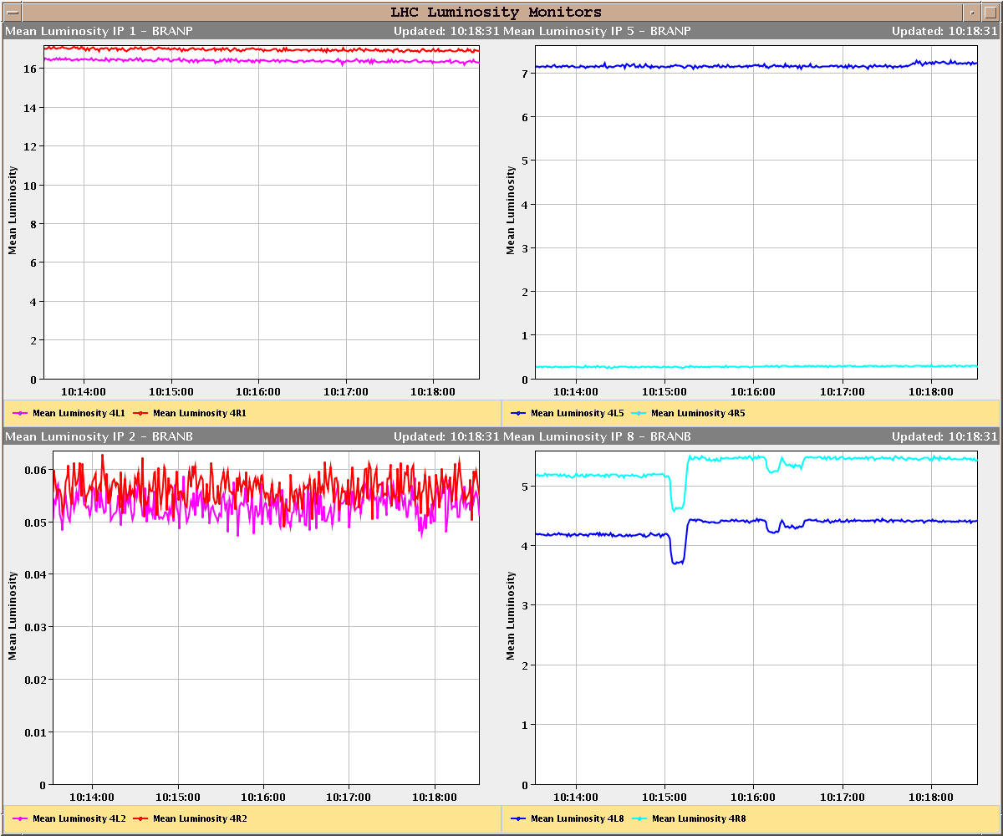
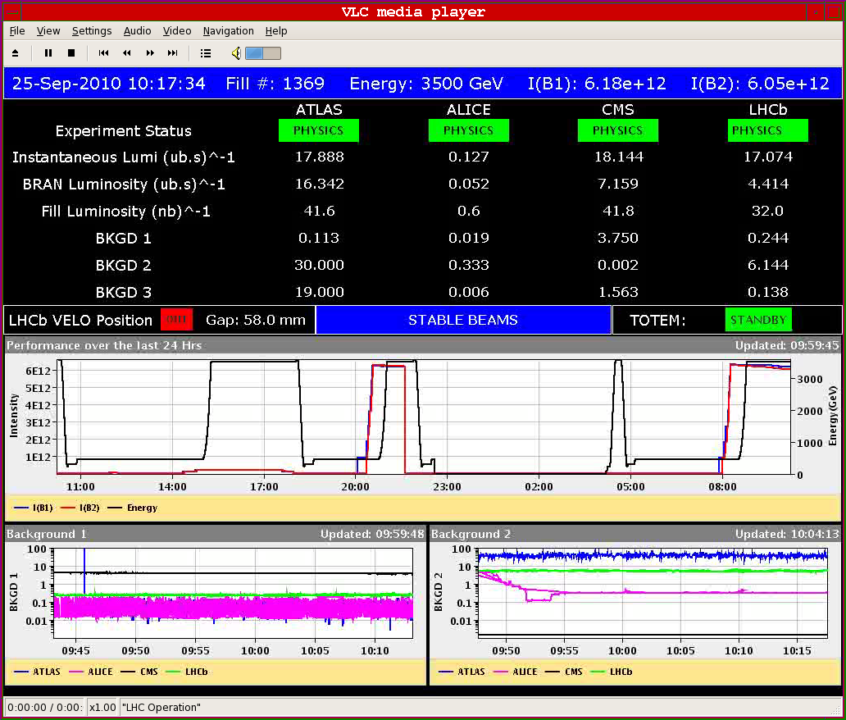
Stable beams #1369
Difference between BRAN and experiment luminosity readings. BI working on that.

Slide 4
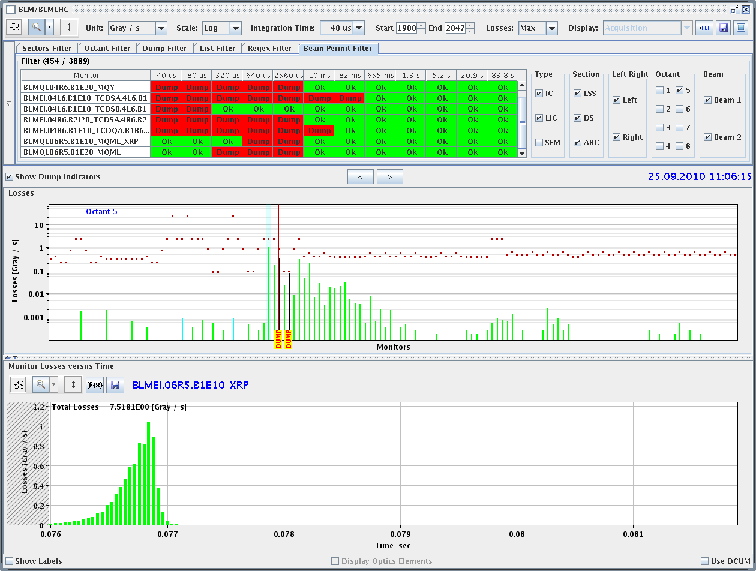
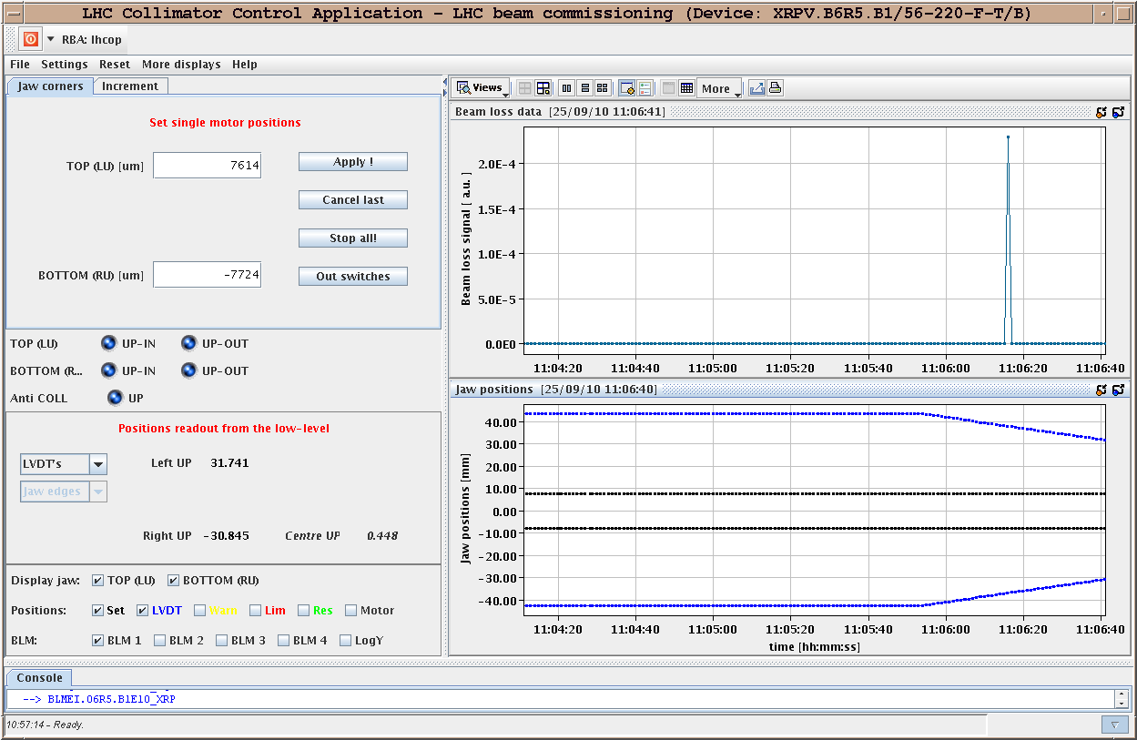
Fast loss #9
11:06: Fast beam loss while moving the Roman Pots (still very far out). Already happened once on 14/8 also during movement of the roman pot and near miss during Roman Pot alignment. Risetime of 0.4 ms, signal relatively strong at 0.3 G/s. Spike in the top and bottom V pot of the far unit XRPV.B6R5.B1. Nothing was seen in the H pot. The near unit was not on.

Slide 5
Saturday
12:00 Filling with 104 bunches for LSS6 BPM test and injection verification
14:00 LSS6 BPM test completed
15:00 10¹³ p per beam at injection
Ramp
  Beams dumped - TCDQ.B2 not ramping
Investigations and tests on TCDQ
  Problem related to sending data to TCDQ when not in a wait state
  Possibility to get TCDQ in a state where it looks armed but does not respond to timing
  Modifications to sequence to prompt for checks and add delays before sending settings
  In longer term modifications needed on the equipment driver to protect against this

Slide 6
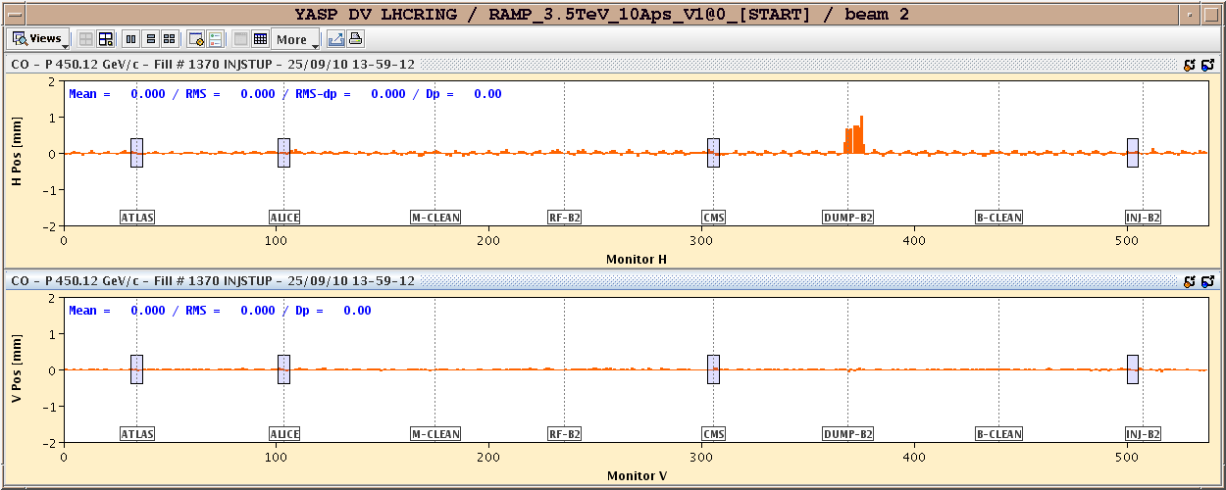
LSS6 BPM
LSS6 BPM test done:
  The bump of 1.2 mm (trim) ran for 80*20 ms = 1.600 s when the beam was dumped.
  We dumped at around 2 mm with the interlock set to 1.5 mm (known offset of 0.5 mm). System 'B' dumped as expected. Analysis of the reaction time to be completed

Slide 7
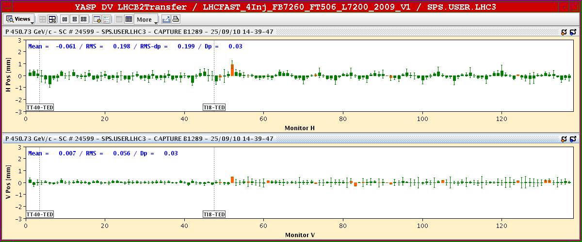
Injection
Re-steering done for B1 & B2:
  Some improvement. Not yet robust

Slide 8
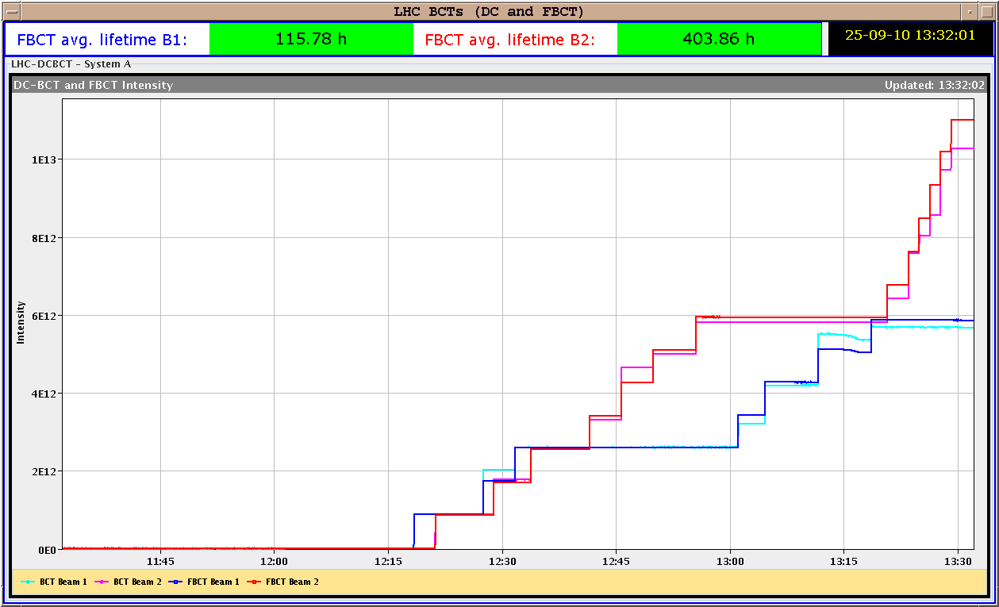
104 bunches
> 10¹³ p !. Still problems with the DC BCT for BOTH beams

Slide 9
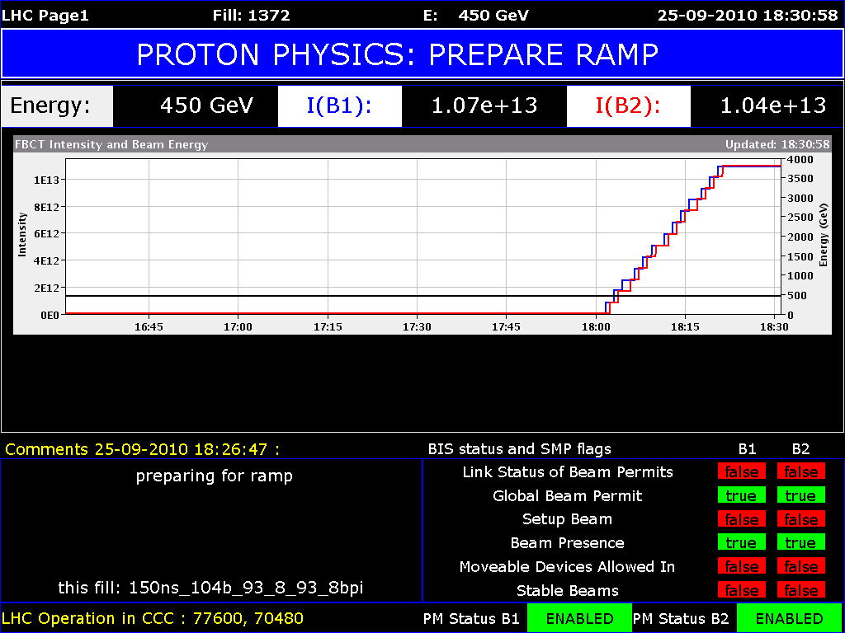
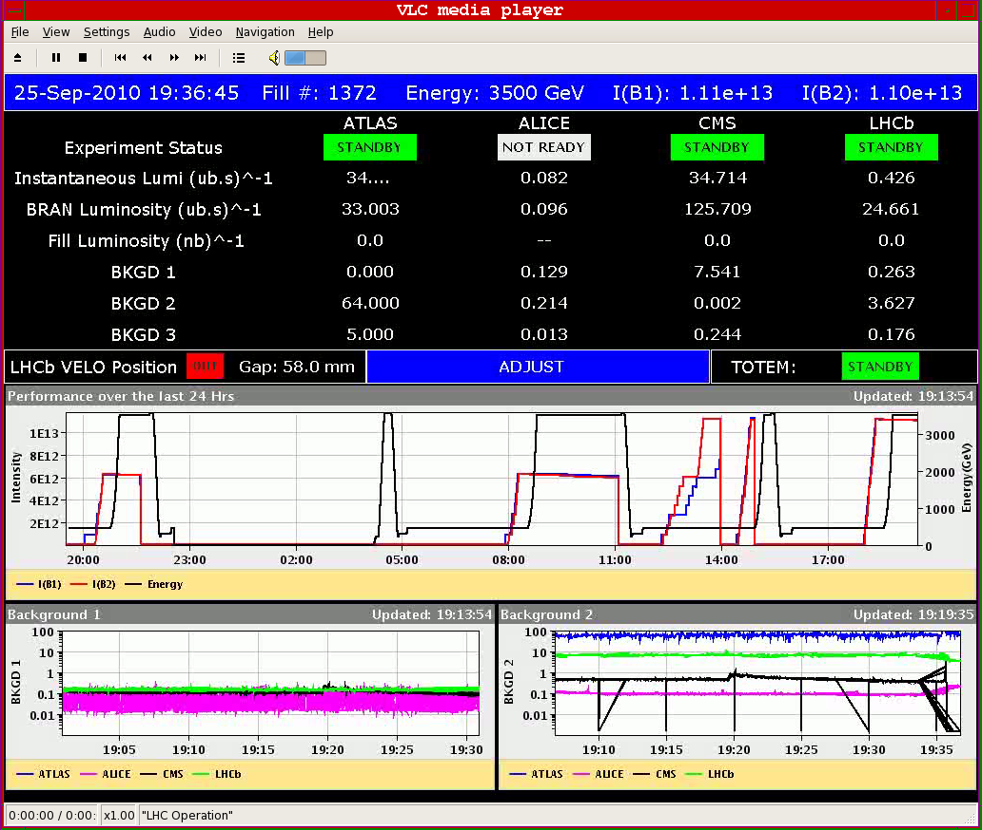
Saturday
17.30 Filling fill 1372
Emittances before ramp
  B1H/V: 2.1/2.2
  B2H/V: 2.3/2.8
Tune feedback stopped between 1 and 2 TeV B1
5.5 MJ per beam !
Squeeze
  Lifetime low around 5cm
  B2 down to ~1h
Collisions
  Luminosity 3.5 10³¹
  Emittance of ~2.8 μm

Slide 10
Sunday
Fill 1372 still running
  One cavity (7B1, 3B1) switched off a few times, restarted OK
Luminosity after 13 hours
  Luminosity 1.5 10³¹
  Corresponds to an emittance of ~4.5 μm
    more blow up than fill 1366 (56 bunches)
  Integrated luminosity over 1pb⁻¹
Extended lumi scans for emittance measurements
Refill for physics
  Q feedback
  Damper

Slide 11
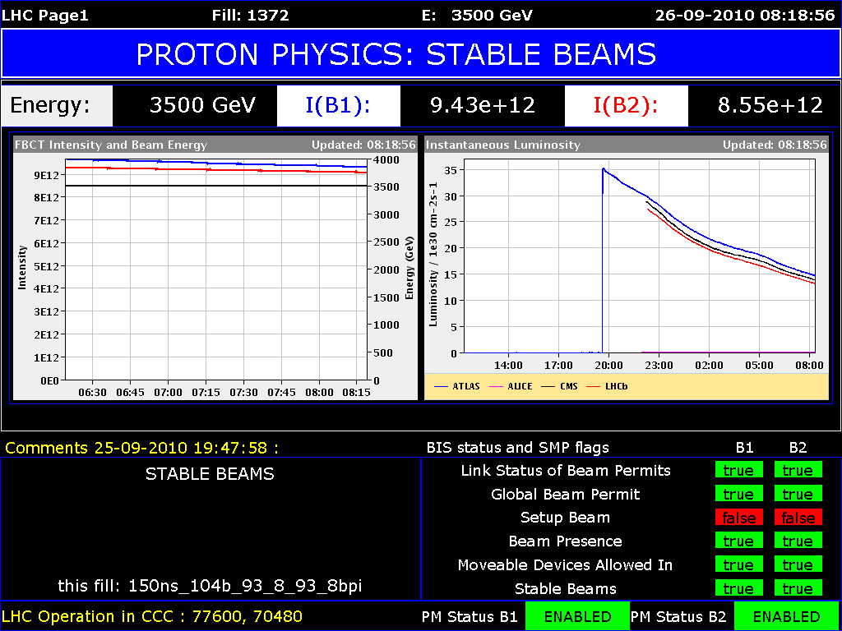
Fill 1372

Slide 12
Fill 1372 intensities and losses
  IPs: 1 5 2 8 - 1 5 8 - 1 5 2
  - 1 5 - 2 8 - 8

Slide 13
To fit in later
Transverse damper firmware update (to prevent glitches positions very close to 0) – W. Höfle
Test of luminosity optimization software - S. White
Gas Ionization Profile Monitor tests - M. Sapinski
Abort gap cleaning – M. Meddahi
Test of new beam presence flag system – M. Gasior
DC BCT – P. Odier
Q kicker – R. Barlow
CO security intervention to be scheduled - A. Bland

