Slide 1
LHC Operation Week 38
Coordination G.Arduini, R.Bailey
Aims for the week
  Complete qualification of the machine for operation with bunch trains
  Physics with bunch trains
    24 bunches
    56 bunches
    104 bunches
Achieved physics with bunch trains up to 104 bunches/beam with luminosities of 3.5 x 10³¹ cm⁻²s⁻¹ and integrated luminosity >1 pb⁻¹ in 13.5 h fill

Slide 2
Statistics
Mon 20/9 at 07:00 to Mon 27/9 07:00
  Set-up with beam: 45 %
  Stable beams: 31 %
  Set-up without beam: 14 %
  Faults: 10 %
  Delivered luminosity: ~ 3 pb⁻¹
Major stops:
  QPS (Quench Heater power supply, World FIP repeater, noisy board on Q10.L2) , TCDQ, RF (noise on cavity 4B1)

Slide 3
Week overview
Machine Protection qualification completed by Wednesday Morning
First Physics fill with bunch trains (24 on 24) on Wed evening
Physics fill (56 on 56) on Thu evening. ALICE sees parasitic collisions at 11 m form IP
Polarity switch of ALICE solenoid and spectrometer of Friday, orbit correction (bump non-closure compensation) all through the cycle
Short physics fill (56 on 56) on Saturday morning dumped by fast loss during movement of Roman Pots (they were still way open at the time of the loss)
Physics fill (104 on 104) on Saturday evening

Slide 4
Yesterday
09:00 Fill luminosity > 1 pb⁻¹ in all high luminosity experiments after 13.5 h
Move to adjust and end of fill measurements (lumi scans)
10:00 – 11:00 TOTEM Roman pot test
12:00-18:00 Capture problems for Beam 1 (finally traced to noise on the voltage on Cavity 4B1)
21:30 Stable beams #1373 150ns_104b_93_8_93_8bpi
Frequent RF trips overnight
Lost 2 BPM crates. 1 fixed. Continued relying on BPM redundance (1 out of 2 BPMs available in the affected area) working and corrector control + BLMs

Slide 5
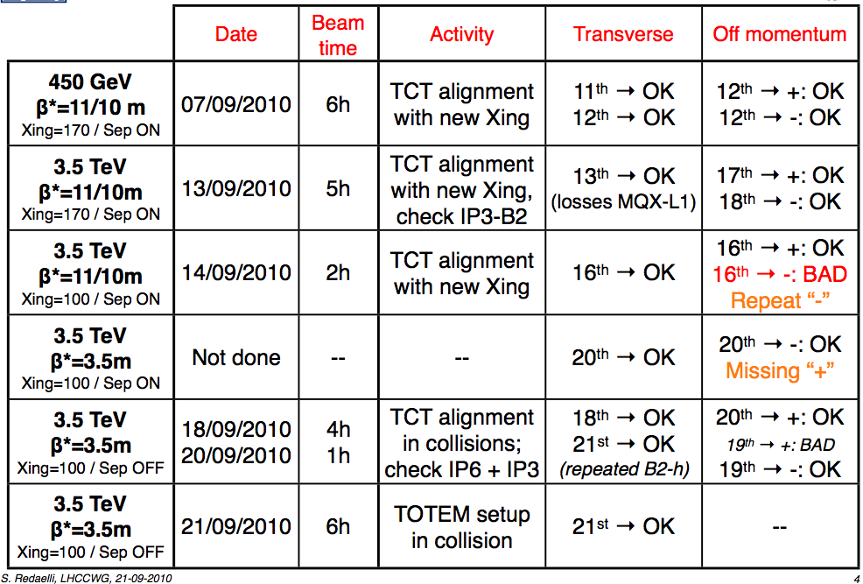
Bunch train commissioning – Machine Protection
Thorough verification of the collimation set-up completed by Wed 22/9 morning
Done - 22nd
Done - 21st
R. Bruce, S. Redaelli, D. Wollmann

Slide 6
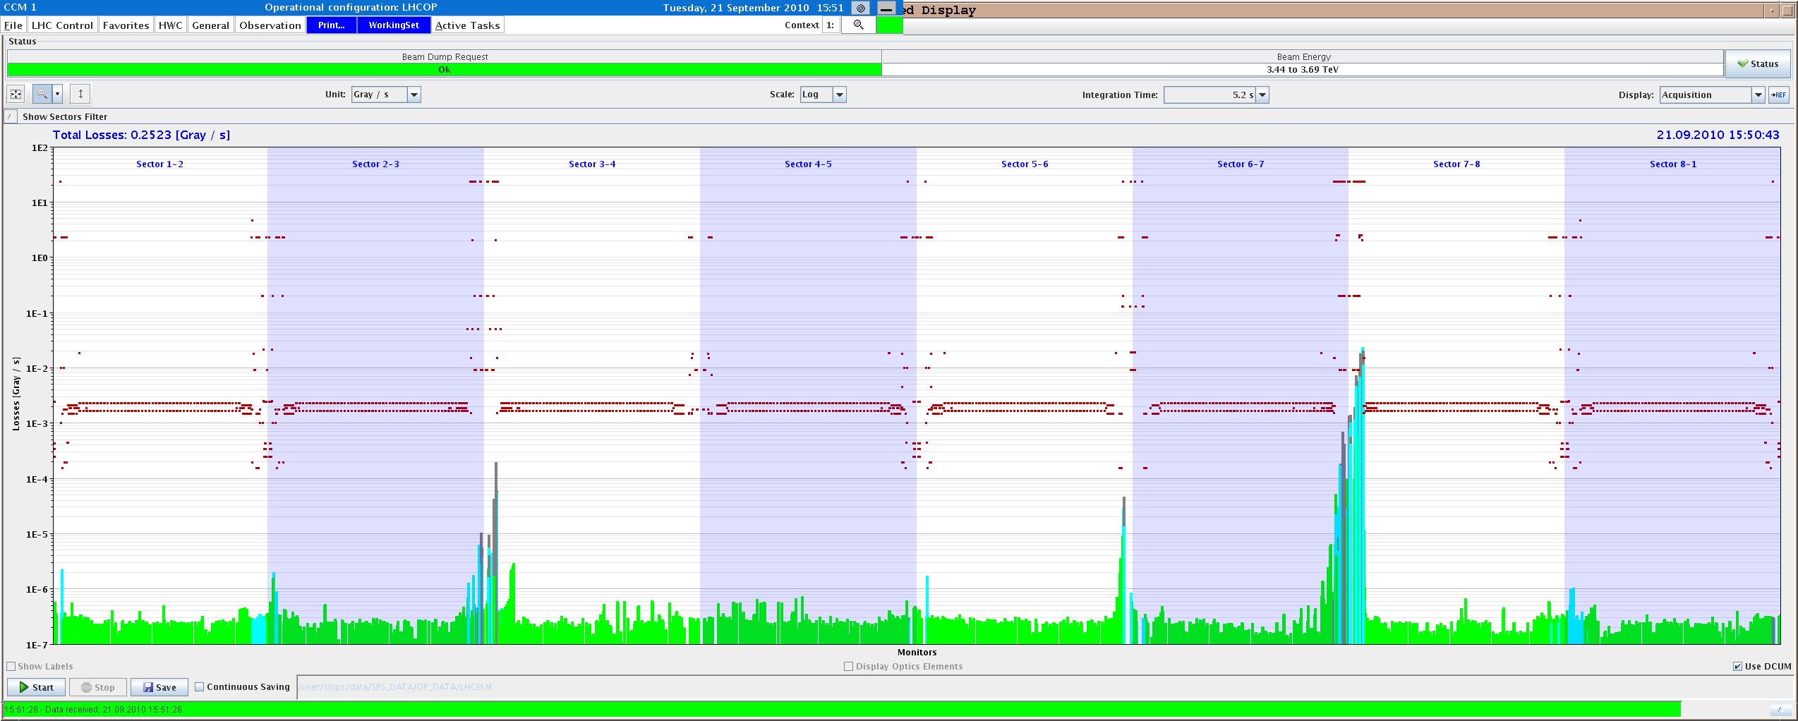

Bunch train commissioning – Machine Protection
TOTEM alignment and protection validation at 20 (H)/18 (V) sigmas. Data taking for TOTEM with tight settings and low intensity (Tue 21/9)
B2H
B2V

Slide 7
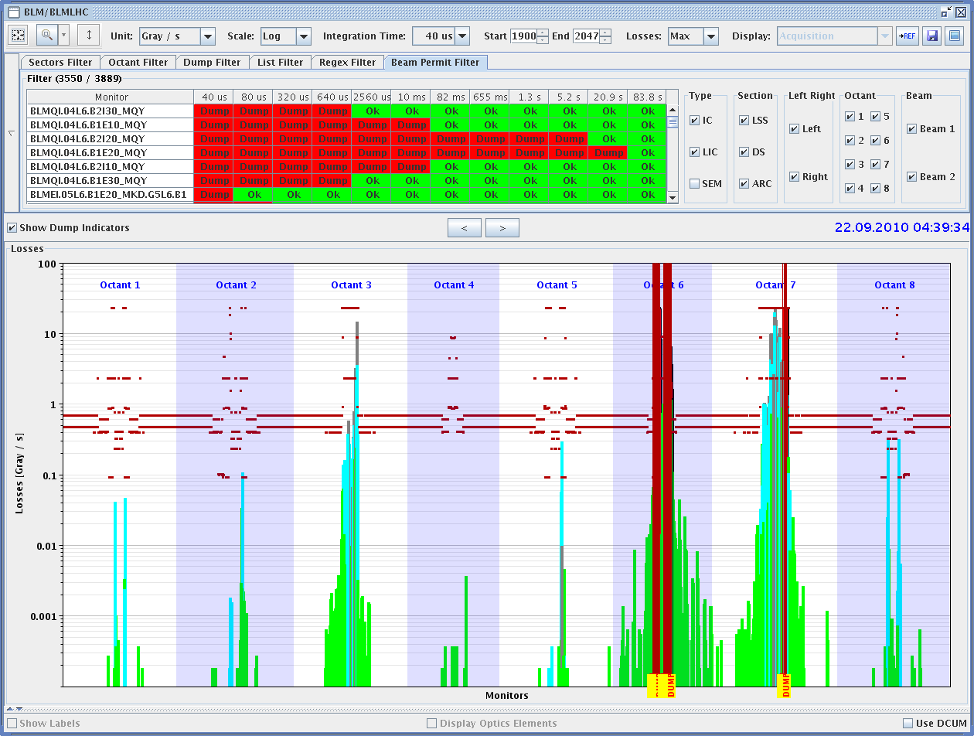
Bunch train commissioning – Machine Protection
Simulation of asynchronous damps in different machine conditions for qualification of the machine protections
C. Bracco, B. Goddard, J. Uythoven

Slide 8
Bunch train commissioning – Emittance control
Damper functions at injection-ramp
damper gain
450 GeV (-6 dB B1HV / -12 dB B2V)
3.5 TeV on (-5 dB B1HV / -11 dB B2V)
maintain damping time
in ramp (exact function
to be calculated)
Max. gain for hump dumping
Q-FB on (-22 dB B1HV / -28 dB B2V)
cycle time

Slide 9
Bunch train commissioning – Emittance control
Fill | # bunches | ε_{H B1} _{@inj} | ε_{V B1} _{@inj} | ε_{H B2} _{@inj} | ε_{V B2} _{@inj} | ε_{HV} _{@coll} (from init. Lumi) | ε_{H} _{@end of coast} (from Lumi scan or WS) | ε_{V} _{@end of coast} (from Lumi scan or WS)
1364 | 25 | 2.5 | 1.9 | 3.2 | 2.7 | 3.2 | 4.0/4.5 | 3.8/4.9
1366 | 56 | 1.7 | 1.7 | 2.0 | 2.3 | 2.2 | 3.5 | 3.5
1369 | 56 | 2.2 | 2.1 | 2.6 | 2.9 | 2.9 | - | -
1372 | 104 | 2.1 | 2.2 | 2.3 | 2.8 | 2.8 | 3.7 | 4.5
New functions for the damper allow to mitigate blow-up due to hump in the vertical plane. Gain functions during the ramp remain to be optimized (ongoing). ~10-20% blow-up during injection plateau and ramp.
Systematic difference B1/B2 already at injection remains an issue ➔ to be followed-up (mismatch?)
Reproducibility of the blow-up in the PS to be followed-up
Blow-up in collision (~40-50 %) to be further studied

Slide 10
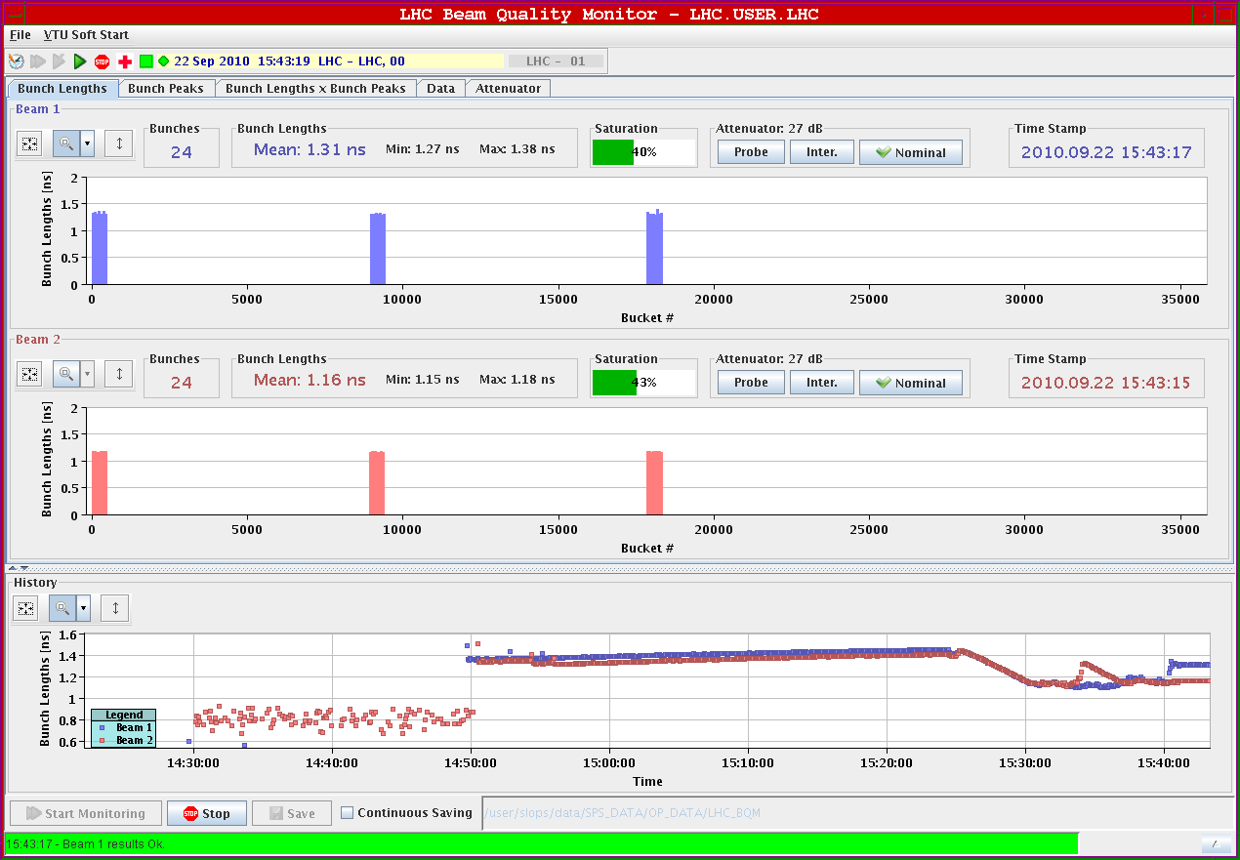
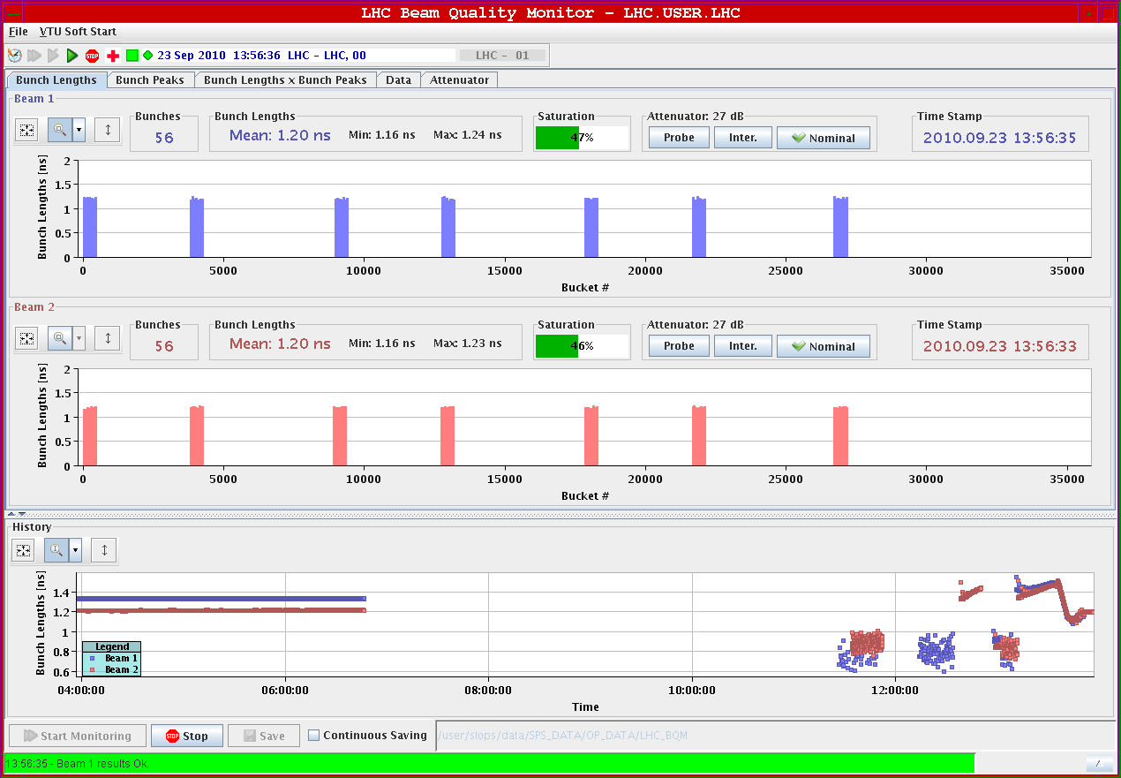
Bunch train commissioning – Longitudinal blow-up
Longitudinal blow-up leading to different bunch lengths for Beam 1 and Beam 2 ➔ functions optimized for bunch trains

Slide 11
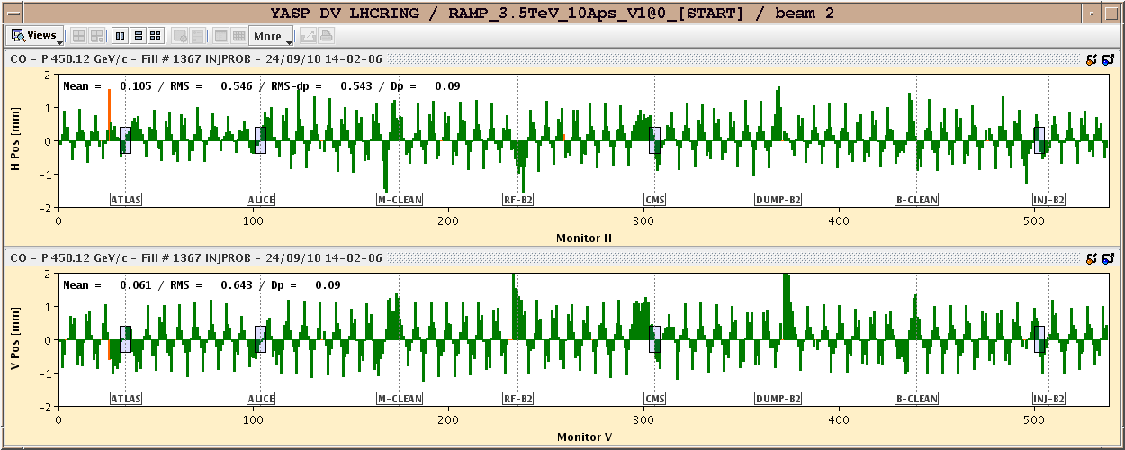
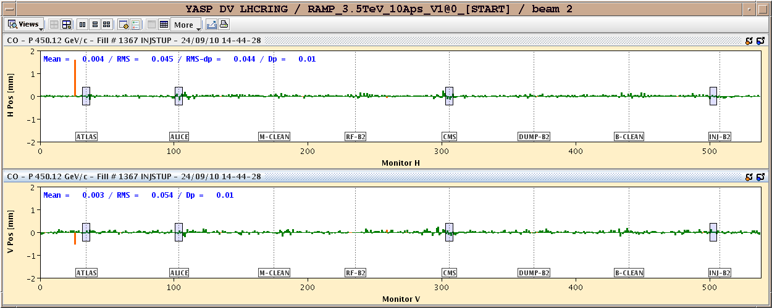
Bunch train commissioning – ALICE crossing angle
Following observations on fill 1366: head on collisions at 11 m from IP on Thu
ALICE polarity switch (polarity of the spectrometer not consistent with crossing angle leading to a reduction of the effective crossing angle at the IP)
After ALICE polarity reversal
After polarity reversal & orbit correction

Slide 12
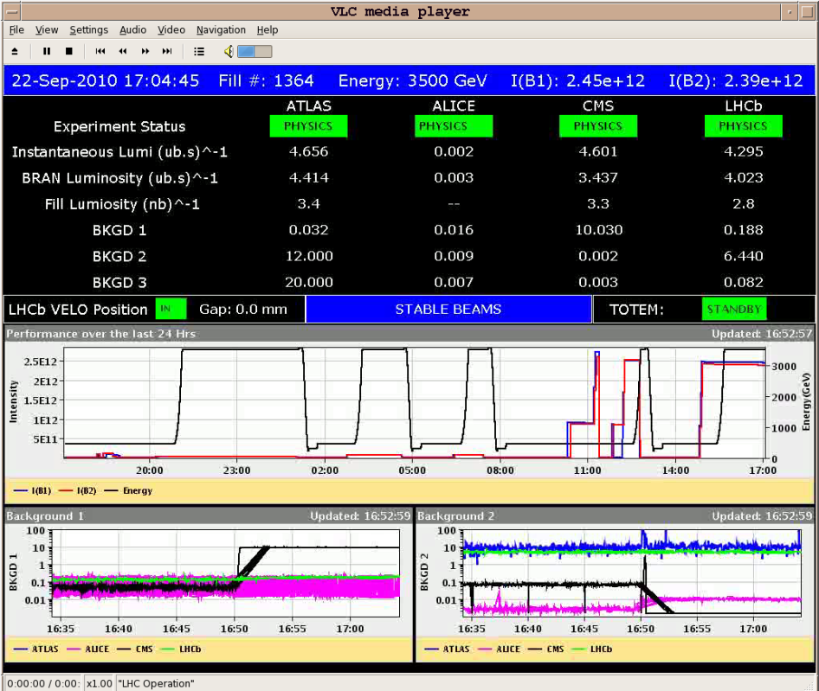
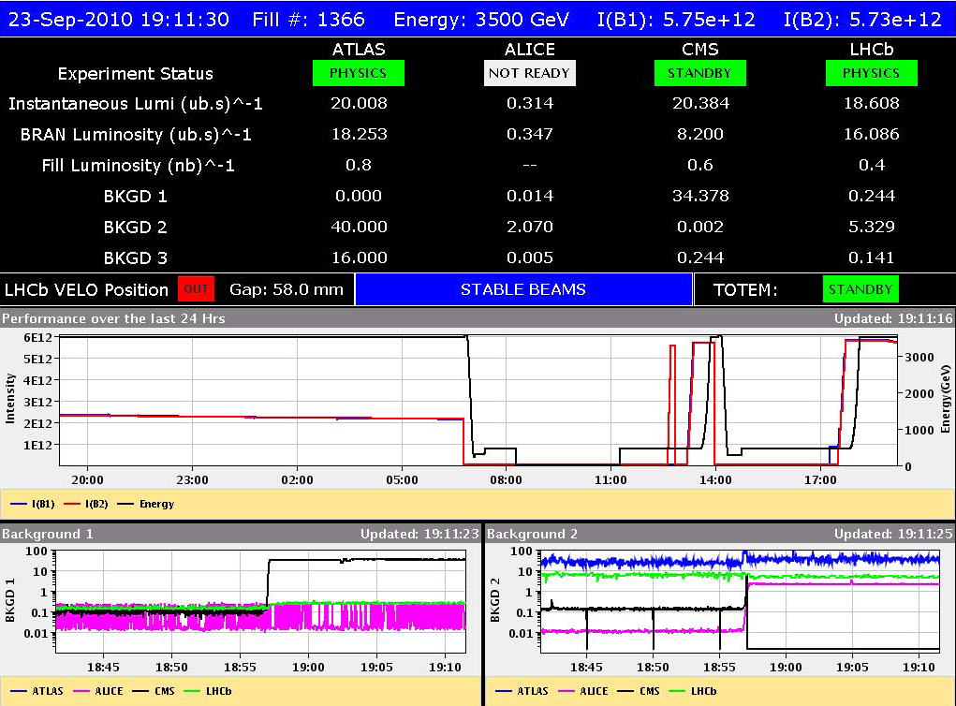
Stable beams
24b_16_16_16 (13.5 h – ~170 nb⁻¹)
56b_47_16_47 (~13 h – 650 nb⁻¹)

Slide 13
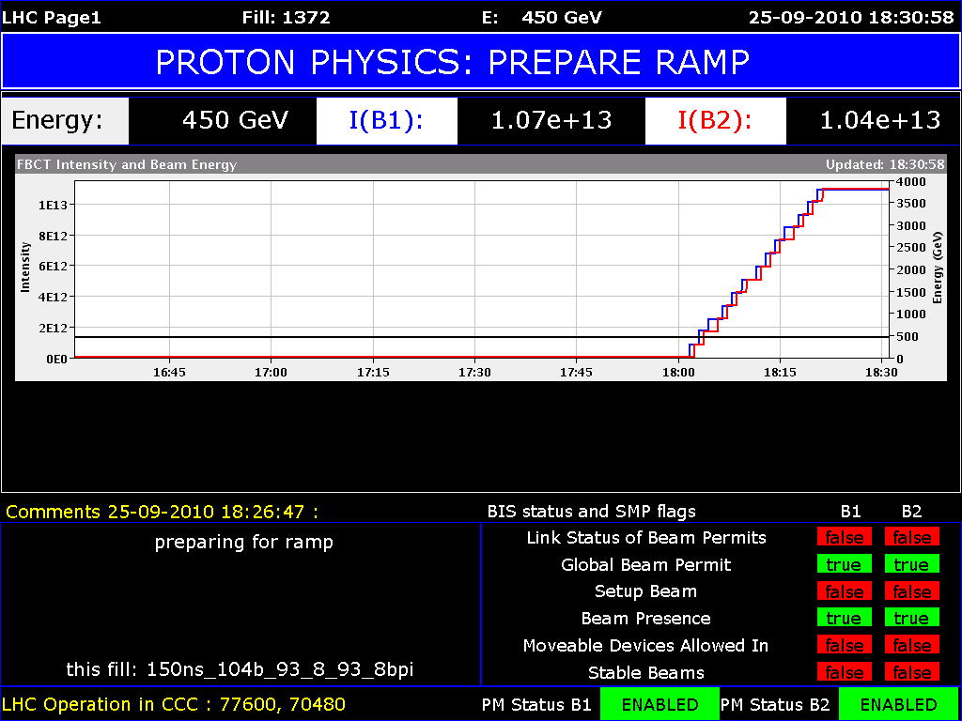
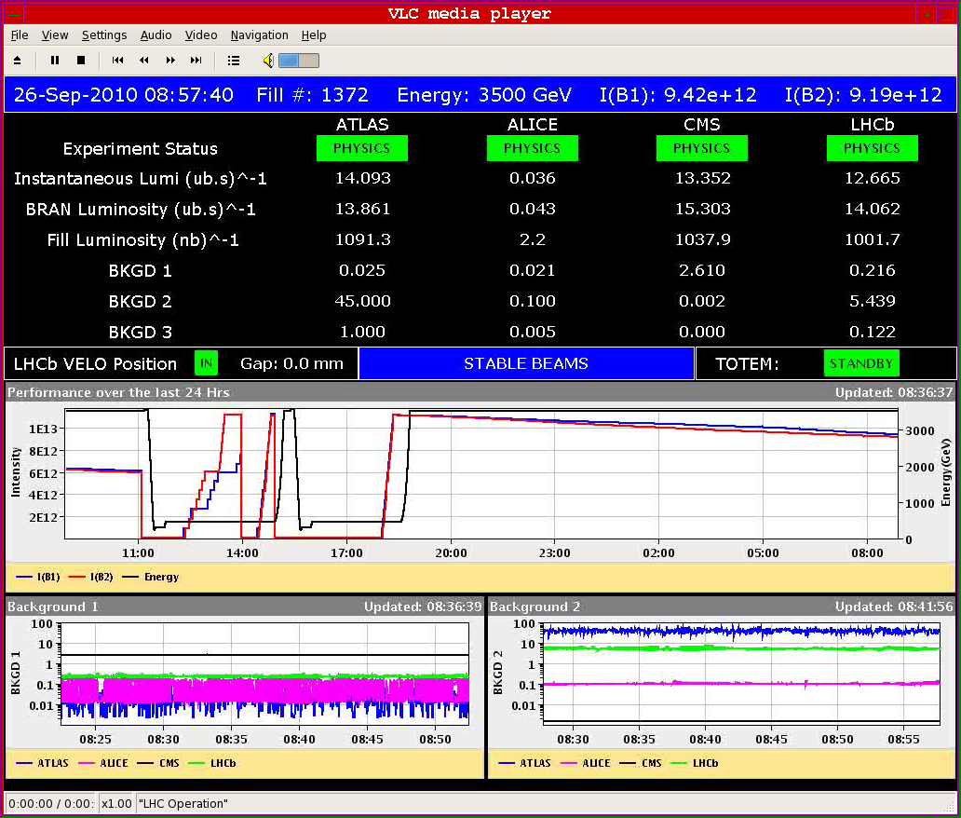
Stable beams
>10¹³ p/beam
5.5 MJ per beam !
Squeeze
  B2 lifetime low around 5 m
  B2 down to ~1h
Collisions
  Luminosity 3.5 10³¹
  Emittance of ~2.8 μm
104b_93_8_93 (14h – >1000 nb⁻¹)

Slide 14
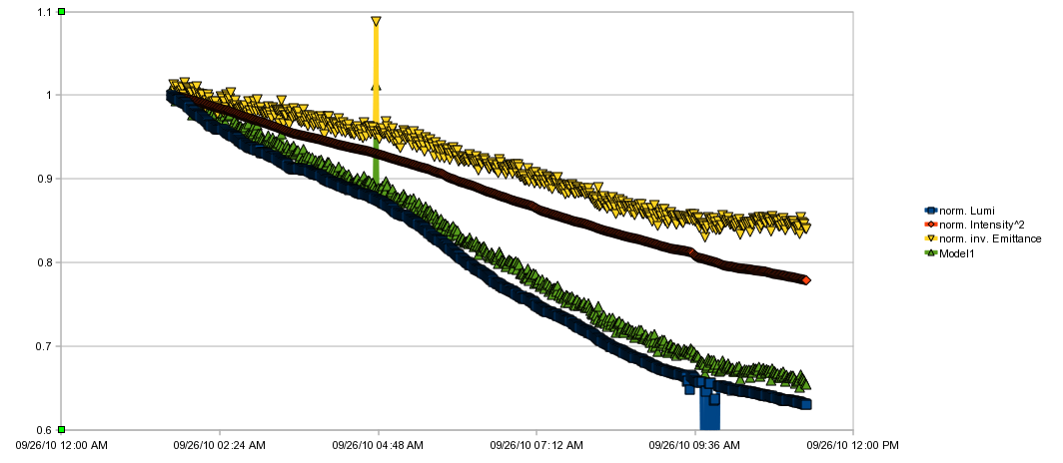
Lifetimes and losses
  IPs: 1 5 2 8 - 1 5 8 - 1 5 2
  - 1 5 - 2 8 - 8
G. Papotti
R. Steinhagen

Slide 15
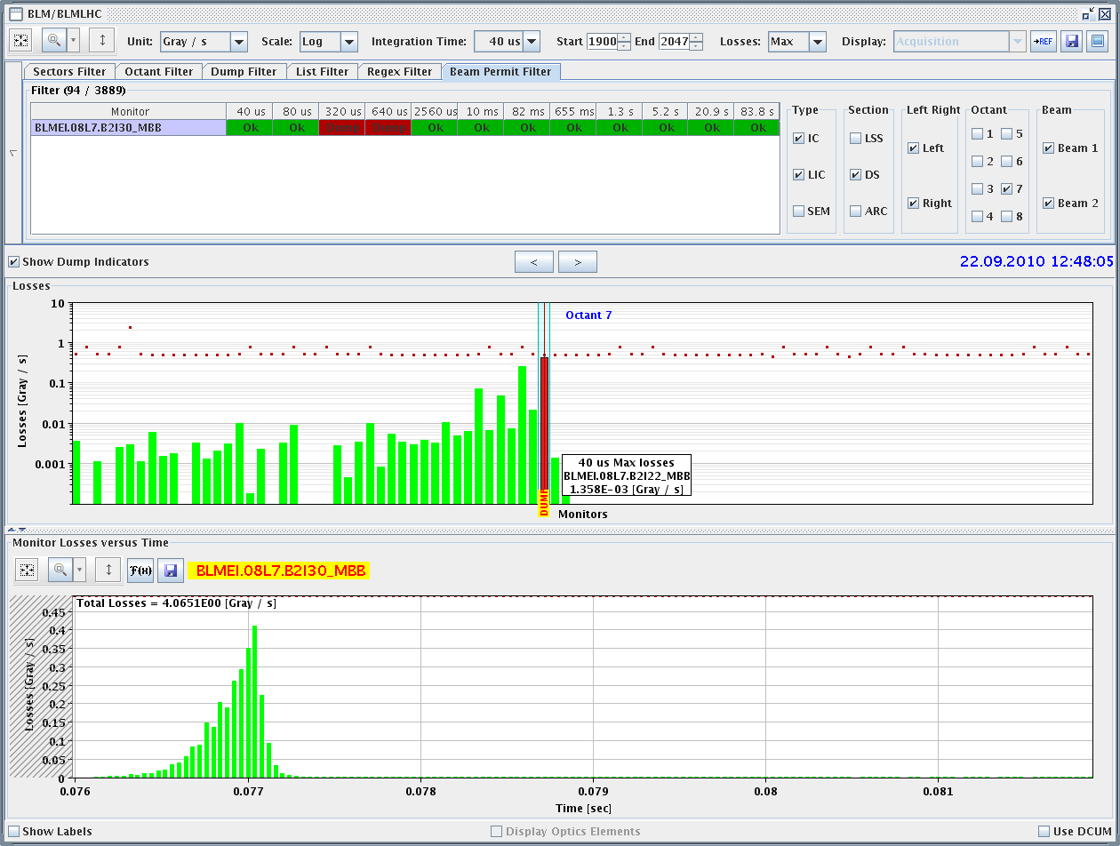
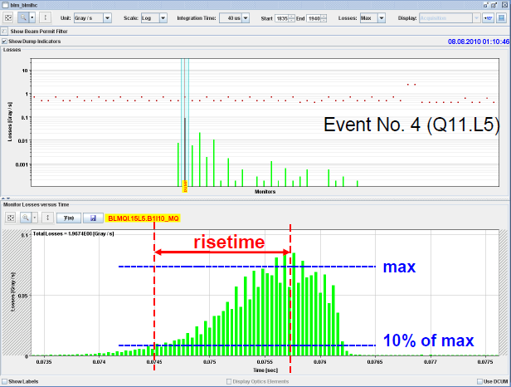
Fast loss #8
Fast loss event type (8L7). Faster rise time as compared to previous events. Same position as first fast loss event (07-07-2010 20:22:19 during the squeeze).
Yesterday
25 bunches – 8/8/2010

Slide 16
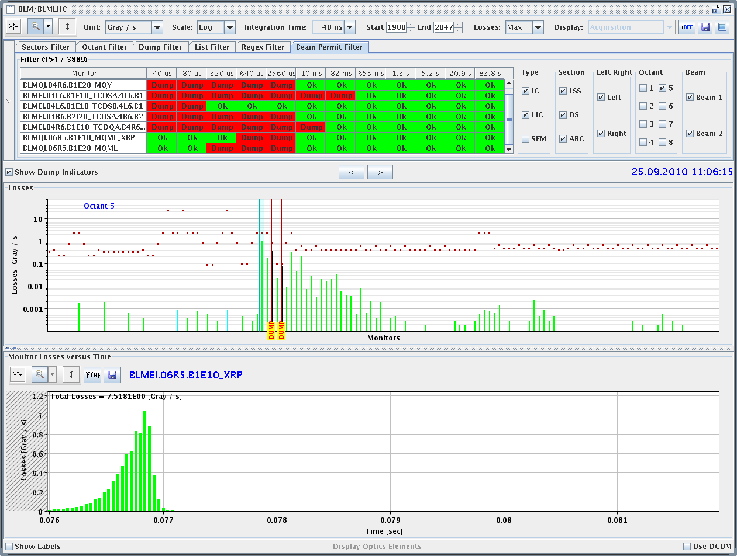
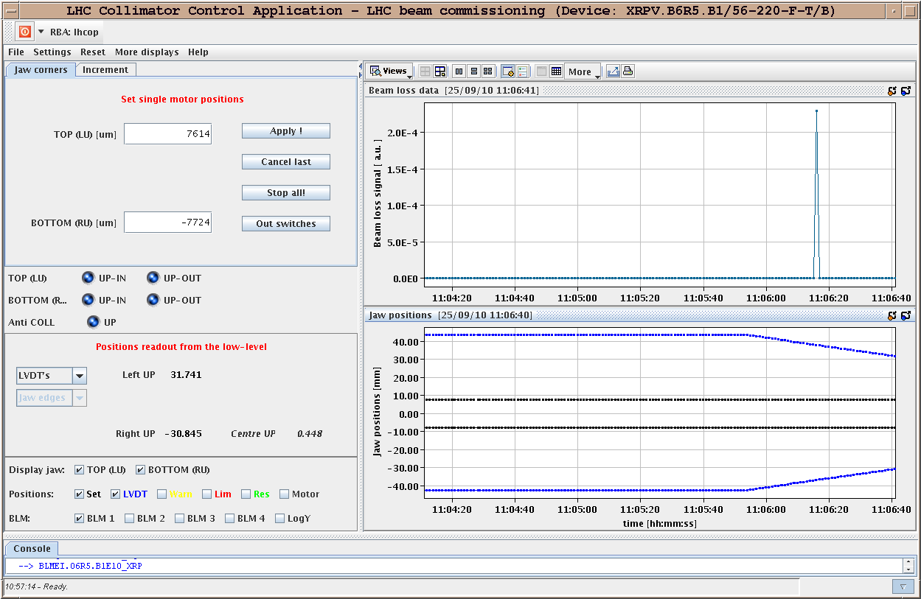
Fast loss #9
11:06: Fast beam loss while moving the Roman Pots (still very far out). Risetime of 0.4 ms, signal relatively strong at 0.3 G/s. Spike in the top and bottom V pot of the far unit XRPV.B6R5.B1. Nothing was seen in the H pot. The near unit was not on.

Slide 17
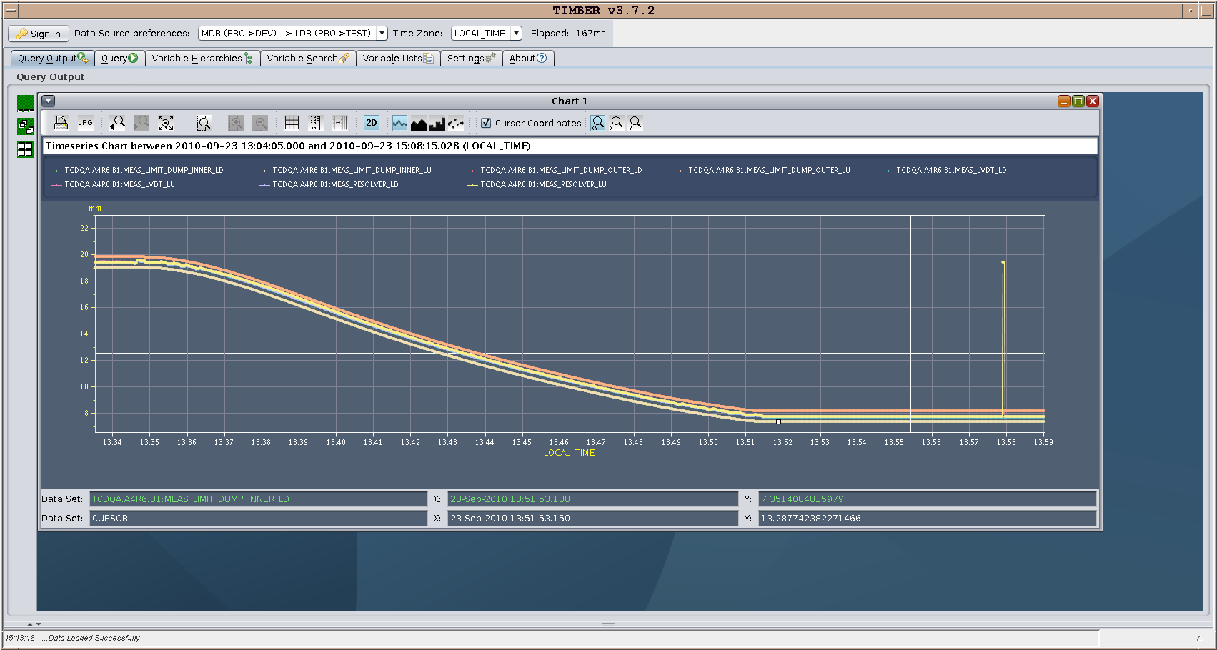
Issues - TCDQ
Thu 23/9
  TCDQ B1 position and limits during the ramp
  Glitch in the position readings at the moment of the beam dump, which correspond exactly to the end of the ramp function.
  Machine protection reacted correctly. Actions to be identified.
Sat 25/9
  TCDQ.B2 not ramping
  Problem related to sending data to TCDQ when not in a wait state
  Possibility to get TCDQ in a state where it looks armed but does not respond to timing
  Modifications to sequence to prompt for checks and add delays before sending settings
  In longer term modifications needed on the equipment driver to protect against this

Slide 18
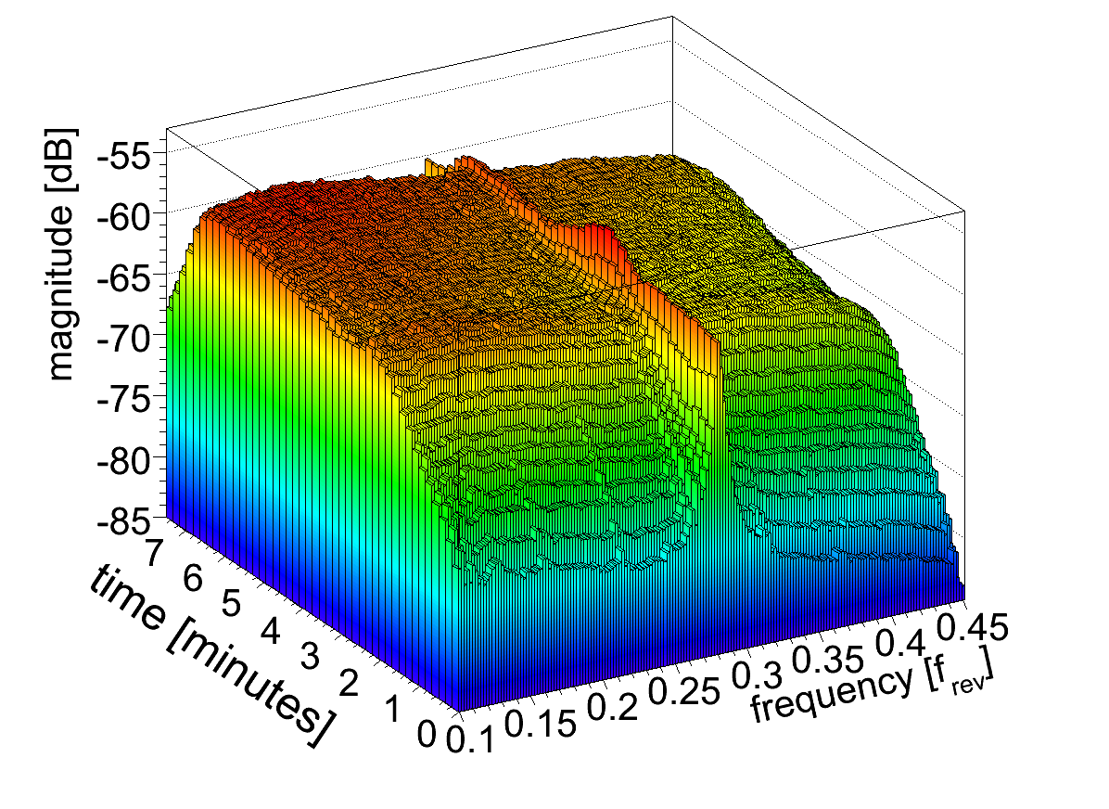
Issues – BBQ (tune measurement)
Noise floor increasing during the ramp (due to bunch length shortening?)
Mostly affecting B1 H
Not enough signal to drive the tune feedback
Had to run the chirp during the squeeze (Sunday)
Development system (with low pass filters) does not suffer form that ➔ access probably required
Need to fix this problem if we want to run without excitation
PLL could help
R. Steinhagen

Slide 19
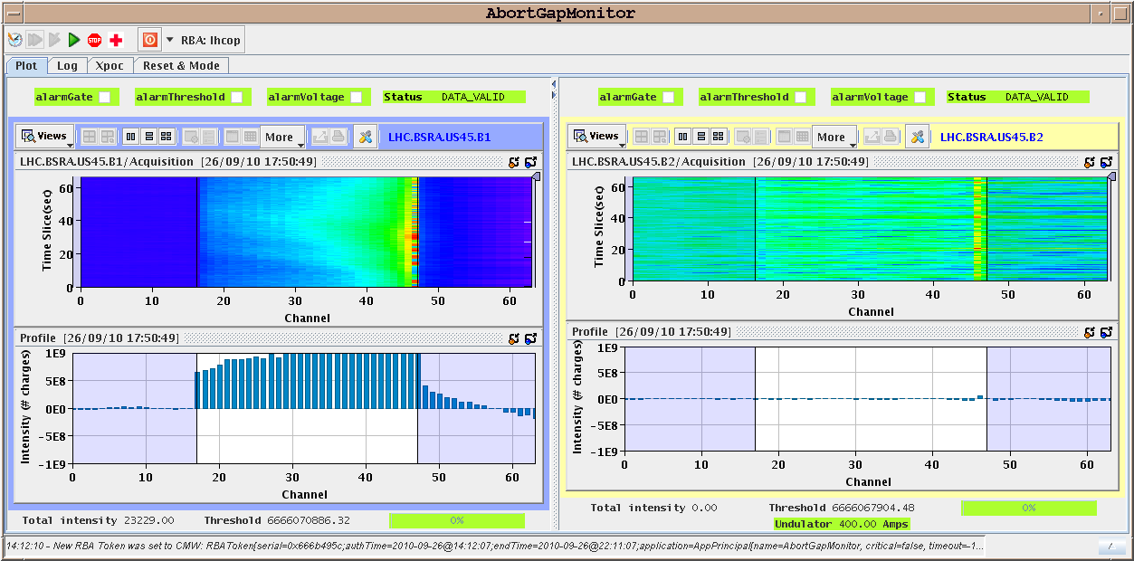
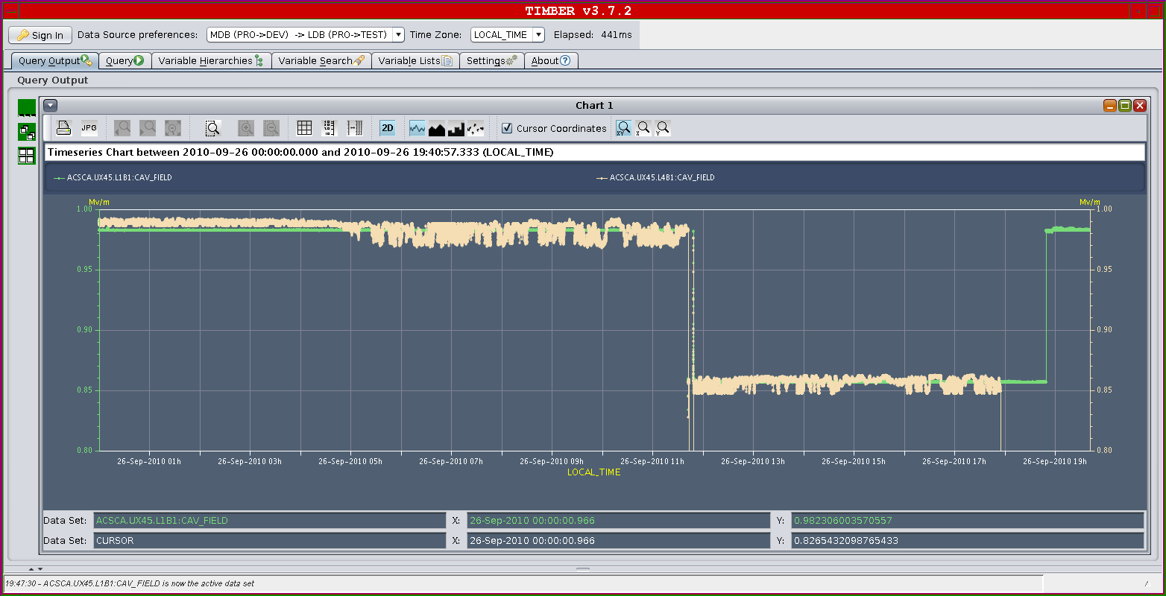
Issues – RF
Observed intermittently low lifetime after injection in pilot and bunch trains on Sunday
Beam debunching
Origin: Noise on cavity 4B1around 5:00 between Sat and Sun night. Could explain higher loss rate observed during last coast on B1.
In the meantime we switch Cav4B1 OFF and re-arrange counter-phasing and voltage partition to keep ~ 4MV capture voltage and 8 MV during physics.
Since we increased intensity frequent RF trips while in physics
Ph. Baudrenghien

Slide 20
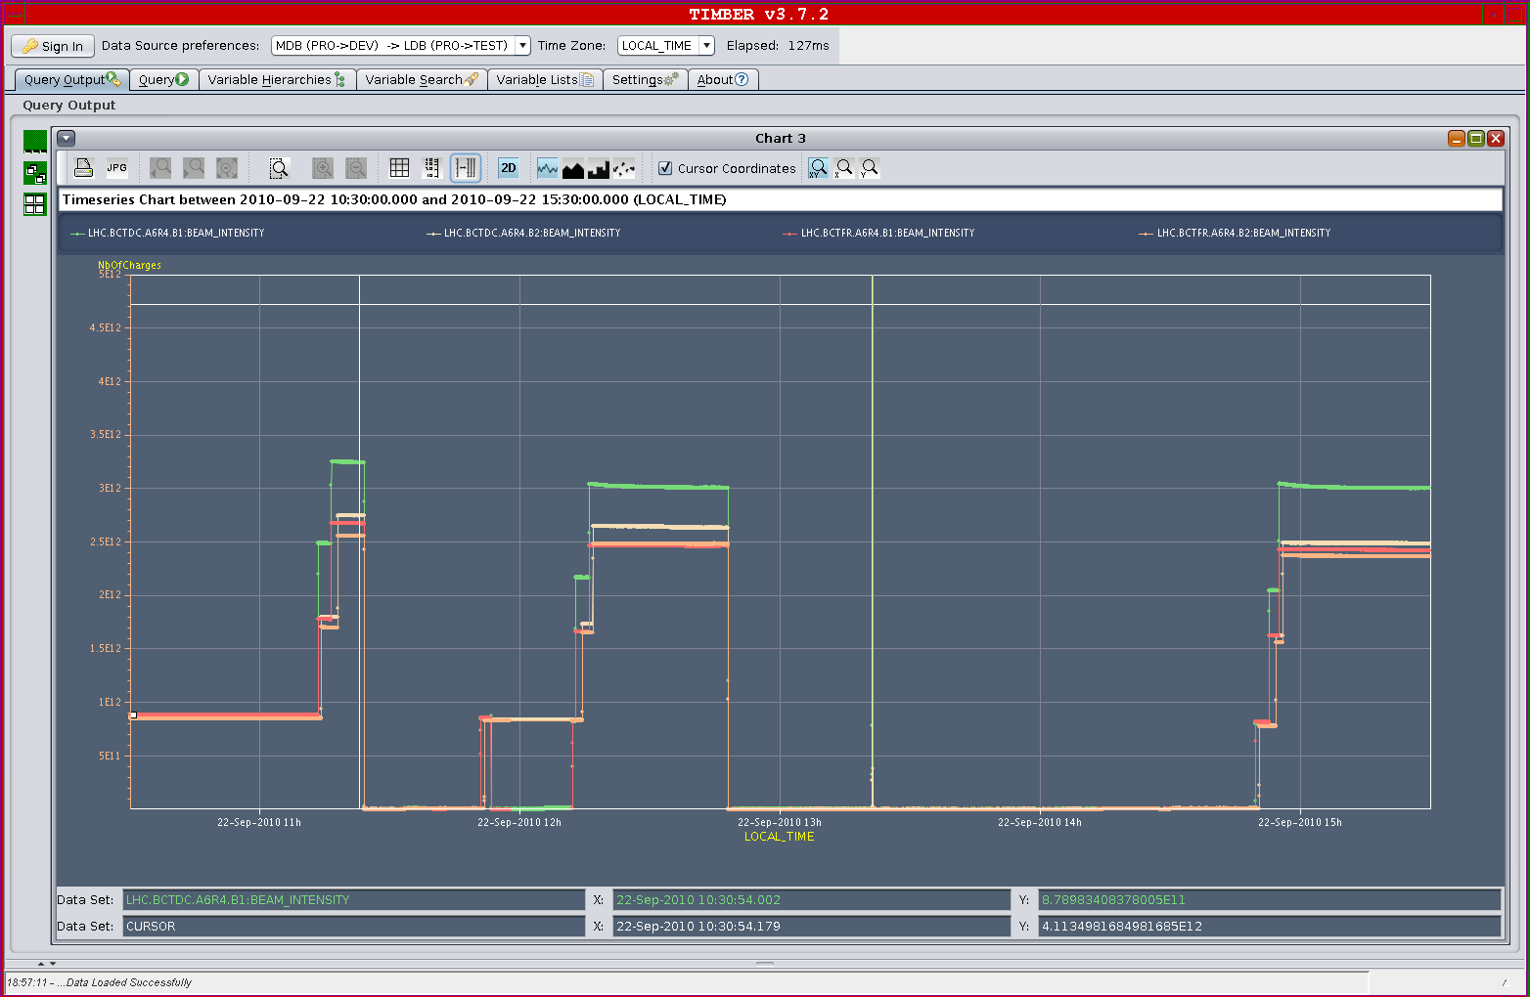
Issues - BCT
Problem with DC-BCT according to the injection pattern. DC BCT data not reliable ➔ BI investigating

Slide 21
To fit in later
Transverse damper firmware update (to prevent glitches positions very close to 0) – W. Höfle
Test of luminosity optimization software - S. White
Gas Ionization Profile Monitor tests - M. Sapinski
Abort gap cleaning – M. Meddahi
Test of new beam presence flag system – M. Gasior
DC BCT – P. Odier
Q kicker – R. Barlow
CO security intervention to be scheduled - A.Bland

Slide 22
Plans
End of fill measurements
Access:
  quench heater power supply on MB.C12L1
  BBQ detector intervention
  DC-BCT ?
RF cavity 4B1 tests without beam and TCDQ tests, BPM crate repair
Physics fill 104 on 104
Machine Coordinators: M. Lamont, J. Uythoven

