Slide 1
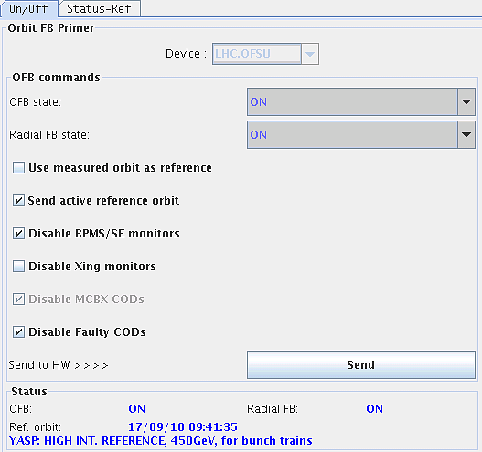
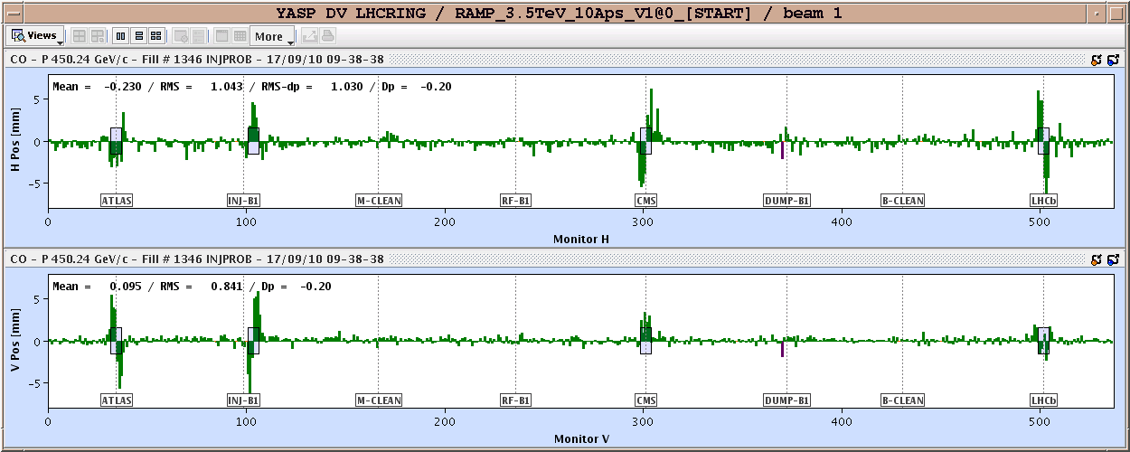
Friday morning
RAMP FOR COLLIMATOR SETUP
Injection
New high intensity orbit reference at 450 GeV "HIGH INT. REFERENCE, 450GeV, for bunch trains": - IP3 optimized for b2 - Got rid of systematic offset in IR2 - Got rid of the horns in S23 due to a missing corrector - re-steered IP6 to collimator alignment reference.

Slide 2
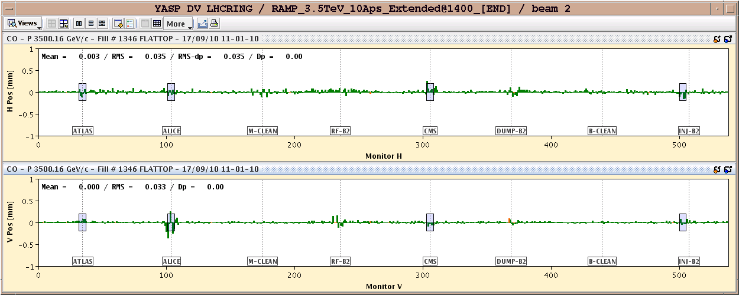
Friday morning
Orbit difference at the end of the ramp with respect to the new reference.
see some structure that is not very nice in IP2.
Note that we tried SVD corrections for the structure in IP2 but we did not manage to correct it away (20% of the proposed SVD correction caused a significantly non closure...)

Slide 3
Squeeze – crossing angles reduced
- Problem with the OFB non taking the "disable" for the Xing monitors during the squeeze part when the Xing is reduced from 170 to 100/110 urad; - Issues of coupling vs. feedback operation.
New orbit established: "HIGH INT. REF, 3.5 TeV, 100/110 urad, for bunch trains"
7 m
Corrected the orbit back to the 110 reference within 30 um.
13:56 3.5 m
RCBXH3.L2 tripped when starting the physics beam process.
the function that starts to fast and causes the QPS to detect a quench. FIXED
Tested collimator functions

Slide 4
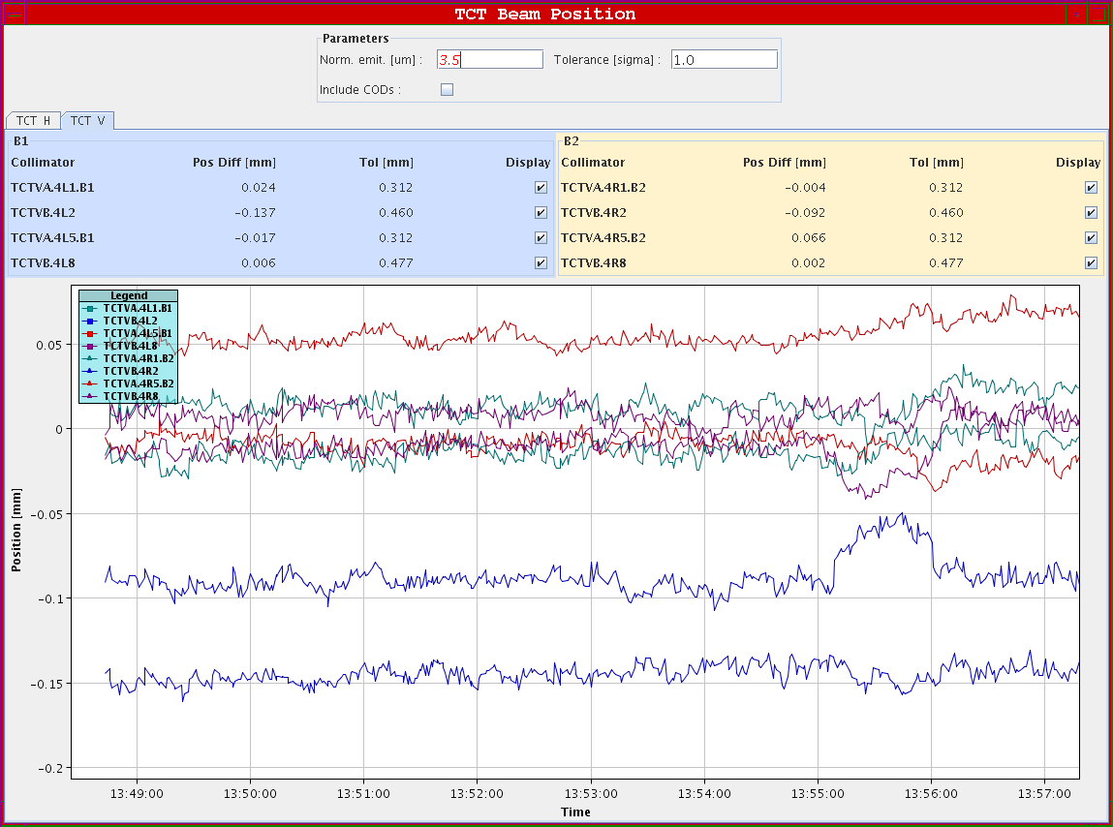
Orbit variation at tertiary

Slide 5
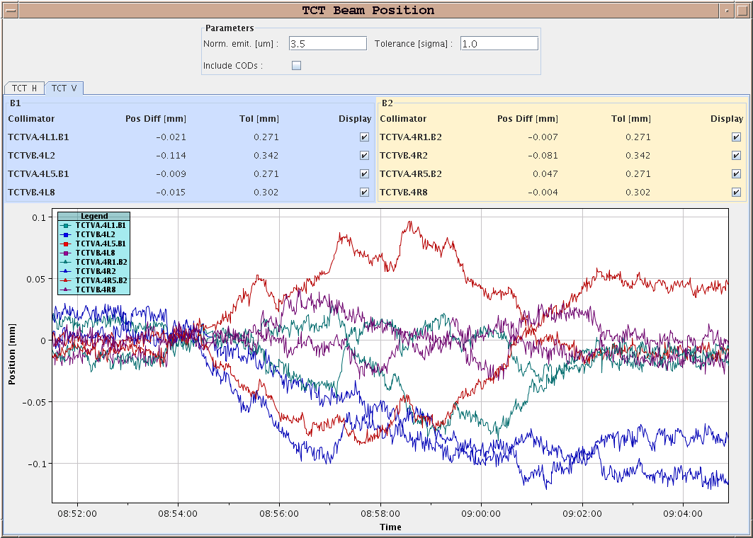
During last step of squeeze
TCT vertical

Slide 6
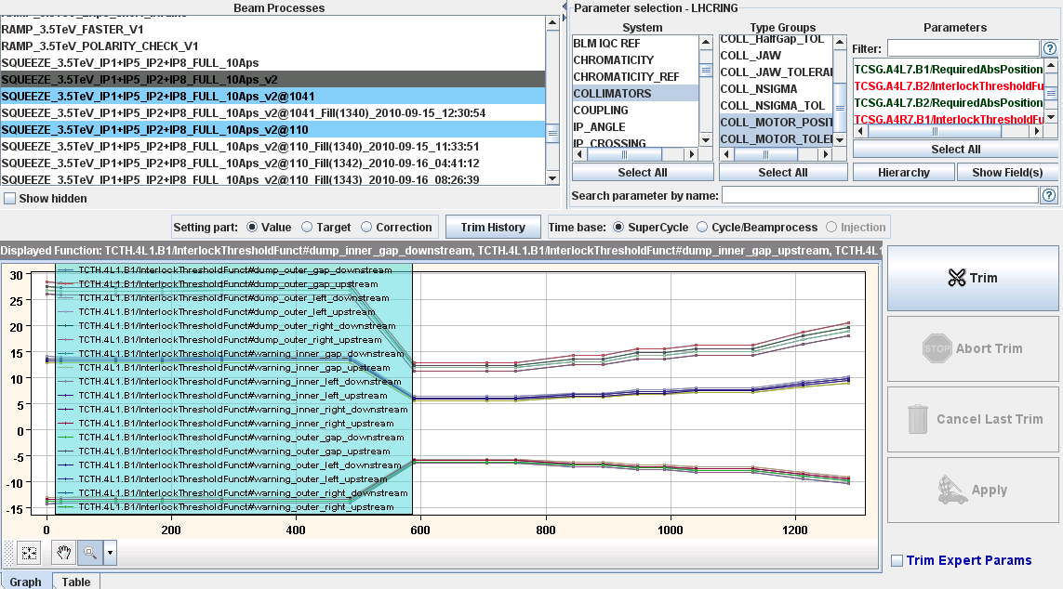
TCT in squeeze – jaw position plus tolerances

Slide 7
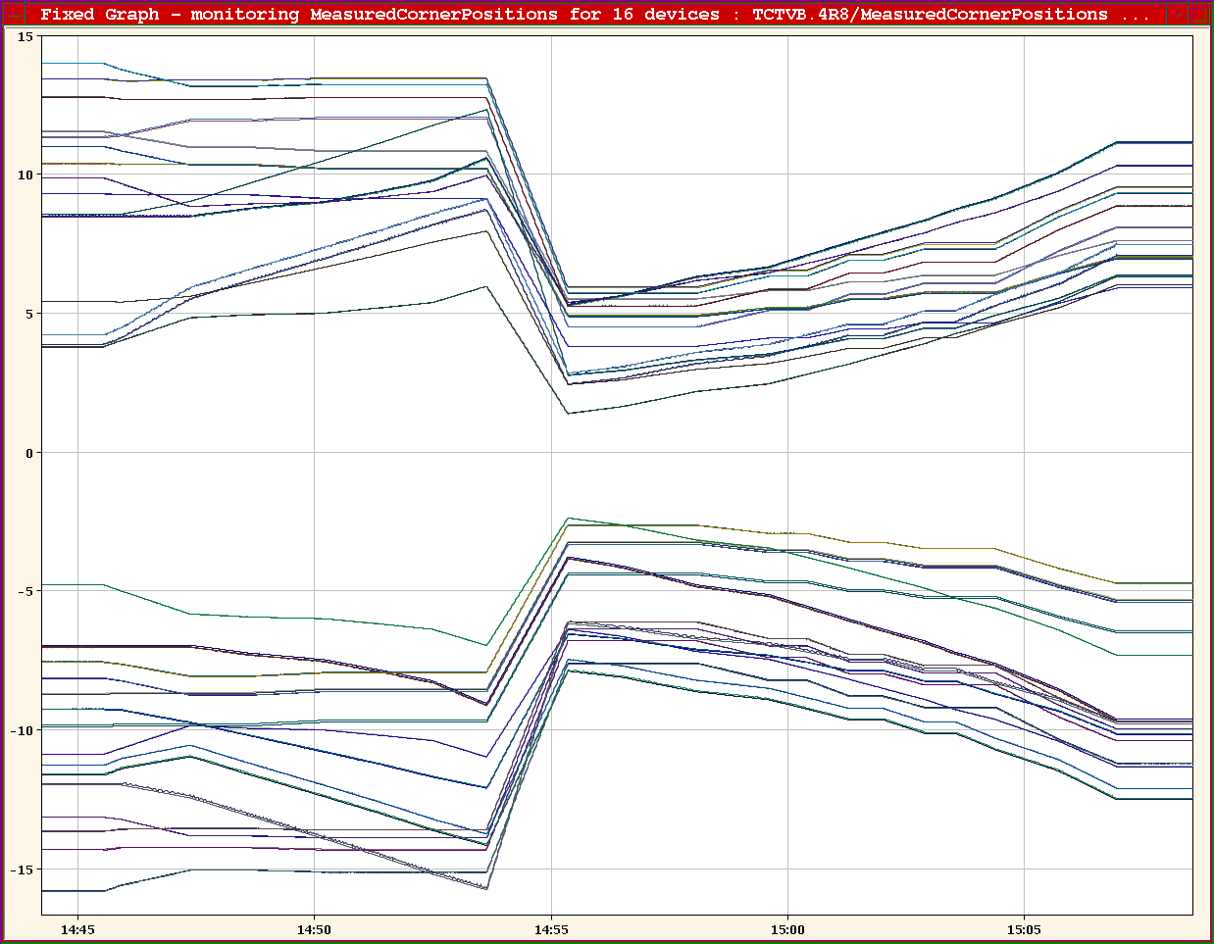
Collimator functions in squeeze

Slide 8
Friday afternoon
Access to fix skew quadrupole circuit
VALDATION OF PIC. Together with Bruno Puccio and Gert-Jan Coelingh, we performed several tests, on the circuits of sector 81 powered from UA87, to validate the PIC connection vs QPS and PC, after the ANYBUS interface replacement of yesterday. We first checked the Global Protection Mechanism functionality, by generating a FPA on the RB.A81 and verifying the removal of the powering permit on all circuits. Result OK. This confirmed, at the same time, the capability of PIC of removing the power permit from all individual circuits in case of problems. We then performed 2 PIC tests: the PIC2_QPS_OK on all circuits and the PIC2_POWERING_FAILURE test on all main circuits. The first one aimed at verifying the good connection between QPS and PIC and the second one the connection between PIC and PC (not really needed for the converter itself, but to check the ability of PIC to dump the beam in case of a converter fault).

Slide 9
Friday evening
Kajetan tested the automatic BPM gain switching at overinjection, a good start.
21:07 start ramp
eek – chromaticity all over the place following feed-forward & attempt to run without TFB – lose beam 2
possibly related to differences between rampdown/combo and pre-cycle following access
Uncover some interesting features of orbit feedback when trying to go through squeeze with one beam

Slide 10
OFB featires
Comment rstein: Problem understood and related to B1-only operation. The number of to-be-used eigenvalues should have been limited to 390/2 in this case. Have to look into what the best strategy is for detecting whether the Orbit-FB should correct only one beam. Transients due to COD/BPM mask enabling/disabling to be followed up. Patch exists but it contains also a less strict check on coupling (Tune-FB) which should be tested with beam. Since above feature does not affect normal operation, will do the release and re-validation only beginning of next week.

Slide 11
Saturday morning
Started shift with rephasing problems. It was only sorted out at ~ 4:45. Most probably the reason was a lose cable connection.
We could not take any proper wire scans.
While waiting for the solution to the rephasing problem the booster ring 3 broke down. The booster guys eventually managed to deliver beam for us from ring 4.
At the injection flat bottom we had some problems with the hump in connection with the tune feedback and damper. With the damper on, the hump peak became higher than the tune and the FB locked onto it. We saw it quickly enough and stopped it. Eventually we could only survive with a tight window on the lower side.
04:16 start ramp This beam was used for the loss map.
Only the off momentum loss map for 170 urad at 3.5 TeV was carried out. With the rephasing problem we did not have any time for the other outstanding loss map.
When preparing for injection again, the MCS check of the BLMs got stuck on one crate. This has not happened so far. And we cannot get out of it without calling an expert to manually stop it. Christos will investigate today what happened.
NOW: in squeeze for final TCT setup in physics conditions

Slide 12
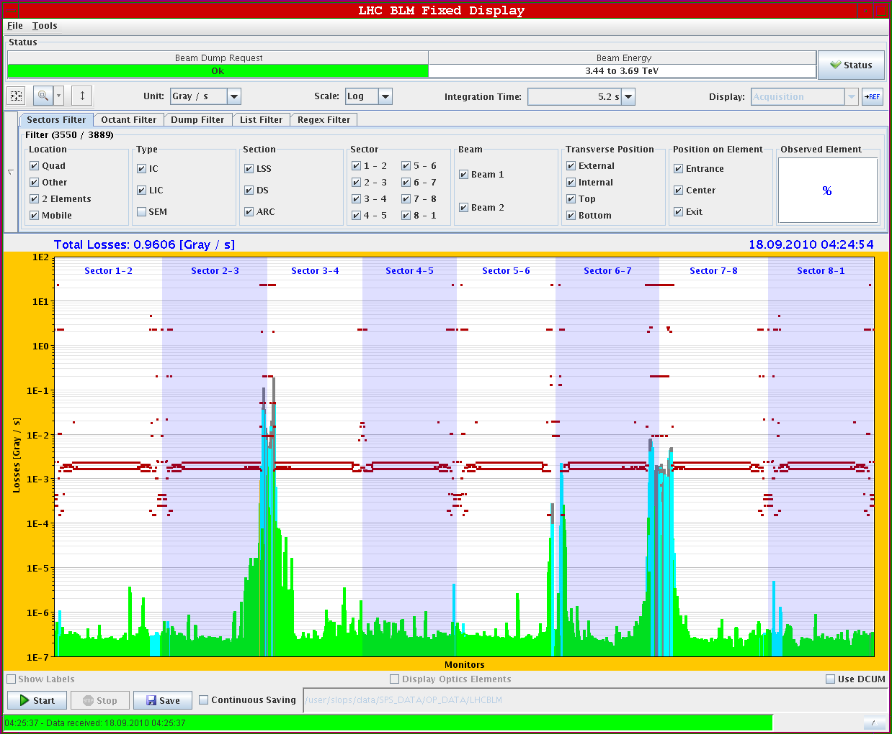
loss map +900 Hz. Flattop, 170 urad crossing angles.

Slide 13
Qualification - status
End ramp | Betatron OK -900 Hz OK +900 Hz OK
Reduced crossing angle | Betatron all planes OK Off momentum all OK except B2
3.5 m separation bump off | Set-up ongoing need 3 fills for qualification
BIAG dumps | To do at each set-up point

Slide 14
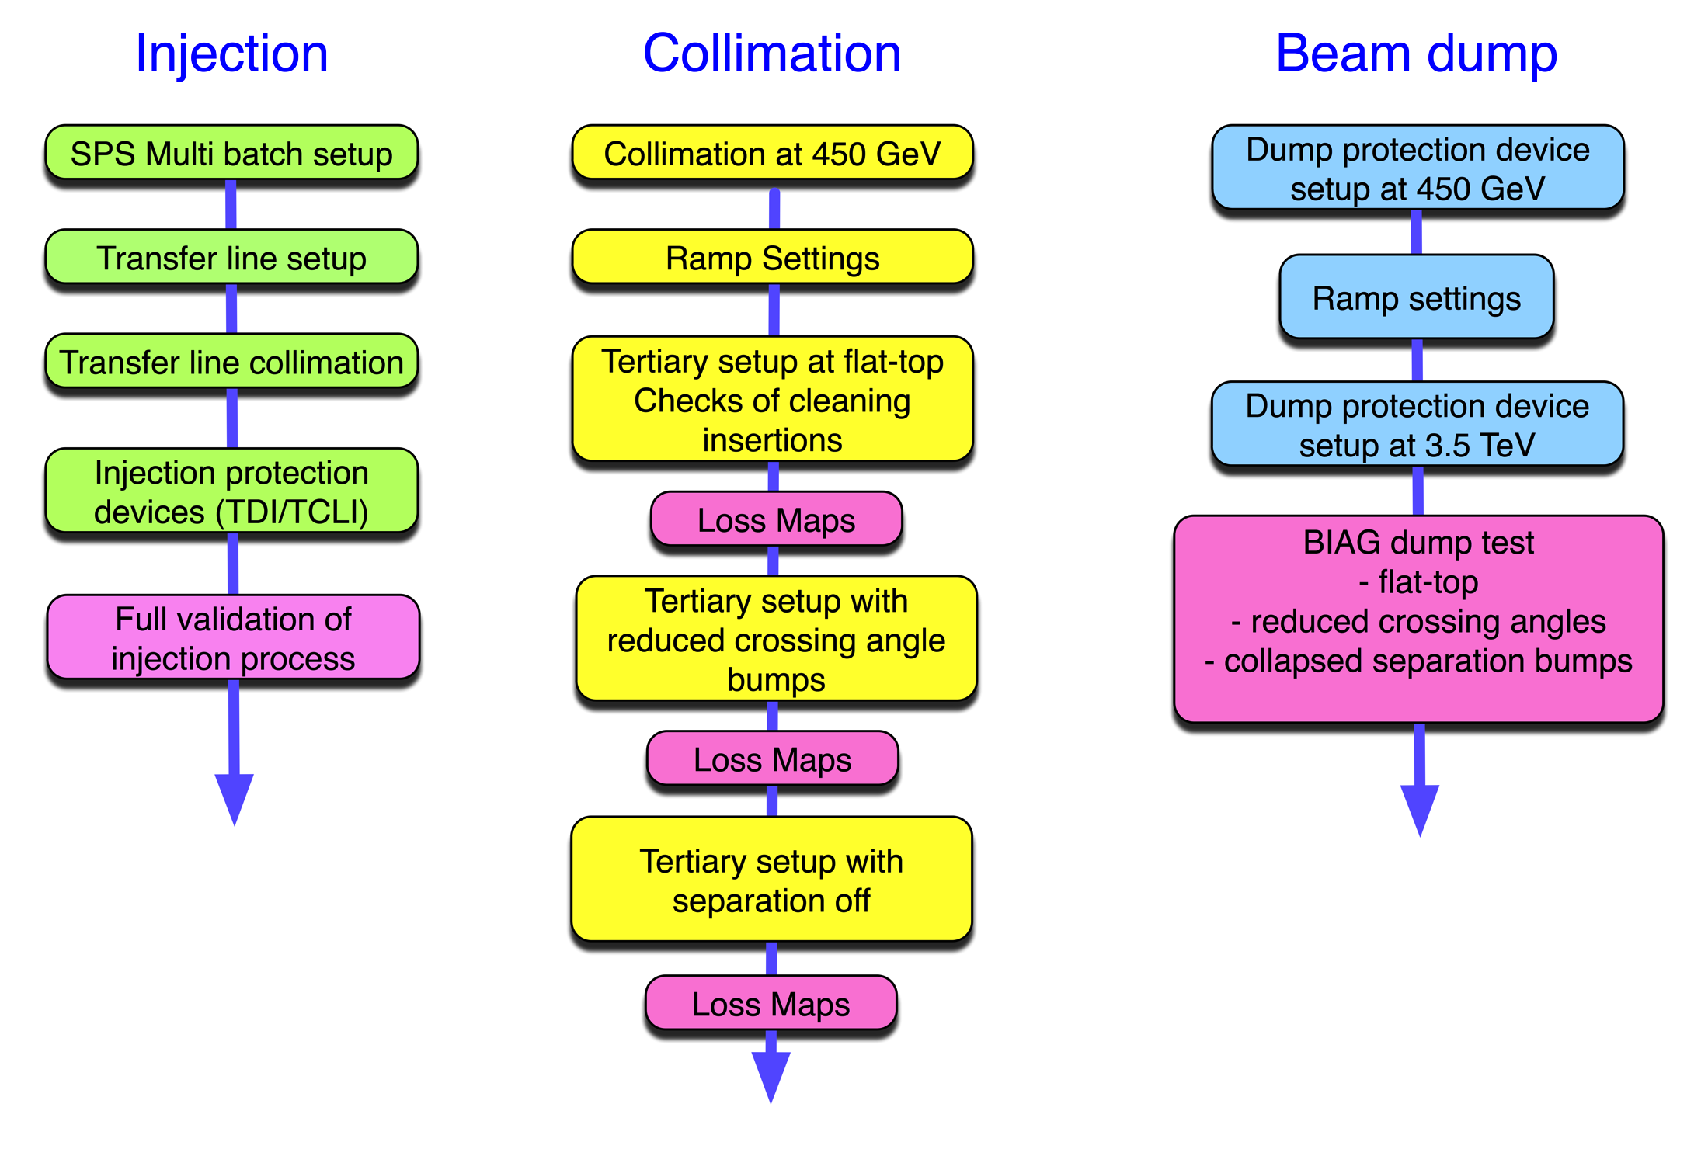
Commissioning bunch trains status

Slide 15
Next 24 hours
Collimator set-up & loss maps
This afternoon:
injection protection wrap-up
async dump at 450 GeV
quench test at 450 GeV
Overnight
loss maps
Tomorrow
async dumps tests

