Slide 1
Week 36
Machine coordinators R.Assmann, R.Bailey
Main aims for the week
Work with ramp and squeeze at 10 A/s
Commission bunch trains on crossing angles
Setting up for injection of unsafe beams
Setting up ramp and squeeze
Setting up IR collimation through the cycle
Setting up RF, transverse damper, BI etc for new conditions
 | % | Mon | Tue | Wed | Thu | Fri | Sat | Sun
Beam availability | 66.7 | 22.5 | 15.5 | 9.5 | 12.0 | 15.0 | 20.5 | 17.0
Set-up without beam | 12.8 | 1.5 | 4.0 | 4.5 | 2.5 | 4.0 | 1.0 | 4.0
Faults | 20.5 | 0.0 | 4.5 | 10.0 | 9.5 | 5.0 | 2.5 | 3.0
 | 100.0 | 24.0 | 24.0 | 24.0 | 24.0 | 24.0 | 24.0 | 24.0

Slide 2
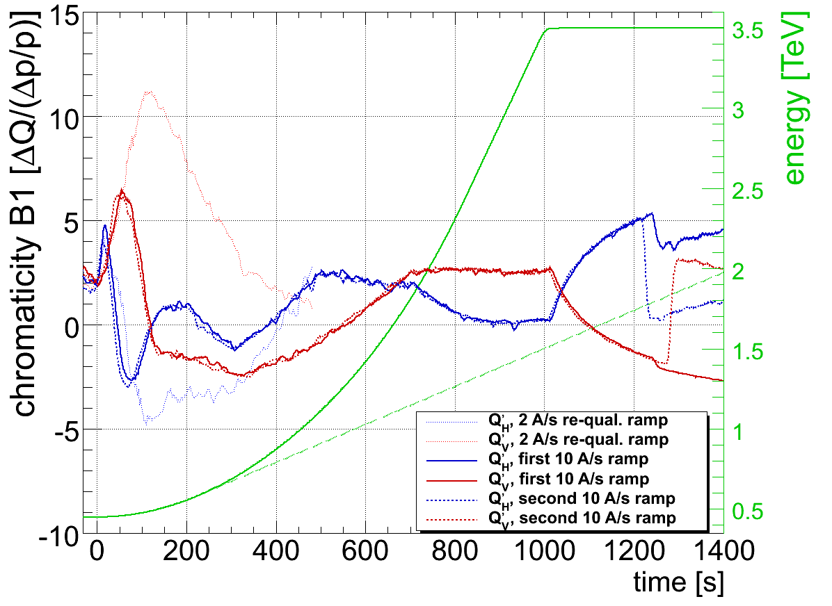
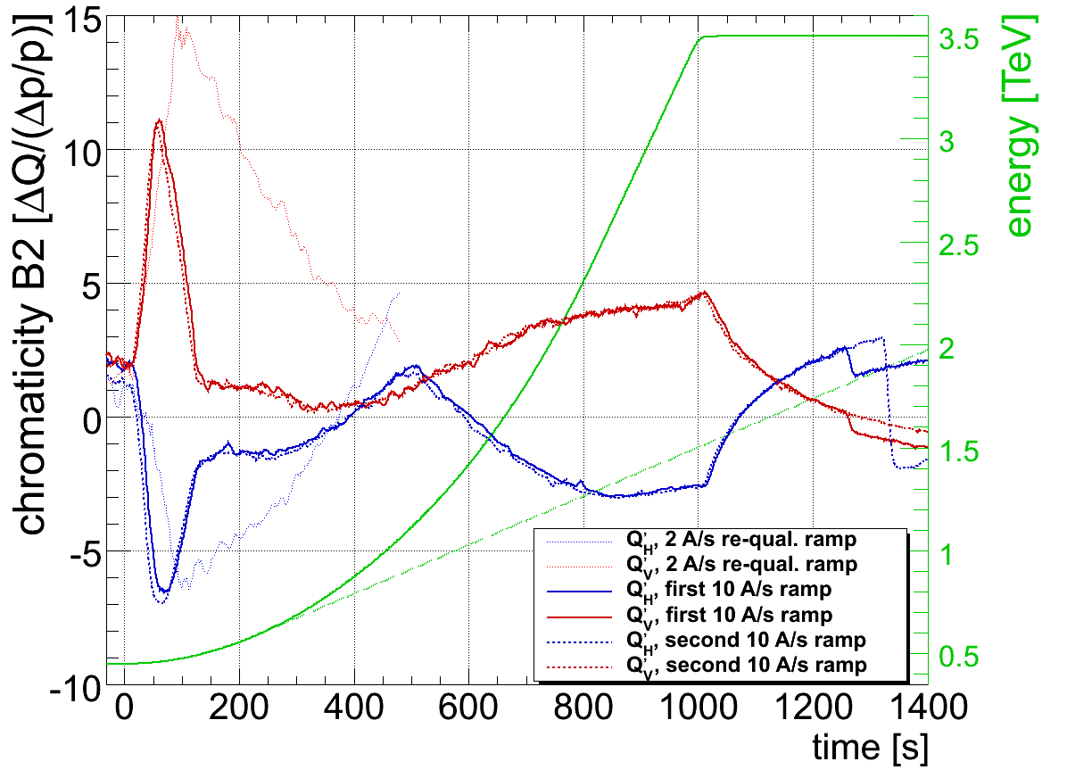
Ramp with 10 A/s
Chromaticity during the ramp reproducible (RS)

Slide 3
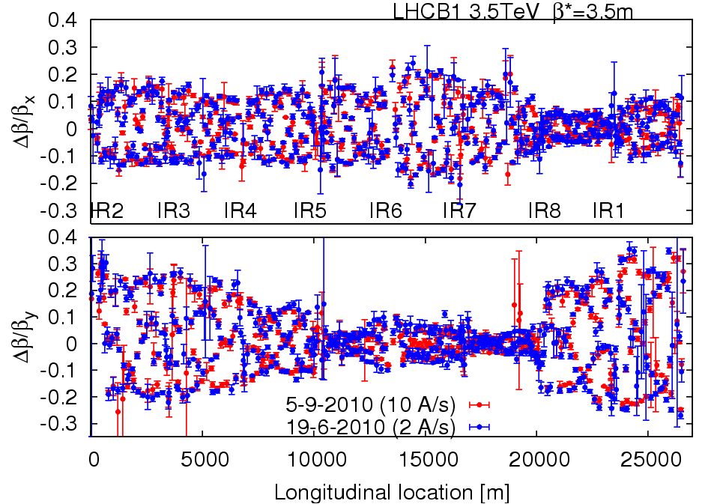
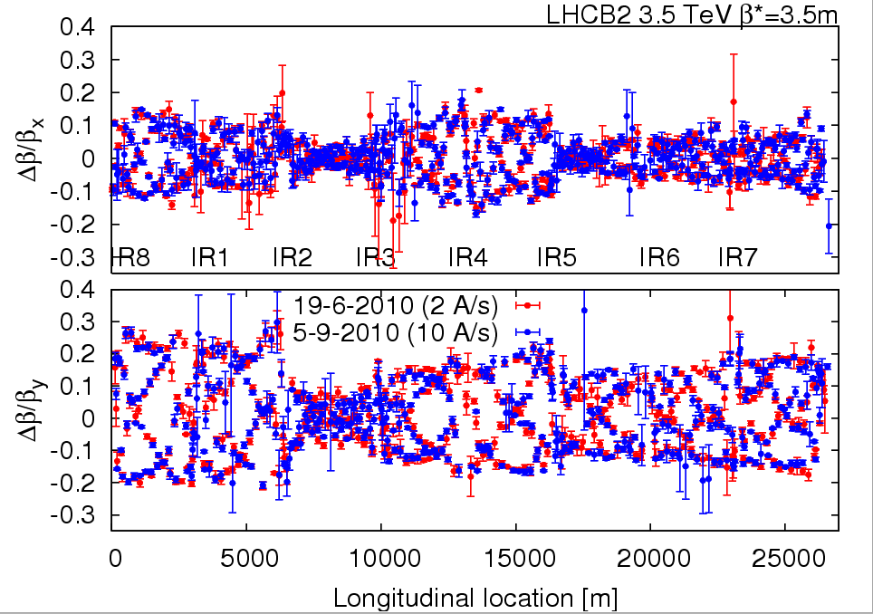
Squeezed optics
Beta-beating measurements reproducible (RT et al)

Slide 4
Crossing angles
External crossing angles
IR1: -170 μrad at inj./ramp and -100 μrad in squeeze/collision
IR2: +170 μrad at inj./ramp and +110 μrad squeeze+collision
IR5: +170 μrad at inj./ramp and +100 μrad in squeeze/collision
IR8: -170 μrad at inj./ramp and -100 μrad in squeeze/collision
Good for beam-beam (do we need it for 150ns ?)
Bad for aperture and MP (are we ready to do this ?)
Strategy
Start with nominal angles at injection
Measure IR apertures
Test parasitic beam-beam with lower angles
Decide based on this

Slide 5
Injection and injection protection (BG et al)
Several shifts, but with limited beam availability
TDI alignment checked and confirmed
Trains of 4 nominal bunches to the downstream TEDs then into LHC
Measured centre of TL collimators - moved the gap, recorded losses in TL and LHC injection region
Found changes of up to 0.5 sigma
Looks like with good trajectory correction we can hope for this kind of stability
Trimmed all new settings in and adjusted thresholds, drove all the settings and thresholds through the sequencer
Centered
TCDIV 20607 TCDIH 29050 TCDIV 29012 TCDIH 29205 TCDIH 29465
TCDIV 29234 TCDIV 29509
TCDIH 87441 TCDIV 87645
TCDIH 88121 TCDIV 88123 TCDIV 87804
Ready by Thursday to start the protection validation tests to allow injection of unsafe beam
Used to inject trains of 8 for beam-beam studies (Friday)

Slide 6
Collimation at 450 GeV (RA et al)
Essentially done through Tuesday
TCT’s at injection set to 8.5 σ: ~expected triplet aperture
no margin to calculated triplet aperture, assume n1 calculation has some margin
16 TCT’s around experiments set up to nominal crossing angle (170 μrad).
Total margin from protection to TCT/triplet: ~0.8 mm. Requires orbit tolerance ~0.2 mm.
Injection protection collimators checked: Problem found and corrected with loss maps.
7 out of 10 loss maps done.
Setup complete, loss maps mostly done

Slide 7
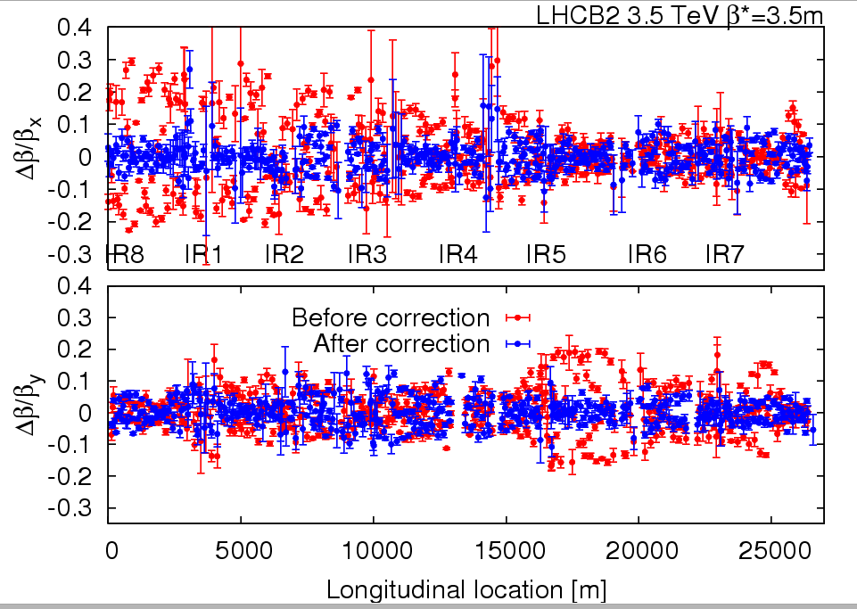
Test ramps and optics studies at 3.5, 3.5
Wednesday night
Ramp OK
Trimmed Xing angles 1 and 2 to 100 and 110 and corrected closure
Lost B1 with a corrector trip when doing IR5
Continued with B2, Xing angles 5 and 8 to 100 and 100
Squeeze B2
Brief optics studies on B2
Global correction
100 quads !
Impressive results !
IP1 3.22 0.22 3.62 0.40 IP2 3.83 0.61 3.43 0.26 IP5 3.67 0.07 3.28 0.25 IP8 3.26 0.10 3.51 0.09

Slide 8
Lifetime vs Crossing Angle (WH et al)
Friday afternoon
3 batches of 8 bunches, spacing 150 ns → up to 6 LR interactions per bunch
170 → 100 μrad
90 μrad
80 μrad
70 μrad
60 μrad
50 μrad
40 μrad
30 μrad
20 μrad
100 μrad
Conclusion: Minimum required crossing angle is 100 μrad in 2010.

Slide 9
Measured 450 GeV Aperture (SR et al)
Friday night
On-momentum, as relevant for collimation and protection.
Predicted aperture bottlenecks in triplets (n1=7) do not exist.
“Measured” n1 = 10–12 (on-momentum)
Beam / plane | Limiting element | Aperture [σ]
Beam 1 H | Q6.R2 | 12.5
Beam 1 V | Q4.L6 | 13.5
Beam 2 H | Q5.R6 | 14.0
Beam 2 V | Q4.R6 | 13.0

Slide 10
Off-Momentum Aperture B1
For large momentum offset (0.3%): losses in Q10.R6
For specified momentum offset (0.15%): losses in Q6.R2 (same bottleneck as on-momentum).
Aperture in Q6.R2 was reduced from 12.5 sig to 11 sig.
The equivalent n1=9.2 must be compared to design of n1=7.
Difference probably due to better orbit.

Slide 11
Conclusion from Aperture
Plenty of aperture at triplets: > 13 σ (n1 > 10)
Can open tertiary collimators, e.g. to 13 σ at injection.
Will provide 6 σ margin to injection and dump protection.
Can stay with 170 μrad crossing angle at injection. Only possible reason to change: simplify operational procedure: same settings at injection and top energy.
Subsequent decision (Saturday)
Stay with 170urad crossing angle at injection
This will then be valid for all bunch spacing in the future
Open tertiary collimators to 13 σ at injection (from 8.5 σ)
Set up procedures to handle Xing angle change through the cycle

Slide 12
Collimator set up needed
TCTs at 450 GeV for larger aperture (not beam based)
Loss maps to qualify
IR3 (9) at end of ramp
TCTs (16) at
End of ramp needs qualification
Reduced Xing
End of squeeze needs qualification
Collision needs qualification
Qualification at high energy means
H and V with on-momentum, +, -, and asynch dump
3-4 ramps needed for each
So a few shifts needed !

Slide 13
RF setting up (PB, AB, JW)
Saturday morning
Pilot and LHC3 energy difference observed
Fixed by correcting LHC3 energy on SPS flat top (~0.1GeV)
Transfer line and injection look OK (experts to check)
With pilot bunches, the optimum frequencies were found for beam 1 and beam 2. They were found to be 22 Hz apart (~1.5e-4 in dp/p)
The frequency found for beam 2 (400.788865) was close to the previously used nominal value, and we used this as the reference for both beams
The energy of ring 1 was trimmed by -1.2e-4 using the orbit correctors to bring it in line with ring 2
The stable phase offset in the phase loop was also checked and adjusted for both beams

Slide 14
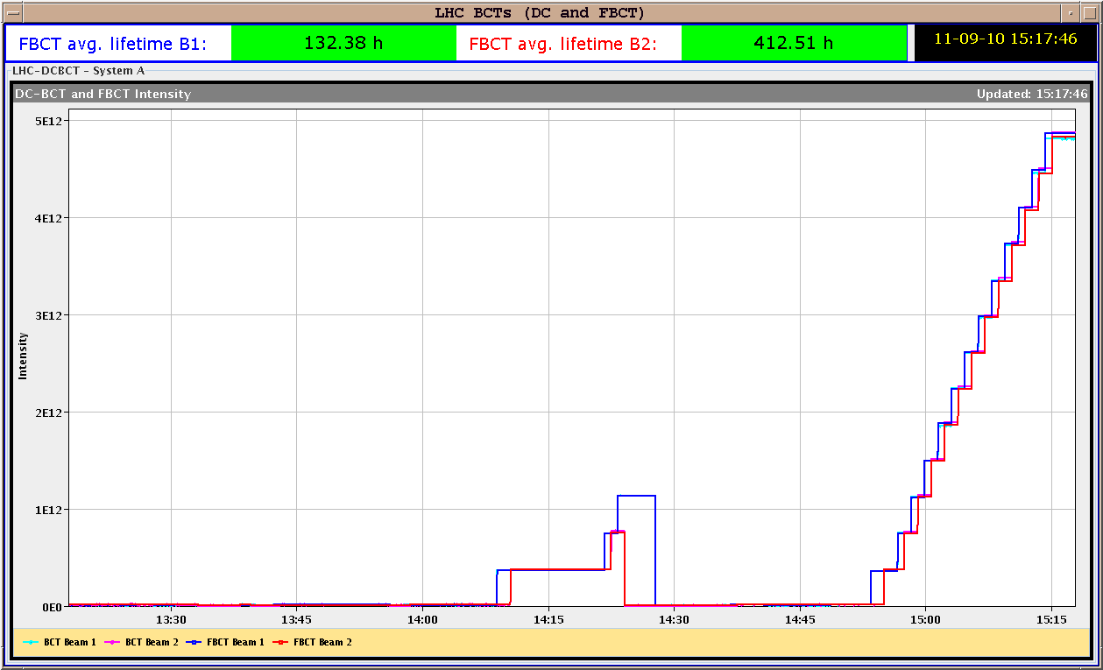
RF setting up (PB, AB, JW)
Finally the complete injection sequence of 13x4 bunches per beam was executed and went smoothly with very little uncaptured beam

Slide 15
New orbit references established on the way
New orbit references for injection and ramping were made ( and set as Golden) and are called: High Int: Ref. HIGH int. with IR3/6/7 steered to MAY ref (E-matched) Low Int: Ref. LOW int. with IR3/6/7 steered to MAY ref (E-matched)
When arriving on the FT with 170 urad Xing angles, one should correct back to those references.

Slide 16
Setting up TCT at 450 GeV (RA et al)
Saturday afternoon
15h00 – 23h00: Collimator ramp setting up (SR, RB)
dry ramp without beam for collimators
B2 interlock collimator TCSG.7L3.B2. Positions are all within limits
B1 interlock collimator TCLA.7R3.B1. Positions are all within limits
Recommendation from low level experts: fewer points for the ramp functions. Fixed issue → several collimator ramps without beam OK.
Also included a collimator TCLA.B5L3.B2 that had been disabled for operation and fixed in a technical stop.
15h00 – 23h00: Opening tertiary collimators to 13 σ:
Gaps increased for same beam center (no beam based calibration) from 8.5 to 13 σ.
Ramp functions and MP limits adapted accordingly.
23h00 – 07h00: Qualification:
Loss maps with nominal bunch at injection, with & without injection protection.
Test ramp with collimators and beam

Slide 17
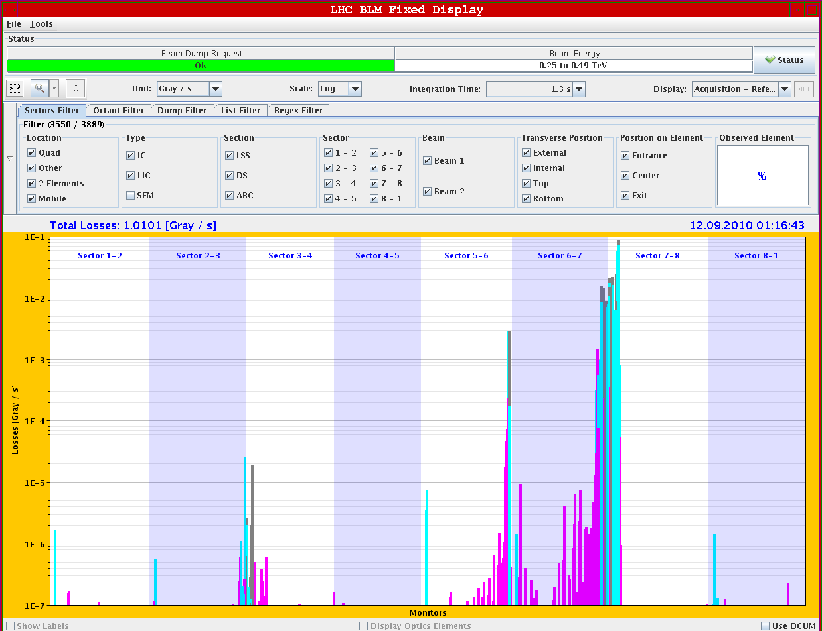
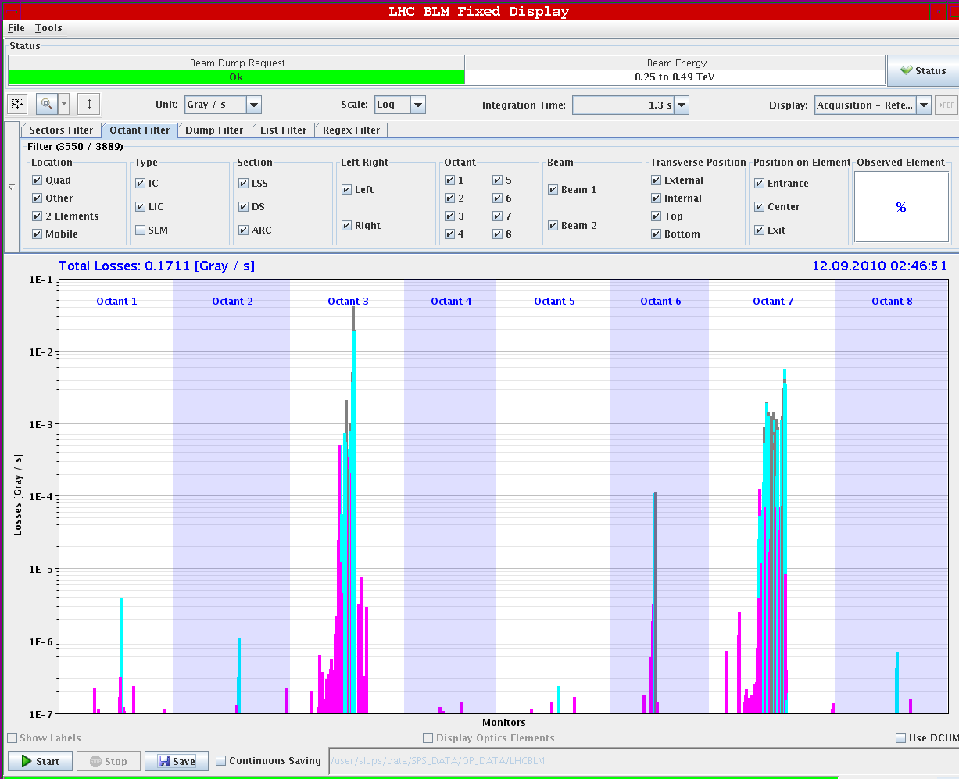
Loss Map examples at 450 GeV
Loss Map B2 H
Loss Map Pos. Energy B2
Looks fine…
No losses seen in triplets, very low losses in tertiary collimators.
No significant losses in SC magnets.
Confirms measured large aperture!
To be done: Asynchronous dump test (B. Goddard et al)

Slide 18
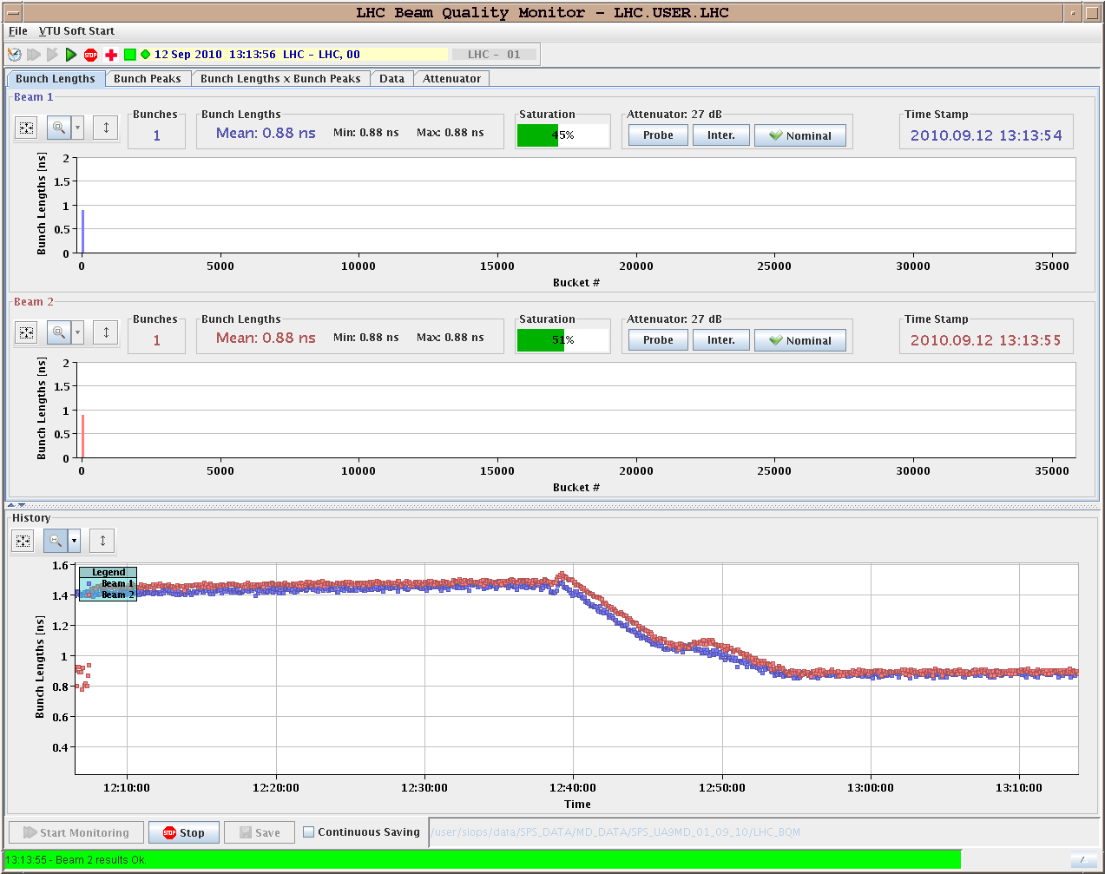
Ramp commissioning (ML, JW, PB, AB)
Sunday
Ramp single nominal bunch with new ramp and new RF functions
Voltage ramping from 3.5 MV to 8 MV and coupler motion at start
Power OK for all cavities
Longitudinal blow-up not violent enough: asked for 1.25 ns, get only 0.9 ns. Updated for next ramp..

Slide 19
Orbits at 3.5 TeV (JW)
Orbit references made for the flat top (with 170urad Xing) and after the reduction of the Xing to 100/110 urad
After the flat top, the first stage of the squeeze was carried out and included a reduction from 170 to 100/110 in the Xing angle
The orbit showed unexpected changes around the IRs but this was due to masks for the OFB being correctly set The only IR were the masks were exact was IR8: and there it worked very well (clean orbit and no leakage)
Understood and should be OK next time

Slide 20
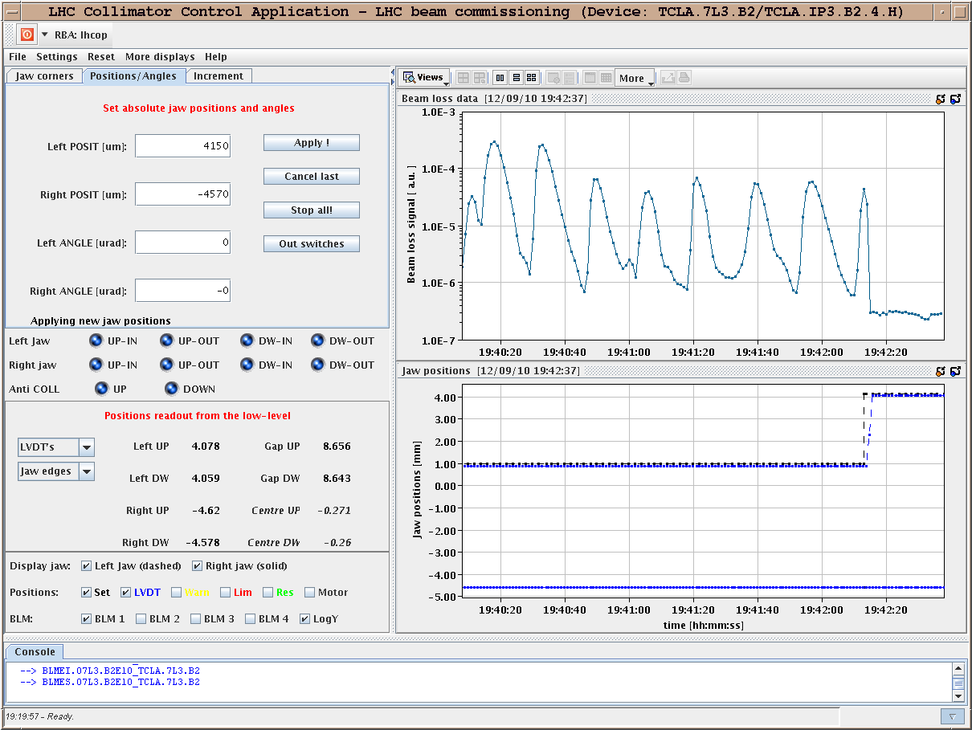
Collimation at 3.5 TeV (RA et al)
Some interesting effects ...
B2 horizontal very difficult to work with due to high losses uncorrelated with collimator movement.
periodic losses seen centering of TCLA.7L3.B2, roughly 15s periodicity. Difficult to set up collimators under theses conditions
periodic loss pattern - goes away when collimator retracted ?

Slide 21
Collimator set up summary (SR)
The beam conditions were not ideal: we experienced high loss rates uncorrelated to collimator movement and poor lifetime, particularly in B2.
Performed collimator alignment at flat-top with 170 urad crossing for the following devices:
B1: Horizontal TCTs (4 collimators); B1: Vertical TCTs (4); B2: Vertical TCTs (4); B2: Vertical TCLA in IP3; B2: 2 horizontal collimators in IP3, probably to be repeated.
Also performed loss maps for the following cases: B1-V, B1-H, B2-V.
The preliminary analysis of loss maps shows good cleaning and hierarchy. In particular, we see no indication of losses at the TCT collimators and at the triplet magnets

Slide 22
Overnight
Ramp and squeeze with new set up
Problems with tune feedback
Seetings for high / low intensity ?
Lost beam 1 during the squeeze (no TFB)
Unclear situation for Xing compensation / orbit
Beta-beat measurements ?
Beam dumped at 6.45 for fat refill before injectors OFF
Ramp and squeeze with new set up ongoing

Slide 23
PLL commissioning at 450GeV (Monday)
re-validated beam-transfer-functions (BTFs) with various damper settings
BTF phase-responses were within 10deg the same as during last measurements (and initial setup done last December)
locked the PLL on tune and applied dp/p modulations to test the tracking bandwidth and tune measurement stability for various ADT gains and dQ'+-5 trims
initial observations (more details in log):
The PLL gave nice tune tracking signals, provided the excitation and set-bandwidth was large enough.
With the tested excitation amplitudes no obvious beam size growth has been seen in addition to the already constant increase which seem to occur regardless of whether the damper was on/off (observation of the previous ADT expert tests) or whether the PLL excited the beam or not (this test)

Slide 24
K-modulation at 450 GeV (Monday)
Completed the intended measurement programme nearly as planned for the vertical plane in IR1 for crossing angles of -170, -100 and -50 urad
We lost half of B2 due to a beam instability (seen on the tune) while modulating Q2L1 with a crossing angle of +100 urad (Q1 scans were OK). We aborted the missing Q2 and Q3 modulations in favour for some scans in H since this would have been the fourth measurement point in the vertical plane.
For the horizontal plane only the modulation of Q1 at 2 and 1 mm separation has been performed. The feed-down effects were generally small (kicks much below 1urad) but the global r.m.s. generally at least four times larger than the residual BPM noise floor.

Slide 25
Transverse damper (Monday, Tuesday)
Monday
Gains were changed for beam 2 and beam 1 dampers and emittances recorded
Emittance increase again does not depend on damper gain
Could run at higher gain than our standard gains
Tuesday
Issue found in the Beam Position module firmware is now understood.
In the given machine time we tried to set up the new scheme, however there are still some issues which need to be resolved when author of the firmware will come back from holidays.
Workaround at the moment is to keep the orbit in the damper pickups Q7 and Q9 slightly off center (~0.5mm).

Slide 26
Outlook
Sun | M | 8 | Ramp commissioning, longitudinal blowup, ramp nominal
Sun | A | 8 | Collimation set up at 3.5TeV (IR3 and TCTs)
Sun | N | 8 | Loss maps at 3.5TeV (end of ramp)
Mon | M | 8 | Injection protection qualification for injection of unsafe beam part 1
Mon | A | 8 | Loss maps at 3.5TeV (end of ramp)
Mon | N | 8 | Collimation set up at 3.5TeV (TCTs at end of ramp and with reduced Xing)
Tue | M | 8 | Injection protection qualification for injection of unsafe beam part 2
Tue | A | 8 | RF set up with multibuch injection, transverse feedback
Tue | N | 8 | Collimation set up at 3.5TeV (TCTs at end of squeeze and collision)
Wed | M | 8 | Loss maps at 3.5TeV (end of squeeze)
Wed | A | 8 | Ramp and squeeze bunch trains
Wed | N | 8 | Loss maps at 3.5TeV (collision)
Thu | M | 8 | Collimation integration into sequencer and tests
Thu | A | 8 | Ramp and squeeze bunch trains - collisions with 3 trains of 8
Thu | N | 8

