Slide 1
Friday 10.9
07.00 Setting up after access for power convertor in S81
Then hit a series of problems
Collimator communications: water leak stopped remote reset unit – access at point 7 – water leak on ventilation
Temporarily fixed
Definitive repair needs to stop cooling plant so “days” needed
RF Module M2B2 tripped – access at point 4
Thyrotron replaced
Gave access point 8 for temperature sensor on RQTL9.R7B1 (see yesterday)
Gave access to ALICE ATLAS and LHCb
12.00 Access finished. Restart
Problems with the BPM interlock in P6 for system 'A' on B2
Some redundancy. Masked for now (BI continue to investigate)
Took trains down the lines to TEDs while waiting
15.00 Pilots in

Slide 2
Note on TCLIA/TCDQ Problems
Two problems yesterday. Fully understood.
TCDQ: Problem with controls. Disarm command returns OK but in fact device stays armed. Starts ramp at next timing event → B. Goddard following up.
TCLIA: Human error during check of injection settings (2 out of 88 devices).
Selected TCLIA by error and reset them to old settings. Fail-safe, as first injection afterwards must be pilot → problem caught and fixed.
Cannot to 100% exclude human errors.
Therefore thorough testing mandatory after each new commissioning!

Slide 3
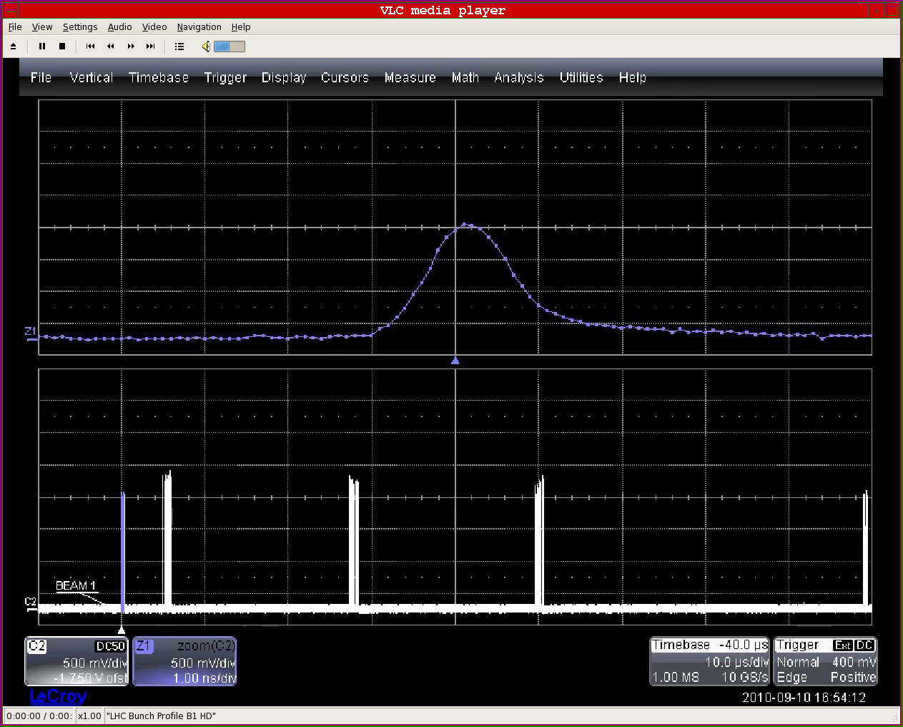
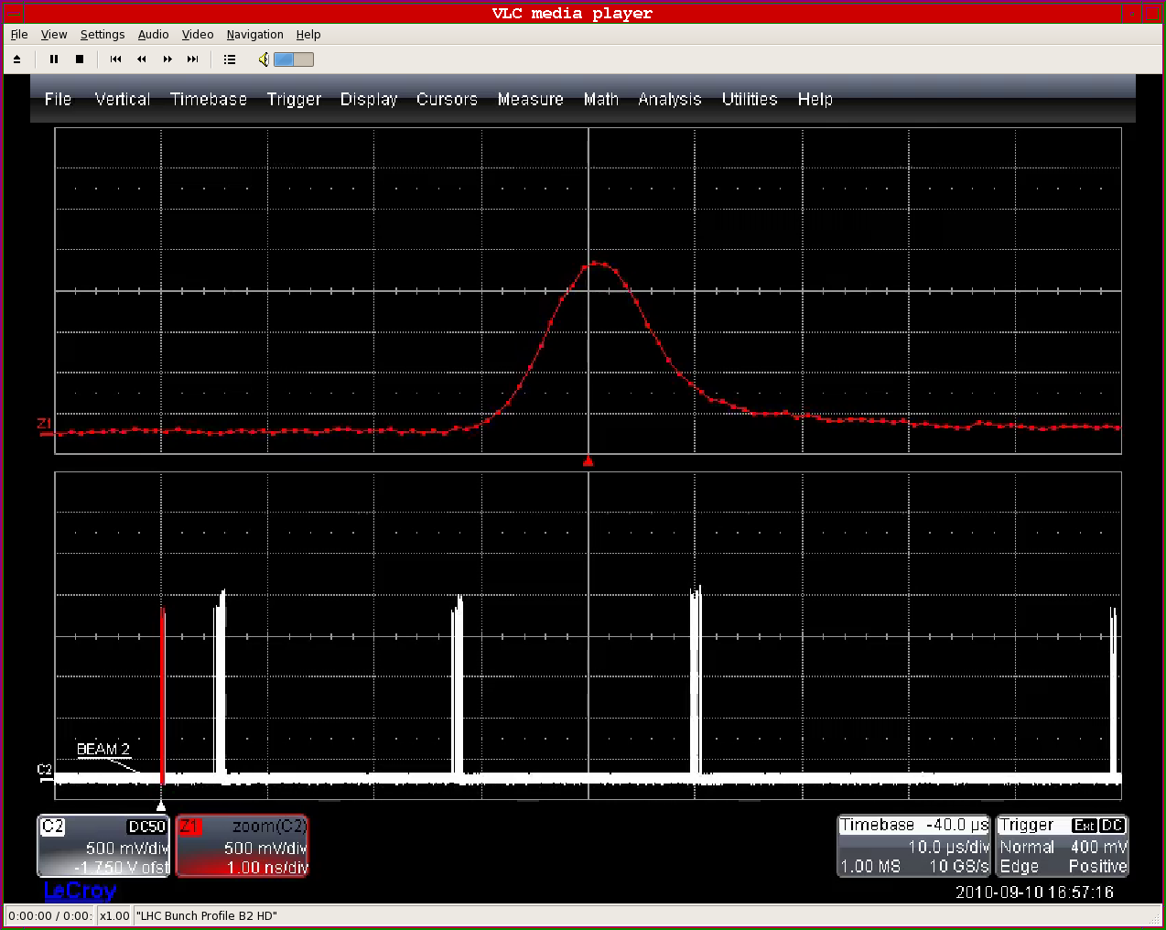
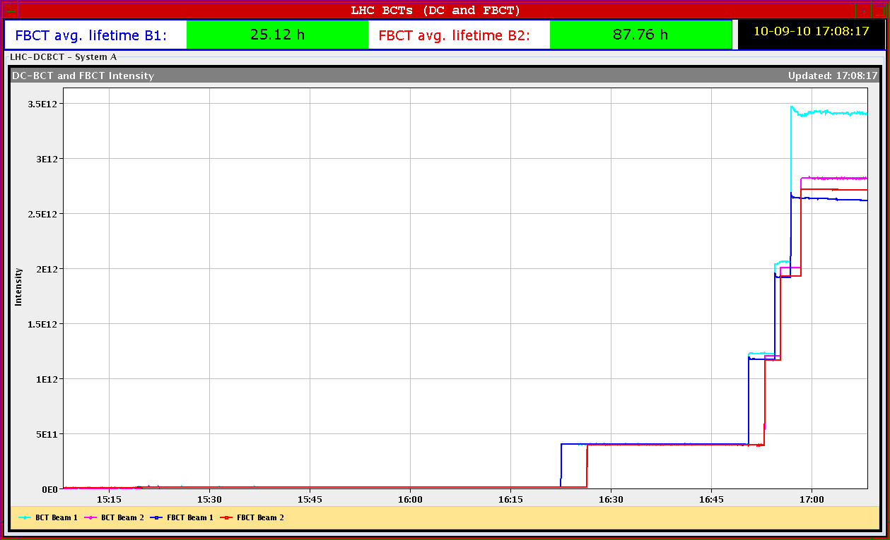
Friday 10.9
17.00 Inject 1 train of 4, then 3 trains of 8, both beams
Problem with DCBCT on B1

Slide 4
Friday 10.9
Preparation of TCT collimators for the crossing angle scan
From ~18.00, reduction of crossing angle
Steps of 10 urad
Lifetime drops seen from 90 urad onwards
Went down to 20 urad, lifetime around 1h
Back to 100 urad, lifetime jumps back up
Aperture studies
Test ramp with pilot bunch
Two collimators in IR3 with interlock at 3.5 TeV → to be fixed
Beam 1 loss during squeeze → coupling exceeded 75% of the tune split during the squeeze, which forced first the B1 (@5:24) and later the B2 Tune-FB (@5:33) to switch 'OFF'. The tunes drifted, B1-QV likely crossed the third order resonance causing the large but slow losses around 5:35 (R. Steinhagen).

Slide 5
Lifetime when Reducing Crossing Angle
3 batches of 8 bunches each, spacing 150 ns → up to 6 LR interactions per bunch
170 → 100 μrad
90 μrad
80 μrad
70 μrad
60 μrad
50 μrad
40 μrad
30 μrad
20 μrad
100 μrad
Conclusion: Minimum required crossing angle is 100 μrad in 2010.
(Werner Herr et al)

Slide 6
Required Orbit Change Margin
Injection oscillations: ± 1.5 mm (B. Goddard et al)
Closed orbit (efficient): ± 1.0 mm (J. Wenninger et al)
Closed orbit (limit): ± 0.5 mm (JW)
Correctors: > 5 μrad ≈ 1.2 mm, (JW)
Total:
Margin for beam offset change required: ± 2.5 mm

Slide 7
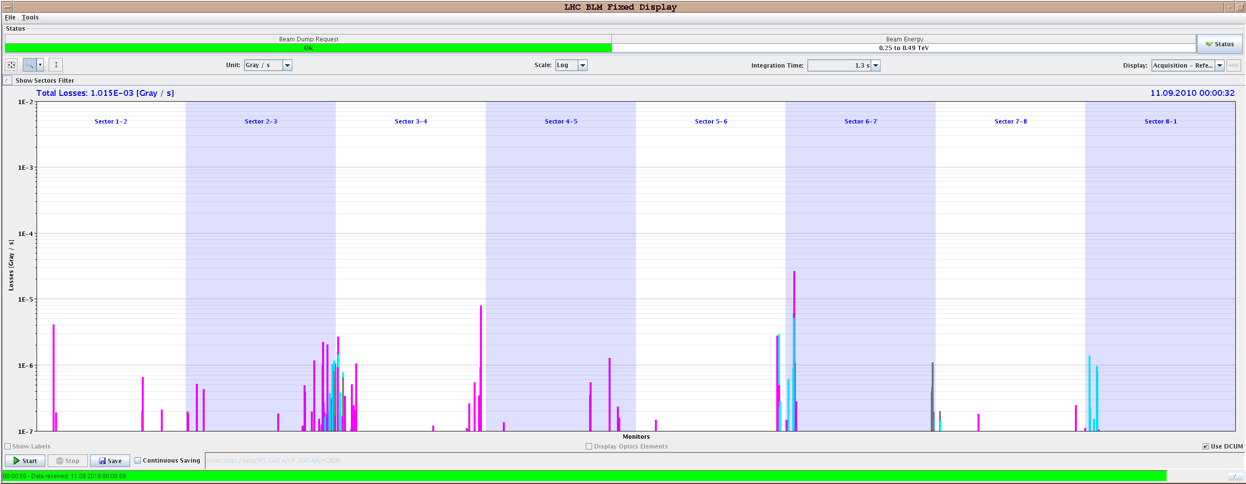
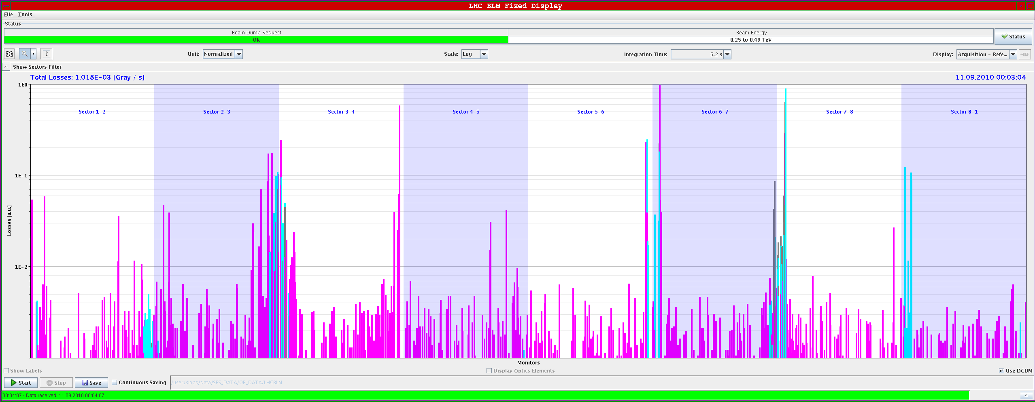
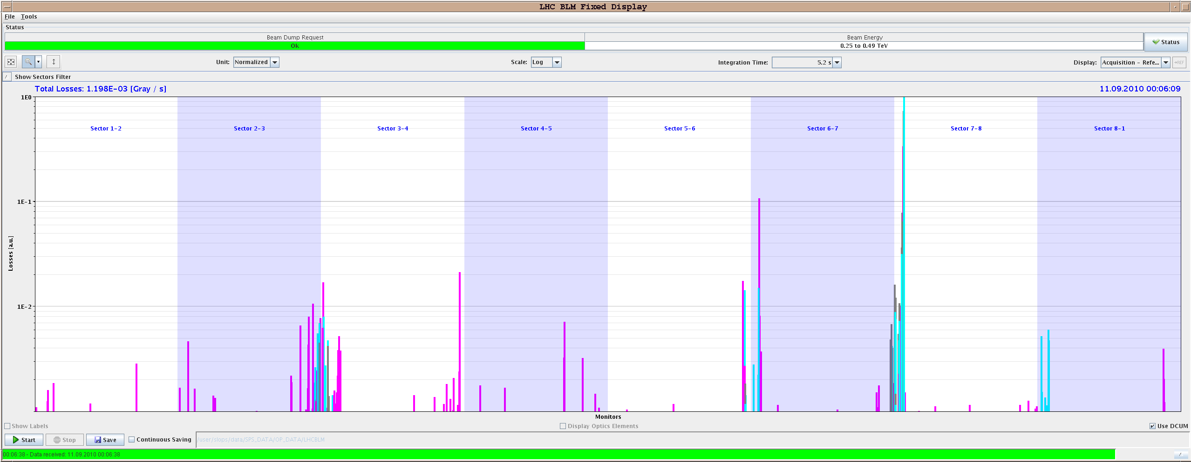
Measuring Global Aperture: B2 V
Emittance blow-up method
Q4.R6
TCPV = 15 sig
Loss at Q4 higher than at TCP
Loss at Q4 about same as TCP
Loss at Q4 lower than at TCP
Q4.R6
TCPV = 13 sig
Q4.R6
TCPV = 12 sig

Slide 8
Measured 450 GeV Aperture
On-momentum, as relevant for collimation and protection.
Predicted aperture bottlenecks in triplets (n1=7) do not exist.
“Measured” n1 = 10 – 12 (on-momentum) instead design n1 = 7.
“We discovered the aperture gold mine for performance”.
Beam / plane | Limiting element | Aperture [σ]
Beam 1 H | Q6.R2 | 12.5
Beam 1 V | Q4.L6 | 13.5
Beam 2 H | Q5.R6 | 14.0
Beam 2 V | Q4.R6 | 13.0

Slide 9
Off-Momentum Aperture B1
For large momentum offset (0.3%): losses in Q10.R6
For specified momentum offset (0.15%): losses in Q6.R2 (same bottleneck as on-momentum).
Aperture in Q6.R2 was reduced from 12.5 sig to 11 sig.
The equivalent n1=9.2 must be compared to design of n1=7.
Difference probably due to better orbit.

Slide 10
Conclusion from Aperture
Plenty of aperture at triplets: > 13 σ (n1 > 10)
Can open tertiary collimators, e.g. to 13 σ at injection.
Verify new settings with loss maps.
Will provide 6 σ margin to injection and dump protection. Fulfill Brennan’s and Joerg’s requirements.
Can stay with 170 μrad crossing angle at injection. Only possible reason to change: simplify operational procedure: same settings at injection and top energy.
Shows benefit in directly measuring the limiting factors, like aperture. Was delayed since months.
Can also review settings for injection protection → Relax?
Should measure aperture also at top energy with 3.5 m beta*. If similar margins found → smaller beta* with same risk level.

Slide 11
Not to forget
To fit in before we ramp nominal bunch (Saturday ?)
Capture / energy matching
RF longitudinal blowup. V reduction at injection.
Transverse feedback setting up to be finished ?
The present tune-fitter settings are optimised for single bunch intensities below 5e10. Need Ralph before ramping with nominal beam
I need to change the settings and validate them for the new damper settings beforehand.
Please put pretty Q'(t) pictures in the logbook...
Beam transfer team (not Bren) available Sunday for protection qualification
2 shifts needed .. Bumps at many phases

Slide 12
Not to forget
We removed RCBH28.L3B1 from the hardware groups SECTOR23
No beam from injectors Monday 07.30 to 08.30
Problems with polarity switching of ALICE solenoid (until next TS)
No remote switching
Plan polarity switches during working hours
Pass by the piquet EPC (16-1919)

Slide 13
Plan Ahead
Sat 07h00: RF setup
Sat 15h00: Collimation setup 450 GeV. Open TCT’s. Ramp with collimators → fix ramp issue with two IR3 collimators beforehand.
Sat 23h00: Loss maps at 450 GeV.
Sun 07h00: Injection protection qualification.
Sun 15h00: Collimation setup at 3.5 TeV: IR3.
Sun 23h00: Ramp and squeeze commissioning with 1 nominal bunch.

