Slide 1
Wednesday 8.9
External crossing angles:
IR1: -170 μrad at inj./ramp and -100 μrad in squeeze/collision
IR2: +170 μrad at inj./ramp and +110 μrad squeeze+collision
IR5: +170 μrad at inj./ramp and +100 μrad in squeeze/collision
IR8: -170 μrad at inj./ramp and -100 μrad in squeeze/collision
Good for beam-beam (do we need it for 150ns ?)
Bad for aperture and MP (are we ready to do this ?)
Strategy (Wednesday)
Work with nominal angles at injection
See if we can run like this
Measure IR apertures
Test parasitic beam-beam with lower angles
Decide (Friday?)

Slide 2
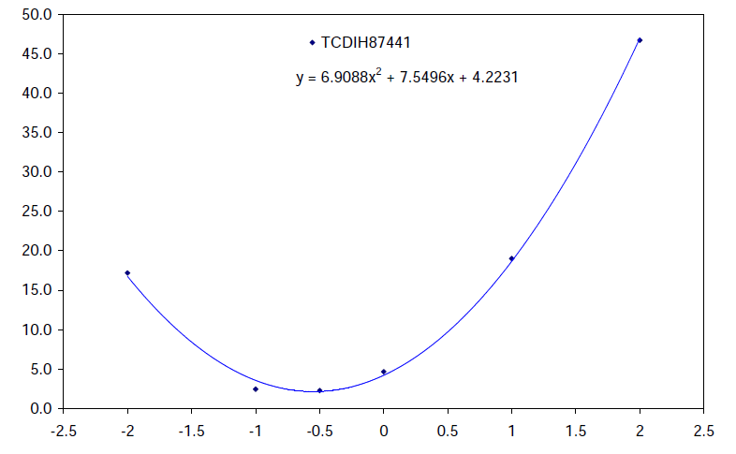
Wednesday 8.9
07h00: Scheduled access for QPS*3, RF, CMS, ALICE
12h00: Recover but then problems
RF module. We now work with 2B2 klystron off.
Lost sector 81 due to electrical problem (access needed)
14h00: Started injection work in TL to TEDS
Centering checks of 5 TCDIs with trains of 4 ~nominal
Some offsets of up to 0.5 sigma found and corrected
Gaps at +- 4.5 sigma

Slide 3
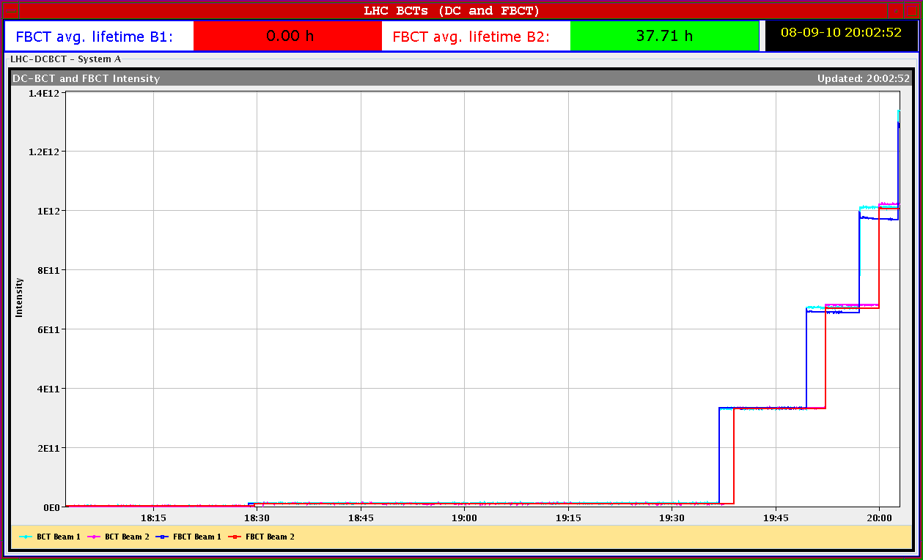
Wednesday 8.9
19h00: Continuation commissioning of injection of bunch trains
Centering of collimators with trains of 4 ~nominal
Started with interleaved B1 and B2, but a lot of uncaptured beam, B1
We had 7 batches in B1 and 6 in B2
Both beams dumped with unbunched beam on TDI giving losses B1
Partial data taken for both beams

Slide 4
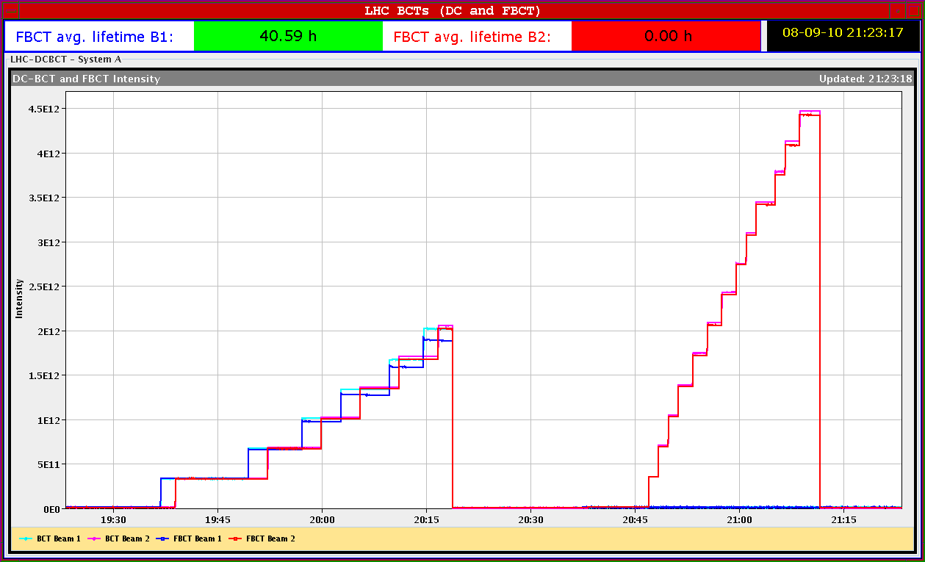
Wednesday 8.9
21h00: Continuation commissioning of injection of bunch trains
Beam 2 only
Losses increase at +1.5 sigma, no increase out to -2.5 sigma
13 * 4 trains of ~nominal
Clean beam dump
Beam 1 only …
SPS off at 22h
BA1 transformer

Slide 5
Wednesday 8.9
23h00: Continuation commissioning of injection of bunch trains
Beam 1 only
SPS off at 23.30
BA1 transformer again
***SUMMARY of INJECTION STUDIES*** Checking TL collimators with bunch train injections (4 nominal bunches):
moved the gap, recorded losses in TL and LHC injection region
centered the following collimators: TCDIV.20607 TCDIH.29050 TCDIV.29012 TCDIH.29205 TCDIH.87441 TCDIV.87645 Stopped centering of TCDIH.29645 due to SPS injection transformer problem. All new settings are trimmed into LSA and thresholds adjusted.

Slide 6
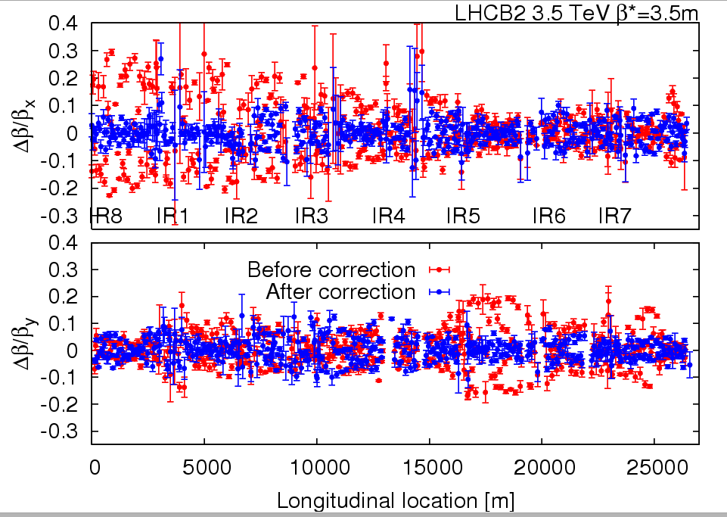
Wednesday 8.9
Night
Ramp, but beam lost protection interlock
Had to mask collimator position interlocks, one was missed
Ramp OK
Trimmed Xing angles 1 and 2 to 100 and 110 and corrected closure
Lost B1 with a corrector trip when doing IR5
Continued with B2, Xing angles 5 and 8 to 100 and 100
Squeeze B2
Brief optics studies on B2
Global correction
Impressive results !
IP1 3.22 0.22 3.62 0.40 IP2 3.83 0.61 3.43 0.26 IP5 3.67 0.07 3.28 0.25 IP8 3.26 0.10 3.51 0.09

Slide 7
Thursday 9.9
Aperture studies (until ~ midday)
Continuation commissioning of injection of bunch trains
Still 2 shifts needed
Beam 1 capture issues
Orbit cleaning

Slide 8
Week Planning
9 | Thu | M | 5 | IR aperture measurement at 450GeV
9 | Thu | A | 11 | Injection / injection protection - crossing angles ON, injection protection
9 | Thu | N | 8 | Ramp test with new collimator functions (1e10 the 1e11). PLL in parallel ?
10 | Fri | M | 8 | Injection / injection protection: crossing angles ON - injection of trains of 12
10 | Fri | A | 3 | First look at beam-beam with trains of 12
10 | Fri | A | 5 | Ramp of 1e11. RF longitudinal blowup. V reduction at injection.
10 | Fri | N | 8 | Reserve
11 | Sat | M | 8 | RF set up with 4 bunches of 150ns spacing. Transverse feedback.
11 | Sat | A | 8 | Collimation set up at 3.5TeV. End of ramp and after Xing angle change.
11 | Sat | N | 8 | Loss maps.
12 | Sun | M | 8 | Reserve
12 | Sun | A | 8 | Collimation set up at 3.5TeV. End of squeeze and collision settings.
12 | Sun | N | 8 | Loss maps.
13 | Mon | M | 8 | Injection / injection protection: crossing angles ON - injection of trains of 4
13 | Mon | A | 8 | RF set-up with more batches at injection
13 | Mon | N | 8 | Collimation set up at 3.5TeV and loss maps.
14 | Tue | M | 8 | Collisions ?

