Slide 1
Tuesday 7.9.
08h30: Collimation setup 450 GeV
11h18: RF module M1B1 trip. Beam 1 dumped. Continue with b2.
13h23: Beam 2 collimation complete. First loss map.
Access in UX45 to fix the problem with RF module.
New software for BCT. Voltage reduction at injection tested.
14h55: Injection.
RF module M1B1 trip. B1 lost again.
Problem with crossing angle: hysteresis problem.
Recycling RCBXs.
Reference orbits saved & BPM calibration
18h31: Continuing collimation setup:
Setup last two b1 collimators.
Check on injection collimators.
Loss maps.

Slide 2
BI Ring Intensity Measurements
M. Ludwig
DCCT
offset correction by software is now deployed, and also the precision calibration is corrected.
Small bugs fixed, diagnostics improved, crates come up correctly now after reboot.
The CCC sequencer triggers the analogue offset compensator (coarse offset correction), followed by SW off. corr. (fine correction).
New version deployed A and B systems.
FastBCTs
there is a calibration patch now which uses the abort gap for offset correction, which seems to work fine. Studies continue
the jitter observed on the LOBW channel with small beams ~few e9 was due to modified automatic gain switching behavior following the installation of the attenuators, it is understood and fixed now.

Slide 3
RF Voltage Change for Injection
Andy, Delphine
The total voltage function descends from 7MV to 3.5MV triggered by the 1s injection forewarning, then ramps up to 7MV after the injection.
It was tested from Delphine's development system, not yet working in the operational environment (always select disable inj trim in injection sequencer).

Slide 4
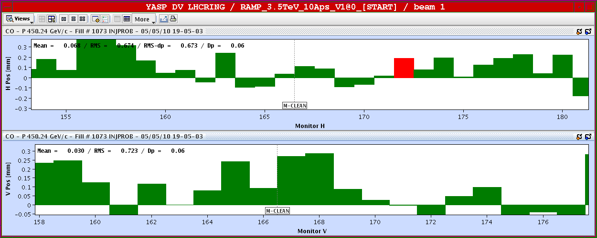
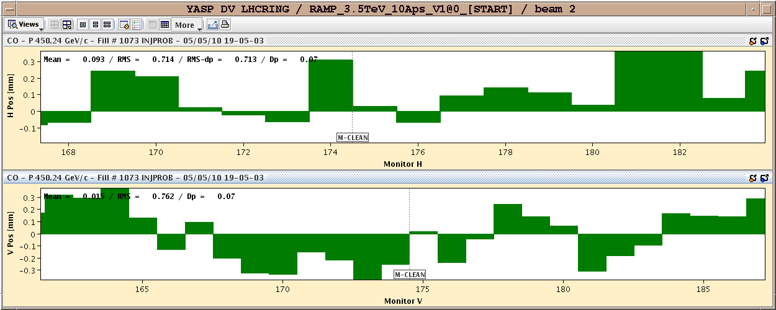
New Reference Orbit in IR3: Diff to May 5
B1
B2

Slide 5
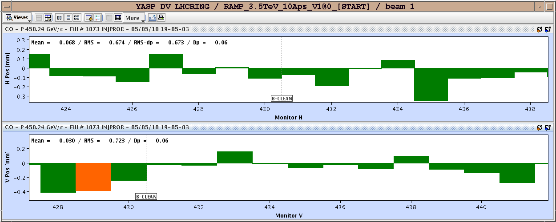
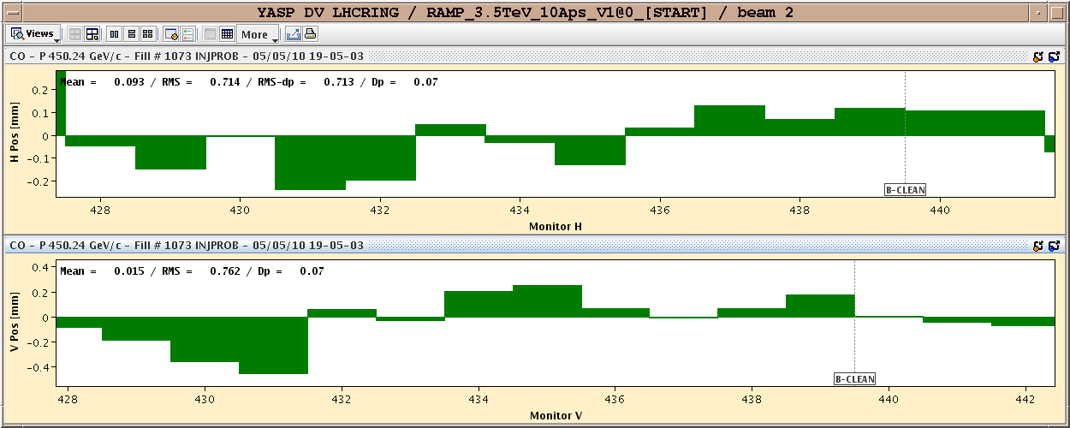
New Reference Orbit in IR7: Diff to May 5
B1
B2

Slide 6
Impact on IR3/IR7 Collimation Setup
Goal is not to set up again IR3 and IR7 collimators.
Need to keep as close as possible to old reference (May 5)
Differences to old reference: ~ 0.4 mm
Seems still to work for injection. However, if this orbit is kept up to 3.5 TeV (as planned), 0.4 mm will correspond to >2 sigma.
If this reference is used, we “incorporate” the 0.4 mm difference. Becomes invisible for operation.
Seems too big:
Decide whether changes are real or instrumental.
If real, correct to ~ 0.1 mm maximum difference. Possible according to Joerg.
If orbit cannot be restored, we can always set up all collimators for a new orbit → prefer not to, as this takes quite a bit of time.

Slide 7
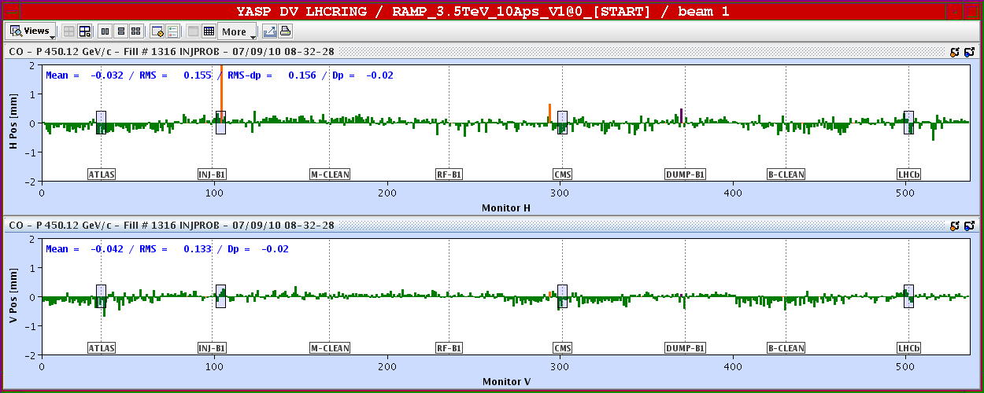
Orbit: Temperature Effects Seen
Not possible to correct → Weekend reference orbit saved before BPM calibration.

Slide 8
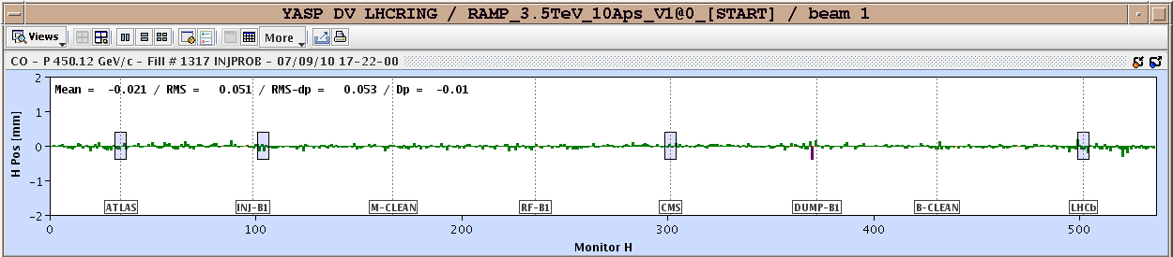
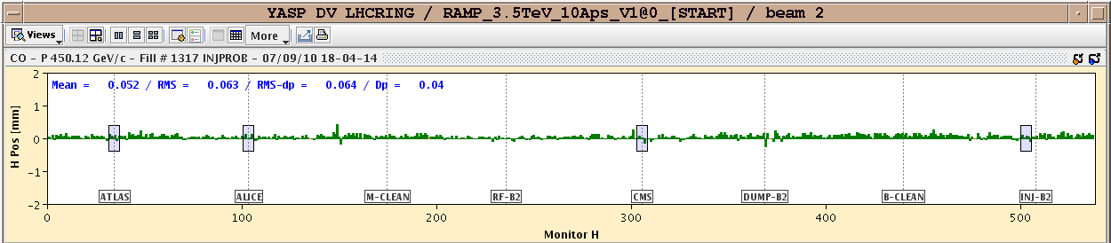
New Ref Orbit with BPM Calibration
Corrected back to start of collimation setup with crossing angle
Then performed BPM calibration (R. Jones)
Then saved new reference with fresh BPM calibration.
Understanding: After BPM calibration (should be performed regularly) come back to “BPM-calibrated” reference much better.
Effect of BPM calibration → good?

Slide 9
Tuesday 7.9.
22h20: 450 GeV collimation setup complete, loss maps mostly done:
16 TCT’s around experiments set up to nominal crossing angle (170 μrad).
TCT’s at injection set to 8.5 σ: ~expected triplet aperture (no margin to calculated triplet aperture, assume n1 calculation has some margin).
Total margin from protection to TCT/triplet: ~0.8 mm. Requires orbit tolerance ~0.2 mm.
Injection protection collimators checked: Problem found and corrected with loss maps.
7 out of 10 loss maps done.
Intervention on BLM’s: Exchanged one BLETC module which detected to have one broken link by the newly introduced automatic optical link check. There is redundancy on the links and it has worked correctly as expected. The safety has not been compromised at any way. This was the first time we have been able to act in advance of a ?false dump request? from degraded electronics. Completed the intervention by driving the settings on the new card and running the MCS and Sanity Checks.
23h40: Start of transverse damper studies.

Slide 10
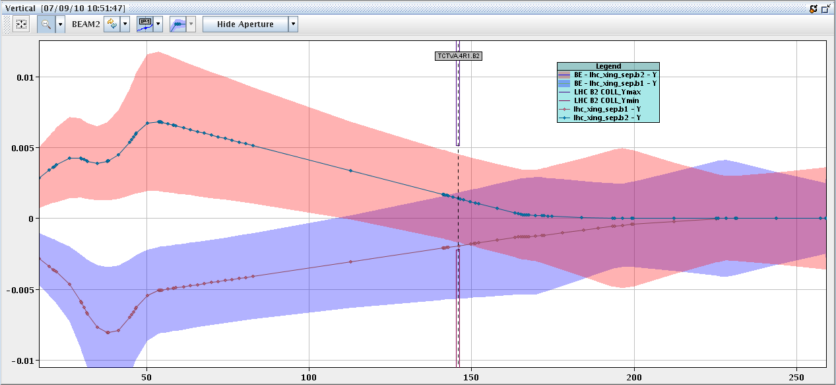
New OP Tool Checked During Setup
Beam envelopes around
measured beam position
Collimator

Slide 11
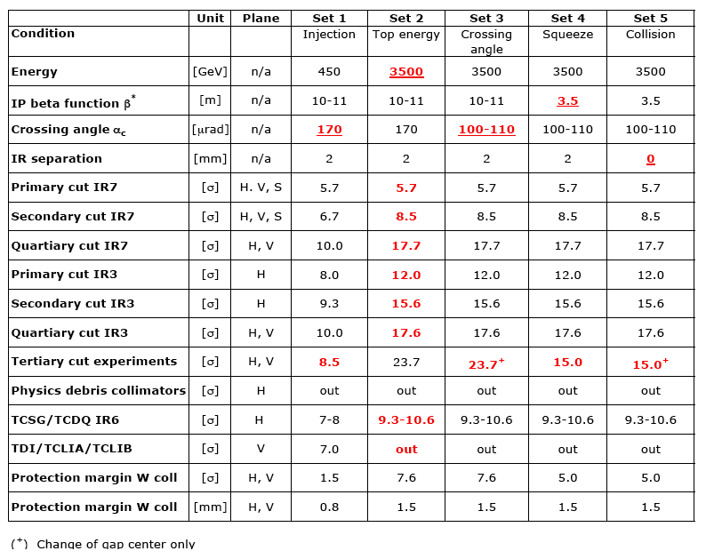
New Collimation Settings

Slide 12
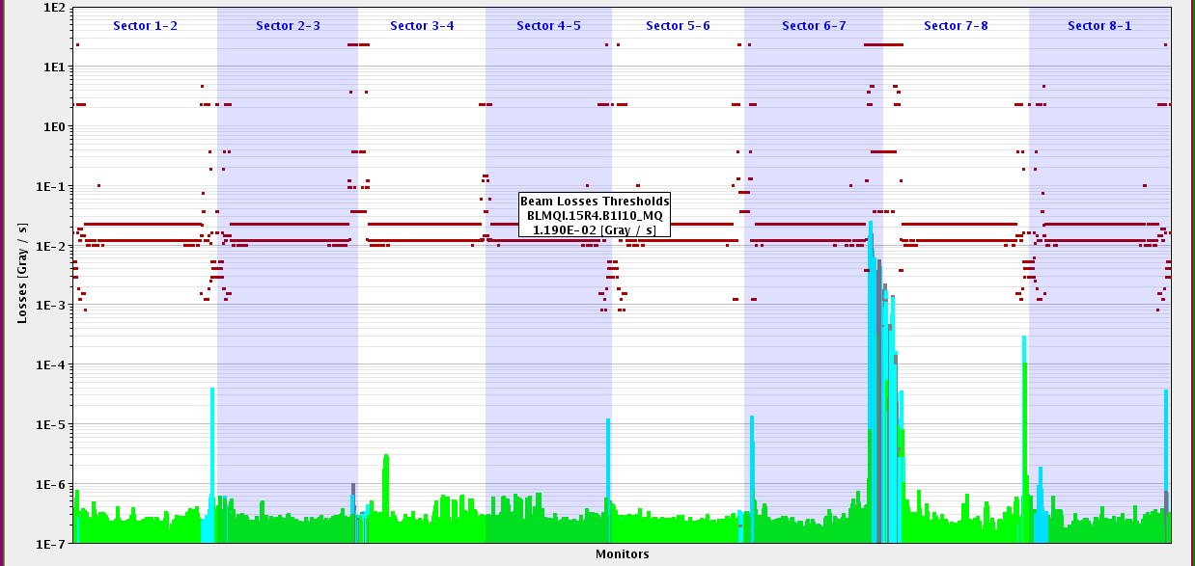
Loss Map B1 V
Injection protection out
LHC-b
ALICE
ATLAS
CMS
Detailed analysis to be performed! Preliminary:
Tighter injection aperture: 1-2 % leakage into IR8! 10 times above 3.5 TeV leakage. No losses seen in SC IR aperture.
Protection of n1=8 seems to be sufficient (calculated is n1 slightly less than 7 for IR8).

Slide 13
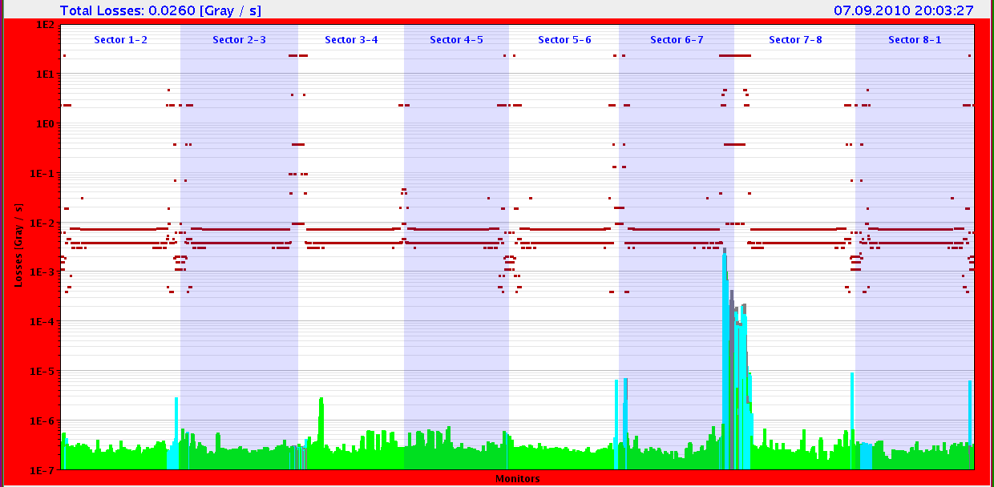
Loss Map B1 H
Injection protection out
Lower losses in IR8.

Slide 14
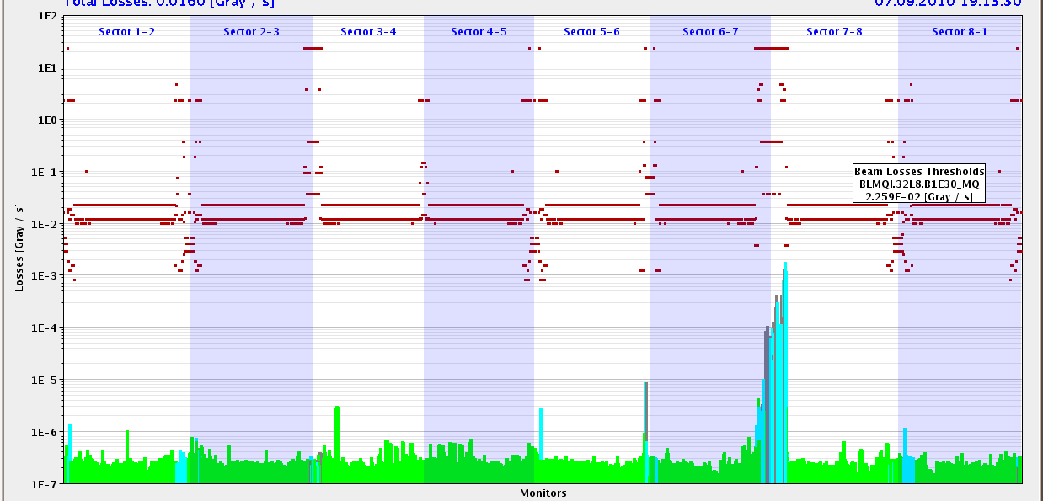
Loss Map B2 V
Injection protection out
CMS
Detailed analysis to be performed! Preliminary:
Tighter injection aperture: 0.2 % leakage into IR5! Similar to 3.5 TeV leakage. No losses seen in SC IR aperture. Helped by “cleaning” in IR6.
Protection of n1=8 seems to be sufficient (calculated is n1 of 7.1 for IR5).

Slide 15
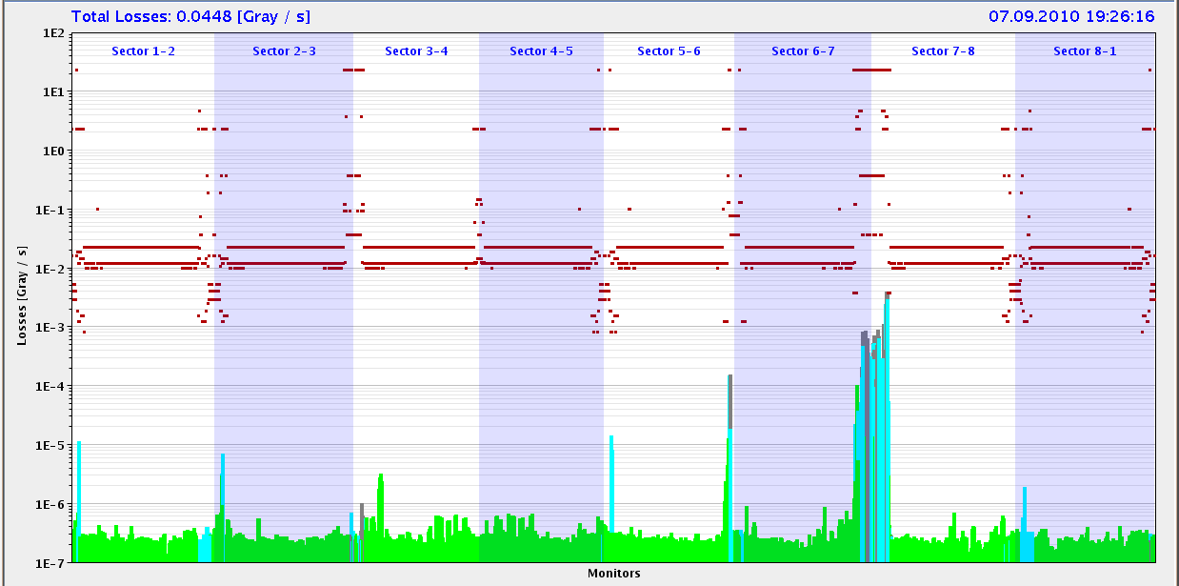
Loss Map B2 H
Injection protection out
H cleaning does not look too nice.
Higher leakage to IR5.

Slide 16
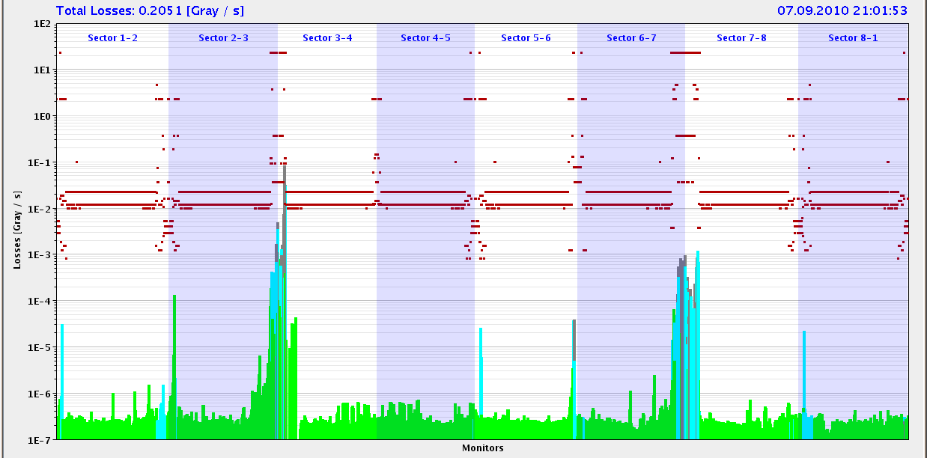
Loss Map Off-Momentum B2 (neg. E)
Injection protection out

Slide 17
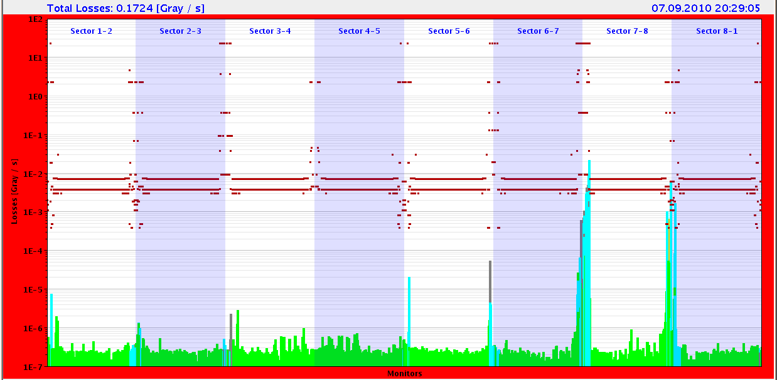
Loss Map B2 V With Inj Coll in

Slide 18
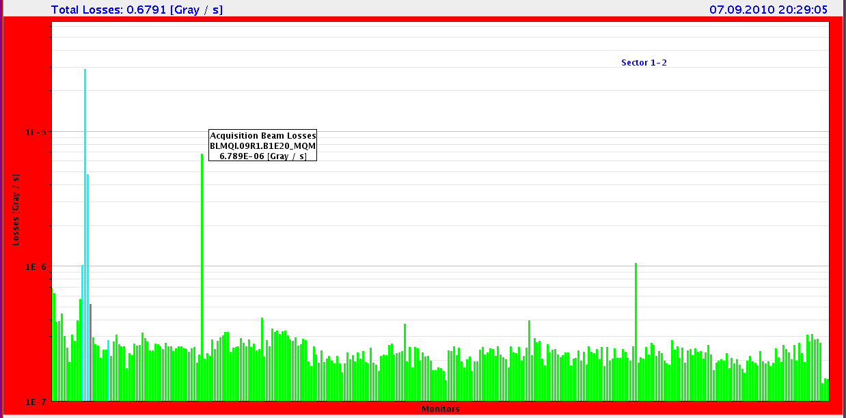
Loss Map B2 V With Inj Coll in
Losses in Q9 in IR1!?

Slide 19
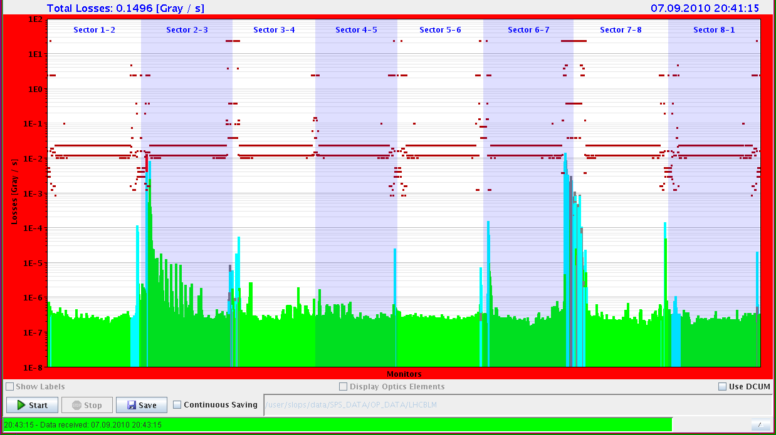
Loss Map B1 V With Inj Coll in
Problem for injection collimator in IR2.

Slide 20
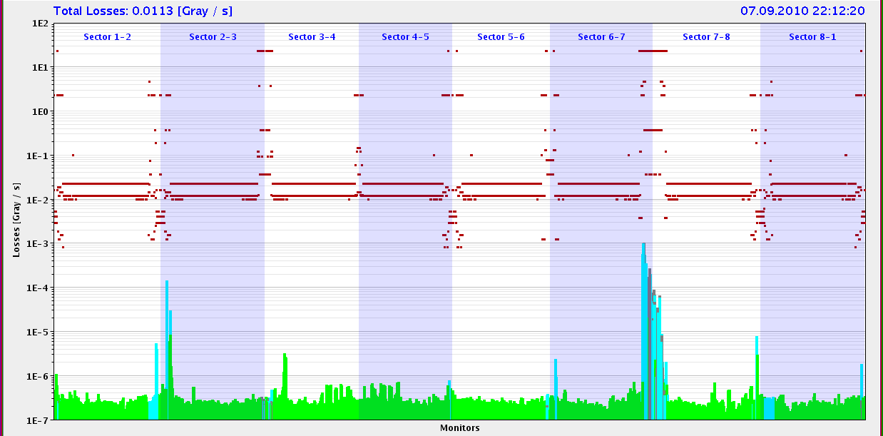
Loss Map B1 V With Inj Coll in
Problem for injection collimator in IR2 solved.

Slide 21
Losses at Injection: Prel. Summary
The aperture is much tighter at injection with nominal crossing angles (7 mm bumps in IR’s).
As expected, increased losses in experimental IR’s, even with TCT’s at 8.5 σ (tighter settings requested after n1 calculation).
Chosen TCT setting seems to protect the triplets and TAS (margin in n1?). Nothing terrible seen. Detailed analysis required!
Propose to keep this in order to provide 0.8 mm total tolerance budget for IR protection (would be smaller otherwise).
Tight control of orbit at injection (~0.2 mm, to be discussed) is required to keep IR’s protected by injection and dump protection collimators.
Requires further detailed analysis by collimation and injection/dump protection teams.

Slide 22
Wednesday 8.9.
23h40: Start of transverse damper studies.
01h20: Transverse damper studies completed.

Slide 23
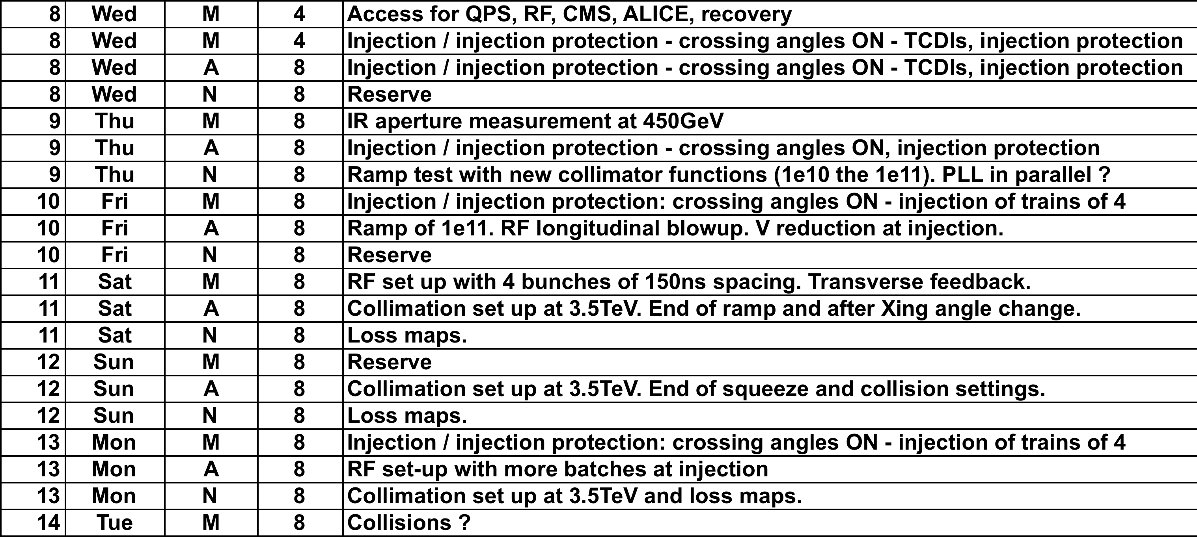
Week Planning
To be added: Interlock tightening at injection (Joerg)

Slide 24
Ahead

