Slide 1
LHC status - Week 35
G. Arduini, M. Lamont
Main aims:
Recovery after technical stop
Commissioning of ramp with 10 A/s
Commissioning of bunch trains with 150 ns spacing

Slide 2
Statistics
From the end of the technical stop (Thu 2/9 at 18:00 to Mon 6/9 07:00)
Beam: 48 %
Set-up without beam: 18 %
Faults: 34 %
Major stops:
Cryogenics Sector 34 (~13 h), QPS (~6 h), XPOC (~3 h), PS MPS cooling & RF trip of 4 cavities (~2 h)

Slide 3
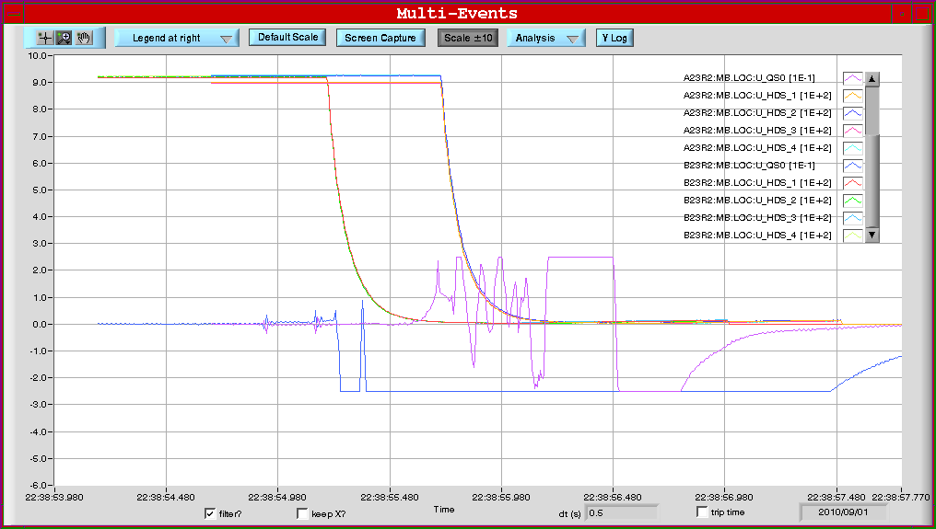
RB.A23
Switch-opening test on RB.A23 caused quenches in 4 magnets:
B23R2 at 22:38:55.196 Elec. perturbation of 2nd switch triggers old QPS (board B)
A23R2 at 22:38:55.704 500 ms later, little understood propagation phenomenon
C23R2 at 22:41:19 symmetric quench by thermal propagation @ 400 A
B22R2 at 22:41:19 heaters fired as 3 neighbors were quenched
A23R2 previously measured excess splice resistance by nQPS: 28 nOhm.
Measurement individual aperture- and inter-aperture-splice resistances.
preliminary analysis confirms the order of 30 nOhm – no degradation.
Excess resistance is not concentrated in one splice but is distributed in both apertures.
OK for powering
U_HDS:
B23R2
A23R2
1st switch
U_QS0:
A23R2 resistive transition
2nd switch

Slide 4
Commissioning steps
Crossing angles setting-up
10 A/s ramp and squeeze
Injection/Injection protection
RF and Transverse feedback
Bunch train setting-up in the injectors

Slide 5
Crossing angles
Polarities for ALICE solenoid/spectrometer: + + (last time changed in May!)
Polarity for LHCb spectrometer: -
External crossing angles:
IR1: -170 μrad at inj./ramp and -100 μrad in squeeze/collision
IR2: ±170 μrad at inj./ramp and ±110 μrad squeeze+collision
IR5: +170 μrad at inj./ramp and +100 μrad in squeeze/collision
IR8: -170 μrad at inj./ramp and -100 μrad in squeeze/collision
IP2 with parallel separation (3 to 4 sigmas).

Slide 6
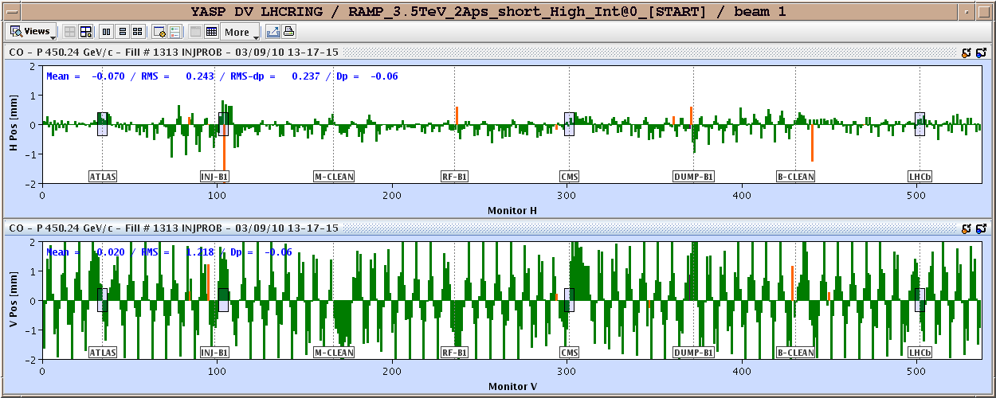
ALICE Polarity Change
Can be corrected using compensator magnets and MCBX ➔ need time to verify corrections to be implemented for each polarity.

Slide 7
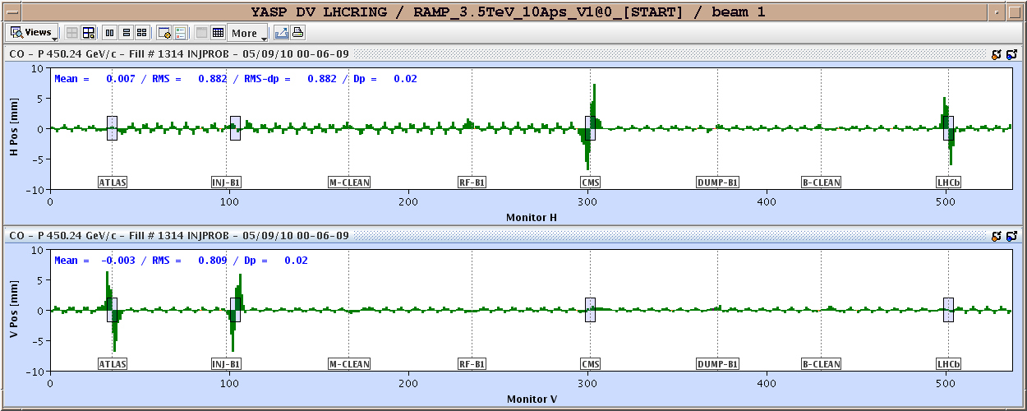
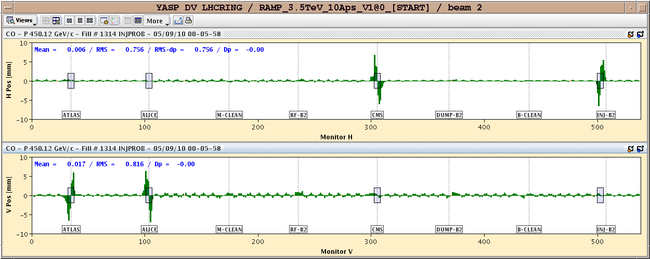
Crossing angles
Non-closures (rms): - B1 H/V : 0.44/0.27 mm - B2 H/V : 0.14/0.31 mm
Calculated corrections for each point separately

Slide 8
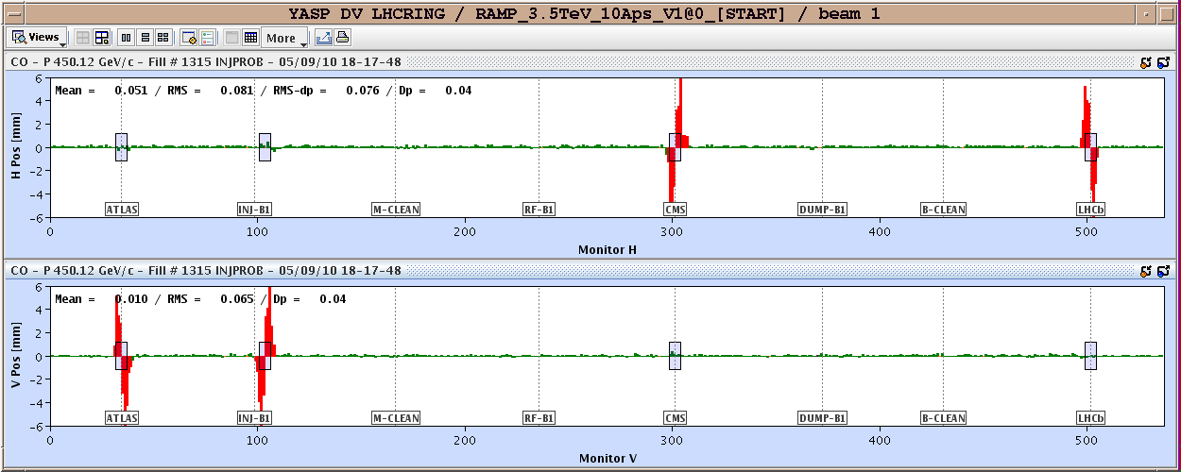
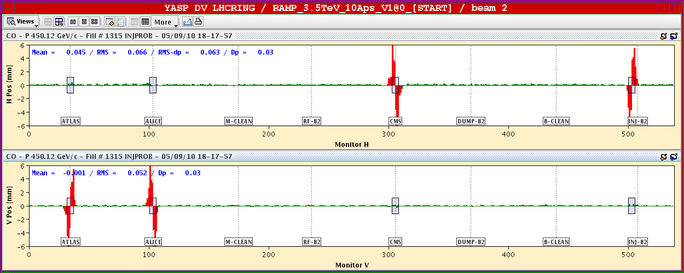
Crossing angles
Non closure corrected Golden orbit defined at 450 GeV/c. Ramp with crossing angles ON done. Measurement and non closure correction calculation during the squeeze.

Slide 9
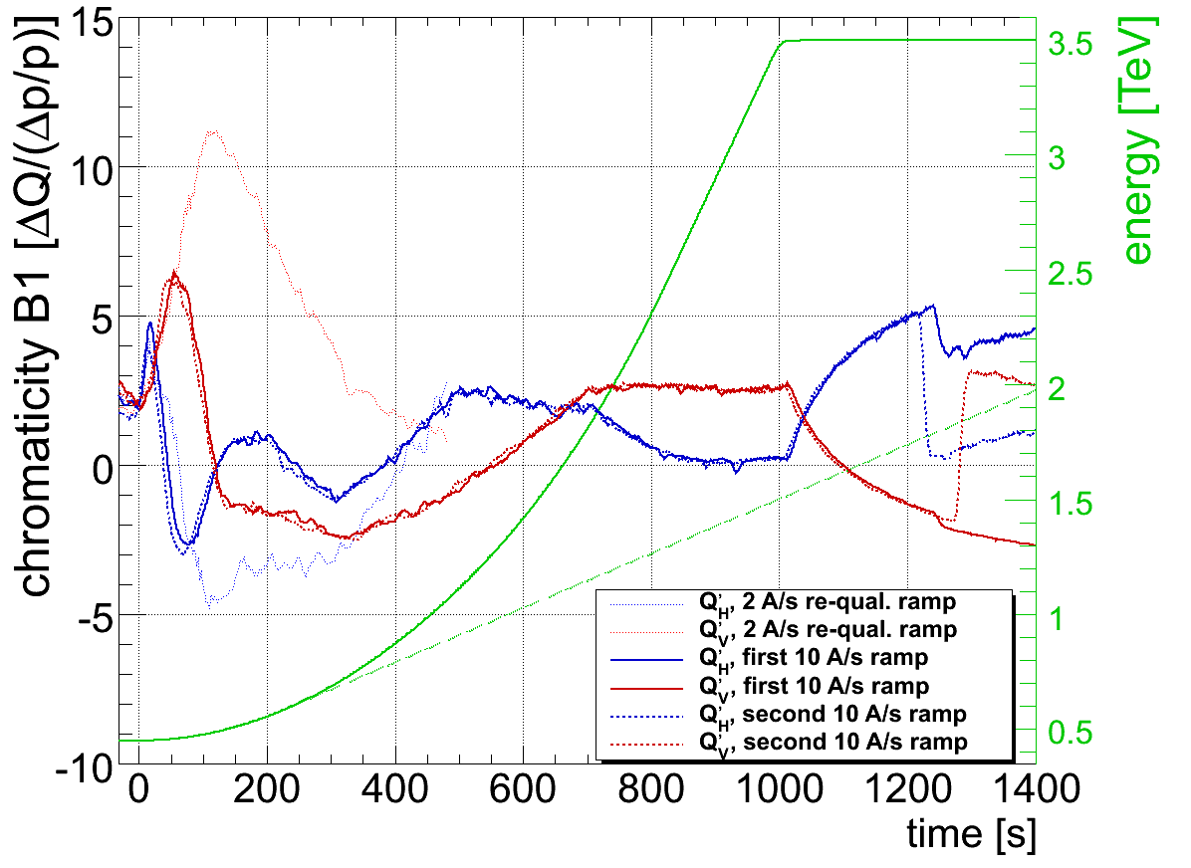
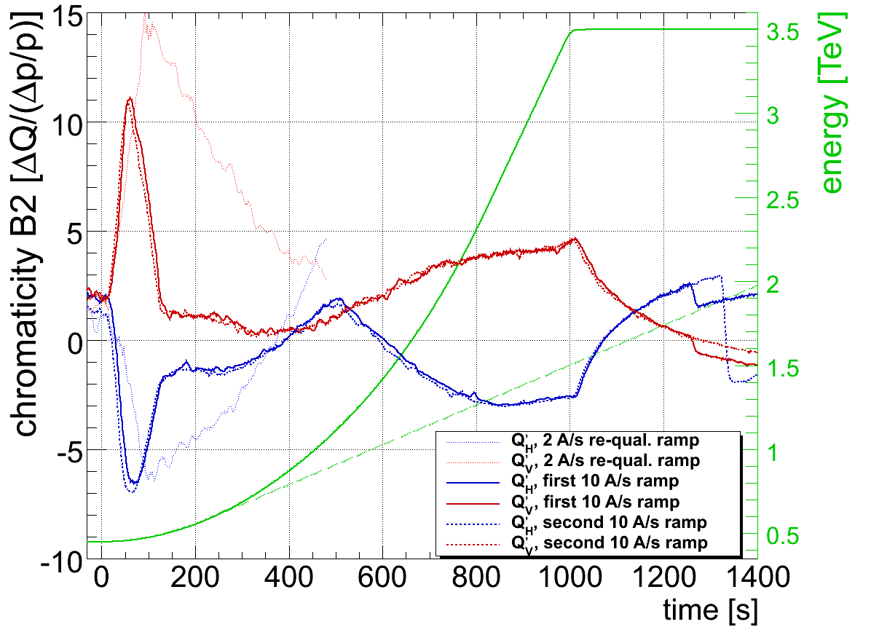
10 A/s ramp
Chromaticity during the ramp ➔ feedforward to be implemented today via expert application
R. Steinhagen

Slide 10
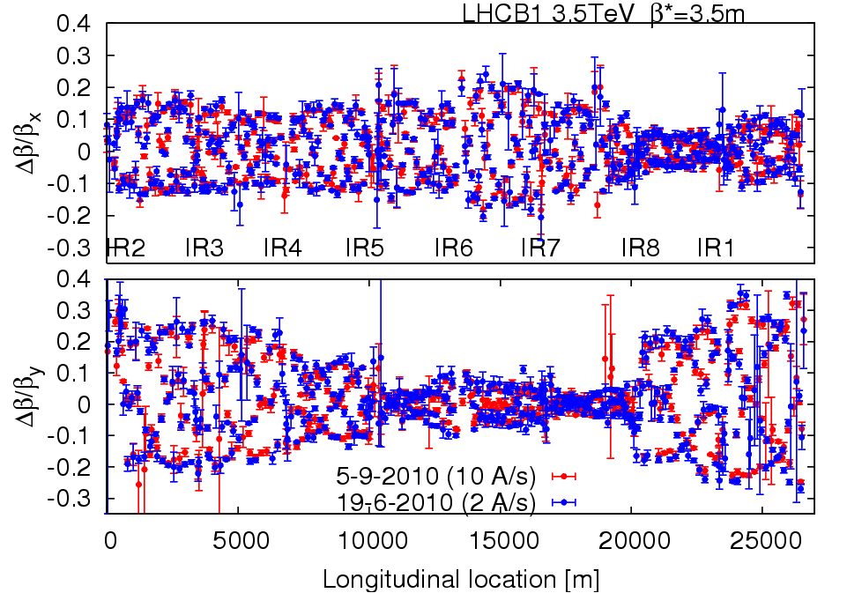
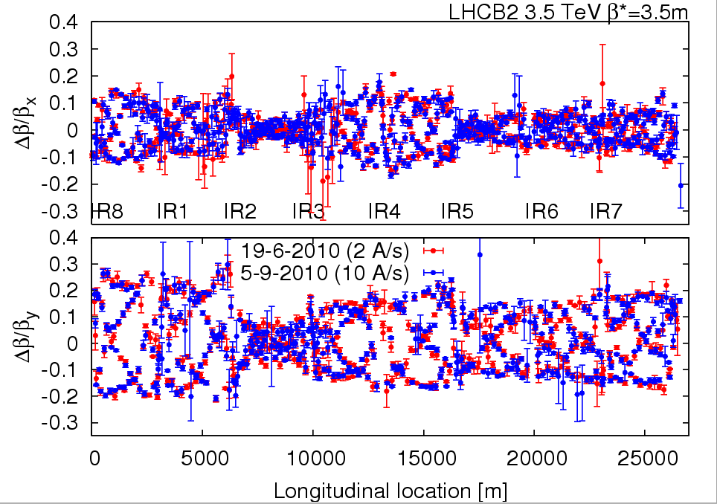
Squeeze
Beta-beating measurements: reproducible
R. Tomas et al.

Slide 11
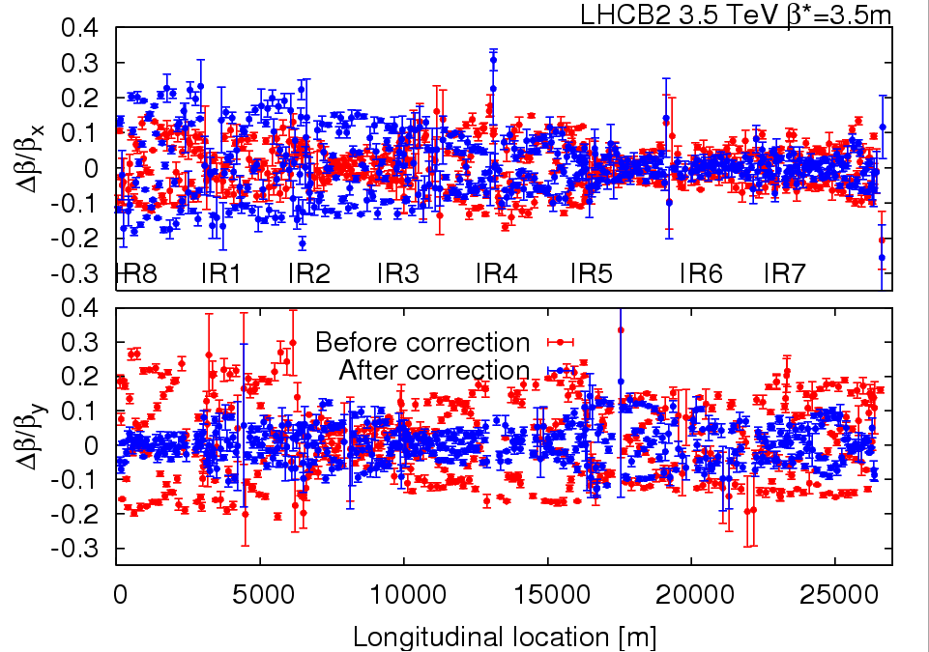
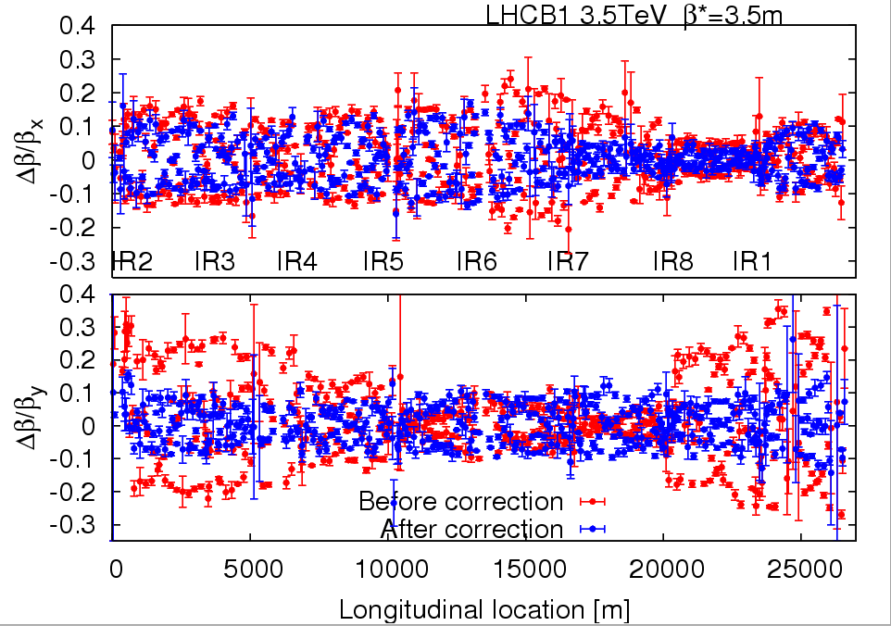
Squeeze
Correction of beta*: below 20%. Clear improvement in the V-plane. Verification and possible second iteration ongoing (issues with the incorporation of the trims being addressed)
R. Tomas et al.

Slide 12
Squeeze (Beta*)
Before correction (June-July measurements)
Beam1:
X Y IP1 3.75±0.1 4.04±0.28 IP2 3.36±0.68 2.91±0.50 IP5 3.80±0.67 3.10±0.51 IP8 3.25±0.39 3.63±0.45 Beam2:
X Y IP1 3.69±0.32 3.44±0.05 IP2 3.37±0.06 4.03±0.14 IP5 3.80±0.13 4.12±0.14 IP8 3.77±0.07 2.92±0.25
After correction
Beam1: X Y IP1 3.87±0.04 3.82±0.58 IP2 3.53±0.25 3.45±0.06 IP5 3.67±0.13 3.35±0.13 IP8 3.30±0.05 3.62±0.11 Beam2: X Y IP1 3.41±0.70 3.84±0.19 IP2 3.85±0.43 3.57±0.15 IP5 3.70±0.10 3.79±0.06 IP8 3.67±0.06 3.36±0.05
R. Tomas et al.

Slide 13
Injection protection
Beam 1:
Injection protection collimators re-centered with (vertical) crossing angle ON TDI: angular scan performed. A further control on the sign of the tilt for the upper jaw is needed. TCLIA and TCLIB have been re-centered for B1. 5 mm orbit offset found at TCLIA.
Beam 2:
Centering of injection protection collimators: no relevant difference has been recorded, as expected (horizontal crossing).
All new settings and thresholds have been updated in the trim application for the fastRamp beam process.
Settings and threshold tested via the sequencer.
Injection of nominal bunch OK
C. Bracco, B. Goddard

Slide 14
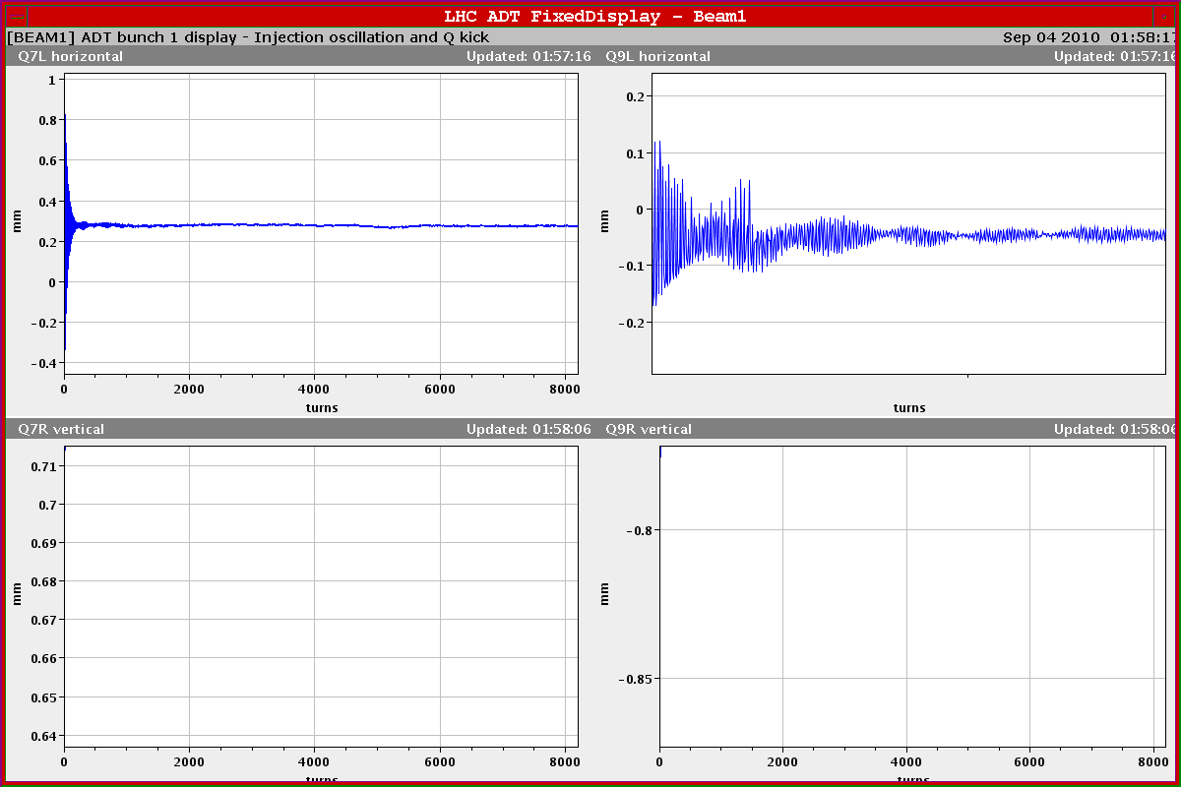
Transverse feedback
Noise reduction of the BPM by factor ~2 by optimization of the dynamic range. Saturation level set to ±2 mm for 1 ns bunch length and 1.3x10¹¹ Before improvement it varied between 1.8 um and 2.8 um.
Main aim: allow detecting smaller oscillation amplitudes (e.g. Hump) and allow operation at larger gain
During tests observed problem: “Close to zero there is a small glitch observed” ➔ to be further investigated
W. Hoefle, D. Valuch

Slide 15
RF
New RF functions: capture voltage set to a fixed 3.5 MV during flat bottom using -+ 60 deg counter-phasing and scalar 7 MV total in order to allow operation with all cavities ON during first 50 s of ramp, zero counter-phasing and reduce scalar voltage from 7 to 3.5 MV. Voltage seen by beam ~ constant 3.5 MV then ramp voltage linear from 3.5 MV to 8 MV (reached at end ramp) start long blow-up when voltage reaches 5 MV (one third of ramp)
P. Baudrenghien

Slide 16
Bunch train setting-up in the injectors
Cycle for up to 4 x 12 bunches with 150 ns spacing commissioned. Bunch population ~1x10¹¹
Transverse emittances in the range 2.5-2.7 μm (initially obtained by transverse blow-up in the PS and SPS) since yesterday completely done in the PS
From time to time observed long bunches at injection in the SPS
Transfer line setting-up to be performed

Slide 17
Others
Splash events for CMS (Beam 1) last night: took longer than expected: Inject & dump limited by XPOC analysis time+ FMCM interlocks from time to time on the SPS extraction septum.

Slide 18
Plan
Squeeze with beta-beating correction incorporated on-going together with verification of the non-closure of the crossing angles. Expected to continue until midday
Injection/Injection protection set-up
Collimation set-up at 450 GeV
Next coordination team: R. Assmann, R. Bailey

Slide 19
Pending requests
Access in point 2 for scope removal (K. Dahlerup-Petersen) – 3 hours (including re-qualification of the QPS after intervention)
Sector 78 energy extraction test (K. Dahlerup-Petersen) – 2 hours

