Slide 1
Week 34
Physics fills (bunch intensity 0.9 → 1.1e11 p):
  #1298 (Sun/Mon): 48b x 48b. Beam dump due to fast beam losses in IR3 (MQ22.R3). (8h18).
  #1299 (Tue): 48b x 48b. Duration physics 3h16. Beams dumped due to RD1.R2 trip.
  #1301 (Tue/Wed): 50b x 50b. Duration physics 14h26. End-of-fill studies.
  #1303 (Thu): 50b x 50b. Duration physics 13h14. Beams dumped with fast beam loss event Q25.R5. Luminosity > 10³¹ in ATLAS and CMS!
  #1305 (Fri): 50b x 50b. Duration physics 3h30. End-of-fill studies. Delivered integrated luminosity in 2010 > 3,000 nb⁻¹
  #1308 (Sat/Sun): 50b x 50b. Duration physics 13h42. Programmed dump.
  #1309(Sun/Mon): 50b x 50b. Duration physics 11h00.
Total time in physics in past 7 days: 67h26 (~40% of time), > 1.5 pb⁻¹
In addition, commissioning work…
About 3 shifts lost with access in LHC or injectors.

Slide 2
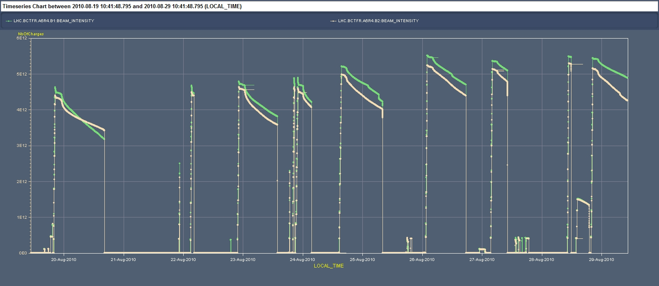
Current History (up to Sun noon)
Massi Ferro-Luzzi
50b x 50b
48b x 48b
Bunch-train commissioning

Slide 3
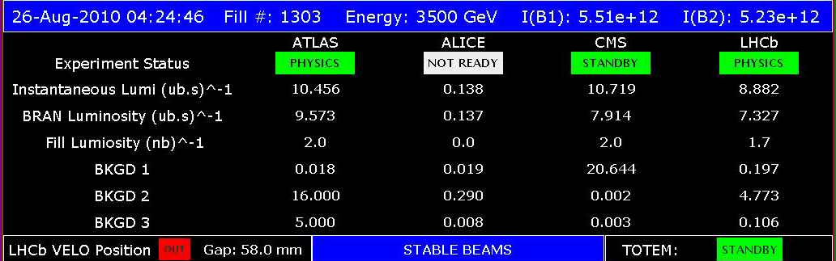
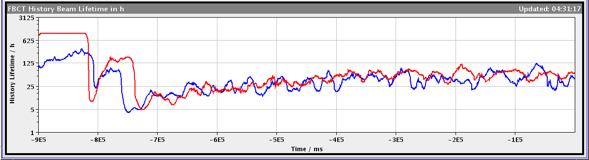
New Record Lumi

Slide 4
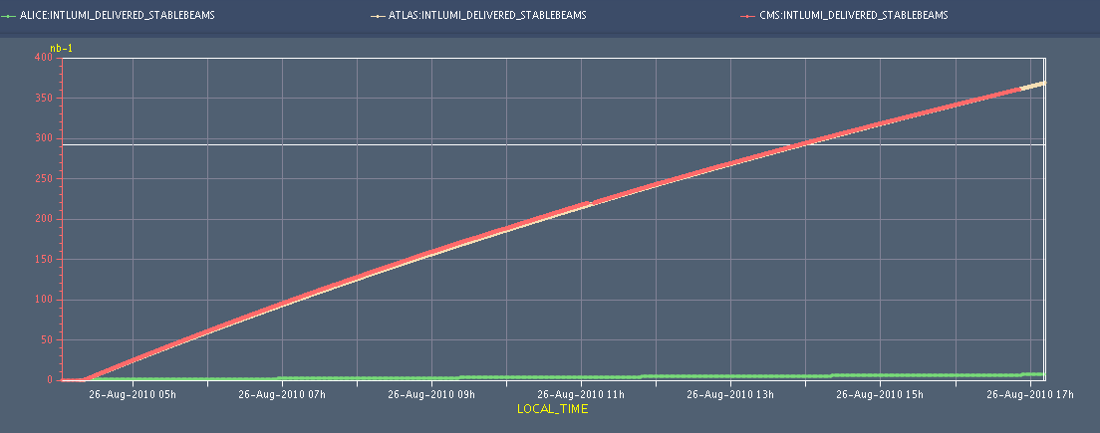
Integrated Luminosity in 1 Fill
370 nb-1 over 13 hours.

Slide 5
New Fill Pattern
Goal: Avoid parasitic crossings in IR2 and IR8.
Therefore: 48b x 48 b → 50b x 50b
Expect: Lower losses and higher luminosity lifetime.

Slide 6
Intensity Loss Fill 1298 (first 2 h)
1 LR in 2 (33m)
1 LR in 2 (33m)
1 LR in 8 (33m)
1 LR in 8 (33m)
1 LR in 2 (22m)
1 LR in 2 (22m)
48b x 48b
no Long Range interactions
with Long Range
  IPs: 1 5 2 8 - 1 5 8 - 1 5 2 - 1 5 - 2 8 - 8

Slide 7
Intensity Loss Fill 1295 (first 2 h)
1 LR in 2 (33m)
1 LR in 2 (33m)
1 LR in 8 (33m)
1 LR in 8 (33m)
1 LR in 2 (22m)
1 LR in 2 (22m)
48b x 48b
no Long Range interactions
with Long Range
  IPs: 1 5 2 8 - 1 5 8 - 1 5 2 - 1 5 - 2 8 - 8

Slide 8
Intensity Loss Fill 1301 (first 2h)
50b x 50b
no Long Range interactions
with Long Range
  IPs: 1 5 2 8 - 1 5 8 - 1 5 2 - 1 5 - 2 8 - 8

Slide 9
Intensity Loss: summary across fills
48 bunches
50 bunches

Slide 10
End of Physics Fills
In total 7 physics fills over last week.
2 fills dumped by fast loss events: MQ22.R3 and Q25.R5.
1 fill dumped by QPS trip
2 fills ended with end-of-fill studies (normal end).
2 fills ended with programmed dump (normal end).

Slide 11
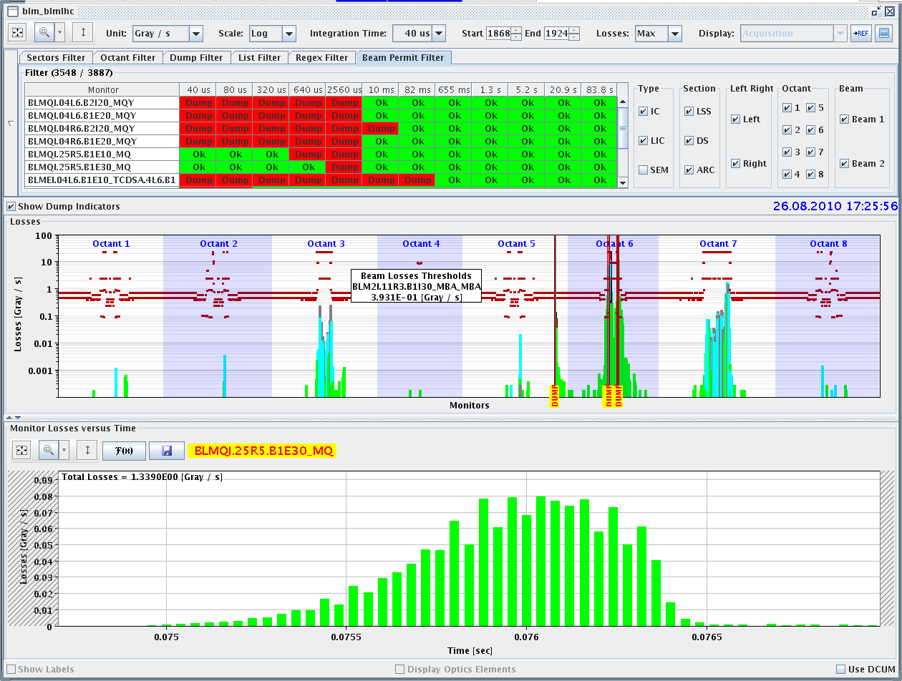
Beam Dump with Fast Loss
Q25.R5

Slide 12
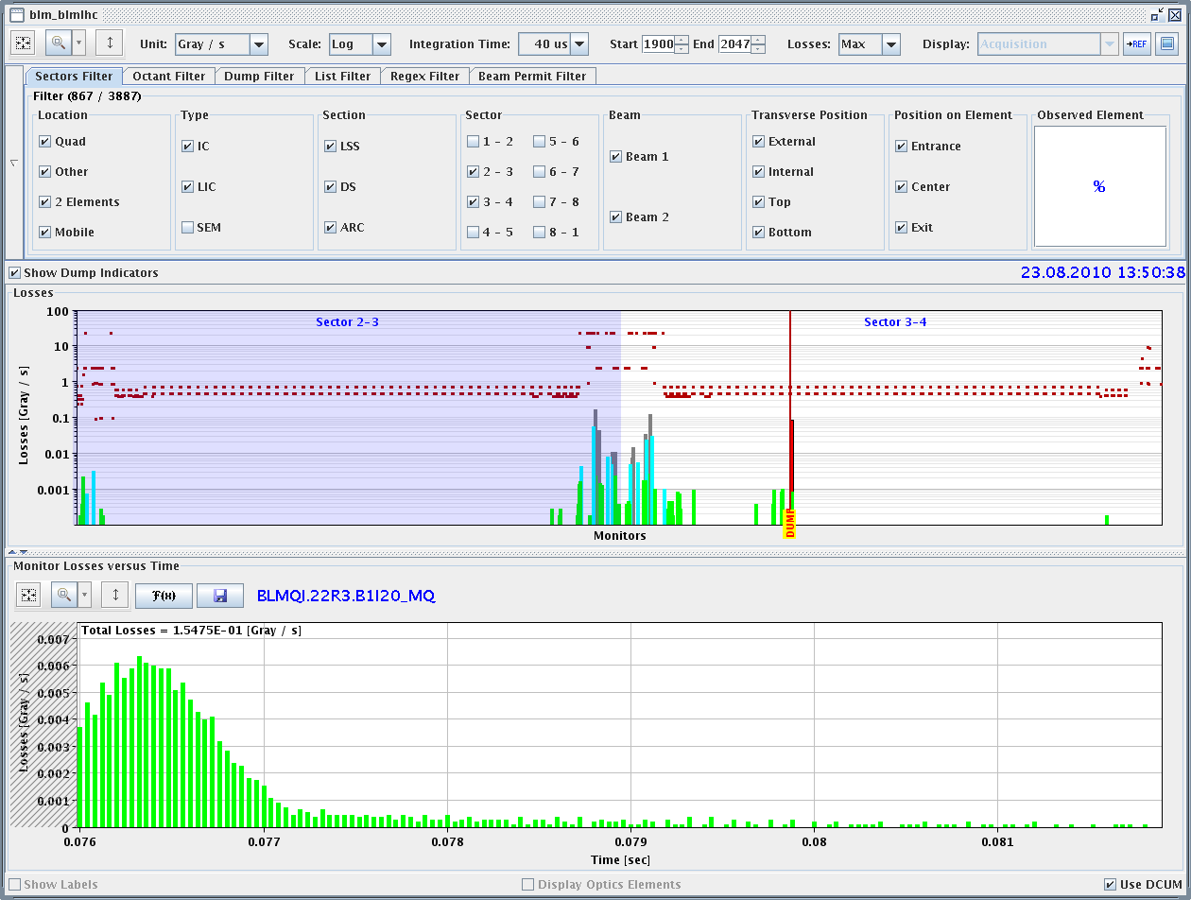
Beam Dump with Fast Loss
Q22.R3

Slide 13
Other Beam Loss Events
Fast beam loss spike at primary collimators.
RF trips.
Beam dump due to losses during chromaticity measurement.

Slide 14
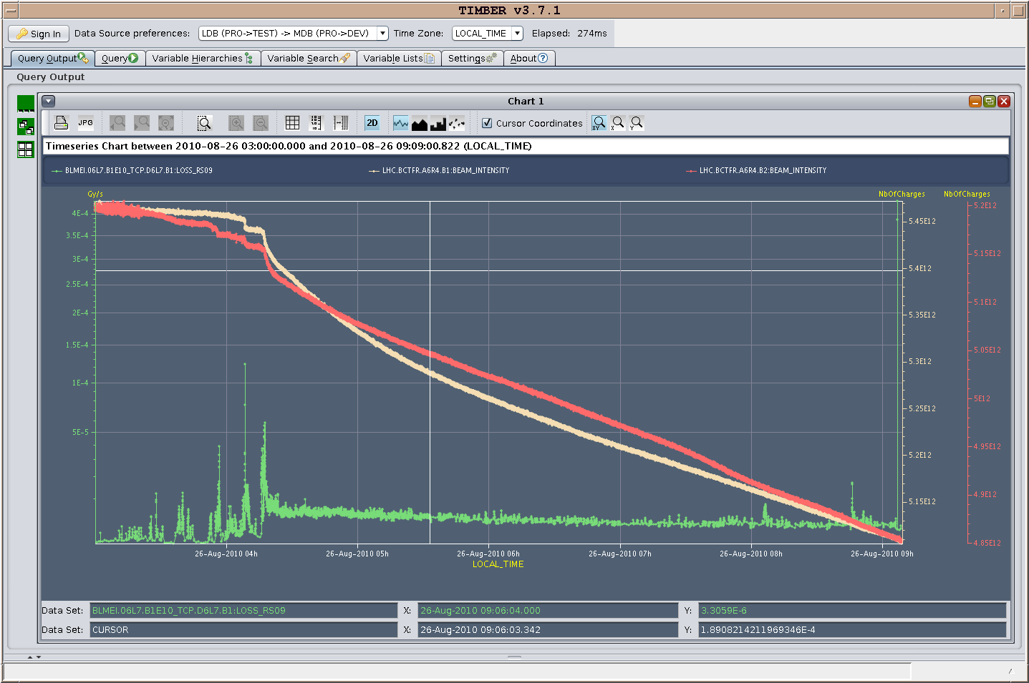
Loss Spikes in Stable Beams
Intensities
Loss at primary collimators B1

Slide 15
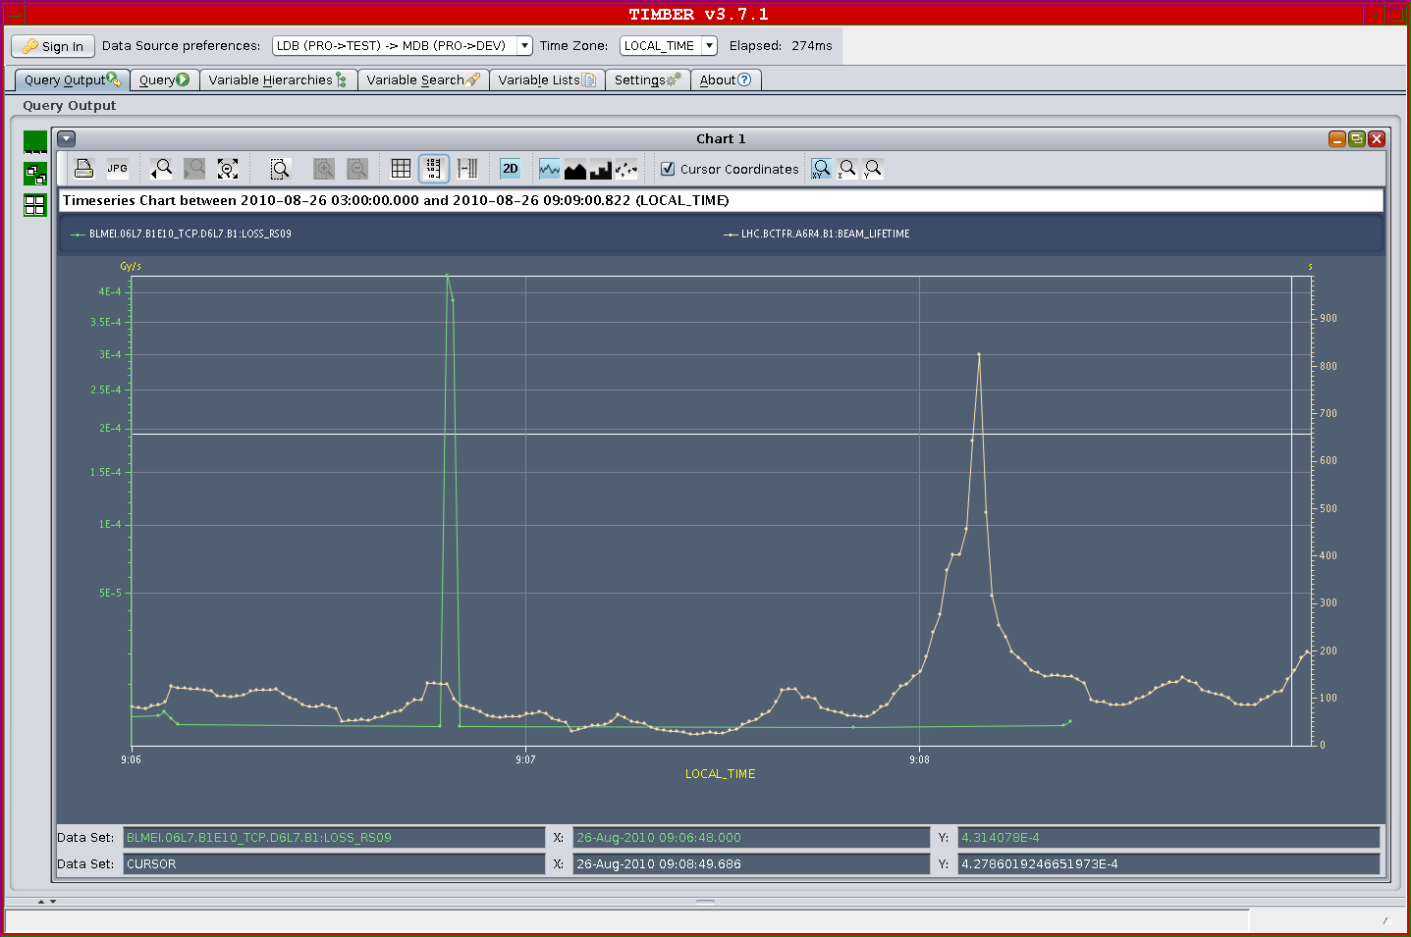
Loss Spikes in Stable Beams
factor ~30 in BLM at TCP
not visible in lifetime
~50 h

Slide 16
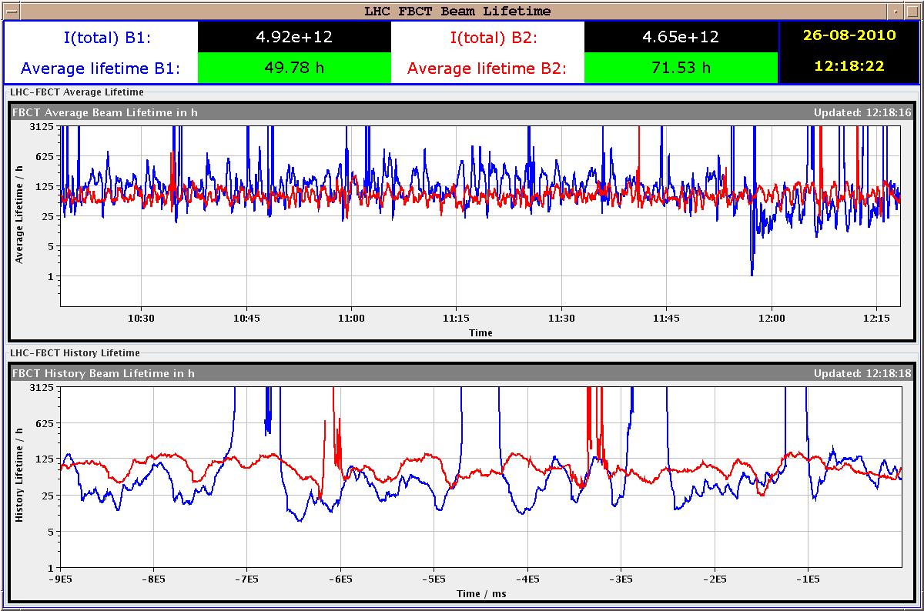
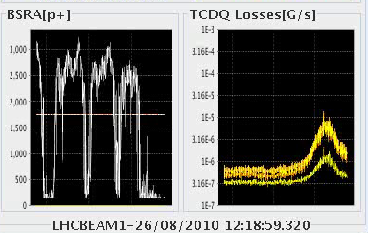
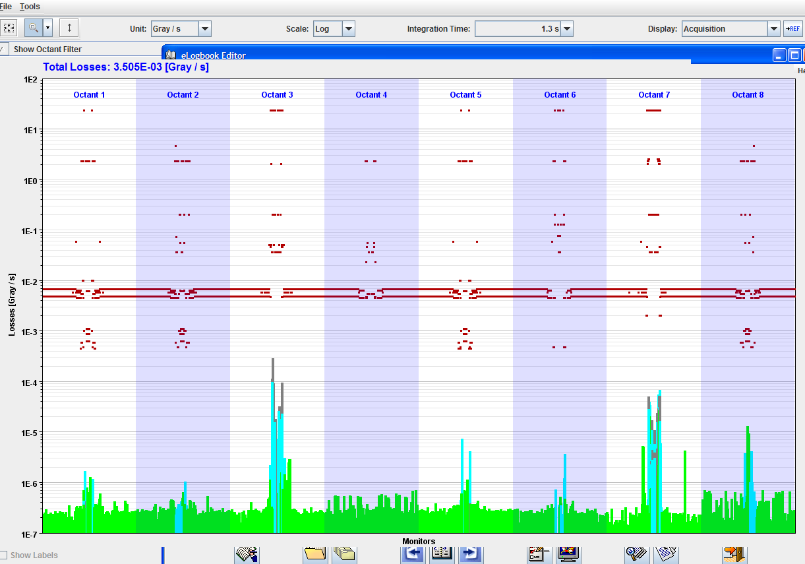
RF Trip: cavity 2B1

Slide 17
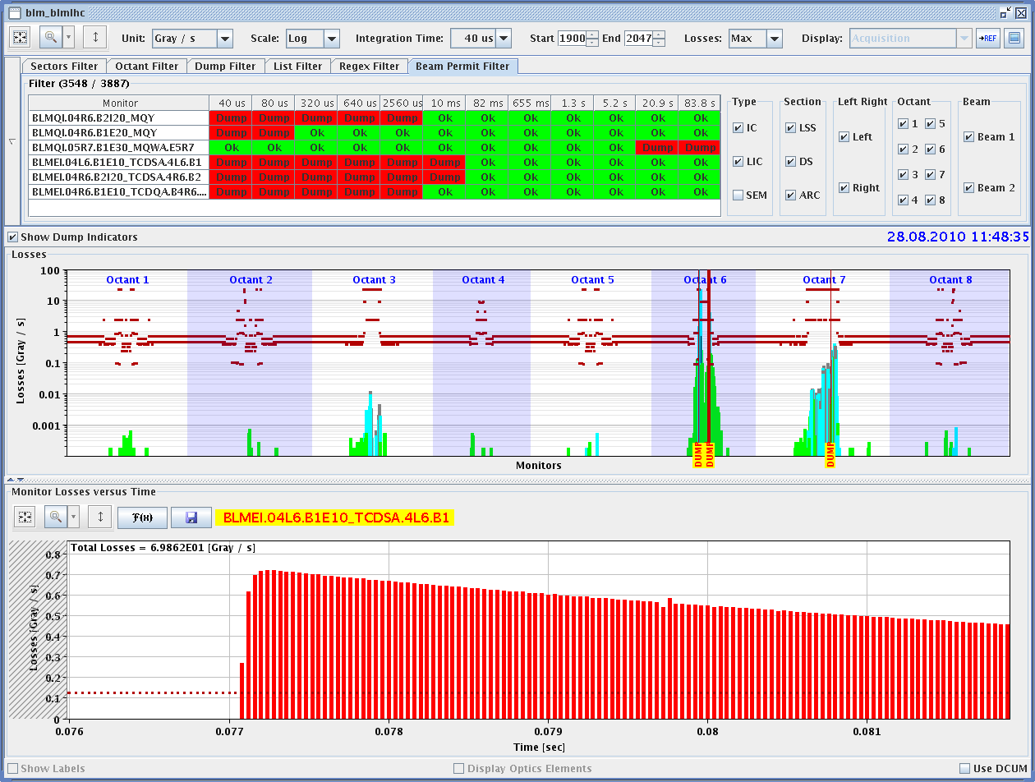
Dump During Chroma Measurement

Slide 18
Other Work on Physics Beams
Tune feedback
Loss maps for regular collimation monitoring
Beam distribution and loss modulation
Luminosity-Induced Losses

Slide 19
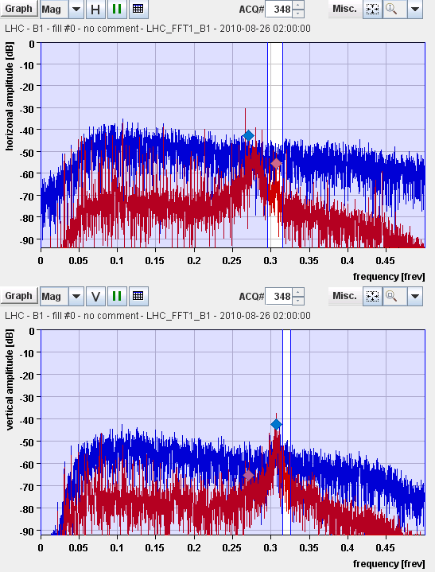
Tune Detection Improvement
Tune detection affected by noise ion the beam.
Reducing the time-constant responsible for the DC suppression of the peak voltage variations of the longitudinal carrier to help reliable detection.
N.B. gains stayed the same.
See curves: Blue before, red after change.
R. Steinhagen

Slide 20
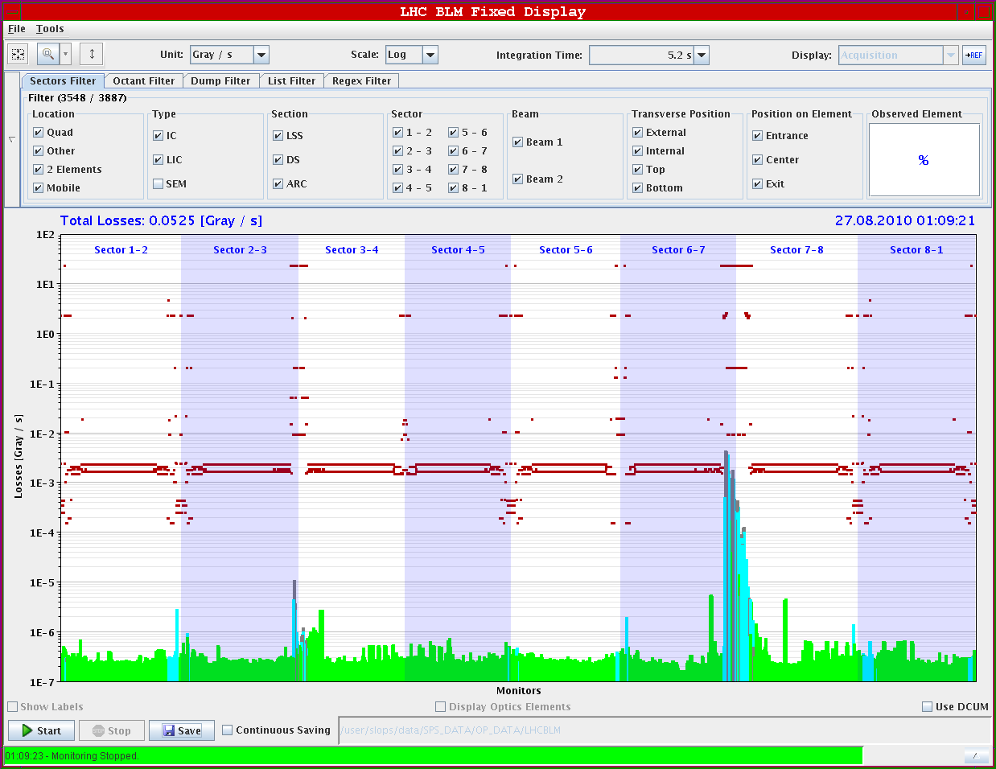
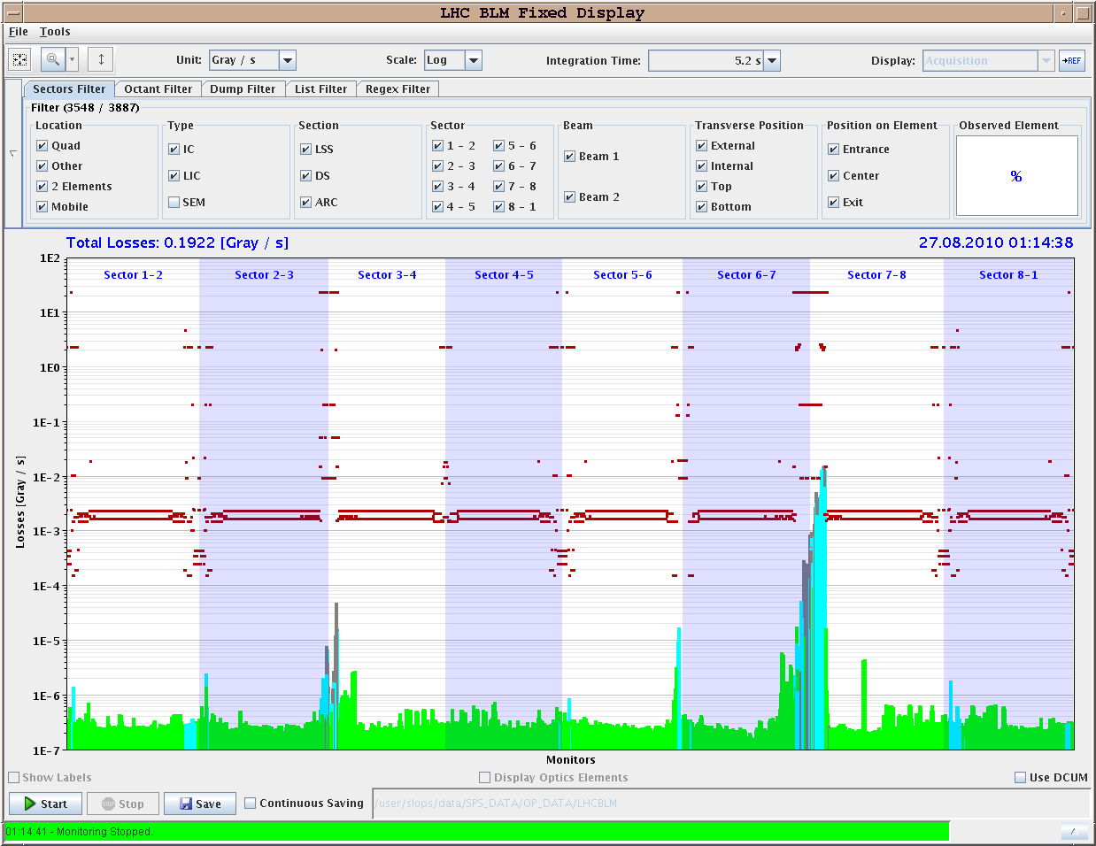
Beam Loss Maps (Regular Monitoring)
Beam 1 vertical
Beam 2 vertical
IR7 cleaning still quite good since June 12 setup. Being analyzed in detail.
IR3 anomaly probably also seen for beam 2 → will be fixed with bunch train setup. Not done yet.

Slide 21
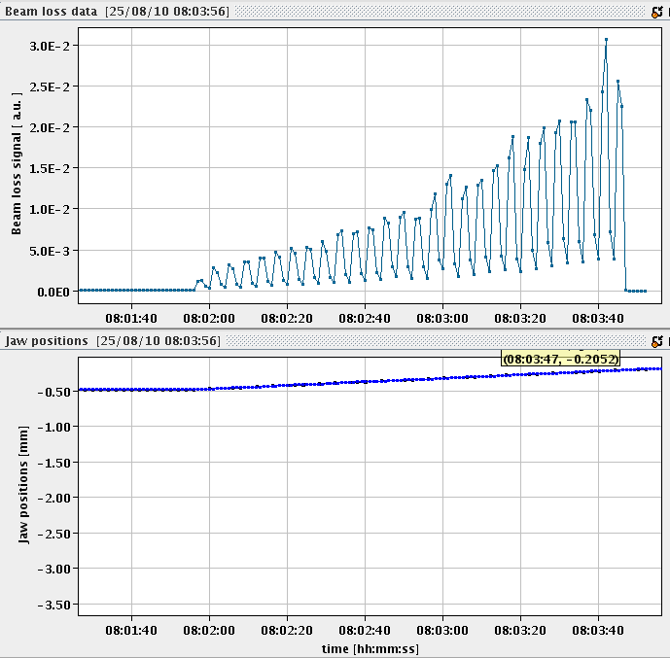
Measuring Tails (10 min end-of-fill)
Beam Loss
Jaw towards beam
Jaw position
TCP.D6R7.B2

Slide 22
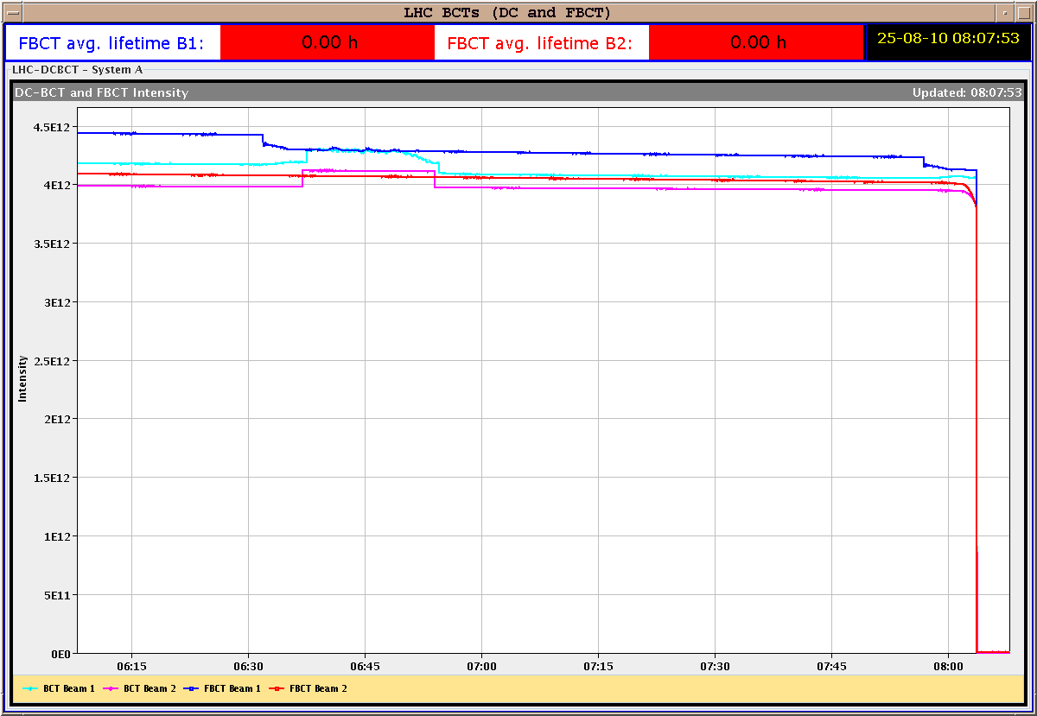
Beam Intensity
- 1.5e11 p
- 3.5 %
Beam dumped from beam loss on Q5 in IR7 (warm) with 84 s integration time!

Slide 23
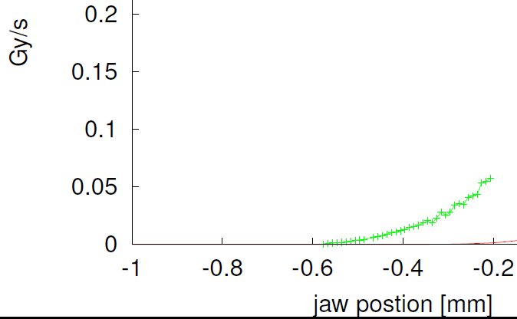
Beam Distribution: Beam 2 Tail V
~ 5.7 σ
~ 4.7 σ
~ 3.7 σ
3.5%
of beam within 1.5 σ
σy = 0.27 mm

Slide 24
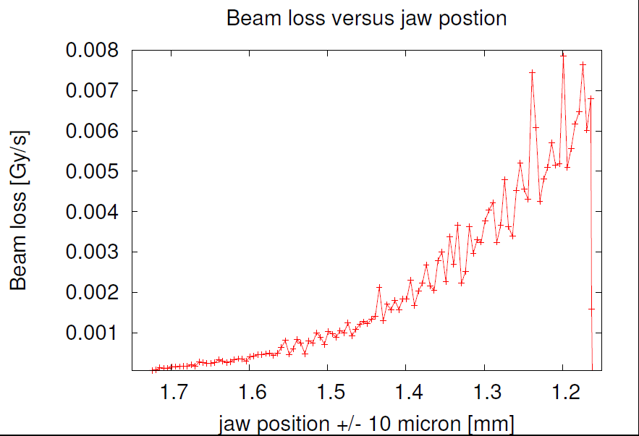
Beam 2 H Tail after 3h30 of Physics
Florian Burkart et al

Slide 25
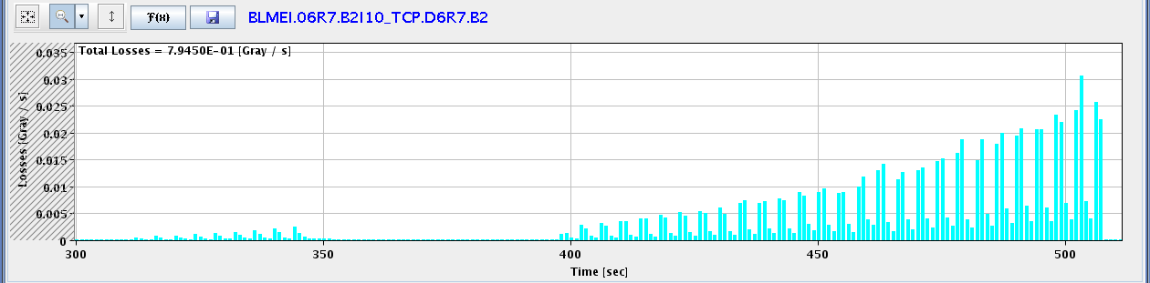
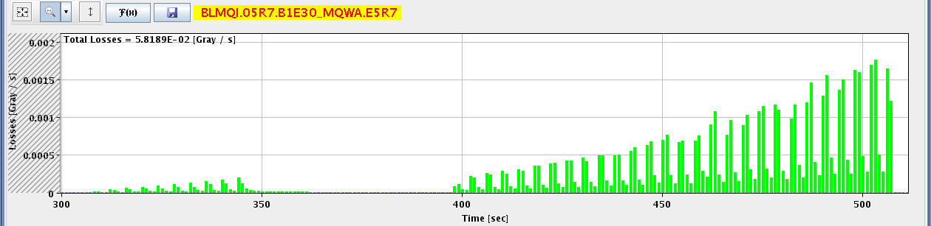
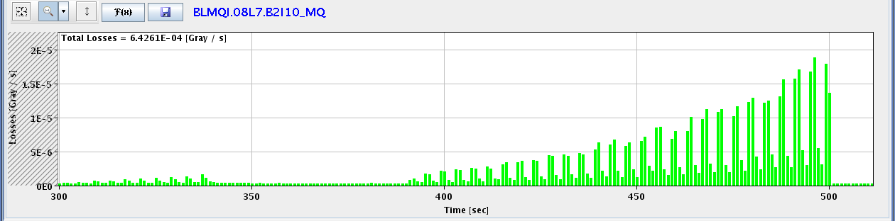
Loss Locations Around Ring
IR7 TCP: 30,000 μG/s
IR7 Q5 (warm): 1,700 μG/s
8 s
IR7 Q8 (SC): 18 μG/s

Slide 26
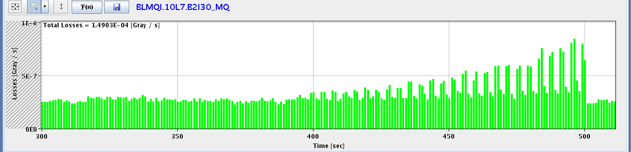
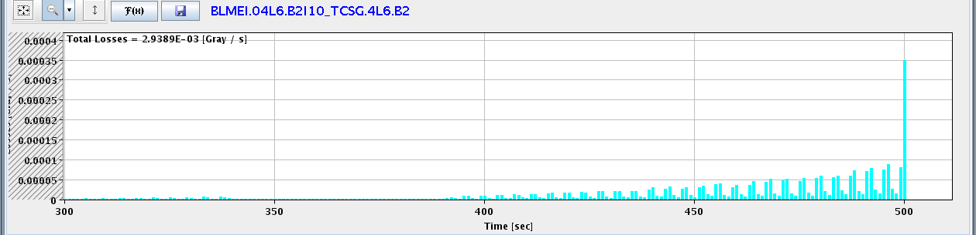
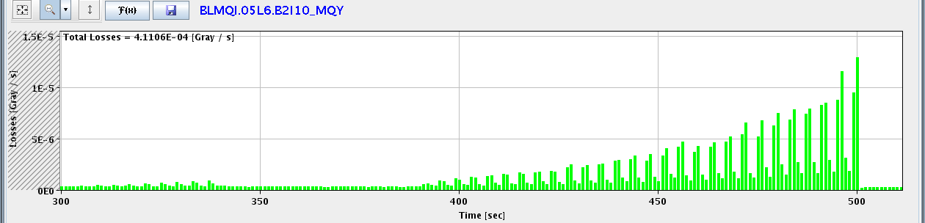
IR7 Q10 (SC): 0.8 μG/s
IR6 TCSG: 900 μG/s
IR6 Q5 (SC): 12 μG/s

Slide 27
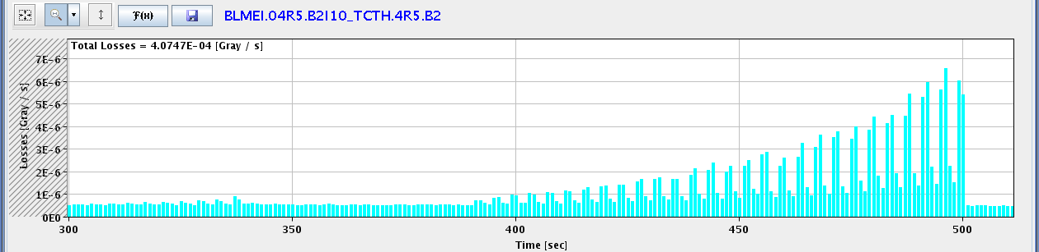
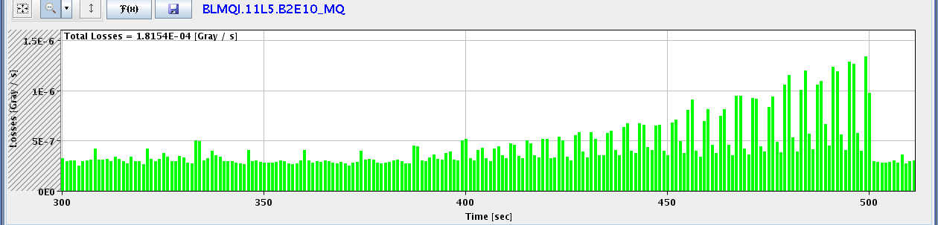
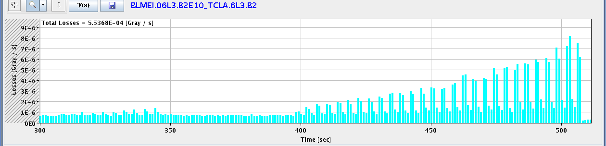
IR5 TCTH: 6.5 μG/s
IR5 Q11 (SC): 1.3 μG/s
IR3 TCLA: 8 μG/s

Slide 28
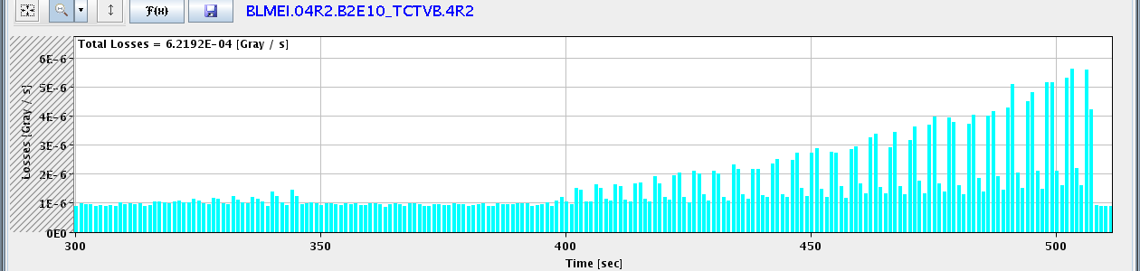
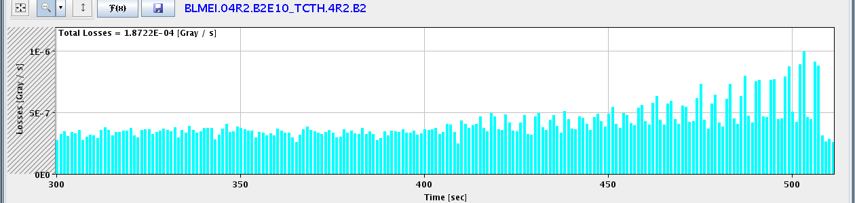
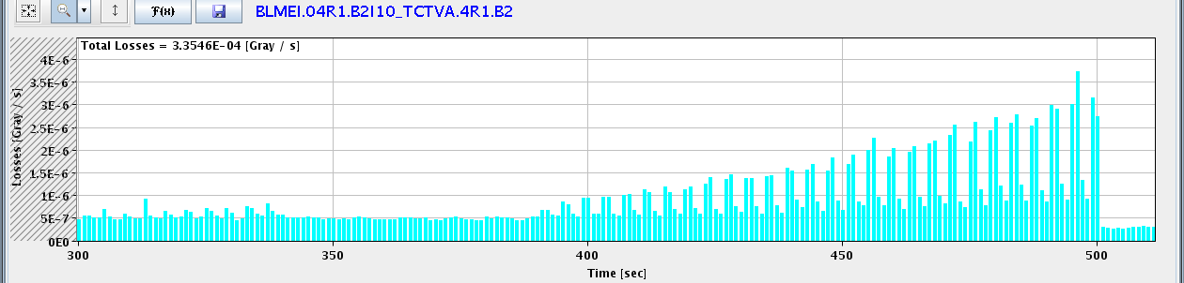
IR2 TCTVB: 5.5 μG/s
IR2 TCTH: 1 μG/s
IR1 TCTVA: 3.7 μG/s

Slide 29
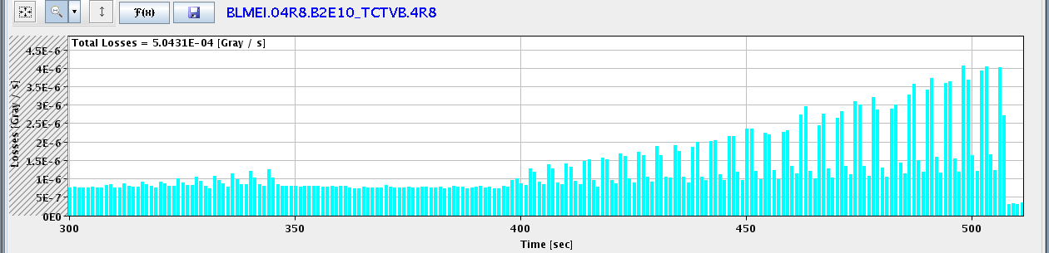
IR8 TCTVB: 4 μG/s
Easily identify all collimation-related losses around the ring.
Notice temporal shift between measurements around ring (8s). Could explain puzzling previous observations: cold losses before losses at collimators!
See loss distribution and efficiency for vertical losses.

Slide 30
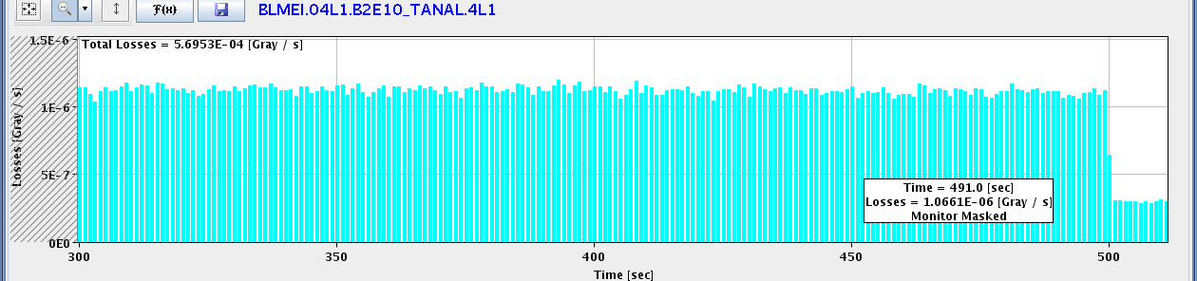

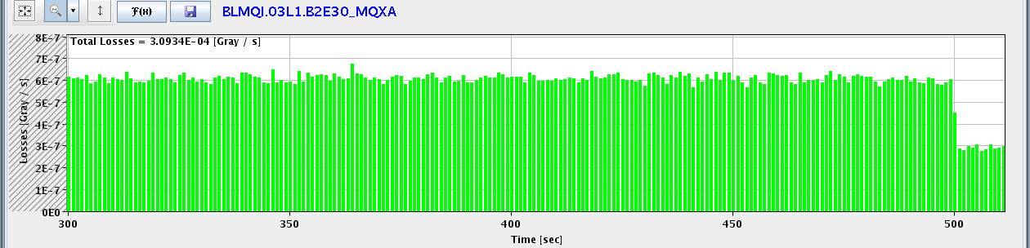
Luminosity-Induced Losses IR1: Selection
Beam dump
IR1 TAN L
IR1 TAN R
IR1 Q3L (SC)

Slide 31
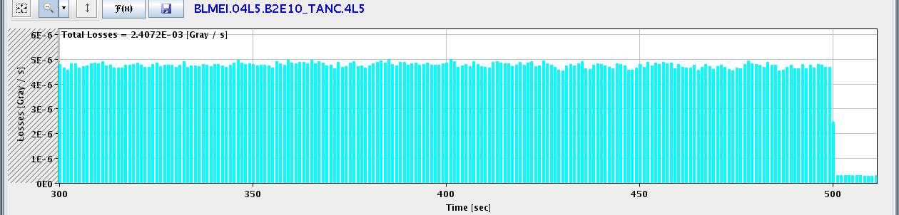

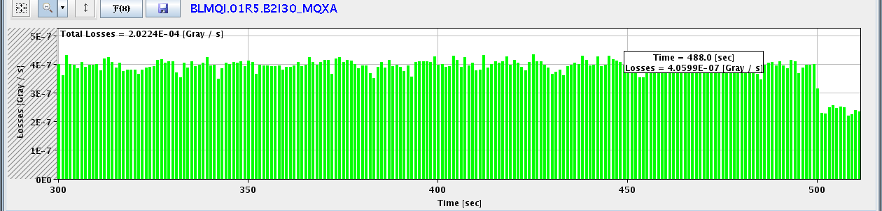
Luminosity-Induced Losses IR5: Selection
Beam dump
IR5 TAN L
IR1 TAN R
IR1 Q1R (SC)

Slide 32
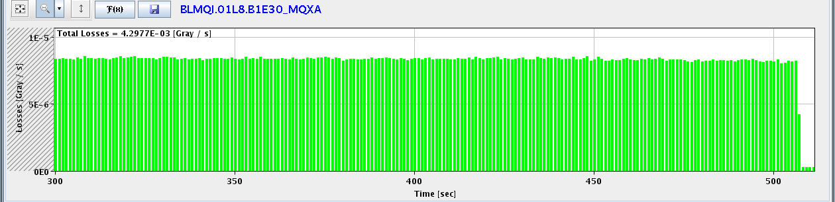
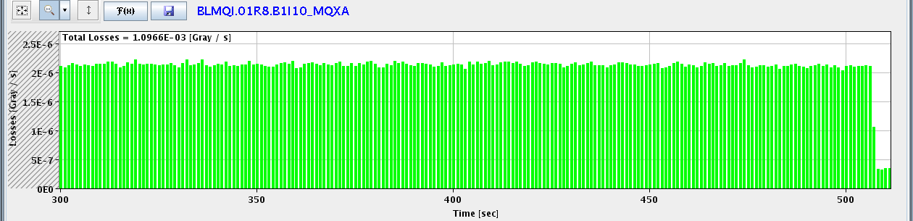
Luminosity-Induced Losses IR8: Selection
Beam dump
IR8 Q1L (SC)
IR8 Q1R (SC)

Slide 33
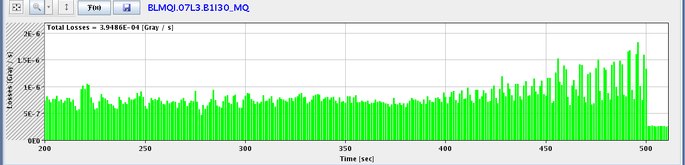
Luminosity-Induced Losses IR3
Beam dump
IR3 Q7 L (SC)
Luminosity: ~ 5e30 cm-2 s-1
Induced losses Q7.L3: 5e-7 Gy/s
Quench limit Q7 at 3.5 TeV: 4.7e-3 Gy/s
factor 10,000 margin at 3.5 TeV for factor 2,000 in lumi → might become critical for luminosity at 7 TeV with lower quench limit (predicted bottleneck – high dispersion)

Slide 34
Bunch Train Commissioning
Work hampered by bad quality of injected 150 ns trains.
Problems:
  SPS tune kicker acting randomly.
  SPS transverse blow-up not working.
  SPS scraper breaking.
Some injections OK, then really bad losses.
Might have seen first SEU error due to heavy beam loss at transfer line collimator.
Seen interesting effects on beam lifetime.
In the end out of 2 shifts only a few hours for work on transverse damper.

Slide 35
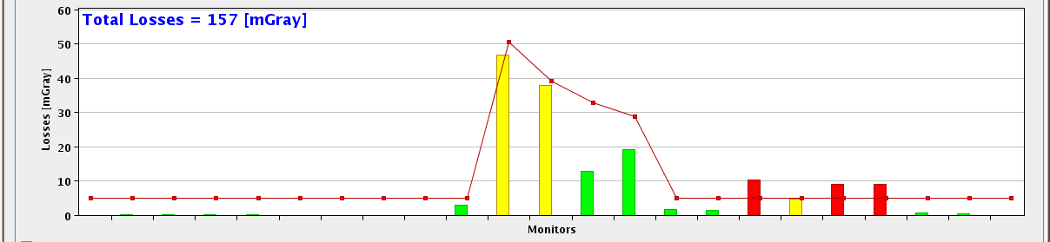
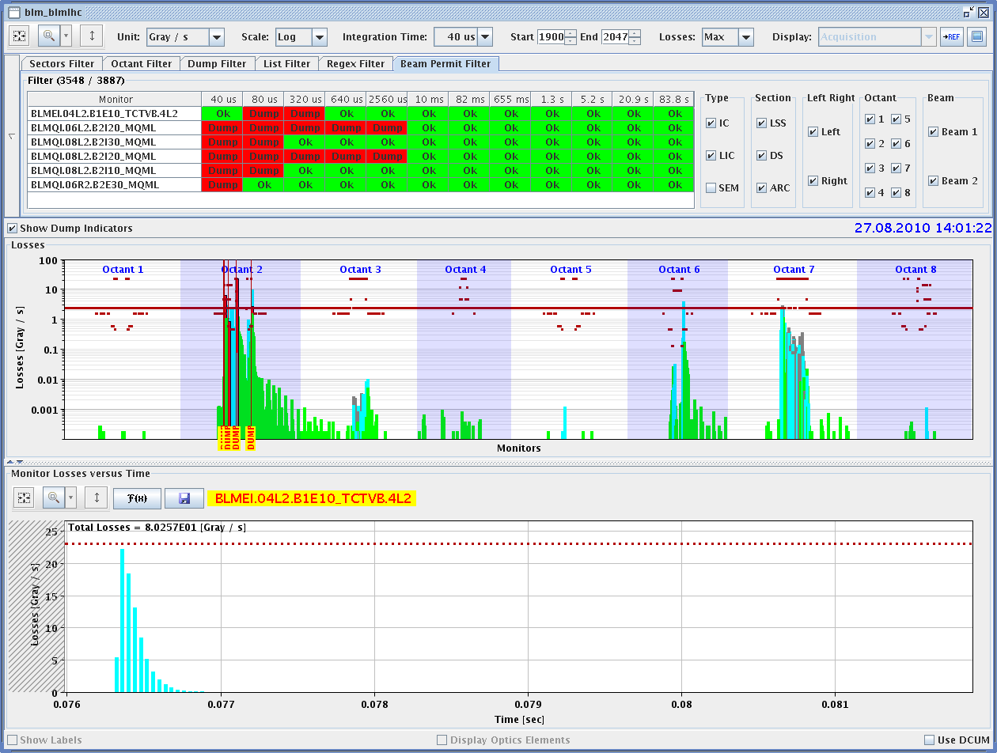
Losses in TI2 and LHC Ring (14h03)
Beam 1

Slide 36
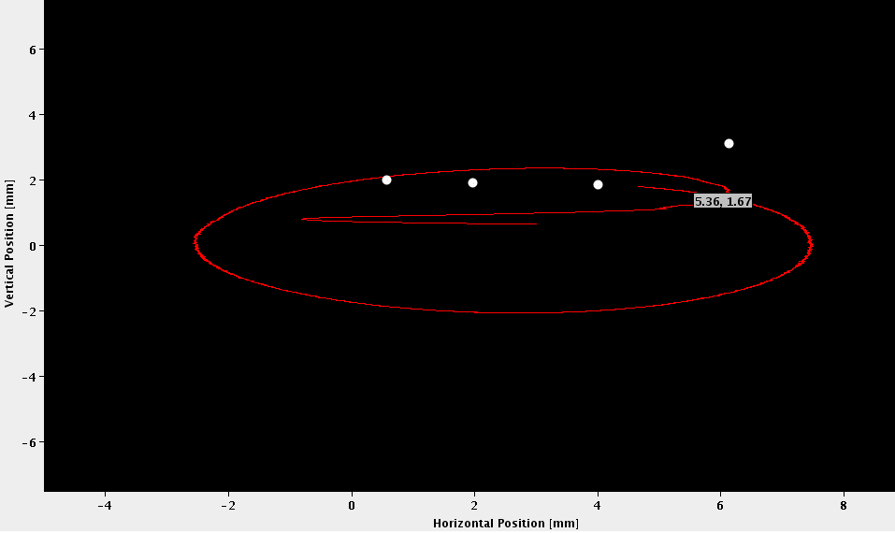
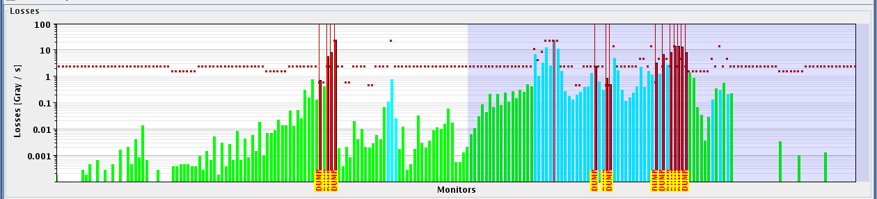
LHC Inj. Losses (16h14, Beam 2)
4 nominal bunches
injected
At same time:
Loss of QPS-OK on RB.A81, on magnet A8R8

Slide 37
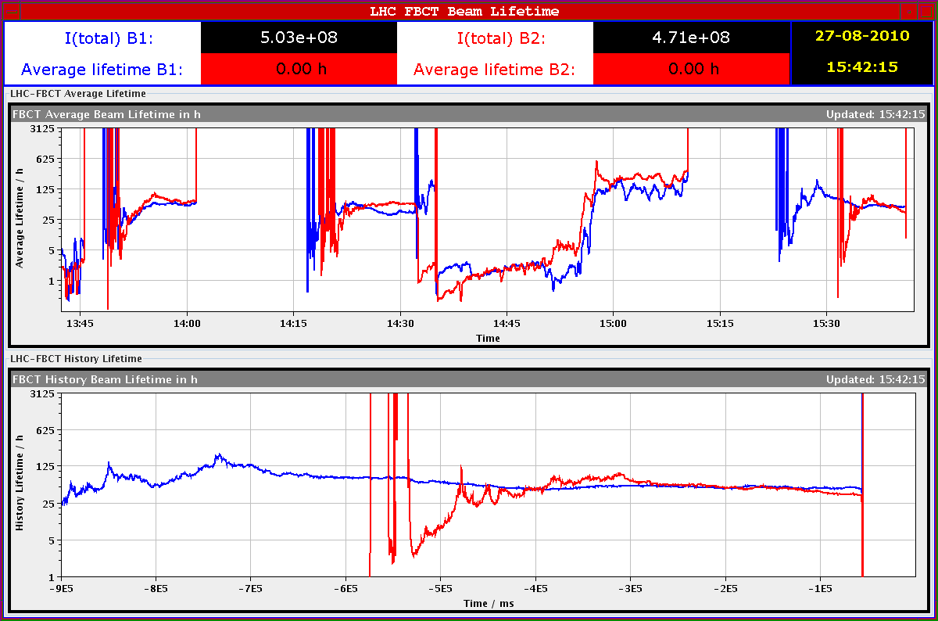
Long-Range Effects on Lifetime (450 GeV)
4b x 1e11, 1b x 1e10
no crossing angle
4b x 1e11 without
crossing angle
2 beams
1b x 1e10
per beam
4b x 1e11 with
crossing angle in ATLAS&CMS
2 beams

Slide 38
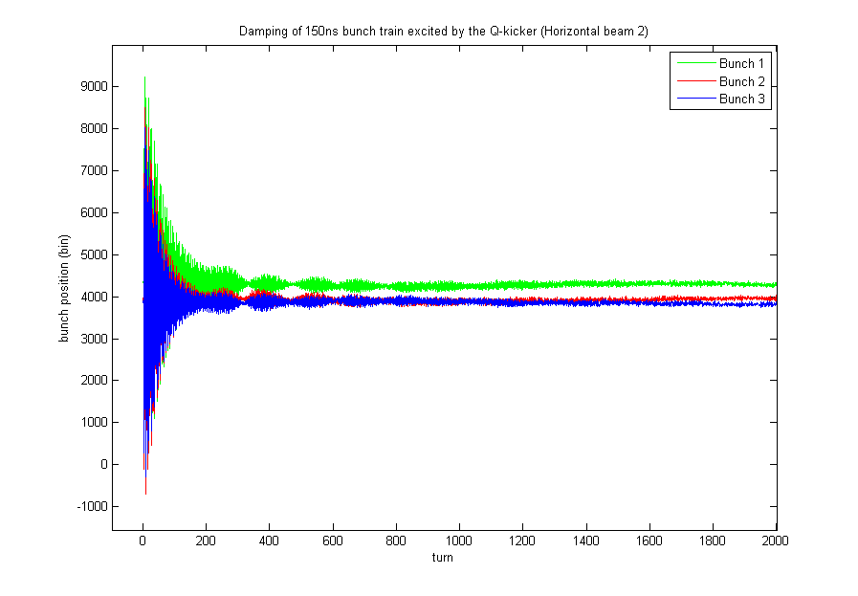
Beam 2, horizontal plane, kicking a batch of 4 bunches/150ns by Q kicker. Graph shows how oscillation of each individual bunch is damped. Beam was gone before measurement of bunch 4
Daniel Valuch, Maarten Schokker, Gerd Kotzian

Slide 39
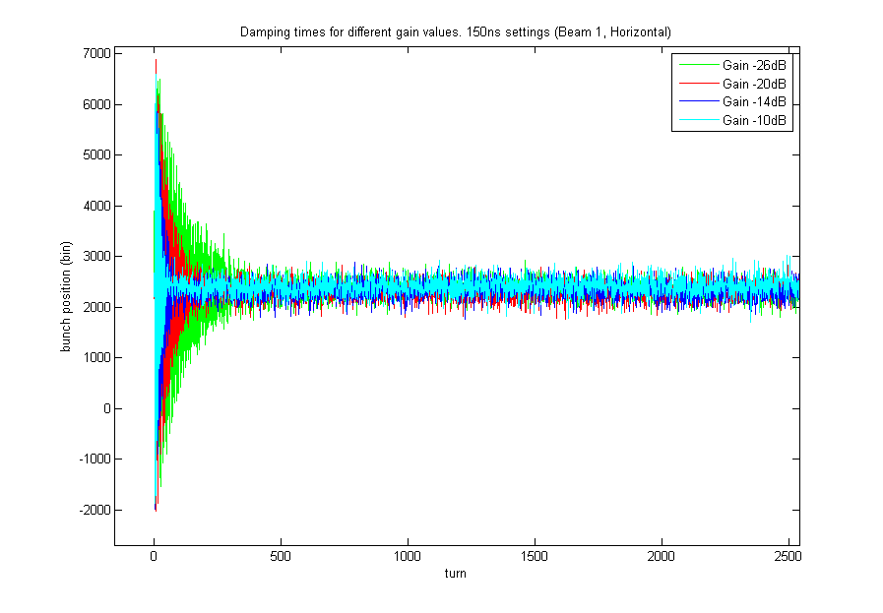
Verification of damping times for different electronic gain values. 150ns settings, beam 1, horizontal plane. Note that currently used gain at injection is set to -20dB.
Daniel Valuch, Maarten Schokker, Gerd Kotzian

Slide 40
Transverse Damper Planning
complete low noise set-up with new firmware for all dampers, started 27.08.2010
evaluate the 150 ns scheme now deployed
run for Physics with this scheme (already used in a few fills)
introduce the required improvements after 20.09.2010
required improvements are:
full damping strength for edges of batches
full damping strength for bunches at large spacing
improvements may need a filling scheme identifier from control system (LSA) communicated to damper software / crates
W. Hoefle

Slide 41
Outlook Bunch Train Commissioning
See Malika’s presentation at last LMC.
Possible sequence of detailed tasks (my view):
  Recover machine from technical stop. Run 1 nominal bunch through full cycle with present setup.
  At 3.5 TeV measure beta*, triplet-to-beam offsets with k change technique.
  At 450 GeV, introduce crossing angles.
  Commission injection (incl. protection) for at least 12 bunches per train (nominal bunch intensity). Sufficient for factor 3 intensity increase.
  Check instrumentation, RF and transverse damper. Tune if necessary.
  Re-establish reference orbit for 450 GeV.
  Perform required re-setup of ring collimators (depends on orbit changes). Regenerate collimator functions for ramp, including change to 10 A/s.
  Qualify collimation and protection with loss maps at 450 GeV. Asynchronous dump test.
  Commission ramp to 3.5 TeV with 10 A/s and with crossing angles.
  Re-establish reference orbit at 3.5 TeV before squeeze.

Slide 42
Outlook Bunch Train Commissioning
Continued…
  Perform required re-setup of ring collimators (depends on orbit changes). Include new setup for momentum cleaning of beam 2 (not working).
  Qualify collimation and protection with loss maps at 3.5 TeV before squeeze. Asynchronous dump test.
  Re-commission the squeeze, with any possibly required changes in beta* for IR2 (from 3.5m to 10m?).
  Measure beta* and triplet-to-beam offsets with k change technique.
  Optimize collision point.
  Re-establish reference orbit at 3.5 TeV after squeeze.
  Perform required re-setup of ring collimators (depends on orbit changes).
  Qualify collimation and protection with loss maps at 3.5 TeV after squeeze. Asynchronous dump test.
  Ramp with high intensities.
  Check instrumentation, RF, transverse damper and feedbacks at 3.5 TeV. Tune if necessary.

Slide 43
This week…
This week: Mike Lamont and Gianluigi Arduini

