Slide 1
Summary Friday 26.8.
01h38: Ramp down and pre-cycle.
03h04: Injection for physics.
04h14: Start ramp.
06h11: Stable beams fill #1305.
09h41: Adjust mode: end of fill meas. of transverse tails (B2, H).
10h18: Ramp down and pre-cycle.
11h54: Bunch train commissioning (ADT, PLL, injection):
13h27: Brunch trains stored.
13h46: Beams dumped (low lifetime).
14h35: Bunch trains injected. Start of studies: ADT, PLL, Inj.
14h55: Crossing angle (100 μrad) put in IR1 and IR5.
15h13: Beams lost when injecting second batch into beam 2.
17h45: Bunch trains stored.
18h47: Beams lost. End bunch train studies (1h40 min).

Slide 2
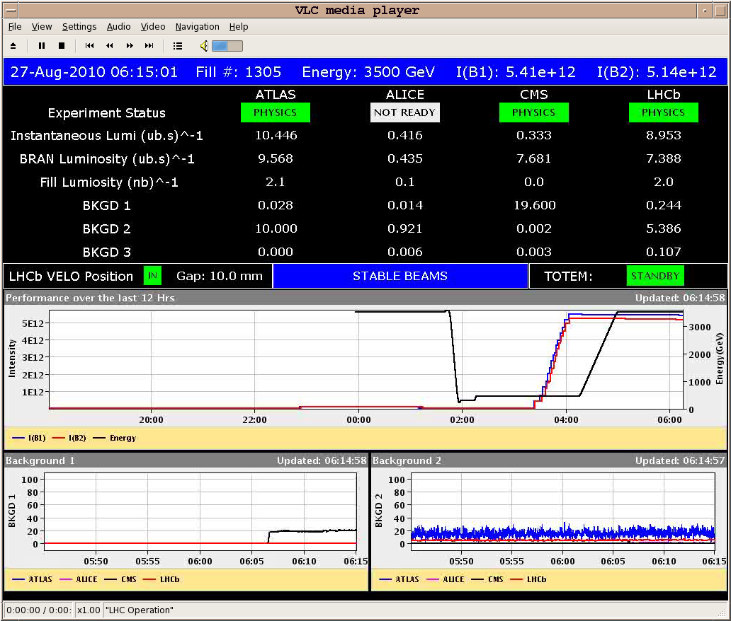
Stable Beams Fill #1305

Slide 3
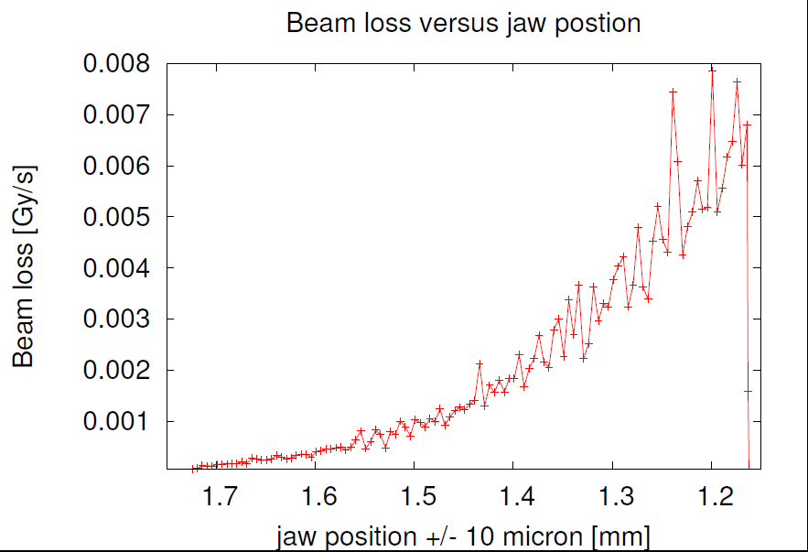
Transverse Tails after 3h30 of Physics
Florian Burkart et al

Slide 4
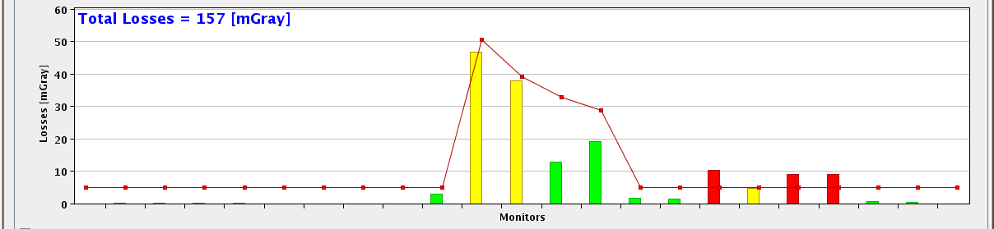
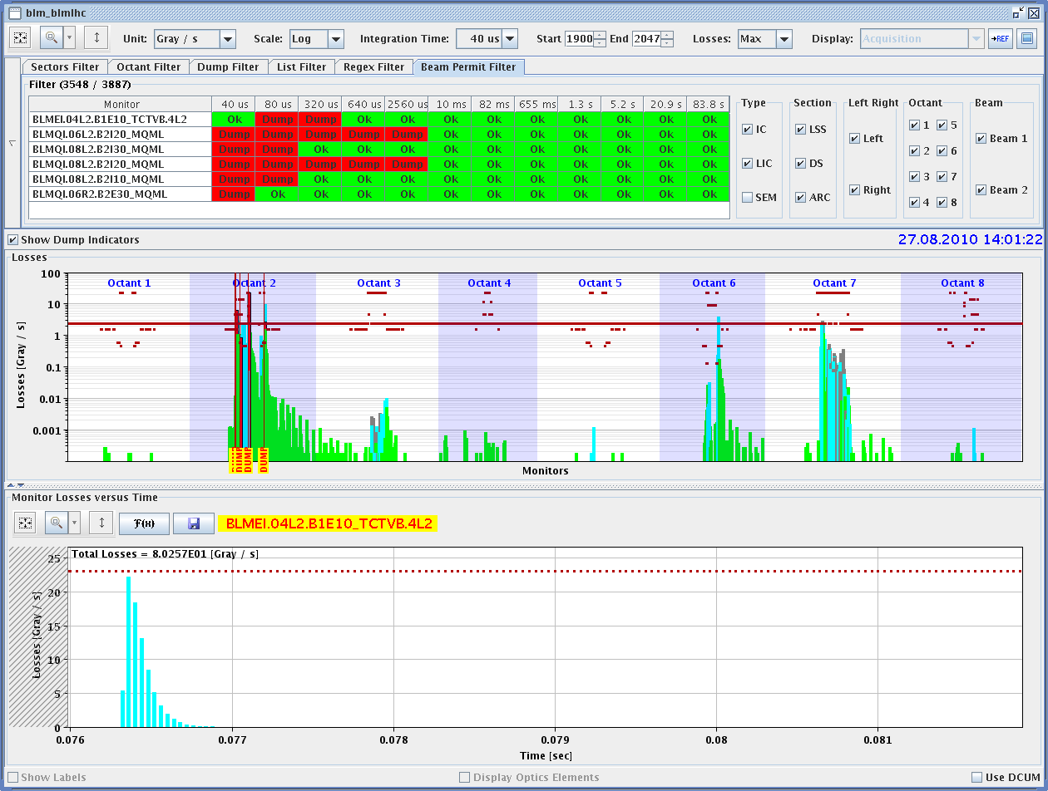
Losses in TI2 and LHC Ring (14h03)
Beam 1

Slide 5
LHC Inj. Losses (16h14, Beam 2)
4 nominal bunches
injected
At same time:
Loss of QPS-OK on RB.A81, on magnet A8R8

Slide 6
Reasons for Bad Bunch Train Injection
LHC injection setup seemed to be OK, problems incoming from the SPS from time to time.
Two problems identified in the SPS:
Erratic kicking from tune kicker.
Transverse emittance blow-up not working in the SPS → too large emittance and beam becoming unstable. Switched off.
After these changes:
Still lost 1 injection with dump of both beams in the LHC.
Second attempt worked fine.

Slide 7
Long-Range Effects on Lifetime
4b x 1e11, 1b x 1e10 no crossing angle
4b x 1e11 without
crossing angle 2 beams
1b x 1e10
per beam
4b x 1e11 with
crossing angle in ATLAS&CMS
2 beams

Slide 8
ADT progress
27.08.2010
new firmware deployed with new algorithm for the calculation
of the normalized bunch position → ease of set-up for optimization of S/N
successfully tested this new firmware; used now operationally
firmware includes a flag selecting old algorithm or new algorithm
removed temporary attenuators for beam 1 and set-up
with a target of +/- 2 mm acceptance and saturation at 1.3e11 protons per bunch
(expected to give a factor >2 improvement in S/N) → not finished as of 19:00
beam 2 uses old algorithm (set by flag in new firmware)
tested damping with bunch train of 4 bunches spaced 150 ns → ok at first sight
reduced peak hold from 25 bunch places to 6 → reduction of gain for
isolated bunches: necessity for bunch spacing dependent procession to be checked
W. Hoefle

Slide 9
ADT and bunch spacing
issue: full kick strength only available for frequencies up to 1 MHz
need to play some “tricks”
625 ns
625 ns
scheme
for Physics
until now
best for bunch spacing > 625 ns
what we want
(ideally)
injection damping for bunch trains
W. Hoefle

Slide 10
150 ns peak hold scheme being tested
150 ns peak hold
less gain when operated
with isolated bunches
(already used in fill 1305)
150 ns bunch trains
less gain for bunches at edge of batch
but similar , i.e. full gain for center of batch
[assuming common error of batch]
W. Hoefle

Slide 11
Planning
complete low noise set-up with new firmware for all dampers, started 27.08.2010
evaluate the 150 ns scheme now deployed
run for Physics with this scheme (already used in fill 1305)
introduce the required improvements after 20.09.2010
required improvements are:
full damping strength for edges of batches
full damping strength for bunches at large spacing
improvements may need a filling scheme identifier from control system (LSA) communicated to damper software / crates
W. Hoefle

Slide 12
Summary Friday 26.8.
Problems appearing in the afternoon:
16h14: At time of injection loss of 4b train (4e11 p): lost QPS-OK on RB.A81, on magnet A8R8, close to transfer line collimators. Can continue at injection but must be fixed before next ramp.
16h50: Alarm on UPS unit EBS21/28 in RE28 (I limit haute). Decision for required access at 18h00 (risk to break batteries without intervention). Earliest time for access: 22h00 (external company).
17h09: Lost QPS OK on RB.A78 :quench heaters discharging in A18R7 (HTS 4). Can continue at injection but must be fixed before next ramp.
19h47: Lost sectors 12 and 23 due to UPS problem (see above).
20h00: Access to fix various problems. Length of access increased due to wait time for external company (UPS).
Note: DIP verified to have been working since Thursday.
Note: Logging found not working since 1.5 days for many collimators. Was fixed in the afternoon but loss of data! Alarm needed!

Slide 13
Summary Friday 27.8 to Saturday
23h00: UPS intervention team arrived.
23h24: Internal water fault on PC RB.A56. Breaker on 18 kV supply tripped.
01h00: UPS diagnostics – at least 5 modules to be replaced in UPS. Takes at least 5 h up to a full day. Work could only start during daytime hours.
01h10: Decision taken to strap the broken UPS unit and to run with the remaining unit (increased load of this unit to 30%).
01h30: Access to fix water fault on PC RB.A56: increase water flow.
02h23: Machine closed.
02h40: Switch A on RQTF.A56.B2 did not work. To be replaced.
07h00: Machine closed again. Pre-cycle starting.

Slide 14
Decision on UPS situation
UPS unit EBS21/28 in RE28 could not be repaired over night.
Possibility 1: Stop and repair. Most likely takes us into Sunday.
Possibility 2: Accept loss of UPS redundancy until technical stop. Still have 1 UPS working, but reduced autonomy to 1-2 hours. Hypothetical risk: Power cut + UPS failure + quench would leave circuits unprotected.

Slide 15
Program ahead
Sat 09h00: Decision on UPS. If continuing with 1 unit then following program.
Sat 12h00: Physics 50b x 50b.
Sun 07h00: Ramp down and pre-cycle. Change LHC-b polarity.
Sun 09h00: k-modulation measurement for triplets
Sun 17h00: recover for physics. Change LHC-b polarity
Sun 20h00: Physics 50b x 50b
Mon 05h30: end of beam before technical stop

