Slide 1
Saturday 21.8.
Morning & Day: Recovery from Cryo problems:
20:00: Cry recovered for pre-cycle in S56 and S67;
22:15: Starting injection;
22:30: Injection kicker fault - sparking (called experts); spark occurred after clean injection;
22:30: Beams dumped due to Cryo problem for right IR5 triplet (back by 01:00);
Preparing new physics fill with 48 bunches:
03:30: Injection finished ➔ 4.5 10¹² protons per beam in 48 bunches;
ε_{x1} = 2.6 μm; ε_{y1} = 2.6 μm; ε_{x2} = 2.8 μm; ε_{y2} = 3.2 μm;
03:40: Start ramp; losses in IR3 at beginning of ramp;
➔ Beams dumped by SIS TCDQ_B2 interlock triggered by the
TCS_BEAM_OFFSET_B2;
04:50: Trip of RCBYVS4.L1B1 during the ramp down combo;
➔ power module to be exchanged on RCBYVS4.L1B1, access needed in Pt 1;

Slide 2
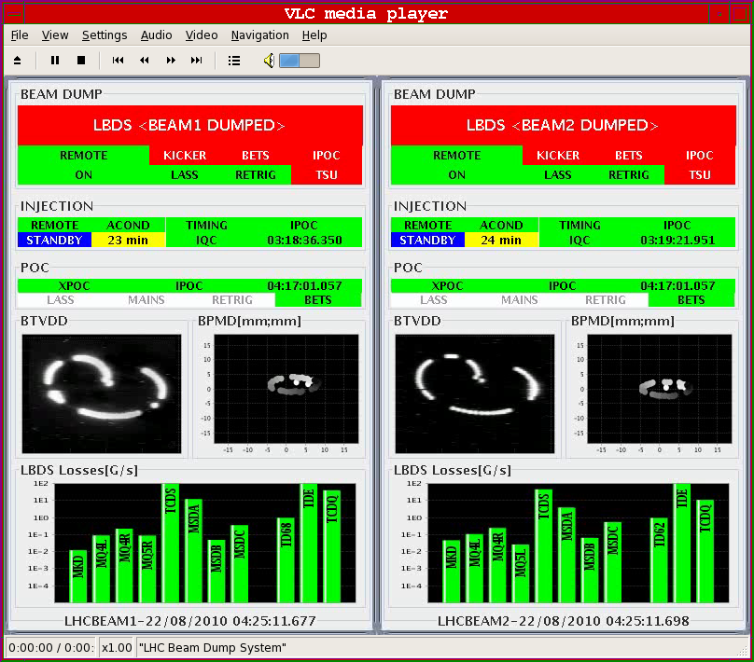
Firday 19.8.
Beam dump
looked OK:

Slide 3
Sunday 22.8.
Morning: Access in Pt1:
06:50: PC permit sector 45 lost due to perturbation on electrical network; ALICE and LHCb dipoles also tripped;
RD1.LR5 also down (water cable fault);
QPS: RQTF.A81B1 we changed QPS board;
08:00: Access finished;
9:00: Preparing new physics fill with 48 bunches

Slide 4
Week 33
Open Issues for next Technical Stop:
CMS cooling for central tracker.
Ion pumps in dump line MKB (B2 only 4 out of 8 pumps working; few days intervention).
BLM racks (in buildings SR1 and SR5 and both at position BY02): would like to correct the way the power cable for the multi-plug arrives inside the rack.
QPS boards: several boards had to switch from channel A to B.
Access team to replace oxydized connectors for PAD-PX24 (3 hours).
CV needs to replace a motorization of the water valve of the sector 56 (3h).
RCBH18.R7B2 – Miguel Cerqueira Bastos.
RCSSX3.L1 super blocked for cryo.

