Slide 1
Thursday 19.8.
Morning: Machine in access:
BLM crate in Pt7 (broken power supply);
RQT12.R1B1 repair of FGC: access in PM15;
09:00: RCBCH6.R8B1 tripped ➔ access required in Pt8;
ATLAS asked if they could have short access in shadow of Pt8 intervention;
13:00: LHC ready for beam but now we have problems in the SPS:
MST extraction septum in fault;
Problem with the access chain.
15:00: Beam back in the SPS:
Injection setup in the LHC;
Loss map studies in IR3 ➔ looks good at 450 GeV;
Tested Radial-Loop using external RF frequency trims;

Slide 2
Thursday 19.8.
16:45: MPS fault in the SPS:
No beam for 1 hour;
Second loss map measurement;
Dispersion measurement at 450 GeV for Beam2;
18:15: Inject nominal bunches for Q-feedback & Damper studies:
Initial problems with BQM (SPS used old bunch structure);
Observe some ‘odd’ excitations in horizontal BBQ for B2;
Measure PLL and BBQ spectra with different damper gains ➔ good result for PLL measurements;
19:10: Dump beams to prepare new fill:
XPOC error due to losses at TCDS Beam1 ➔ BLM thresholds for new – shorter bunch spacing?;

Slide 3
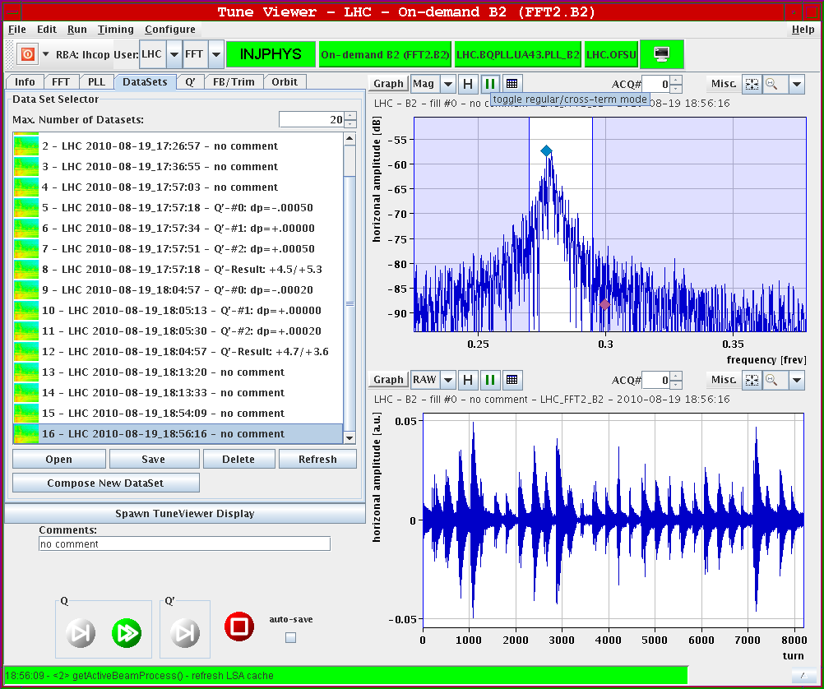
Thursday 19.8.
Horizontal
BBQ for
Beam2:

Slide 4
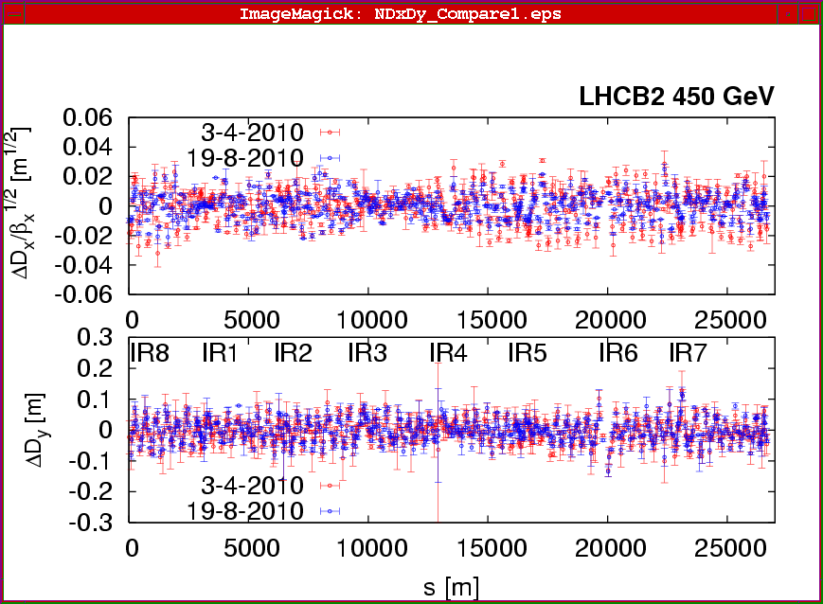
Thursday 19.8.
Dispersion measurements:

Slide 5
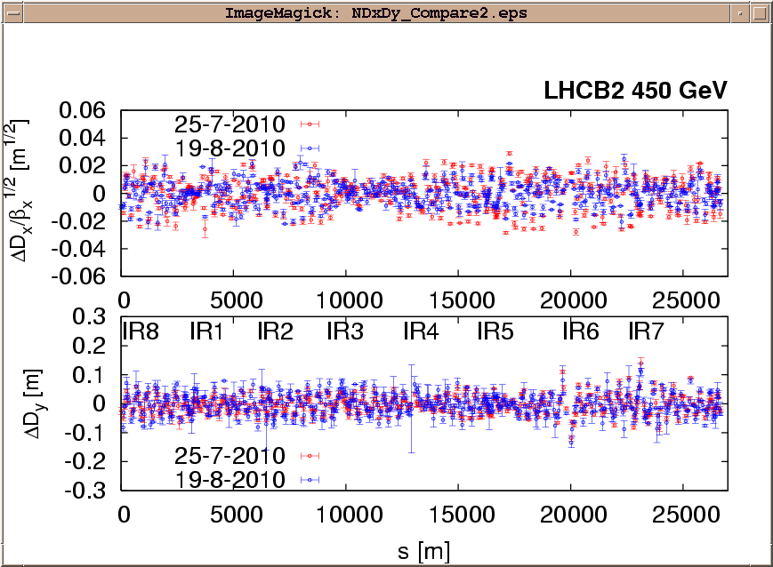
Thursday 19.8.
Dispersion measurements:

Slide 6
Thursday 19.8.
19:45: Start preparation of Physics fill:
20:30: Injection finished ➔ 4.5 10¹² protons per beam in 48 bunches;
ε_{x1} = 2.9 μm; ε_{y1} = 2.9 μm; ε_{x2} = 3.3 μm; ε_{y2} = 3.5 μm;
21:00: Start ramp;
21:40: End ramp;
22:20: Start Squeeze
Initial luminosity: L = 6.65 10³⁰ cm⁻² sec⁻¹;
23:30: Stable physics; L = 6.15 10³⁰ cm⁻² sec⁻¹;
➔ integrated luminosity = 160 nb⁻¹ after 9 hours;

Slide 7
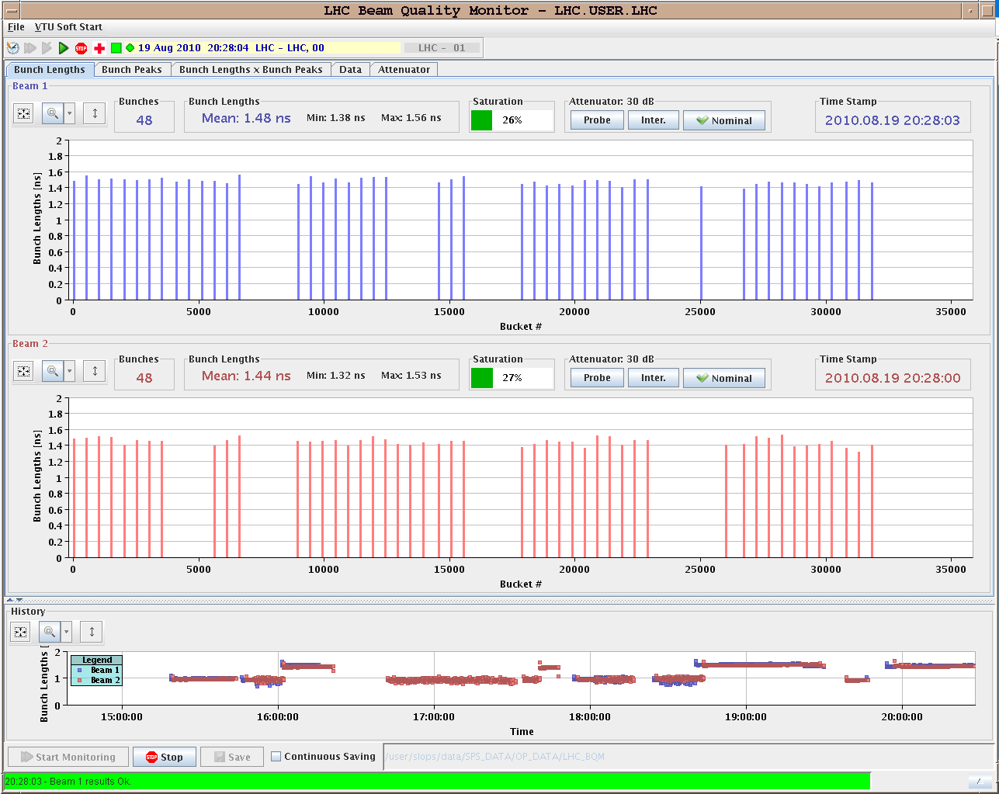
Thursday 19.8.
48 bunches
in both
beam:

Slide 8
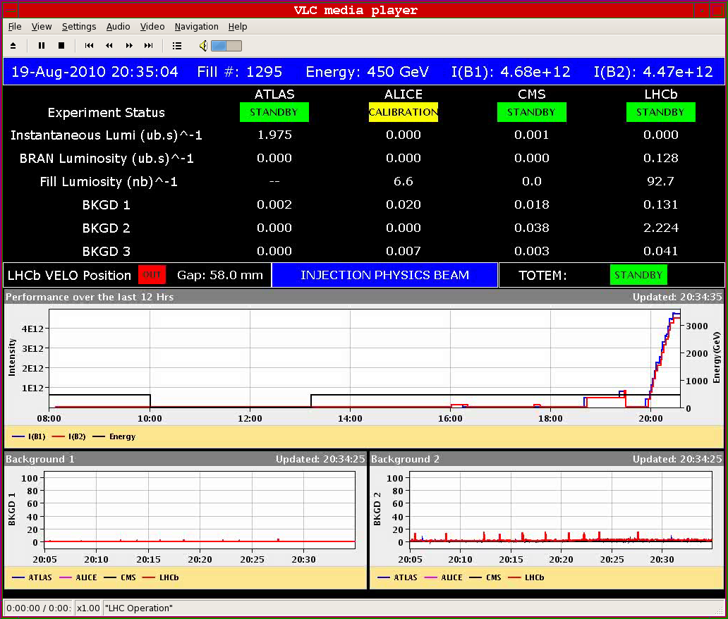
Thursday 19.8.
48 bunches
in both
beam:

Slide 9
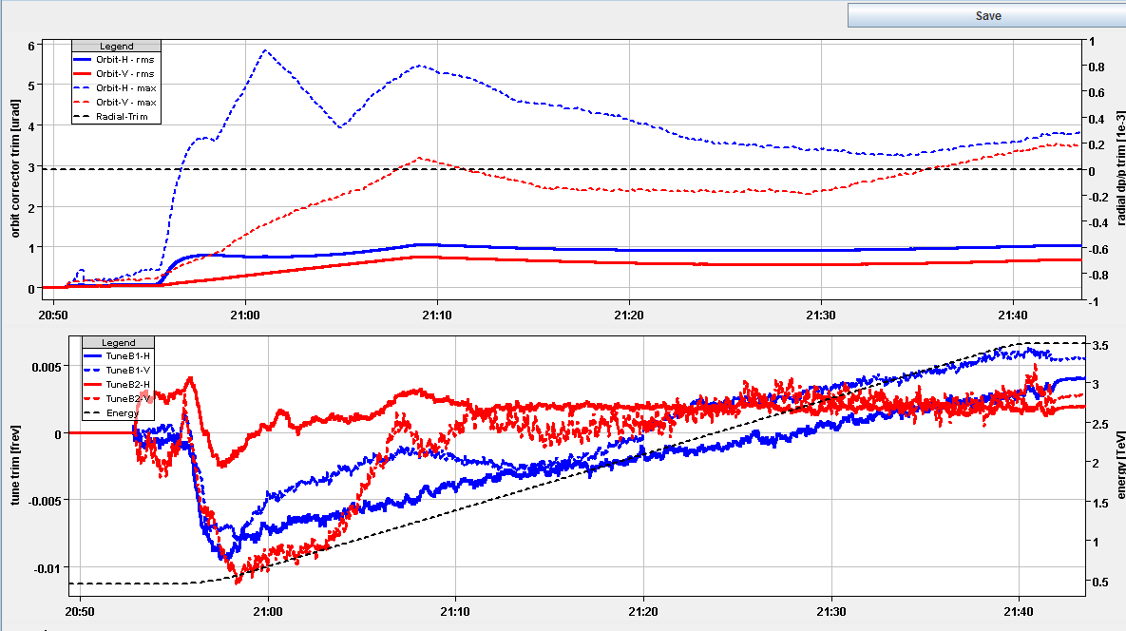
Thursday 19.8.
Feedback during ramp:

Slide 10
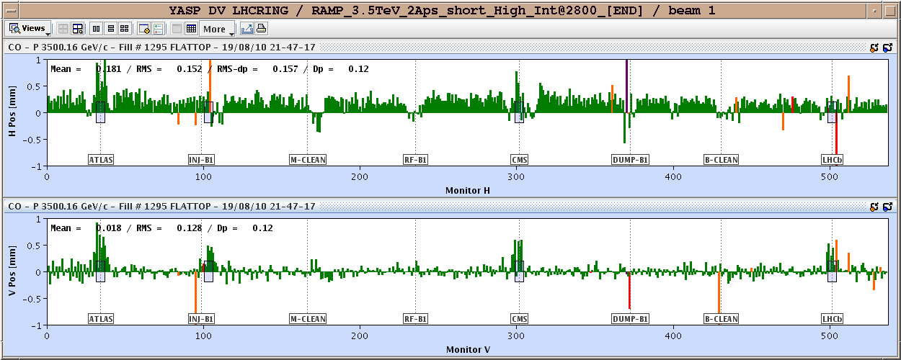
Thursday 19.8.
Orbit difference with respect to collimator reference at end of ramp:

Slide 11
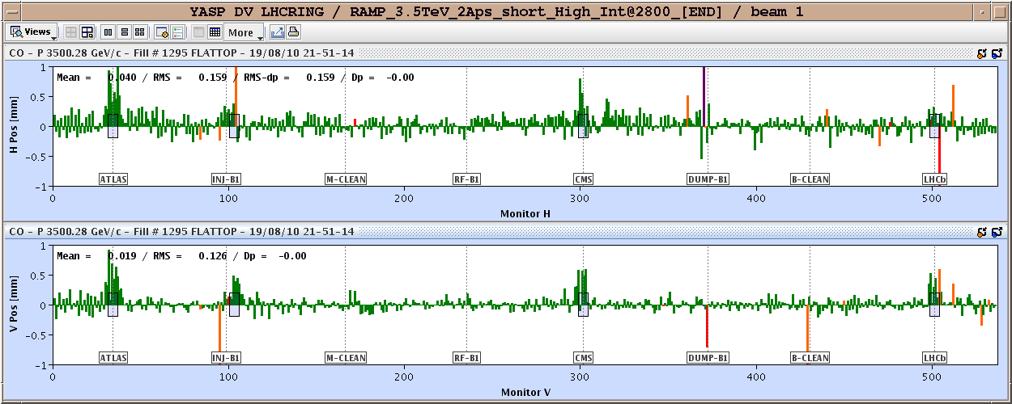
Thursday 19.8.
Orbit difference with respect to collimator reference after +15 Hz RF trim:

Slide 12
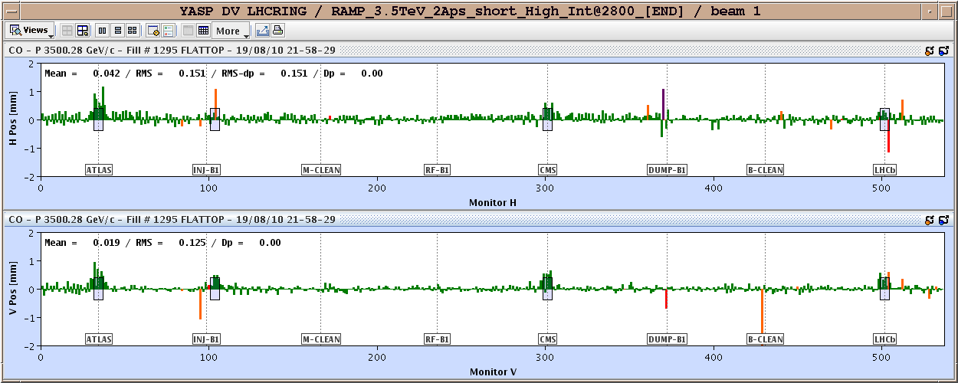
Thursday 19.8.
Orbit difference with respect to collimator reference after +15 Hz RF trim and several corrections:

Slide 13
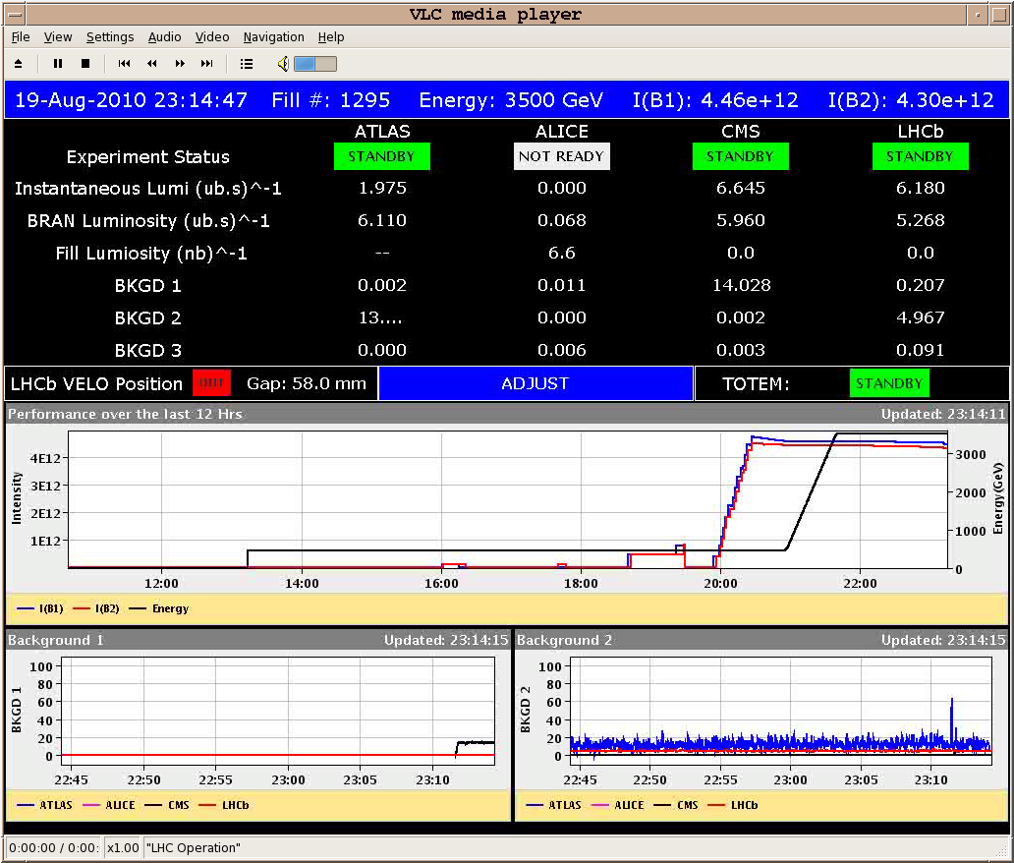
Thursday 19.8.
48 bunches
in both
beam:
Initial
Luminosity

Slide 14
Friday 20.8.
Morning:
Keep physics fill until noon.
Early afternoon: End of fill studies:
damper & lumi scan.
Late afternoon & over night:
New Physics Fill with 48 bunches per beam.
Weekend:
Physics Fills with 48 bunches per beam.

Slide 15
Week 33
Open Issues for next Technical Stop:
CMS cooling for central tracker.
Ion pumps in dump line MKB (B2 only 4 out of 8 pumps working; few days intervention).
BLM racks (in buildings SR1 and SR5 and both at position BY02): would like to correct the way the power cable for the multi-plug arrives inside the rack.
QPS boards: several boards had to switch from channel A to B.
Access team to replace oxydized connectors for PAD-PX24 (3 hours).
CV needs to replace a motorization of the water valve of the sector 56 (3h).
RCBH18.R7B2 – Miguel Cerqueira Bastos.

