Slide 1
Saturday 8.5.
03:00:Start preparation of new physics fill:
03:00: Start Pre-cylce after LBDS setup studies
04:50: End of Pre-cylces
08:00: Start of ramp
08:30: Ramp finished & start squeeze
09:20: Separation bumps collapsed
09:30: Collimators in ‘Stable Beam’ conditions
09:40: Cryo conditions lost in S23.
Cryo maintain was lost in S23 for 6 seconds. RB went into slow power abort , RQD/RQF tripped, and some other citcuits also tripped. Beams lost.
12:40: Beams back at injection settings and Starting Collimation verifications:
Initial problems with over injection (10¹¹ / bunch by 14:00)

Slide 2
Saturday 8.5.
Summary of Collimation studies (10¹¹ / bunch):
Loaded collimation settings at 450 GeV for nominal bunch intensity from yesterday (improved beam-based calibration method ➔ higher accuracy with increased intensity and correction for halo cuts during setup). - We provoked stored beam losses in H, V and off-momentum (positive and negative) for beam 1 and beam 2. Separate loss maps recorded. - Results looked fully OK in preliminary visual inspection, but further detailed analysis required. Much lower (invisible) losses in tertiary collimators. Like expected in simulations. - All collimators set back to previous settings in the end (low bunch intensity). - Did not perform beam scraping for additional cross-checks of beam size and beta at the collimators. To be done later.

Slide 3
Saturday 8.5.
Summary of BLM response studies (10¹¹ / bunch):
Moved in TCP's and two last TCLA's in IR3 to intercept injected pilot bunch for BLM response studies.
Dump of injected beam onto collimators 1. to verify filter settings on TCPs in IP3 2. to test the signal responce of BLM monitors left of IP3

Slide 4
Saturday 8.5.
17:20: End of Collimation setup & preparation of physics fill:
18:50: emittance measurement: Injections: B1H 1.83; B1V 1.87; B2H 2.76; B2V 3.3
B1 = 3.5 10¹⁰; B2 = 4.1 10¹⁰ per beam in two bunches
19:30: Start of ramp
20:20: End of Ramp:
3.5 TeV: B1H 2.6; B1V 2.7; B2H 3.6; B2V 4.0 ➔ ca. 50% - 25% increase
20:40: Separation bumps collapsed
21:20: Starting squeeze
22:24: Collimators in ‘Stable Beam’ conditions
Coll: B1H 3.0; B1V 3.0; B2H 3.8; B2V 3.7 ➔ ca. 5% - 10% increase

Slide 5
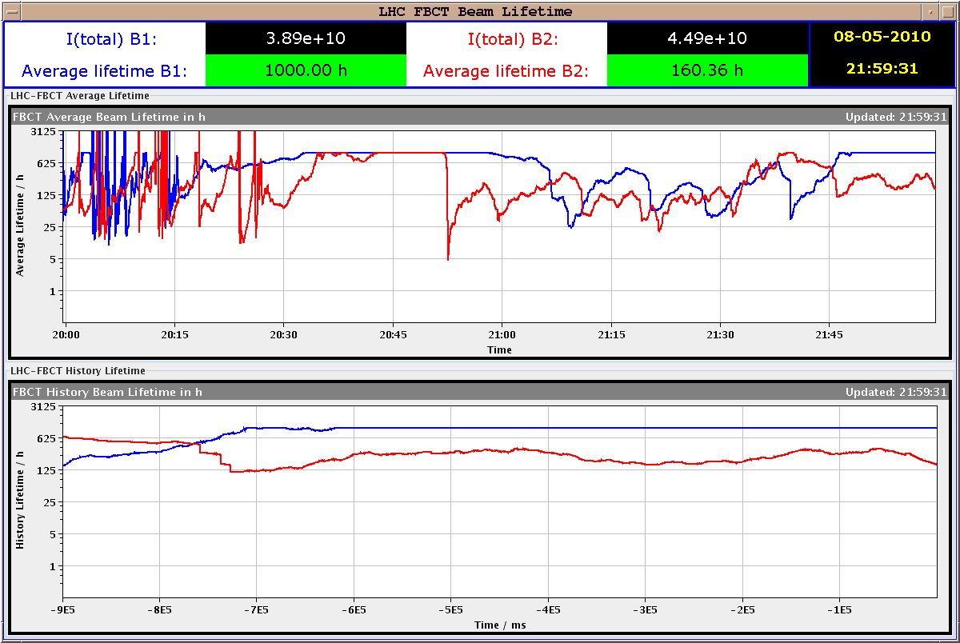
Saturday 8.5.
Lifetimes:

Slide 6
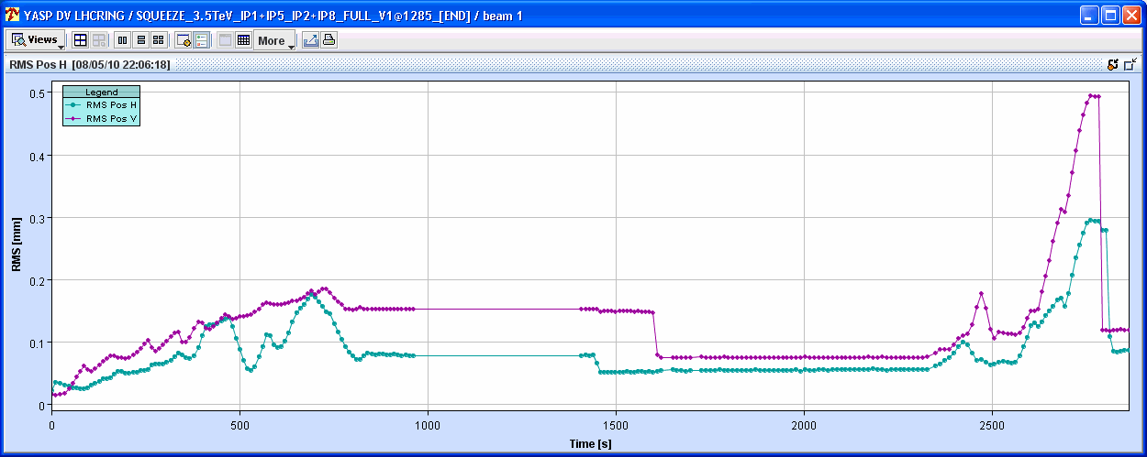
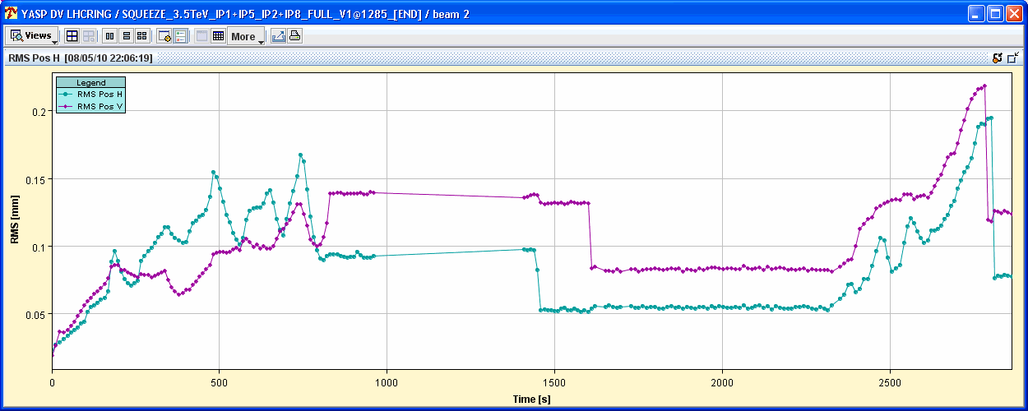
Saturday 8.5.
Lifetimes:

Slide 7
Sunday 9.5.
Plan for the day:
Physics fills!
Plan for next week:
Physics fills!
cleanup of outstanding issues (LBDS, abort gap cleaning etc.)

