Slide 1
Wednesday 4.5.
04:30: Started LHC Damper studies; working on Beam2
10:00: In parallel aperture measurements in Pt6 for Beam1
14:20: Electrical problems in the SPS:
2hours without beam injections
➔ continue aperture measurements in Pt6 with Beam1
16:30: SPS beam is back
new injection setup in the LHC (orbit, tune, Q’)
17:00: Start BPM calibration with different gain modes:
Took an orbit reference at 9e10 protons/bunch,
scraped the beam using the horizontal TCP collimators in Pt7,
stopped at given intermediate intensity,
took an orbit references at each intensity step and
continued until the BPMs stopped triggering in low-gain mode
switched to high-gain and scraped beam until all BPMs stopped triggering (well below 1e9 p/bunch)

Slide 2
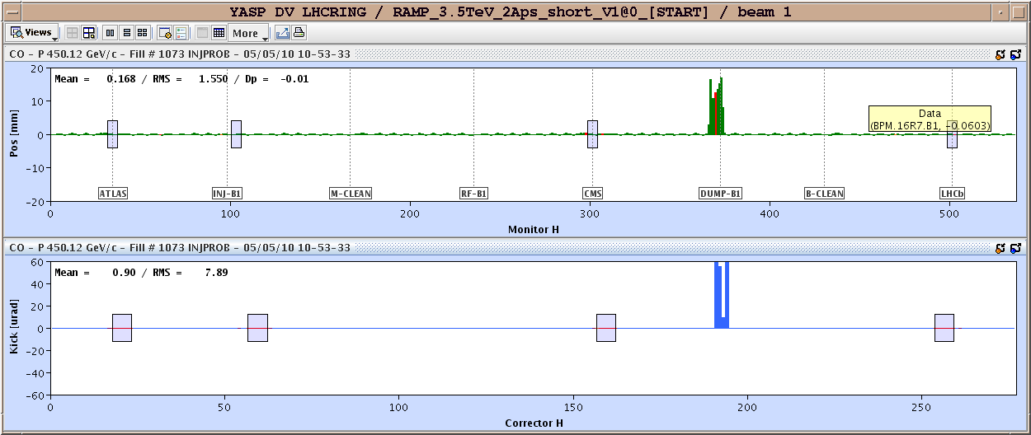
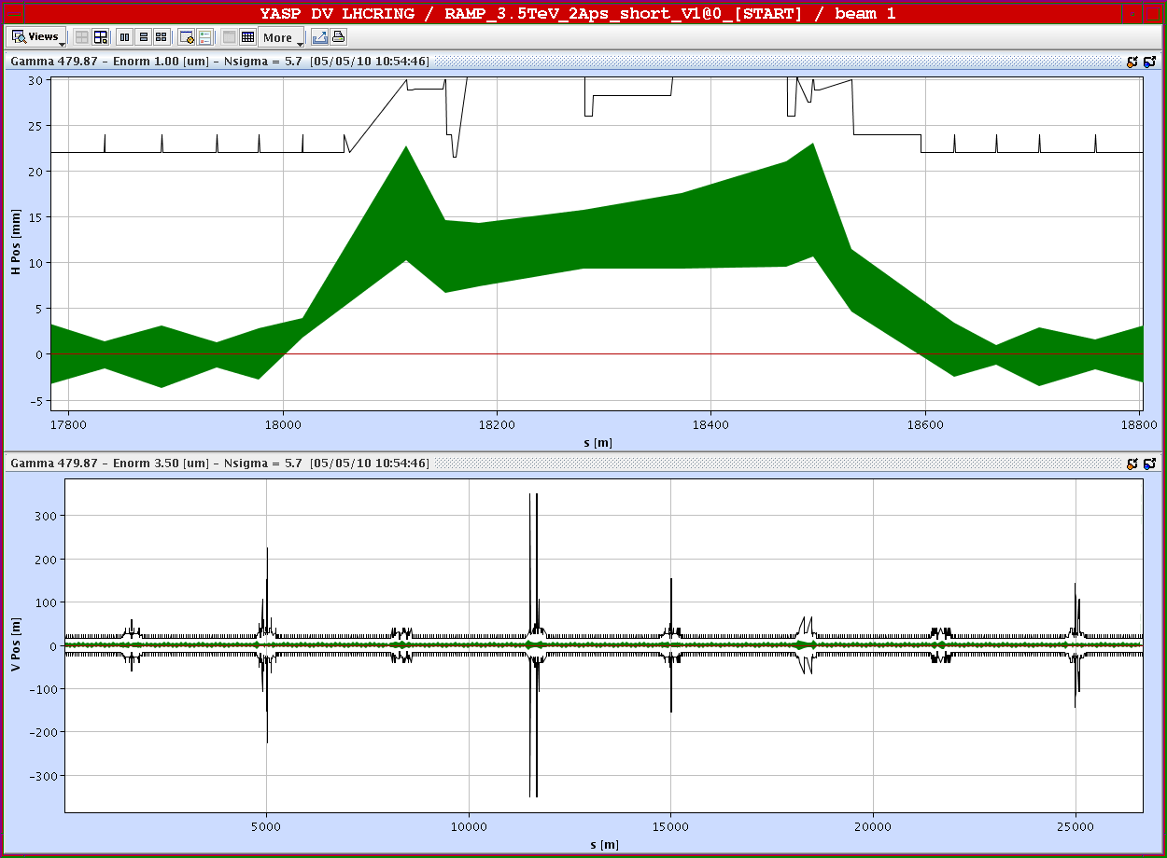
Wednesday 5.5.
Aperture measurements in Pt6 for Beam1:

Slide 3
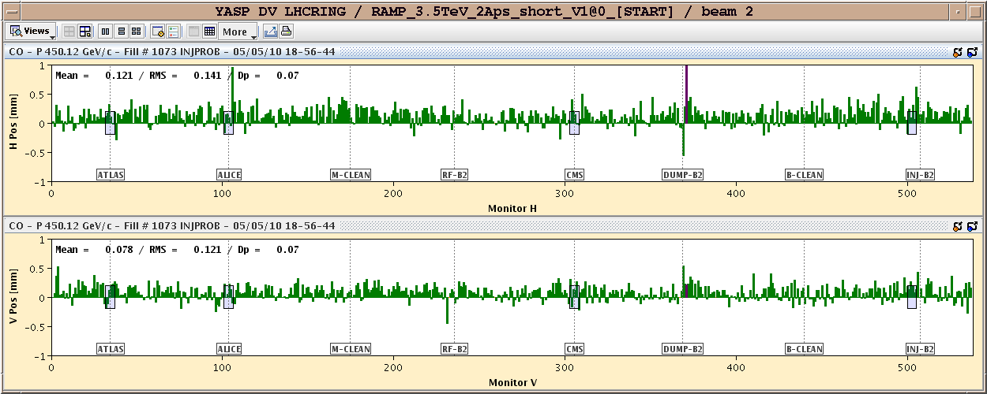
Wednesday 5.5.
Orbit shift when going from low to high bunch intensity gain:
9 10⁹ ➔ 9 10¹⁰ ➔ systematic shift of ca. 300 μm; shift seems to be mainly systematic into one direction; gain switch @ 2 10¹⁰

Slide 4
Wednesday 4.5.
18:00: Start Collimation setup ➔ planned until 01:30
new golden orbit established.
30 collimators set up for each beam during this shift. 11 still to go.
Beam was debunched after 2.5 hours of collimation setup (50% Jan)!
19:00: Communication problem with QPS card for RB in S67 can not be revived by soft reset.
02:00: switch off sector 67, left ON only RQ4 and RQ5 as they are the slowest to precycle.
02:20: power cycle on RQD.A67 was successful ➔ close switches and restart.
02:30: Precycle of S67 started
04:00: Several problems when trying to prepare machine for beam.
Sequence stops with error when trying to put collimators to parking
problem with LBDS

Slide 5
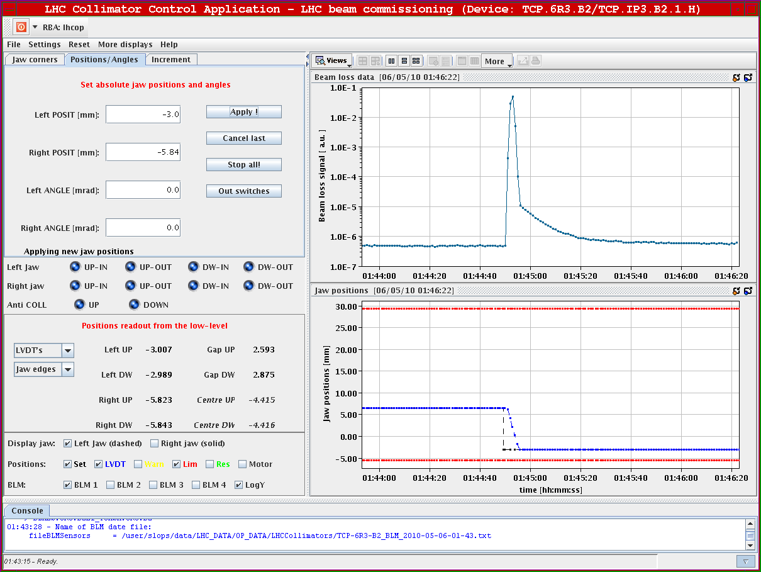
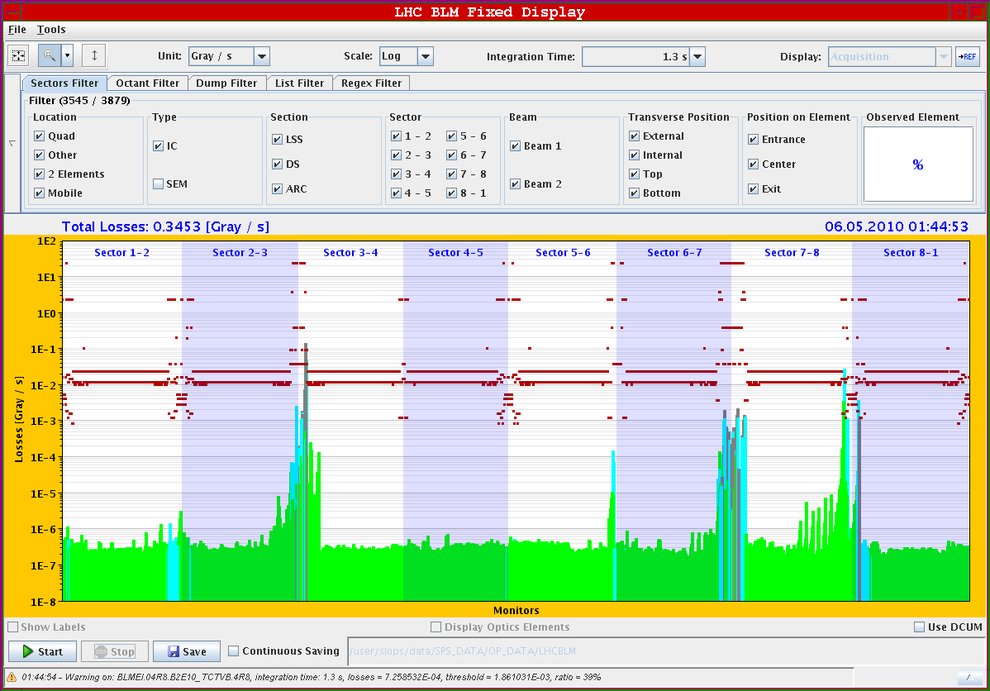
Wednesday 5.5.
Full beam scraping of B2 with TCP.6R3.B2:

Slide 6
Wednesday 4.5.
04:30: Beam circulating again
04:30: start β-beat measurement program
testing AC dipole with tune feedback on.
start β-beat measurement at injection.
06:00: Lost ARC45 (network perturbation 18 kV?)
➔ protection dump

Slide 7
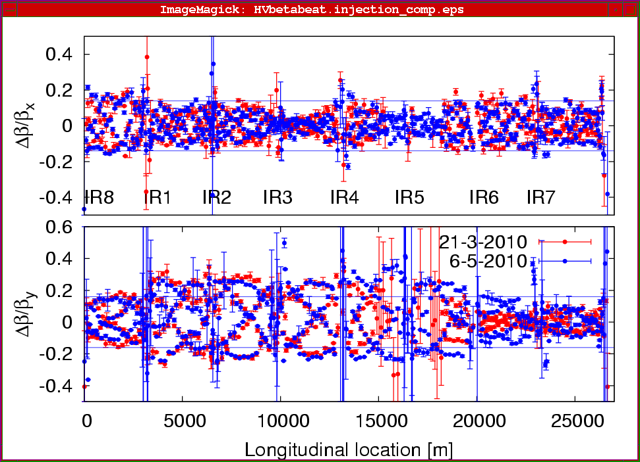
Wednesday 5.5.
β-beat measurement for Beam1 at 450 GeV:

Slide 8
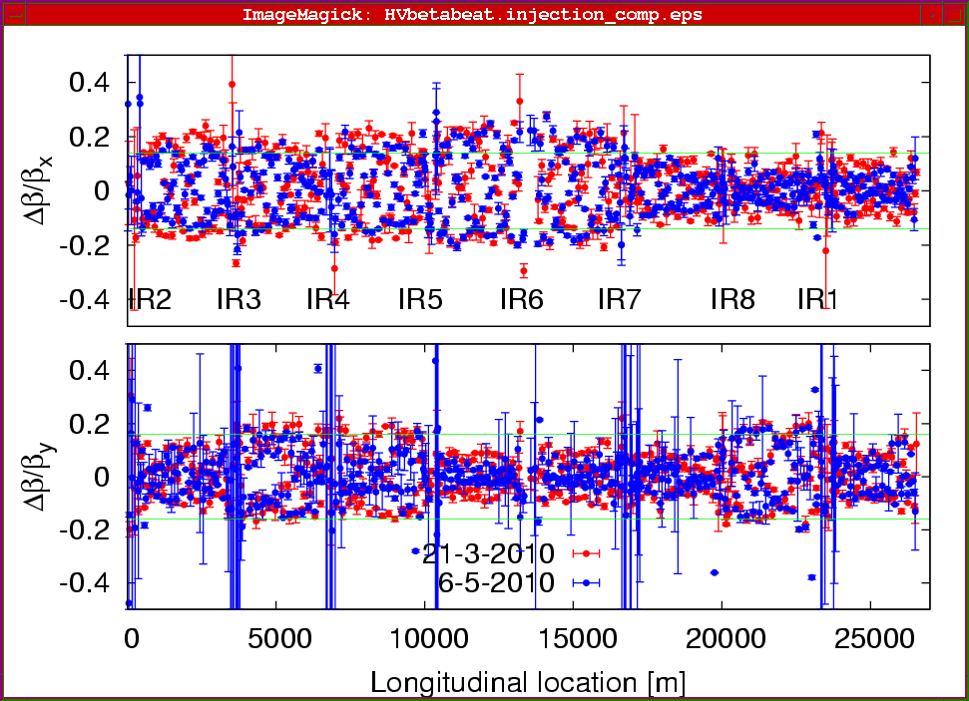
Wednesday 5.5.
β-beat measurement for Beam2 at 450 GeV:

Slide 9
Thursday 6.5.
Plan for the day:
Night: optics measurements during ramp if QPS reset successful.
Morning: Damper studies & abort gap cleaner.
Afternoon: continue collimation setup at 450 GeV in preparation for ramp with high intensities.
Physics fill for the night (optics measurement during ramp?)
Plan for tomorrow:
Morning LBDS
Afternoon: abort gap cleaning – n₁;

