Slide 1
Friday 16.4.
05:30: Physics fill from the night shift
09:50: Start squeeze in IR 1 & IR5:
10:58: Start squeeze in IR8:
β-beat correction using ‘knobs’ for Q5 and Q6 adjustments.
RQS.A56B2 tripped with a fast power abort at 11:25 when squeezing IP8 ➔ probably due to settings in squeeze file
12:20: Start squeeze in IR2:
14:31: Beam dump from SIS (missing COD signals):
Just before we could start β-beat measurements.
16:30: 3 hour access:
Quench heater problem in S67; Cryo temperature sensor for RQTL9.67; RCBV17.L1B1 & RCBV12.L4B1 fixed by EPC; CMS, ALICE, ATLAS and TOTEM; Compensator Pt8 (switch ON);
19:00: Access finished and machine closed:
Problems closing the tunnel (sirens); beam only back at 03:00am.

Slide 2
Saturday 17.4.
06:00: Physics fill from the night shift
16:40: Start squeeze in IR 1 & IR5:
β* = 2m reached at 17:10 ➔ ca. 30 minutes total for squeeze
17:30: Start squeeze in IR8:
β* = 2m reached at 17:55 ➔ ca. 25 minutes total for squeeze
β-beat correction using ‘knobs’ for Q5 and Q6 adjustments done via settings.
18:05: Start squeeze in IR2:
Reached β* = 5m but lost most of Beam2 after trip of RQS .A78B2. Caused by too high dV/dt in function settings.
Continue squeeze with Beam1 ➔ change of β–beat during squeeze is small!
23:30: Preliminary studies for TCD adjustments with Beam1 only
01:00: Preparing new fill for the night
06:45: Beam dumped:
again via missing COD signals in SIS

Slide 3
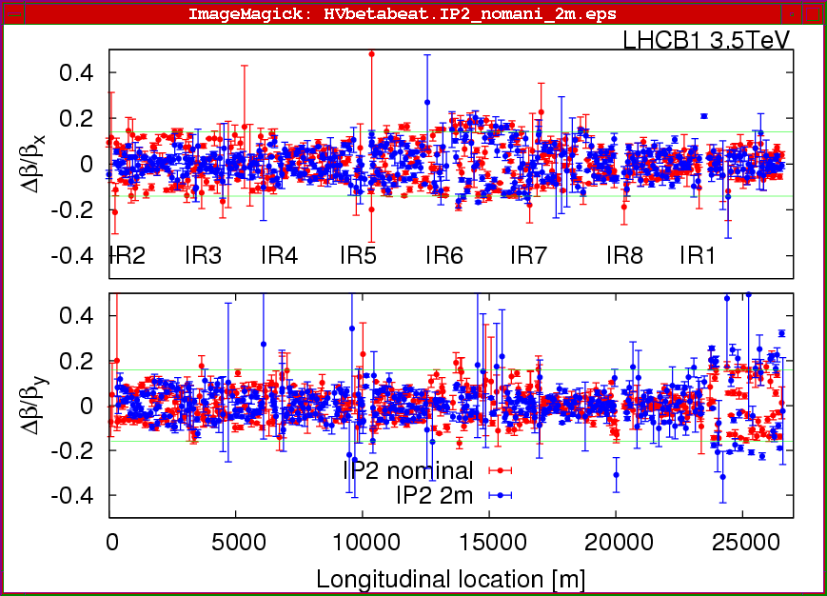
Saturday 17.4.
β-beat for Beam1 at β∗ = 2m in IR2 (all other IPS at β∗ = 2m):

Slide 4
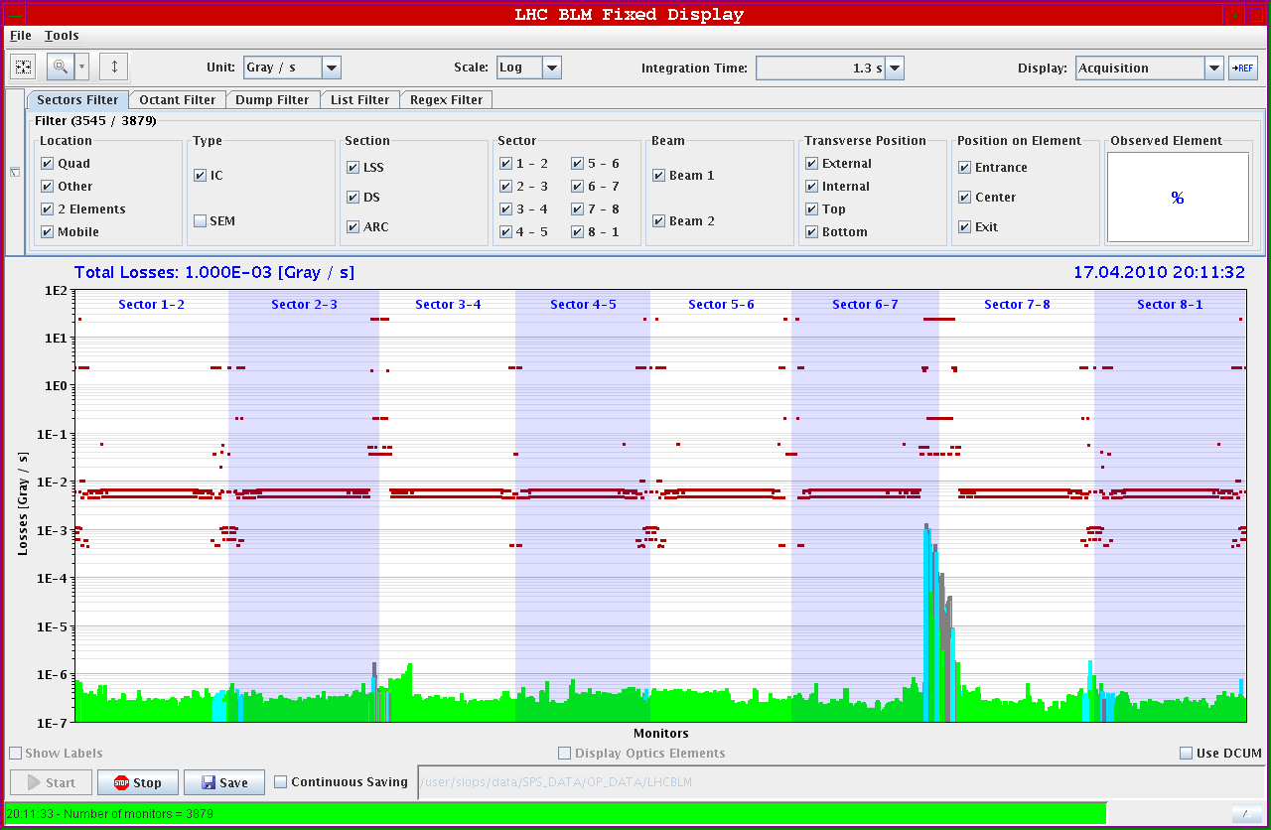
Saturday 17.4.
Losses during AC dipole measurements (β* = 3m in IP2):

Slide 5
Sunday 18.4.
09:00: Preparing new Physics fill.
11:30: Stable beam conditions
followed by luminosity scans in the experiments.
15:00: Beam dump via BIC:
Lost BLM signals in Pt4.
18:30: Preparing new fill for squeeze studies.
19:20 starting the ramp with orbit feedback
21:00 both beams lost during coupling correction (BLM in IR7)
22:30: Preparing new fill for the night.
Sector 21 down following strong beam loss in R1, starting at cell 18.
Quenched magnets are : A20R1, B20R1, C20R1, A22R1. Dipole B21R1 was quenched a bit later by the QPS itself
RQD in S12 weas not at injection level!

Slide 6
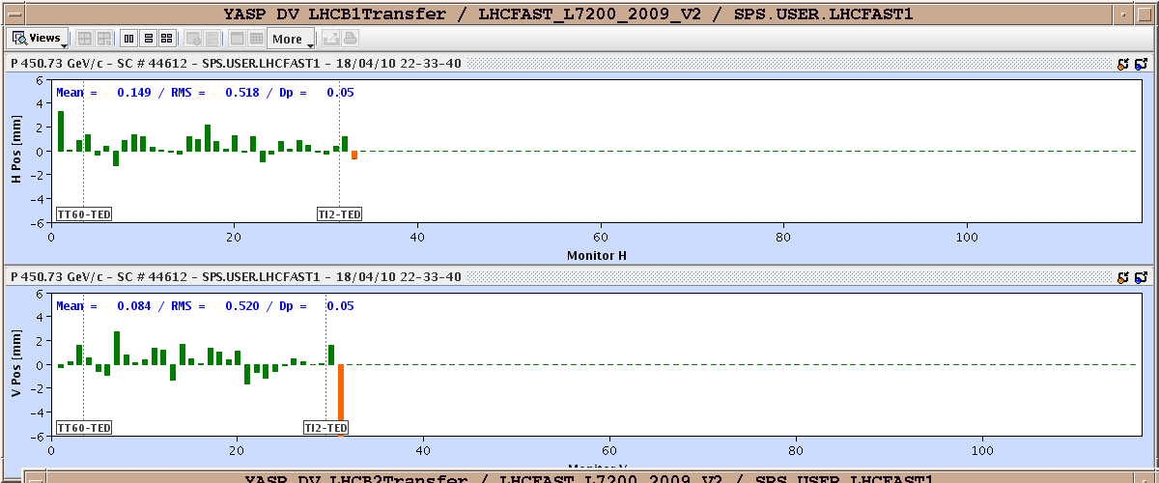
Sanday 18.4.
Trajectory in transfer line:

Slide 7
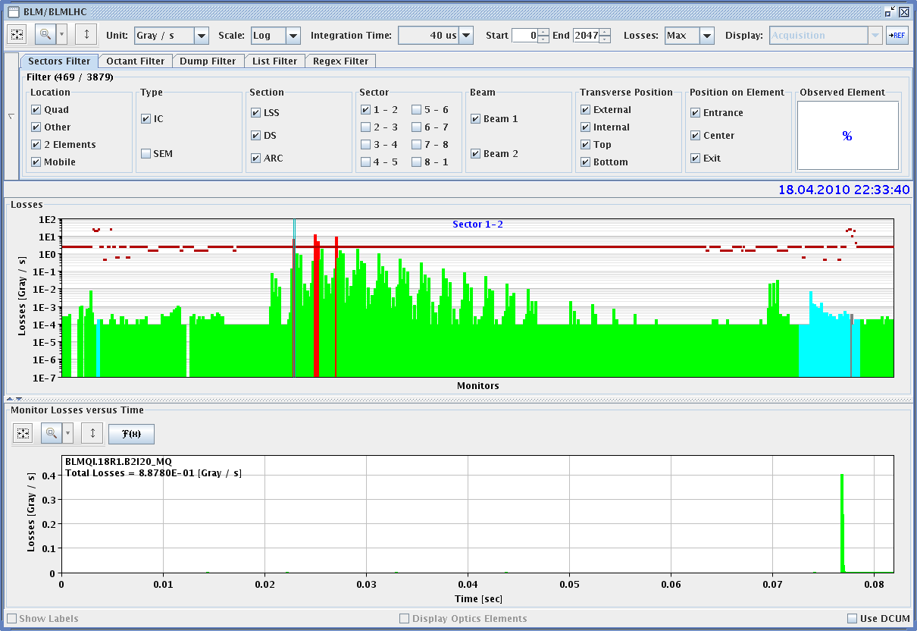
Sanday 18.4.
Losses in Sector12:

Slide 8
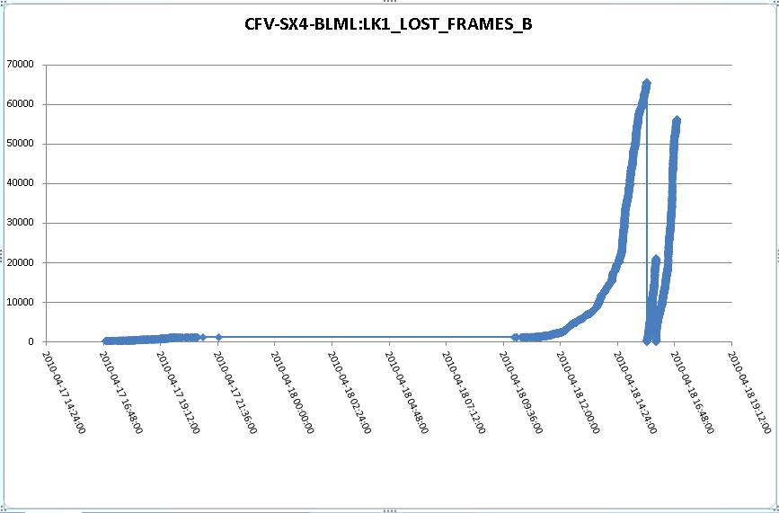
Sanday 18.4.
Lost frames for BLMs in Pt4:

Slide 9
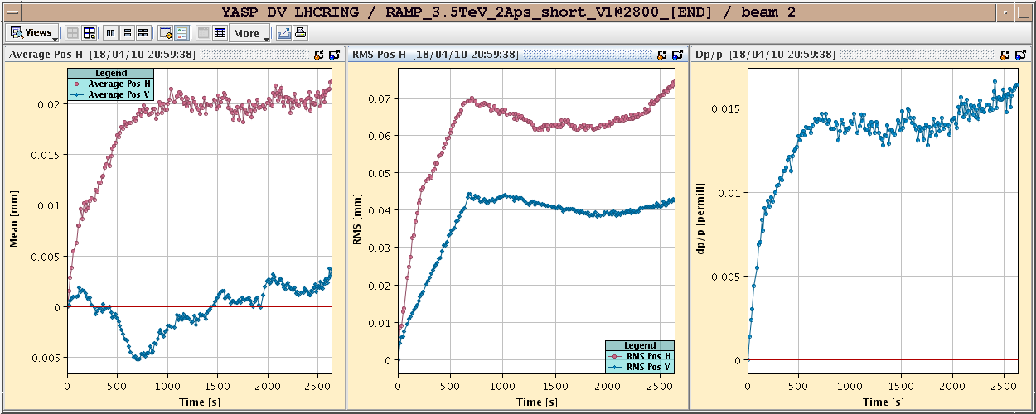
Sanday 18.4.
Orbit during ramp with feedback on:

Slide 10
Sunday 18.4.
01:30: Beam back.
01:50:Both beams circulating.
02:00: starting ramp.
03:30: at 3.5 TeV.
03:55: stable beams.
05:15: Both beams dumped; perturbation by electrical network?
06:30: Preparing new fill

Slide 11
Monday 18.4.
Plan for the day:
Repeat ramp and squeeze procedure at end of physics fill.
End of fill studies for establishing ‘stable beam’ conditions with squeezed optics.
Afternoon: Damper studies
Physics fill for the night.

