Slide 1
Friday 16.4.
05:30: Physics fill from the night shift
09:00: End stable beam mode
09:50: Start squeeze in IR 1 & IR5:
β* = 5m squeeze finished at 10:18 ➔ 28 minutes.
β* = 2m reached at 10:33 ➔ 15 minutes ➔ 43 minutes total for squeeze
10:58: Start squeeze in IR8:
β* = 5m squeeze finished at 11:21 ➔ 23 minutes.
β* = 2m reached at 11:29 ➔ 8 minutes ➔ 31 minutes total for squeeze
β-beat correction using ‘knobs’ for Q5 and Q6 adjustments.
RQS.A56B2 tripped with a fast power abort at 11:25 when squeezing IP8 ➔ large coupling
12:20: Finished squeeze in IR1,IR5 and IR8: ➔ 2.5 hours

Slide 2
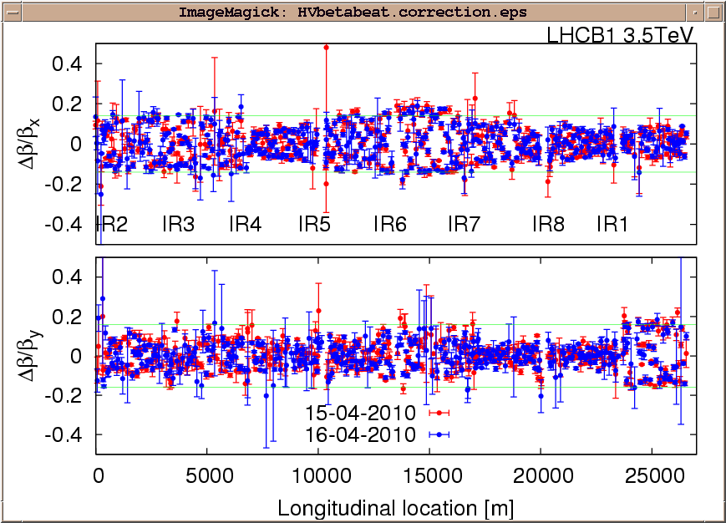
Friday 16.4.
β-beat after IR8 corrections:

Slide 3
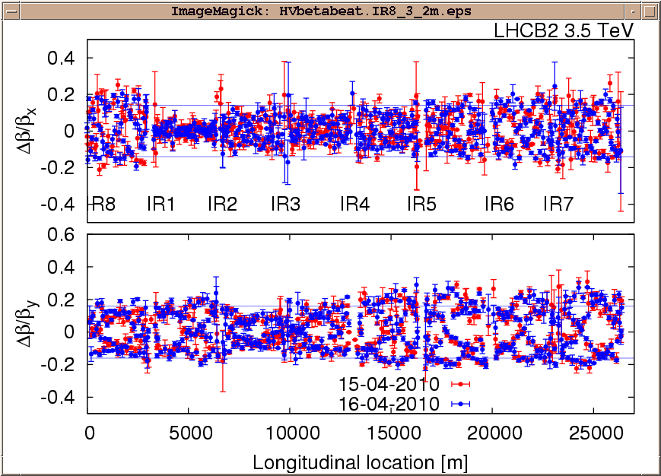
Friday 16.4.
β-beat after IR8 corrections:

Slide 4
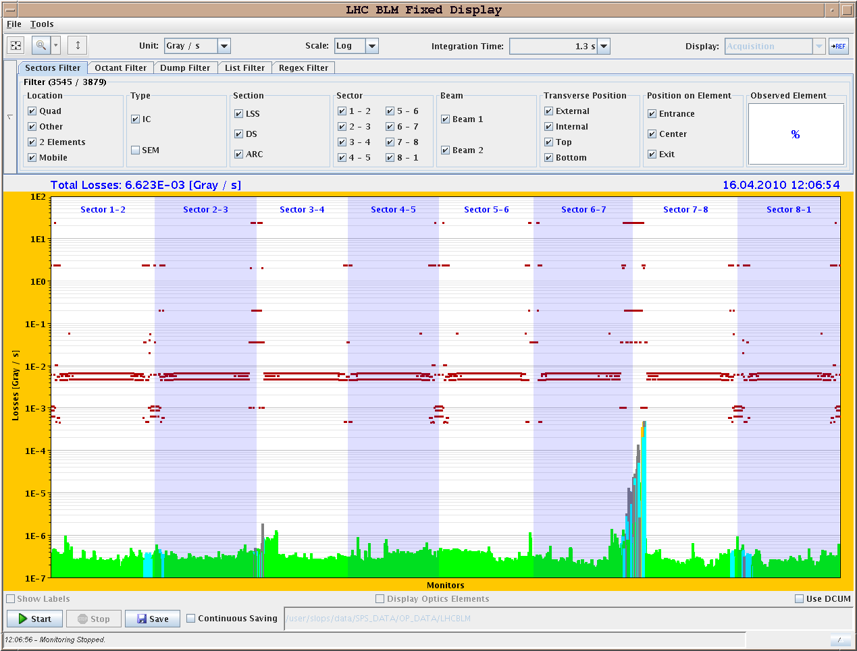
Friday 16.4.
Losses during AC dipole measurements after IR8 corrections:

Slide 5
Firday 16.4.
12:20: Start squeeze in IR2:
12:20: squeeze to β* = 9m ➔ 20 minutes.
12:40: squeeze to β* = 7m ➔ 10 minutes.
12:50: squeeze to β* = 5m ➔ 7 minutes; followed by Q, orbit and coupling correction.
12:57: squeeze to β* = 3m ➔ 30 minutes; followed by corrections.
13:36: squeeze to β* = 2m ➔ 10 minutes; coupling is large: c- = 0.02; followed by corrections of Q, orbit and coupling.
14:00: Luminosity scans in IR8
14:31: Beam dump from SIS:
orbit excursion from both beams, H + V. triggered at 14:14:53. CMW disconnected on property from OFSU. The CMW connection was re-established 10 seconds later, at 14:15:03. The system was setup to accept a short disconnection as happened here of up to 10 seconds. Unfortunately this was exactly the time of the disconnection. For the moment (while beams are of low intensity), the delay has been increased.

Slide 6
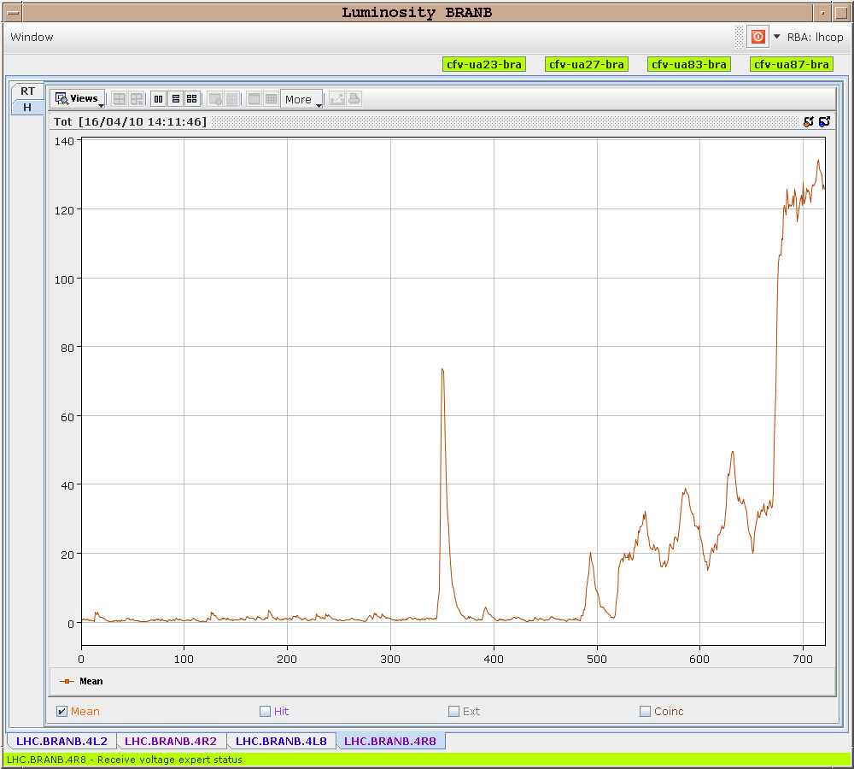
Thursday 15.4.
Luminosity scans
in IR8:

Slide 7
Firday 15.4.
16:30: Prepare access:
Quench heater problem in S67;
Cryo temperature sensor for RQTL9.67;
RCBV17.L1B1 & RCBV12.L4B1 fixed by EPC
CMS, ALICE, ATLAS and TOTEM;
Compensator Pt8 (switch ON);
All access should be finished within 3h;
19:00: Access finished and machine closed:
problems related to the siren and closing the tunnel.
Problem solved by midnight only.
Cancelled LBDS studies (aperture in Pt6 @ 450 GeV).
Preparation of physics fill for the night:
03:10: Problems incorporating settings (invalid time error) and LSA.
04:30: start ramp

Slide 8
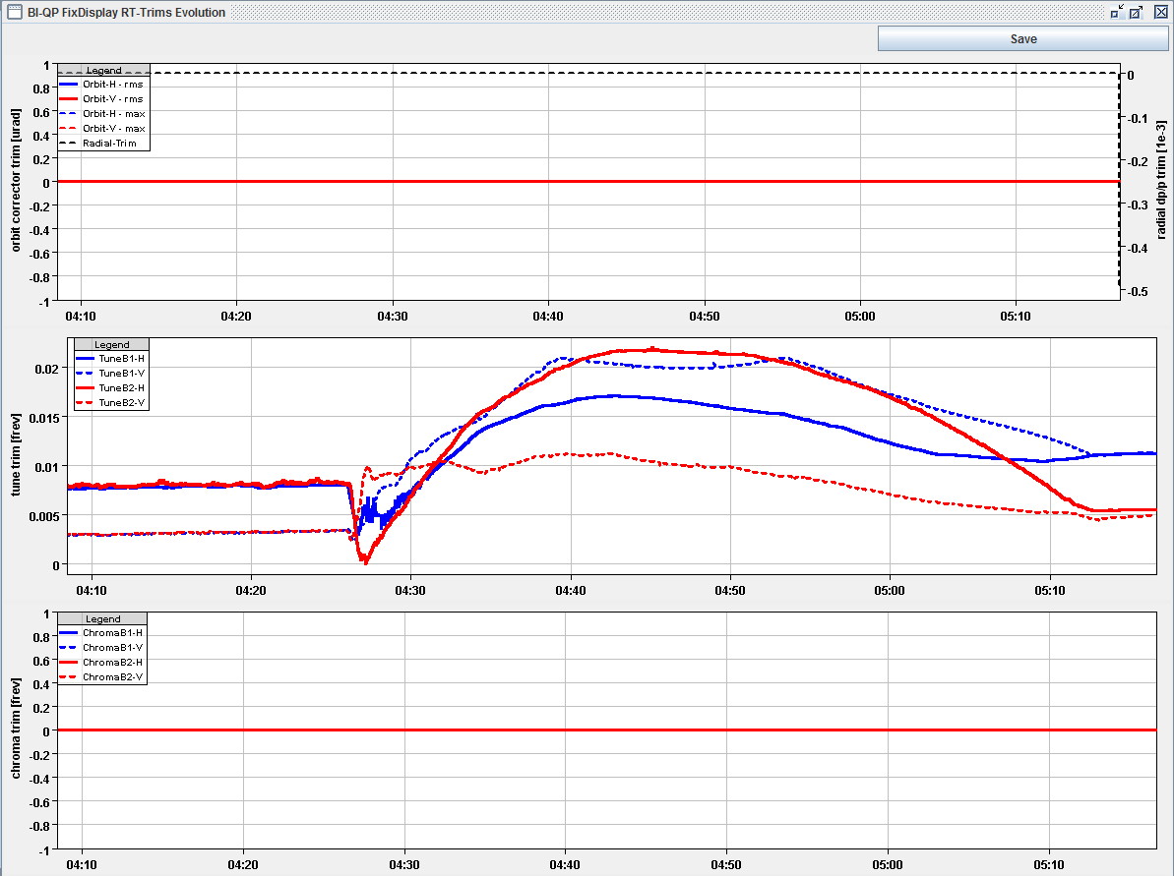
Thursday 15.4.
Tune feedback during ramp:

Slide 9
Saturday 17.4.
06:00: Stable beams for physics.
Noon:
Start optics squeeze.
Afternoon:
β-beat measurement and correction.
Optics and orbit measurements and corrections.
IP steering.
Night:
Adjustment of tertiary collimators.
End of fill studies with setup squeezed optics.
Physics fill for the night.
Sunday:
Repeat ramp and squeeze procedure.
End of fill studies for establishing ‘stable beam’ conditions with squeezed optics.

