Slide 1
Wednesday 14.4.
06:00: Physics fill from the night shift
Some separation scans.
10:30: End stable beam mode
Problems with settings for squeeze.
Problem with Q5.R8 still been investigated. There seem now to be also other possible solutions – analysis ongoing.
12:45: Start squeeze in IR 1 & IR5
Orbit & coupling not too good at 2 m. Corrected again.
Coupling of 0.01 on B1, corrected to 0.002.
14:30: Start squeeze in IR8
OK down to 5 m.
Beam lost going to 2 m. V tune drifts to 1/3 order resonance. Beam dump from beam excursion (could be due to loss in intensity!).

Slide 2
Wednesday 14.4.
16:00: Ramp down
Trip of RU.L4 during U_res reset (@ 400 A), lost cryo in matching section.
19:00: Cryo back, pre-cycle matching section
QPS_OK signal from RB67 not OK
Heater 3 of magnet B8L7 discharged.
Signal masked temporarily, repair in next access.
20:45: Injecting
Usual adjustments
22:00: 10 bunches 1E10 in B2 for Shottky, inject-dump on B1 for LBDS dump channel aperture studies.
22:30: CMS solenoid ramping down.
PC fault – over temperature.

Slide 3
Wednesday 14.4.
00:00: LBDS B1 studies finished
phase scan for horizontal 0, 30, 60 done, 90 interrupted at 10 sigma, tbd.
found strange losses in P3, last absorber, seen for phases 0, 30 and 60, but not 90 degrees.
00:00-04:00: various troubles..
SPS compensator, PS, hump
04:00: Filling for physics
06:30: STABLE BEAMS
PM1 for B1 disabled – not clear how this is possible…

Slide 4
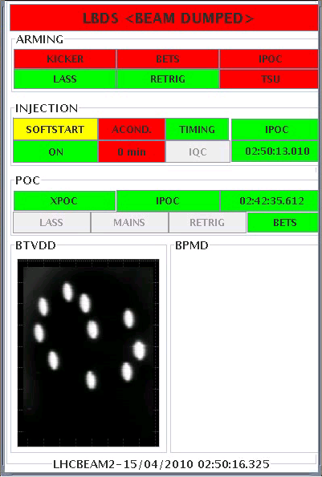
Dump…
Dump of the 10 bunches

Slide 5
Hump
Our friend the hump on the lifetime - ~ 7 minute period

Slide 6
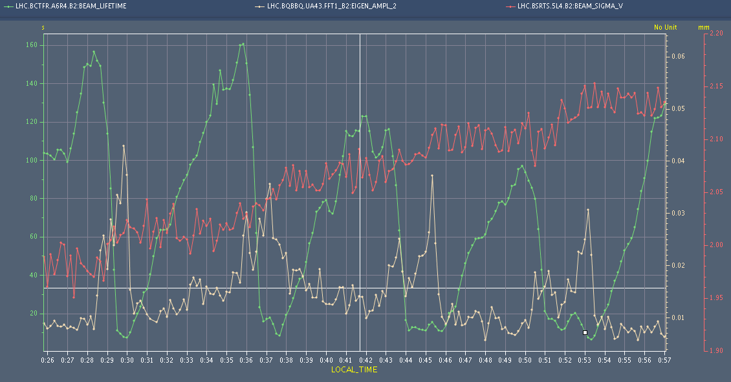
Hump
Our friend the hump on the lifetime, tune amplitude and size

Slide 7
Plan for today:
Squeeze 2-2-2-2 starting now. Careful check of optics, overlap scans, TCTs..
If time permits : higher intensity injection, LBDS continued – to be evaluated later today

