Slide 1
Tuesday 13.4.
05:00: Physics fill from the night shift
09:30: End stable beam mode
Optics measurement (both beams both planes).
Incorporation of ramp settings for IR1 and IR5.
10:50: Start squeeze in IR 1 & IR5
First step to 9m in IR1 and IR5. Then to 5m and 2m followed by optics measurements.
Large coupling at β* = 2m: c₋ = 0.0155
➔ tune, Q’ and coupling corrected for β* = 2m

Slide 2
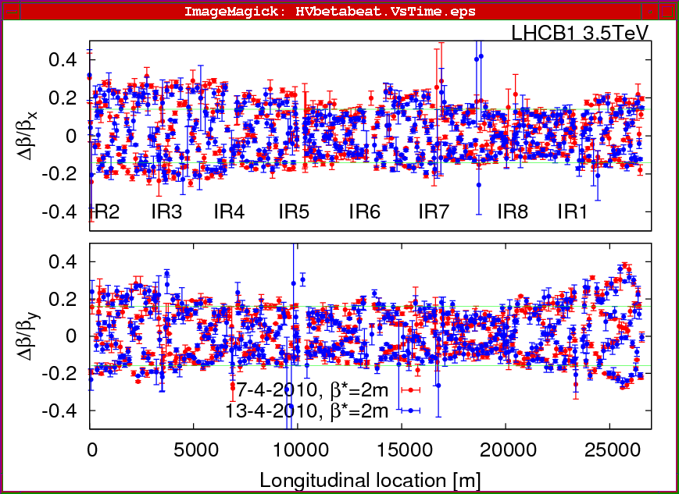
Tuesday 13.4.
β-beat for Beam1 @ β* = 2m before correction:

Slide 3
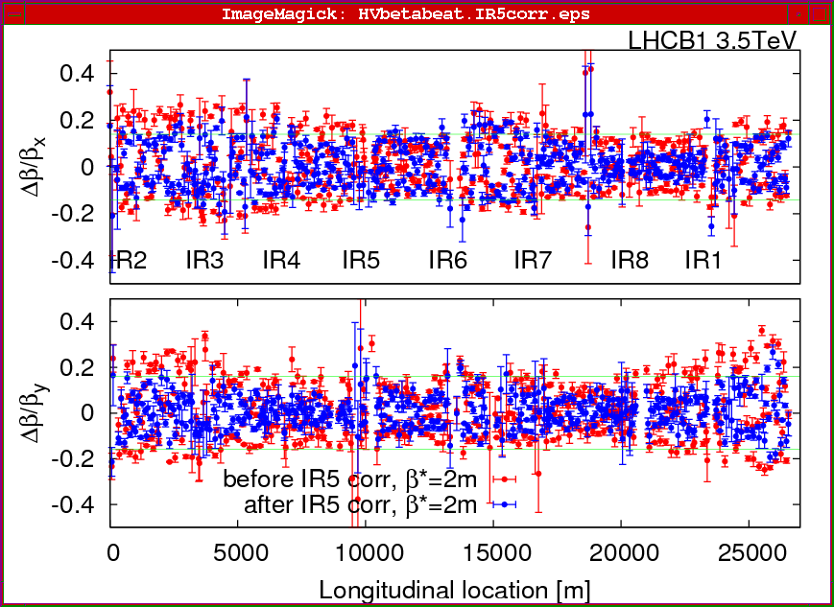
Tuesday 13.4.
β-beat for Beam1 @ β* = 2m after correction using IR5 Q2:

Slide 4
Tuesday 13.4.
Beam1 intensities during squeeze in IR1 & IR5:
9:35: tunes back to injection
values;
loss of RCBV17.L1B1 end of squeeze to β* = 2m
large losses at end of squeeze in Beam2
in IR7

Slide 5
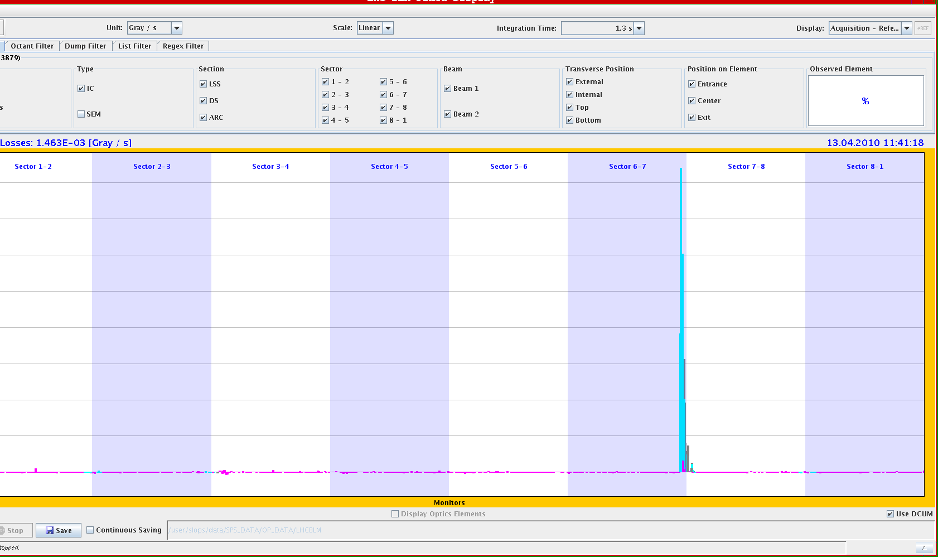
Tuesday 13.4.
Beam losses in IR7 at end of squeeze to β* = 2m:

Slide 6
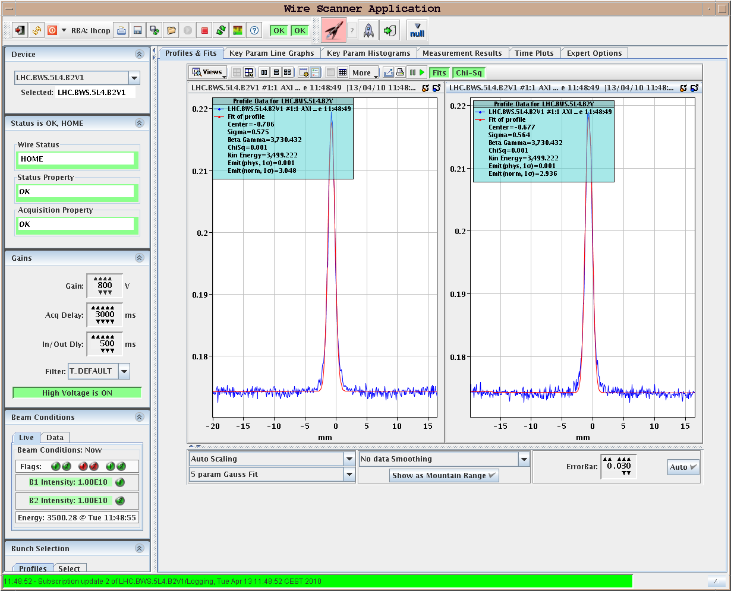
Tuesday 13.4.
Beam2 vertical beam size after squeeze to β* = 2m: ε_{v} = 3.0 μm
all other beam
sizes are smaller

Slide 7
Tuesday 13.4.
16:00: Start squeeze in IR8 to β* = 5m:
Vertical beam size in Beam2 very large: ε_{v} = 13.5 μm!
Attempts to measure β-functions for Beam2 generate large beam losses.
Measure only β-functions for Beams before and during squeeze.
Moving IR8 collimators to 12.8 sigma settings.
17:20: Start squeeze in IR8 to β* = 3.5m:
Beam2 losses towards end of squeeze.
17:55: Start squeeze in IR8 to β* = 2 m.
Losses during the squeeze.
18:35: Start β measurement in both beams with to β* = 2 m.
Losses during AC dipole measurements.
Large β-beat for Beam1: 40%! But β*‘s are OK.
Very good correlation with correction using Q5.R8.B1 by +5%!?!
19:00: Start transverse IP adjustments

Slide 8
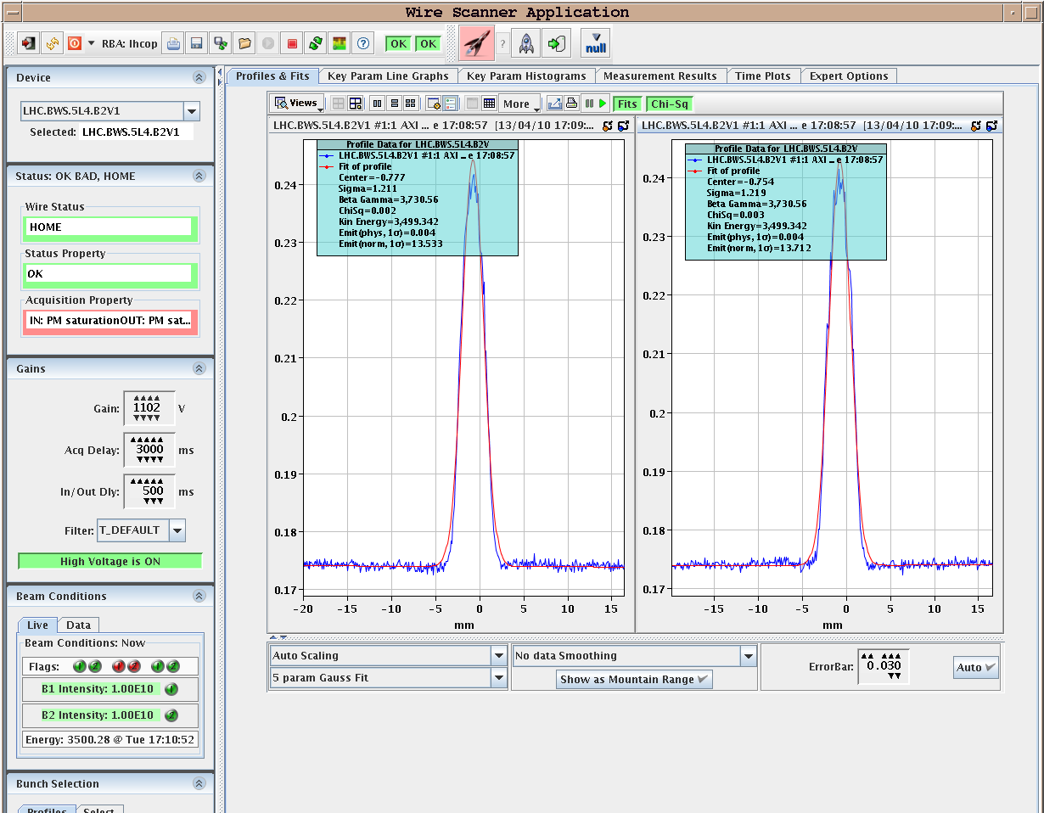
Tuesday 13.4.
Beam2 vertical beam size at beginning of squeeze in IR8:
ε_{v} = 13.5 μm!
all other beam
sizes still
around 2 μm.

Slide 9
Tuesday 13.4.
Beam intensities during squeeze in IR8:

Slide 10
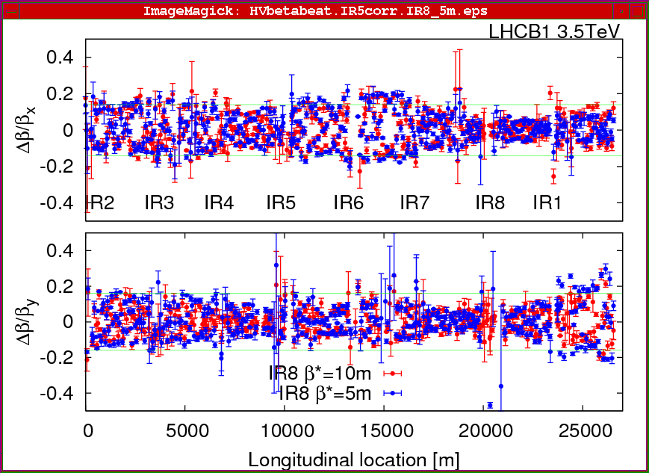
Tuesday 13.4.
β-beat for Beam1 before squeeze and @ β* = 5m in IR8:

Slide 11
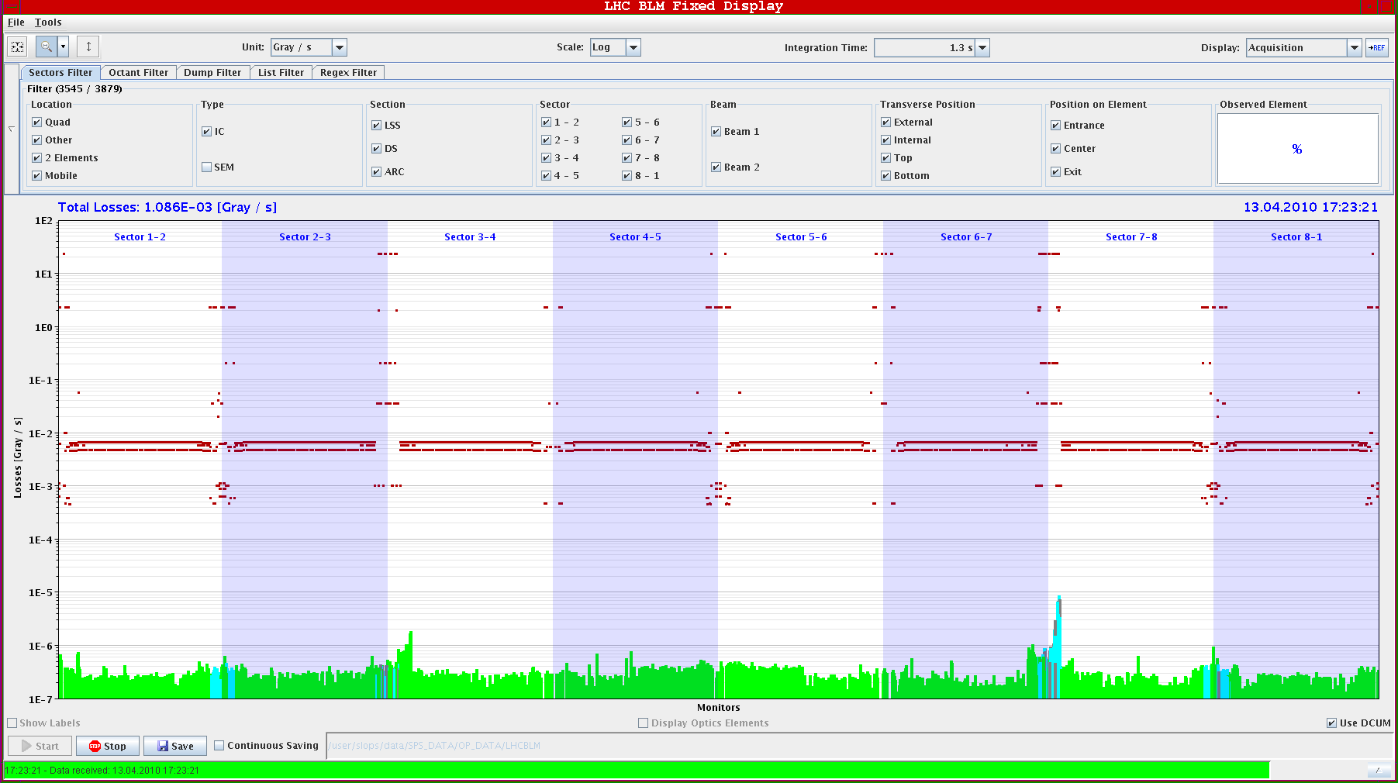
Tuesday 13.4.
Beam losses in IR7 at end of squeeze to β* = 3.5m in IR8:

Slide 12
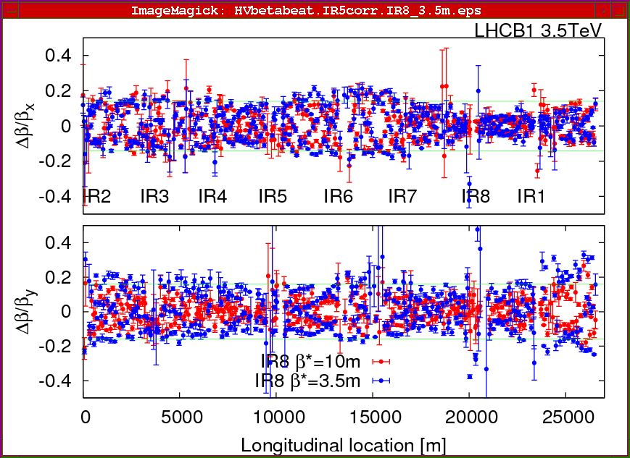
Tuesday 13.4.
β-beat for Beam1 after squeeze and @ β* = 3.5m in IR8:

Slide 13
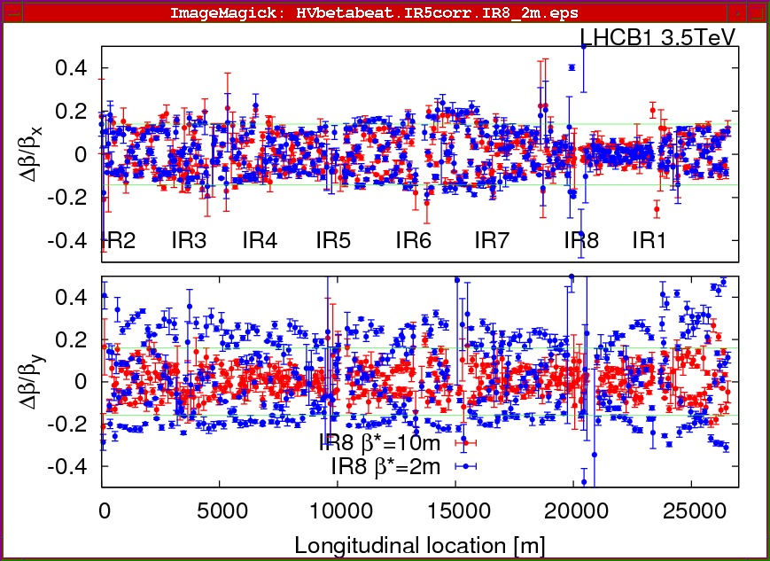
Tuesday 13.4.
β-beat for Beam1 after squeeze and @ β* = 2m in IR8:

Slide 14
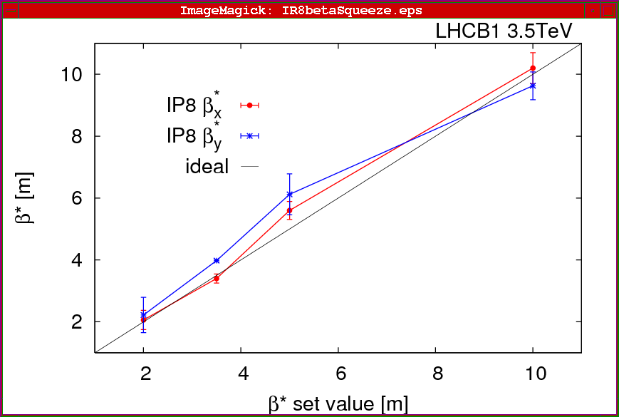
Tuesday 13.4.
β∗ during squeeze to β* = 2m in IR8:

Slide 15
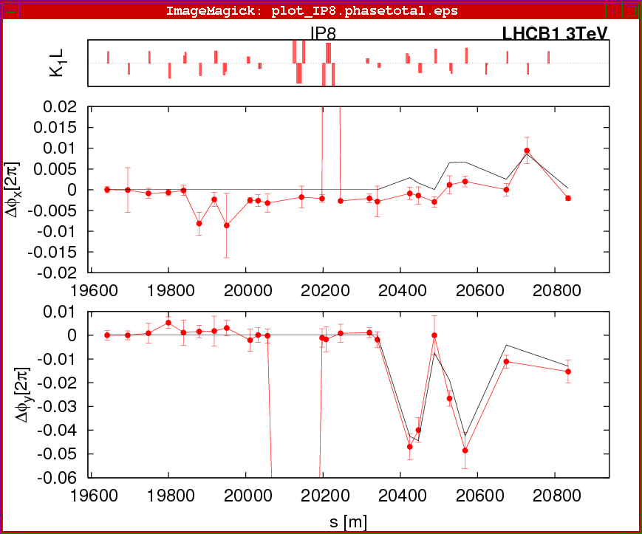
Tuesday 13.4.
Very good correlation for correction with Q5.R8.B1 (+5%):

Slide 16
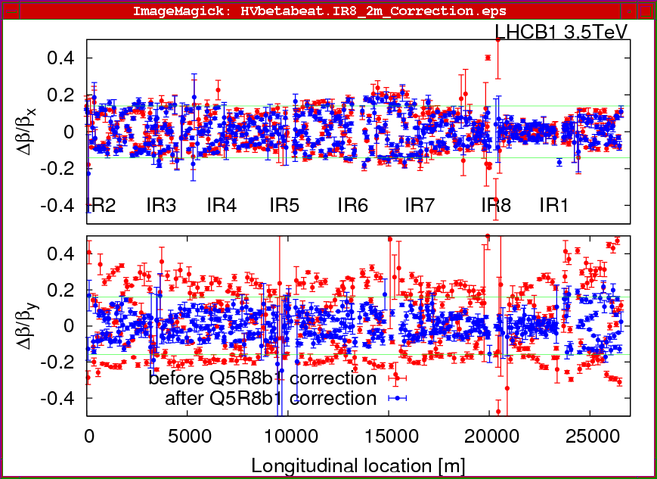
Tuesday 13.4.
β-beat for Beam1 after squeeze and @ β* = 2m in IR8 after
correction
of Q5:

Slide 17
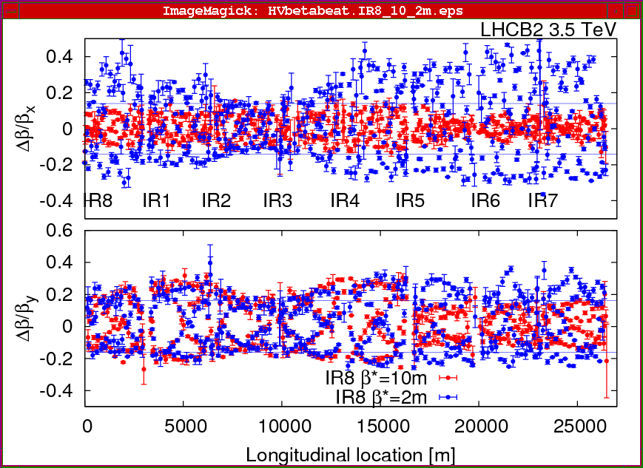
Tuesday 13.4.
β-beat for Beam2 after squeeze and @ β* = 2m in IR8:

Slide 18
Tuesday 13.4.
21:00: Finish IP scans:
large offsets in IR5 and IR8 wrt zero orbit.
initially no collisions in IR8 ➔ large difference between end of ramp settings
21:00: Revisit of β–beat origin in IR8:
Vertical beam size in Beam2 very large: ε_{v} = 13.5 μm!
21:50: Switching off RD1.LR5 to test fast BCT interlock
beams correctly dumped via interlock.
22:00: XBOC studies
seems to be OK now.
01:00: Ramp with beam abort at 800 GeV.
after some problems preparing next fill (IQC sequencer; LHCf)
Dump at 800 GeV well centered on beam dump.
new b3 prediction assuming ramp-down combo from 6 kA @ 2 A/s
Q’ measurement during snap back: very clean signals
04.20: Preparing Physics fill for the night: stable beams at 05:50.

Slide 19
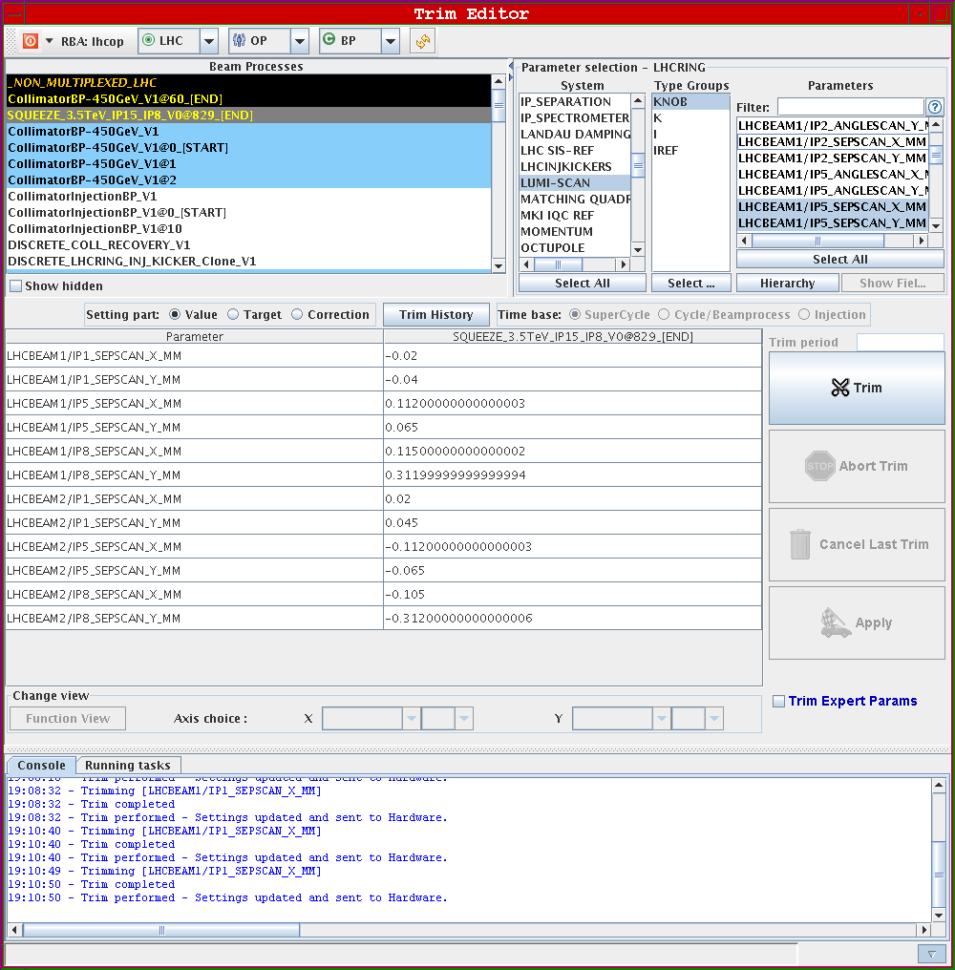
Tuesday 13.4.
Transverse IP settings
after corrections after
squeeze:

Slide 20
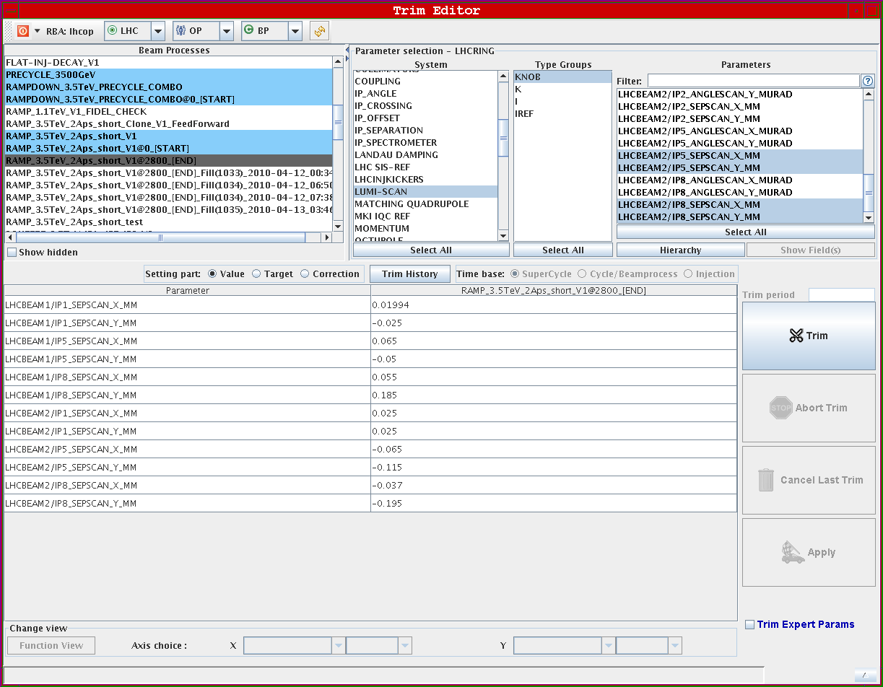
Tuesday 13.4.
Transverse IP settings after corrections at end of ramp:
-ca. 60 μm for CMS
-ca. 100μm for LHCb

Slide 21
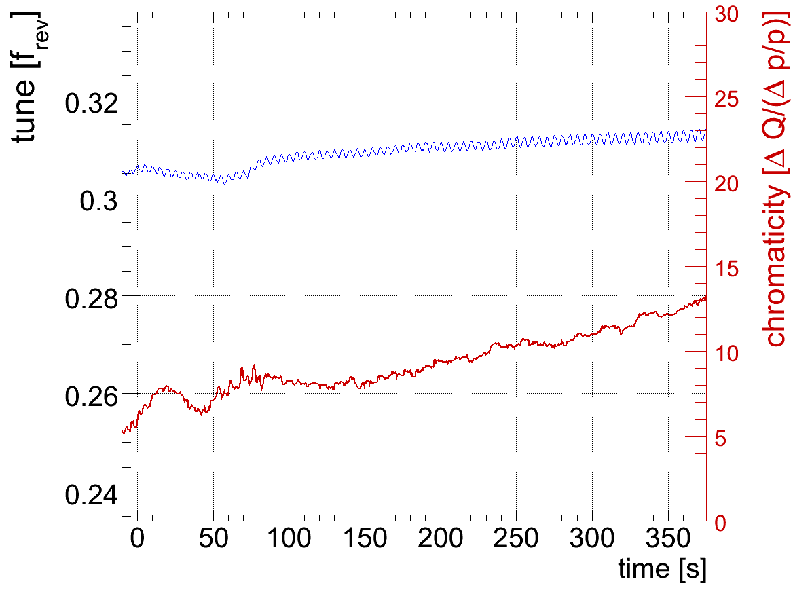
Tuesday 13.4.
Q’ measurement during 800 GeV ramp: Beam2 Vertical

Slide 22
15.4.
Plan for the morning:
Squeeze in IR1 & IR5.
Squeeze in IR8.
Establishment of corrected orbit reference followed by re-adjustment of tertiary collimators.
Measurement of loss hierarchy.
Simulation of asynchronous beam dump.
Afternoon:
LBDS studies as preparation for higher intensities.
Schottky measurements.
Night:
Physics fill with squeezed optics if possible.
Thursday:
Continuation with preparations for higher beam intensities.

