Slide 1
Saturday
6:13 – 15:00 STABLE BEAMS
  scans etc.
15:00 moved to ADJUST
Squeeze to 2 m in two steps 11 – 5 – 2
  remarkably smooth
  tertiary collimators in at 5 m
  lifetime actually went up during second step
Tunes, orbit, coupling (using IT skew quads)
Scans in CMS and Atlas
  CMS missing initially
Alice solenoid off (and back on later)

Slide 2
Collimators – IR3
Settings have been evaluated for tertiary collimators in IR8 and beta* of 3 m (2010 scenario agreed in 2009). Corresponding settings, taking into account TCT calibration in IR8:
Beam 1
  TCTH.4L8.B1 L = 8.16mm R = -6.86mm
  TCTVB.4L8 L = 8.38mm R = -9.34mm
Beam 2
  TCTH.4R8.B2 L = 7.19mm R = -7.84mm
  TCTVB.4R8 L = 8.95mm R = -8.77mm
This corresponds to a setting of 15.3 nominal sigma. Note that the settings were adjusted on the spot to the changed squeezed IR8 optics. IR8 collimator beta values from LSA database different by up to 40m (20-30%) compared to collimation reference case.

Slide 3
Sunday morning
Squeeze in IR8
  Wrestling settings
  Eventually to 5.5 m OK
  had to stop here
    RQTL13.L8B1 limited to 300 A, need 352 A to go to 2 m. As the lowest quench current for this magnet was 407 A, J-P Tock gives go ahead to up limit to 352 A
    FGC update requires resync and reset so now further for now
MP test switch off one warm D1 magnet.
  Preliminary analysis while waiting for the PM: the first channel to trigger was the FMCM in IP1 as expected. Then, we had errors from all BLM input due to the missing sanity check (not done in the last 24h due to the long store!).
  Test successful!

Slide 4
Sunday morning
Pre-cycle
Problems, problems, problems “extremely troublesome”
  Stefano wakes up half the controls group
05:43 beam back
IQC/XPOC issues
Too higher intensities in SPS
…

Slide 5
Fill 1031
LHCb 2nd lumi-scan
Bumps collapsed
LHCb lumi-scan
ATLAS lumi-scan
CMS lumi-scan
Ramp finish
Ramp start
VELO in
Mirko Pojer

Slide 6
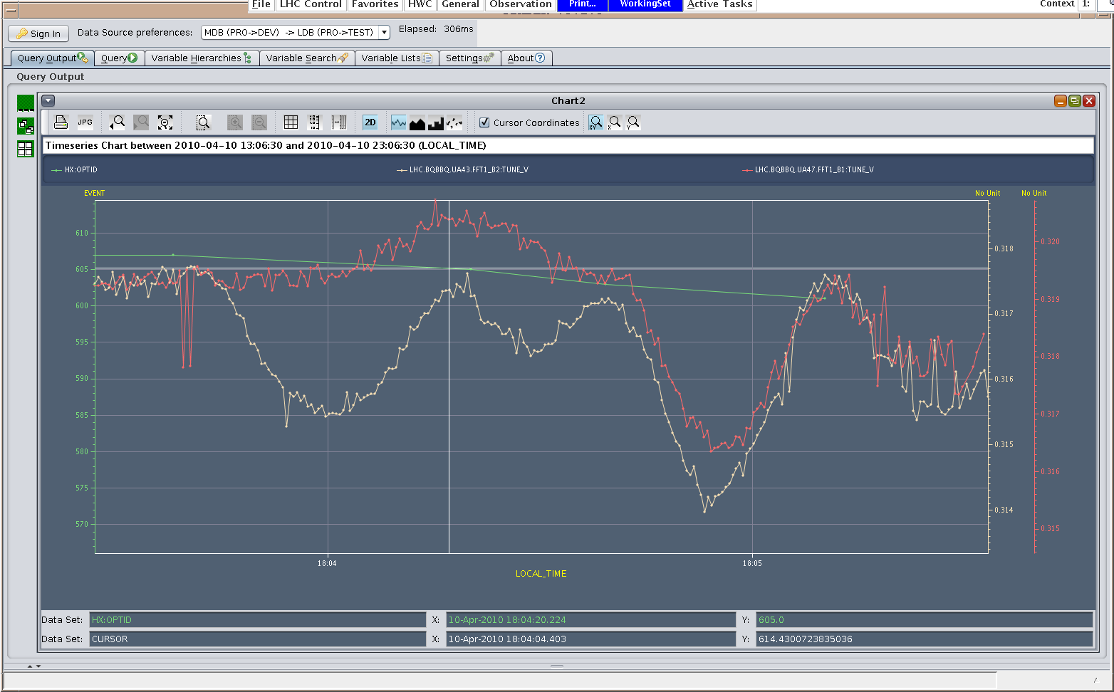
Tunes – squeeze part 2

Slide 7
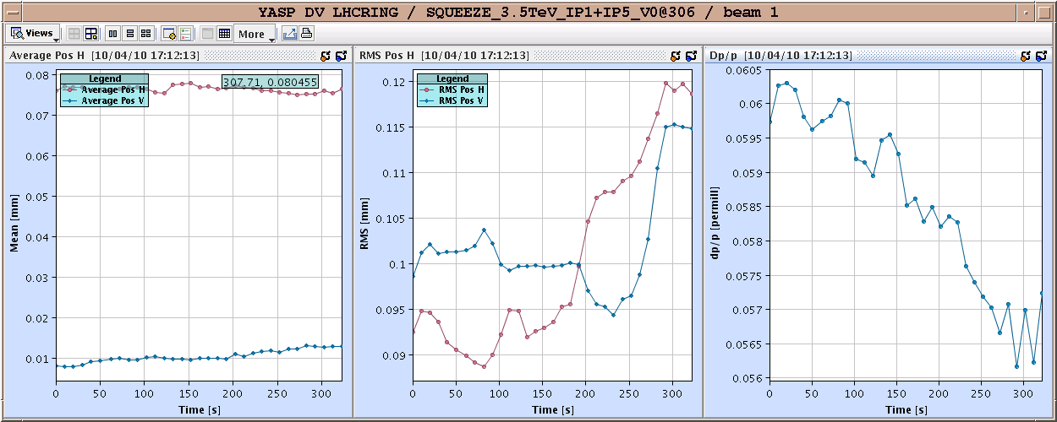
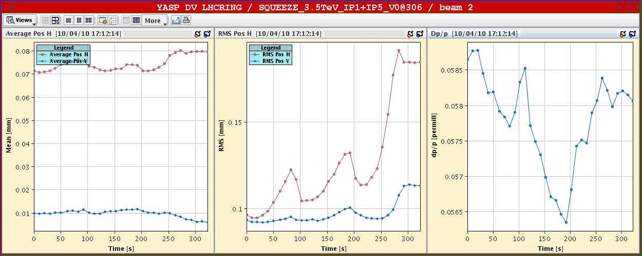
S Part 1

Slide 8
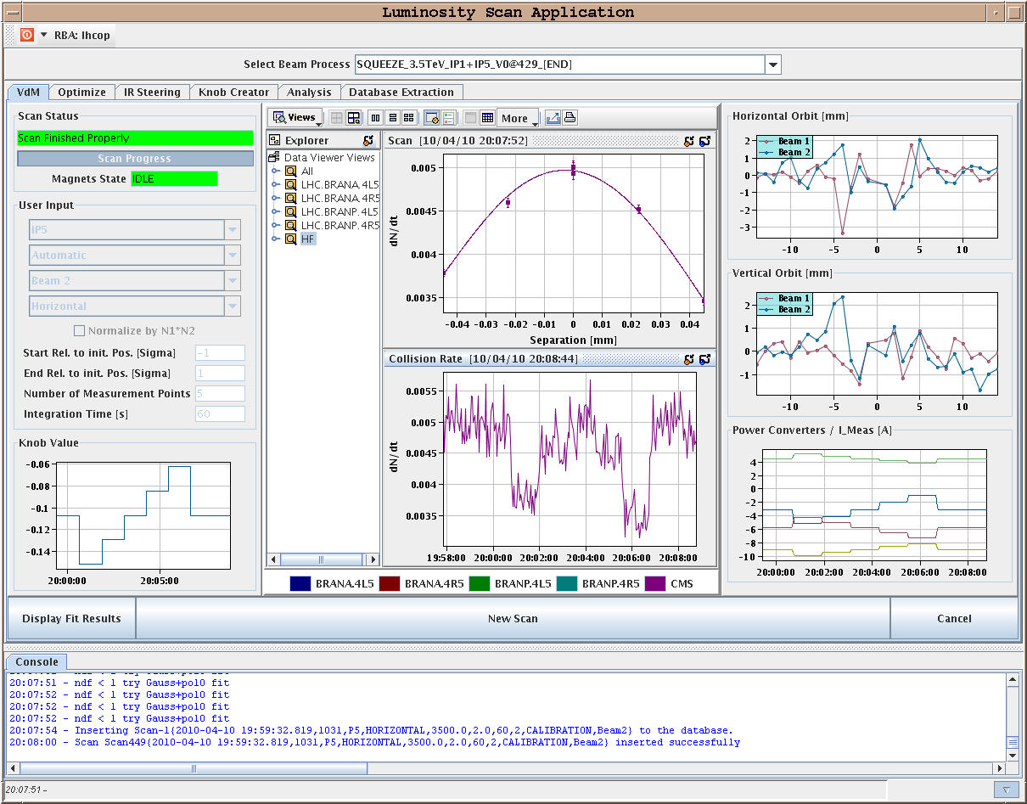
CMS

Slide 9
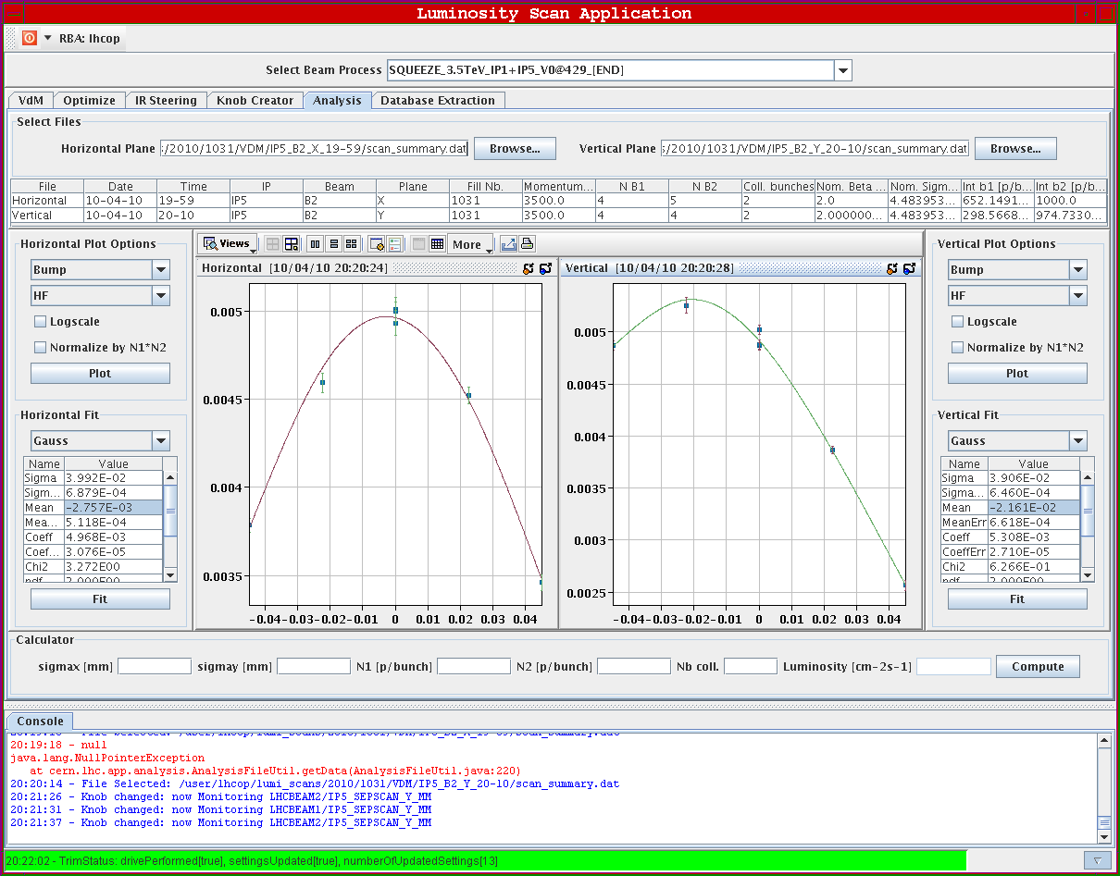
CMS

Slide 10
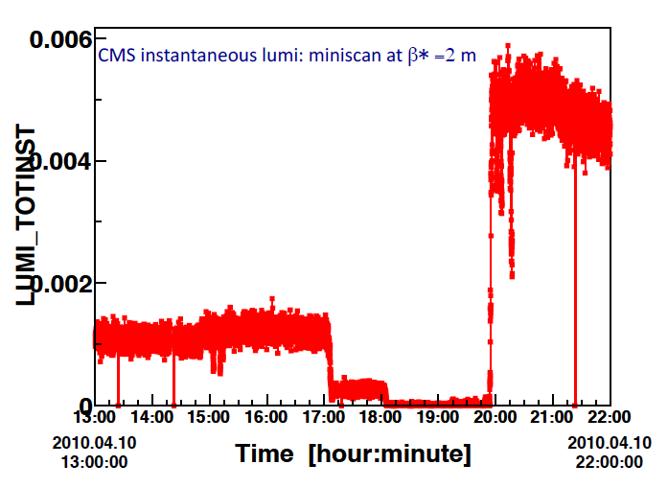
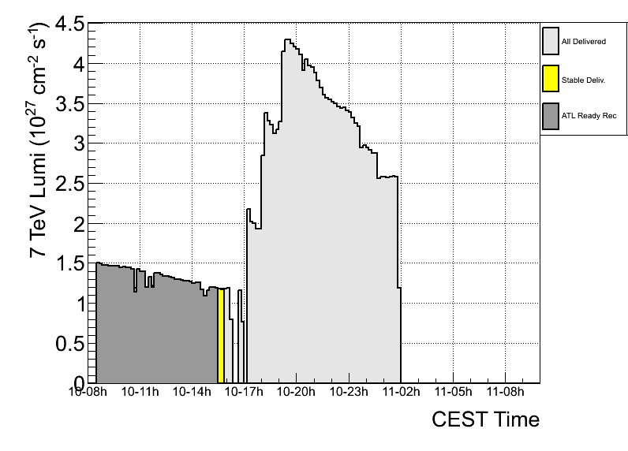
IP1&5 lumi vs squeeze
Raw (online) lumi plots on 10 apr 2010, during the squeeze to 2m in IP1 and IP5
Factor gained (raw numbers):
  ~4.5 in Pt5 (after min scan)
  ~4 in Pt1
Not corrected for lumi decay over the ~5h of squeeze and mini scans
atlas

Slide 11
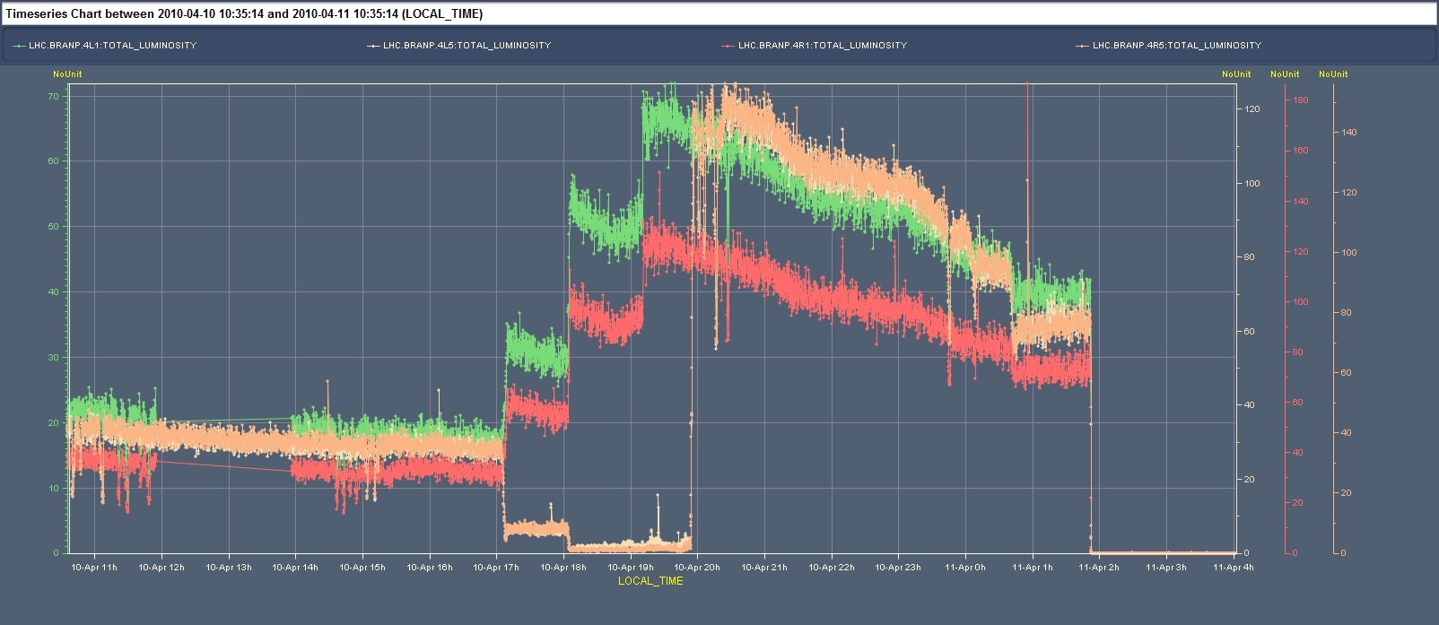
BRAN-P in IP1 and IP5 during squeeze
Also observe factor ~4++ increase in luminosity during the squeeze test of 10 Apr 2010

Slide 12
Program for the day
Circulating beams at 450 GeV – checks
Transverse damper studies – Wolfgang Hofle
15:00 Trial ramp and squeeze
  Pilot intensity
  All the way to 2-2-2
  Async dump tests as pre-qualifier for stable beams

