Slide 1
Wednesday 8th April
10:30: Stable beams
12:53 Lost cryogenics maintain in MSL2
faulty valve on DFBM in 12
16:30 Beam back
17:00 Ramp for squeeze
QTF/QTD trips
lost to RT trim following use of wrong tune references at start of ramp – will now systematically load references from sequencer
20: 15 Ramp for squeeze

Slide 2
Squeeze
Bunches (1,1)
Bumps collapsed
Collimators at physics settings
Tunes, orbit, chromaticity, coupling at each step
0 | 11 m. tunes 0.28/0.31
23 | 11 m. tunes 0.31/0.32
118 | 9 m.
221 | 7 m.
306 | 5 m. TCTs in to 2 m settings
348 | 4 m.
367 | 3.5 m. skipped
398 | 2.5 m
429 | 2.0 m.

Slide 3
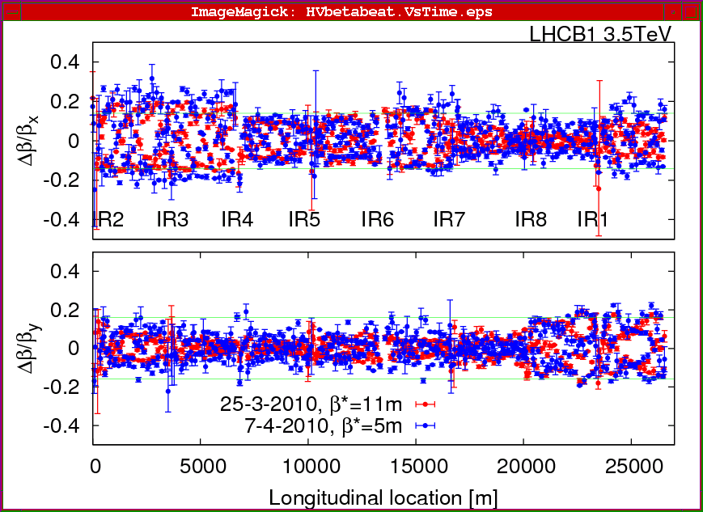
5 m

Slide 4
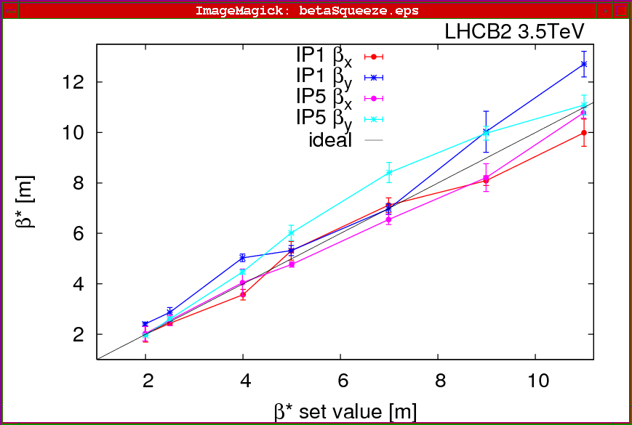
Measured betas beam2

Slide 5
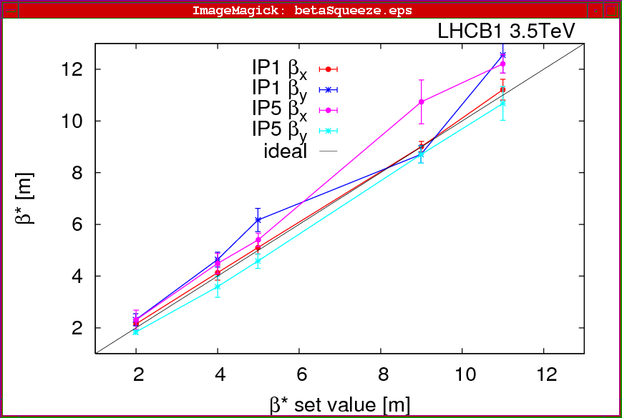
measured betas – beam 1

Slide 6
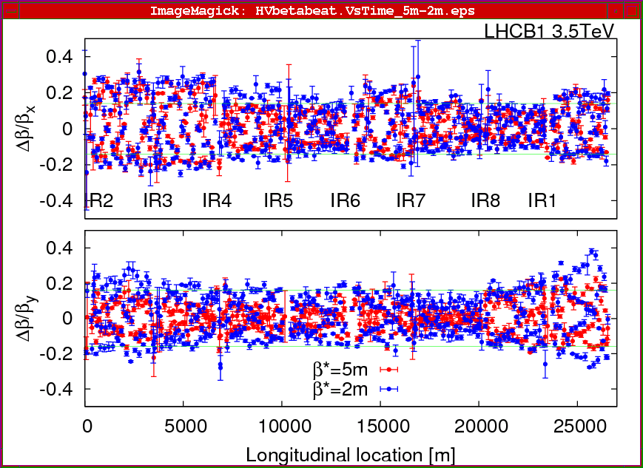
Beating worse at 2 m for beam 1

Slide 7
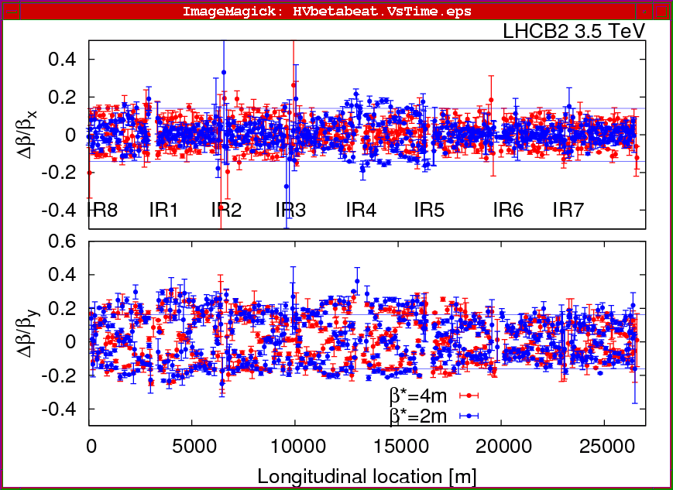
Beam 2

Slide 8
Wednesday
Orbit feedback tests
05:00 programmed dump & prepare for access
Access all day Thursday
07:30 Radiation Protection fanning out across ring
Vacuum chamber modifications on TEDs end of TI8 and TI2
Type testing of QPS modifications – energy extraction/power converter off issue – should open way to 10 A/s in MBs
++
Hope to closed either side of S56 for powering tests in the afternoon
18:00 Access should be finished
Evening: powering tests and pump-down of TI2 & TI8

Slide 9
Intermediate Orbit FB commissioning summary
Test were done at 3.5 TeV with no big problems.
Corrections converge and setup bandwidths were as expected (~0.1 Hz). In response I increased the effective bandwidth to about 0.25 Hz. We tested horizontal and vertical loops against external perturbations (orbit bumps) and verified that the FB ignores/is insensitive to radial frequency trims. The latter are supposed to be dealt with by the radial loop and/or Q' measurement as part of minimising and decoupling the inter-loop dependences.
Ralph Steinhagen

Slide 10
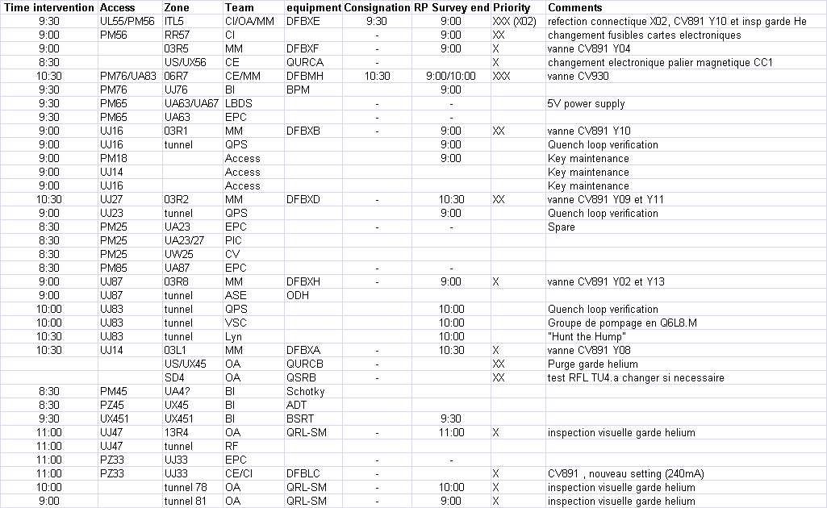
Thursday
plus some last minute ADIs
Mirko Pojer

Slide 11
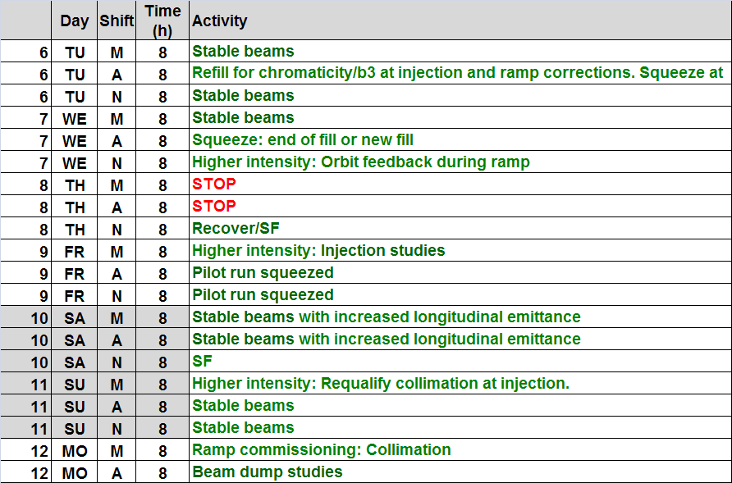
Next week or so

