Slide 1
Status Report Tuesday – Wednesday
01h00: Start of ramp.
02h46: Stable beams.
15h00: Beams lost due to undulator trip. Drift of the undulator RU.L4 resistive voltage signal during the last two days (no reset). During recovery RT trim checks.

Slide 2
Long fills at 3.5 TeV…
48 h
Over 48 hours we were 31 hours in stable beam for physics at 3.5 TeV!
This was 65% availability for physics at 3.5 TeV over 48h!
Not bad for week 12 of beam operation (2009+2010)!

Slide 3
Long fills at 3.5 TeV…
Intensity Beam 1
Intensity Beam 2
Beam energy

Slide 4
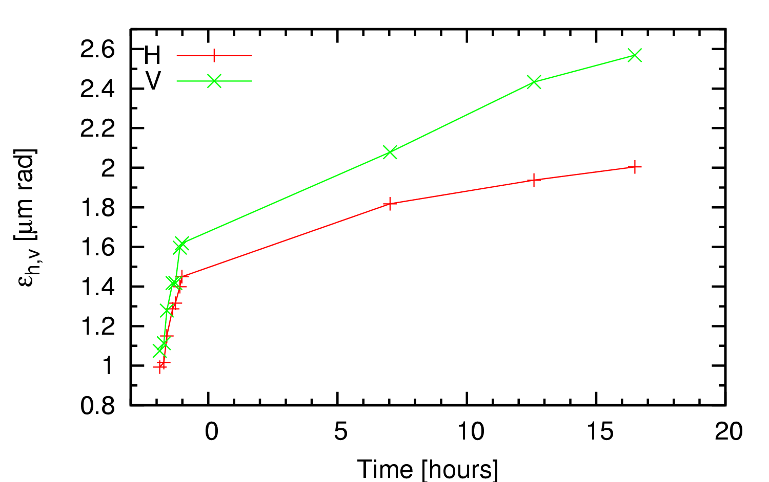
Emittance Evolution Beam 1 – Fill 1022
Stable beams
+100 %
Ramp

Slide 5
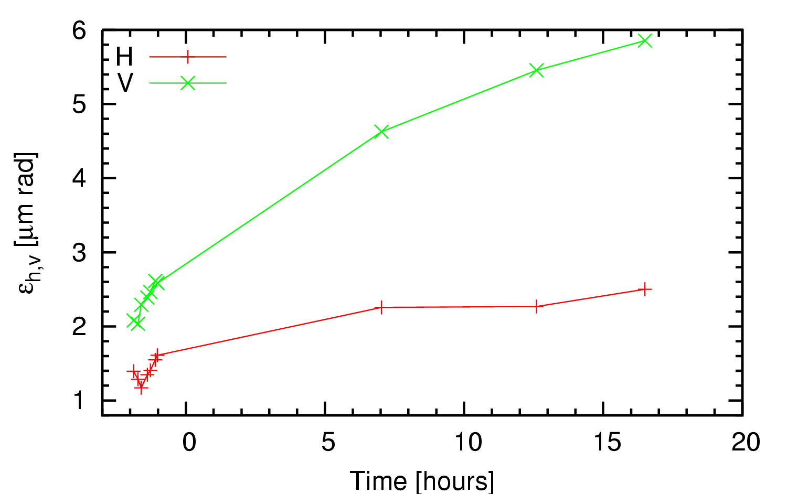
Emittance Evolution Beam 2 – Fill 1022
Stable beams
Ramp
+100 %

Slide 6
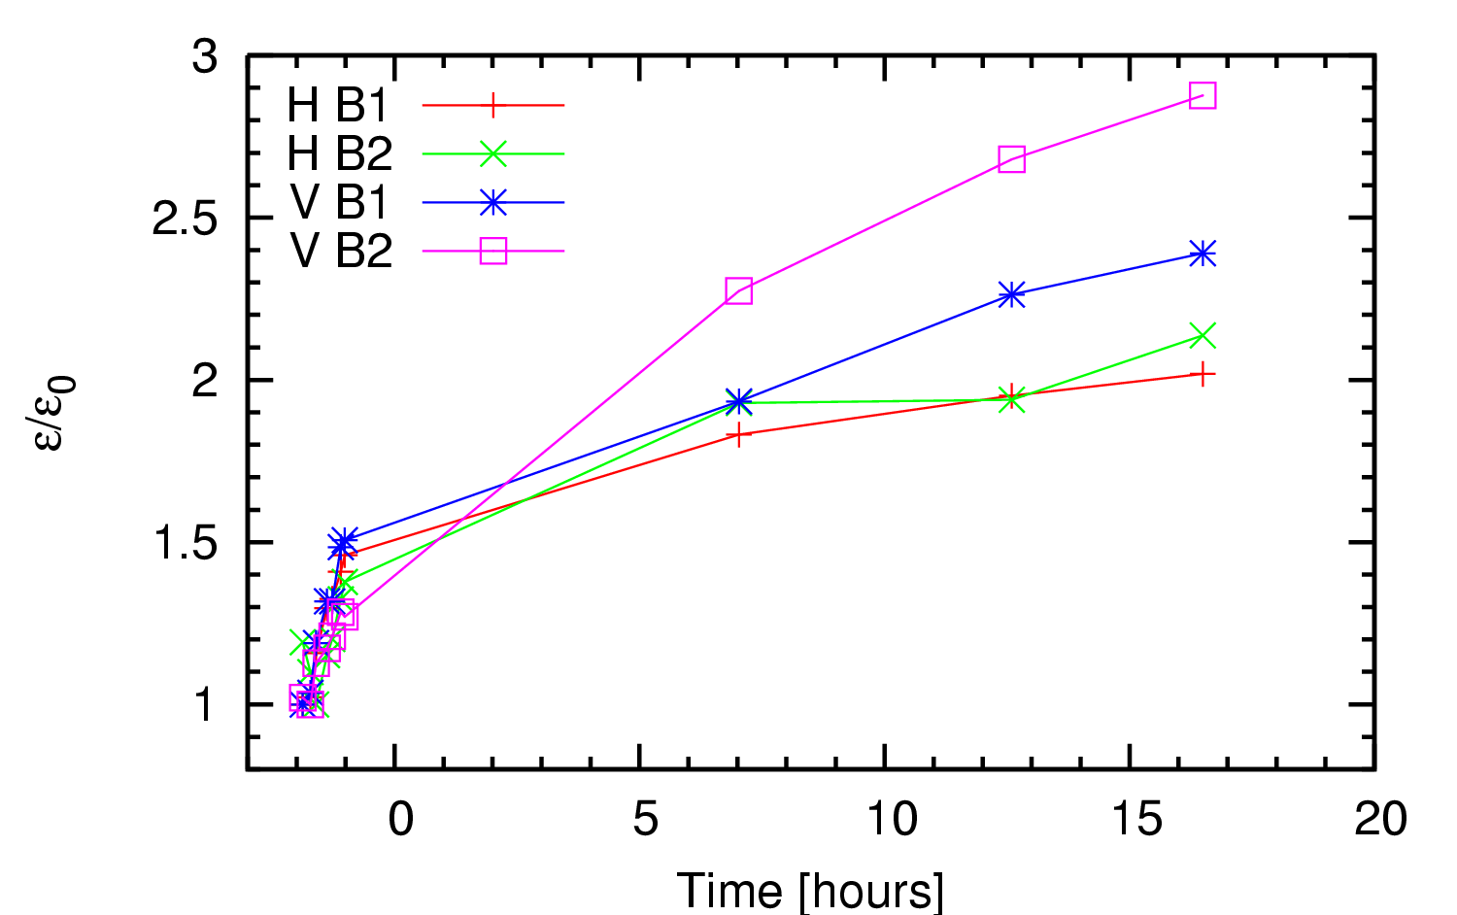
Emittance Ratio – Fill 1022
Ramp
Correct growth in ramp with better chromaticity control!
➔ b3 correction
Stable beams

Slide 7
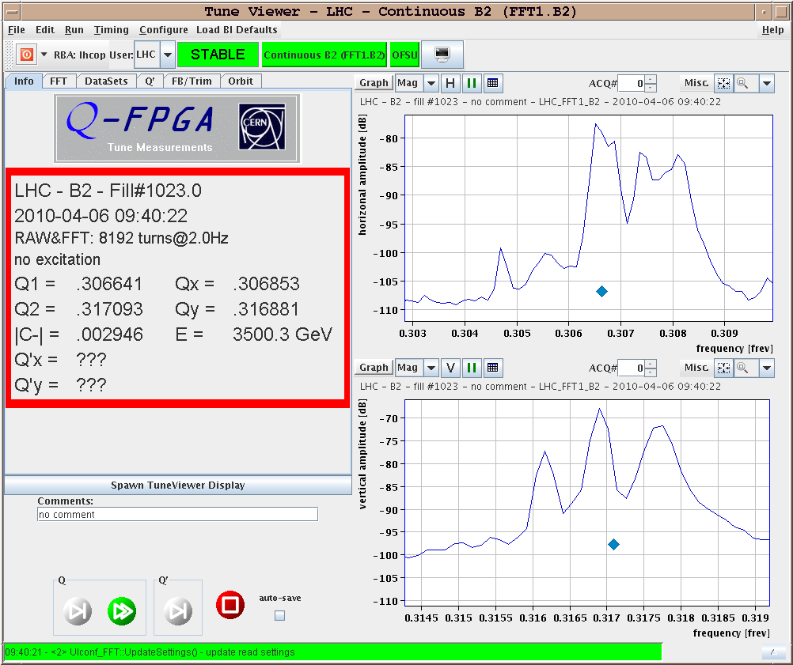
Tune Spectrum in Collision – Fill 1023
1.5e-3

Slide 8
Status Report Tuesday – Wednesday
15h00 – 19h30: Beams at 450 GeV. b3 trims adjusted. Introduce b3 trim for change of chromaticity during snapback ("by hand").
21:15: Start of ramp. Lost half of beam 1. No losses for beam 2. Chromaticity measured during the ramp for next iteration on b3.
22:15: Beams lost at 3.5 TeV while preparing for the squeeze, due to RT trims. Reverted b3 trims.
22:15 – 06:00: Recovery. Access for RQTD.A81.B1 (controller fault). Pre-cycle.

Slide 9
Night Shift Summary
At 22h00 beams were dumped after a Q feedback trim that made the RQTDs tripped for B2. Neverhteless RQTD.A81B2 tripped as well.
Switches for this circuit opened and could no be closed anymore.After computing the error we would get in the beta function, etc (using madx) with the RQTD.A81B1 off, thanks Bernhard H.!!!, we saw this would be negligible. We tried to generate a new TUNE_TRIM knobs without this circuit, but unfortunatelly it is not trivial to use the knob generation application.
So we had to do an intervention in the tunnel and the switch B was replace (thanks Richard M.) the intervention was over by 3h30.Then we saw the RQD/F of sector 56 had lost the QPS OK, but not the PC permit since they were at injection settings. We called the MP3 on call to get the OK for the ramp in this conditions. The fault being a controller fault. We got the OK to ramp at 7h00 when Markus Z. came for the shift and did a reset of the controller.
During this time we injected B1/B2 and did the measurments: Q, Q', C, orbit, emittance, etc. Now everything is ready for the ramp.

Slide 10
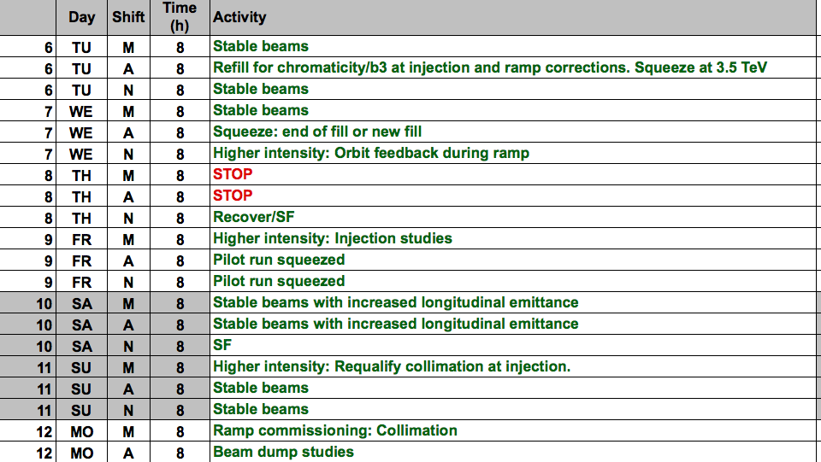
Program Ahead

