Slide 1
Friday
00:00 ready for injection for Physics fill
02:00 Lost half of the beam during the ramp (dump and re-fill)
04:00 Ready to ramp
06:00 Collapsing separation bumps
06:37 Cryo lost in point 4
23:30 Recovered cryo conditions

Slide 2
Saturday
01:00 Inject and prepare fill or physics
04:30 Stable beams
07:30 End of fill: dump due to FMCM triggers following EDF perturbation
11:00 Non linear chromaticity measurement and off-momentum beta beating
14:30 Chromaticity measurement during the ramp.
16:30 Ramp-down and preparation for physics
Ready for physics at ~21:00 but beam lost during the adjust phase

Slide 3
Sunday
02:49 Beam dump due to trip of RQF.A78 followed by trip of triplet L5 (current lead temperature gauge)
06:00-11:30 Access for triplet temperature gauge repair (L5) and quench heater power supply replacement (sector 34)
12:00 Prepare for Physics fill
17:30 Stable beams

Slide 4
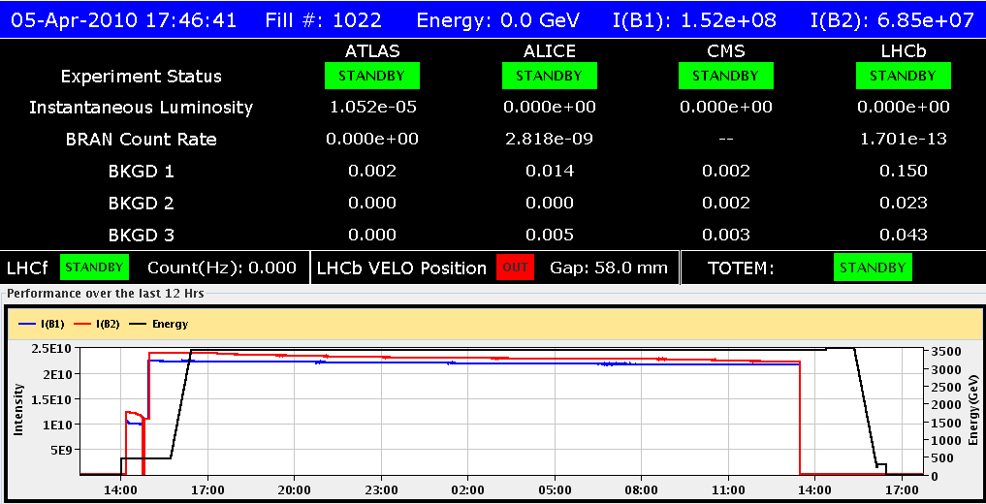
Monday
Fill 1022 – 19 hours

Slide 5
Fill 1022
Single beam lifetimes:
Beam 1: 990 hours
Beam 2: 730 hours
Very good beam-gas, negligible luminosity burn, negligible diffusion
Luminosity lifetime
40 – 50 hours
Mainly from gentle beam blow-up (tau ~ 40 hours for B2V)
optimum fill length for 6 hour turn around – 22 hours.
Beam tune shift ~ 0.0015 (one plane, 4 collision points, reduced emittances)

Slide 6
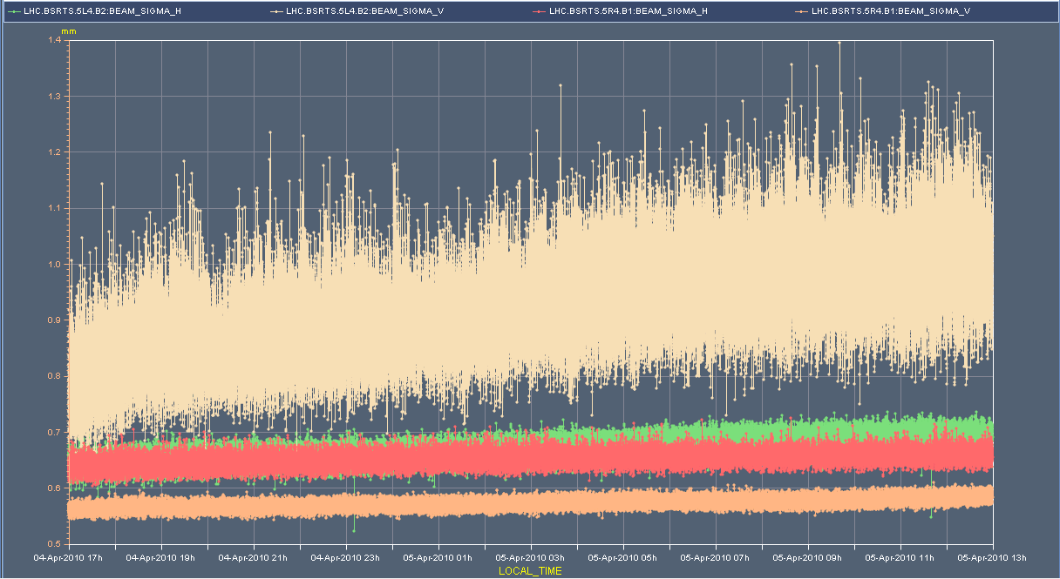
Sync light

Slide 7
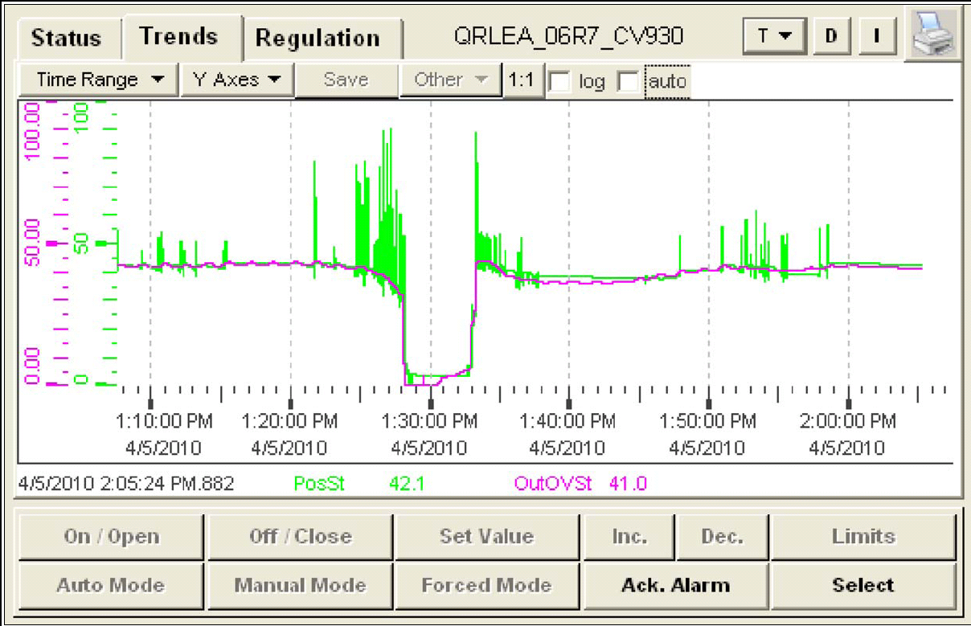
Monday evening
13:30 lost fill 1022 to DFB valve problem – cryo maintain removed
Followed by problem with on branch A2 of RB.A78 energy extraction switch – access required – micro-switch controller (Knud & team)
Back in stable beams by 02:46

Slide 8
Incoming
Stable beams
18 hours machine stop – Thursday 06:00
b3 - at injection
Track Q’(t) (and Q(t)), unload lattice sextupoles from b3 error
Ramp
B3/Q’ – snapback - track Q’ in first part of ramp
Orbit feedback
Collimators
Squeeze
Revisit mechanics & iterate
Collimation and stable beams
Injection
Higher intensities
detailed planning at LMC on Wednesday

