Slide 1
Saturday to Sunday
Availability: 24h00. Unplanned maintenance: 0h00. Planned maintenance: 0h00.
07:00: Studies with AC dipole.
11:00: Beam setup, loss optimization, 2 RF cavities restarted. LHCb magnets turned on. Orbit corrected.
16:00: Beam tuning of pilot bunch: lifetime > 125h both beams.
17:00: Injection of several single bunch intensities (pilot, fat pilot, half nominal): 5e9-6e10.
21:00: LHC beam quality checks in SPS and TL.
22:30: Reinjection LHC. Halo stability check.
23:30: Aperture studies. Standard method plus alternative emittance blowup/collimator technique.

Slide 2
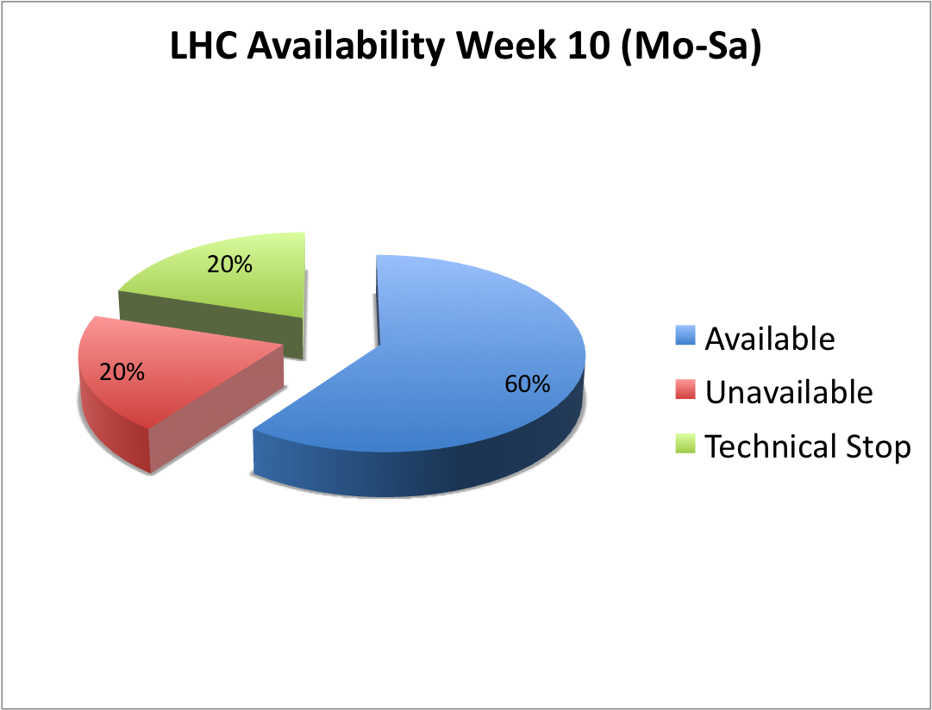
Availability Tracking

Slide 3
Summary AC Dipole
AC-dipoles tested for both planes in both beams.
Check flicking the key generates maskable interlock.
Signals checked on OASIS and globals defined for both beams.
AC-dipole used at 10 % and 20 % of maximum strength at 0.02, 0.01 away from tune and on tune.
Generally no losses at 10 % and 0.02 away from tune.
On tune and 10 % kick, the beam was lost after about 400 turns; with 20 % on tune after about 300 turns.
No beam losses: no increase in beam size.
Small beam losses: beam is scraped and beam size is reduced.
Very similar behavior for different beams and different planes.
Beam losses always at collimators in point 7 - collimators were in at protection = nominal.
When exciting on tune, all beam dumps were clean with no BLM losses in point 6.

Slide 4
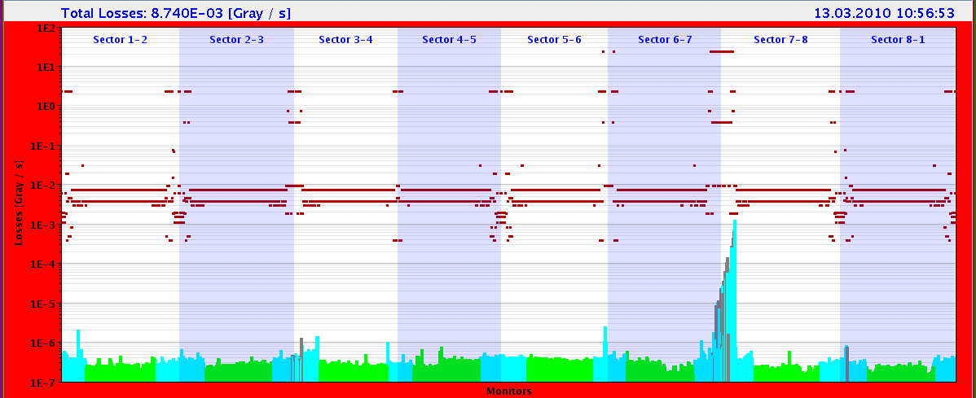
AC Dipole to Collimation (300 Turns)

Slide 5
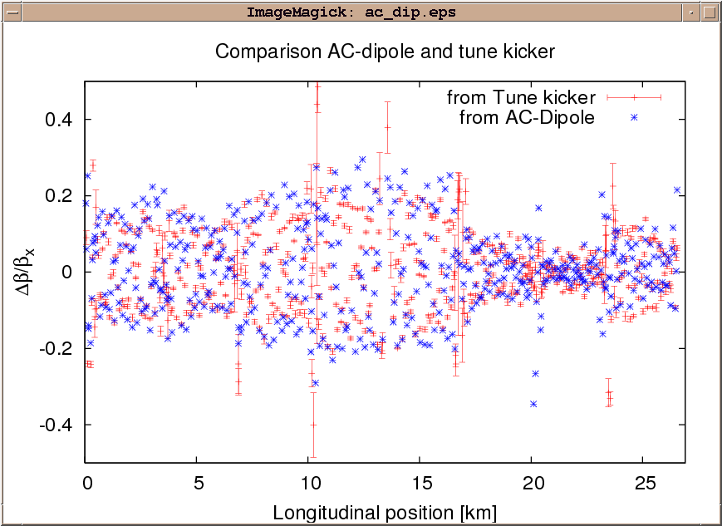
Beta Beat: AC dipole versus tune kicker

Slide 6
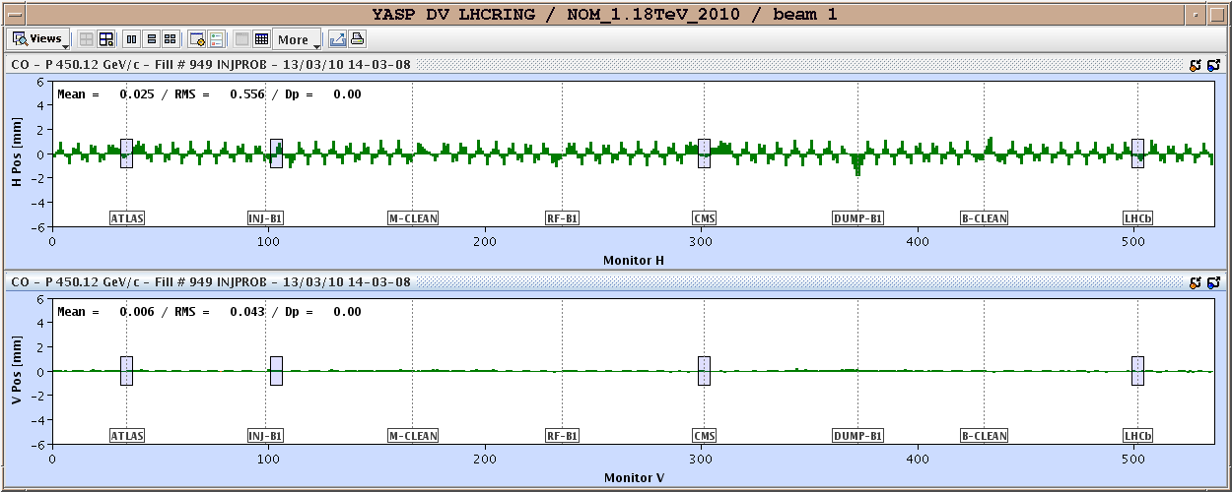
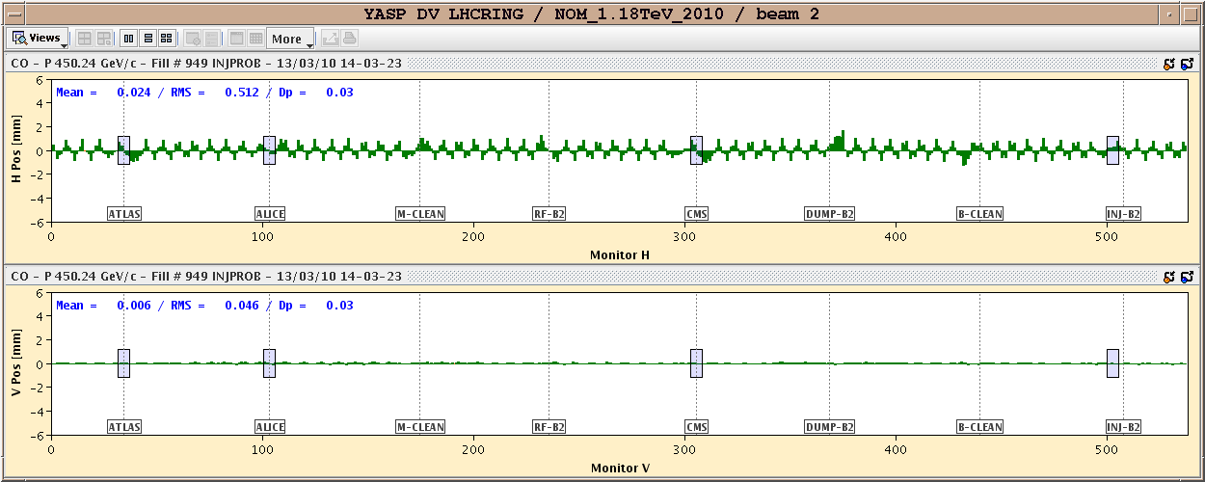
LHC-b Magnet Switched On
Orbit
Non-Closure

Slide 7
Summary Beam Quality Tuning @ 5e9 p
Ensured clean injection with pilot bunches (with and without SPS scraping).
Optimized tunes, chromaticity and orbit (to reference).
Stopped all beam excitation (including real time trims from tune viewer).
Achieved high beam lifetime in both pilot beams (>60 h, often maxing out to > 125h).
Characterized emittance stability with time for pilot bunch. No significant emittance growth versus time in B1 (H and V) and B2 (H). Emittance growth in B2 (V): 0.95 micron rad per hour.

Slide 8
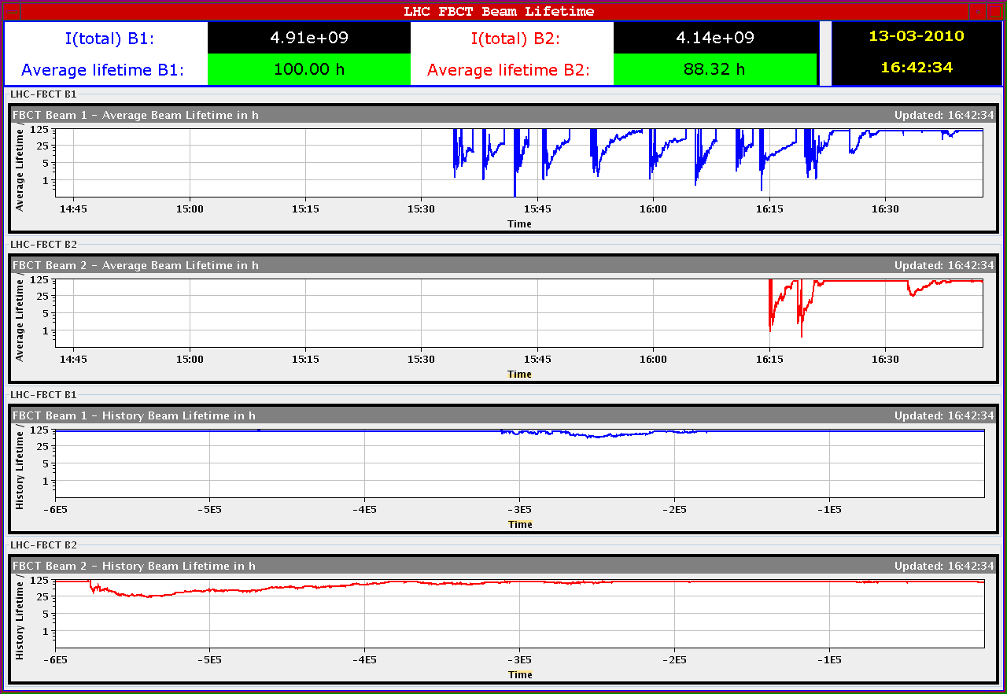
Intensity Lifetime Pilot Bunches

Slide 9
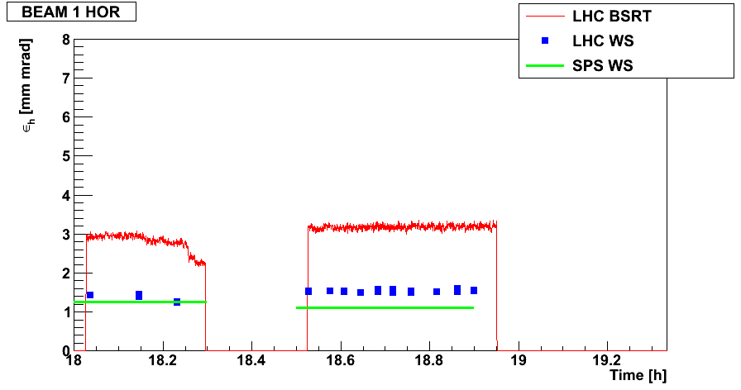
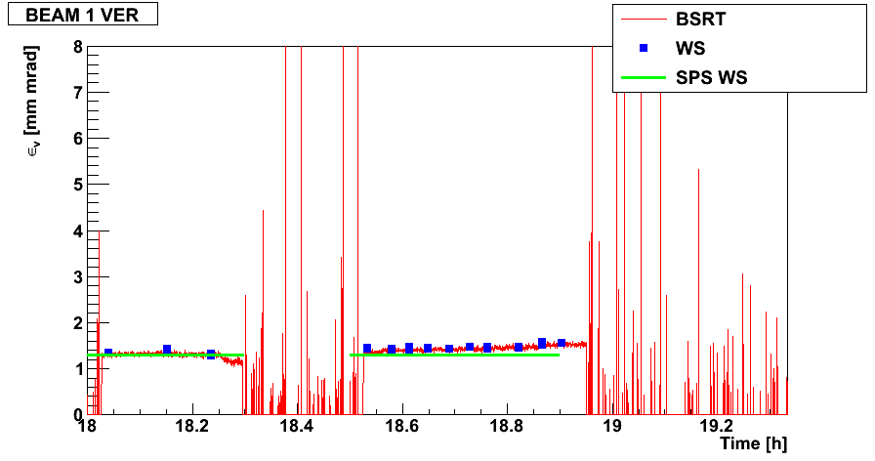
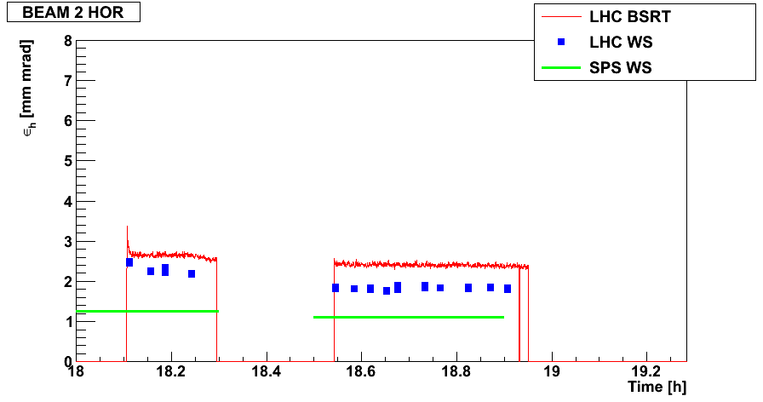
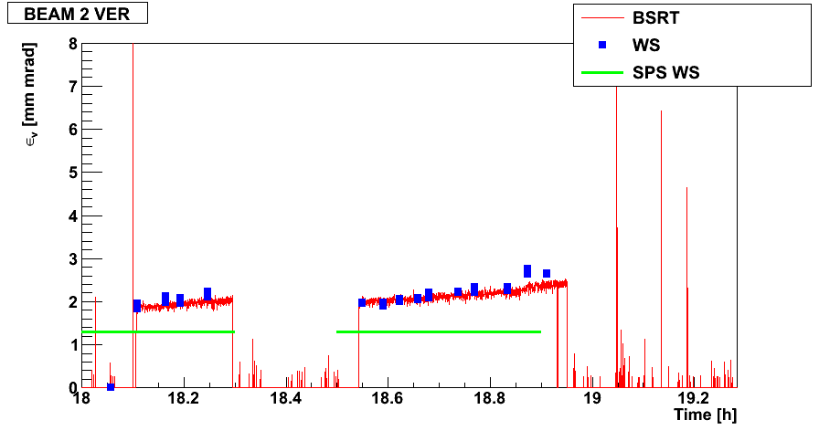
ε versus time
Beam 1
V
H
Beam 2
V
H
F. Roncarollo

Slide 10
Emittance Growth B2 V plane
Fitted emittance growth: 0.95 μm-rad per h
F. Roncarollo

Slide 11
Summary Beam Quality Tuning @ 5e10 p
Injection of bunches with intensities from 5e9 to 6e10 p.
Pilot (5e9) and fat pilot (2.5e10) OK with very small losses.
Achieved injection of "half nominal" with 3.5e10 p into beam 2. Had some losses. Seemed to show higher emittance coming in and larger emittance growth (to be verified).
Two injections of "half nominal" with 3e10 p (B2) and 6e10 p (B1) produced significant losses and BLM triggered beam dump. Note that we injected into the LHC with circulating pilot (different bucket): problems in LHC ring settings are therefore excluded.
Afterwards, preliminary checks on beam quality in SPS and TL (emittance, orbit) did not show any problems. Also injection kickers seem fully OK. Can it be energy spread?
Then used pilot bunch intensity to check spikes in halo losses, synchronous with the SPS cycle for nominal tunes. Saw a max factor 2 increase related to SPS cycle (was factor 10 close to 1/3 resonance). Need more intensity to study this in relevant conditions.

Slide 12
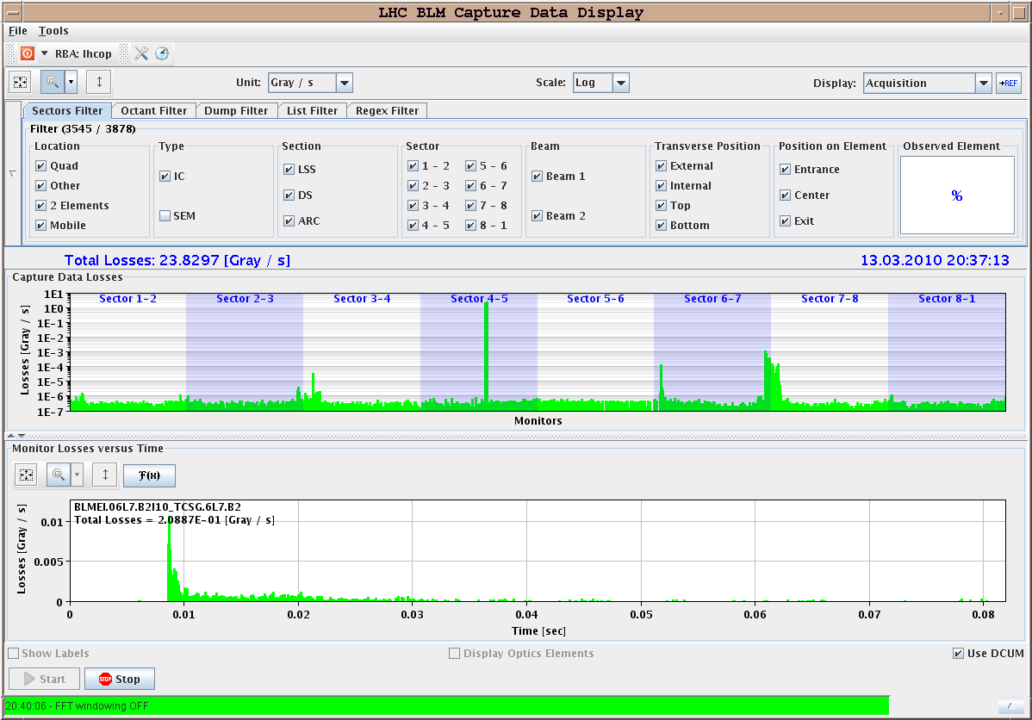
B1 Injection: Pilot (5e9)
20:37
MAX: 0.001 Gy/s

Slide 13
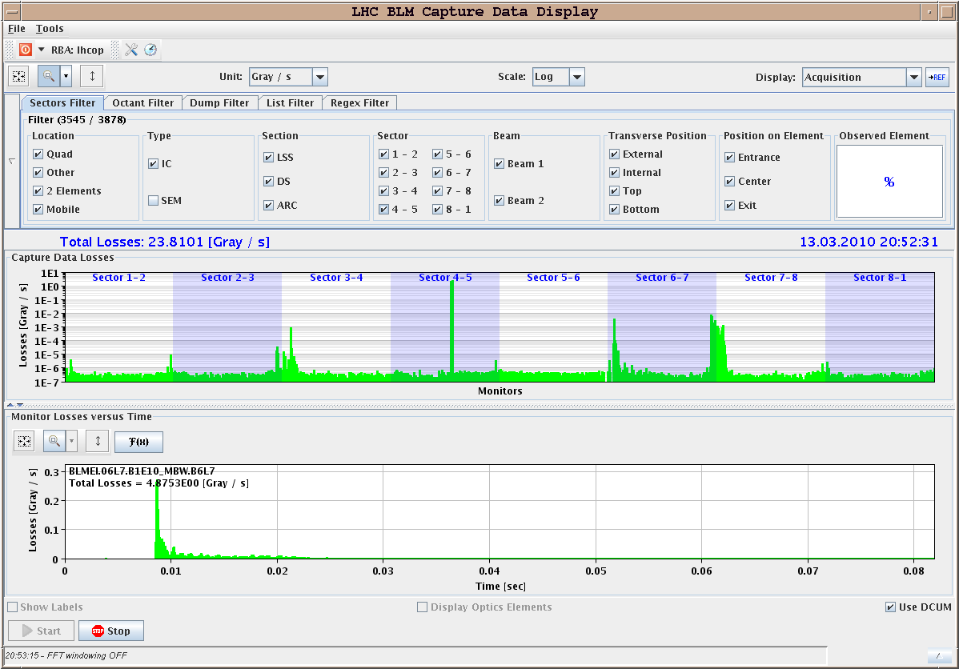
B1 Injection: Fat Pilot (2.5e10)
20:52
MAX: 0.01 Gy/s

Slide 14
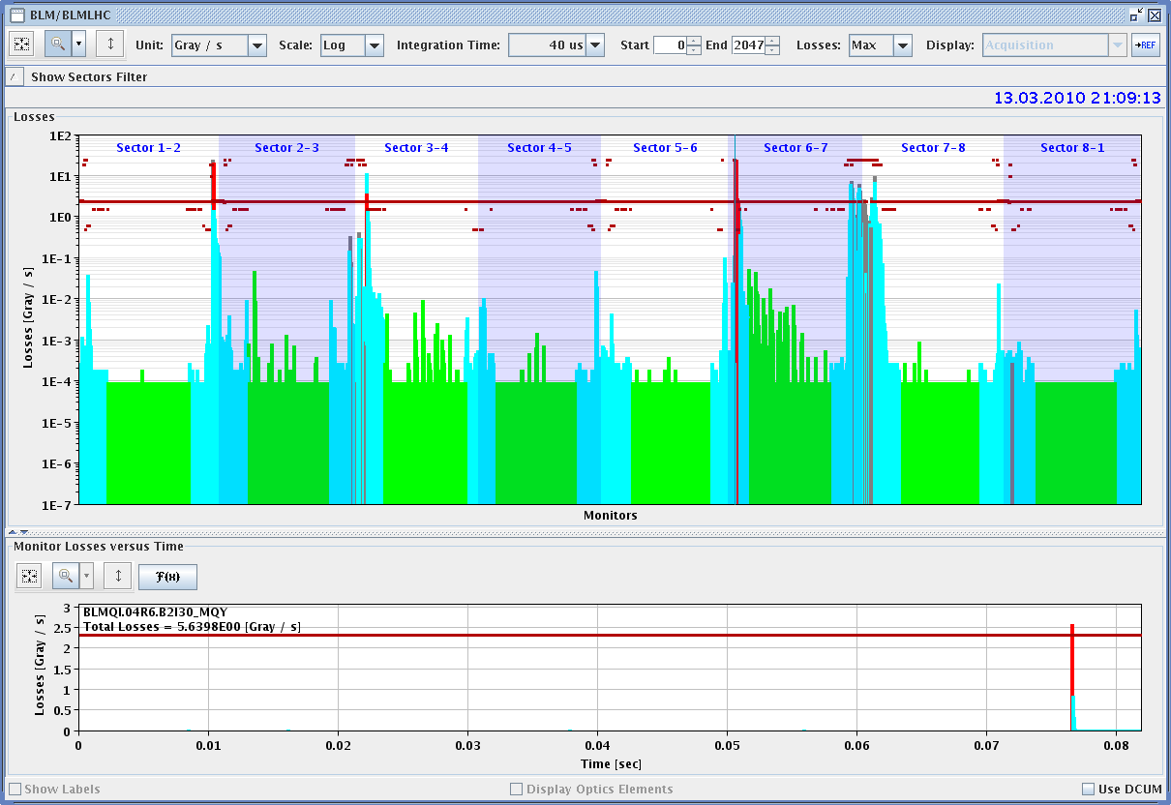
B1 Injection: Half Nominal Bunch (6e10)
21:09
MAX: 23 Gy/s
2,000 times higher losses than 17min before with 40% of this intensity!

Slide 15
Aperture
Standard method (kick in phases) continued on beam 2, H and V. Beam 1 done on Fr/Sa night.
Aperture bottle-necks identified.
Alternative emittance blow-up/collimator technique identified Q6R2 and Q4R6 as aperture bottle-necks, as seen before with standard technique.
Then closing TCP to shadow aperture bottle-neck. For 12mm setting of TCP, H, IR7 we shadow.
This is about 12 sigma. In on-momentum n1, this corresponds to n1=10+-1.4)
To be repeated with design off-momentum offset to get full n1.

Slide 16
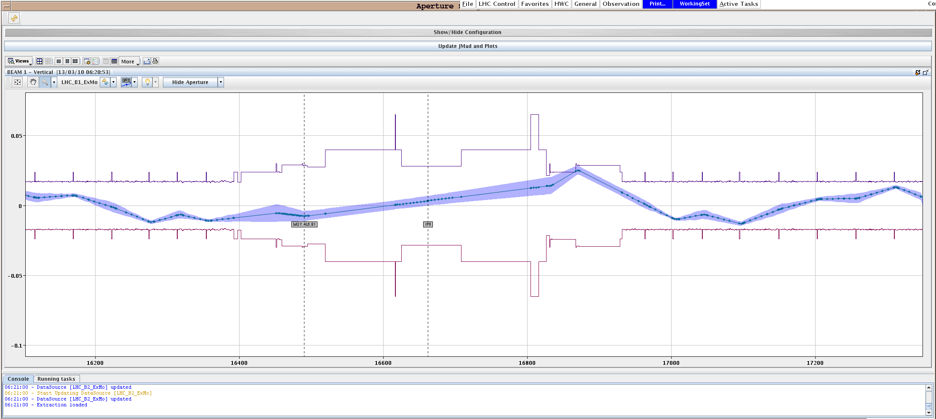
Aperture Kick Method (B1 H)
Stefano, Massimo et al

Slide 17
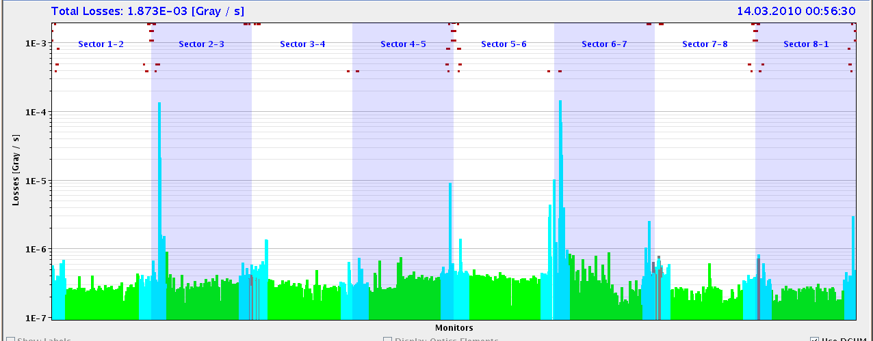
Aperture B1 H Limits (collimators open, ε blowup)
First test…
Q6R2
Q4R6
Same bottlenecks as found Fr/Sa night with kick method (Stefano, Massimo).
Then: close primary collimator to shadow these loss locations.

Slide 18
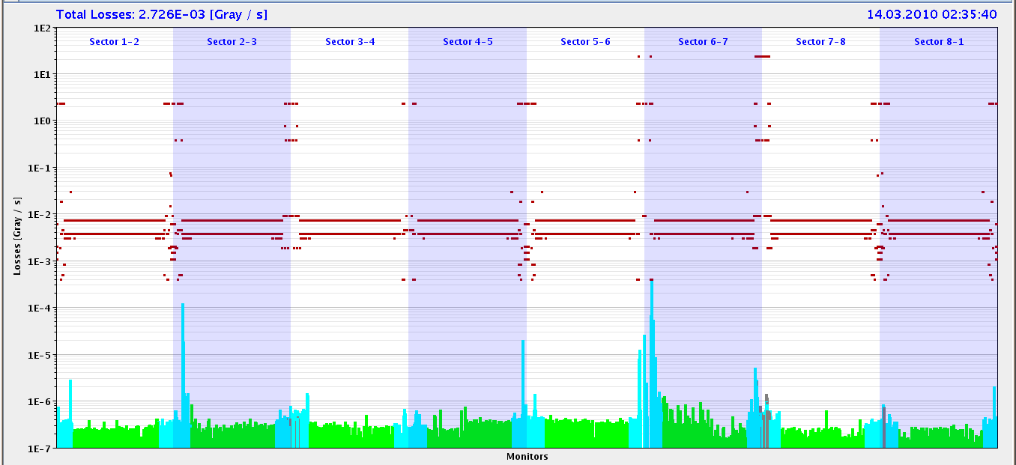
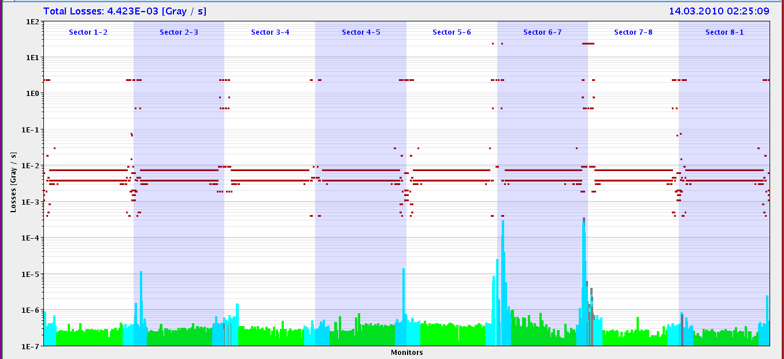
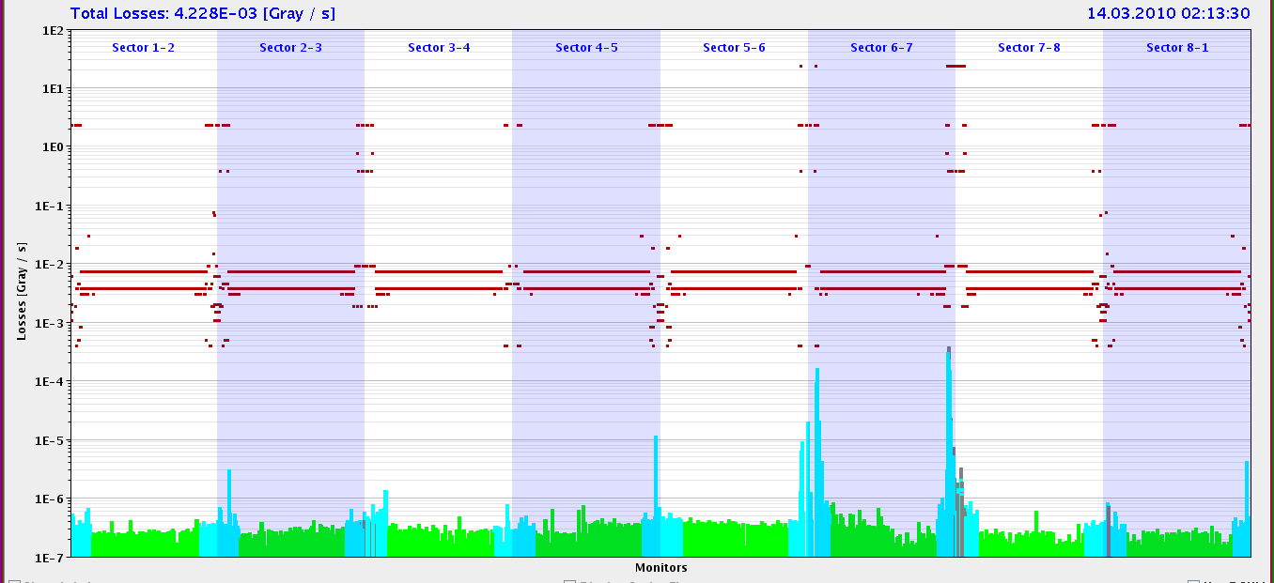
Shadowing Aperture Bottle-Neck
TCP: 13.65 mm
TCP: 12.65 mm
Q4R6
Q4R6
TCP: 11.65 mm
TCP: 10.65 mm
Q4R6
Q4R6
TCP setting for shadow on H aperture B1: 12 mm
Preliminary estimate on-momentum n1: 10 +- 1
To be repeated with off-momentum offset to get full n1!

Slide 19
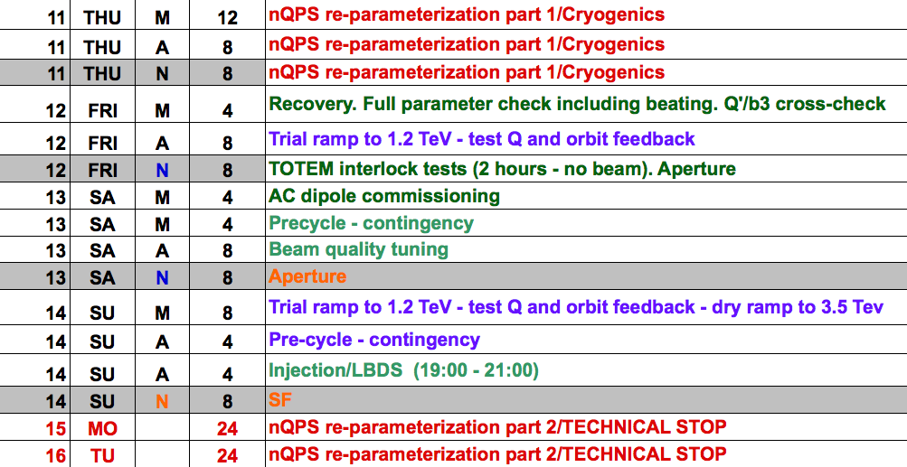
Schedule
5 e10

