Slide 1
Friday to Saturday
Availability (to 21:00): 11h00. Unplanned maintenance: 1h00. Planned maintenance: 9h00
02:00: Machine closed.
09:00: Cryogenics all OK. Preparing pre-cycle.
10:00: Pre-cycle started.
11:30: Pre-cycle finished.
14:00: Beam back. Orbit corrections, injection check, tune adjustments.
15:00: PIC on 60A power converters.
16:00: Beam back. Chromaticity adjustments. Beta beat. Orbit feedback tests. LSA bugs.
21:00: Start of ramp with beam to 1.18 TeV. Arrive very nicely at top at 21:11.

Slide 2
Saturday
TOTEM test finished very successfully!
All case studies were tested and the interlock logic is OK for all of them.
Results of tests documented online with snapshots. All cases associated to beam dumps are also documented by global PM events
Philippe who finished the RF adjustments in SR4:
The Front-End of the phase loop has been adjusted to prepare for bunch intensity increase.
Both rings can now take at least 5E10 single bunch. Exactly what intensity limit will be clarified on Monday...Hopefully up to nominal.
With these settings we can still deal with single-bunch pilot 5E9 OK. However how far below 5E9 will be clarified on Monday.

Slide 3
Summary of aperture measurements.
We could complete the phase space coverage for both H and V planes of beam 1. Work was done in parallel with RF tuning in preparation for higher intensities ("cross talk" not always transparent...).
Measurements were done with orbit bumps at different phases. Loss location are listed in detail in the logbook for the different cases.
Reference machine: golden orbit used for collimator setup, separation bumps on in all IPs.
No indication of major problems with the aperture. Measurements with golden orbit and with corrected beta-beat indicate a better aperture than last year. Detailed look at the data is needed to take into account the measured beta values.
Main aperture bottlenecks: Q4 quadrupoles in IP6, Q6-L2 and Q6-R2. Complete list in logbook

Slide 4
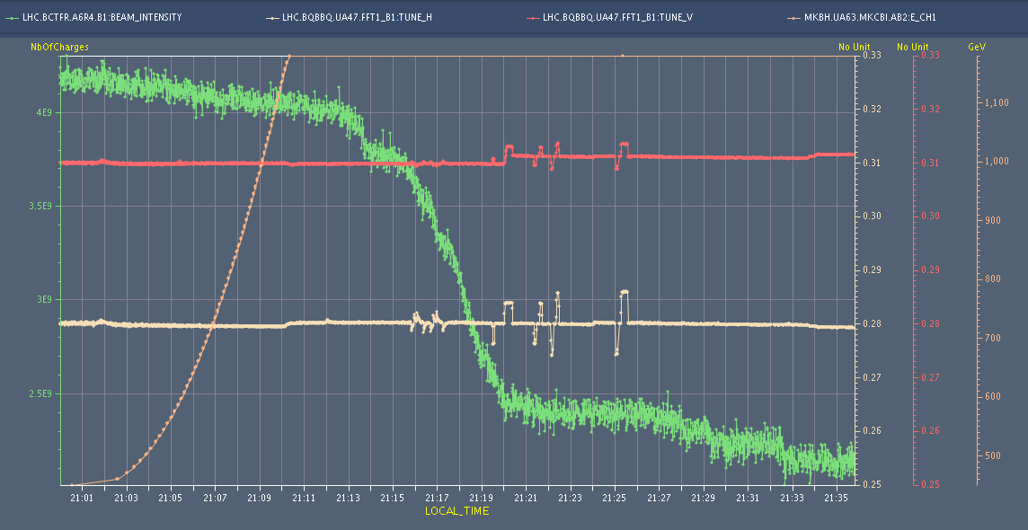
ramp

Slide 5
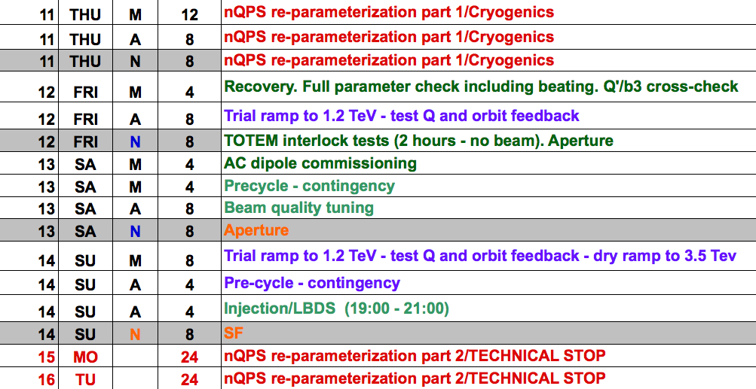
Schedule
5 e10

