Slide 1
Progress with beam
Mike Lamont

Slide 2
Bunch trains and crossing angles at injection
Werner Herr et al

Slide 3
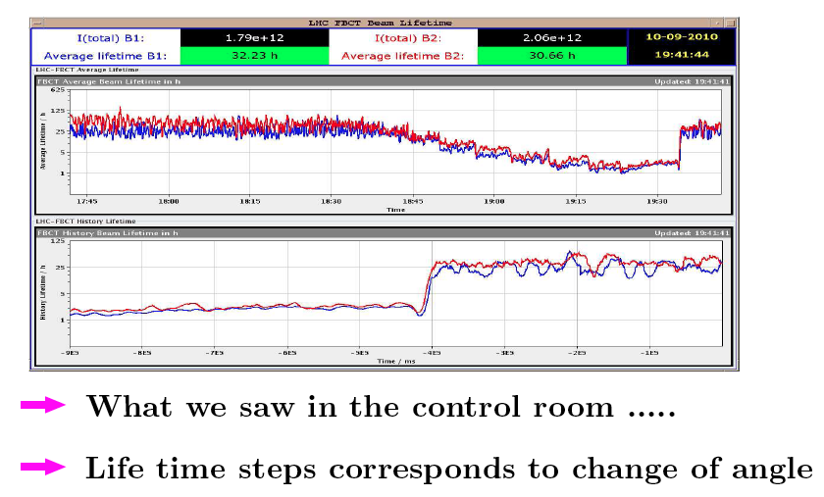
Bunch trains and crossing angles at injection
Werner Herr

Slide 4
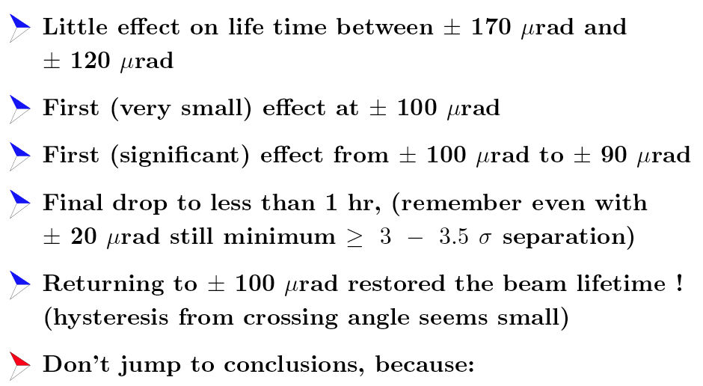
Observations
Werner Herr

Slide 5
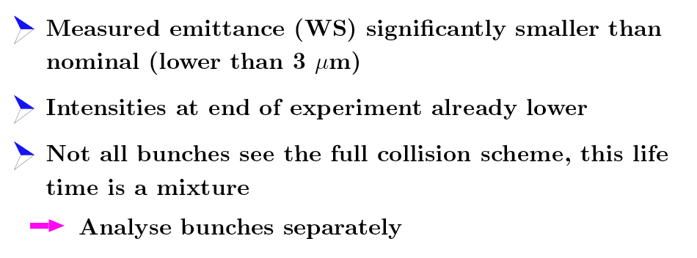
…
Werner Herr

Slide 6
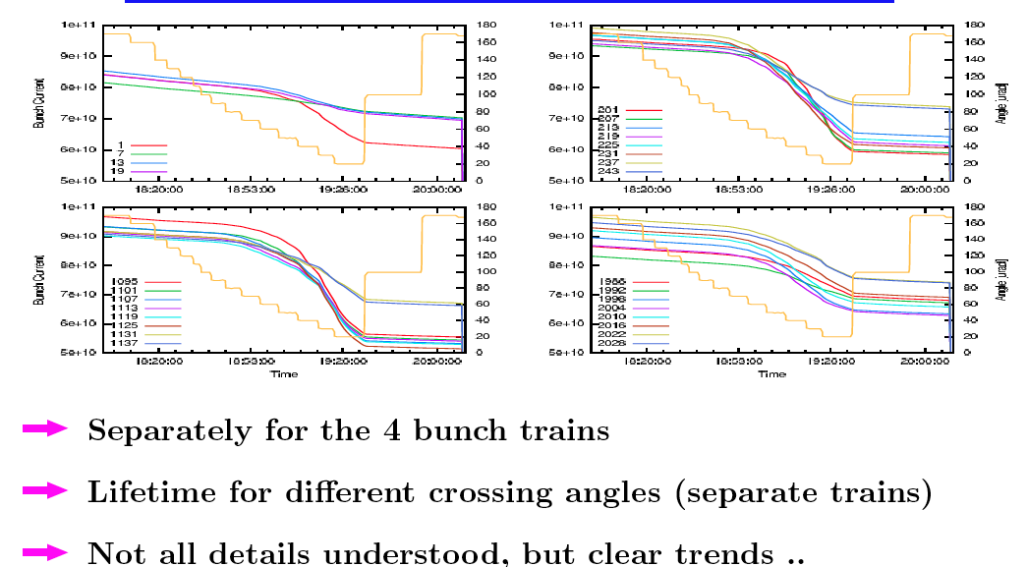
Individual bunch behaviour
Werner Herr

Slide 7
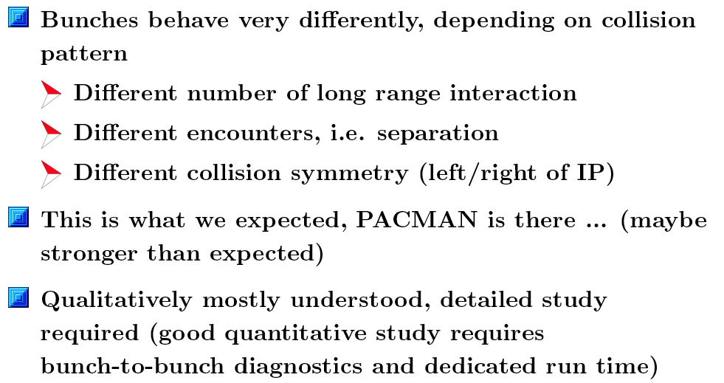

Slide 8
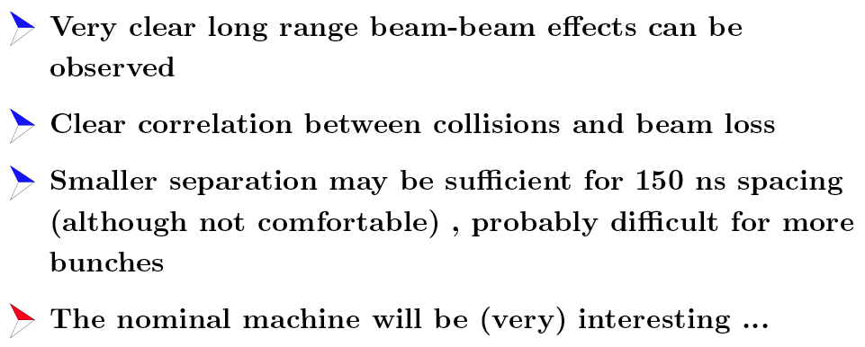
Beam-beam summary
Werner Herr

Slide 9
Global aperture measurements at 450 GeV with 170 urad crossing angle
R. Assmann, R. Giachino, M. Giovannozzi, D. Jacquet, L. Ponce, S. Redaelli, J. Wenninger

Slide 10
Method
Global aperture measurement
  Open collimators
  Measure loss map (crossing 1/3 resonance) to determine minimum aperture in the ring.
  Close primary collimator until the largest loss peak is onto the collimator.
  Repeat for both beams and planes.
Off-momentum aperture performed
  RF frequency changed to get 1.5×10⁻³ Δp/p (compatible with n1 computations).
  Repeat excitation on resonance.
The Assmann method

Slide 11
Results
On-momentum aperture (expressed in terms of nominal sigmas)
Aperture bottlenecks:
Off-momentum contribution:
  Beam 1 (H): reduction by 1.5 sigma
  Beam 2 (H): reduction by less than 1 sigma
 | Horizontal | Vertical
Beam 1 | 12.5 | 13.5
Beam 2 | 14.0 | 13.0
 | Horizontal | Vertical
Beam 1 | Q6.R2 | Q4.L6
Beam 2 | Q5.R6 | Q4.R6
Massimo Giovannozzi

Slide 12
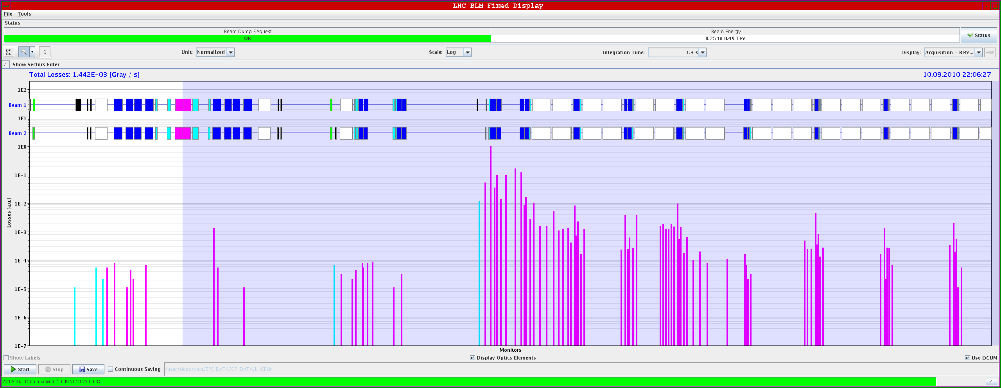
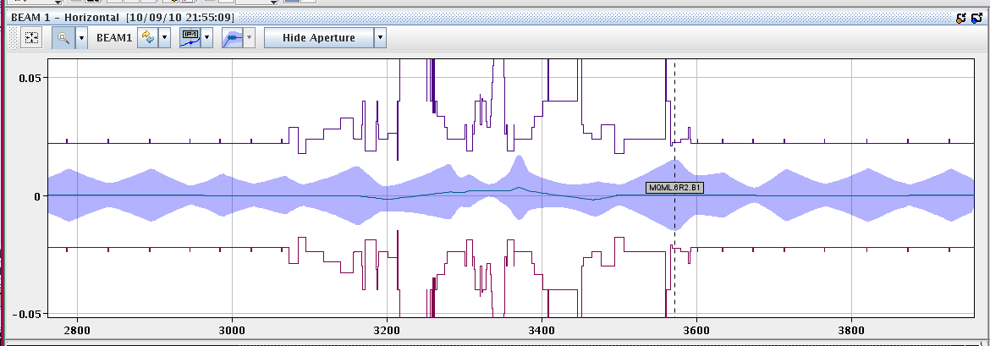
Few images – IR2

Slide 13
Comments
Standard question
  n1=7 sigma gives an aperture of 7×1.2=8.4 sigma: what is the reason for the discrepancy?
  Tolerances used for the computation of n1:
    Beta-beating -> 20%: it seems in good agreement with measurements.
    CO budget -> 4 mm (radial): it seems rather pessimistic (see later).
    Mechanical -> fixed tolerances with cold bore measured profiles: might be pessimistic.
  We should not forget about the factor 1.2 to translate from n1 to apertures: is it still adequate?
Massimo Giovannozzi

Slide 14
Aperture - Conclusions
Massimo Giovannozzi
Change from initial expectation (thanks to the outstanding machine quality): no many distributed bottlenecks all around the arcs.
Also at injection, we have isolated bottlenecks in the IRs (seen already in sector test measurements).
Implications on machine protection to be carefully evaluated.
No bottleneck in the triplet was found. The 170 μrad crossing angle can be used in operation at injection (in terms of aperture).
It would be nice to be allowed to measure aperture at top energy! To be seen how to extrapolate at top energy these results (min β*)…

Slide 15
Agreed bunch train configuration
Plenty of aperture at triplets: > 13 σ (n1 > 10)
  Can open tertiary collimators, e.g. to 13 σ at injection.
  Will provide 6 σ margin to injection and dump protection.
Can stay with 170 μrad crossing angle at injection.
  Only possible reason to change: simplify operational procedure: same settings at injection and top energy.
Subsequent decision
  Stay with 170urad crossing angle at injection
  This will then be valid for all bunch spacing in the future
  Open tertiary collimators to 13 σ at injection (from 8.5 σ)
IR | 450 GeV Flat-top | Squeeze Stable beams
1 | -170 | -100
2 | 170 | 110
5 | 170 | 100
8 | -170 | 100

Slide 16
Optics measurements and corrections at Beta*=3.5m
C. Alabau, R. Calaga, R. Miyamoto, F. Schmidt,
R. Tomás and G. Vanbavinckhove

Slide 17
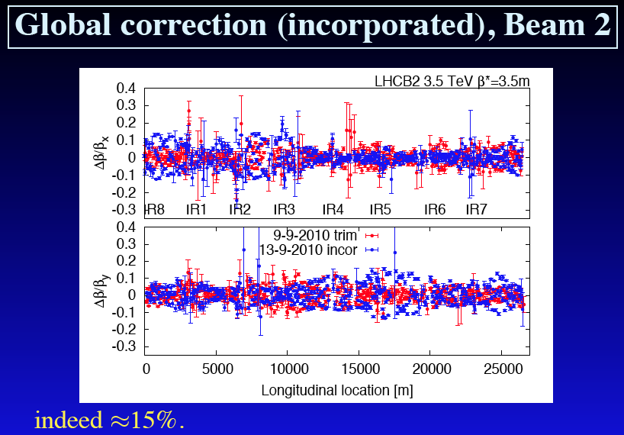
Optics

Slide 18
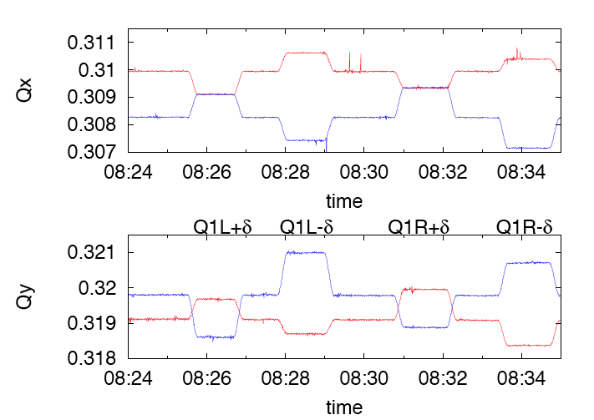
K-modulation, IP8 Q1s

Slide 19
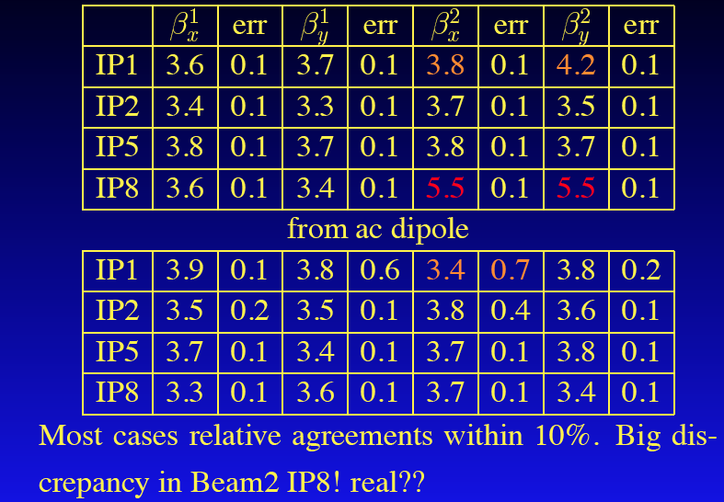
Beta*rom K-modulation & ac dipole

Slide 20

Rogelio’s conclusions

Slide 21
RF
P. Baudrenghien, A. Butterworth BE-RF

Slide 22
Old ramp vs. new ramp
2 A/s ramp (~ 45 min long)
Longitudinal Blow-up in SPS: ~ 1.5 ns, 0.5 eVs
Capture with matched voltage 3.5 MV
Voltage rise from 3.5 MV to 5.5 MV in parabolic part of ramp, then constant 5.5 MV
Only 4 lines per beam
10 A/s ramp (1020 s long)
Longitudinal Blow-up in SPS: 1.5 ns, 0.5 eVs
Capture with matched 3.5 MV
Voltage rise from 3.5 MV to 8 MV from start ramp to end ramp. 8 MV in physics
8 lines per beam
RF bucket at 450 GeV unchanged:
  Bucket area 0.94 eVs
  Bucket Half Height Δp/p 6.6E-4
  Synchrotron freq: 42 Hz

Slide 23
Old bucket vs. new bucket @ 3.5 TeV
5.5 MV
  Bucket area 3.3 eVs
  Bucket half height Δp/p: 3E-4
  Synchrotron freq: 19 Hz
8 MV
  Bucket area 4.0 eVs
  Bucket half height Δp/p:3.6E-4
  Synchrotron freq: 23 Hz
Motivation:
  Higher voltage to reduce losses during physics. Would go to 12 MV in 2010. Design value is 16 MV
  Linear voltage rise makes bunch length control easier
  No cavity left idling without feedback to prepare for high intensity

Slide 24
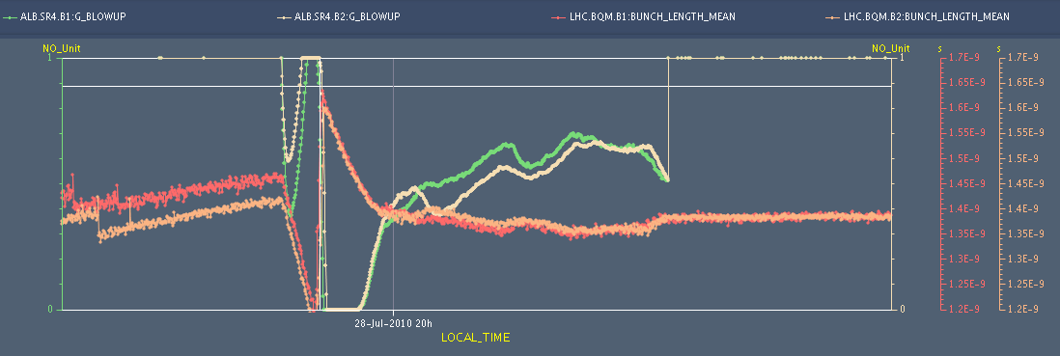
Longitudinal blow-up
Previous target: 1.4 ns
New target: 1.2 ns (design report value). Presently 1.3 ns
Blow-up with old 2A/s ramp

Slide 25
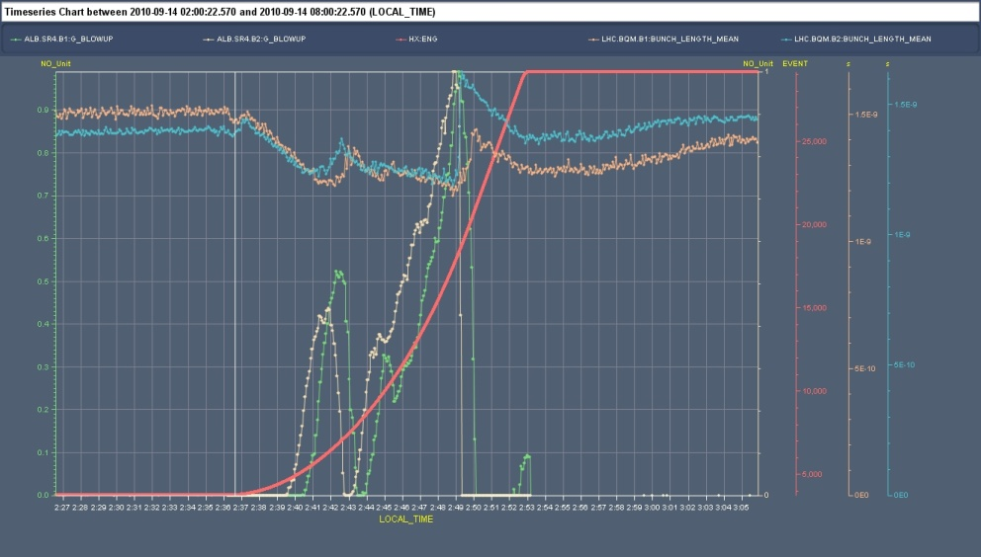
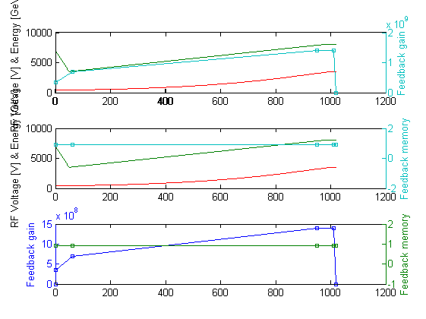
Longitudinal blow-up with new ramp (3)
Ramp 3: Sept 14, early morning
Blow-up a bit too strong: in the last third of ramp
But we end-up with correct 1.3 ns long bunches
Since optimized
Blow-up settings

Slide 26
Ramp & squeeze
Bumps in ramp trivially at constant amplitude
Extended ramp (now 1400 s)
  6 minutes at flat-top for programmed correction of b3 decay
Crossing angles reduced from 170 to 100/110 in first 100 s of squeeze – slight change of beta* in point 8
  Disable all BPMs in the bumps in OFB
Crossing angle held constant thereafter
Separation bumps off in collision beam process
  108 s
  Alice now has beams separated with the right sign
  Previous lumi scan trims magically appear as well

Slide 27
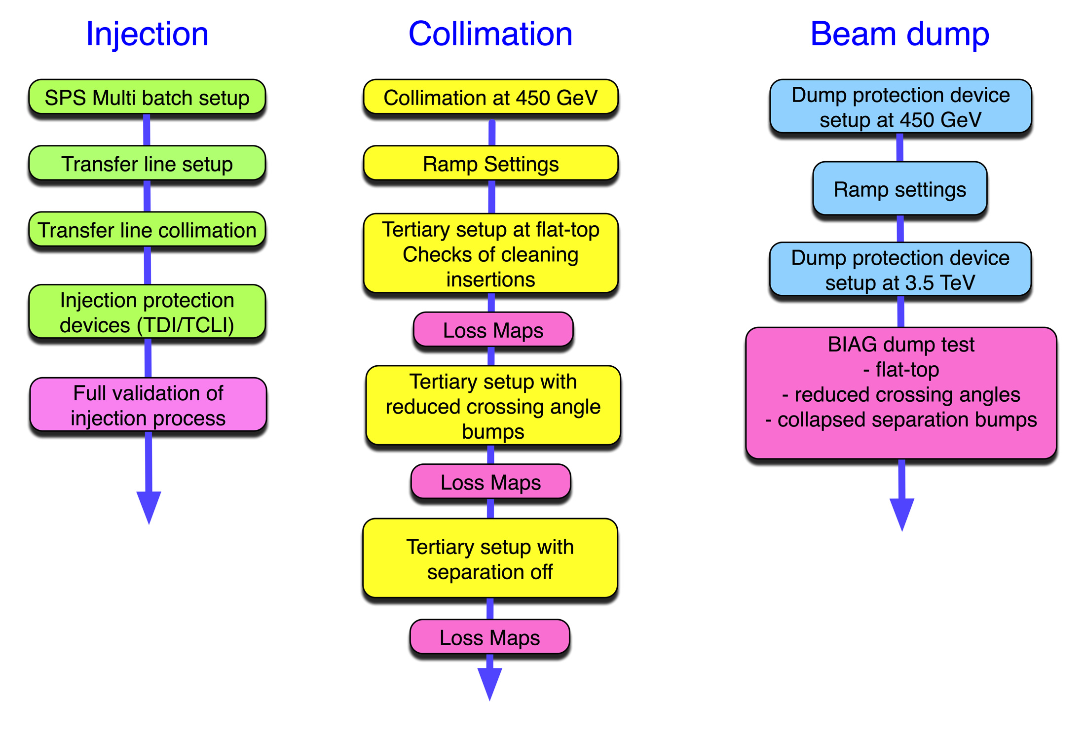
Commissioning bunch trains

Slide 28
Injection & protection
W.Bartmann, C.Bracco, B.Goddard, V.Kain, M.Meddahi, V.Mertens, A.Nord, J.Uythoven, J.Wenninger, OP, BI, CO, ABP, collimation, …

Slide 29
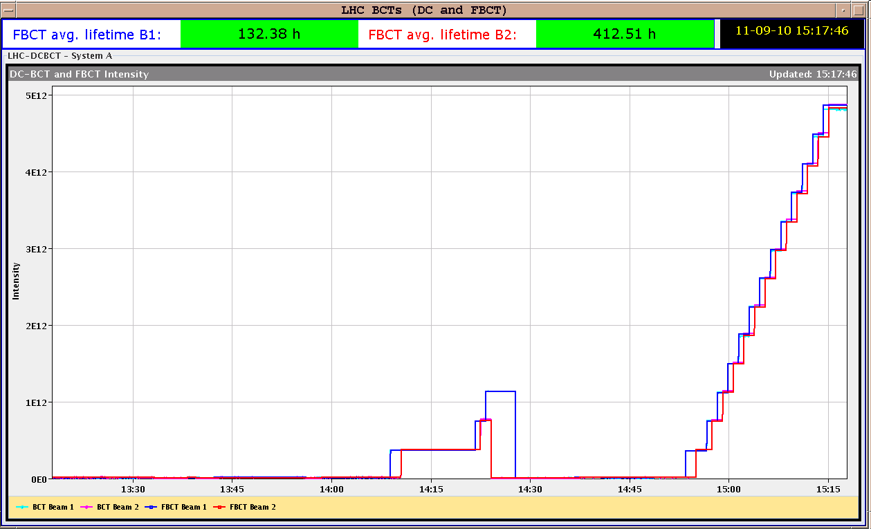
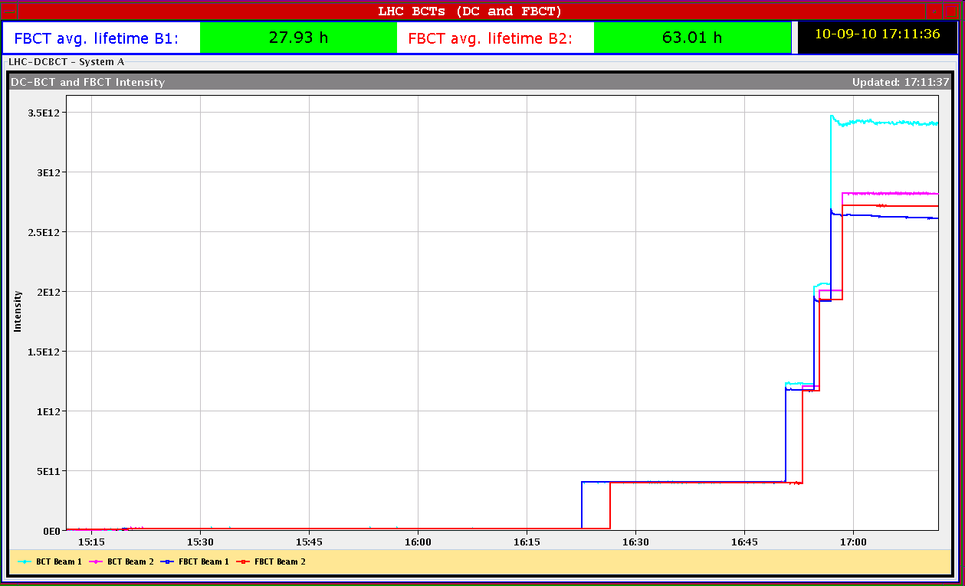
Injecting 150 ns trains of 4 and 8b
52b in 150 ns trains of 4b
22 minutes to fill
(2x13 injections)
28b in 150 ns trains (1x 4b, 3x 8b)

Slide 30
Issues with protection device settings
TCDQ at 3.5 σ while injecting nominal 4b
  Ramped TCDQ to 3.5 TeV settings while at 450 GeV
  Understood where problem came from
    Pilot circulating well, no interlock anywhere
    Combination of HW bug, settings tests and executing a collimator subsequence with pilot circulating.
    Would be good to catch this kind of gross error before injecting (e.g. if tungsten collimator moved in by error)
  Make 1st injection ‘minimum quantum’ from injector chain??
  Before any other fixes, need to make sure NO changes between injection of pilot and first high intensity batch – procedure for OP to check
Brennan Goddard

Slide 31
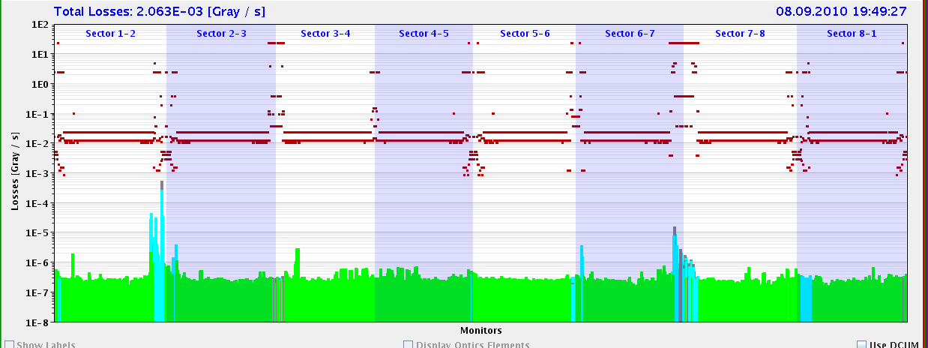
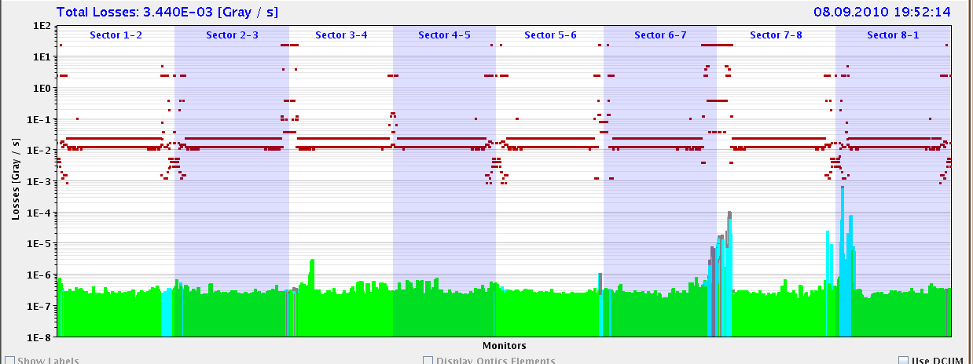
Beam loss margins
Data taken with 4b and 8b injections
  At least 1 day after setup of lines and TCDIs
  For 4.6 Gy/s B1 and B2 MQM/MQML thresholds, 80b injection OK
  Seems to be enough margin for 2010 (36b per injection)
Nb | B1* | B2*
4b – TCDI | 40-75 | 15-30
8b - TCDI | 12-15 | 5-8
4b – TCTVB | 74 | 70
8b - TCTVB | 5** | 17
B1 – 4b
B2 - 4b
*Q8 for B1, Q7 for B2 : note that dump threshold for Q8 (B1 limit) is factor 2 higher than Q7 for B2
**Before B1 RF adjustments

Slide 32
System limit (protection tolerance)
Brennan Goddard
Nominal setting
Setting + tolerance
OK
OK
OK
NOT OK
TCDI protection level measured at 5.0 sigma jaw setting (will use 4.5 sigma)
3oo4 validations look fine (pending analysis of full impact loss maps)
TI 2 vertical plane not OK – knob problem and time limited – to remeasure (1h)

Slide 33
Inj&Pro’s Conclusions
Trajectories and TCDI setup done
  Adjustments made after LHC3 energy, to return to nominal situation (TCDI centres rechecked – very small changes)
  Needs ~4h to reset up and check lines if drifts accumulate
150 ns trains of 4 and 8b injected without problems
Loss margins checked, and look OK to max 40-80b per injection
Injection protection system validation checks ongoing
Validated at 5 σ, and operate at 4.5 σ if possible
Need to monitor injection oscillations and LHC orbit, to ensure tolerances
Plan for increasing injected intensity looks feasible, to 24 and possibly eventually 36b. Will spend some weeks with 12b per injection.
Brennan Goddard

Slide 34
Collimation
IR7 – rely on correcting back in 12th June reference
IR3
  readjust beam 2 – cure anomaly
  new orbit reference in IR3
Adjust tertiary collimators
  1. 450 GeV
  Constant setting in ramp
  2. Reduce crossing angle – re-centre TCTs
  3. Squeeze – set TCTs to 15 sigma
    Hold orbit, follow nominal beam size
  4. Collapse separation bumps

Slide 35
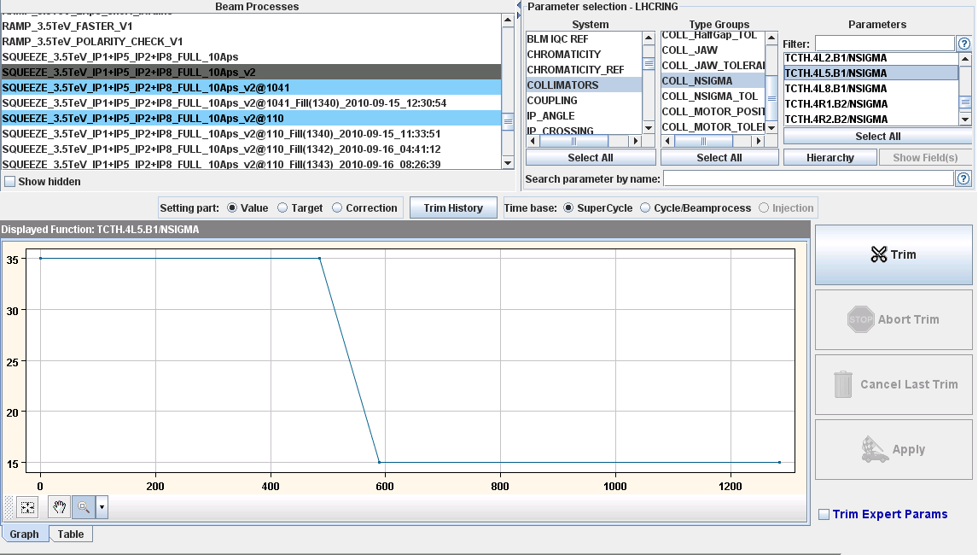
TCT in squeeze – beam sigma

Slide 36
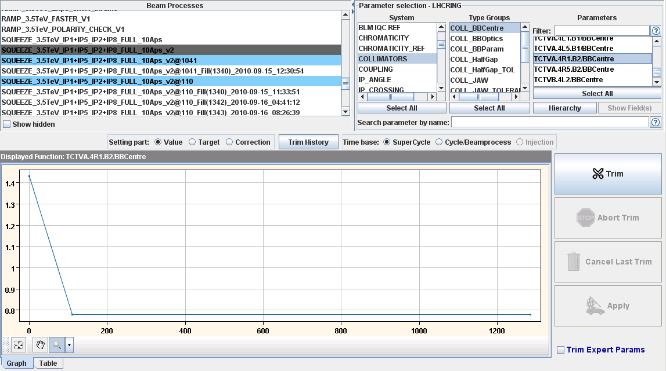
TCT in squeeze – beam position

Slide 37
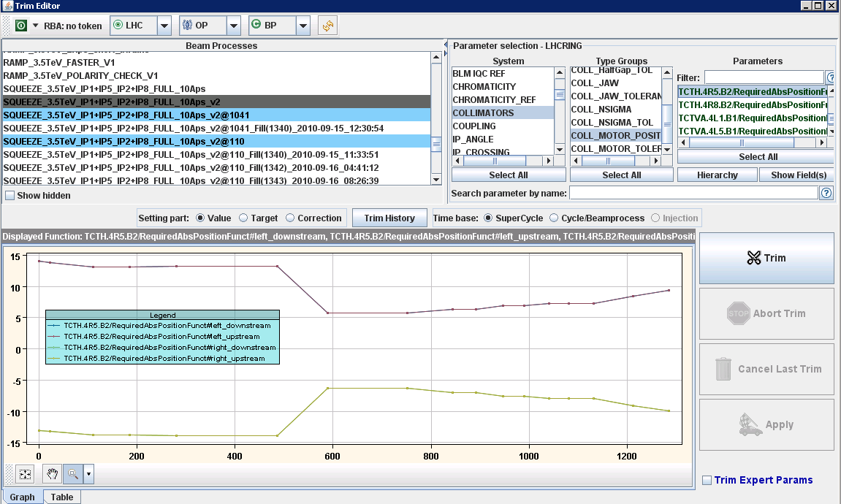
TCT in squeeze – jaw position

Slide 38
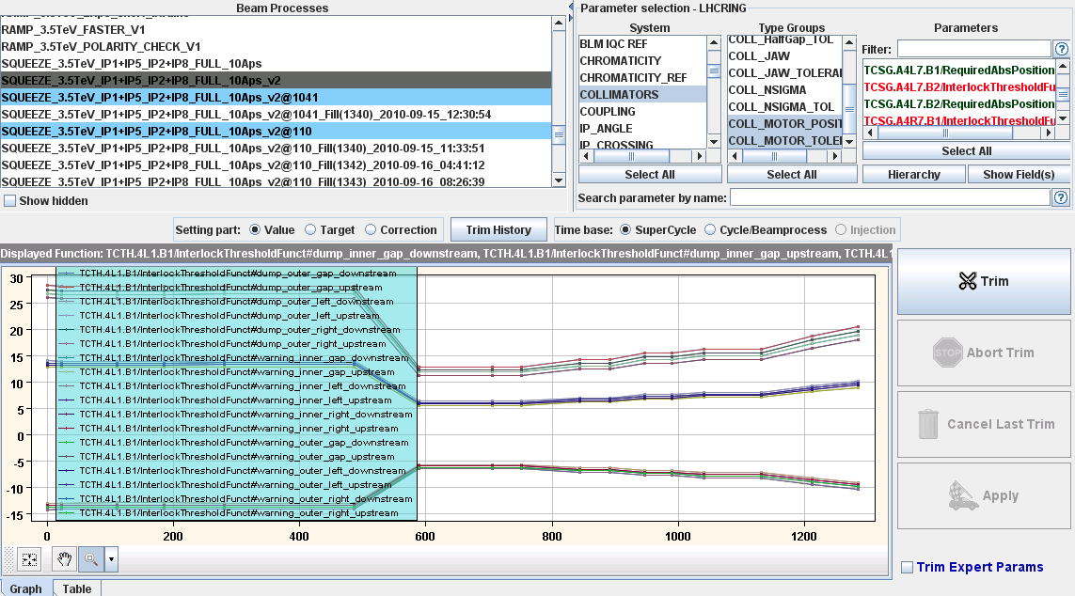
TCT in squeeze – jaw position plus tolerances

Slide 39
Collimator setup - qualification
Protection against beam losses is qualified by
  (1) generating strong diffusive losses (loss maps),
  (2) energy errors (off-momentum loss maps)
  (3) by a beam dump with beam inside the abort gap (asynchronous dump test).
These test most (all?) irregular beam loss scenarios.
All results are as expected, no unexpected loss location or leakage.
Ralph Assmann

Slide 40
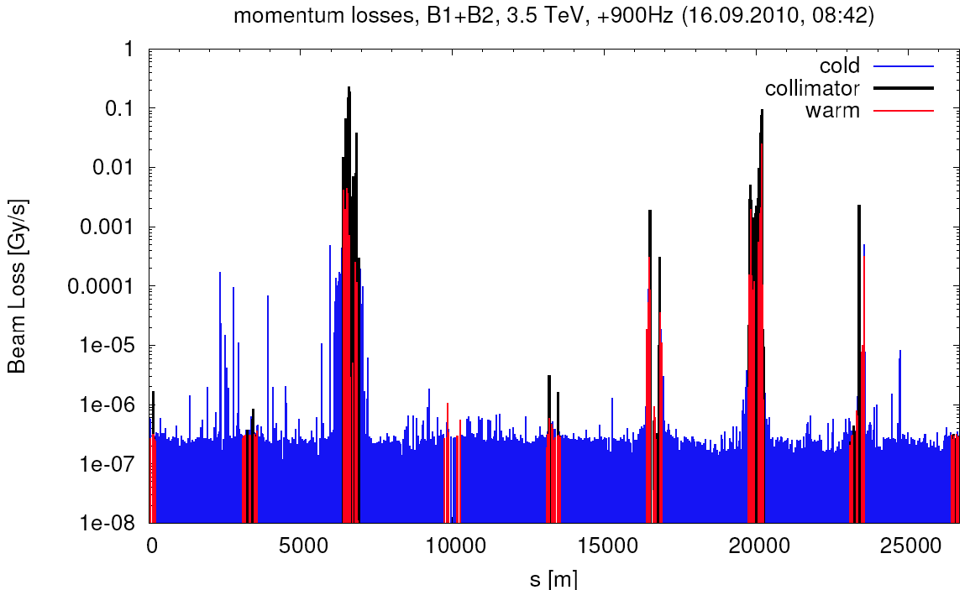
Questionable loss map
momentum losses with +900Hz. we seem now to have a hierarchy problem in IR3 B2 for particles with a lower momentum.
Daniel Wollmann

Slide 41
Qualification - status
End ramp | Betatron OK -900 Hz OK +900 Hz to do
Reduced crossing angle | Betatron all planes OK Off momentum all OK except B2
3.5 m separation bump off | Set-up ongoing need 3 fills for qualification
BIAG dumps | To do at each set-up point

Slide 42
Commissioning bunch trains status

Slide 43
BTC – other
TDI checks and maybe measure again 1-2 phases in the TLs - so another 4 hours should do it
Request to do some loss tests whenever possible.
  RADMONs have been installed closed to the triggering QPS racks and the QPS team has applied a firmware update for which there is no more need of access in case of SEE. The desired intensity is 10^11.
Test flat bottom with fixed 7 MV and adiabatic voltage reduction for few seconds at each injection
Quench levels at 450 GeV

Slide 44

Plans for increasing injected intensity
Start this weekend with 3*8
Progressively increase injected intensity
  Stay with 8/12b, until step to 144/192b total
  Option for 400b to use 24 or 36b per injection
Brennan & Malika

Slide 45
Conclusions
Interesting results from aperture and beam-beam studies
  Interesting consequences for future operation
Systematic optimization with good results:
  Optics
  RF
  Feedbacks…
Bunch train commissioning progressing well and on track to deliver first bunch train collisions this weekend
  Just inside the estimated 2 weeks required commissioning time
  Many thanks to collimation and injection & protection teams

