Slide 1
Injection and protection
W.Bartmann, C.Bracco, B.Goddard, V.Kain, M.Meddahi, V.Mertens, A.Nord, J.Uythoven, J.Wenninger, OP, BI, CO, ABP, collimation, …

Slide 2
Outline
TDI and TCLI setup
TL steering and stability
TCDI setup
Injecting trains of 4 and 8b
Issues with protection device settings
TCDI protection settings and validation tests
Beam loss margins and plans for increasing injected intensity

Slide 3
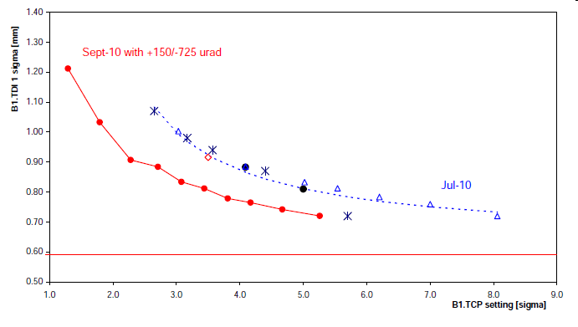
TDI/TCLI setup
Cross-checked TDI tilt with new method
  Find beam, retract, scan tilt angle – worked well
  Confirmed values found by analysis
Applied 1 mrad tilt to lower TDI jaw for B1
  Improved scale error by factor ~2 (still residual)
Centered all TDI/TCLI wrt new injection orbit
  5 mm offsets for TCLIA.B1
TDI.B1

Slide 4
TL steering and stability
Monday 6th: redid completely TI 2 and TI 8 steering with ‘final’ LHC3 cycle
  Used 4b in 150 ns trains
  Corrected back to July TCDI setup trajectories
    Changes of about 1 mm, mainly in H
    Corrected with 1-2 correctors, max 10 urad
    RMS 250 μm for both planes in TI 8, and 170 μm in TI 2 (wrt July reference)
  Corrected injection oscillations to <0.5 mm

Slide 5
Recall: Orbit and Trajectories
Reproducibility of orbit at the extraction point in the SPS: Ok within the measurement precision (~200 μm)
Trajectory in the TL (BPM close to collimators): maximum difference = 700 μm (RMS of errors 100-200 μm)
Beam 1
Beam 2
BPM | Max difference [mm]
TI2.BPMIV.20704.V | 0.3
TI2.BPMIH.29004.H | 0.7
TI2.BPMIH.29004.V | 0.5
TI2.BPMIH.29304.H | 0.6
TI2.BPMIV.29104.V | 0.7
TI2.BPMIV.29504.V | 0.6
BPM | Max difference [mm]
TI8.BPMI.87407.H | 0.7
TI8.BPMI.87604.V | 0.3
TI8.BPMI.87804.V | 0.2
TI8.BPMI.87904.H | 0.5
TI8.BPMI.88104.H | 0.5
TI8.BPMI.88104.V | 0.6

Slide 6
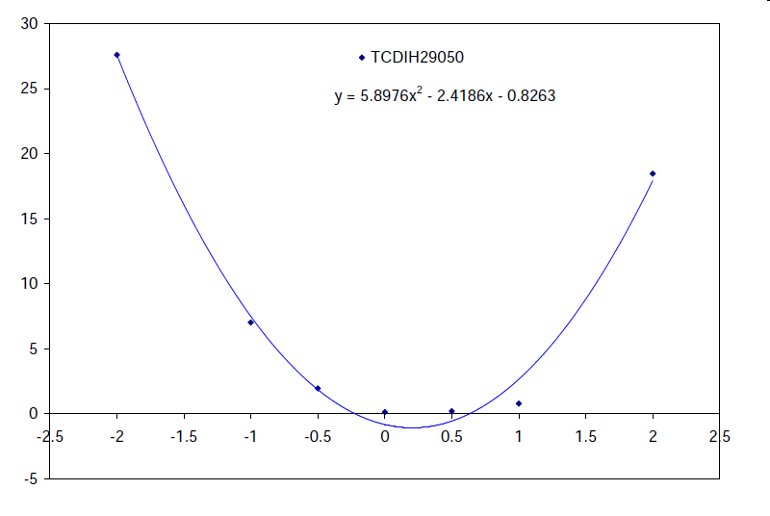
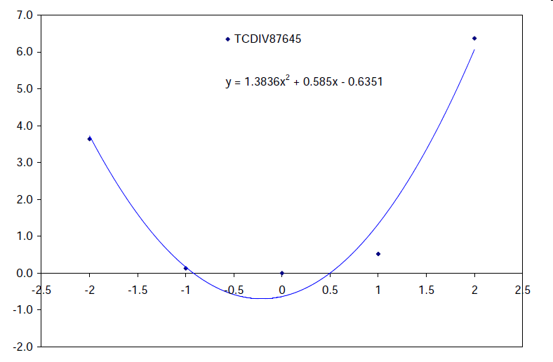
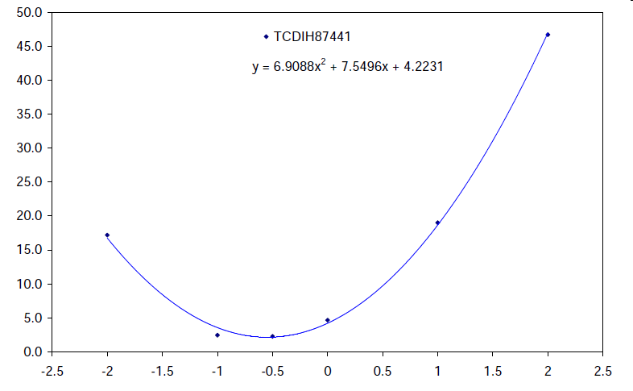
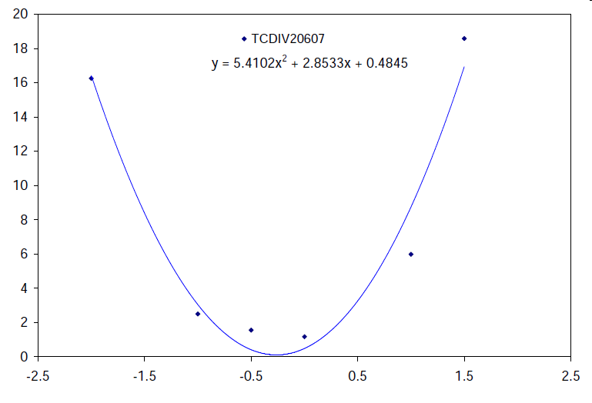
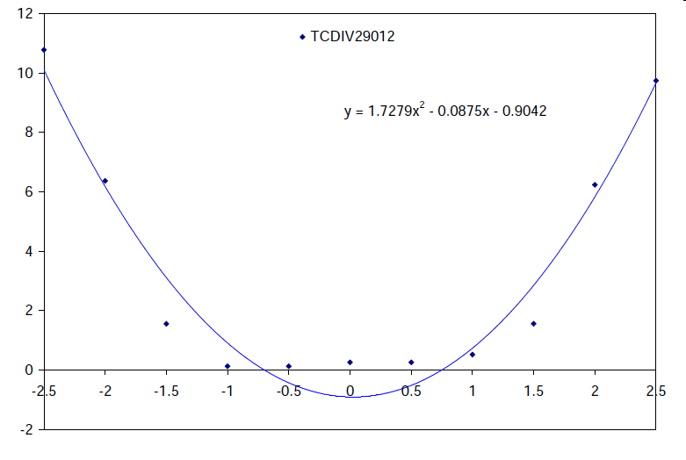
TCDI setup
Wed 8th / Thurs 9th : LHC3 cycle with 4 nominal bunches injected...time consuming (1 point per 2-3 minutes)
  13 collimators centered: move only one jaw closer to beam (keep protection level), response on TL/LHC BLMs
Changes of up to 0.8 mm / 0.5 sigma seen wrt July
Would ideally like 1 nominal bunch on LHC3 cycle...any chance for SPS?

Slide 7
TDI/TCDI settings protection level validation
Validating TCDI protection, at setting of 5 σ
Will operate at setting of 4.5 σ
  Gives some reasonable operational margins to the measured injection aperture
  Allows settings to be relaxed by 0.5 σ if needed (TCDIH with large D_{x} in each line)
  Need to scan phases and amplitudes with pilots and measure transmission – time consuming
Leave TDI/TCLI at 6.8 σ
  Loss issues are from uncaptured beam, not transverse

Slide 8
Change of SPS extraction energy on LHC3
Corrected LHC3 extraction energy to LHCFAST1
Energy changed from 451.15 to 451.19 GeV
  0.1 per mil change
Setup done last week on old energy: yesterday rechecked
  Large (>1mm) trajectory and factor 2-4 higher losses
  Both lines resteered in H and V
  Injection oscillations corrected again
  4 TCDIs checked for centring (critical H, max D_{x}/√β)
  Total time about 4 h – might need to repeat this process at intervals of a few weeks
Hopefully no more changes like this
  Or keep LHC3 cycle (high intensity, ergo most critical) parameters constant and change the others if possible

Slide 9
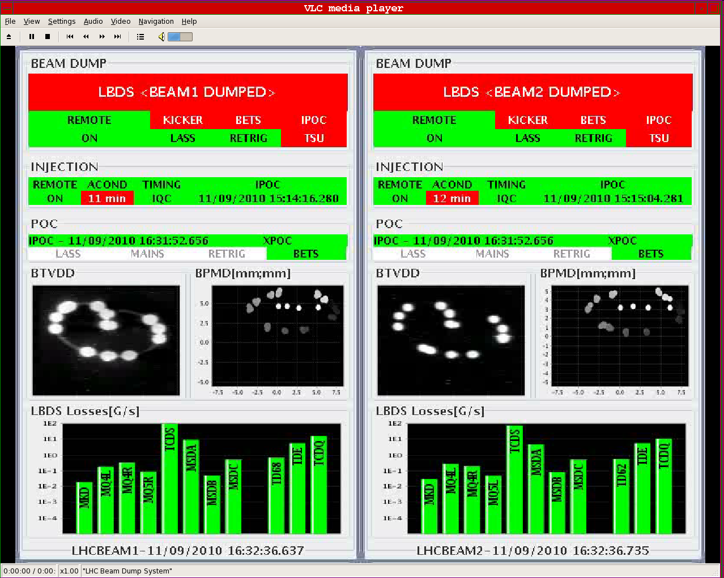
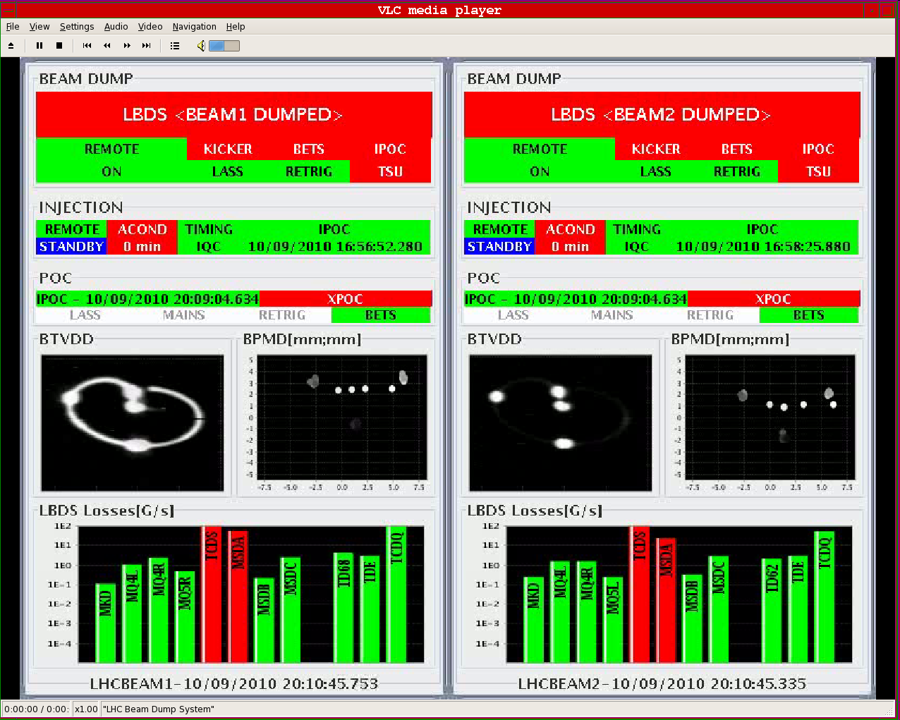
Injecting 150 ns trains of 4 and 8b
4b injection now operational
  SPS extraction kicker synch checked and OK
  Problems with LHC BCTs (BPF, readings). Solved.
  Losses always below LHC BLM dump levels
  Full 52b injection scheme tried several times – low losses on IQC (done with few or no latched) and in LHC
  B1 capture losses sorted out (SPS energy mismatch)
8b injection used to fill for beam-beam checks
  First injected 4b witness train – cumbersome. Keep??
  Otherwise losses etc. looked fine
Dumping of 4b and 8b trains all OK (as expected)
B1 52b
B2 52b
B1 28b
B2 28b

Slide 10
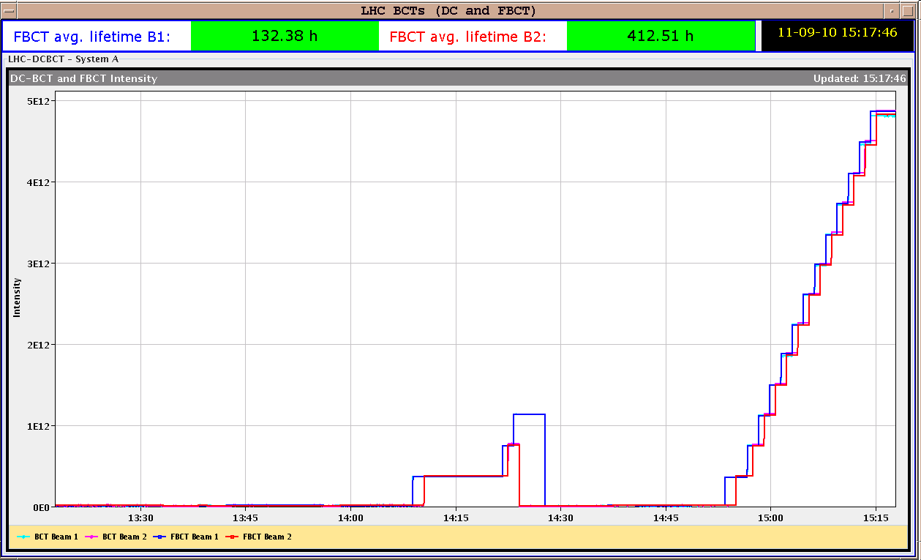
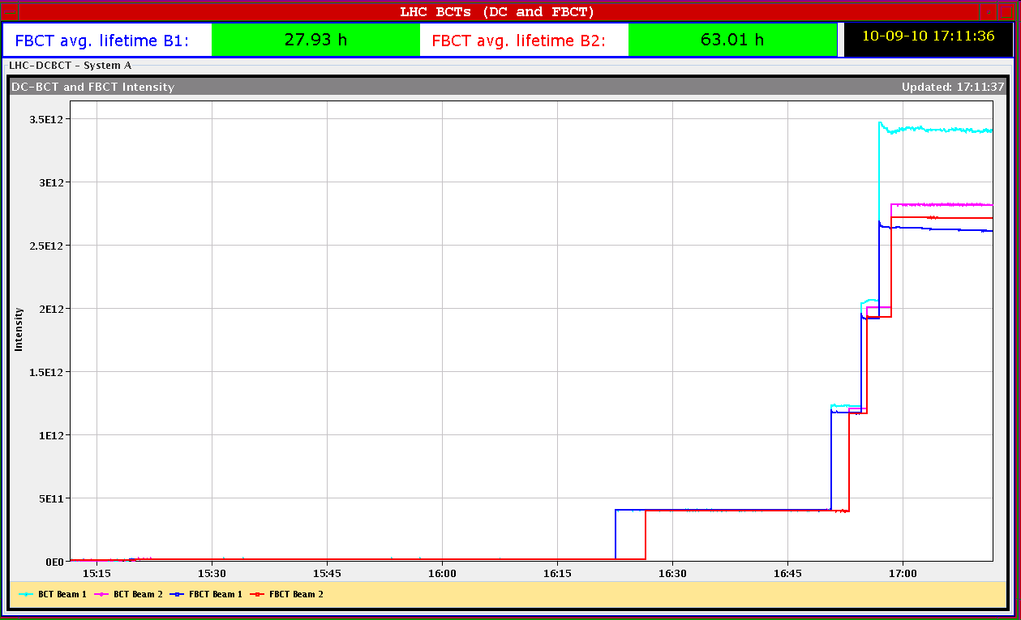
Injecting 150 ns trains of 4 and 8b
52b in 150 ns trains of 4b
22 minutes to fill
(2x13 injections)
28b in 150 ns trains (1x 4b, 3x 8b)

Slide 11
Issues with protection device settings
TCDQ at 3.5 σ while injecting nominal 4b
  Ramped TCDQ to 3.5 TeV settings while at 450 GeV
  Understood where problem came from
    Pilot circulating well, no interlock anywhere
    Combination of HW bug, settings tests and executing a collimator subsequence with pilot circulating.
    Would be good to catch this kind of gross error before injecting (e.g. if tungsten collimator moved in by error)
  Make 1st injection ‘minimum quantum’ from injector chain??
  Before any other fixes, need to make sure NO changes between injection of pilot and first high intensity batch – procedure for OP to check

Slide 12
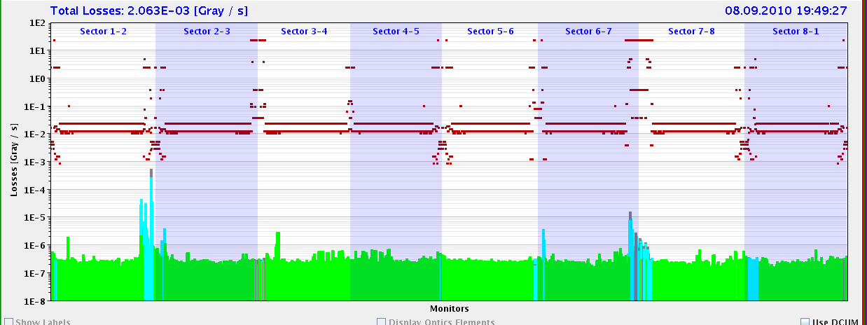
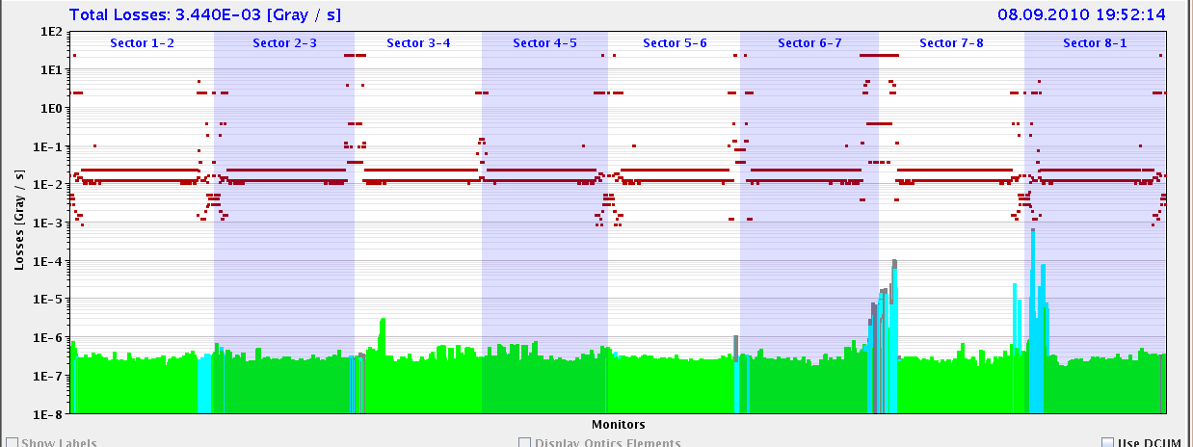
Beam loss margins
Data taken with 4b and 8b injections
  At least 1 day after setup of lines and TCDIs
  For 4.6 Gy/s B1 and B2 MQM/MQML thresholds, 80b injection OK
  Seems to be enough margin for 2010 (36b per injection)
Nb | B1* | B2*
4b – TCDI | 40-75 | 15-30
8b - TCDI | 12-15 | 5-8
4b – TCTVB | 74 | 70
8b - TCTVB | 5** | 17
B1 – 4b
B2 - 4b
*Q8 for B1, Q7 for B2 : note that dump threshold for Q8 (B1 limit) is factor 2 higher than Q7 for B2
**Before B1 RF adjustments

Slide 13
Plans for increasing injected intensity
Progressively increase injected intensity
  Stay with 8/12b, until step to 144/192b total
  Option for 400b to use 24 or 36b per injection

Slide 14
Conclusions
Trajectories and TCDI setup done
  Adjustments made after LHC3 energy, to return to nominal situation (TCDI centres rechecked – very small changes)
  Needs ~4h to reset up and check lines if drifts accumulate
150 ns trains of 4 and 8b injected without problems
Loss margins checked, and look OK to max 40-80b per injection
Injection protection system validation checks ongoing
Plan to validate at 5 σ, and operate at 4.5 σ if possible
Need to monitor injection oscillations and LHC orbit, to ensure tolerances
Plan for increasing injected intensity looks feasible, to 24 and possibly eventually 36b. Will spend some weeks with 12b per injection.

