Slide 1
1st-turn dispersion of beam 2 data taken by Jörg et al on 10 September ~16:30
Frank Zimmermann
Mike’s 14:00 meeting, 16.09.2008
Thanks to Masamitsu Aiba, Kajetan Fuchsberger, Massimo Giovannozzi, Mike Lamont, Rogelio Tomas

Slide 2
equal to zero within the noise of this measurement

Slide 3
large incoming dispersion oscillation with 1-2 m amplitude

Slide 4
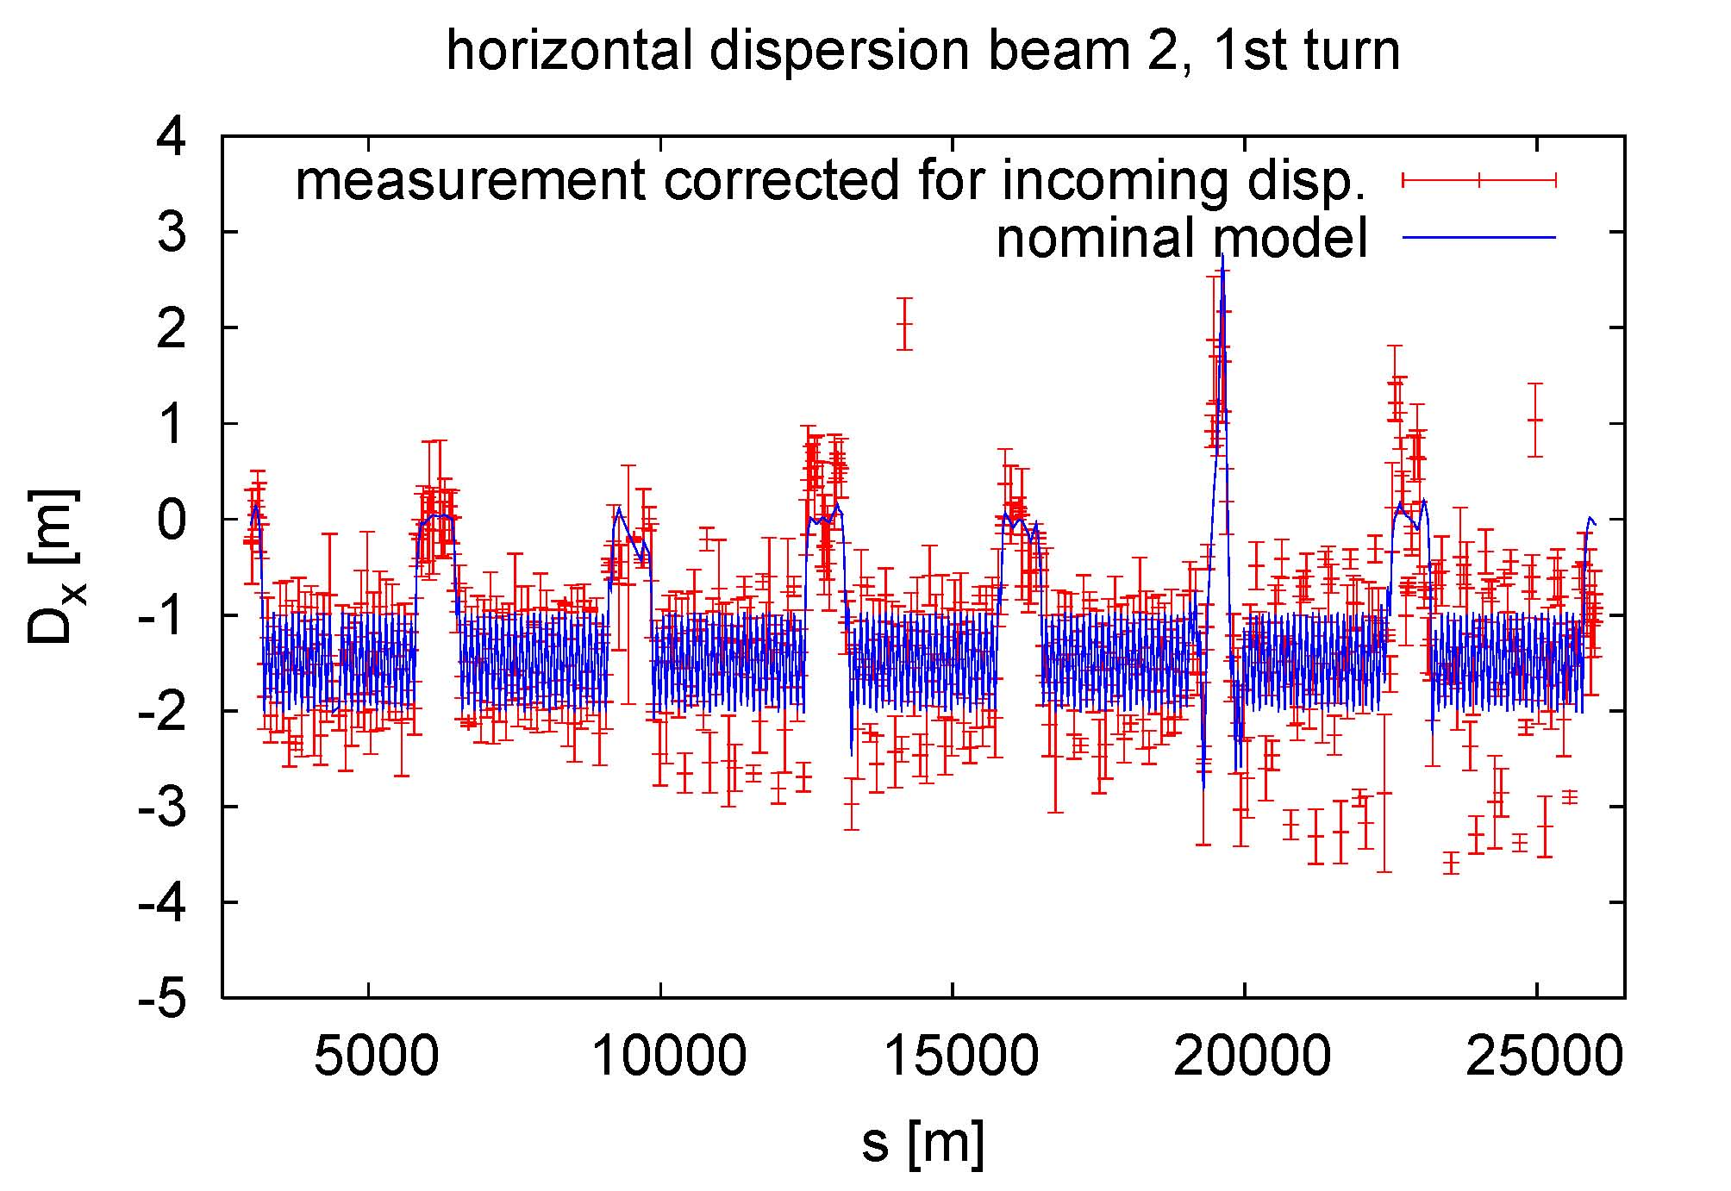
overall dispersion looks pretty good;
rather beautiful in all LSS’s except LSS2
IR3
IR6
small problem?!
larger problem?!
“ring dispersion” after taking out incoming oscillation by fitting over first 10 km

Slide 5
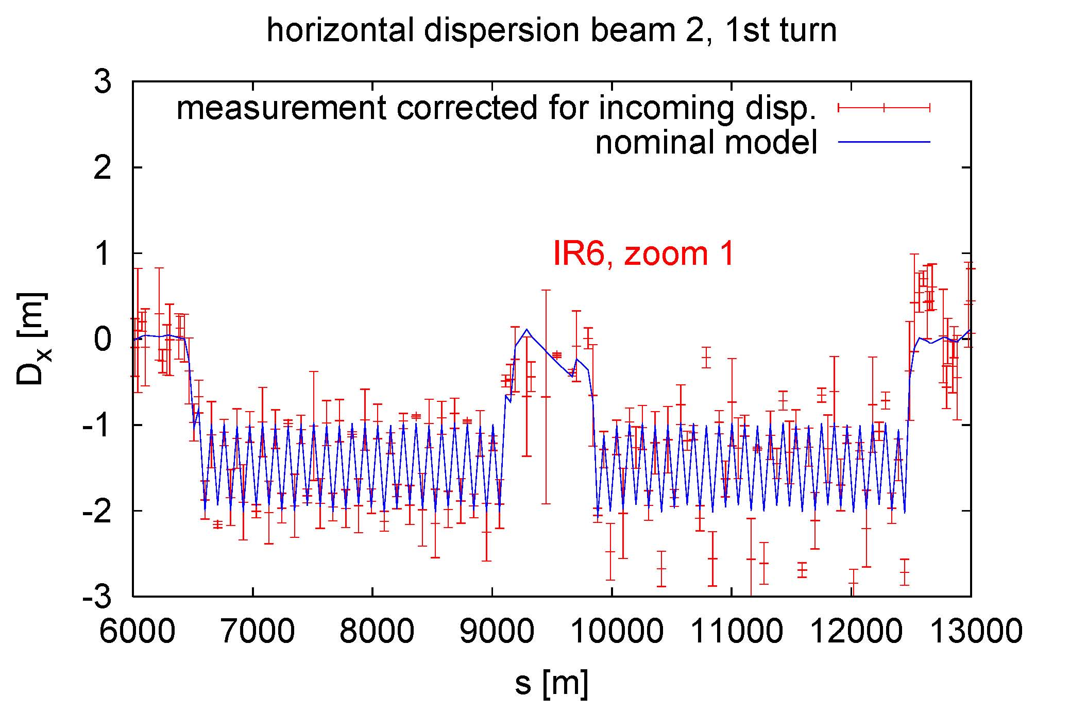
zoomed view of dispersion around IR6, taking out the dispersion mismatch observed in preceding arc

Slide 6
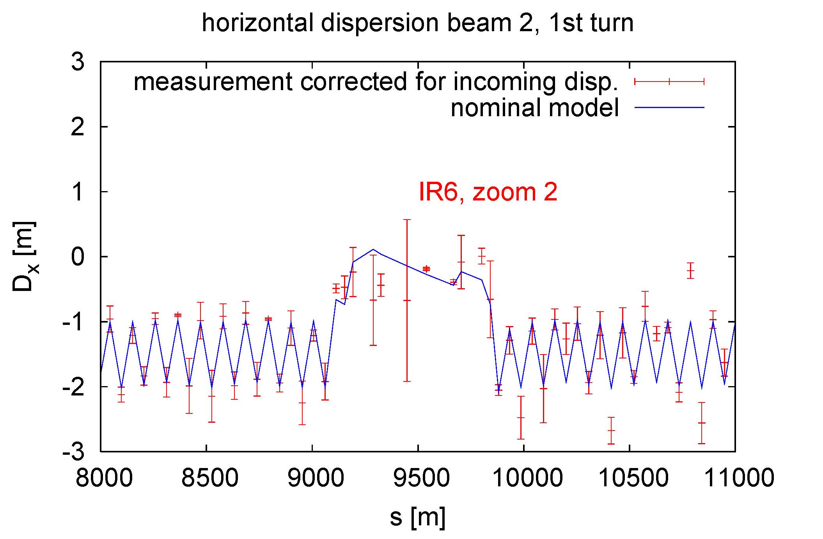
some deviation
already seen before
the IR center?!
further zoom of dispersion around IR6, taking out the dispersion mismatch observed in preceding arc

Slide 7
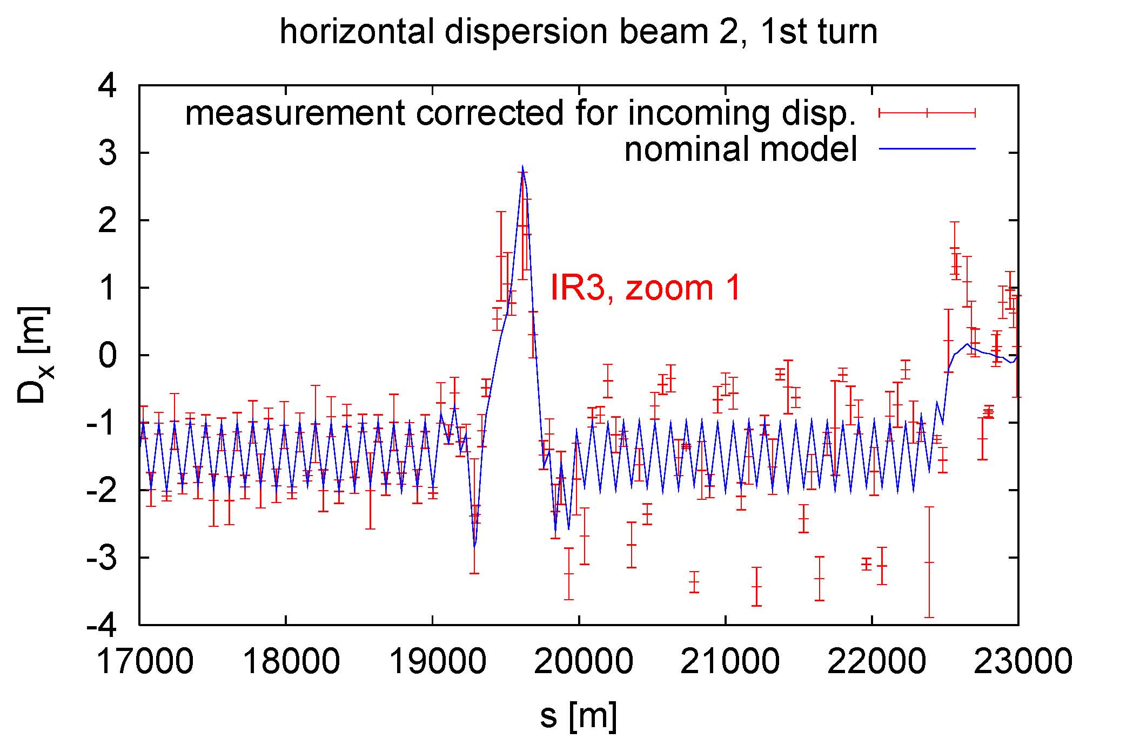
zoomed view of dispersion around IR3, taking out the dispersion mismatch observed in preceding arc

Slide 8
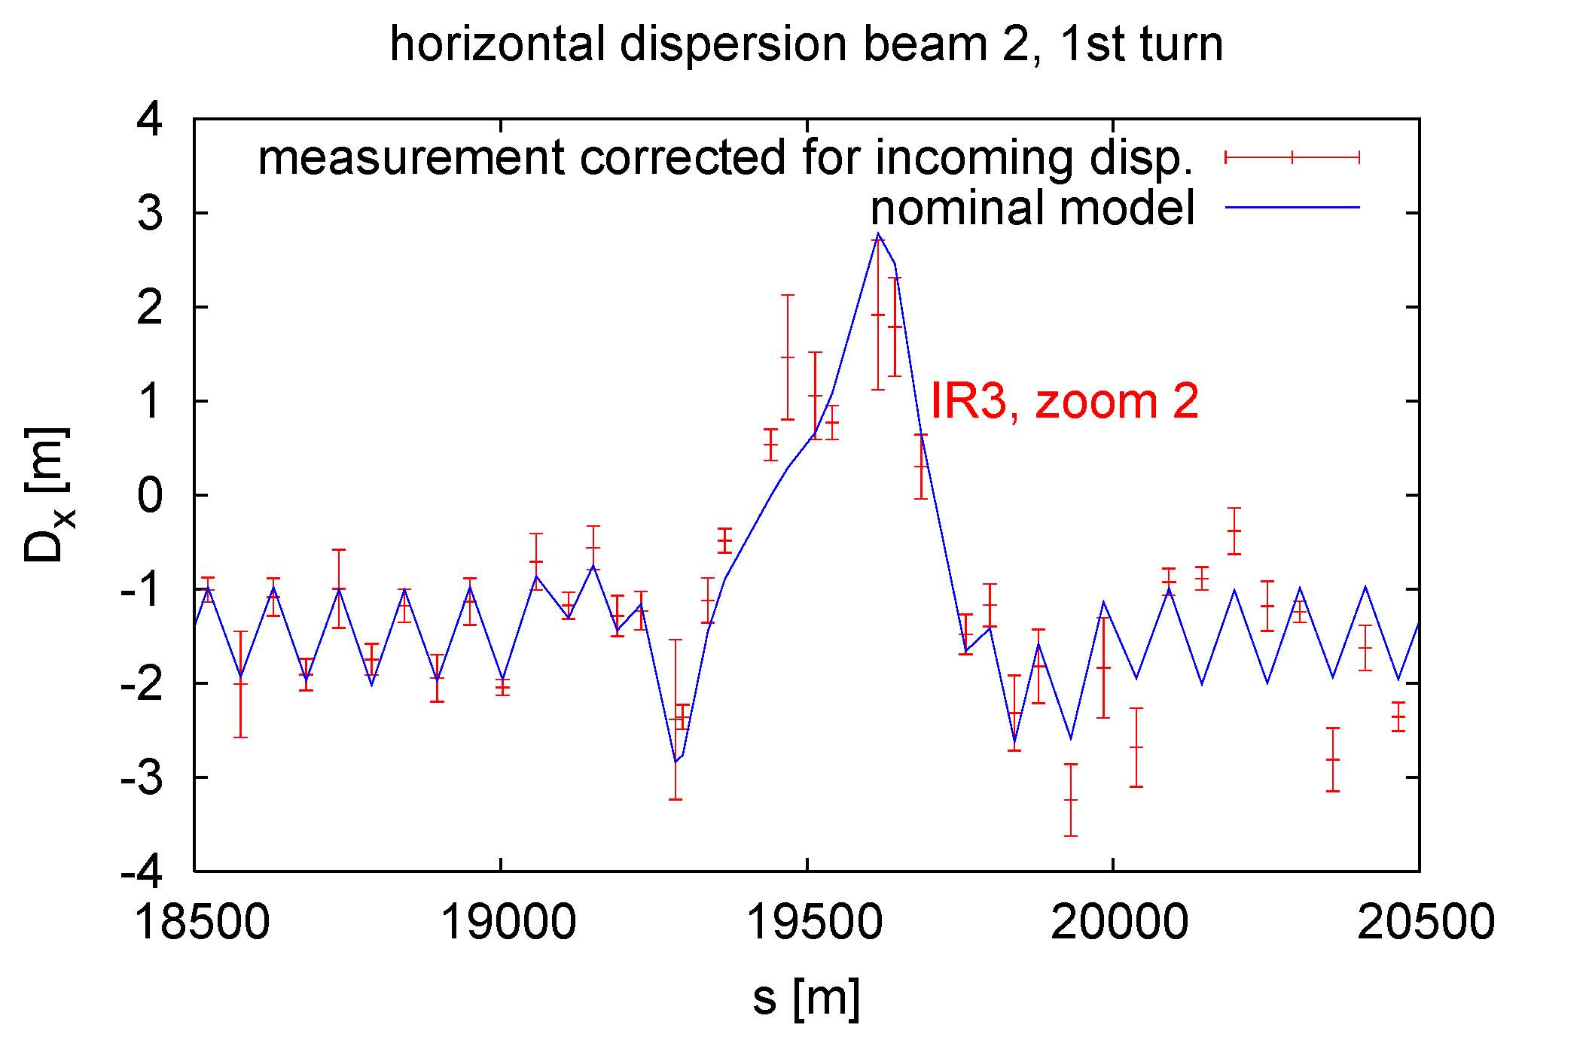
some deviation
already seen before
the IR center?!
further zoom of dispersion around IR3, taking out the dispersion mismatch observed in preceding arc

Slide 9
trial and error studies
effect of a wrong polarity for various
quadrupoles & quadrupole combinations
in IR3 and IR6:
QTL11LR3, QTL11R3, odd QTLs (7,9,11) LR3,
odd QTLs L3, odd QTLs L3+QT13,
QTL11R3+QT9L3, QTL11R3+QT13R3, QTL11LR6,
Q6LR3, Q6L3, QT5LR3, QT5R3, QT5L3,
QT4LR3, QT4LR3+QTL11L3, QT4LR3+QTL9L3
QT4R3, QTL5L3, QTL5R3, QTL5LR3,…

Slide 10
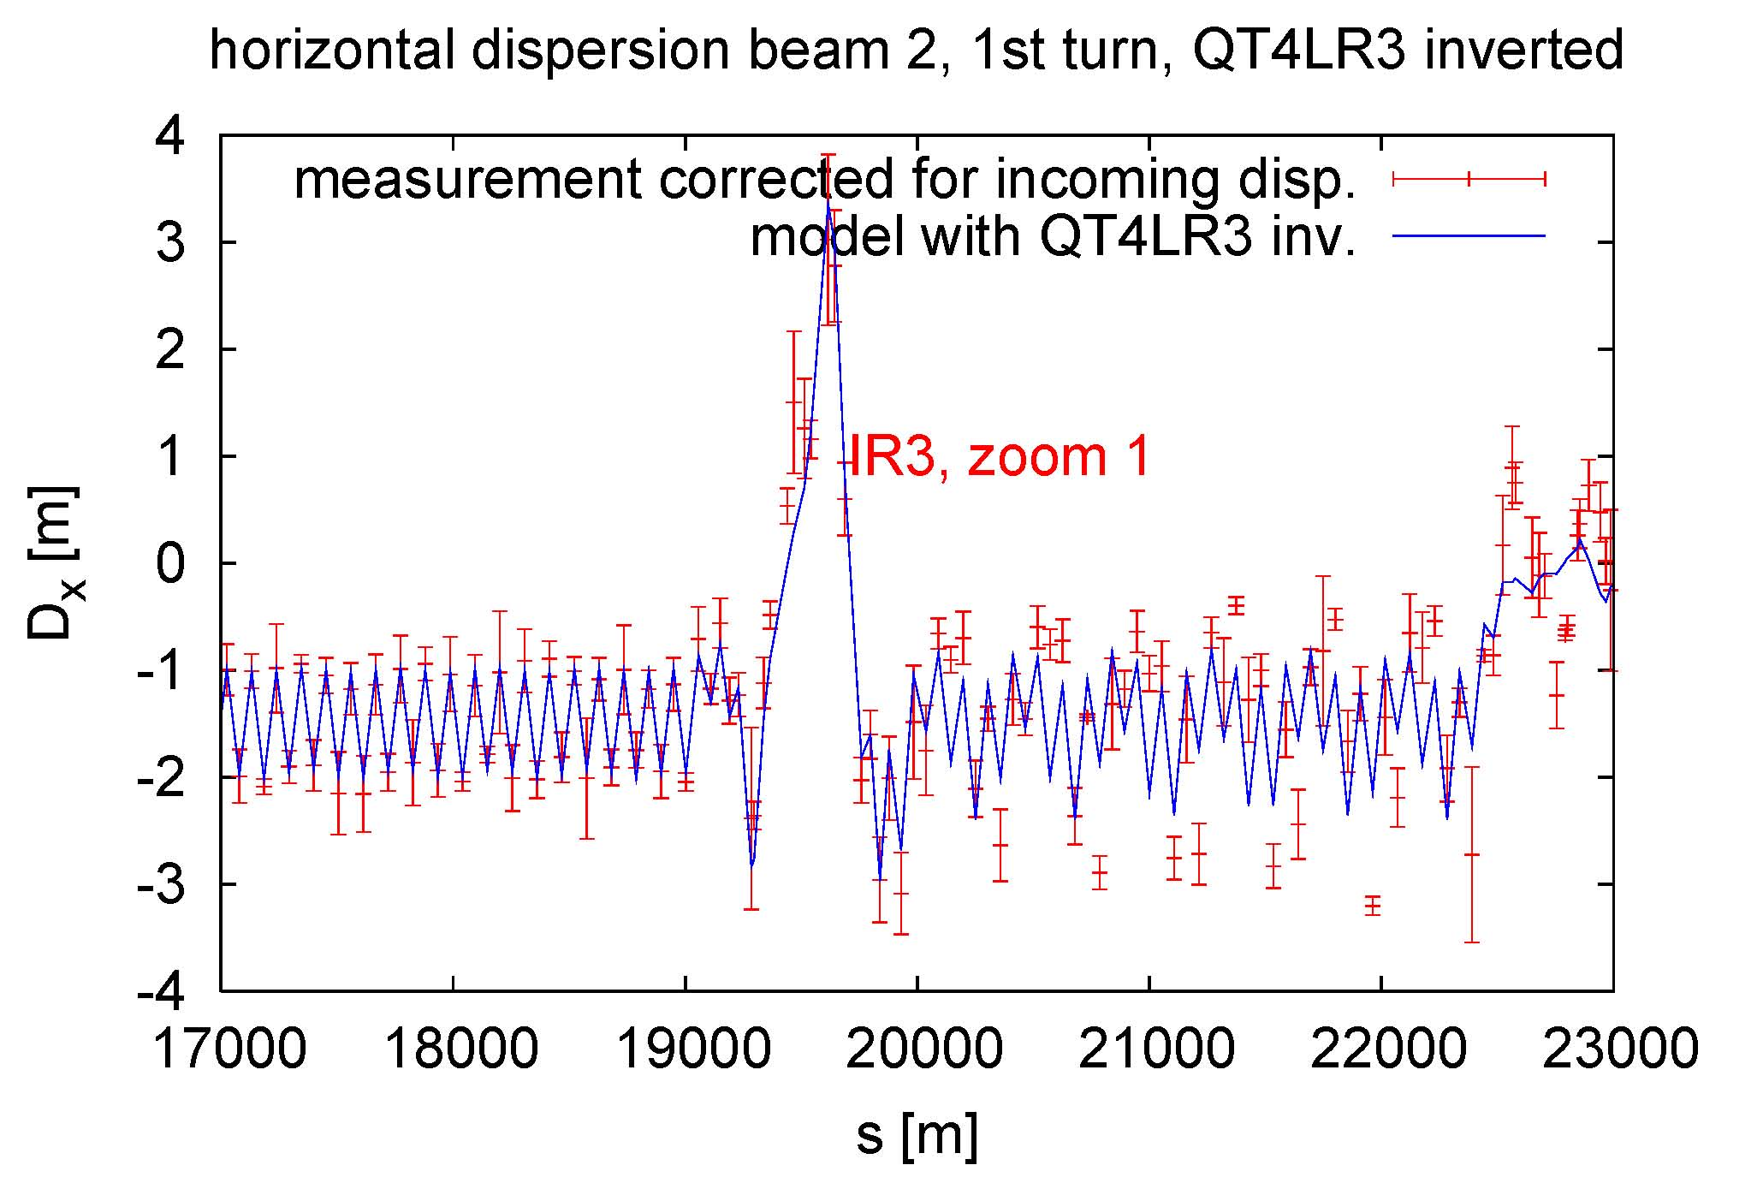
dispersion around IR3, with QTL4 LR3 inverted,
after taking out dispersion mismatch of preceding arc

Slide 11
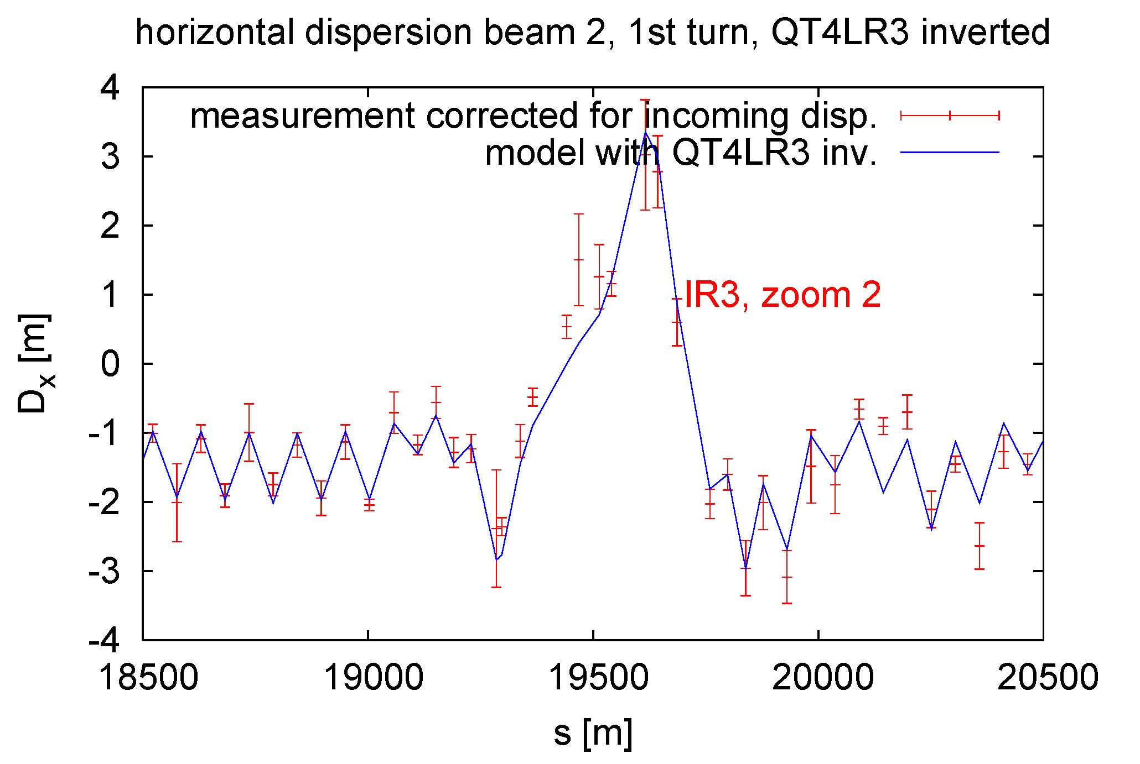
closer view of IR3 dispersion, with QTL4 LR3 inverted,
after taking out dispersion mismatch of preceding arc

Slide 12
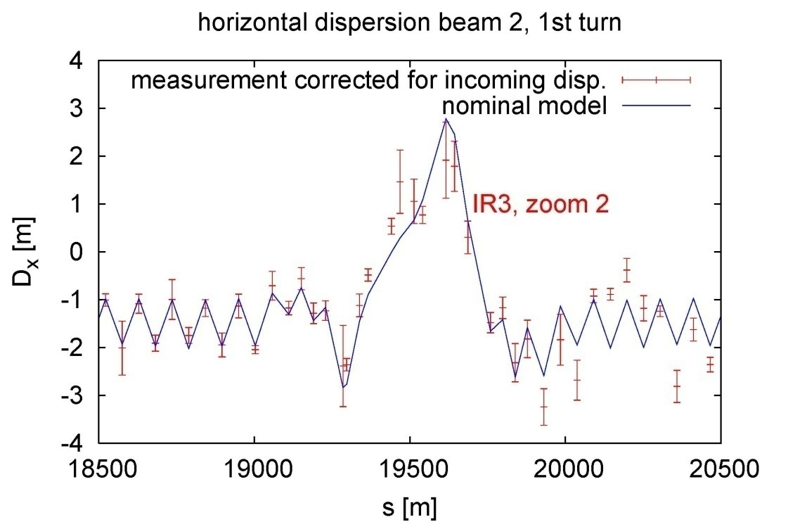
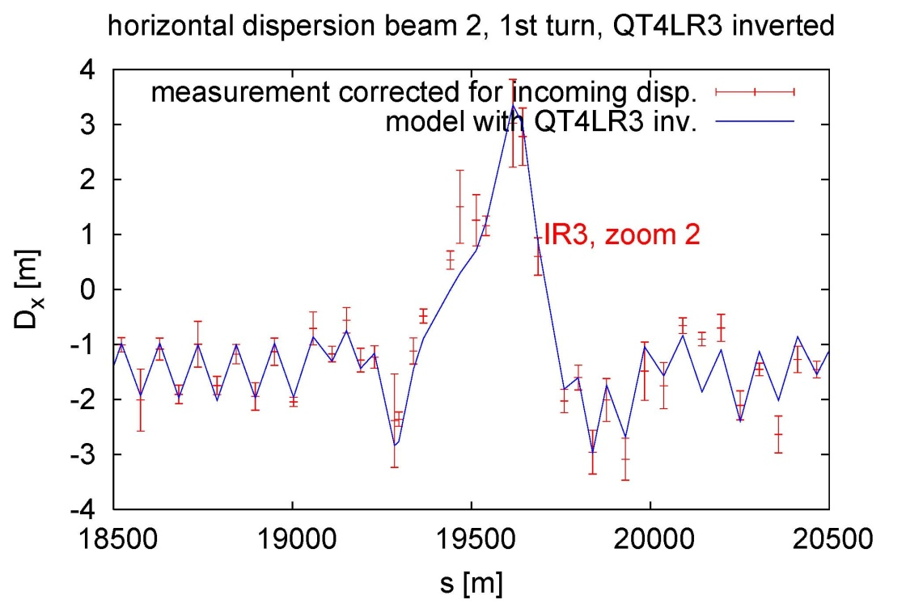
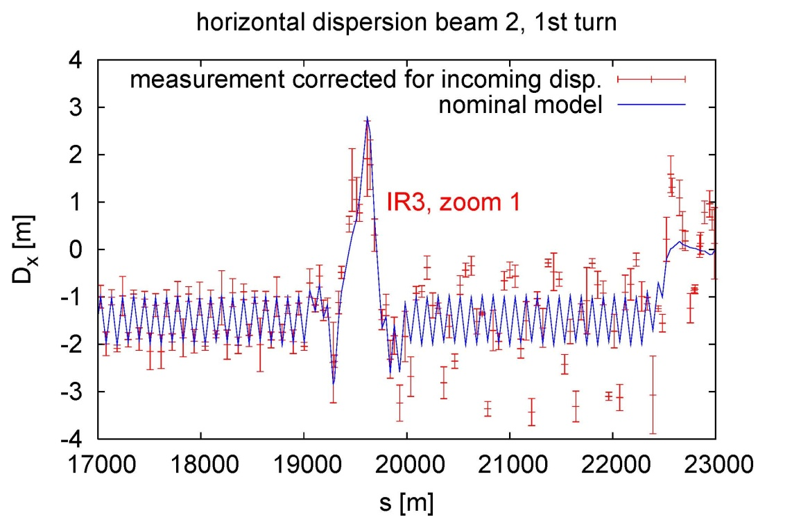
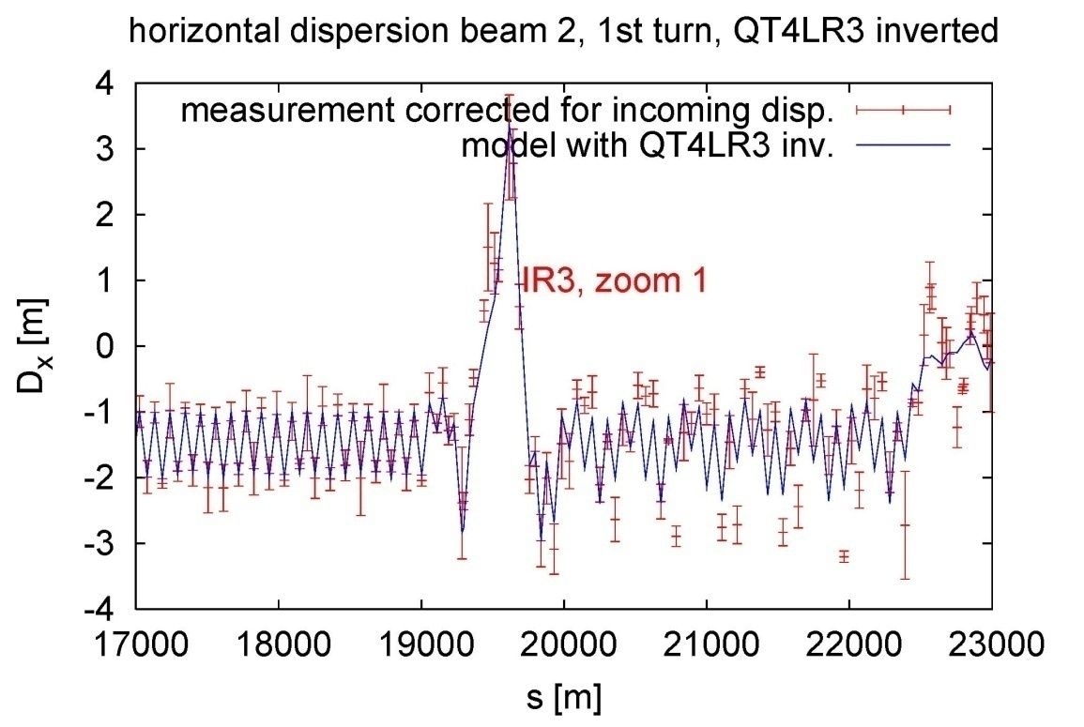
nominal model
model w QT4 LR3 inverted

Slide 13
discussion over the weekend
Massimo+Mike: QT4 was checked and double checked, even with Hall probes; must be OK
Rogelio+Kajetan+Masamitsu: not clear
back to the drawing board
try quadrupoles with similar effect as QT4

Slide 14
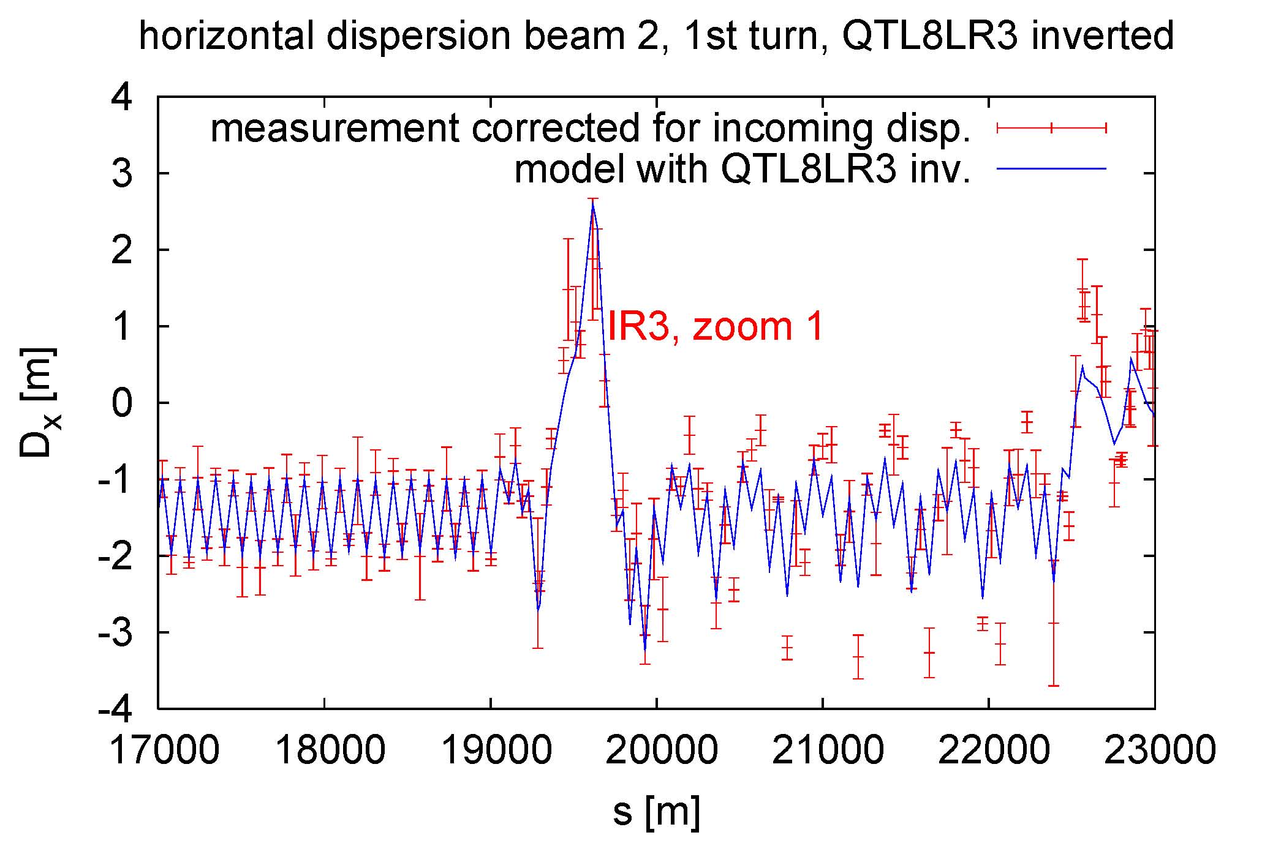
dispersion around IR3, with QTL8 LR3 inverted,
after taking out dispersion mismatch of preceding arc

Slide 15
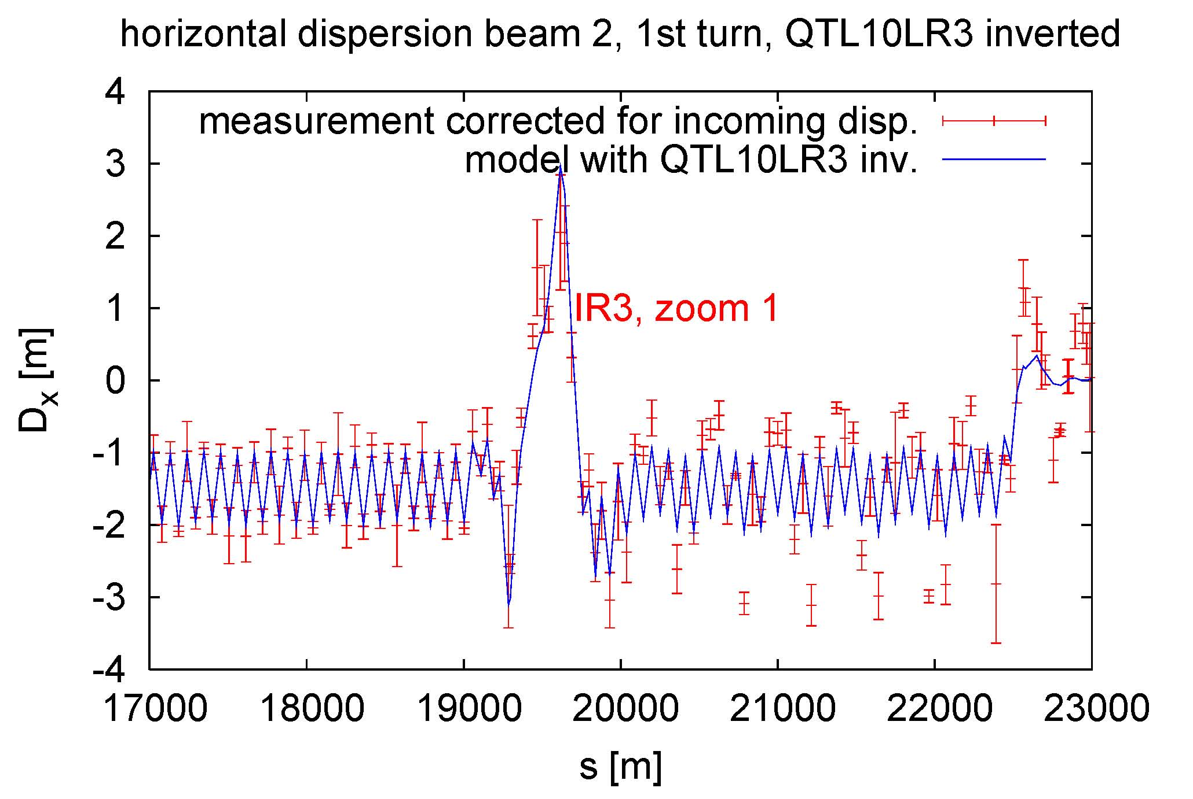
dispersion around IR3, with QTL10 LR3 inverted,
after taking out dispersion mismatch of preceding arc

Slide 16
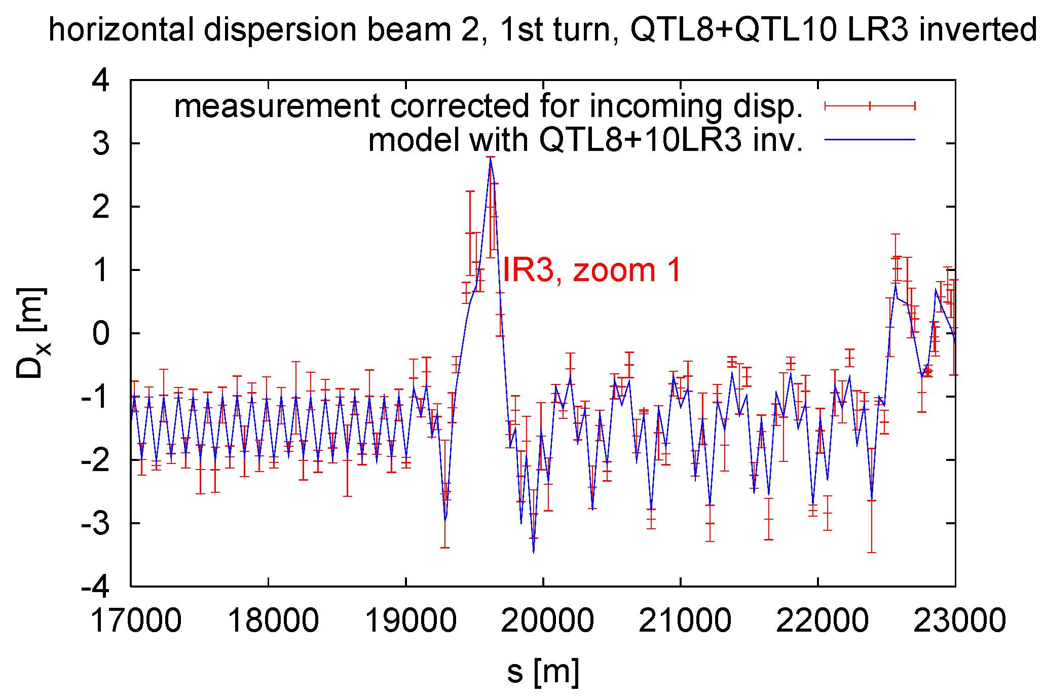
bingo!
dispersion around IR3, with QTL8+10 LR3 inverted,
after taking out dispersion mismatch of preceding arc

Slide 17
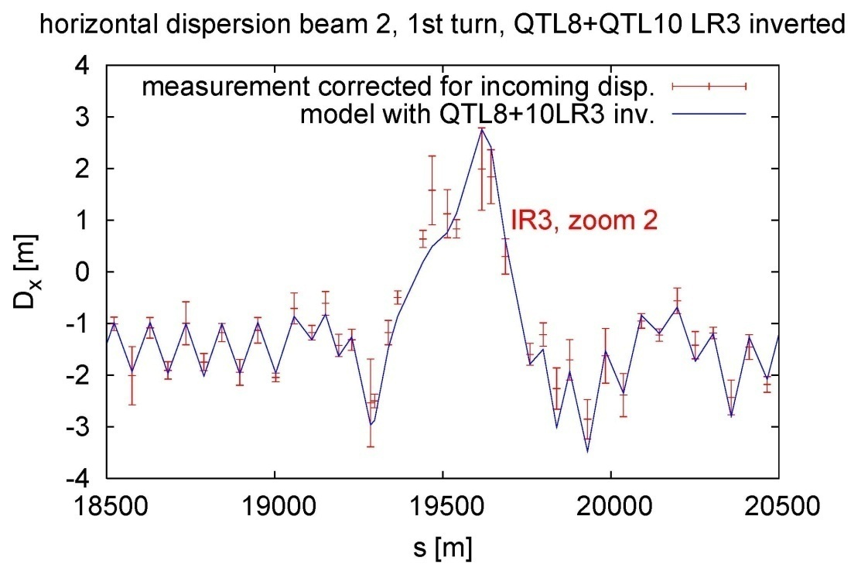
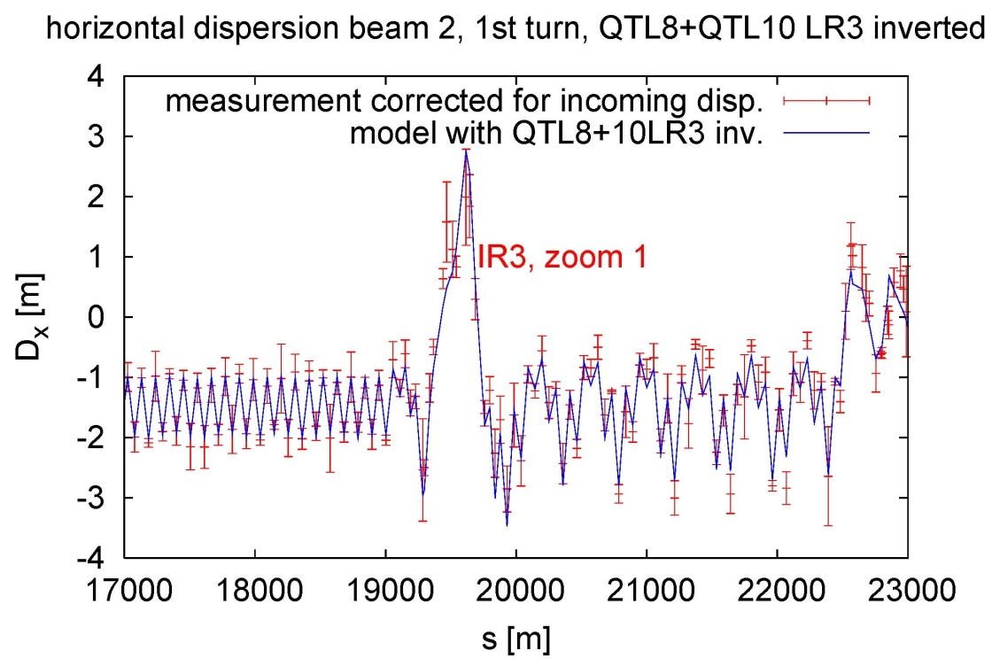
nominal model
model w QT8+10 LR3 inv.

Slide 18
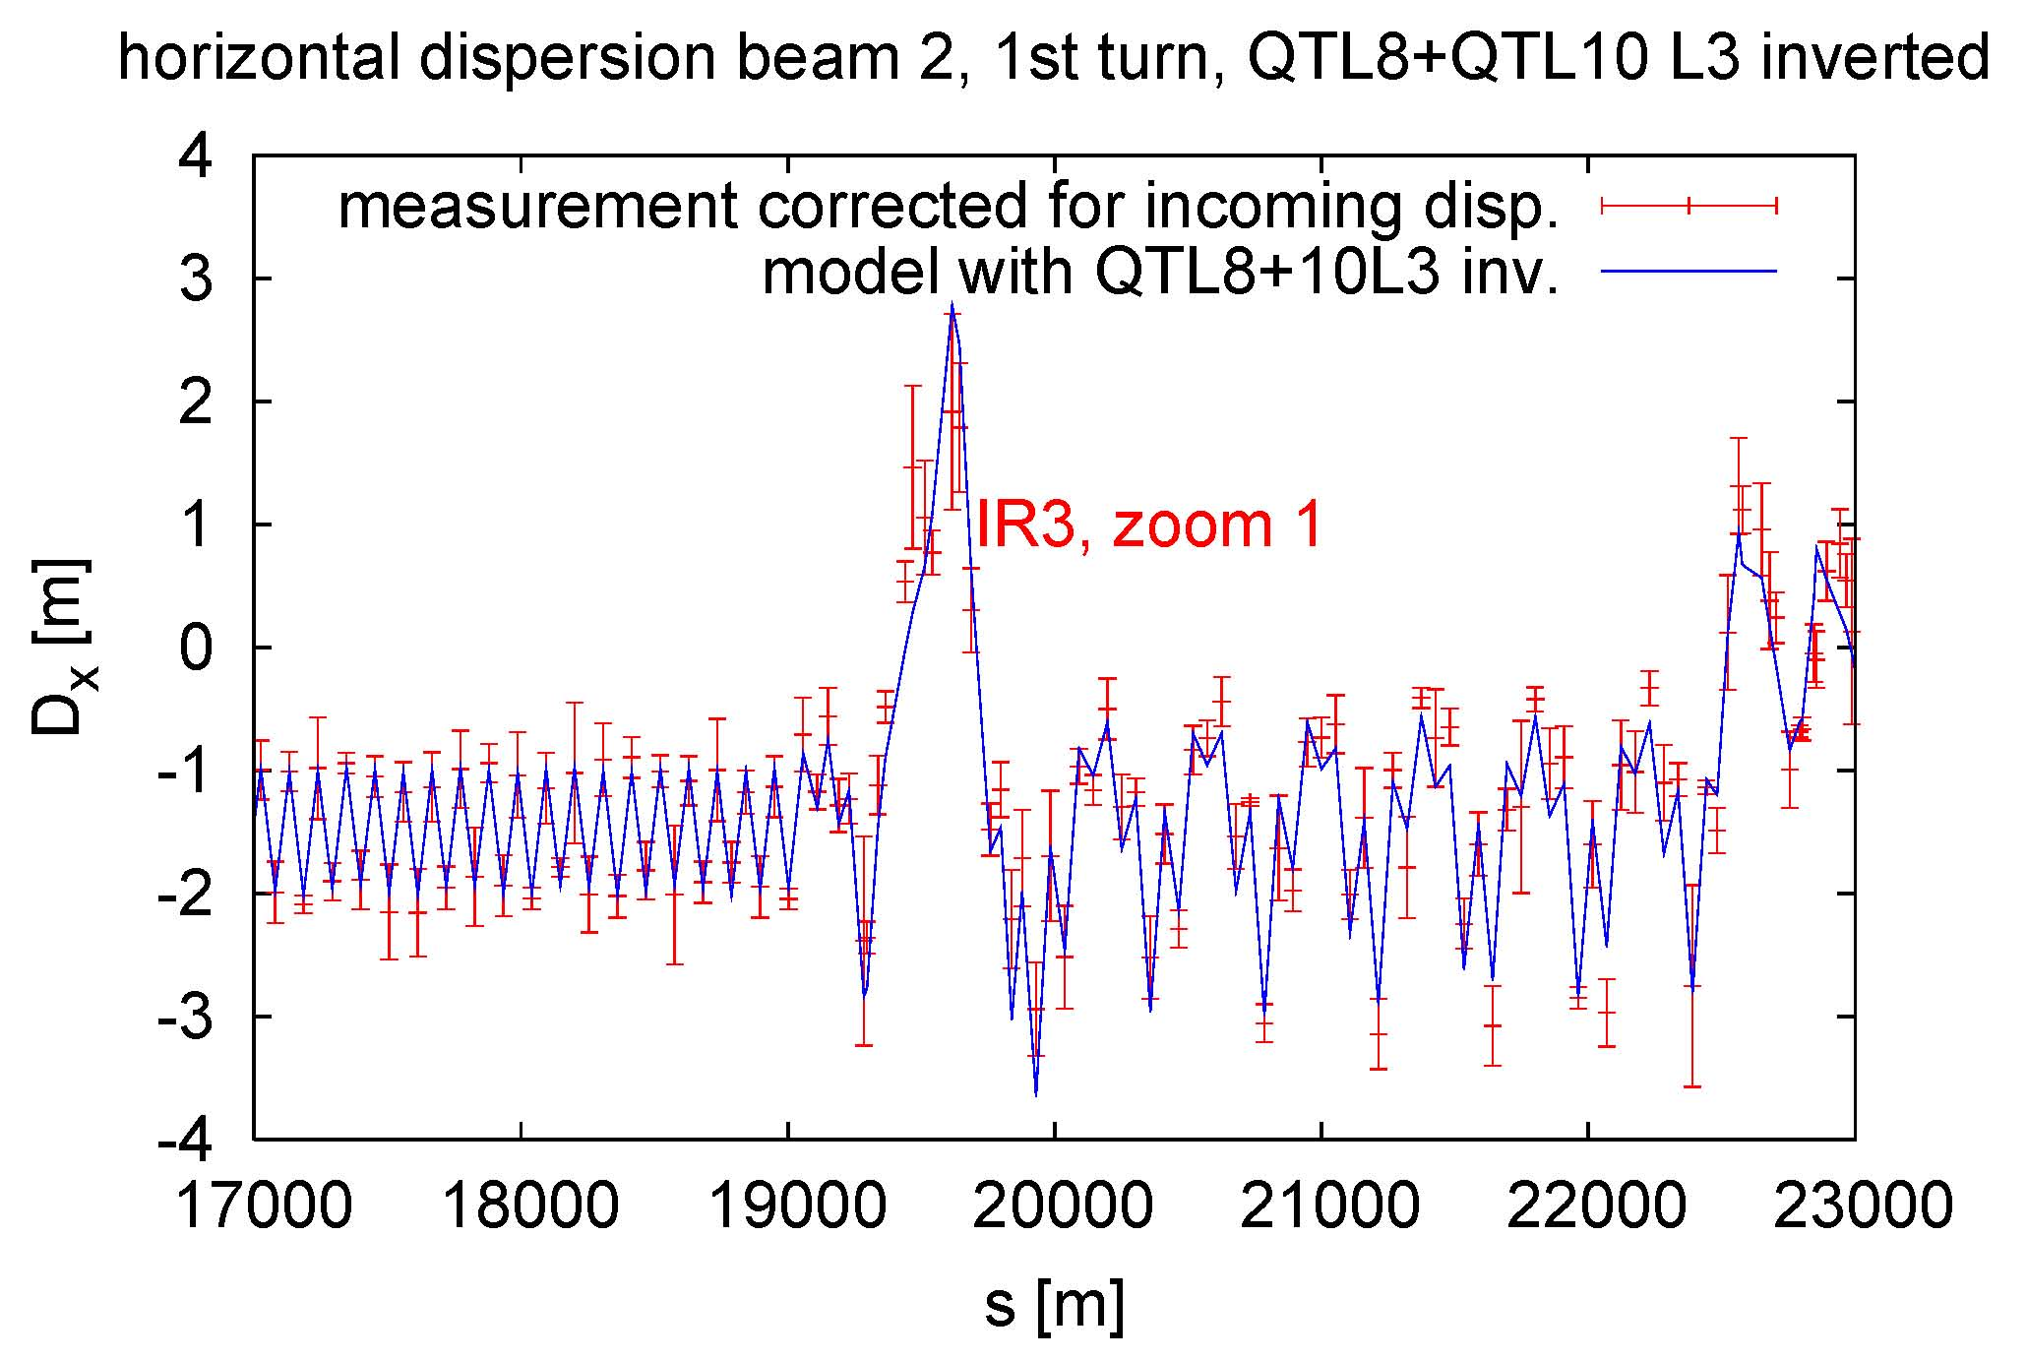
QTL8+10 R3
are very weak
and their
polarity hardly
affects the result
dispersion around IR3, with QTL8+10 L3 inverted,
after taking out dispersion mismatch of preceding arc

Slide 19
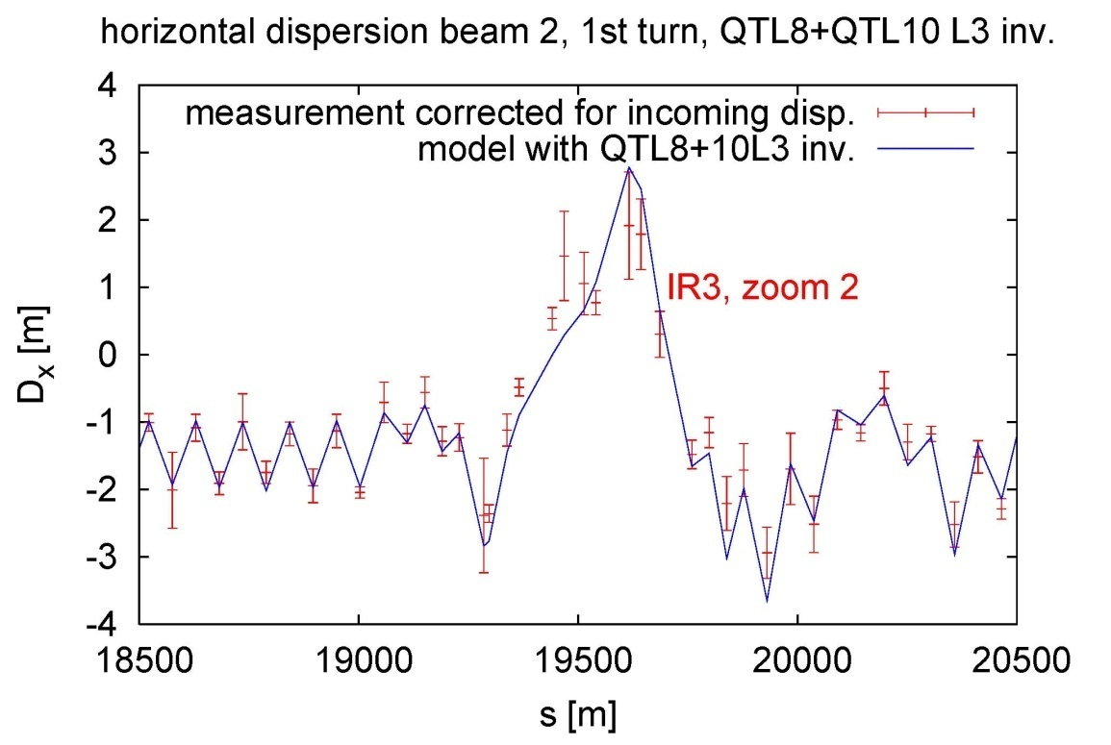
nominal model
model w QT8+10 L3 inv.

Slide 20
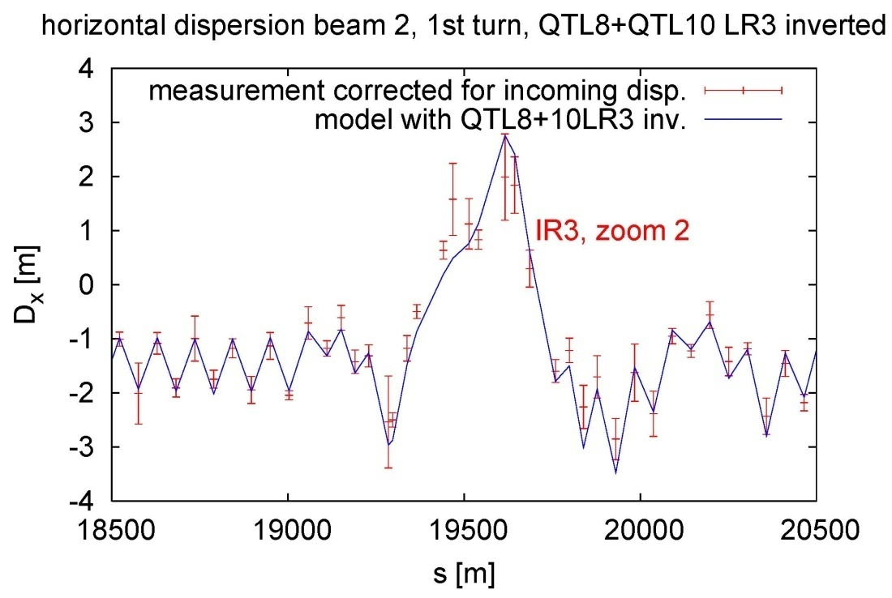
model w QT8+10 LR3 inv..
model w QT8+10 L3 inv.

Slide 21
conclusions
attempt to extract “ring dispersion” by taking out incoming oscillation; this type of “measured” ring dispersion changes with underlying model
measurement with circulating model should be better
dispersion shows only two regions where errors may be present: IR3 and perhaps IR6
dispersion is very sensitive to polarity errors in the IR3 region
QTL8+QTL10 L3 (+R3) may have wrong polarity
BPM data and optics are remarkably precise

