Slide 1
MD25 ns - 14/12/2012
G. Arduini, H. Bartosik, G. Iadarola, G. Rumolo
Machine Coordinators: M. Lamont, B. Holzer
T. Baer, Cryogenics, Operation, Vacuum teams and many others

Slide 2
After difficulties with RF injected and ramped to 4 TeV 12+72 bunches
~1.1x10¹¹ p/b
Got with 1.02 x10¹¹ p/b in collision with ~3.1 μm.
B2H
B1V
B2V

Slide 3
BSRT in collision (B1)

Slide 4
Beam-Beam MD (Beam-Beam team)
Started at 6 AM due to issues with RF over night:
We had 1 train of 72 bunches spaced by 25 ns colliding head-on in IP1 and IP5 with a beta* = 1m and a half crossing angle of 145 urad. We reduce the crossing angles in IP1 and IP5 simultaneously in steps of 10% (145-130-117-106-96-87-72-65 urad), we observe the bbb losses and record luminous spots from ATLAS. Losses are observed for each step clearly on Beam 1 while Beam 2 seems transparent to the reduction of crossing angle. Onset of losses at around 106-96 urad. The onset of losses is consistent with experiments performed with 50ns beams, which indicates that DA losses occur at a normalized separation of 5 sigma. The total losses on beam 2 is about 1/3 of the total losses observed on beam1. The positive effect of the lower intensity seems also visible giving smooth loss rates for the different crossing angles wrt to the sharper ones observed for the 50 ns case.

Slide 5
65 μrad
72 μrad
87 μrad
96 μrad
106 μrad
130 μrad
117 μrad
145 μrad

Slide 6
Beam-beam (T. Baer)
Effect of beam-beam kick after dumping B2 only

Slide 7
UFOs (T. Baer)
for this fill: 8 UFOs in ~3hours at flat top. This is about twice more than for 1374b 50ns fills.

Slide 8
Heat load evolution
12:00-13:20 Fill with 12+2x72 bunches after loss map intermezzo to understand abnormal pattern observed in collision. Kept this for a short period (~1/2 hour) given the low heat load
12+2x72
12+72 (RF dump)
12+72 BB MD

Slide 9
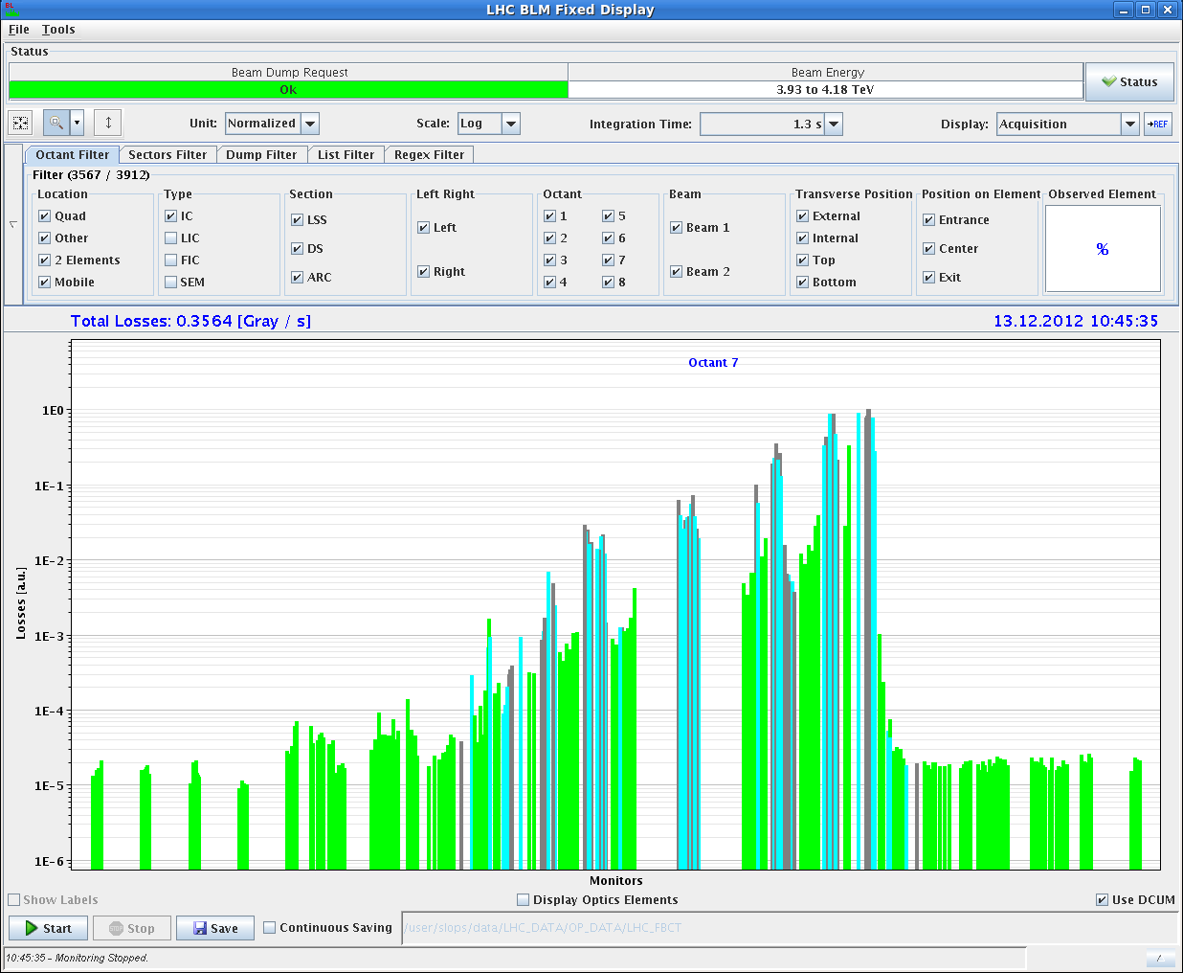
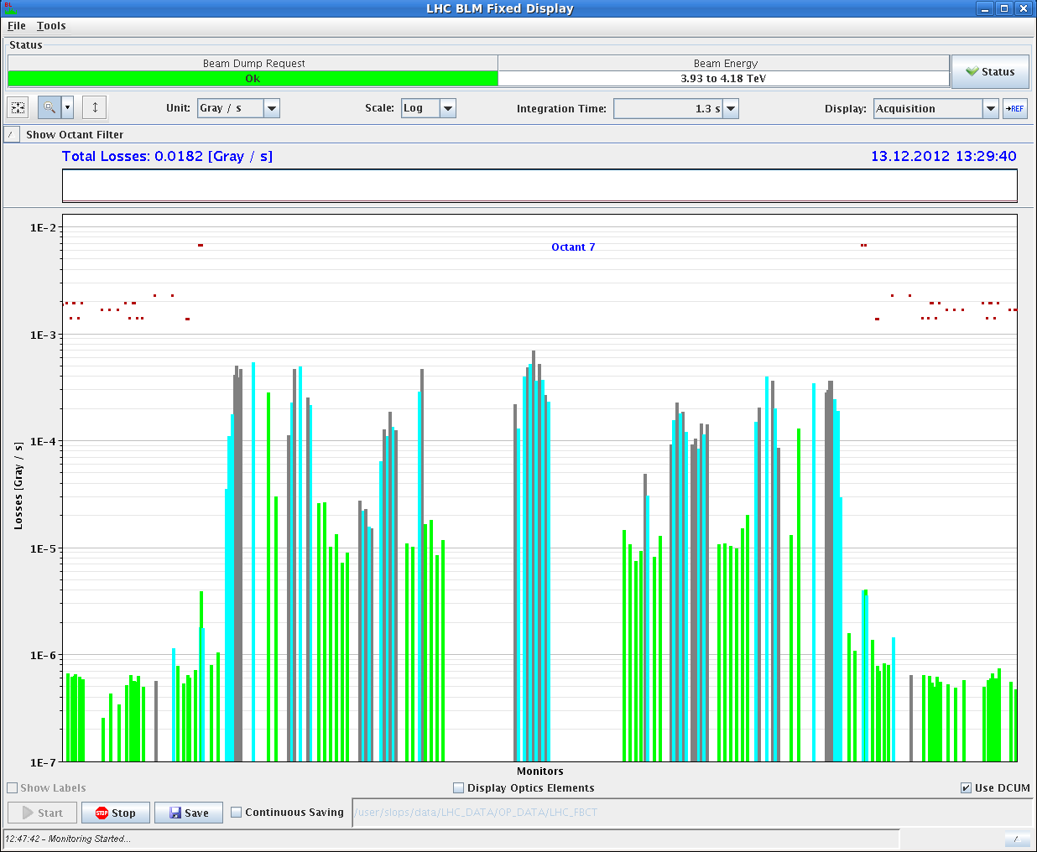
Squeeze and attempt collision.
Abnormal loss pattern indicating violation of the collimation hierarchy at the end of the squeeze, not seen at the end of the ramp. Cannot go through the squeeze with high intensity until understood
Beams dumped while going to collision (SW intlk)
End of squeeze B1+B2 losses
Flat-top B2 losses

Slide 10
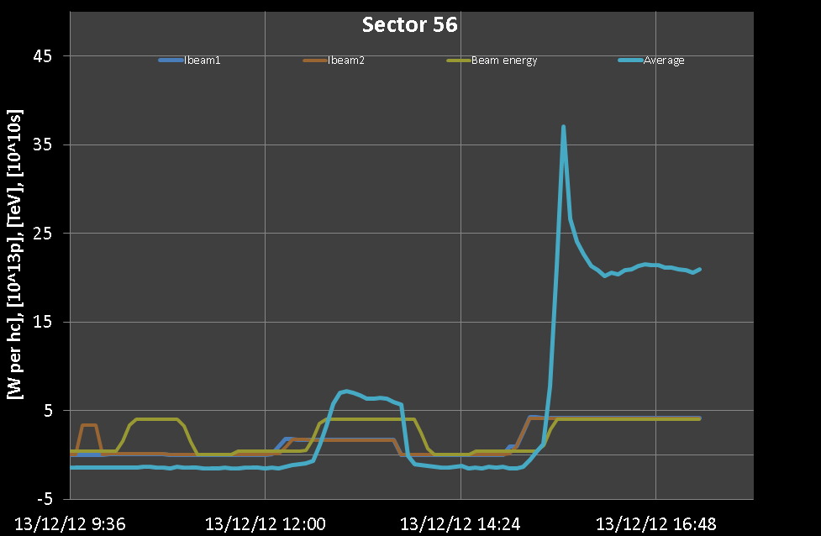
15:00 – 17:50 Ramp with 12+5x72 = 372 bunches
Kept at flat top for ~2 hours. Then dump to increase intensity. Spike occurring during the ramp starting at ~2 TeV when photoelectrons start to play a role.

Slide 11
V. Baglin
Pressure at arc extremities 78 during previous fill. Photon stimulated gas desorption appears at 2 TeV i.e. photoelectrons are produced. At this time, the cryogenic system observed a larger heat load due to photoelectrons induced multipacting.

Slide 12
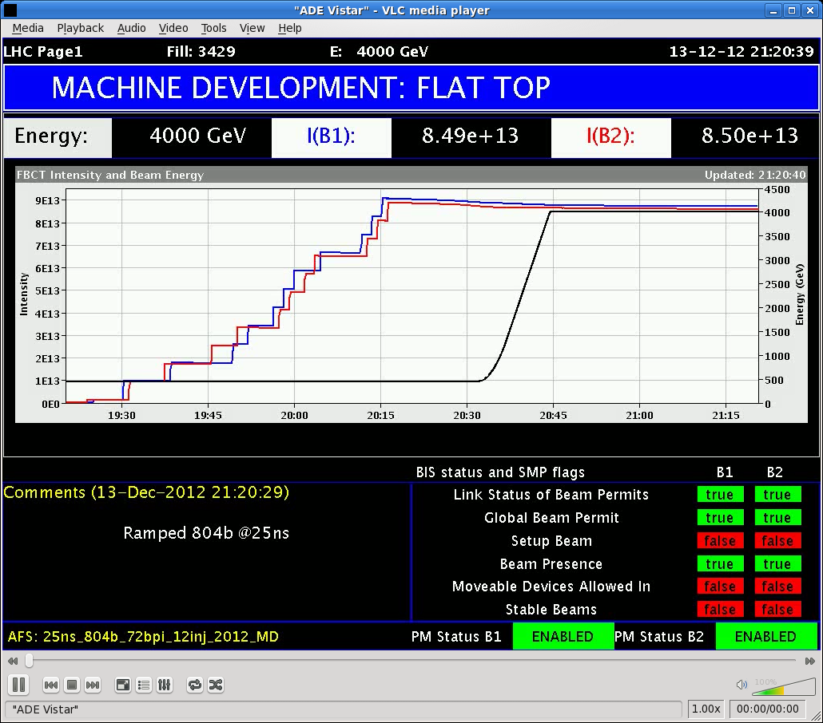
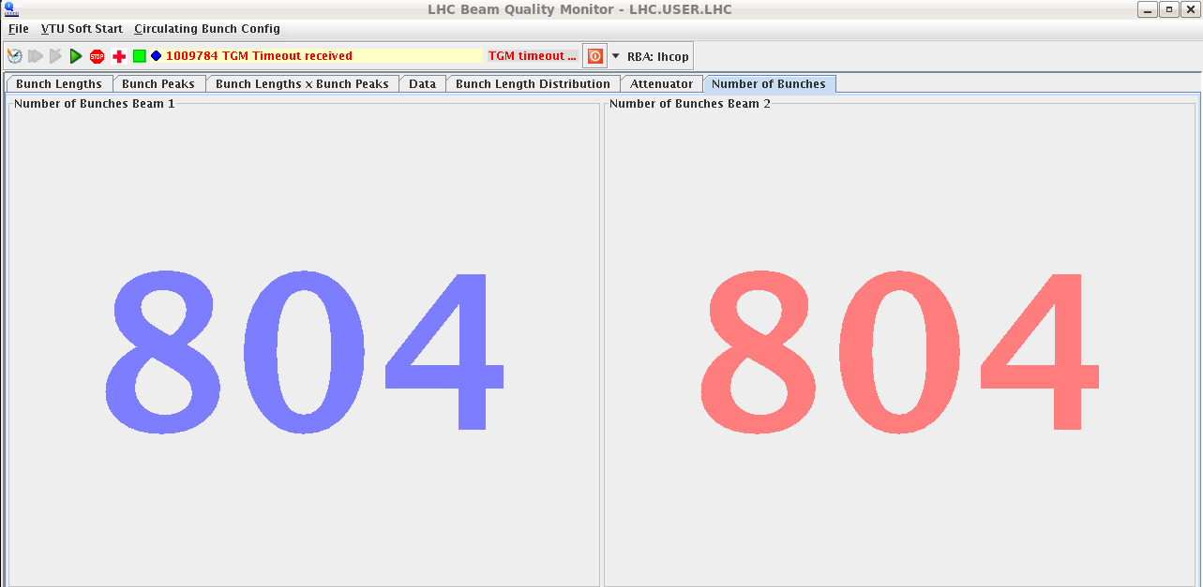
19:00-20:46. Filling with 12+11x72 = 804 bunches and ramp. Filling in steps to allow cryo team to adapt regulation. A lot of work with loss of cryo start in two sectors during the ramp.

Slide 13
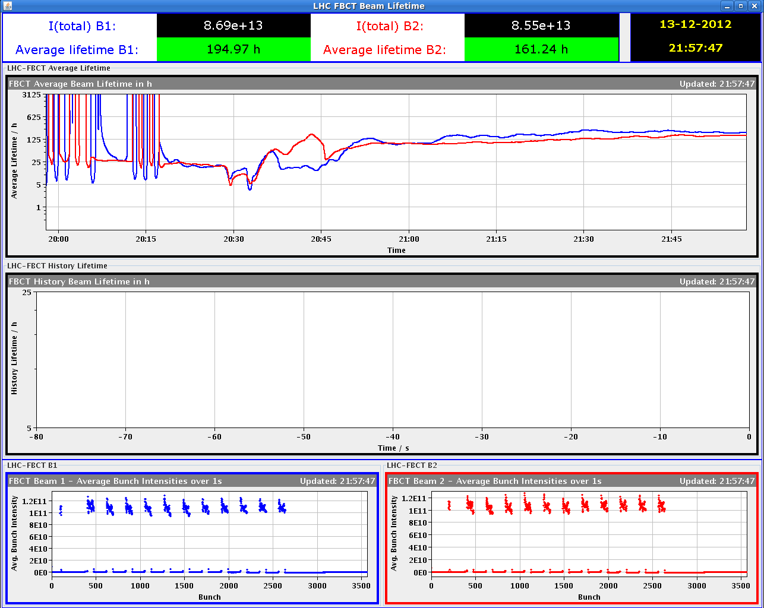
Low lifetime (down to 5 hours) at low energy when reducing the damper gain before starting the ramp. Recovering during the ramp

Slide 14
Exhausted cryo team
+ Serge Claudet (did not want to appear)

Slide 15
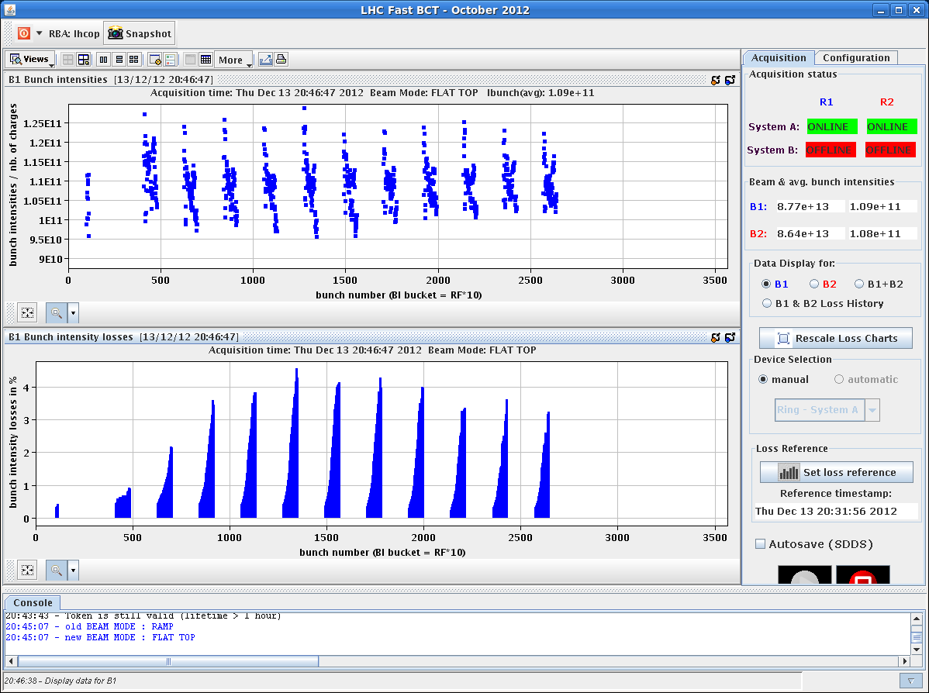
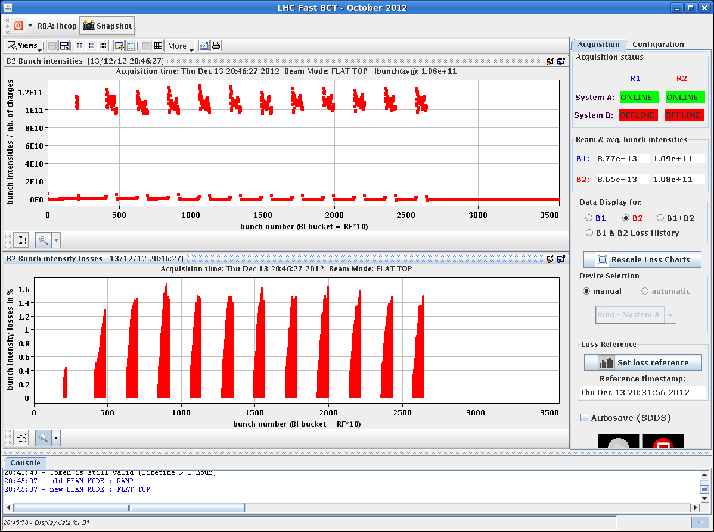
Loss pattern (inj. + ramp)

Slide 16
Emittances (B1)

Slide 17
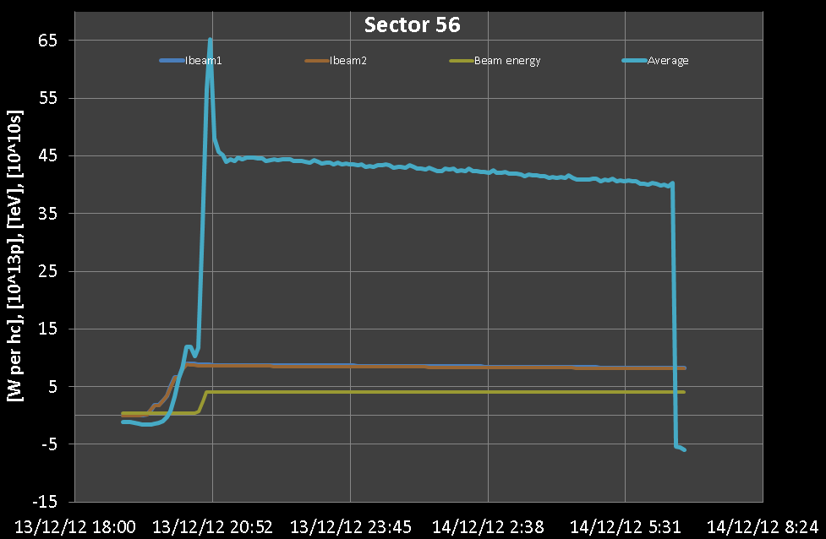
Heat load
Heat load not varying significantly (~ linear with intensity). SEY evolution to be estimated and compared with laboratory measurements SEY vs. electron dose

Slide 19
4TeV Arc UFOs with 25ns
T. Baer
With 50ns, 1374b: ≈ 1.3 arc UFOs per hour
Fill 3428 (156b):
27 arc UFOs in 2.25 hours -> 12.0 UFOs per hour
Fill 3429 (804b): 71 arc UFOs in 9.75 hours -> 7.3 UFOs per hour
highest UFO activity in first hour.
In fills 3427 – 3429: 5 UFOs > 10% of BLM dump threshold Largest UFO: 42% of BLM dump threshold
71 arc UFOs ($≥$cell 12) during fill 3429 (804b). Signal RS04 > 2∙10⁻⁴ Gy/s.

Slide 20
Plan
Morning:
Loss map at the end of squeeze and in collision (with 12 bunches)
BCMS injection (12 bunches available on the same cycle)
Afternoon:
Fill with 804 bunches
Night:
Calibration fills at 450 GeV (72 bunches trains and 288 bunch trains)
Tomorrow: physics 25 ns provided loss maps understood

